Slide 1
Amazon Seller Assistant
Counting, not ranking — a pipeline comparison

Slide 2
Finding Signal for a Winning Product
Prebuilt Opportunity Finder
Money Loser

Slide 3
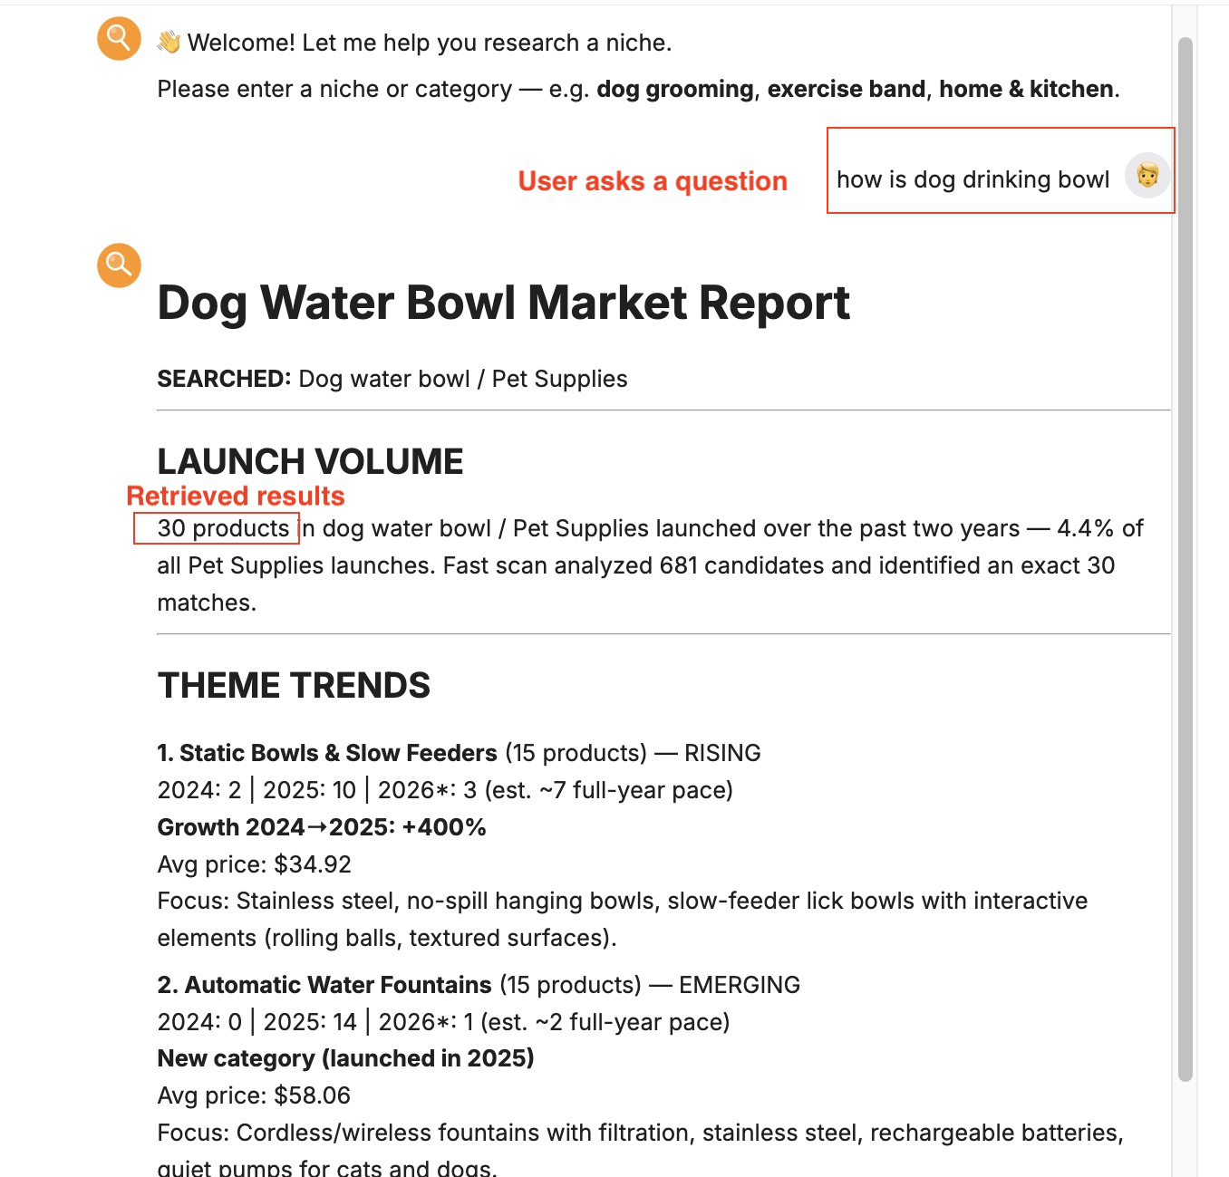
What I Need
✗ One winning product ✓ Launching trend
Must have
Clean data
Good retrieval
Nice to have
Natural language interaction

Slide 4
Pipeline Design
DATA INGESTION — BUILT ONCE, OFFLINE
Keepa API
+ embedding
ChromaDB Index
Query
live user question or eval run
cat_selector_agent
clarify? · concept · categories
SIMPLE
STRUCTURED
Rank / Rerank
every item scored, no cap
classifier_agent
confident vs. candidate paths
Rerank
candidate paths only
• also scored for eval
mode-selected
analysis_agent
tool calling → report
Report

Slide 5
Golden Dataset Benchmark
QUERY
COUNT
QUERY
COUNT
PRECISION
RECALL
LATENCY
COST
invisible unicorn leash
0
birthday party balloons
9
0.72
electric guitar strings
0
dog drinking bowl
11
0.59
0.84
345s
$0.021
left-handed scissors
0
bluetooth speaker
24
dog Halloween costume
0
baby toys
27
0.36
gluten free pasta
1
essential oil diffuser
37
ice tray
1
kids costumes
55
yoga mat
1
car phone mount
62
graduation gown
3
solar powered garden light
78
48s
wireless gaming mouse
6
summer dress
453
$0.0009
simple
structured
simple
structured
simple
structured
simple
structured
~2x
1.2x
7x
25x
LEGION STANDARD Diverse, Immutable, Versioned
Source: legionintel.com/command-papers/ai-agent-evaluation-building-an-evaluation-platform-that-scales

Slide 6
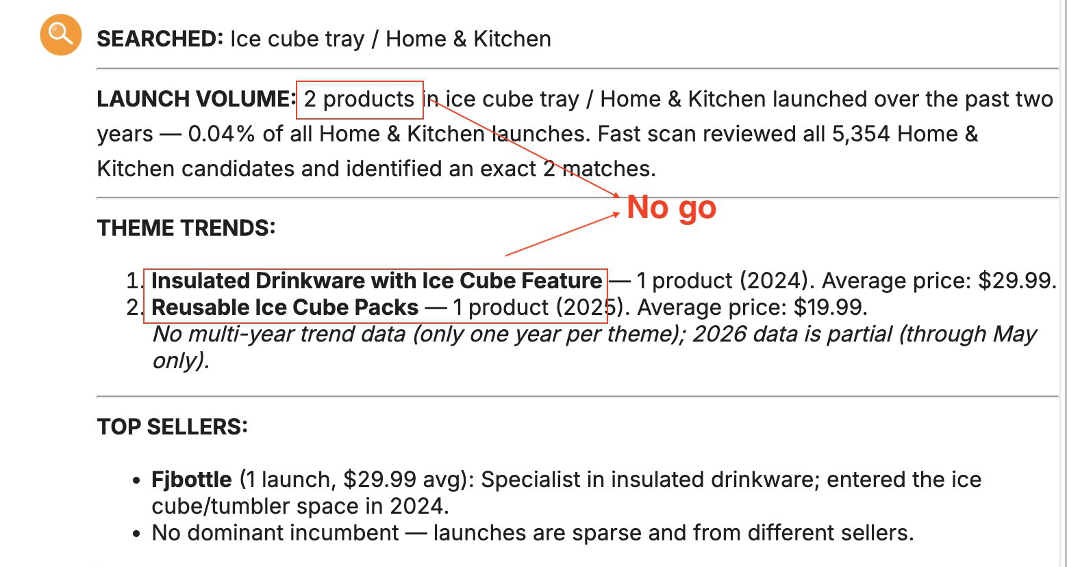
Clear No-Go = $$ Saving
A confident zero is a result, not a failure — it saves the launch spend.

Slide 7
AI Tender Review System
A case study in deploying AI for compliance in a regulated environment — tender review
Nasi Li-Purcell

Slide 8
Slow and High-Stakes
Manual
Time-consuming
Compliance
High-stakes if wrong

Slide 9
What the System Delivers
Traceability
Auto-detect
Human-in-the-loop
Every parsed clause and every extracted rule carries its exact source: file, page, character span, on-page bounding box.
A vendor's submission is automatically resolved, read, and checked against the tender's own rules — no manual page-hunting.
Nothing ships as a silent verdict. Flagged fields get a real Confirm / Reject / Note action, logged with who and when.

Slide 10
Two-Stage Design
One rubric, authored once — evaluated against every vendor
STAGE 1 · RULE EXTRACTION
Tender Documents
RULE EXTRACTION
parse + author rubric
Rule Rubric
JSON, per schedule
STAGE 2 · RULE EVALUATION
Vendor 1 Documents
Vendor 2 Documents
Vendor N Documents
RULE EVALUATION
vendor docs + rule rubric
RULE EVALUATION
vendor docs + rule rubric
RULE EVALUATION
vendor docs + rule rubric
Verdict
Verdict
Verdict
Vendor 1 is real, tested end to end. The same rubric is designed to apply unchanged to every other vendor in the tender.

Slide 11
Step-by-Step System Design
DETERMINISTIC
DETERMINISTIC
HUMAN + AI
Tender Docs
Parse
Resolve Citations
Author Rubric
Rule Rubric
126 rules · 13 files
reused for every check
DETERMINISTIC
LLM · VISION
LLM · TEXT
LLM · VISION
+ HUMAN (IF FLAGGED)
Vendor Docs
Classify Pages
Resolve
Extract
Check
1 of N vendors, human-triggered
vision_index.json
vendor_extractions.db
not found
Pass
Needs Review
Disqualified
Dormant
after reviewer confirms / rejects
Report
rtm.db

Slide 12
Three Evals Against Real Data
Parse
→
Resolve Citations
→
Author Rubric
→
Rule Rubric
⋯
Classify
→
Resolve
→
Extract
→
Check
→
Verdict
→
Report
STEP
DATASET / SCRIPT
RESULT
Parse + Citation
traceability_groundtruth_eval_2.md
239/241 resolved · 99.2%
Vision Extraction
eval_dataset_20.py
20/20 · 100%*
Resolve (semantic search)
vendor_check_orchestrator.py
12/12 attempted found a real page
*Vision extraction: small, selection-biased sample, near-zero coverage of the messiest tender. Resolve: only 12 of 15 items have anything to look for — the other 3 never attempt resolve at all (physical sample, covered by a sibling rule, or extractor not yet built), not 3 failed attempts. Of those 12, literal title matches are reliable across repeat calls; semantic-only matches have proven non-reproducible (5 identical calls, same input, temperature 0 — found/not-found flipped) — routed to human review rather than trusted blind.

