Slide 1
Diabetes Predictor
Can a good one be modeled from the given data?

Slide 2
BACKGROUND
Obtained patient data, based on a questionnaire supervised by doctors
Data consisted of
age,
gender,
the presence or not of 14 symptoms,
and whether the patient tested positive for diabetes
The question: Could a good diabetes predictor be modeled from this data?

Slide 3
KEY FINDINGS
Dataset good for prediction of diabetes
Three models with mean absolute error (mae) of 0.06 or better
One of them very good with mae of only 0.03

Slide 4
KEY FINDINGS
Furthermore, columns in dataset were well chosen even though no column was super predictive independently
Columns were very predictive together
No column needed to be eliminated

Slide 5
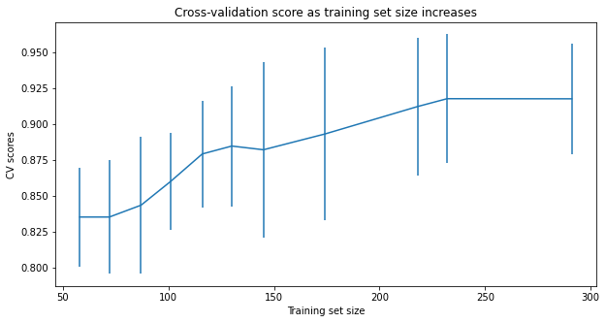
KEY FINDINGS
Data amount sufficient
Even though small (total 520, with 364 training set)
Appeared to be sufficient in context based on cross-validation score
Benefits of increased training set size levels off at about 235 and training set consists of 364

Slide 6
KEY FINDINGS
Take on overfitting: possibly, but this investigation was still useful
The data source was from a single hospital, so possibly overfitted
Good news though: the investigation found the type of data and type of models are likely a good basis for a more universal predictor

Slide 7
MODELING RESULTS AND ANALYSIS Feature Data
Since the features/symptoms were binary, it seemed beneficial to convert the one non-binary column (age) into a binary one
Based on various examination of the data, the column age_over_47_point_5 was substituted for age

Slide 8
MODELING RESULTS AND ANALYSIS Feature Data
Eliminate any columns? – part 1
A Pearson coefficient correlation heatmap was used to find too strong correlations between symptoms, possible elimination of one
The strongest correlation was 0.6 between polyuria and polydipsia – not enough to eliminate one

Slide 9
MODELING RESULTS AND ANALYSIS Feature Data
Eliminate any columns? – part 2
A Pearson coefficient correlation heatmap was used to find how correlated each symptom and diabetes_found to see if only top correlations should be used in model
There were a range in correlations – from (absolute) 0.01 to 0.67 and a top 8 was noted, so possibly, but…
A later kbest test would indicate that using all 16 symptoms would produce the best results

Slide 10
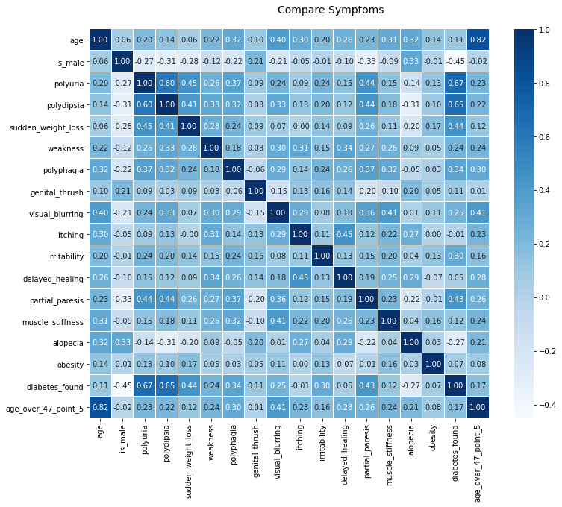




MODELING RESULTS AND ANALYSIS Feature Data

Slide 11
MODELING RESULTS AND ANALYSIS Model Selection
Gradient Boosting Classifier, Linear SVC, and Logistic Regression models were examined.
Gradient Boosting Classifier was chosen because, even though all three models did well, it led in every category looked at, including:
Comparison of confusion matrices before the final choosing of GridSearchCV best hyperparameters
Metrics shown in the table in the next slide using the best parameters found from GridSearchCV

Slide 12
MODELING RESULTS AND ANALYSIS Model Selection
Model | Features - all boolean | Hyperparameters | Metrics
 | (same for all models) |  | training set score using default scoring (10 cross-validation) |  | training set score using mae (10 cross-validation) |  | mae of predicted vs test
 |  |  | mean | std | mean | std
Gradient Boosting Classifier (winner) | is_male polyuria polydipsia sudden_weight_loss weakness polyphagia genital_thrush visual_blurring itching irritability delayed_healing partial_paresis muscle_stiffness alopecia obesity age_over_47_point_5 | learning_rate: 0.25 max_depth: 3 n_estimators: 88 | 0.97 | 0.04 | 0.03 | 0.04 | 0.03
Linear SVC |  | tol: 1e-07 | 0.91 | 0.06 | 0.09 | 0.06 | 0.06
Logistic Regression |  | solver: newton-cg | 0.91 | 0.07 | 0.09 | 0.07 | 0.06
 |  | solver: newton-cg | 0.91 | 0.07 | 0.09 | 0.07 | 0.06

Slide 13
SUMMARY AND CONCLUSION Summary
The dataset was from a very limited source (a single hospital) and had only 520 rows, which is not the ideal.
However, it also did not have any columns/symptoms that needed to be eliminated to improve the results.
It produced three good models with very little data cleaning.

Slide 14
SUMMARY AND CONCLUSION Conclusion
This dataset is useful for diabetes prediction!
Certainly within the context of that hospital, but very possibly as a template for data collection for more universal prediction.
Note: although it is possible that additional symptoms that would have improved the diabetes prediction models developed here, the symptoms provided offered a promising start.
Also, for the same or similar datasets, the three model types, but particularly Gradient Boosting Classifier, would be a good place to start to develop a universal model.

