Slide 1


Recurrent Deep Network Models for Clinical NLP Tasks:
Use Case with Sentence Boundary Disambiguation
Benjamin C. Knoll
Elizabeth A. Lindemann
Arian L. Albert
Genevieve B. Melton
Serguei V.S. Pakhomov

Slide 2
I have no conflicts of interest to disclose.

Slide 3
Background

Slide 4
Sentence Boundary Disambiguation (SBD)
Automated detection of sentence boundaries.
Common approach: Rule-based or statistical methods.
Logistic Regression / Maximum Entropy.
Assumptions and domain knowledge built into the models: manual feature selection.
General domain English accuracy: 95%+^{[1]}

Slide 5
Why SBD?
SBD is often the first step in any clinical Natural Language Processing (NLP) pipeline.
Downstream components rely on correct sentence segmentation to function.
Clinical text differs from general-domain English text substantially in both structure and content.
What is a sentence? Do the same general-domain rules about sentences apply to clinical notes?
Often sentences don’t end with punctuation or any sentence-terminating symbols.^{[2]}

Slide 6
Methods

Slide 7
Datasets
Medical Information Mart for Intensive Care (MIMIC-III)^{[3]} | Fairview Health Services (FV)
Affiliated with Harvard University. | Affiliated with the University of Minnesota.
Patient records for critical care units of the Beth Israel Deaconess Medical Center. | Inpatient and Outpatient records for various departments and specialties.
De-identified. Publicly available online for researchers, subject to DUA. | Not de-identified. Not publicly available.
749 randomly sampled notes annotated for sentences. | 952 clinical notes manually annotated for sentences. Stratified sampling: 272 inpatient, 680 outpatient.

Slide 8
Sentence Endings
Type | MIMIC | FV
No symbol | 6,018 (25.4%) | 23,506 (53.8%)
Period | 12,698 (53.7%) | 13,619 (31.2%)
Colon | 4,855 (20.5%) | 6,180 (14.2%)
Question Mark | 24 (0.1%) | 261 (0.6%)
Quotation | 4 | 58 (0.1%)
Exclamation Point | 4 | 19
Semi-colon | 48 (0.2%) | 10

Slide 9
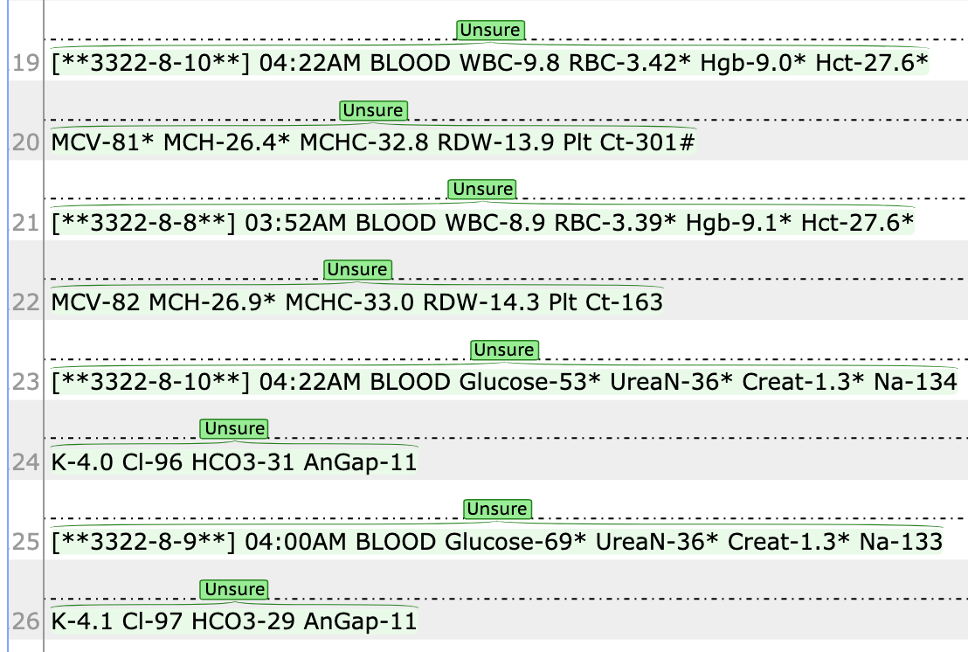
Manual Annotations
Two types of annotation:
Sentence
Unsure
Overlap of 100 MIMIC notes annotated by two annotators:
Ignoring text segments labeled as “Unsure” by either annotator: Cohen’s Kappa of 0.957.
29.1% of tokens in Unsure for MIMIC, 8.5% for FV

Slide 10
Task
Treated sentence boundary disambiguation as a sequence-labeling task.
“B” tag used for the first token in every sentence.
“I” tag used for tokens inside sentences.

Slide 11
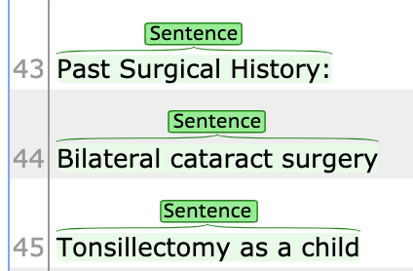
Task
Past/B Surgical/I History/I :/I
Bilateral/B cataract/I surgery/I
Tonsillectomy/B as/I a/I child/I

Slide 12
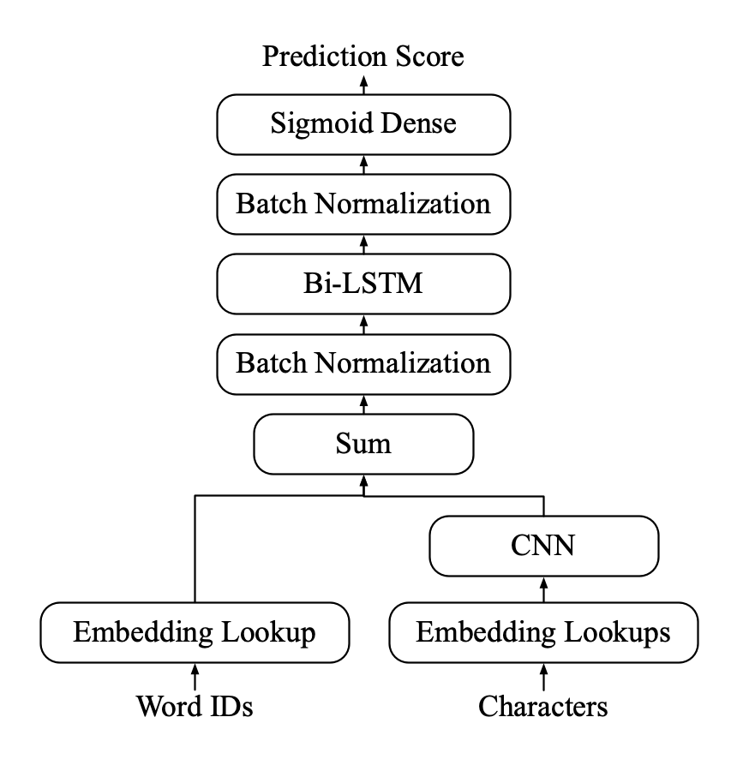
Architecture
Deep Neural Network Architecture.
fastText word embeddings and CNN word characters representation.
Bi-directional Long Short Term Memory (bi-LSTM) context builder.
Sigmoid dense prediction (Binary Logistic Regression).
Built and trained in tensorflow using Keras model and layers.

Slide 13
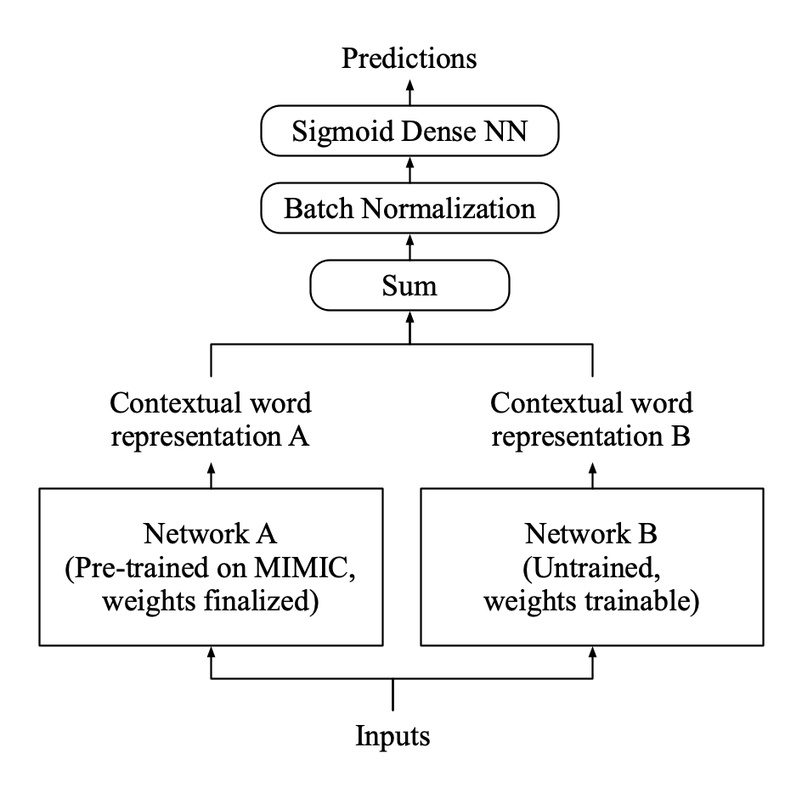
Architecture: Ensemble
Train two networks:
First using the MIMIC dataset.
Second using the FV dataset.
Second network functions as a “correction.”

Slide 14
Experiment Structure

Slide 15
Experiments
Baseline: Logistic Regression on vectors of characters in context.
All experiments were evaluated against the hold-out FV dataset.
Evaluated using B tag binary classification accuracy.
Sentences annotated as Unsure ignored for the purpose of evaluation.

Slide 16
Experiments
7 different experimental models:
LR-MIMIC and LR-FV: Logistic Regression models trained on each corpus.
NN-MIMIC and NN-FV: Deep Neural Network models trained on each corpus.
NN-MIMIC+FV: Deep Neural Network model trained on the combined corpora.
NN-MIMIC then FV: Deep Neural Network model trained on MIMIC then resumed on FV.
Ensemble: Ensemble architecture with layers trained on MIMIC and then other layers trained on FV.

Slide 17
Results

Slide 18
Results
Method | Precision | Recall | F1
LR-MIMIC | 0.511 | 0.840 | 0.636
LR-FV | 0.650 | 0.948 | 0.771
NN-MIMIC | 0.829 | 0.971 | 0.895
NN-FV | 0.923 | 0.991 | 0.956
NN-MIMIC+FV | 0.919 | 0.995 | 0.956
NN-MIMIC then FV | 0.910 | 0.992 | 0.949
Ensemble | 0.933 | 0.989 | 0.96

Slide 19
Results
Method | Precision | Recall | F1
LR-MIMIC | 0.511 | 0.840 | 0.636
LR-FV | 0.650 | 0.948 | 0.771
NN-MIMIC | 0.829 | 0.971 | 0.895
NN-FV | 0.923 | 0.991 | 0.956
NN-MIMIC+FV | 0.919 | 0.995 | 0.956
NN-MIMIC then FV | 0.910 | 0.992 | 0.949
Ensemble | 0.933 | 0.989 | 0.96

Slide 20
Results
Method | Precision | Recall | F1
LR-MIMIC | 0.511 | 0.840 | 0.636
LR-FV | 0.650 | 0.948 | 0.771
NN-MIMIC | 0.829 | 0.971 | 0.895
NN-FV | 0.923 | 0.991 | 0.956
NN-MIMIC+FV | 0.919 | 0.995 | 0.956
NN-MIMIC then FV | 0.910 | 0.992 | 0.949
Ensemble | 0.933 | 0.989 | 0.96

Slide 21
Results
Method | Precision | Recall | F1
LR-MIMIC | 0.511 | 0.840 | 0.636
LR-FV | 0.650 | 0.948 | 0.771
NN-MIMIC | 0.829 | 0.971 | 0.895
NN-FV | 0.923 | 0.991 | 0.956
NN-MIMIC+FV | 0.919 | 0.995 | 0.956
NN-MIMIC then FV | 0.910 | 0.992 | 0.949
Ensemble | 0.933 | 0.989 | 0.96

Slide 22
Results
Method | Precision | Recall | F1
LR-MIMIC | 0.511 | 0.840 | 0.636
LR-FV | 0.650 | 0.948 | 0.771
NN-MIMIC | 0.829 | 0.971 | 0.895
NN-FV | 0.923 | 0.991 | 0.956
NN-MIMIC+FV | 0.919 | 0.995 | 0.956
NN-MIMIC then FV | 0.910 | 0.992 | 0.949
Ensemble | 0.933 | 0.989 | 0.96

Slide 23
Results
Method | Precision | Recall | F1
LR-MIMIC | 0.511 | 0.840 | 0.636
LR-FV | 0.650 | 0.948 | 0.771
NN-MIMIC | 0.829 | 0.971 | 0.895
NN-FV | 0.923 | 0.991 | 0.956
NN-MIMIC+FV | 0.919 | 0.995 | 0.956
NN-MIMIC then FV | 0.910 | 0.992 | 0.949
Ensemble | 0.933 | 0.989 | 0.96

Slide 24
Results
Method | Precision | Recall | F1
LR-MIMIC | 0.511 | 0.840 | 0.636
LR-FV | 0.650 | 0.948 | 0.771
NN-MIMIC | 0.829 | 0.971 | 0.895
NN-FV | 0.923 | 0.991 | 0.956
NN-MIMIC+FV | 0.919 | 0.995 | 0.956
NN-MIMIC then FV | 0.910 | 0.992 | 0.949
Ensemble | 0.933 | 0.989 | 0.96

Slide 25
Discussion
Generalizability remains a problem for building NLP models for clinical text.
Significant penalty to F1 of 0.06 evaluating model trained on MIMIC against FV.
Transfer learning shows promise for domain adaptation.
Ensemble method shows improvement vs. combined or continued methods.

Slide 26
Conclusions

Slide 27
Conclusions
Improvement using deep networks for sentence segmentation over LR.
Generalization performance improvement using the ensemble method.

Slide 28
Further Work
Other meta-learning and ensemble methods.
Quantifying downstream gains due to improvements in sentence segmentation.

Slide 29
References
[1] J.C. Reynar, and A. Ratnaparkhi, A maximum entropy approach to identifying sentence boundaries, in: Proceedings of the Fifth Conference on Applied Natural Language Processing, 1997: pp. 16–19.
[2] D. Griffis, C. Shivade, E. Fosler-Lussier, and A.M. Lai, A Quantitative and Qualitative Evaluation of Sentence Boundary Detection for the Clinical Domain., AMIA Joint Summits on Translational Science Proceedings. AMIA Joint Summits on Translational Science. 2016 (2016) 88–97. http://www.ncbi.nlm.nih.gov/pubmed/27570656
[3] A.E.W. Johnson, T.J. Pollard, L. Shen, L.H. Lehman, M. Feng, M. Ghassemi, B. Moody, P. Szolovits, L. Anthony Celi, and R.G. Mark, MIMIC-III, a freely accessible critical care database, Scientific Data. 3 (2016) 160035. doi:10.1038/sdata.2016.35.

Slide 30
Acknowledgements
Michael Hietpas - annotator
NIH/NCATS UL1TR002494, NIH/NCATS U01TR002062, NIH/NIGMS R01GM102282, and AHRQ R01HS022085. The content is solely the responsibility of the authors and does not necessary represent the official views of the National Institutes of Health or the Agency for Healthcare Research and Quality.

Slide 31
Thank You!
Source code: github.com/nlpie/clinical-sentences
MIMIC Sentences Corpus and Models: Will be hosted on Physionet.org and linked from the above repo
NLP/IE Group website: healthinformatics.umn.edu/research/nlpie-group
Contact: benknoll@umn.edu or nlp-ie@umn.edu

