Slide 1

Final Project Presentation
Insurance Complaint Analysis

Slide 2
Contents
Introduction
Evolution of Insurance
Overview of Insurance Complaints Dataset
Research Questions & Exploratory Data Analysis (EDA) Questions
Data Challenges and Software selection
Exploratory Data Analysis & Methodology
Model Initialization
Results
Conclusion and Recommendations

Slide 3

Introduction
Insurance is reliable financial security for both individual and businesses.
The Texas Department of Insurance plays a crucial role in maintaining fair treatment between the consumers and insurance companies.
By improving the complaint handling procedures, we can enhance improve the customer satisfaction.
Scope: This research mainly focuses on the factors influencing trends and patterns that causes delay in handling the complaints.

Slide 4

Evolution of Insurance
Insurance from the concept of risk pooling and collective responsibility this traces back to around 1750 B.C. with the Code of Hammurabi.
Lloyds of London established in the late 17th century which gave a start to modern insurance practices which facilitates transactions between buyers and sellers.
Types of Insurances
Life insurance.
Health insurance.
Auto insurance.
Other types like property, pet, business, and travel insurance provides according to the user needs.

Slide 5
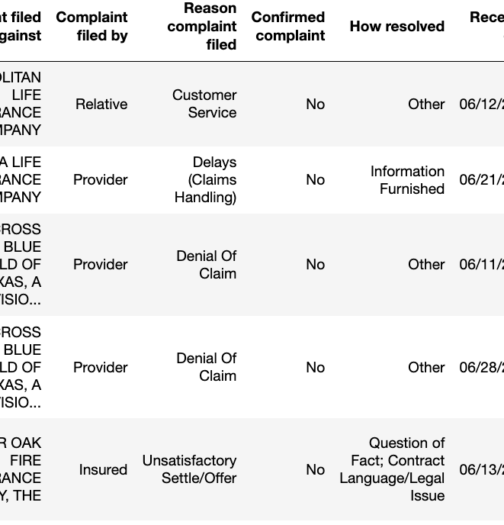
Overview of Insurance Complaints Dataset
This dataset was provided by Data.gov.
data.austintexas.gov is the publisher and it is maintained by the TDI ODP Administrator.
The dataset is less than a year old which was created on August 25, 2023, and was the latest updated on February 25, 2024.
For analysis we got 246,243 instances and 17 features.
Dataset Link: https://catalog.data.gov/dataset/insurance-complaints-all-data
The dataset contains information on complaints, parties involved, resolution methods, and timing. Attributes ranging from text-based (e.g., Complaint filed against/by, Reason complaint filed, Keywords) to categorical (e.g., Complaint type, Coverage type/level) and temporal (e.g., Received date, Closed date).
* The above image is the sample view of the dataset

Slide 6

Research Questions & Exploratory Data Analysis (EDA) Questions
Research Questions:
What are the primary factors influencing complaint resolution? How do variables like complaint type, coverage type, and respondent role impact resolution outcomes?
How have insurance complaints evolved over time, considering seasonal trends, variations in complaint frequency, and changes in complaint types?
What are the key factors contributing to effective complaint handling procedures, including response time variations, resolution rates, and best practices?
Exploratory Data Analysis (EDA) Questions:
How do reasons for filing complaints differ between confirmed and unconfirmed complaints?
What is the average time taken to resolve a complaint?
What proportion of complaints are resolved compared to those that remain unresolved?

Slide 7

Data Challenges and Software selection
Handling the missing values can be challenging. One of the important column “Keywords” has many missing values , that’s is about 19% of the keyword's column has missing values, for this issue are planning to impute the missing values with mode and key words column have multiple key words In row , we planning to divide the keyword column into multiple columns
Python (3.x.x): Primary language due to its rich ecosystem and research focused functionality.
Libraries:
Pandas: For data manipulation and analysis.
NumPy: For numerical operations.
Matplotlib & Seaborn: For data visualization.
Scikit-learn: For machine learning tasks.
Word Cloud: For visualizing text data (keywords).
Notes:
Data Challenges and Software selection:
Navigating the insurance complaints dataset poses several challenges that require careful consideration. Firstly, handling missing values, particularly in the "Keywords" column, which constitutes about 19% of the data. Our approach involves imputing missing values with mode and restructuring the keywords column to address multiple keywords per row. Inconsistencies in date formats, data complexity, and predicting resolution times further complicate analysis. To overcome these challenges, we employ Python (3.x.x) due to its rich ecosystem and flexibility. Leveraging libraries such as Pandas for data manipulation, NumPy for numerical operations, Matplotlib and Seaborn for visualization, Scikit-learn for machine learning, and Word Cloud for visualizing text data, we aim to extract meaningful insights and address the complexities inherent in the dataset effectively.

Slide 8
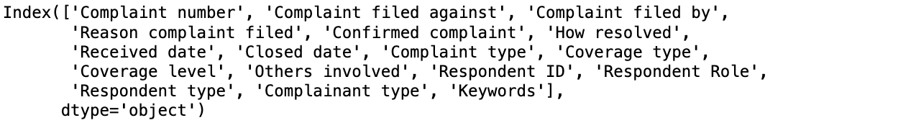
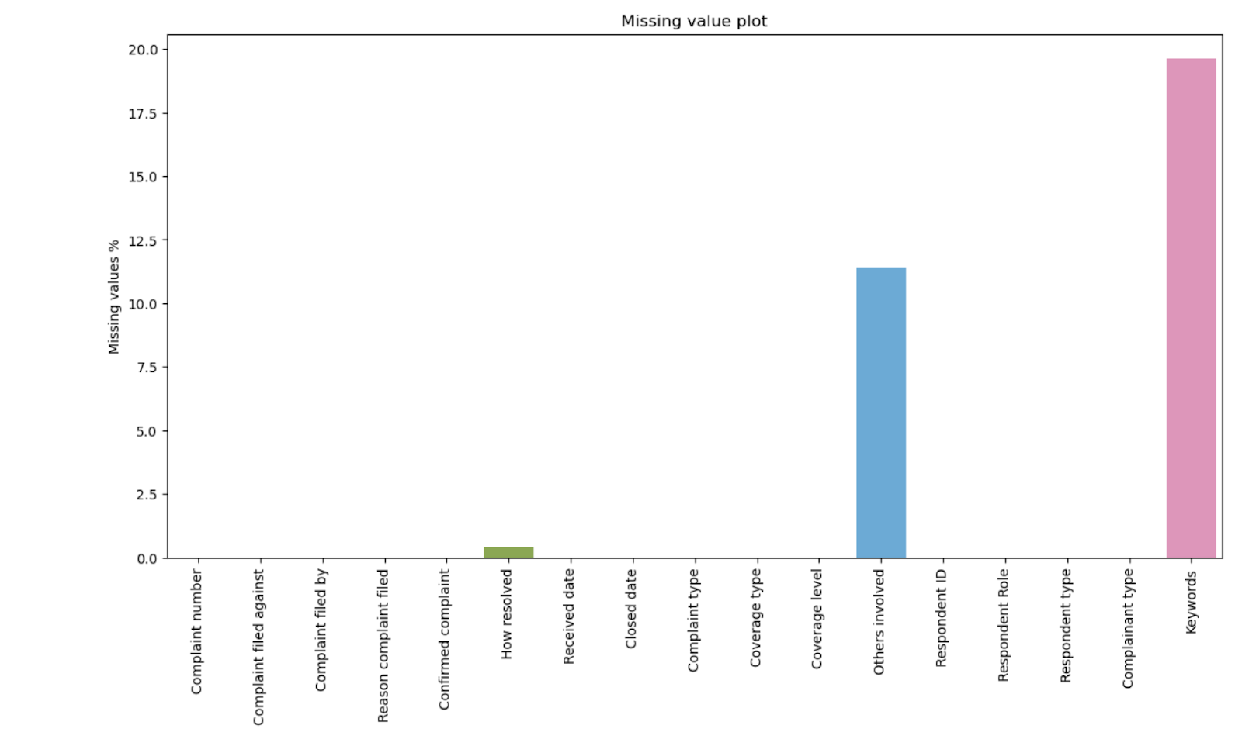
Exploratory Data Analysis & Methodology
By importing the dataset into pandas' data frame, it will digital like spread sheet for easy access and data manipulation.
A quick inspection to reveal its organisation and dimensions.
Missing Value Identification:
Every data which is large will have some missing cells.
This bar chart shows the missing values and was created using matplotlib.
X-axis shows the column names and Y-axis shows the percentage of missing values.

Slide 9
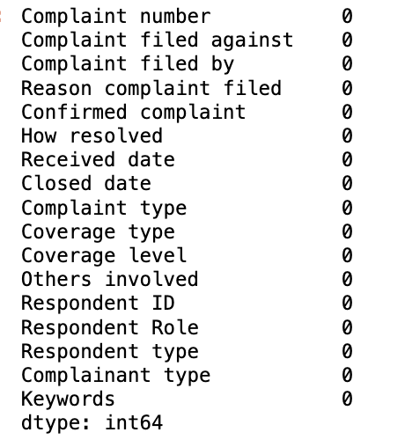
Handling Missing Values:
To keep track on the affected columns creating “missing columns” will be helpful.
We will categorize the columns into text-based and numerical for better understanding.
Text – based columns will be filles with mode and numerical columns will be filled with median.
* The above figure shows the no.of missing values
left after handling the missing values

Slide 10
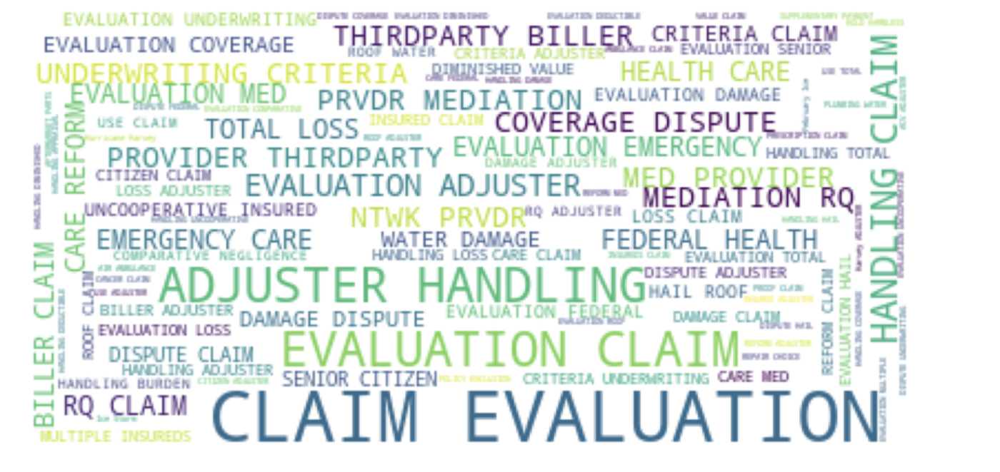
This figure shows us which keywords are most common in our data.
Larger words mean they appear more which gives us understanding of the important topics.

Slide 11
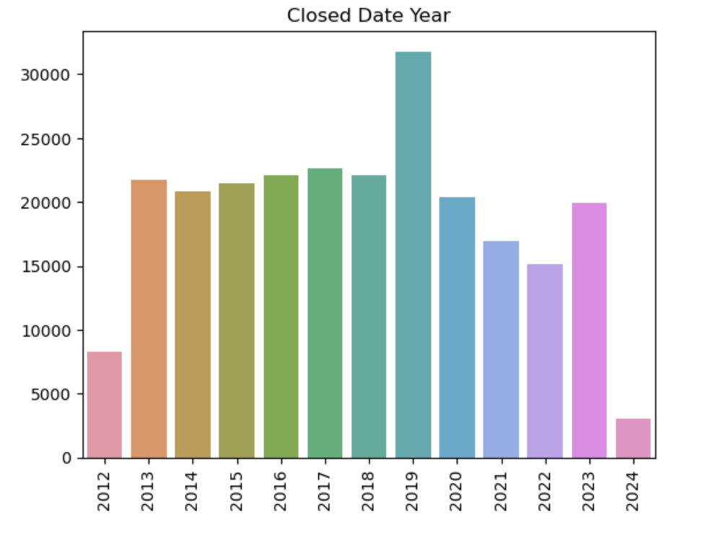
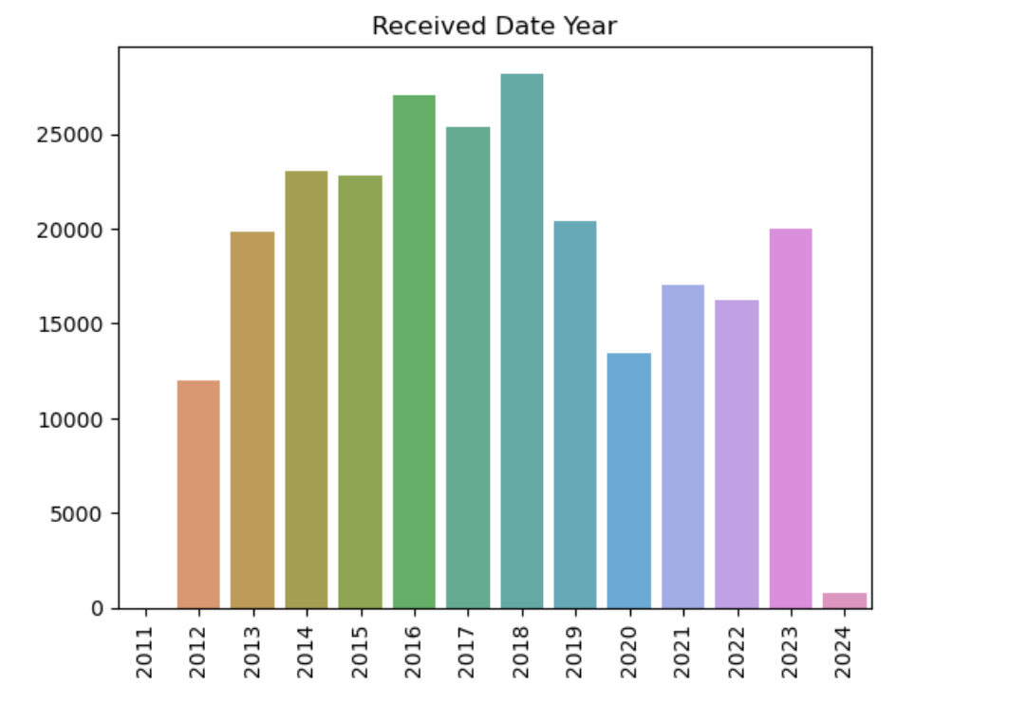
‘Time_taken_to_close’ will be calculated by checking the difference between Received date and Closed date which will provide resolution time for each complaint.

Slide 12
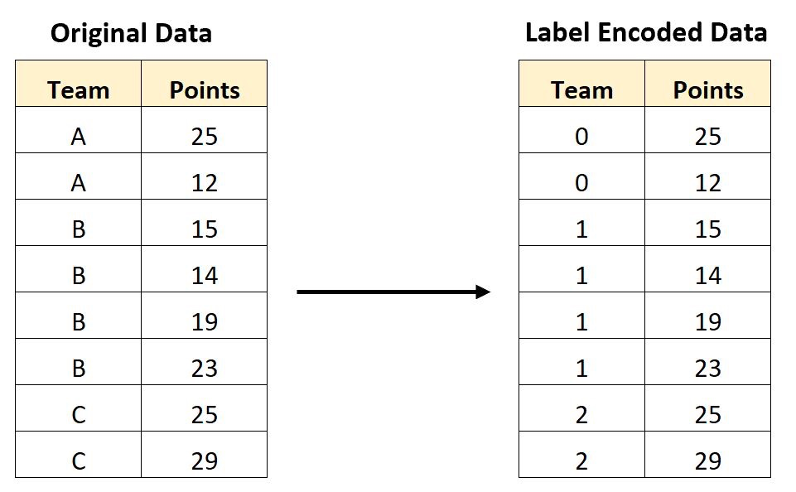
Label encoding is used to convert categorical data to numerical format.
For example, a dataset with categorical variable, "Team", and a numerical variable, "Points". The label encoding process assigns a numerical value to each category in the "Team" variable. The team "A" is assigned the value 0, team "B" is assigned the value 1, and team "C" is assigned the value 2.

Slide 13
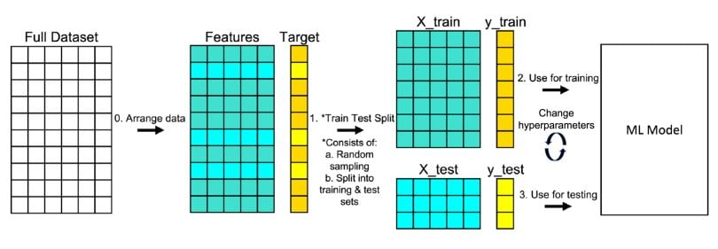
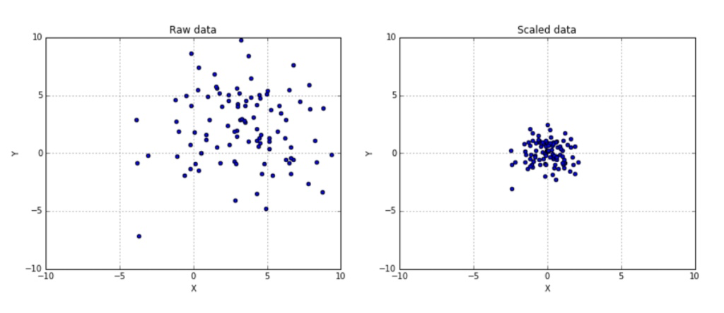
Train-Test Split:
Feature Scaling: The dataset will be going through normalization technique using standard scaler from sklearn.preprocessing.

Slide 14
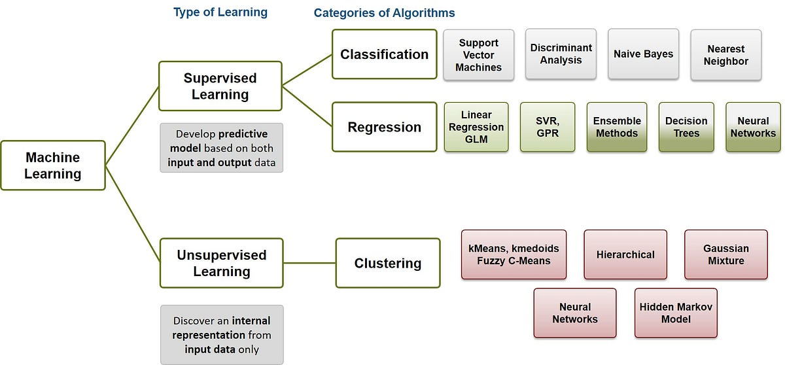
Model Initialization
We have considered and compared the below classifiers to learn patterns from labelled training data and then use this knowledge to predict the labels
Random forest classifier
Decision tree classifier
Gradient boosting classifier
logistic regression
K neighbours' classifier
XGB classifier
SVC and Ada boost

Slide 15
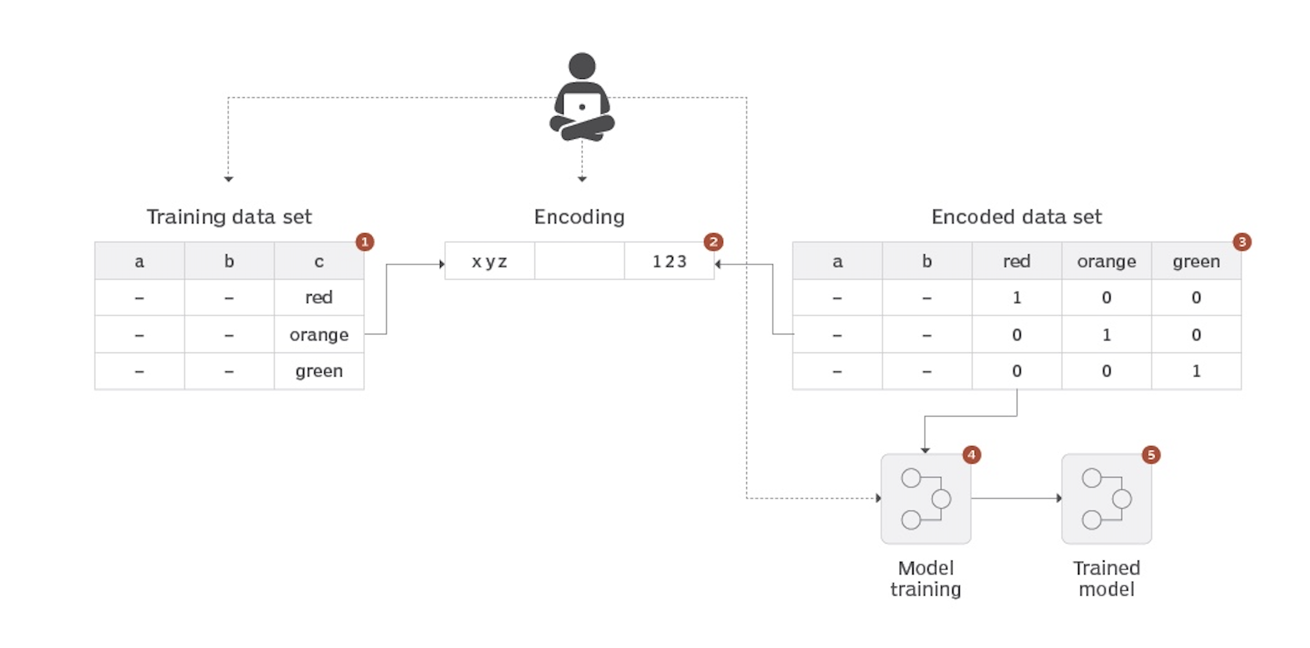
Application of Encoded Data into the Model

Slide 16
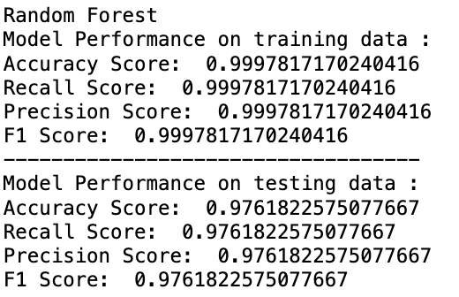
Results
The random forest model showed exceptional performance, with an accuracy score of 0.99978 with respect to the training data, and a slightly lower score of 0.976 for the test data with a probability of overfitting The decision tree also performed well ( accuracy score 0.99979), but its test score was 0.9598, more than -Fitting concerns also require caution. Gradient boosting showed strong results with accuracy scores between training and test data (close to 0.965). indicating that it is not too convenient. Other models such as Logistic Regression, K- Neighbors Classifier, XGB Classifier, Support Vector Classifier, and AdaBoost Classifier showed different performances with Logistic Regression being the least accurate and XGBClassifier and SVC showed strong robustness.

Slide 17

Conclusion and Recommendations
Random Forest and Decision Tree exhibited the best performance on both training and testing data, with Random Forest showing slightly better generalization to unseen data.
With a 97.6% success rate in predicting complaint resolution the model demonstrates its efficiency in accurately predicting whether a complaint will be resolved or not.
Further real time integration into the workflows can be done that can be deployed as an API endpoint or incorporating with the existing systems for automated decision making.
Creating a user feedback loop where the model can be given as input to improve and address any flaws in the real-world insurance business.

Slide 18

Questions?

