Slide 1
Intelligence and Fertility in the NLSY79 Respondents
Joe Rodgers, Mason Garrison, Ally Hadd
Vanderbilt University
Behavior Genetic Association
June 20, 2014

Slide 2
Introduction
My talk today will present both methodological innovation, and also interesting empirical results
The methodological innovation involves fitting bivariate DF analysis models and using new NLSY79 kinship links
The empirical results are related to several fertility variables in the NLSY79
Completed family size
Age at first intercourse
Age at first marriage
Age at first birth
All of these in relation to intelligence

Slide 3
National Longitudinal Survey of Youth (NLSY) Kinship Linking Files
We will use the NLSY79 (original cohort, N=12,686, a household probability sample with lots of related kin)
We have recently completed an NIH-funded kinship linking effort using direct ascertainment of kinship relatedness; we’ve linked approximately 95% of the potential kinship pairs in the NLSY79

Slide 4
One of the several remarkable features of the NLSY is the abundance of sibling and other kinship pairs, at representative levels
These are publicly available through our online CRAN repository
In both the NLSY79 and NLSY-Children data, there are over 42,000 kinship pairs, representing two generations and also links across the generations
In the NLSY, just like in the real world out there, there are lots of:

Slide 5


SIBLINGS and other KIN
(of all ages!)

Slide 6
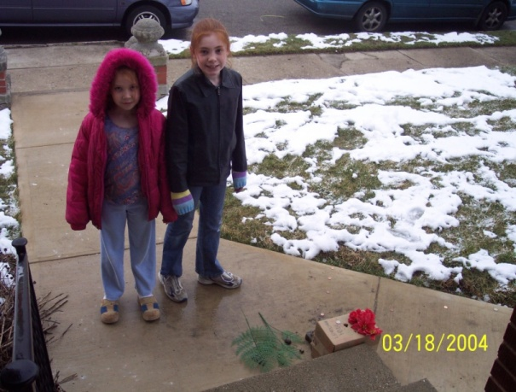
Today I’ll focus on the female-female kinship pairs for our fertility-intelligence study
The equivalent analyses using male-male pairs (and also cross-gender pairs) is ongoing

Slide 7
Among the female-female kinship pairs living together in 1979 are:
Second cousins (R=.0625)
First cousins (R=.125)
Half siblings (R-.25)
Full siblings/DZ twins (R=.50)
MZ twins (R=1.0)

Slide 8
With N’s approximately representative of U.S. households in 1979
Among the female-female kinship pairs living together in 1979 are:
Second cousins (R=.0625) – N=17 pairs
First cousins (R=.125) – N=29 pairs
Half siblings (R-.25) – N= 67 pairs
Full sibs/DZ twins (R=.50) – N=955 pairs
MZ twins (R=1.0) – N=5 pairs
Total N = 1078 kinship pairs, 2156 individual respondents

Slide 9
Three designs will be used:
A sister-comparison design
A univariate biometrical ACE design
A bivariate biometrical ACE design
All directed toward the question of how intelligence links to fertility outcomes

Slide 10
Measurement
Completed Family Size – number of biological children born by 2010, when respondents were age 45-53
Age at first intercourse – reported in the mid 1980’s (often twice), when respondents were around 20-25
Age at first marriage – reported repeatedly, up to 2010
Age at first birth – reported repeatedly, up to 2010
AFQT (age standardized)– part of ASVAB given in 1980, ages 15-23

Slide 11
Summary Statistics, overall NLSY Female-Female dataset
N mean stddev max min
CFS 2013 2.0 1.4 11 0
AFI 2268 17.8 2.3 26 10
AFM 2027 24.0 5.6 14 49
AFB 2039 23.7 5.5 14 45
AFQT 2485 64.8 21.9 104.5 3

Slide 12
Sister-comparison design
First analysis:
Compare the smarter “sister” to the less smart “sister” on fertility outcomes
Schematic diagram:

Slide 13
Ancestral (background) genetic and environmental heterogeneity is controlled
NLSY79
Full Sibs
Smarter
NLSY79
Half Sibs
LessSm
Smarter
LessSm
. . .
. . .
Fert
Fert
Fert
Fert
compare
compare

Slide 14
Fertility Means by Female IQ Status (and Stddev)
Overall female-female dataset
(N≈1000 pairs)
SmarterSis LessSmartSis p<
CFS 2.02 (1.39) 2.07 (1.44) ns
AFI 17.86 (2.30) 17.70 (2.20) .05
AFM 24.01 (5.46) 24.15 (5.92) ns
AFB 24.00 (5.56) 23.47 (5.56) .01

Slide 15
Univariate Biometrical ACE Design
Estimate h², c², and e²
Typical assumptions
No assortative mating, equal environments, additive model
Estimation method – LS, using DF Analysis:
Kin1=b0 + b1*Kin2 + b2*R + b3*Kin2*R + e
b1 estimates c², b3 estimates h²

Slide 16
Variable Correlation Matrix (double entered, N≈2000 individuals)
CFS AFI AFM AFB AFQT
CFS 1.0 -.13 -.22 -.36 -.16
AFI 1.0 .07 .41 .28
AFM 1.0 .39 .07
AFB 1.0 .47
AFQT 1.0

Slide 17
Fertility ACE Estimates (double entered, N≈2000 individuals)
h² c²
CFS .73 -.18
AFI .26 .24
AFM .33 -.05
AFB .77 -.02
Note: nothing about AFQT/intelligence
in these correlations

Slide 18
Bivariate Biometrical ACE Design
Bivariate DF Analysis, new approach
Old approach – DF regression model:
Var2=b0 + b1*Var1 + b3*R + b4*Var1*R + e
Note: Var1 and Var2 must be standardized
Note: fit to a double-entered dataset
See Rodgers, Kohler, Kyvic, & Christenson, 2001, Demography

Slide 19
New Approach:
Uses original single-entry DF Analysis Model, with a proband and co-kin
The proband is the smarter sister, the co-kin is the less-smart sister (or can be run in reverse) – and we enter fertility scores as the variables

Slide 20
Conceptualization:
In single-entry DF Analysis model, it is often arbitrary which member of the kinship pair is #1 and which is #2
Double entry solves this problem, converts to an intraclass correlation problem
But in single entry, there are 2^{N} th possible orderings of the kinship pairs
The one we’re using is often an arbitrary one – unless we have probands (e.g., DeFries & Fulker’s first DF Analysis paper)
In this case, by ordering with smarter sister in the first variable, and less-smart sister in the second, we solve the arbitrary ordering

Slide 21
Then, with this order, we use a different variable in the DF Analysis,
creating a bivariate problem
If there is differential regression across kinship categories, this would implicate AFQT scores as being causal/correlational in relation to that pattern

Slide 22
Fertility ACE Estimates (single entered, with smarter/less smart sister as proband; N≈600 pairs)
high IQ low IQ original DF
sis proband sis proband double entry
h² c² h² c² h² c²
CFS 1.04 -.33 .82 -.22 .73 -.18
AFI .03 .35 .49 .16 .26 .24
AFM .29 -.04 .16 .02 .33 -.05
AFB .78 -.01 .72 .01 .77 -.02

Slide 23
Discussion
Bivariate DF Analysis methods are in progress
To test whether h² (or c²) is higher in the bivariate case, we’ll use a resampling strategy
Note several violations of the additive model (negative variances) – fit dominance models

Slide 24
Lots of genetic variance in fertility outcomes is implied by these results
Consistent with past studies of the NLSY fertility variables
We’ve added two new fertility variables, age at first birth and age at first marriage
They clearly have some of their own variance, but also overlap in interesting and predictable ways

Slide 25
Only in AFI do we find any hint of shared environmental variance
Consistent with previous NLSY results

Slide 26
In conclusion, we note that value of the NLSY79 – as well as the NLSY-Children – for conducting biometrical studies
Online you can access the kinship links through R, or send me an e-mail and I’ll send you SAS and CSV files
cran.r-project.org/web/packages/NlsyLinks/

Slide 28
Fertility Kinship Corrs & ACE Estimates (double entered, N≈2000 individuals)
cousins half-siblings full-siblings h2 c2
CFS .05 -.17 .19 .73 -.18
AFI .03 .47 .37 .26 .24
AFM .12 -.07 .11 .33 -.05
AFB -.24 .39 .36 .77 -.02
Note: nothing about AFQT/intelligence in these correlations

