Slide 1
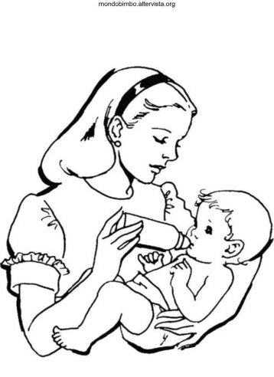

Do Intelligent Girls Delay Age at First Intercourse? Different Results Within-Families Versus Between-Families
Joseph Lee Rodgers and S. Mason Garrison Department of Psychology and Human Development, Vanderbilt University
Presented at International Society of Intelligence Research, September 18, 2015

Slide 2
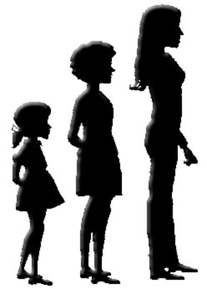
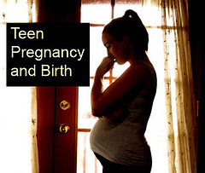

We address this interesting, and policy-relevant, question by introducing you to three earlier research papers, written in 2000, 2010, and 2011
These three papers set the stage for a methodological innovation that we present to study the relation between intelligence and adolescent sexual behavior

Slide 3
Halpern, Joyner, Udry, and Suchindran “Smart Teens Don’t Have Sex (or Kiss Much Either)” Journal of Adolescent Health, 2000
“Results: Controlling for age, physical maturity, and mother’s education, a significant curvilinear relationship between intelligence and coital status was demonstrated; adolescents at the upper and lower ends of the intelligence distribution were less likely to have sex. Higher intelligence was also associated with postponement of the initiation of the full range of partnered sexual activities.”
“Conclusions: Higher intelligence operates as a protective factor against early sexual activity during adolescence, and lower intelligence, to a point, is a risk factor.”

Slide 4
But Halpern et al used a cross-sectional sample, a between-family design
Is intelligence the actual causal influence, as implied by their conclusion? Is higher intelligence indeed a “protective factor” in relation to precocious sexual involvement during adolescence?
Or, alternatively, does intelligence indirectly stand in for other more proximate protective factors, such as maternal education, household SES, etc.?
Those who use cross-sectional data cannot distinguish between processes that act to create differences between families and processes that create differences among family members
If we look inside the family, we untangle those processes

Slide 5
Lahey & D’Onofrio “All in the family: Comparing siblings to test causal hypotheses regarding environmental influences on behavior.” Current Directions in Psychological Science, 2010
“…researchers test causal hypotheses to construct models of environmental influences that can withstand attempts at refutation. Randomized experiments provide the strongest tests of causal hypotheses but are not always feasible, and their assumptions cannot always be met. ”
“Sibling-comparison designs provide robust quasi-experimental tests of causal environmental hypotheses, but they are underused in psychology in spite of their power, feasibility, and convenience.”

Slide 6
Genetic
heterogeneity
Common
Ancestral
Background
Environmental heterogeneity
Sister #1
Sister #2
outcomes
outcomes
compare
children
children
outcomes
outcomes
compare

Slide 7
Harden & Mendle ”Why Don’t Smart Teens Have Sex? A Behavioral Genetic Approach” Child Development, 2011
“Using a sample of 536 same-sex twin pairs who were followed longitudinally from adolescence to early adulthood, this study tested whether relations between intelligence, academic achievement and age at first sex were due to unmeasured genetic and environmental differences between families. ”
Twins who differed in their intelligence or their academic achievement did not differ in their age at first sex.
“the association between intelligence and age at first sex could be attributed entirely to unmeasured environmental differences between families.”

Slide 8
We use a different dataset from the Add Health data used by Halpern et al, and Hardin & Mendle
We use a sibling comparison design promoted by Lahey & D’Onofrio
Like Hardin & Mendle, we address the question of causality, in a quasi-experimental context

Slide 9
The National Longitudinal Survey of Youth (NLSY79 and NLSY-Children)
In 1979, the NLSY79 was a household probability sample of 12,686 U.S. adolescents
The females have given birth to around 13,000 biological children between 1970 and 2010 – these are the NLSY-Children
The NLSY kinship links that we have developed over the past 20 years identify the siblings – and other levels of relatedness – for over 42,000 NLSY79 and NLSYC respondents

Slide 10
Mother-Child-Aunt-Nibling (MCAN) tetrads were created using the NLSY Kinship Links (Rodgers et al., 2015)
Three tetrad designs were employed, in which the genders of Gen2 were the defining feature:
Mother-Daughter-Aunt-Niece (MDAN) included the oldest female child from each of the sisters
Mother-Son-Aunt-Nephew (MSAN) included the oldest male child from each of the sisters, and
Mother-Child-Aunt-Nibling (MCAN) included the first born child from each of the sisters.
In each case we identified around 300 families (1,200 individuals) from families that met the inclusion criterion

Slide 11
Measurement
Self-reported age at first intercourse (AFI) was collected within each of the NLSY dataset
For the NLSY79 mothers, intelligence was measured in 1980 using the Armed Forces Qualifying Test (AFQT)
For the NLSY Children, intelligence was measured at age 9-10 using the unrotated first principal component of PIAT-Math, PIAT-Reading Recognition, PIAT-Reading Comprehension, PPVT, and digit span

Slide 12
Statistical Model
We adapted Kenny and colleagues (2001; 2006) reciprocal standard dyad model.
Y_{i∆} = β₀ + β₁Ybar _{i} + β₂Xbar _{i} + β₃X_{i∆}
where Y_{i1} = max(Y_{ij} ); Y_{i2} = min(Y_{ij} ); Y_{i∆} = Y_{i1} − Y_{i2}; X_{i∆} = X_{i1} − X_{i2}

Slide 13
Common
Ancestral
Background
Smarter
Sister
Less Smart
Sister
NLSY79
NLSYC
children
children
AFI outcomes
AFI outcomes
compare

Slide 14
Results
We examined the relationship between AFI and intelligence using two designs: between and within families
The between-family design allowed us to replicate previous researchers who used a cross-sectional sample
The within-family design allowed us to evaluate intelligence differences within the family, to address issues of causality

Slide 15
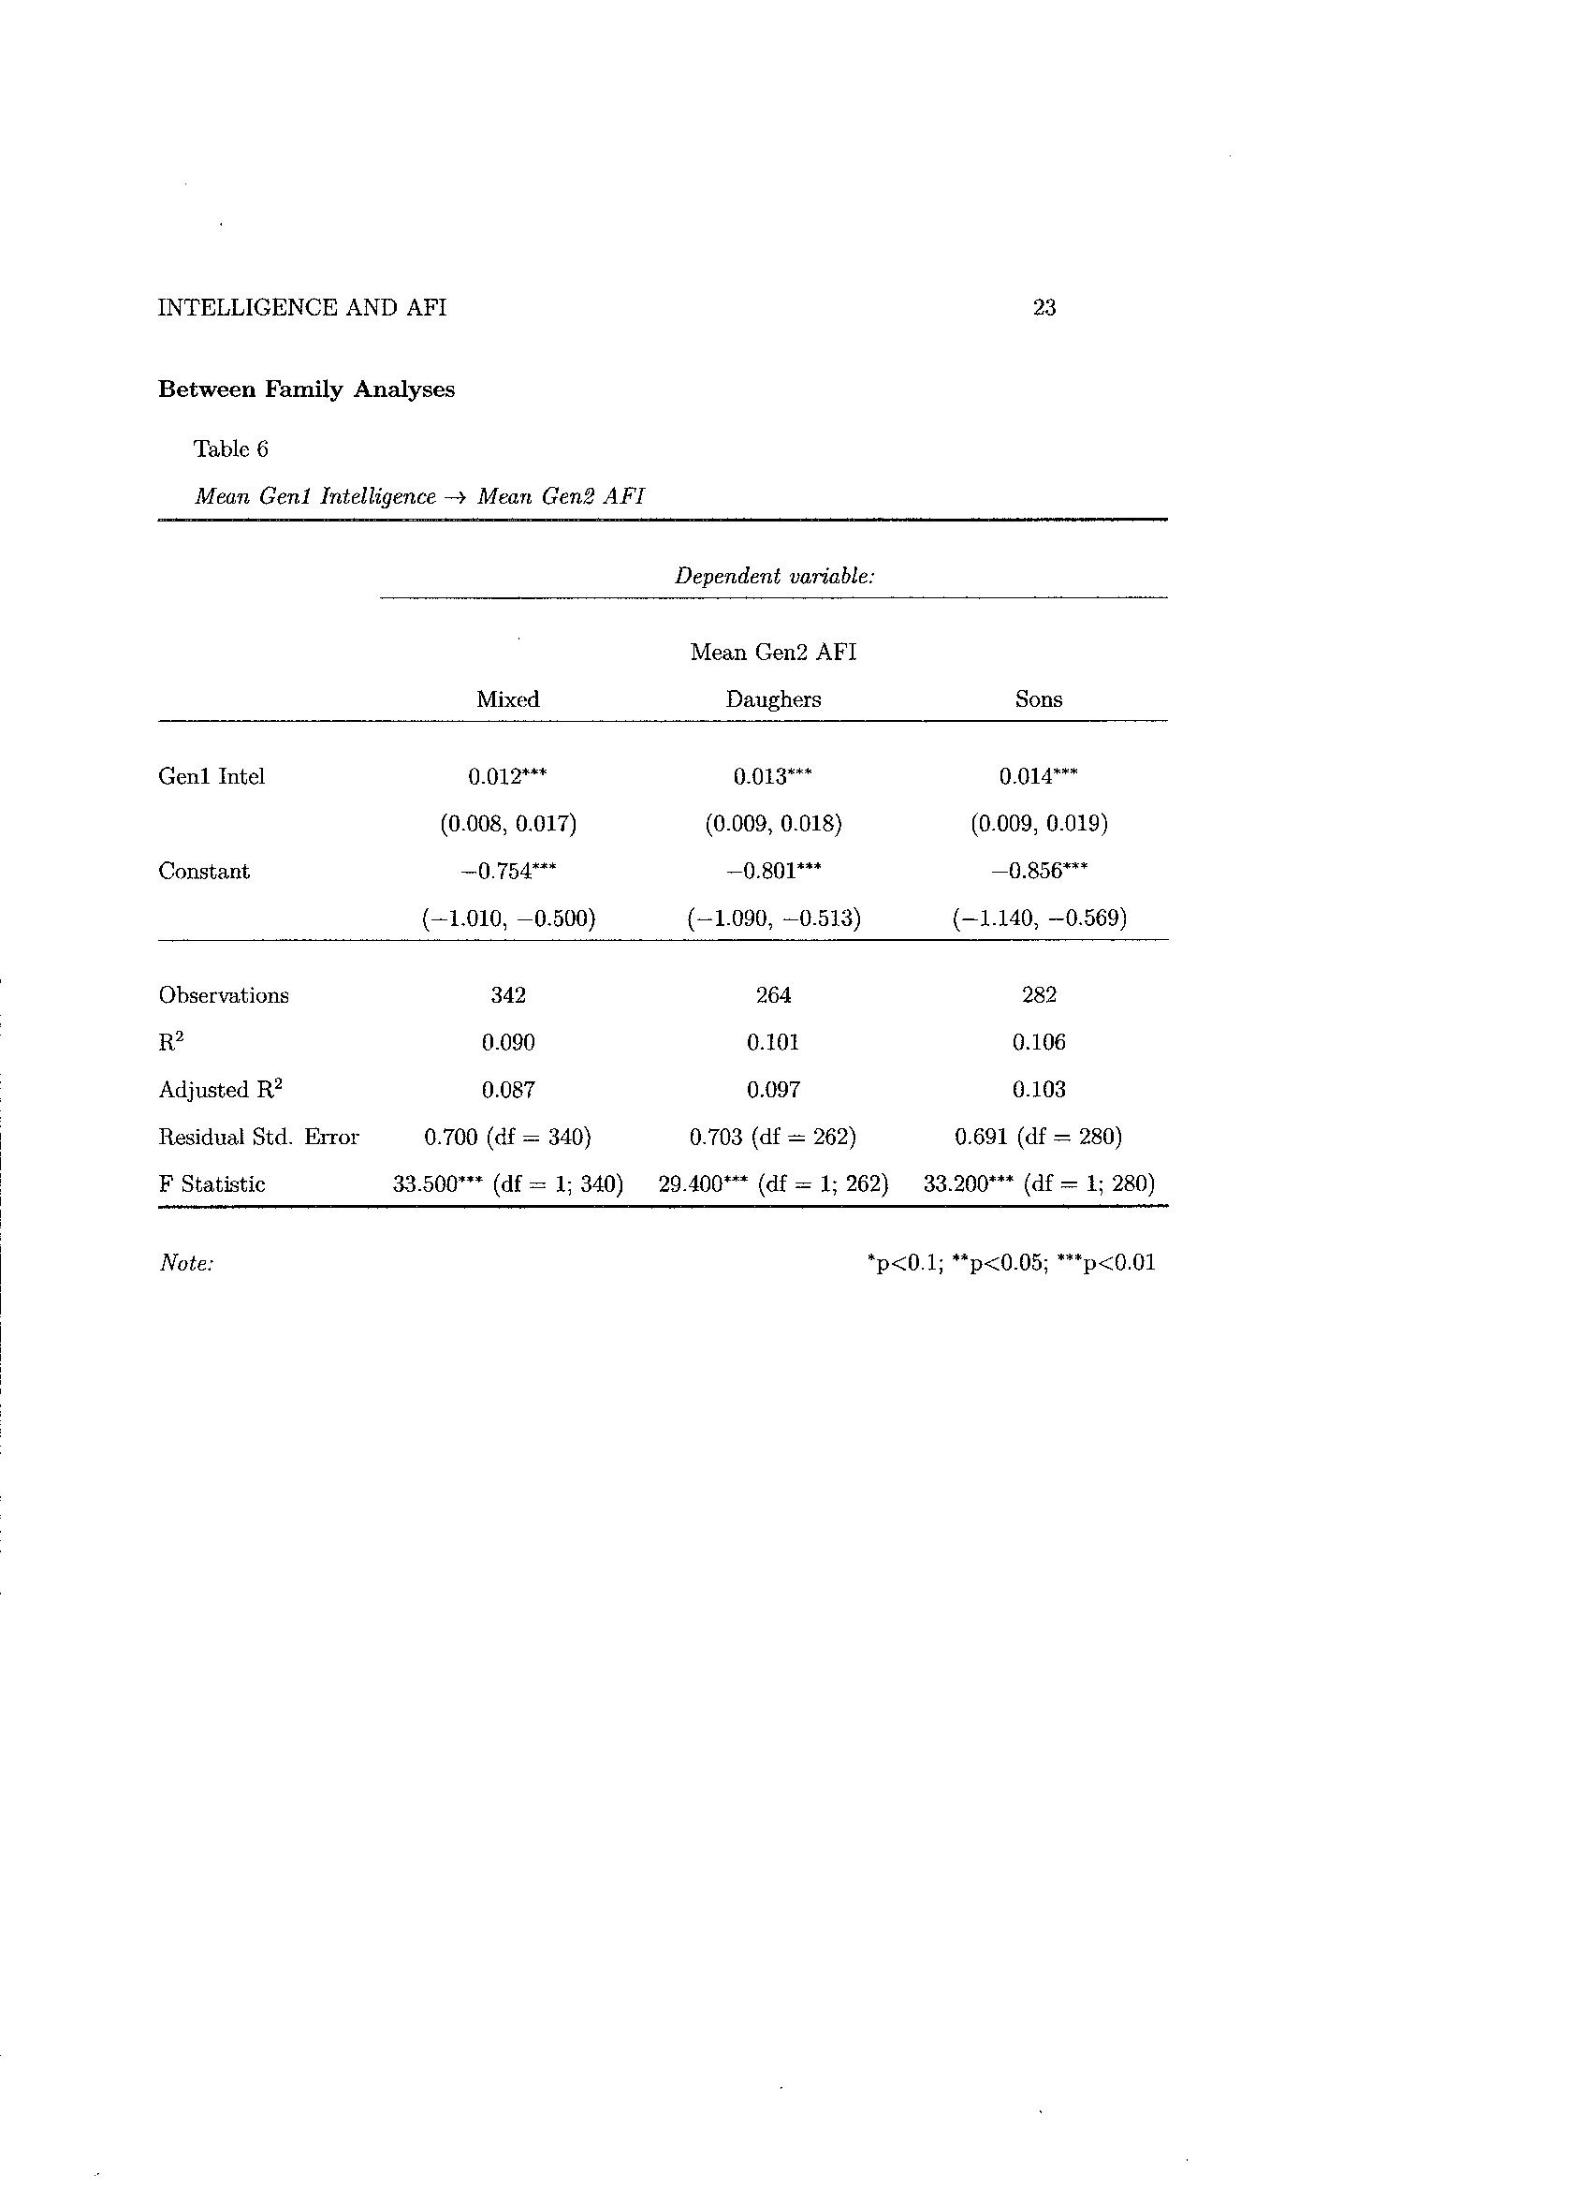

Slide 16
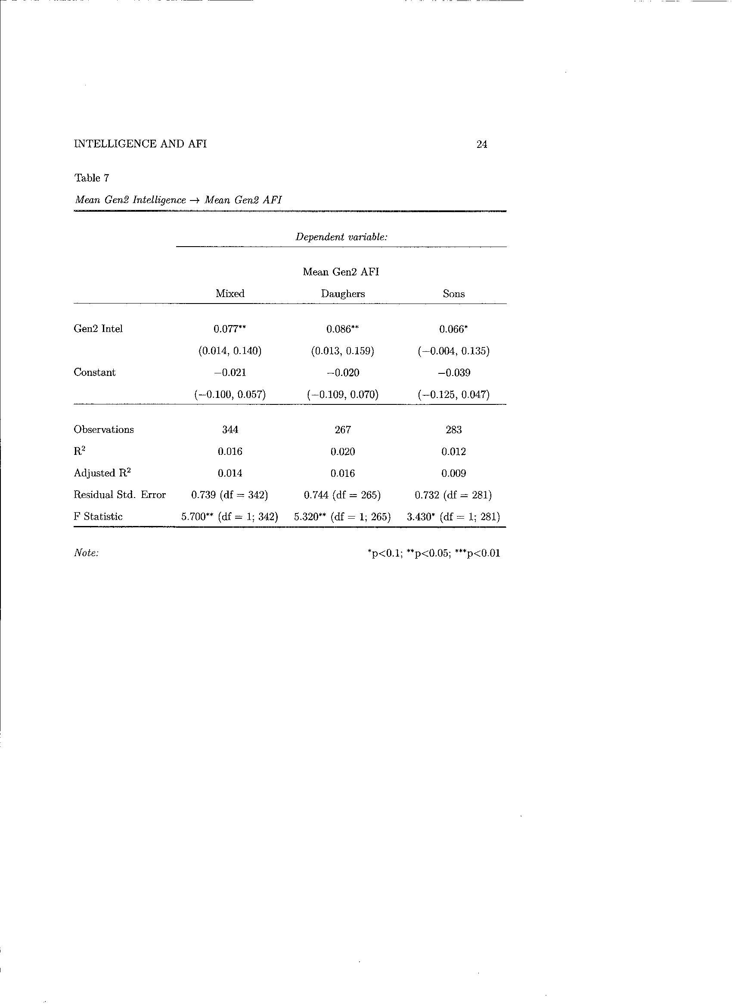

Slide 17
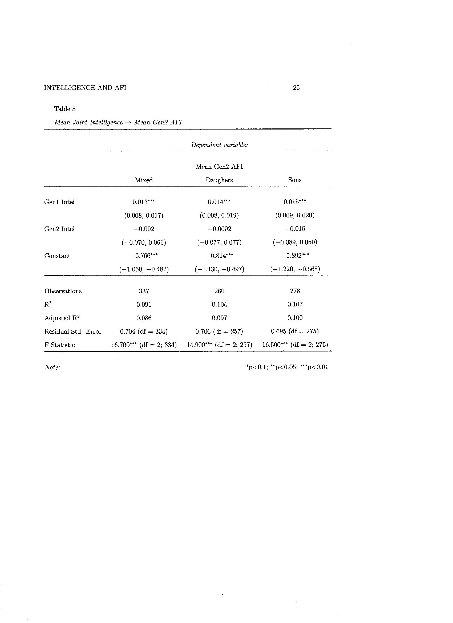

Slide 18
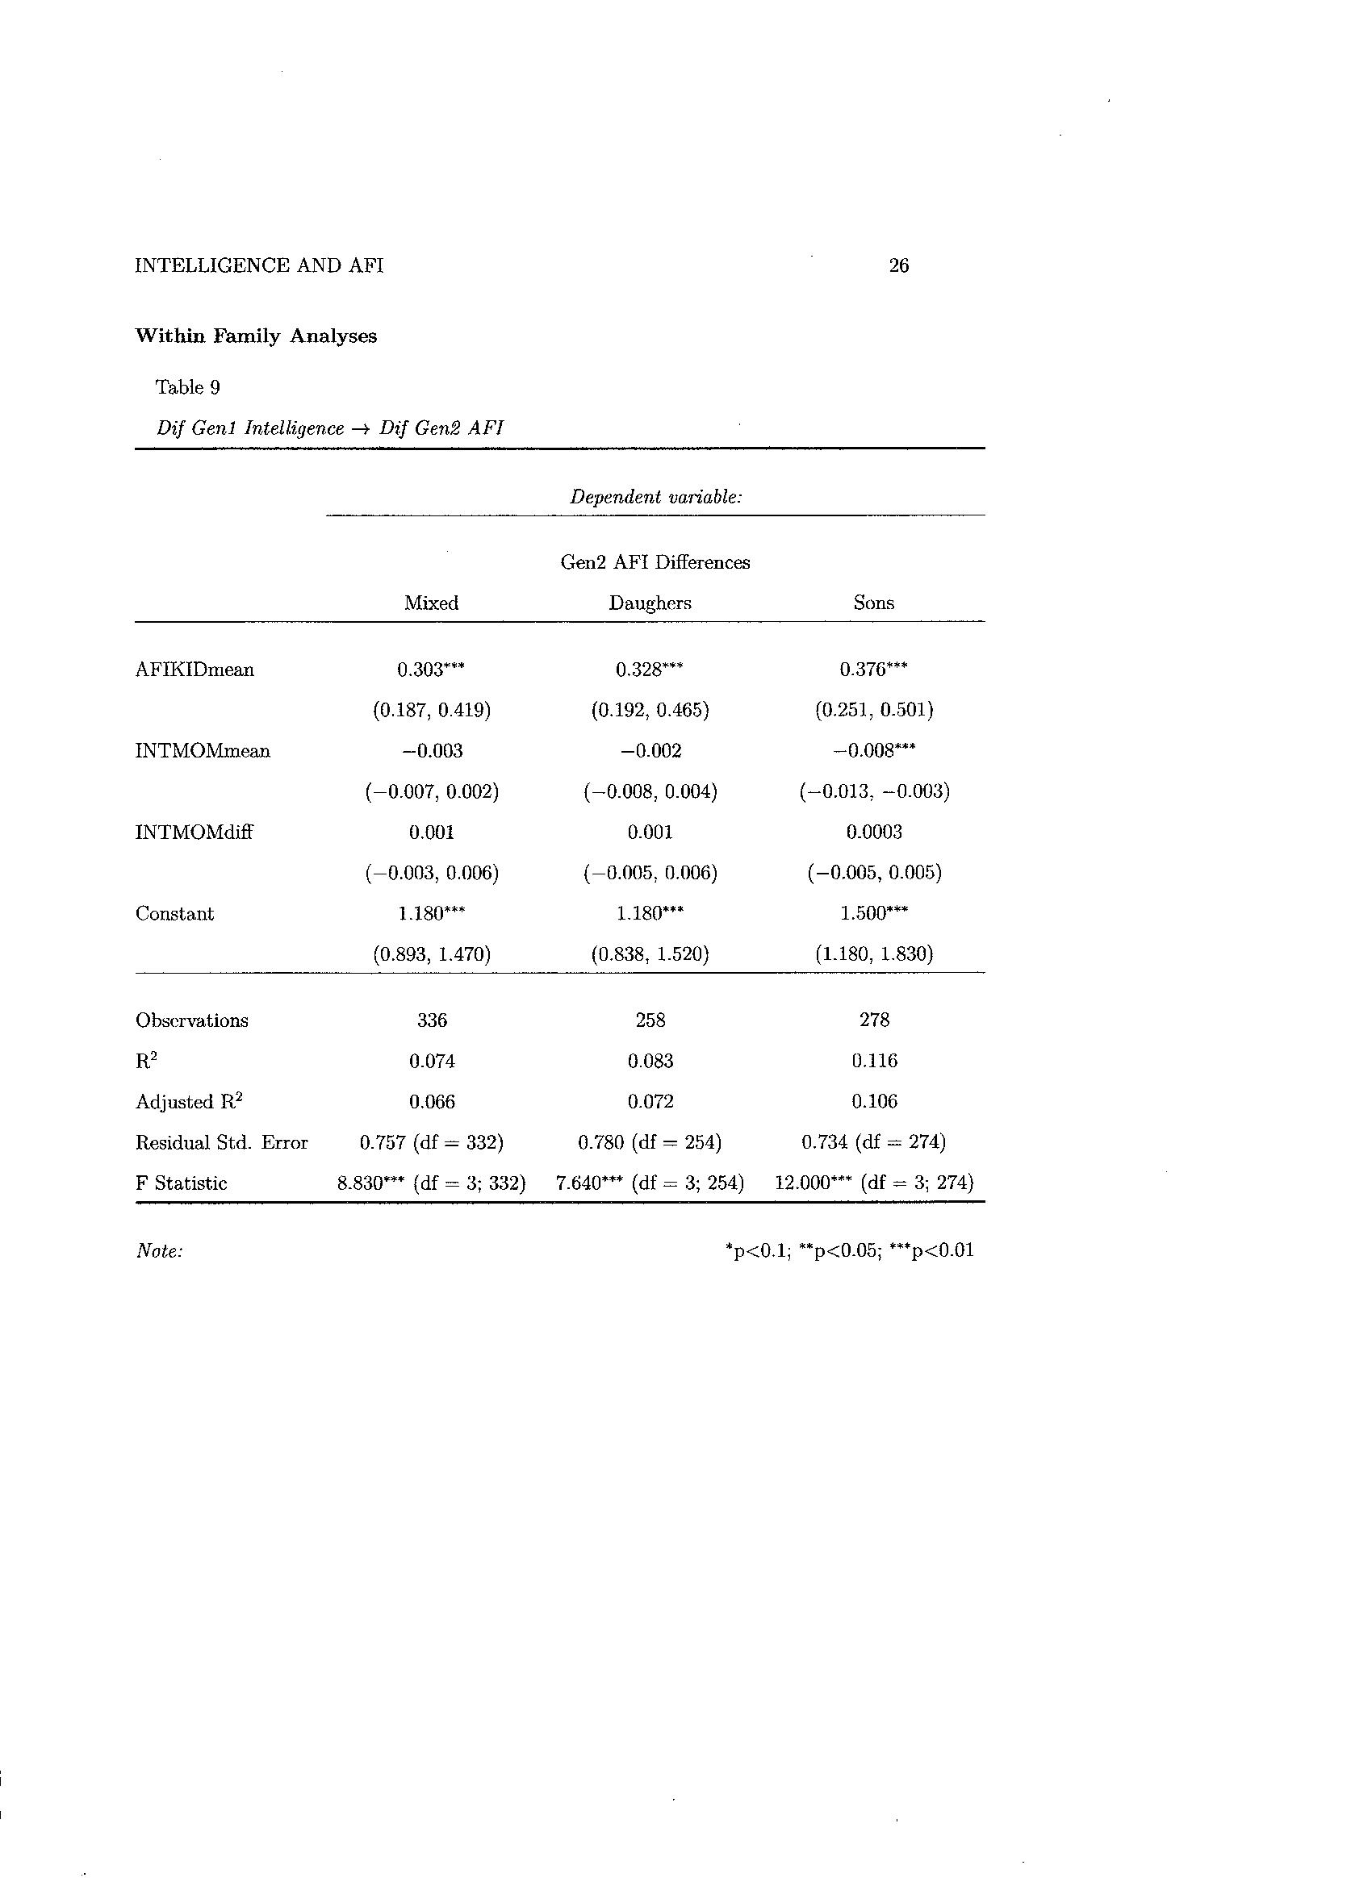

Slide 19
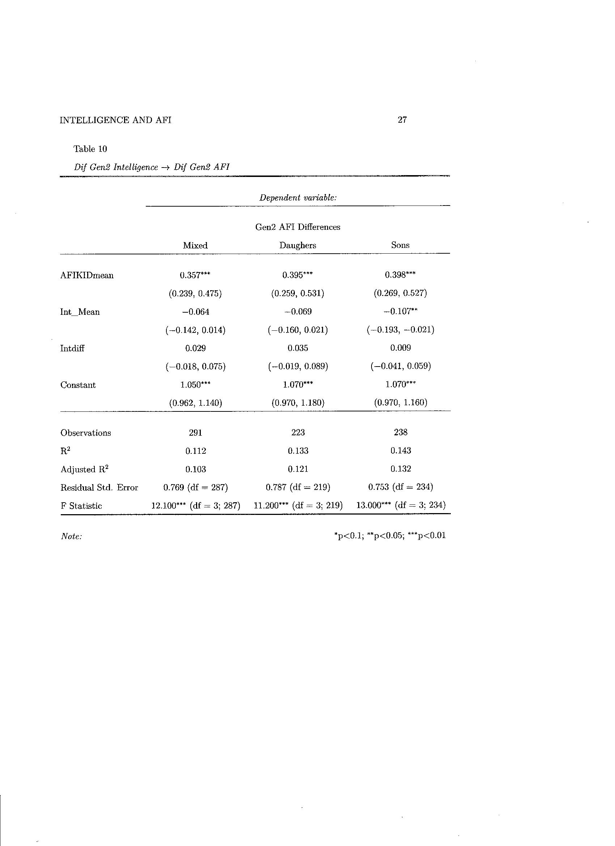

Slide 20
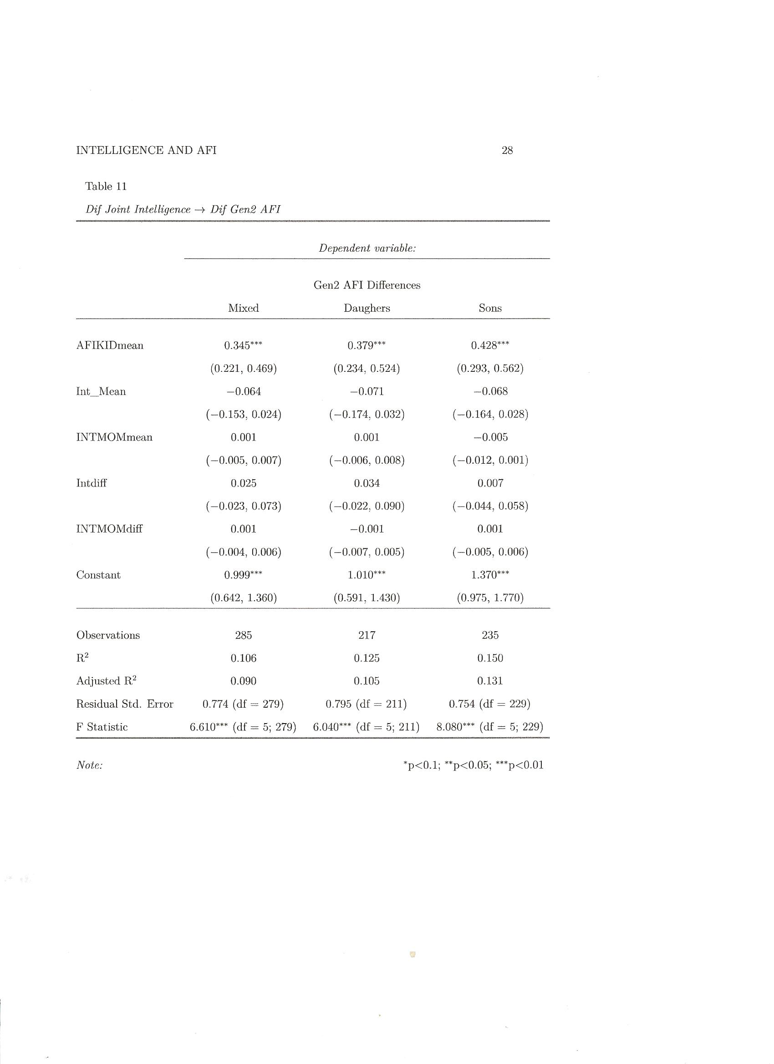

Slide 21
Summary
Both mothers IQ and child’s IQ predict AFI variance between families
Mother’s IQ dominates child’s IQ, suggesting that family-level rather than direct individual-level intelligence is the source
But looking inside the family, all predictive ability of mother’s IQ goes away
And all predictive ability of child’s IQ goes away

Slide 22
How do we interpret this?
Rodgers et al, American Journal of Sociology, 2008, looked at the relationship between IQ and education as they influenced age at first birth in Danish twin data. Their conclusion:
“variance in AFB emerges from [IQ and education] differences between families, not differences between sisters within the same family.”
We have exactly the same result in the current study

Slide 23
Note that the IQ differences between siblings are relatively small; is this important?
Under a purely genetic model, Rodgers & Rowe, Intelligence, 1987, estimated the average absolute deviation in IQ among random pairs to be 17.1 IQ points, compared to 12.1 for full siblings. But cousins, who also are in our study, deviate on average by 16.1 IQ points, nearly as much as random pairs
We believe that differences within the family simply are not important for defining AFI outcome differences

Slide 24
This finding matches the Harden & Mendle biometrical analysis of Add Health, where they found that only shared environmental influences mattered – those would manifest in between-family differences, but not in within-family differences
Further, we’re not convinced that in these between-family analyses, intelligence is the actual cause of AFI differences – if so, we think they would perhaps diffuse a bit, but would still show up in within-family analyses

Slide 25
Rather, we think maternal and child IQ are indirect measures of many other household features, any one of which may be more proximal as the causal explanation – income, parental education, family interaction, etc.
Or, the whole package of these features may stand in for a general environmental factor, a “little e,” which indexes the quality of home environment – a composite of parental income, intelligence, education, family interaction, etc.

Slide 26





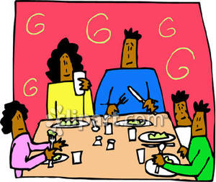

e

