Slide 1
Original and Replication Research with the
NLSY79 and NLSY97
Kinship Links
Will Beasley, Michael Hunter, David Bard,
Mason Garrison, Patrick O’Keefe, & Joe Rodgers
BGA 2019
Notes:
I’m Will, a member of Joe Rodgers’ team that has been using the NLSY since the early 90s.

Slide 2
Two and Half Samples
NLSY79 42k familial relationships
Gen1: 12k randomly drawn teenagers in 1979
Gen2: 11k children of Gen1 moms
NLSY97 2.5k sibling relationships
Gen1: 10k randomly drawn teenagers in 1997
Only 1.8k have 1+ sibling
Notes:
For our team’s first 20 years, almost all our effort was towards creating the 42k kinship links within the two generations of the NLSY79.
Our current grant created the NLSY97 kinship links, which has 2,500 sibling relationships among 1,800 participants.
The 97 sample is completely independent of the 79. Different families.

Slide 3

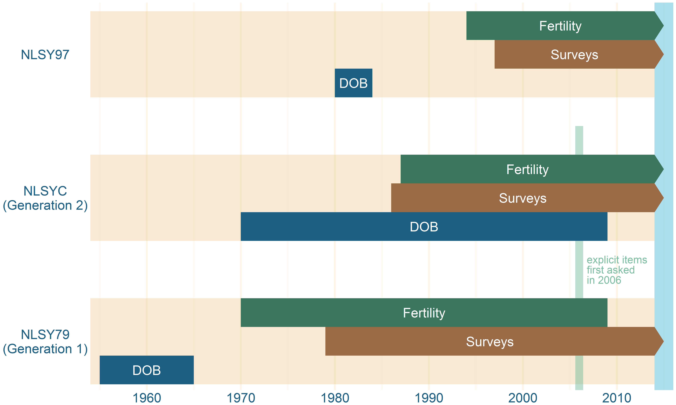
Timeline of Samples
Notes:
Here’s a quick glance of the samples. At the bottom you see the 79 Gen1s were born around 1960, and have been answering questions for forty years.
In the middle, the Gen2s have been answering questions almost that long.
At the top you see the 97s were born around 1980, and have been answering questions for twenty years

Slide 4
Two and Half Samples
NLSY79: 42k familial relationships
Gen1: 12k randomly drawn teenagers in 1979
Gen2: 11k children of Gen1 moms
NLSY97: 2.5k sibling relationships
Gen1: 10k randomly drawn teenagers in 1997
Only 1.8k have 1+ sibling
Notes:
The 97 linking effort went smoother than I expected, but the 79 probably makes the most sense for beginning BGers. It has a larger volume of links, and also a huge variety of relationships. Including full sibs, half sibs, adoptive sibs… Parent-child. Aunt-Niece. Lots of cousins.
But the 97 items cover several topics the 79 doesn’t, which might better support your research.
Also, you could use both 79 & 97 for an additional instance of replication.

Slide 5
BG with the NLSY
Can benefit 3+ types of BG labs:
1. small labs
2. maturing labs
3. distinguished labs
Notes:
BG is a small part of my professional life. Most of my time I’m running the Clinical Data Warehouse of our Med School.
And the NLSY provides a lot of the same benefits to a variety of labs: small, medium, & big.
But better than a CDW, the NLSY is a nationally representative sample.

Slide 6
Small Lab
Don’t have your own life course data set?
Just download 37 years of detailed history of the NLSY79 extended families.
Learn the survey and items relevant to your research within a few weeks.
Analyze and draft the manuscript within a few months.
The subsequent investigations will proceed even faster.
Notes:
Here are the benefits if you’re a small lab. You probably don’t posses the time or funding to establish your own life course dataset. Yet you can immediately download 37 years of professionally-developed & groomed items.
It will take a few weeks to learn the survey, and a few more months to analyze and write about your findings.
It’s very realistic to submit a manuscript within a semester.

Slide 7
Maturing Labs
Planning which topics and instruments to introduce in your expanding twin study?
Run similar analyses on this nationally-representative sample while writing your grant proposal.
The results can justify which topics & items are likely to be (un)fruitful with your sample.
And the Small Lab benefits apply to you too.
Notes:
If you have a growing twin study, the 40 years of NLSY items can inform which topics and instruments make the cut of your upcoming waves. Estimate population trajectories. Estimate b/n & w/n subject variability. Estimate power.
Use it for your internal planning and also the justification in your funding proposals.
For our clinical data warehouse, at least 25% of the projects aren’t research themselves, but feasibility assessments incorporated in funding proposals.

Slide 8
Distinguished Lab
Already manage your own productive twin study?
Leverage the thousands of economic, cognitive, education, and health variables
Replicate and further support your substantive findings.
The Small & Maturing lab apply to you too.
Notes:
Finally, no matter how huge or established or molecular your twin study is, your conclusions can always be strengthened by replication in an independent sample. Especially a nationally representative random sample.
Like the small labs, you can replicate your findings within a semester.

Slide 9
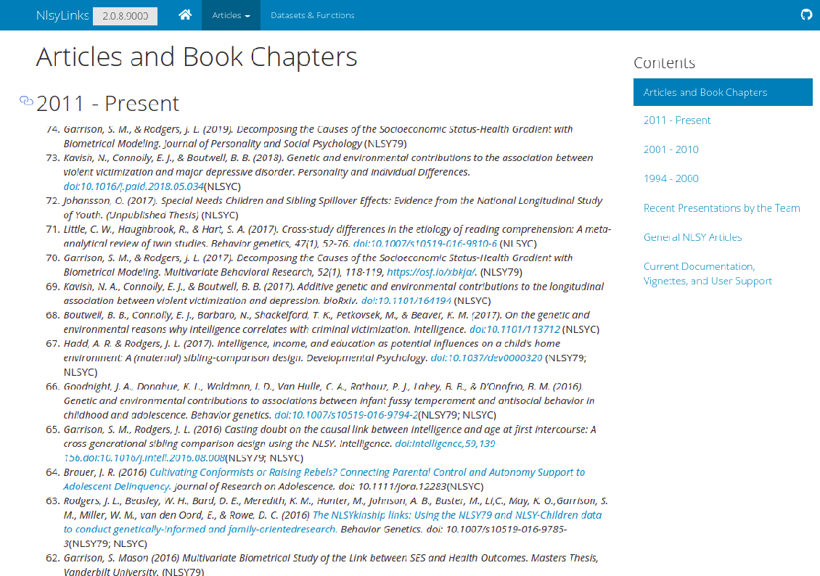
Not Just Hypothetical Productivity
70+ articles across ~8 teams have been published using our links.
Only the surface has
been scratched of
the thousands of
NLSY items.
http://nlsy-links.github.io/NlsyLinks
Notes:
I’m confident because we’ve seen so many publications using our kinship links from all ages and outlets. At least 10 in this list of 70 are theses and dissertations.
And the topics investigated are nowhere close to being exhausted.

Slide 10
Support & Future Releases
Our kinship links & datasets are stable, but not frozen.
Future efforts to facilitate reproducibility and non-BG.
Documentation & Support:
https://nlsy-links.github.io/NlsyLinks
https://groups.google.com/d/forum/nlsy-links
whb4@ou.edu
Notes:
The kinship links are stable, but we still add to the 79 Gen2s as more information becomes available each survey wave.
I’d like to continue to make NLSY research quicker to start and easier to build. Some of our future plans focus on the NLSY elements to apply to all investigations, not just BG.
We’ve always been funded to support other researchers using the links I started a Google Groups recently to move some of that public, but we’ll still happily answer emails.

