Slide 1

Circuit Design (WS2020/21) Prof. Dr. –Ing Andreas Siggelkow
Nils Schlegel, 32067 & Tara Jaishi, 32289

Slide 2
Circuit Design Application
Matching Covid-19 Restriction
Monitoring
Visualizing
Security

Slide 3
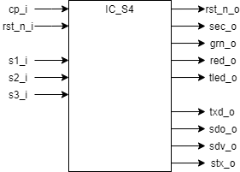
Circuit Design Block Digram

Slide 4
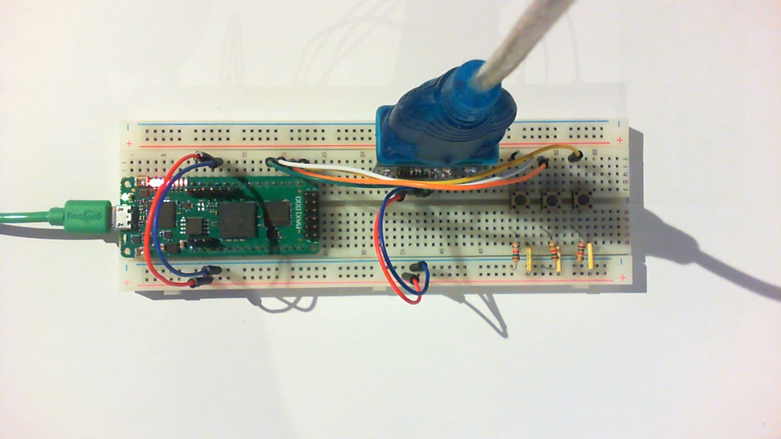
Circuit Design
Board Setup

Slide 5
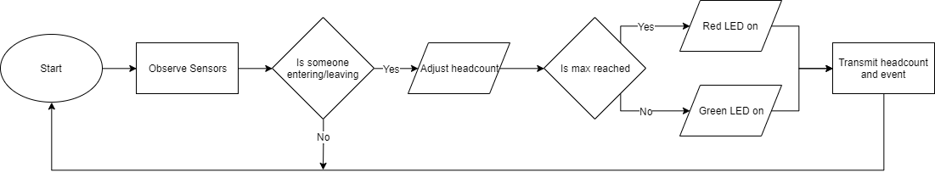
Circuit Design Flow Chart

Slide 6
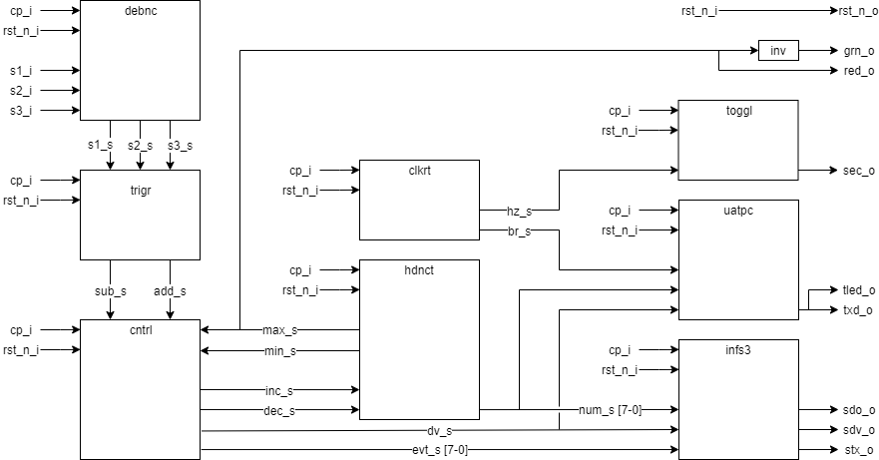
Circuit Design Top-Level

Slide 7
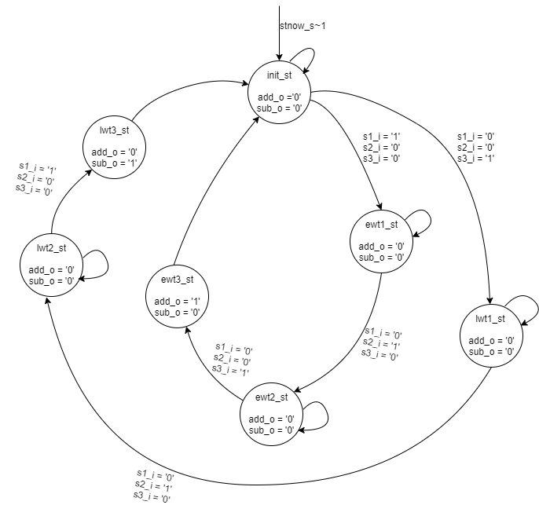
Circuit Design Trigger

Slide 8
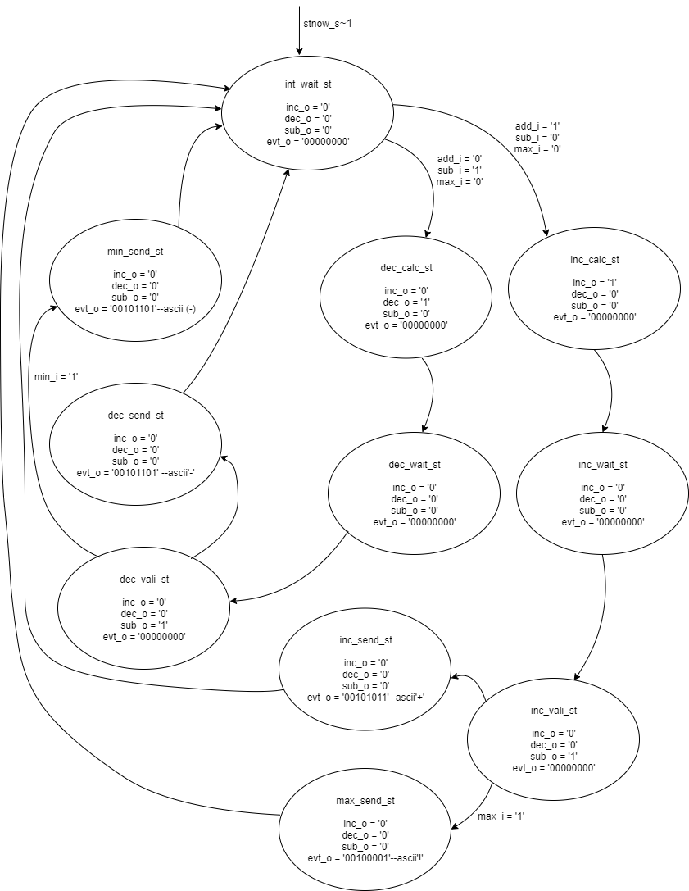
Circuit Design Control Unit

Slide 9
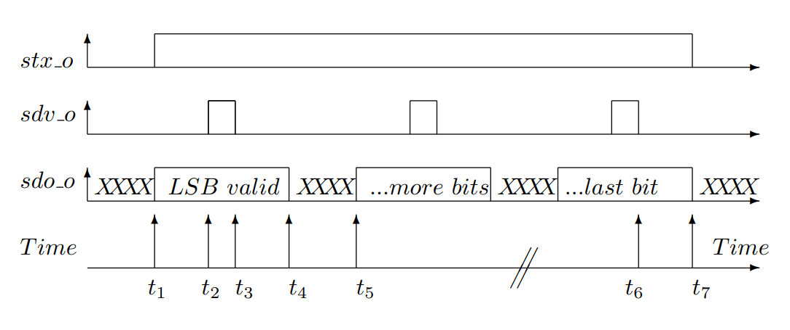
Circuit Design Interface S3
3-Wire-Interface

Slide 10
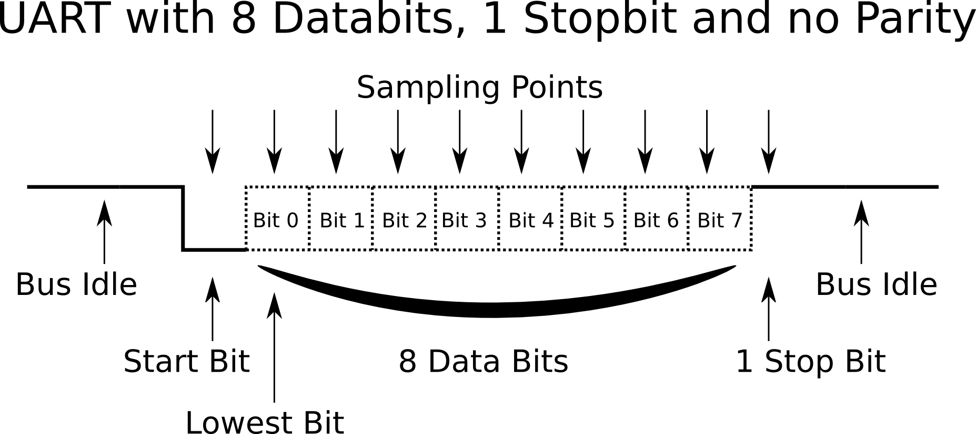
Circuit Design UART

Slide 11
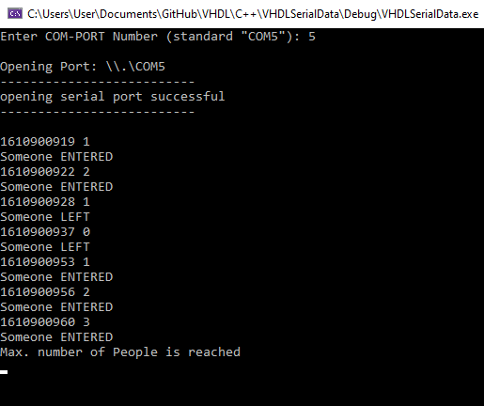
Circuit Design Program

Slide 12
Circuit Design Implementation
In real world assumptions:
Only one door to enter/exit
Everyone completes the enter/leave process completely
No one enters, when the room is full
No one leaves, when room is already empty

Slide 13

Circuit Design
Thank you
Link: https://github.com/nlsy/VHDL

