Slide 1
Lending Club Case Study
Group Members
Nishant Awasthi(Group Facilitator)
Bharat Vattaparambill

Slide 2
Problem Statement
  We work for a consumer finance company which specializes in lending various types of loans to urban customers. When the company receives a loan application, the company has to make a decision for loan approval based on the applicant’s profile. Two types of risks are associated with the bank’s decision:
  If the applicant is likely to repay the loan, then not approving the loan results in a loss of business to the company
  If the applicant is not likely to repay the loan, i.e. he/she is likely to default, then approving the loan may lead to a financial loss for the company
  The aim of this case study is to identify patterns which indicate if a person is likely to default, which may be used for taking actions such as denying the loan, reducing the amount of loan, lending (to risky applicants) at a higher interest rate, etc.

Slide 3
Analysis approach
In this case study, we have used EDA to understand how consumer attributes and loan attributes influence the tendency of default.
Following steps are followed in the analysis:
  First load data and get shape.
  Drop all coulmns with all value Nan or if column values are same like 0.
  Drop columns like URL or cutomer behavior variables which may not have any impact.
  Describe dataset.
  Drop rows for Current as we are not interested in this : we are interested in Fully paid and Charged off.
  Create derived columns if required.
  Create plots to check for univariate and Bivariate analysis.
  Conclusion

Slide 4
Data Cleaning
Steps followed in the data cleaning
Find out how many empty rows and columns are there in the data set.
Find out which columns have all null values and remove them.
Drop the customer behavioural columns which are not considered for the analysis.
We have dropped the columns having more than 90% of missing values.
int_rate has been cleaned and standardized.
After the data cleaning the number of columns reduced from 111 to 31.

Slide 5
Derived Metrics
has_defaulted column has been derived from loan_status.
Created income_category from annual_inc column.
Categorical division of the following columns is done.
  Loan Amount Invested.
  Annual Income.
  Interest Rate.
  emp_length

Slide 6
Univariate Analysis
Following variables are considered for the Univariate analysis.
  Loan Status
  Funded Amount Invested
  Annual Income
  Term of loan
  Employment Length

Slide 7
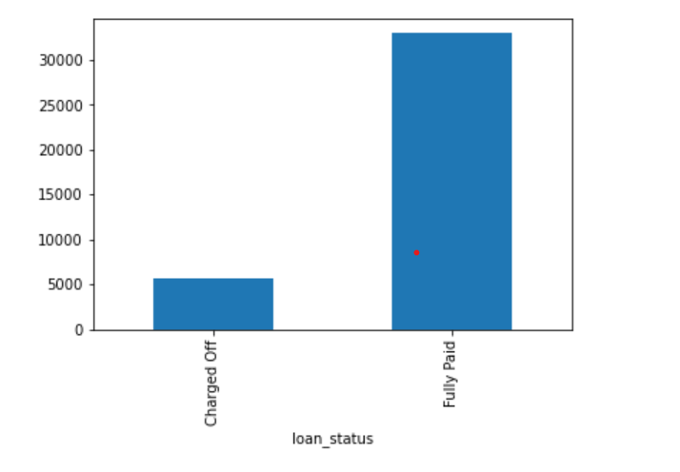
Observations from Univariate Analysis
Loan amount is in the range 5000 to 15000.
Around 14.16% loans were charged off out of total loan issued.
Loan status is
Fully Paid | 83 %
Charged off | 14 %
Current | 3

Slide 8
Bivariate Analysis
Following are the variables considered for bivariate analysis.
  Loan amount
  Interest rate
  Annual income
  Grades
  Income Category

Slide 9
Results of Bivariate Analyses

Slide 10
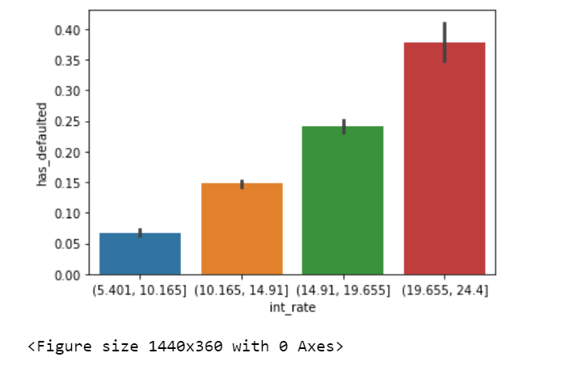
Observations from Bivariate Analysis
• From above bar plot we can observe that higher interest rate is a driving factor for high defaults.

Slide 11
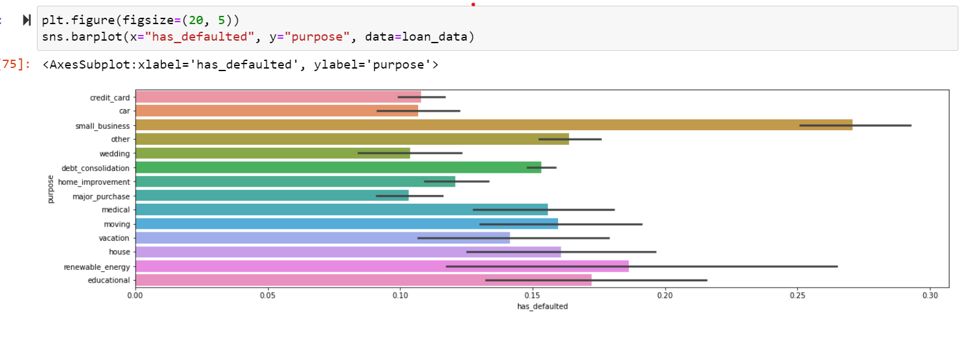
Observations from Bivariate Analysis
Analysis of purpose with defaults
Borrowers with purpose 'small_business' have highest rate for defaults.

Slide 12
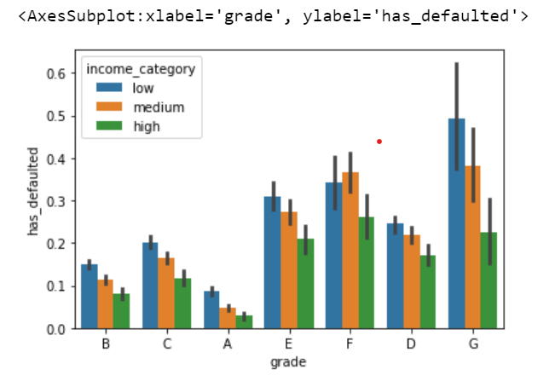
Grades vs. Charged off proportion
Grades vs. Charged off proportion
Chances of charged off is increasing with grades moving from "A" towards "G“.
In loans with different grades, loan with G grade have defaulted the most.

Slide 13
Conclusions :
Summary of All the Observations
Annual income
  loan amount increases when borrower has high income level.
  low income group borrower are less likely to pay the loan.
Interest rate: Higher interest rate has led to high defaults.
Term of loan: Long term loans has high defaults.
Grade Analysis: Providing loan to a borrower with credit grade G could be risky as loan with G grade have defaulted the most.
Purpose of loan : Borrowers with purpose 'small_business' have highest rate for defaults
Earlier Bankrupt Borrowers : Borrowers, who went bankrupt earlier, will most probably default.

Slide 14
Thank You.

