Slide 1
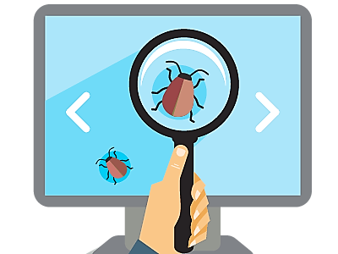

Test Automation – Overview
Testing, Types of Testing, Test Automation, Back-End Testing
SoftUni Team
Technical Trainers
Software University
https://softuni.bg
Notes:
Hello everyone. Welcome to the "Test Automation – Overview" lesson from the "QA Automation" training program at SoftUni.
I am doctor Svetlin Nakov, senior technical trainer and co-founder of SoftUni and I will teach this lesson.
In this lesson I will make an overview of quality assurance and test automation basic concepts and technologies, such as:
the role of the QA automation engineers (or so-called software development engineers in test),
the software testing process, test types and test levels,
the test automation concepts, frameworks and tools,
such as NUnit, Selenium and Appium
and the concept of continuous integration and continuous delivery.

Slide 2

Table of Contents
Software Quality Assurance: Introduction
Testing, Test Types and Test Levels
Test Automation: Overview
Back-End: Concepts and Technologies
Back-End Test Automation, Frameworks and Tools
Unit Testing and testing frameworks
Automated Integration Testing
Continuous Integration and Continuous Delivery (CI/CD)
Notes:
I will start with explaining what is software quality assurance (QA)
and what activities it involves,
what is software testing, the types of software testing
and what are tools to perform testing.
I will explain the concept of software testing,
the most used test types (such as functional and non-functional tests, white-box and block-box tests),
and the levels of software testing (such as unit testing, integration testing and system testing).
I will explain the typical testing process in software projects,
the concept of test plans, test scenarios and test cases,
with some real-world examples.
I will explain and demonstrate with small live examples the concept of
software test automation and typical frameworks and tools used in it.
I will show you examples of unit tests, based on the NUnit framework,
examples of integration tests, based on NUnit and RestSharp,
examples of complete Web UI automation test, based on Selenium Web Driver
and examples of automated tests for mobile apps, based on Appium.
Finally, I will explain and demonstrate the concepts of:
continuous integration (CI),
continuous delivery (CD),
and will demonstrate how CI/CD pipelines can be implemented in GitHub Actions.
Let's begin.

Slide 3
You Have Questions?
sli.do #QA-Auto-BackEnd

Slide 4

Software Quality Assurance
Introduction
Notes:
In this section I will explain what is "software quality assurance",
its goals, concepts, principles, processes and tools.
I will introduce some QA concepts like:
QA engineering, software testing, bug reporting and bug tracking, test automation and continuous integration.

Slide 5

Software Quality Assurance (QA)
What is "software quality assurance" (SQA)?
Software quality assurance aims to assure that the software is bug free (behaves as expected)
Performed by the Quality Assurance engineers (QA engineers)
Most of the QA work is software testing
Manual testing (click and check the results)
Automated testing (QA automation)
Modern QA engineering relies mostly on test automation
Continuous integration and continuous delivery (CI/CD pipeline)
Notes:
Software quality assurance (QA) aims to assure that:
the software works correctly,
is free of bugs (defects),
and behaves as intended.
Software QA is an engineering discipline,
which applies principles, practices, processes and tools to ensure the software quality.
Professionals who implement and maintain QA processes are called "QA engineers".
QA engineering aims to
find the defects and problems in the software development,
earlier in the software development process,
before they reach the end-users.
Software is being tested and inspected
and the development process is being monitored and tracked
in order to find issues (which are also called bugs, defects or problems),
and to report and track them until they get fixed.
Defects and other issues are reported and tracked through
a bug tracking system (also called issue tracker).
In the bug tracking system issues are first logged,
then developers work and fix them
and finally the QA engineers verify and close them.
The software QA activities (such as software testing, bug reporting and tracking and test automation)
are performed by the Quality Assurance engineers (QA engineers).
QA engineers are technical members of the development team,
who are responsible for the software quality.
QA engineers plan, design, automate and execute tests and review the test results.
When an issue is found, it is reported in the issue tracking system and is tracked until resolved.
QA engineers, together with developers implement
the process of automated testing, continuous integration and continuous delivery.
Most of the QA work is software testing.
Software testing is the process of examining the software with set of tests to ensure the it works correctly and is bug free.
Test techniques include the process of executing a program, service, application or system with the intent of finding software bugs (errors or other defects) and verifying that the software product is fit for use.
Testing can be performed manually by hand or can be automated (programmed as script).
Testing can cover a single function or component, the integration between several components or the entire system.
Testing can be black-box (testing without looking inside the code) or white-box (read the code and test suspicious pieces of it).
Testing can be functional (test certain use-case) or non-functional (test the performance, compatibility or security).
Manual testing is "testing by hand".
It consists mainly of "clicking on the user interface, filling the forms and checking the results".
Manual testing is preferred for testing quality aspects, which cannot be easily automated, such as:
usability testing (checking whether the user interface is user-friendly and easy to use),
compatibility testing (checking whether the user interface behaves correctly on different hardware devices, operating systems, Web browsers and environments),
system testing and acceptance testing (testing whether the entire system works as expected).
Manual testing is done by manual QA engineers, which typically follow preliminary prepared test scenarios.
Automated testing (QA automation) is widely used in modern software development.
Automated tests are programs or scripts, which test certain functionality or quality aspect of the software.
Once written, the automated tests are executed continuously many times,
and they ensure that the tested component or subsystem works in the same way over time,
regardless of code changes during development.
Re-executing the same tests to confirm, that the code changes do not affect already tested software,
is called "regression testing".
Automated tests are either written by developers or by QA engineers.
Automated tests usually test the functionality of the system (whether it behaves as expected).
Automated tests can cover a single function or component (unit tests)
or the interaction between components (integration tests).
Continuous integration and continuous delivery (the so-called CI/CD pipeline)
is a practice in modern software development,
where the code is integrated, tested and deployed continuously
and automatically after each significant change in the code.
Continuous integration (CI), together with automated testing
allows developers to find the bugs early
and to continuously maintain the quality of the software.
Continuous delivery (CD) is a practice in modern software development,
which allows to integrate, deploy and release new features continuously
in short release cycles with a lot of automation.
The continuous integration and continuous delivery is often used together in a CI/CD pipeline,
which I will explain and demonstrate later.

Slide 6
QA and QA Automation Overview
Manual testing
Type of software testing in which tests are executed manually without using any automated tools
A human performs the tests step by step, without test scripts
Tests are executed one-by-one in an individual manner
Automation testing
Type of software testing in which tests are executed automatically via test automation frameworks
Testers utilize tools and scripts to automate testing efforts
Requires coding and test maintenance

Slide 7

Software Testing
Test Types and Test Levels
Notes:
Software testing is the QA main activity, that ensures the software quality.
In this section, we shall discuss the test types, test levels and the testing process.
We shall explain the different types of tests, involved in software testing,
such as functional and non-functional testing,
black-box and white-box testing,
manual and automated testing.
We shall explain the concept of different test levels, which include
unit testing, integration testing and system testing.
We shall discuss the software testing process, which involves several steps such as:
test planning,
test development
and test execution.
We shall also explain what is a test scenario and how it is covered by several test cases.

Slide 8
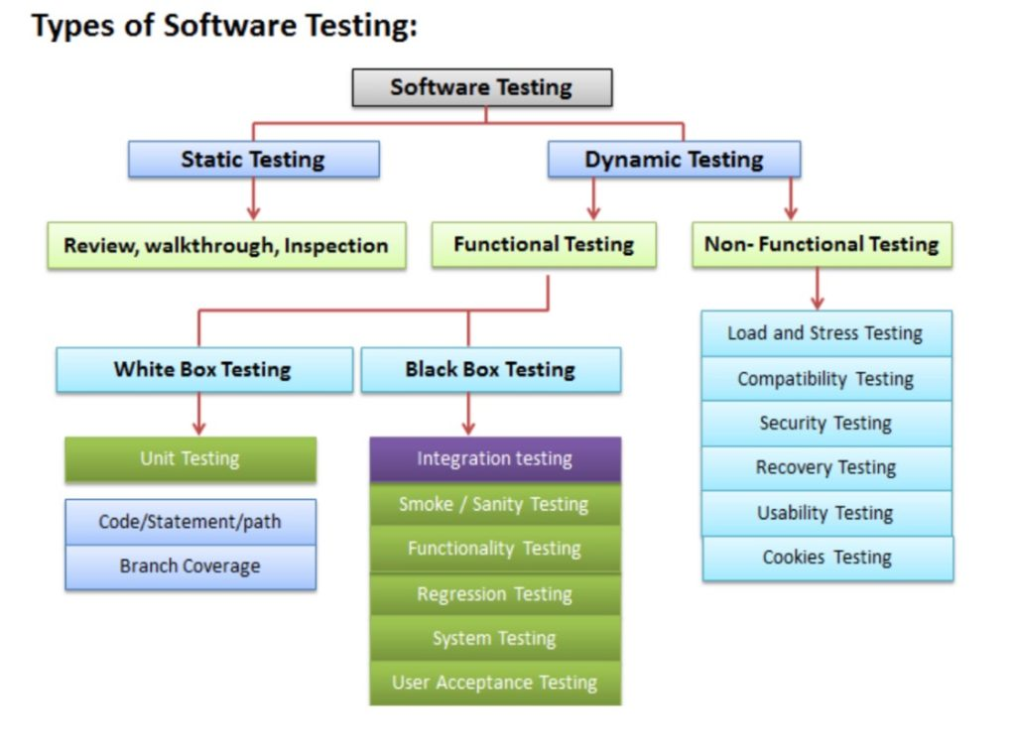
Software Testing and Test Types
Testing checks whether software conforms to the requirements, aims to find defects
Types of software tests
Functional and non-functional
Black-box and white-box tests, regression tests
Stress tests, load tests, UX and usability tests, security tests
Most of these test types can be automated with code
Notes:
Software testing checks whether software conforms to the requirements.
This means to check whether the software does what it should really do,
and if it does it correctly, without side effects, without bugs, hangs or crashes,
whether its behavior is stable,
whether the performance is good,
whether the user interface and usability are good
and many other quality aspects.
Software testing is a tool to reduce the defect rates.
Testing aims to find the defects and report them for fixing.
When the software is well tested, the chance for undiscovered defects is low.
When the software is not tested at all, or is not well tested,
there is a high chance for defects to appear during its execution.
Software testing uses many different types of testing.
Testing techniques can be static and dynamic.
Static testing is based on code reviews and inspections,
which find potential problems,
without running the code.
Dynamic testing is based on examining the code in action:
run the software and check for problems.
Testing can be functional and non-functional, depending on what we test.
Functional testing checks whether the software works correctly, according to the requirements.
It check the functionalities of the software by executing certain features
with different input data and entrance conditions
and evaluating the behavior, output data and exit conditions.
Functional testing can be based on different black-box techniques and white-box techniques,
can be performed manually or can be automated.
Non-functional testing checks quality aspects, which are beyond functionality.
Non-functional testing include usability testing, performance testing, security testing and others.
Testing can be black-box and white-box,
depending on how we design the tests.
Black-box testing checks whether the software behaves correctly,
regardless of the details how it is internally implemented.
During the black-box testing, the software is used as a "black box", which is closed, and it is unknown what's behind the cover.
Anyone can perform black-box tests, without having access to the source code.
The tester chooses input data and entrance conditions,
in attempts to cover the main case and the special cases (such as boundary values and state transitions),
but without having information about how the software works internally.
White-box testing is based on inspecting the source code
and looking for suspicious fragments in it,
then designing test cases to check the suspicious code.
In white-box testing an internal perspective of the system,
as well as programming skills,
are used to design test cases.
The tester chooses input data and entrance conditions,
based on the execution paths, visible from the source code.
Regression tests check whether a functionality, which worked correctly in the past,
still works correctly, after the code is changed or refactored.
Stress tests, load tests and performance tests,
check how the software behaves under heavy load,
under unusual environmental conditions
and whether it meets the performance requirements
(such as maximum page load time).
UX and usability tests check whether users can use the software with ease,
whether they find how to do something without explicit training and
whether users are satisfied with the user interface and user experience.
Security tests check different security aspects of the software, such as
security vulnerabilities, software misconfigurations, incorrect encryption, and others,
which can lead to unauthorized access, data leakage and other damage.
Depending on how tests are executed, they can be manual and automated.
Manual tests are executed by people, by hand.
Testers run the software, click on the user interface, fill forms, submit data and try to find defects.
This is done by hand, or with the help of some tools, but the tests are executed by a human.
Manual testing can be done ad-hoc or following a preliminary prepared execution steps.
Automated tests are programs or scripts, which test some feature or quality aspect of the software.
They can be manually or automatically executed, as part of the CI/CD pipeline.
Automated tests always follow preliminary designed test scenarios and test cases, implemented as code.
Most of the quality aspects of the software can be automated, but not all.
Some types of testing can only be done by humans, due to their nature.
For example, functional testing and performance testing can be fully automated,
but UX and usability testing should be done by a human.

Slide 9
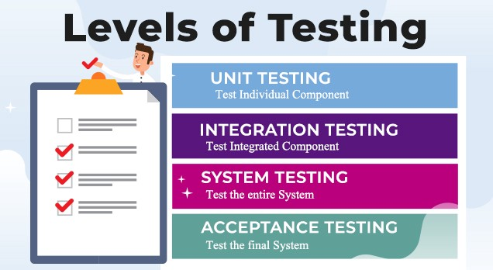
Test Levels
Unit tests
Test single component
Created by developers
Integration tests
Test interaction between components (e. g. APIs)
Created by developers / QA automation engineers
System tests / end-to-end tests
Test the entire system (created by QA automation engineers)
Notes:
Software testing is done at several levels:
unit testing, integration testing and system testing.
Unit tests test a single component (called "unit").
This can be a function or method in the code, a class or other code component.
For example, a set of unit tests can demonstrate that
the service for registering a new user checks for duplicated username and invalid password
and when the input data is correct, it stores the new user in the user repository.
In this case, the unit test will not use a real database (which is an external component).
Instead it will use a fake implementation (mock) of the functions
for accessing the user repository (the database table holding the users).
This way the unit tests check only certain component,
isolated from the other components, which may not exist at this time.
Unit testing aims to verify each component of the software
by isolating it from the other components
and then perform tests to demonstrate that it works correctly.
When a component is dependent on other components,
the external dependencies are replaced during the testing
by mock objects, stubs or using other techniques.
Unit tests are automated tests, written by developers,
that examine the functionality of single component (or unit).
They are small pieces of code (functions or methods),
which automate the testing of certain unit.
Unit testing is performed at the earliest stages of the development process,
long before the software is developed and ready for testing by QA engineers.
When unit testing is implemented,
for each unit, developers write multiple unit tests,
to cover fully its functionality.
Unit tests are examples of automated, functional, white-box tests,
based on a unit testing framework,
such as JUnit, NUnit or Mocha.
We shall learn how to write simple unit tests with live code examples later.
Integration tests check the interaction between several components.
For example, if we test whether the user registration service in the back-end
correctly stores the new user to the database, this is an integration test.
This integration test checks several components together:
the user registration function in the back-end API,
the data access logic,
and the database.
This integration test does not test the entire system.
It does not care about the front-end and the user interface.
Integration tests are examples of automated, white-box, functional tests,
and are usually based on some unit testing framework.
The difference between unit testing and integration testing is that
unit tests examine the functionality of a single unit and they mock the external dependencies,
while integration tests examine the functionality on several units together
and test the integration between the dependent units.
Unit tests are more-simple than the integration tests
and have smaller scope, usually a single public method (or function).
Integration tests implement more complex scenarios.
They test together multiple interconnected components and subsystems.
Integration testing is performed early in the development process,
after some of the components are written and unit tested,
and they need to be integrated together into modules with more complex functionality.
Integration tests are usually written by developers, not by QAs.
We shall learn how to write simple integration tests with live code examples later.
System tests and acceptance tests test the entire system: all its components together.
System tests are manual or automated tests, which cover end-to-end scenarios:
from the front-end, to the back-end, the database and all other system components.
For example, if we test whether after user registration in the mobile app of complex software system,
the new user is correctly stored in the database at the server side, this is a system test.
This system test checks all system components together:
the user interface (the front-end), which is the mobile app in our scenario,
the back-end services at the server side, which are called by the mobile app,
the data access logic, implemented in the back-end to access the database,
and the database server, which stored the app data.
To implement this system test, QA engineers
run the software in a testing environment,
create a database, holding sample testing data,
run the back-end server-side components,
run the front-end component (the mobile app in our scenario),
fill some data in the user registration form, submit the data,
and check the behavior of the mobile app.
The above steps can either be done by hand (manual system testing)
or can be automated (automated system testing).
Automated system testing can be implemented by using DevOps tools and techniques
to automatically deploy and run the required system components
and perform UI tests in the mobile app, using a mobile testing framework.
System testing is performed late in the development process,
when the entire system is ready or partially ready.
System testing is usually performed by QA engineers or test automation engineers.
Modern development processes integrate system testing in the CI/CD pipeline.
Projects with less QA resources implement automated smoke tests during the system testing phase.
The smoke tests check whether the most important functionality works in the most common scenarios.
They just check whether the system is broken or not, without verifying each of its functions.
An example of smoke test could be to check whether the home page of the system opens correctly.
Projects with more QA resources automate the testing of the entire system
with all its functionality, covering all its use cases.
This approach is heavy and time consuming and is rarely used.
Most modern projects automate the system testing for the most important scenarios,
not the entire system with all its components.
Acceptance testing is an extension to system testing, where
the QA team or the project sponsor checks how the product will perform
when it is installed on the user’s system.
Acceptance tests are usually more intensive and more comprehensive than the system tests
and should cover the entire functionality of the software.
The aim of acceptance testing is to evaluate whether the system complies with the end-user requirements
and if it is ready for deployment in the production environment.

Slide 10
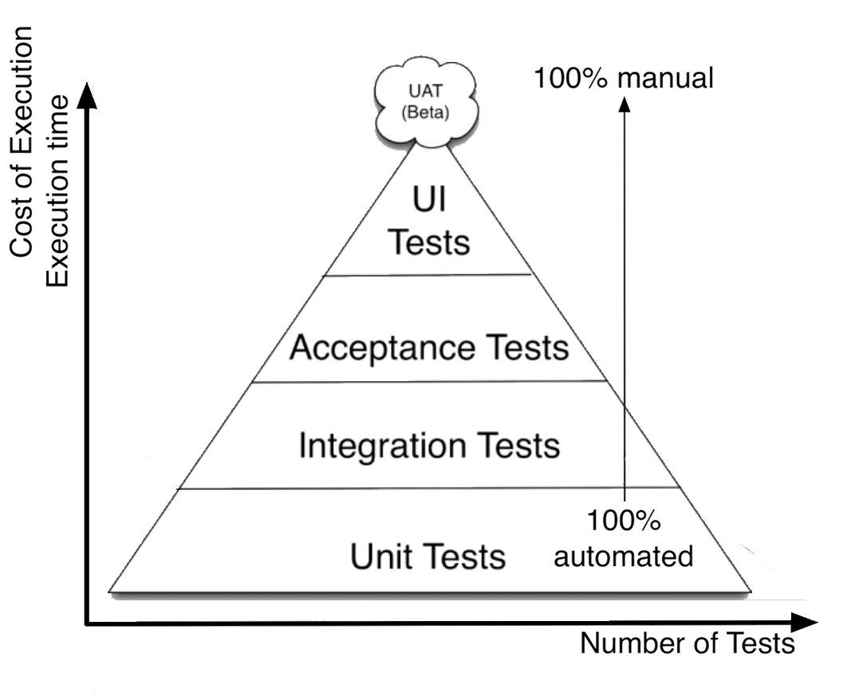
The Testing Pyramid
Unit tests: fully automated
Integration tests: fully automated
System tests / end-to-end : automated (most of them)
Acceptance tests / UI tests: partially automated
Notes:
Let's now explain this classical "testing pyramid",
which illustrates the relationship between the testing levels,
number of tests, costs of execution and the level of automation.
Unit tests are fully automated.
They make up the biggest part of tests, more than all the others.
Unit tests are written by the developers, when they write the code to implement the smallest units of the system.
It takes small amount of time and effort to execute the unit tests, once they are written.
Integration tests are also fully automated.
They make up the next biggest part of tests.
Integration tests are written by the developers, when they write the code to integrate the units of the system into modules.
It takes relatively small amount of time and effort to execute the integration tests, once they are written.
System tests and acceptance tests are partially automated or are manual.
They make up significantly smaller part of tests.
System tests are manually executed by QA engineers
or are automated by QA automation engineers,
when they test the entire system or certain functionality from the entire system.
It takes significant amount of time and effort to perform the system tests, or to automate them.
UI and UX tests are only partially automated and in many cases are handled manually.
They are executed by QA engineers and the project sponsor (who pays for creating the software).
These tests are difficult to automate and usually cost a lot of effort to be performed.

Slide 11
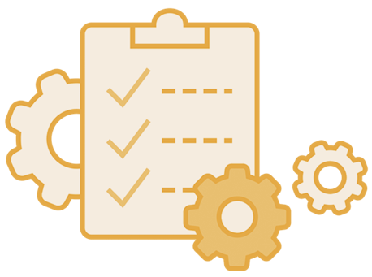
Test Automation Overview
QA Automation Engineers' Roles

Slide 12
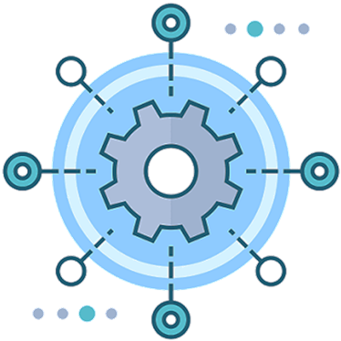
Test Automation
Test automation is critical part of modern software development
Test automation is done at (m)any levels:
Unit tests: written by developers
Integration tests: written by developers and QAs
UI tests / end-to-end tests: written by QAs
Test automation tools record tests / write tests / execute tests
Testing frameworks (NUnit, JUnit, Mocha + Chai, Jasmine, …)
Automated testing tools (Selenium, Appium, Sikuli, Cypress)
API testing, Web testing, Мobile testing, …

Slide 13
Why Automation Testing?
Automation testing is important due to the following reasons:
Manual testing of all workflows, all fields, all negative scenarios is time and money consuming
It is difficult to test multilingual sites manually
Automation does not require human intervention. You can run automated test unattended (overnight)
Automation increases the speed of test execution
Automation helps increase test coverage
Manual testing can become boring and hence error-prone.

Slide 14
QA Automation Engineer's Role
QA automation engineers ensure the software quality through extensive use of automation
Also called "software development engineers in test (SDET)"
Plan, design, implement and monitor the automated tests
Develop and execute test automation scripts to test the software components, the component interactions, the user interface, etc.
Build and monitor CI/CD pipeline (automated build + testing)
Report and track bugs and manage their lifecycle
Write automated regression tests when bugs are resolved
Track the development process, its quality and QA metrics
Perform code reviews, review the requirements and design
14
Notes:
Quality assurance (or QA) is an important role in software engineering.
It is played mainly by QA engineers and partially by software developers.
QA engineers ensure the software quality.
This involves software testing, bug tracking, and tracking of the development process.
QA engineers plan and execute testing activities.
This involves preparation, execution and automation of different types of tests,
reviewing the test execution results and logging the bugs in the bug tracking system.
QA engineers test the software, its functionality, UX and usability, performance, etc.
QAs perform functional tests (checking whether the functionality works as expected),
UX and usability tests (checking whether the user interface is easy to use),
non-functional tests (testing performance, security and compatibility) and others.
QA engineers create test plans, design test cases and execute tests.
Test plans describe what and how to test, test scenarios, schedule and other organizational activities around testing.
Test scenarios describe certain use case or functionality to be tested.
A test scenario is covered by multiple test cases (for example, with valid input and invalid input).
QA engineers execute the tests and evaluate the execution results, and report the issues found.
QA engineers develop and execute test automation scripts.
Test automation is an important activity in modern software testing.
Test automation consists of writing a program or script that executes set of test cases.
Test automation uses testing frameworks and tools
that simplify the implementation of different types of tests,
automate their execution and reporting of the results.
Test automation QA engineers are professionals who have both developer and QA skills.
They work closely with the entire development team to automate the testing activities or pieces of them
and build and maintain continuous integration and continuous testing environment.
QA engineers report and track bugs and their lifecycle.
Once a bug is found, the QA engineers report it in the bug tracking system,
together with a detailed description and steps to reproduce it.
The bug stays in the bug tracker and is accessed by developers, QAs and team management.
Its status changes over time, depending on the efforts and activities to fix the bug.
The bug is initially "new", then is "assigned" to someone, then is "fixed" and finally is "closed".
QA engineers perform regression testing when bugs are resolved.
This means to re-check features and functionalities that worked in the past,
whether they still work correctly after another bug is resolved.
This reduces the chance of introducing new bugs with the fix of some existing bug.
QA engineers track the development process and its quality.
This is quite complex activity.
The development process consists of philosophy, practices, processes and tools for developing software.
QAs track whether the developers follow the established processes (like weekly sprint planning),
the established practices (like using correctly the bug tracker and writing unit tests),
and whether the development follows the established workflow.
QA engineers review the requirements, design and code during the development.
QAs review the requirements to ensure they are well defined and in sync with the business case.
QAs perform design and code inspections
to check whether the established conventions, rules and practices are followed.
QAs review the UI design prototypes to ensure the UX and usability of the planned features.
QA engineers build and monitor continuous integration and continuous delivery (CI/CD) pipeline.
Continuous integration (CI) is the process of automated building and testing of the software
after each commit in the master branch.
This ensures that the new code integrates correctly with the existing code:
compiles without errors and passes all existing automated tests.
QAs are involved to track the quality metrics during the development,
such as test coverage (or code coverage),
defect rates, mean time to detect and mean time to repair defects,
burn down chart, and many others.

Slide 15
QA Automation Engineer's Skills
Developers with QA automation specialization
Technical skills: coding, OOP, back-end, databases, services and APIs, Web technologies, front-end, software engineering, etc.
QA skills: testing frameworks and test automation tools
DevOps skills: containers, cloud, CI/CD pipelines
Logical thinking and problem-solving skills
Planning and organizational skills
Attention to details

Slide 16
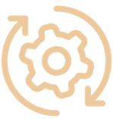
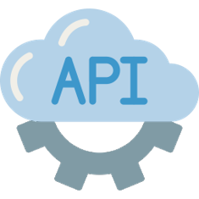
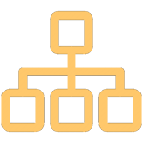
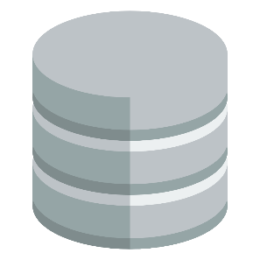
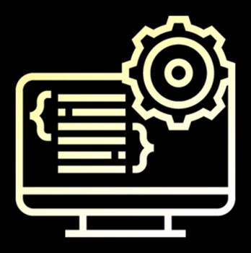

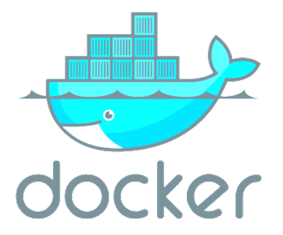
Back-End
Concepts and Technologies

Slide 17
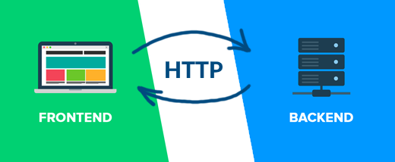
Front-End and Back-End
Front-end and back-end separate the modern apps into client-side (UI) and server-side (data) components
Front-end == client-side components (presentation layer)
Implement the user interface (UI)
Back-end == server-side components (data and business logic APIs)
Implements data storage and processing
APIs connects front-end with back-end
Through protocols like HTTP / REST / GraphQL / gRPC / …
Notes:
Front-end and back-end are important concepts in software development.
Front-end and back-end separate the modern apps into client-side (user interface) and server-side (data processing) components.
Almost all connected software we use every day has front-end and back-end.
The front-end and back-end come form the "client-server" model and are also part of the more complex software architectures.
Most modern apps are not monolith and have client-side (front-end) and server-side (back-end).
The front-end consists of the client-side app components, the so called "presentation layer".
It displays the presentation to the user, the user interface (UI) of the app.
This is what users see on the screen:
text, images, video, fields, lists, icons, buttons, sliders, toolbars, menus and other UI elements.
The front-end is where users interact with the app.
Clicking icons, pressing buttons, sliding a list up and down, selecting items from a list, entering text in text fields, drawing at the screen, playing and recording audio and video: all this is user interaction, and it happens at the front-end.
The data, collected at the front-end, is typically sent to the server-side for processing.
The front-end only executes simple presentation logic, like data validation.
Data storage and business rules are implemented at the back-end.
Example of front-end is the Facebook client app on your smartphone.
It displays the news feed from your friends and allows you to share links, messages and photos.
All the content is stored at the back-end at the Facebook servers and comes through the network.
To display the news feed, the client app sends a request to the back-end API, retrieves the data and visualizes it at the screen.
The back-end consists of the server-side components of the software systems.
It implements data storage, data processing and business logic.
It is typically structured as services, which expose a set of operations.
These services are accessible externally, typically after some authentication.
The back-end exposes an API for the front-end to access server-side logic and data.
API is the application programming interface: the functions and methods, which are available for the client apps.
The back-end systems often use external storage systems, databases and external APIs to implement data storage.
These data storage systems can be relational databases (like MySQL),
document databases (like MongoDB),
key-value storage systems (like Redis),
cloud databases (like Amazon DynamoDB ana Azure CosmosDB),
file storage systems (like Amazon S3 and Azure Blob Storage)
and many others.
Example of back-end is the Facebook server-side functionality, running at the Facebook server infrastructure.
It keeps the users, their friends, the news feeds, the shared links, messages, photos and all the content and processing logic.
This content is delivered to the front-end apps through the network using an API (programming interface).
When a client app requests the news feed for certain user, the back-end retrieves the data from the database and sends it to the client over the network. This is how it works.
Most software systems use the HTTP protocol to connect the front-end with the back-end.
In this scenario the server-side APIs are exposed as operations, available through the standard HTTP methods:
GET, POST, PUT, PATCH and DELETE.
This is known as "RESTful API" – a set of operations to retrieve and modify data using HTTP.
Alternatives to the RESTful APIs are the:
The GraphQL from Facebook, which is a data retrieval query language,
and FALCOR from Netflix, which implements remote data models based on JSON.
Some systems use different protocols than HTTP to connect the front-end with the back-end.
For example, gRPC is a binary-level protocol from Google for invoking remote functionality, designed for high-performance.
Another example is the ReactiveX communication framework, which is based on the publish-subscribe model and implements observable remote data streams.
Still, the HTTP and REST are the dominant technology for interaction between front-end and back-end.

Slide 18
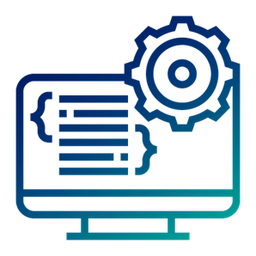
Back-End Technologies
Back-end technologies are about server-side programming
Data management technologies and ORM frameworks
Backend Web frameworks and MVC frameworks
REST API frameworks, reactive APIs, other services and APIs
Microservices, containers and cloud
Back-end developers work on the server-side. They deal with the business logic, data processing, data storage, APIs
Notes:
Back-end technologies are the technologies, platforms and frameworks, which run at server-side part of software systems.
The server-side software components implement logic and processing, which are not related to the user interface.
Back-end technologies provide concepts, frameworks, libraries and tools to build business logic, implement data processing and data storage and exposе programming interfaces (APIs) for the front-end.
Let's look at some of these back-end technologies:
Data management technologies, databases and ORM frameworks,
such as MySQL, PostgreSQL, Entity Framework and Hibernate.
Backend Web frameworks and MVC frameworks,
such as Spring MVC, Django and ASP.NET MVC.
REST API frameworks, reactive APIs, and other services and APIs,
such as ASP.NET Web API, Flask-RESTful and RxJava.
Microservices, containers and cloud,
such as Docker images in Azure and Amazon AWS.
All these back-end technologies are available with:
different programming languages (such as C#, Java, JavaScript, Python, PHP, C++, Go, Swift and others)
and development platforms (such as .NET Core, Java EE, Node.js and others).
Back-end developers play an important role in software development.
They work on the server-side of software systems.
This is a popular profession in the software industry.
Back-end developers deal with the business logic, data processing, data storage and service APIs.
They use database servers, backend platforms, application servers, containers, cloud environments and many other back-end technologies and tools.
The back-end components are often deployed as containers in a cloud environment
or are built specifically for certain cloud platform,
so back-end developers often deal with cloud and DevOps.
Now, let's look at details about databases, ORM systems, MVC frameworks, containers, and operating systems.

Slide 19
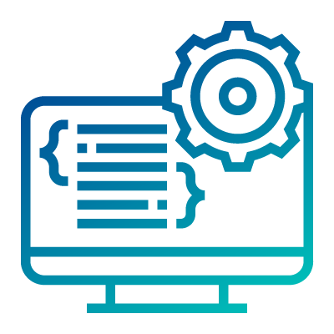
Back-End Languages and Platforms
Back-end technologies: server-side frameworks and libraries
C# / .NET back-end: ASP.NET MVC, Web API, Entity Framework, …
Java back-end: Java EE, Spring MVC, Spring Data, Hibernate, …
JavaScript back-end: Node.js, Express.js / Meteor, MongoDB, …
Python back-end: Django / Flask, Django ORM / SQLAlchemy, …
PHP back-end: Apache, Laravel / Symfony, …
Notes:
Back-end technologies provide concepts, frameworks, libraries and tools to build business logic, implement data processing and data storage and exposе programming interfaces (APIs) for the front-end.
The back-end is the server-side part of the applications, where users and their data are stored and processed.
In software systems, everything you don't see on the screen, is the "back-end" part of the system.
Communication protocols and frameworks, data storage systems and technologies, data processing platforms, frameworks and technologies, cloud technologies and containers, microservices, RESTful APIs, server-side APIs, reactive stream APIs, databases, data access technologies and object-relational mapping frameworks and libraries, message queues, back-end MVC frameworks are all examples of back-end technologies.
We will pay significant attention to the back-end technologies in the professional modules in SoftUni.
Let's look at some of the back-end technology stacks (sets of interconnected technologies, which are built on top of each other).
C# and .NET back-end:
The back-end systems built on top of the C# language and the .NET Core typically use:
the ASP.NET MVC as а back-end Web framework,
the ASP.NET Web API as а framework for building RESTful services, exposed over HTTP,
the Entity Framework as an object-relational mapping (ORM) technology for accessing the database,
MS SQL Server as a relational database system,
and many other back-end .NET technologies, including the Azure cloud environment.
Java back-end:
The back-end systems built on top of the Java language and the Java platform typically use:
Java Enterprise (Java EE) or Spring Framework as а back-end platform,
Apache Tomcat, Spring Boot, JBoss or other Java application server technology,
Spring MVC or Java Servlets + JSP or JSF or other Java Web back-end technology,
Spring Data, Hibernate or Java Persistence API as data access technology,
PostgreSQL or MySQL as relational database server,
and many other server-side Java technologies and cloud environments like Google AppEngine.
JavaScript back-end:
The back-end systems built on top of the JavaScript language typically use:
Node.js as a server-side JavaScript runtime environment,
Express.js or Meteor as a server-side Web technology,
Mongoose or Sequelize as an object persistence framework,
MongoDB or MySQL or other database server,
and many other server-side JavaScript technologies and cloud environments.
Python back-end:
The back-end systems built on top of the Python language typically use:
the Apache Web server or nginx to execute the Python scripts at the server side,
Django, Flask or Pyramid as a back-end Web framework,
Django ORM or SQLAlchemy as an object-relational mapper,
PostgreSQL or MySQL or other database server,
and other server-side technologies and cloud environments.
PHP back-end:
The back-end systems built on top of the PHP language typically use:
the Apache Web server or nginx to execute the PHP scripts at the server side,
a PHP Web framework like Laravel, Symfony or CodeIgniter to structure the Web app,
Eloquent ORM or Doctrine for accessing data,
MySQL or PostgreSQL as database server,
and many other server-side technologies, containers and cloud environments.
Back-end developers deal with the business logic, data processing, data storage and API development.
They use different back-end technologies, platforms and cloud environments, frameworks, libraries and tools.
This is a profession in high demand, which combines technical, analytical and problem-solving skills.
At the professional back-end modules at SoftUni we prepare junior back-end developers and give them the skills and expertise to meet the requirements of the most demanded back-end jobs.

Slide 20
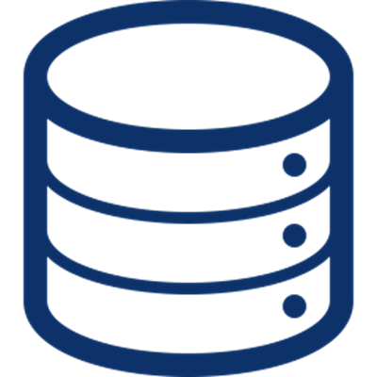
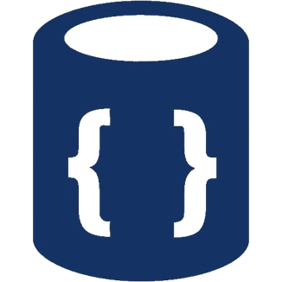
Databases
Databases hold and manage data in the back-end systems
Relational databases (RDBMS)
Hold data in tables + relationships
Use the SQL language to query / modify data
Examples: MySQL, PostgreSQL, Web SQL in HTML5
NoSQL databases
Hold collections of documents or key-value pairs
Examples: MongoDB, IndexedDB in HTML5
Notes:
Databases hold and manage data in the back-end systems.
Almost all software systems use a database in some form.
The data in database systems is organized in tables (holding rows), collections (holding objects), key-value pairs or other structures.
The software, which manages, retrieves and manipulates data in a database, is called DBMS (database management system).
Examples of DBMS systems are MySQL, MongoDB, Redis, Azure Cosmos DB, PostgreSQL, MS SQL Server, SQLite, Elasticsearch and thousands more.
DBMS systems are responsible for:
Data definition: creating and deleting databases, creating and modifying collections, tables or other sets of data records or documents and defining their structure, fields and data format;
Data retrieval: retrieving data, querying data, searching data, filtering data, extracting data, combining data, aggregating data;
Data manipulation: inserting new data, modifying existing data, deleting existing data;
Data administration: users, roles and access control, concurrency control, monitoring, replication, backup and recovery and others
Modern software systems use a DBMS system to manage data, instead of implementing the data management internally.
Relational databases organize data in tables and data rows.
For example, an e-commerce software could have a table holding the products:
Each table row could hold product id, product name, description, vendor, and price.
Some tables in the RDBMS system maintain relationships between them.
For example, one vendor has many related products and each product has a vendor.
This is called "one-to-many relationship".
In relational database the SQL language is used to query and modify data.
SQL (structured query language) is standard database query and manipulation language.
It support simple and more complex commands, such as "SELECT name, price FROM products".
The software packages, which manage relational databases, are called "RDBMS – relational database management systems".
Examples of RDBMS system are MySQL, PostgreSQL, MS SQL Server, Oracle Database and Web SQL (in the HTML5 platform).
We shall learn more about databases and SQL in the database modules and courses in the end-to-end software engineering training program at SoftUni.
NoSQL databases hold collections of documents or key-value pairs.
Document databases (like MongoDB) manage collections of documents (such as products or vendors),
where each document has a set of properties (like name, price and description).
Document databases support
retrieving and querying document collections,
and creating, modifying and deleting documents.
Examples of document-based NoSQL databases are MongoDB and IndexedDB in the HTML5 platform.
Key-value pair databases, such as Redis and Amazon DynamoDB, store keys mapped to values.
These key-value pair structures are also known as "dictionaries".
They support fast "search by key" operation,
but storing collections of data is less flexible.
Key-value data storage systems are good for organizing simple data.
For example, a phonebook can be stored in a key-value store.
Database systems are an important component of most modern software systems,
and therefore software engineers must have at least basic database skills.

Slide 21
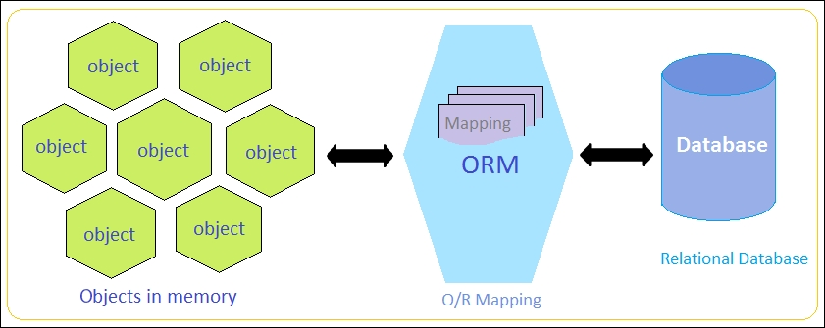
ORM Frameworks
ORM frameworks (object-relational mapping) allow persisting objects in relational database (by mapping classes to tables)
E.g. store JS objects in MySQL database
Popular ORM frameworks:
Entity Framework (C#)
Hibernate (Java)
Sequelize (JavaScript)
SQLAlchemy (Python)
Notes:
When we talk about databases, it is important to mention some data access technologies.
Data access technologies connect programming languages with database systems.
These technologies allow creating databases, defining the data format, storing and manipulating data and retrieving data, using simple or more complex data queries or by executing SQL commands.
For example, the JDBC technology connects Java programs to relational databases, such as MySQL and PostgreSQL.
ORM frameworks (object-relational mapping) allow persisting objects in relational database.
ORM frameworks work by mapping classes to database tables.
Instead of executing SQL commands, when developers use ORM, they work with simple data classes and APIs from the ORM framework to handle the CRUD operations (create, read, update and delete), query the database and execute database-related operations.
This dramatically simplifies the implementation of data access logic in software development.
Examples of using ORM systems are when we need to:
persist JavaScript objects in MySQL database,
or persist Java objects in PostgreSQL database,
or persist C# objects in MS SQL Server database.
These are a few examples of popular ORM frameworks:
Entity Framework, which is the most popular ORM for the C# language and the .NET platform.
Hibernate and Java Persistance API (JPA), which are used as ORM frameworks in Java projects.
Sequelize, which is a popular server-side JavaScript ORM framework for persisting JavaScript objects in relational databases.
SQLAlchemy, which is a popular ORM framework for Python.

Slide 22
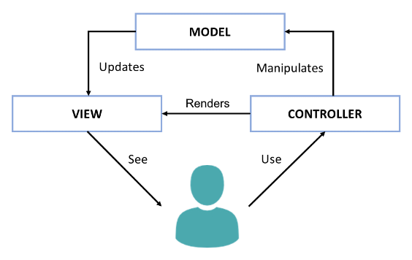
The Model-View-Controller (MVC) Pattern
The Model-View-Controller (MVC) pattern
Controller
Handles user actions
Updates the model
Renders the view (UI)
Model
Holds app data
View
Displays the UI, based on the model data
Notes:
Another important concept from software development is the Model-View-Controller (MVC) pattern.
MVC is an architectural pattern for structuring Web back-end apps,
by dividing their logic into 3 separate components: models, views and controllers.
The MVC pattern is illustrated at the diagram, which shows the interactions between the MVC components.
MVC is complex and some developers need time to understand it.
We shall spend significant time, effort and practical work to learn it, later at SoftUni.
But now, let's briefly explain the MVC pattern.
MVC splits the app into controllers, views and models.
Users interact with the controllers, which modify the data in the models and visualize the data using the views.
For example, let's take a phonebook app.
Users see the phonebook entries on the screen. They are rendered by a view component.
The app model holds the phonebook entries. This is the data model behind the views.
Controllers are responsible for handling the user actions, such as "view the phonebook", "search", and "add new entry".
The controllers, models and views are strongly interconnected, but each of them has well defined responsibility.
The idea of MVC is to build a better app structure, which simplifies development and improves maintenance.
The presentation logic, which displays elements on the screen is always located in the views.
The logic for user interaction, which handles the user input, is always located in the controllers.
The data models and data related logic are in the models.
The MVC app structure is very popular in Web back-end frameworks (such as ASP.NET MVC, Django and Spring MVC).
Variants of MVC sometimes are used in some Web front-end frameworks and mobile app frameworks.
In the MVC model, controllers handle user actions, such as clicking a button or choosing an item from a list.
Depending on the user action, controllers may update the app data model.
Then, controllers render a view (the user interface), which visualizes the data model.
For example, in our phonebook app, the phonebook controller handles the action "click on a phonebook entry".
The action handler loads the data about the selected phonebook entry into a data model object.
Then it shows a view, which displays this data object.
Models holds app data.
Typically models are data classes, which hold the data, that should be displayed at the screen.
For example, in our phonebook app, the data model, used to visualize a phonebook entry, is a data object, holding the phonebook entry details.
Views displays the UI for certain screen from the app, based on the data from the model.
For example, in our phonebook app, the view, which displays the phonebook entries,
takes as an input a data model, holding a list of phonebook entries.
The view iterates over the entries one by one and displays them in a table or list.
MVC is an important paradigm for structuring Web apps back-end developers should learn it.
At SoftUni, we teach MVC as part of the server-side Web development courses and modules.

Slide 23
Web MVC Frameworks
Web MVC frameworks are used build Web applications
Controllers handle HTTP GET / POST and render a view
Views display HTML + CSS, based on the models
Models hold app data for views, prepared by controllers
Examples of Web MVC frameworks:
ASP.NET MVC (C#), Spring MVC (Java), Express (JS), Django (Python), Laravel (PHP), Ruby on Rails (Ruby), Revel (Go), …
Notes:
Web MVC Frameworks are software development frameworks, which implement the Model-View-Controller pattern as foundation to build Web apps.
Web MVC frameworks (such as Spring MVC, Django and ASP.NET MVC) are used build server-side Web applications.
Under the MVC framework Web apps define controllers (holding actions), views and model components.
Actions in the controllers handle the HTTP GET and POST requests from the client Web browser.
They perform the requested operation (such as retrieving data or adding new data)
and render a view to display the result in the client Web browser.
Controllers implement the operations, used to interact with the users.
These operations are invoked as HTTP requests by the client Web browser.
For example, clicking a button, or submitting a Web form, executes an HTTP request,
which is handled by a controller action at the back-end.
Views render data as HTML + CSS for displaying in the client Web browser.
Views are called by the controller actions to render the UI.
They take as input a data model and visualize the data from the model as HTML.
The rendered HTML is returned as an HTTP response.
For example, a view can render a list of items as HTML.
Models hold the app data, which is prepared by controllers to be rendered in the views.
In most cases models are simple data objects or collections of objects.
When a controller wants to return data for displaying in the client Web browser,
it loads the data from the database, puts it in a data model object,
and sends it to the view, which renders it for as HTML.
Examples of popular back-end Web MVC frameworks are the following:
ASP.NET MVC (for C# developers),
Spring MVC (for Java developers),
Express.js (for server-side JavaScript developers),
Django (for Python Web developers),
Laravel (for PHP Web developers),
Ruby on Rails (for Ruby developers),
Revel (for Go Web developers),
and many others …
Almost all the server-side Web development is driven by Web MVC frameworks,
so you need to learn at least one of them if you want to be a back-end developer.
We shall learn MVC frameworks at SoftUni, at the end of our end-to-end training program for software engineers.

Slide 24
Web Services and APIs
Web services expose back-end APIs over the network
May use different protocols and data formats: HTTP, REST, GraphQL, gRPC, SOAP, JSON-RPC, JSON, BSON, XML, YML, …
Web services are hosted on a Web server (HTTP server)
Provide a set of functions, invokable from the Web (Web API)
RESTful APIs is the most popular Web service standard

Slide 25
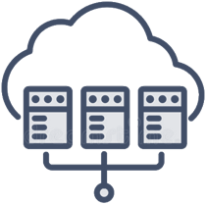
Virtualization and Cloud
Virtualization == running a virtual machine (VM) / virtual environment inside a physical hardware system
E.g. run Android VM or Linux inside a Windows host
Storage, memory, networking, desktops can also be virtual
Cloud == computing resources, virtual machines, storage, platforms and software instances, available on demand
IaaS (infrastructure as a service) – virtual machines on demand
PaaS (platform as a service) – app deployment environments
SaaS (software as a service) – software instances, e.g. Office 365
Notes:
Virtualization, cloud environments and containers are important infrastructural components in modern software development.
Virtualization in the concept and technology of running a virtual machine (VM) or virtual environment inside a physical hardware system.
Simply said, this is a virtual computer, running inside a physical computer.
In a single physical machine (called "host"), several virtual machines can run simultaneously.
For example, in a Windows desktop host, we can run simultaneously an Android virtual machine + two Ubuntu Linux virtual machines + a FreeBSD virtual machine.
Storage, memory, networking and desktops can also be virtual.
Virtual storage means that you can use remote or virtual storage infrastructure, to appear and function exactly like a local hard drive.
Example of virtual storage is the desktop Google Drive client, which displays your files from the drive, as local files on your computer.
Virtual memory is a technology, where external or remote memory resources could be used as local memory.
For example, a USB flash memory can be used as a disk cache in Microsoft Windows, in an effort to increase computing performance.
Virtual networking virtual network infrastructure to be distributed over Internet, without using a physical network equipment.
Virtual desktops are virtual desktop environments, running in a virtual machines, available remotely.
For example, developers may use a virtual Safari Web browser on macOS, for testing a Web front-end app.
Virtualization is a powerful concept and technology in software development and developers should be familiar with it.
The concept of "cloud environment", "cloud infrastructure" or just "cloud" plays an important role in modern computing.
The "cloud" consists of remote computing resources, virtual machines, storage, platforms and software instances available on demand.
The cloud infrastructure, platforms, services and cloud-based software is typically available for rent for a fee.
Some vendors provide free of charge limited versions of their cloud environments.
The cloud environments are offered in several service models:
Infrastructure as a service, platform as a service and software as a service.
IaaS (infrastructure as a service) provides virtual machines and other computing resources on demand, for a fee.
Examples of the IaaS model is when a company hires virtual servers to host their Web sites, or virtual machines do deploy their apps.
Under the IaaS model, developers and system administrators install, manage and maintain their virtual machines, the operating systems, configuration settings, backups, security and everything else.
IaaS services are offered by the major cloud infrastructure providers, such as Amazon AWS, Google Cloud, Azure, DigitalOcean and Rackspace.
The IaaS model is mostly for system administrators and developers who want to completely control their production environments.
PaaS (platform as a service) provides managed environments for app deployments.
"Managed" means that someone else cares about the hardware, software and its maintenance,
and guarantees that the requested environment and services are constantly up and running.
Developers don't care about the execution environment, only for their apps.
For example, you have a Python app and you want to host it in the cloud.
Instead of renting a cloud server, you could deploy and run the app in the Heroku PaaS cloud or in Azure PaaS.
The PaaS model provides cloud environment for deploying and running apps,
where developers do not care about the operating system, software platforms, application servers, database servers and other details.
Developers just send their source code or compiled app to the cloud, configure some settings and the app is live and running.
PaaS platforms typically provide a lot of managed platform services, such as:
databases (relational and document-based),
storage services (files, video, content-delivery networks and others),
message queue services,
logging services,
caching services,
machine learning and artificial intelligent services.
Developers use PaaS to simplify the development, deployment and maintenance of their apps and software systems.
The PaaS model is mostly for developers who want to focus on the software, rather than on the environment that hosts it.
SaaS (software as a service) provides managed software instances in the cloud.
Users pay for hosted software in the cloud (or get a limited version for free) and use it over Internet.
Examples of SaaS service are the Office 365 application suite, Google Docs and WordPress.com website hosting cloud.
The SaaS model is mostly for end users, not for developers.

Slide 26
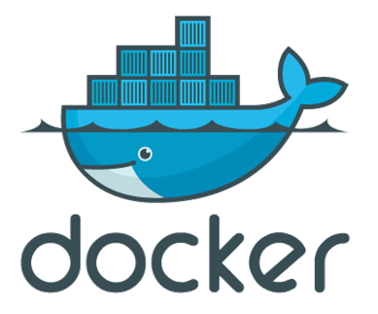
Containers and Docker
Container image == software, packaged with its dependencies, designed to run in a virtual environment (like Docker)
E.g. WordPress instance (Linux + PHP + Apache + WordPress)
Simplified installation, configuration and deployment
Docker is the most popular containerization platform
Runs containers from local image or downloaded from the Docker Hub online repository
Open-source, runs on Linux, Windows, Mac
Notes:
Containers, Docker and other containerization platforms (like "Linux Containers")
provide popular infrastructural concept and technology
to deploy, run and manage software installations and software environments,
packaged as "containers images".
A container image is a standalone executable software package,
bundled together with its dependencies (operating system, code, runtime and others),
and designed to run in a virtual execution environment (like Docker).
Container images are a set of files and folders, packaged as ZIP, TAR or other archive format.
When you run a container image, it creates and runs a virtual app, called "container".
Thus, a container is, ultimately, just a running container image in the host environment.
Containers bundle their own software, code, libraries and configuration files.
Containers are isolated from one another,
but can communicate with each other through well-defined channels.
The container host could start, stop, pause and resume the containers.
A container typically holds an app, together with its runtime environment:
the operating system (such as Ubuntu Linux) +
the app runtime (such as Node.js or Apache + PHP) +
the app code, or its compiled binaries (such as the WordPress source code in PHP) +
the app dependencies (such as libraries, frameworks and configuration settings, like curl, openssl and zlib).
For example, a WordPress instance can run in a container,
which runs Linux + Apache web server + PHP + some libraries,
and holds the WordPress code + some configuration files.
All these components are bundled together and run as a single application in an isolated environment.
The benefits of the containerization technology are:
simplified installation, configuration and deployment.
Containers allow automated configuration and management of virtual software environments,
using tools like Kubernetes.
Containerization is often associated with DevOps.
DevOps combines agile principles and technologies to implement continuous delivery, build automation, continuous integration, automated deployment, automated testing, automated releasing and automated monitoring of the software systems in the software development process.
DevOps engineers often use containers to implement automated provisioning of development, testing and production environments.
Docker is the most popular containerization platform.
It runs as a service on Linux, Windows, and many could environments.
Once you run Docker, you can create container images, using "Dockerfile" scripts.
Docker runs containers from local images
or from images, downloaded from the Docker Hub online repository,
or from images, created by "Dockerfile" scripts.
Docker containers are virtual app instances, which can be started, stopped or put at pause.
Developers can connect to existing Docker containers and manage them from the console.
Docker containers can expose network ports (like the HTTP port 80) to the host environment.
Thus, containers can serve Internet traffic from their host machine.
Docker is open-source software.
It runs on Linux, Windows and Mac.
Docker images can run in many cloud environments, such as "Amazon Elastic Container Service" and Docker for Azure.
Docker Compose is another container-based technology for defining and running multi-container Docker applications.
For example, using Docker Compose developers can run WordPress + MySQL,
in two separate containers, with an integration between them,
so that the WordPress instance store its data in the MySQL database.

Slide 27
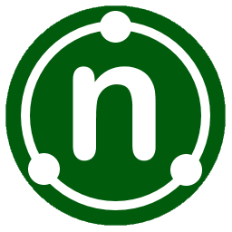


Back-End Test Automation
Frameworks and Tools

Slide 28
Back-End Test Automation's Purpose
The main purpose of back-end testing is to check the database or server-side of the web application
It makes sure that all server-side components have proper intercommunication and cooperation without defects
With proper Back-end Testing, you will be able to:
Have a thorough test of an application and control over its coverage
Discover defects, and resolve them before escalation
Avoid data corruptions or losses, alongside deadlocks
Improve system functionality and stability
Improve data quality and integrity

Slide 29
Unit Testing
Example with NUnit

Slide 30
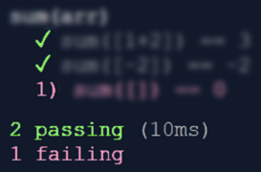
Unit Testing
Unit test == a piece of code that tests specific functionality in certain software component (unit)
int Sum(int[] arr)
{
int sum = arr[0];
for (int i=1; i<arr
.Length; i++)
sum += arr[i];
return sum;
}
void Test_SumTwoNumbers() {
if (Sum(new int[]{1, 2}) != 3)
throw new Exception("1+2 != 3");
}
void Test_SumEmptyArray() {
if (Sum(new int[]{ }) != 0)
throw new Exception("sum [] != 0");
}
Notes:
Unit testing is an important concept and practice in software development.
Unit tests are pieces of code that test specific functionality in certain software component (called "unit").
Unit tests are written by developers (not by QA engineers).
Unit tests are part of the product source code.
They aim to improve the code quality, reliability and maintainability.
This is a simple example to illustrate the idea of "unit testing":
We have a function, which sums the elements of given array of numbers.
We want to test this function, but not by hand.
We want to write code, which confirms that this function works correctly.
This is an example of how we can test the "sum" function:
We write a function to hold the test cases.
This is the first test case, the first check.
It checks whether the sum of the array of two elements [1, 2] is 3.
If the execution result is not as expected, the function will fail with an error.
The second test checks whether the sum of the array, holding a single element [-2] is -2.
The third test checks whether the sum of an empty array is 0.
This example is just a simple way to illustrate the concept of "unit testing".
Don't follow it as best practice. It is not!
It combines multiple test cases in a single test function, and this is a bad practice.
But the idea of unit testing is clear:
Unit tests execute the code with sample input data and entrance conditions
and check whether the returned result, exit conditions and behavior are correct.
Unit testing usually is performed within a unit testing framework,
which organizes and structures the tests consistently.

Slide 31
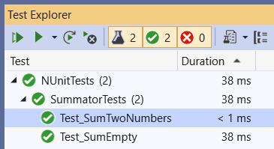
Testing Frameworks – Example with NUnit
Testing frameworks simplify automated testing and reporting
Example: NUnit testing framework for C#
using NUnit.Framework;
public class SummatorTests
{
[Test]
public void Test_SumTwoNumbers() {
var sum = Sum(new int[] { 1, 2 });
Assert.AreEqual(3, sum);
}
}
Notes:
Unit testing frameworks simplify, structure and organize the unit testing process, test execution and reporting.
This an example of how the test cases from the previous example can be structured within the NUnit framework for C#.
We first include the required libraries.
Then we define a "test class".
This is a group of related unit tests.
Within the test suite we define our first test.
It holds a function to check whether the sum of the array [1, 2] is 3.
The second test follows the same syntax:
It checks whether the sum of the array [-2] (a single element) is as expected: -2.
Similarly, the third test checks whether the sum of empty array is 0.
That's all.
When we run the tests, we see a test execution report like this, shown on the screenshot.
I don't want to go into deeper details.
The concept is well illustrated.
Perhaps, I need to mention, that unit testing has not only its technical side:
to use correctly the testing frameworks and libraries.
It has also its engineering side: to decide what and how to test.
Unit test writers usually follow the "AAA pattern":
arrange the input data and entrance conditions,
act (execute the function for testing),
and assert whether the results and the exit conditions are as expected.
Testing usually covers:
the straightforward case – the typical use of the function,
the edge cases (such as empty array or negative numbers),
testing for performance, for error handling, etc.
Testing should be enough to find the bugs and potential problems
and not too much, because it takes time to write and maintain the test cases.
Tools for measuring the so called "code coverage" can give a good sign whether a function is tested enough or not.
Developers should be familiar with unit testing and test automation, even junior developers!
We shall learn in detail the concept of "unit testing" and how to use unit testing frameworks,
how to write efficiently unit tests and integration tests,
how to use tools like "code coverage" and "mocking"
in the advanced programming training modules at SoftUni.

Slide 32

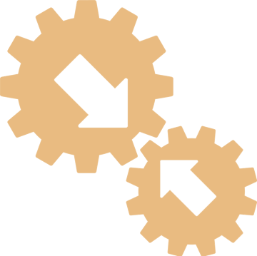
Integration Testing
Example with Mocha
Notes:
Now let's see the process of integration testing through a real-world code example.
…
…
…

Slide 33
Integration Testing
Integration testing test several units (components) together
Aims to expose faults in the interaction between integrated units
Example: test user registration + data access services + database storage (check whether the new user is stored in the DB)
Unit testing vs. integration testing
Integration testing tests the interaction between several units
Unit testing tests a single unit (component)
Integration testing is implemented by:
Testing framework + test stubs / mocks

Slide 34
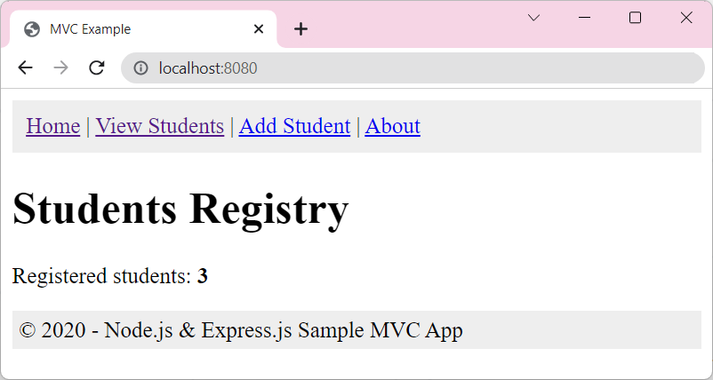
Sample JS App: Students Registry
We have a JS App with integration tests:
Code: https://github.com/nakov/MVC-app-integration-tests-example-mocha

Slide 35
Integration Testing – Example with Mocha
Example integration test with Mocha: load the "Home" page and assert that it displays correctly the count of students from the database
test('Students count', async function() {
let res = await fetch("http://localhost:8888/");
let body = await res.text();
assert.ok(body.includes("Registered students: <b>3</b>"));
});

Slide 36
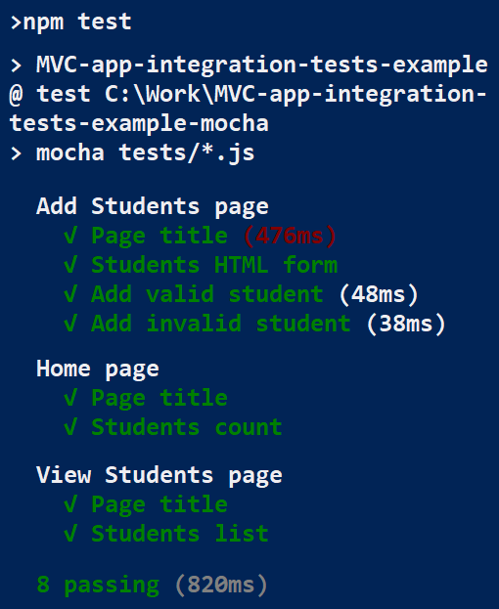
Build and Run Locally (by Hand)
Clone the app repo
Restore the Node packages:
Run the Mocha integration tests
git clone https://github.com/nakov/MVC-app-integration-tests-example-mocha
npm install
npm test

Slide 37
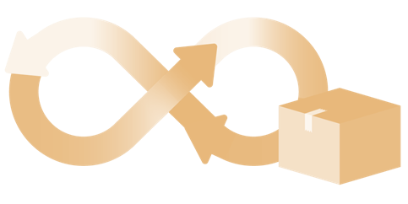
Continuous Integration and Continuous Delivery
The CI/CD Pipeline

Slide 38
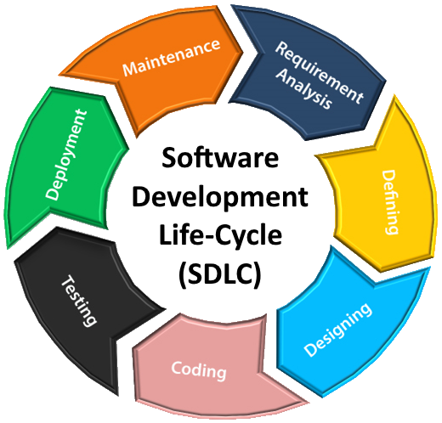
Software Development Lifecycle (SLDC)
Software engineering is not just coding!
The SDLC includes the following activities:
Requirements analysis
Software design
Construction
Testing
Development processes (Waterfall / Scrum / Kanban) define workflow and key practices
Software project management
Release
Maintenance
Notes:
Software engineering is not just coding!
The Software Development Lifecycle (SLDC) always include the following activities (to some extent):
Requirements analysis, software design, software construction, software testing, deployment and maintenance, together with software project management.
Requirements analysis (also called requirements engineering) is the first phase of software projects.
Requirements analysis is the process of determining the business expectations, functionalities and constraints
for a software product, site, app, service or system.
Software requirements define the functionality of the system.
They consist of functional requirements (what the system should do)
and non-functional requirements (like performance and technical constraints).
In software engineering, the requirements are described as formal or informal documentation,
"functional specifications", "user story cards" or "UI prototypes".
Gathering and describing the requirements is the job of the business analysts.
They are the people who talk with the users and project stakeholders
and describe the processes, data flows, and software requirements in a way,
understandable for software developers.
Without clear requirements, writing software is messy and unproductive.
Gathering clear requirements is an important step at the start of any software project,
but it usually lasts to some extent throughout the whole life of the project.
Software architecture and design are the technical plans and blueprints how to implement the software requirements.
The system architecture describes how the system will be decomposed to subsystems (tiers, modules, components, etc.)
and the interaction between these subsystems.
This phase also includes the initial design of the data model (database design).
During the "architecture and design" phase the software architects (or senior developers)
decide on the development stack, platforms, technologies, and tools to be used for development.
The technical design typically gives only the big picture for the system and its structure.
The detailed design is usually created during the software construction, when developers implement the system.
Software construction is the phase in which developers create the software.
It is also called the "implementation phase", because developers write the code to implement the planned functionality.
During the implementation developers not only write code,
but they also debug and test the code, and fix bugs,
take decisions how to implement certain functionalities,
search for libraries and tools for certain functionalities,
design and implement the back-end APIs,
implement the user interfaces of the system,
write automated tests (such as unit tests and integration tests),
and integrate different system components.
The construction takes most of the time and resources during the development.
Software testing and quality assurance confirms that the developed software conforms to the requirements.
Software testing and verification is performed by the quality assurance (QA) engineers.
QA engineers test the code by performing manual and automated testing
and report bugs in the bug tracking system and track the work on fixing the bugs later.
Software release and deployment is the process of building the software packages from its source code,
publishing the new versions of the software on a testing environment,
and after automated and sometimes manual testing, uploading the new version to the production environment.
Release and deployment deals with containers, cloud, servers, builds, installation, configuration and administration of the testing and production environments.
Deployment is usually performed first in a testing environment (a "staging" server), then the product is tested and then deployed in production.
The entire process is typically automated, following DevOps practices and processes.
Software release and deployment is performed by the DevOps engineers (or senior developers),
who write scripts to automate this process and implement the so called "continuous delivery".
Software maintenance is the process of:
monitoring the software and maintaining its normal work,
updating the runtime environments, platforms and libraries,
patching security problems,
bug fixing,
enhancing existing features,
and adding new functionalities to address changing requirements.
Software maintenance is usually a long-lasting process, that is going on for years
and is sometimes mixed with active development of new features.
Software project management is responsible for the planning, scheduling, resource allocation, execution, tracking and delivery of software projects.
Project managers (or software team leaders) are responsible for defining the tasks, prioritizing and scheduling them and tracking and controlling the work progress during the entire software development lifecycle.
Project management is very important for the success of any software project,
so it needs experienced people to handle it responsibly.
All the above-mentioned activities from the software development lifecycle are organized by
software development methodologies, development processes or process frameworks,
such as Waterfall, Scrum and Kanban.
The development process defines the project workflow, development philosophy,
and key management, organizational and engineering practices.
Most systems in modern software engineering are implemented in the spirit of "agile development".
Agile development builds software feature by feature.
Developers iteratively design and build new features, integrate them, deploy them, collect feedback,
fix the problems and proceed with the next feature until the project is completed.
Software development lifecycle, software project management and development methodologies are a broad topic in software engineering,
which developers learn for years during their career growth, as they gain experience.
Junior developers should be familiar with all these concepts but cannot be experts.

Slide 39
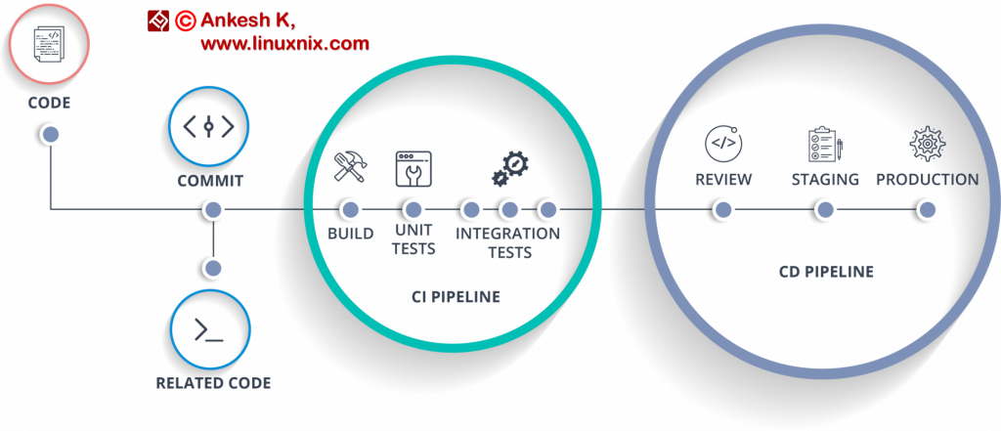
CI/CD Pipeline
CI/CD pipeline
Continuously integrate and release new features
Continuous integration (CI)
Write code, test and integrate it in the product
Continuous delivery (CD)
Continuously release new features
QAs maintain and monitor the CI/CD pipeline

Slide 40
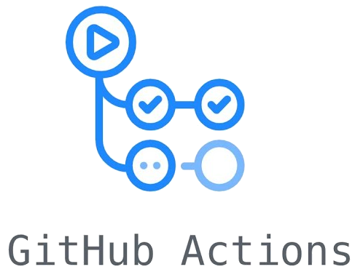
GitHub Actions with CI/CD
With GitHub Actions you can create custom CI workflows
There are different CI workflows based on the language and framework in your repository
You can build the code in your repository and run your tests
GitHub runs your CI tests and provides the
results of each test in the pull request
This way you can see if a change
introduces an error

Slide 41

Summary
QA automation engineers ensure the software quality through automation
Write and maintain automated tests
Back-End overview
Back-End Test Automation
Unit tests
Integration tests
Build and monitor CI/CD pipeline
…
…
…

Slide 42
Questions?
Notes:
42

Slide 43

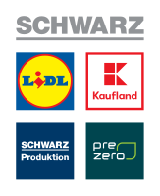










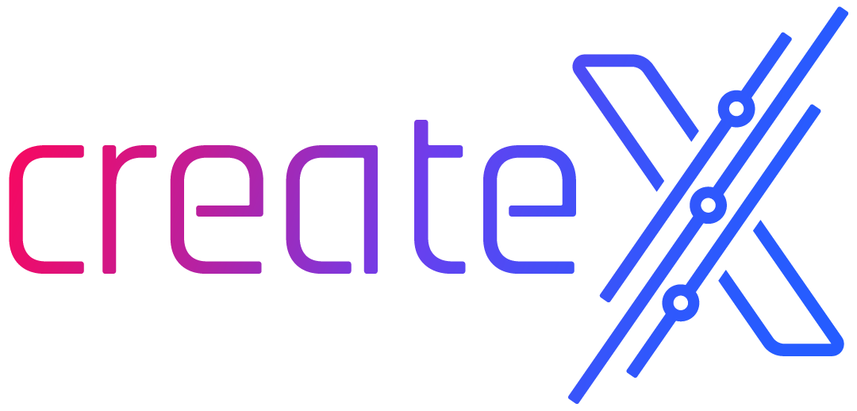

SoftUni Diamond Partners

Slide 44
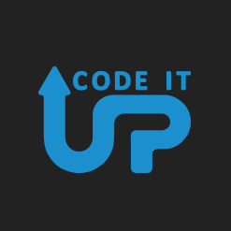
Educational Partners

Slide 45

License
This course (slides, examples, demos, exercises, homework, documents, videos and other assets) is copyrighted content
Unauthorized copy, reproduction or use is illegal
© SoftUni – https://about.softuni.bg/
© Software University – https://softuni.bg
Notes:
45

Slide 46
Trainings @ Software University (SoftUni)
Software University – High-Quality Education, Profession and Job for Software Developers
softuni.bg, about.softuni.bg
Software University Foundation
softuni.foundation
Software University @ Facebook
facebook.com/SoftwareUniversity
Software University Forums
forum.softuni.bg
Notes:
46

