Slide 1

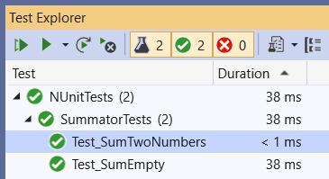
Unit Testing and NUnit Basics
Unit Testing Concepts. Testing Frameworks. NUnit. Writing Your First Test with NUnit
SoftUni Team
Technical Trainers
Software University
https://softuni.bg

Slide 2
Table of Contents
Unit Testing and Testing Frameworks
NUnit Basics: Automated Testing with C# and NUnit
The AAA Pattern: Arrange, Act, Assert
Assertions in NUnit: Assert.That(…)
Code Coverage
Best Practices
2

Slide 3
You Have Questions?
sli.do #QA-Auto-BackEnd

Slide 4

What is Unit Testing?
Automated Testing of Software Components (Units)

Slide 5
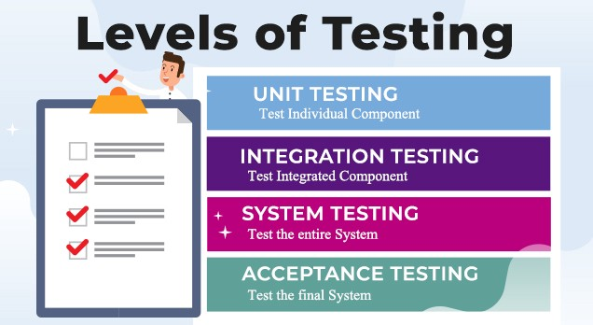
Test Levels
Unit tests
Test a single component (mocking the dependencies)
NUnit, JUnit, PyUnit, Mocha
Integration tests
Test an interaction between components, e. g. API tests
System tests / end-to-end tests
Test the entire system, e. g. Selenium, Appium, Cypress, Playwright
Notes:
Software testing is done at several levels:
unit testing, integration testing and system testing.
Unit tests test a single component (called "unit").
This can be a function or method in the code, a class or other code component.
For example, a set of unit tests can demonstrate that
the service for registering a new user checks for duplicated username and invalid password
and when the input data is correct, it stores the new user in the user repository.
In this case, the unit test will not use a real database (which is an external component).
Instead it will use a fake implementation (mock) of the functions
for accessing the user repository (the database table holding the users).
This way the unit tests check only certain component,
isolated from the other components, which may not exist at this time.
Unit testing aims to verify each component of the software
by isolating it from the other components
and then perform tests to demonstrate that it works correctly.
When a component is dependent on other components,
the external dependencies are replaced during the testing
by mock objects, stubs or using other techniques.
Unit tests are automated tests, written by developers,
that examine the functionality of single component (or unit).
They are small pieces of code (functions or methods),
which automate the testing of certain unit.
Unit testing is performed at the earliest stages of the development process,
long before the software is developed and ready for testing by QA engineers.
When unit testing is implemented,
for each unit, developers write multiple unit tests,
to cover fully its functionality.
Unit tests are examples of automated, functional, white-box tests,
based on a unit testing framework,
such as JUnit, NUnit or Mocha.
We shall learn how to write simple unit tests with live code examples later.
Integration tests check the interaction between several components.
For example, if we test whether the user registration service in the back-end
correctly stores the new user to the database, this is an integration test.
This integration test checks several components together:
the user registration function in the back-end API,
the data access logic,
and the database.
This integration test does not test the entire system.
It does not care about the front-end and the user interface.
Integration tests are examples of automated, white-box, functional tests,
and are usually based on some unit testing framework.
The difference between unit testing and integration testing is that
unit tests examine the functionality of a single unit and they mock the external dependencies,
while integration tests examine the functionality on several units together
and test the integration between the dependent units.
Unit tests are more-simple than the integration tests
and have smaller scope, usually a single public method (or function).
Integration tests implement more complex scenarios.
They test together multiple interconnected components and subsystems.
Integration testing is performed early in the development process,
after some of the components are written and unit tested,
and they need to be integrated together into modules with more complex functionality.
Integration tests are usually written by developers, not by QAs.
We shall learn how to write simple integration tests with live code examples later.
System tests and acceptance tests test the entire system: all its components together.
System tests are manual or automated tests, which cover end-to-end scenarios:
from the front-end, to the back-end, the database and all other system components.
For example, if we test whether after user registration in the mobile app of complex software system,
the new user is correctly stored in the database at the server side, this is a system test.
This system test checks all system components together:
the user interface (the front-end), which is the mobile app in our scenario,
the back-end services at the server side, which are called by the mobile app,
the data access logic, implemented in the back-end to access the database,
and the database server, which stored the app data.
To implement this system test, QA engineers
run the software in a testing environment,
create a database, holding sample testing data,
run the back-end server-side components,
run the front-end component (the mobile app in our scenario),
fill some data in the user registration form, submit the data,
and check the behavior of the mobile app.
The above steps can either be done by hand (manual system testing)
or can be automated (automated system testing).
Automated system testing can be implemented by using DevOps tools and techniques
to automatically deploy and run the required system components
and perform UI tests in the mobile app, using a mobile testing framework.
System testing is performed late in the development process,
when the entire system is ready or partially ready.
System testing is usually performed by QA engineers or test automation engineers.
Modern development processes integrate system testing in the CI/CD pipeline.
Projects with less QA resources implement automated smoke tests during the system testing phase.
The smoke tests check whether the most important functionality works in the most common scenarios.
They just check whether the system is broken or not, without verifying each of its functions.
An example of smoke test could be to check whether the home page of the system opens correctly.
Projects with more QA resources automate the testing of the entire system
with all its functionality, covering all its use cases.
This approach is heavy and time consuming and is rarely used.
Most modern projects automate the system testing for the most important scenarios,
not the entire system with all its components.
Acceptance testing is an extension to system testing, where
the QA team or the project sponsor checks how the product will perform
when it is installed on the user’s system.
Acceptance tests are usually more intensive and more comprehensive than the system tests
and should cover the entire functionality of the software.
The aim of acceptance testing is to evaluate whether the system complies with the end-user requirements
and if it is ready for deployment in the production environment.

Slide 6
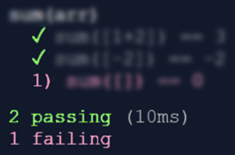
Unit Testing
Unit test == a piece of code that tests specific functionality in certain software component (unit)
int Sum(int[] arr)
{
int sum = arr[0];
for (int i=1; i<arr
.Length; i++)
sum += arr[i];
return sum;
}
void Test_SumTwoNumbers() {
if (Sum(new int[]{1, 2}) != 3)
throw new Exception("1+2 != 3");
}
void Test_SumEmptyArray() {
if (Sum(new int[]{ }) != 0)
throw new Exception("sum [] != 0");
}
Notes:
Unit testing is an important concept and practice in software development.
Unit tests are pieces of code that test specific functionality in certain software component (called "unit").
Unit tests are written by developers (not by QA engineers).
Unit tests are part of the product source code.
They aim to improve the code quality, reliability and maintainability.
This is a simple example to illustrate the idea of "unit testing":
We have a function, which sums the elements of given array of numbers.
We want to test this function, but not by hand.
We want to write code, which confirms that this function works correctly.
This is an example of how we can test the "sum" function:
We write a function to hold the test cases.
This is the first test case, the first check.
It checks whether the sum of the array of two elements [1, 2] is 3.
If the execution result is not as expected, the function will fail with an error.
The second test checks whether the sum of the array, holding a single element [-2] is -2.
The third test checks whether the sum of an empty array is 0.
This example is just a simple way to illustrate the concept of "unit testing".
Don't follow it as best practice. It is not!
It combines multiple test cases in a single test function, and this is a bad practice.
But the idea of unit testing is clear:
Unit tests execute the code with sample input data and entrance conditions
and check whether the returned result, exit conditions and behavior are correct.
Unit testing usually is performed within a unit testing framework,
which organizes and structures the tests consistently.

Slide 7
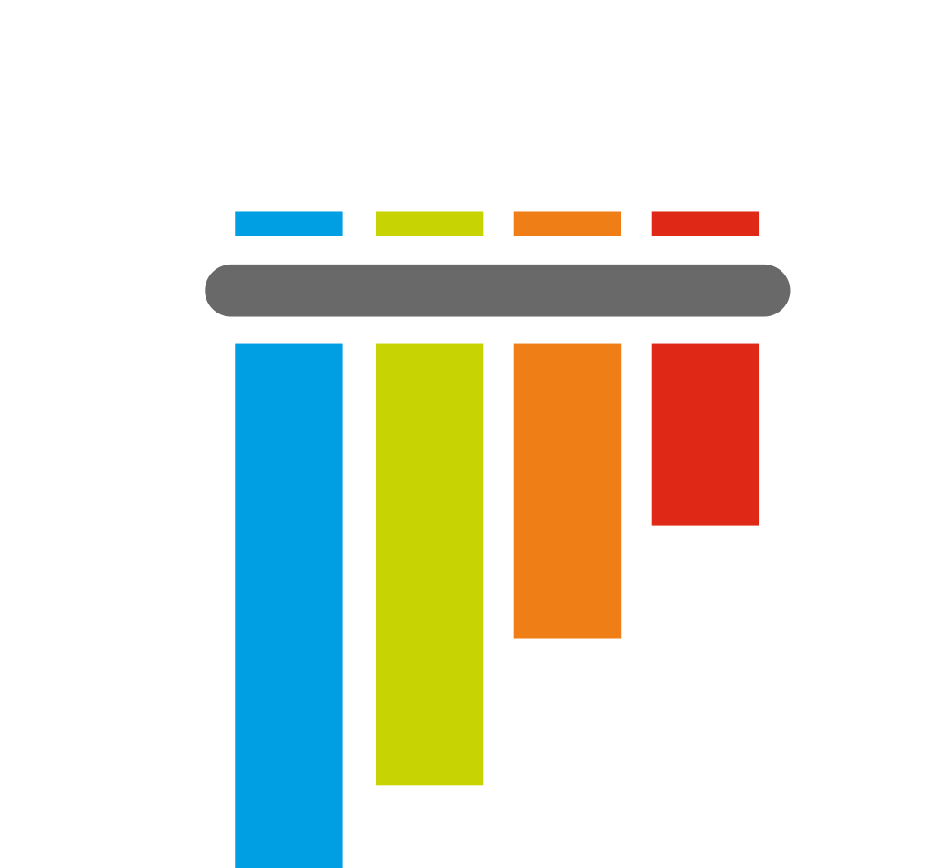




Testing Frameworks
Concepts

Slide 8
Testing Frameworks
Testing frameworks provide foundation for test automation
Consists of libraries, code modules and tools for test automation
Structure the tests into hierarchical or other form
Implement test cases, execute the tests and generate reports
Assert the execution results and exit conditions
Perform initialization at startup and cleanup at shut down
Examples of testing frameworks:
NUnit, xUnit, MSTest (C#), Junit, TestNG (Java), Mocha, Jest (JS), PyTest (Python)
Notes:
Unit testing frameworks execute the tests and generate reports.
Developers use the framework to structure the tests,
to organize them in a hierarchy using classes and functions,
to assert the execution results and exit conditions for correctness,
to handle some specific situations (like "expected error" or "expected timeout")
and to automate some aspects of the testing process
(like initializing the testing environment at startup and cleaning it up at shutdown).
Examples of unit testing frameworks are:
The "Mocha" testing framework for JavaScript
and the JUnit framework for Java.

Slide 9
Testing Framework – Example
Testing frameworks simplify automated testing and reporting
Example: NUnit testing framework for C#
using NUnit.Framework;
public class SummatorTests
{
[Test]
public void Test_SumTwoNumbers() {
var sum = Sum(new int[] { 1, 2 });
Assert.AreEqual(3, sum);
}
}
Notes:
Unit testing frameworks simplify, structure and organize the unit testing process, test execution and reporting.
This an example of how the test cases from the previous example can be structured within the NUnit framework for C#.
We first include the required libraries.
Then we define a "test class".
This is a group of related unit tests.
Within the test suite we define our first test.
It holds a function to check whether the sum of the array [1, 2] is 3.
The second test follows the same syntax:
It checks whether the sum of the array [-2] (a single element) is as expected: -2.
Similarly, the third test checks whether the sum of empty array is 0.
That's all.
When we run the tests, we see a test execution report like this, shown on the screenshot.
I don't want to go into deeper details.
The concept is well illustrated.
Perhaps, I need to mention, that unit testing has not only its technical side:
to use correctly the testing frameworks and libraries.
It has also its engineering side: to decide what and how to test.
Unit test writers usually follow the "AAA pattern":
arrange the input data and entrance conditions,
act (execute the function for testing),
and assert whether the results and the exit conditions are as expected.
Testing usually covers:
the straightforward case – the typical use of the function,
the edge cases (such as empty array or negative numbers),
testing for performance, for error handling, etc.
Testing should be enough to find the bugs and potential problems
and not too much, because it takes time to write and maintain the test cases.
Tools for measuring the so called "code coverage" can give a good sign whether a function is tested enough or not.
Developers should be familiar with unit testing and test automation, even junior developers!
We shall learn in detail the concept of "unit testing" and how to use unit testing frameworks,
how to write efficiently unit tests and integration tests,
how to use tools like "code coverage" and "mocking"
in the advanced programming training modules at SoftUni.

Slide 10
Unit Testing Framework vs. Testing Framework
Unit testing framework == automation testing framework == testing framework == test framework
Many names for similar concepts → why?
Testing frameworks like JUnit and NUnit were initially designed for unit testing, but nothing limits them to wider use
With additional libraries, NUnit and JUnit are used for:
Integration testing, API testing, Web service testing
End-to-end testing, Web UI testing, mobile testing, etc.

Slide 11

NUnit: First Steps
Setup and First Test

Slide 12

NUnit: Overview
NUnit == popular C# testing framework
Supports test suites, test cases, before & after code, startup & cleanup code, timeouts, expected errors, …
Like JUnit (for Java)
Free, open-source
Powerful and mature
Wide community
Built-in support in Visual Studio
Official site: nunit.org

Slide 13
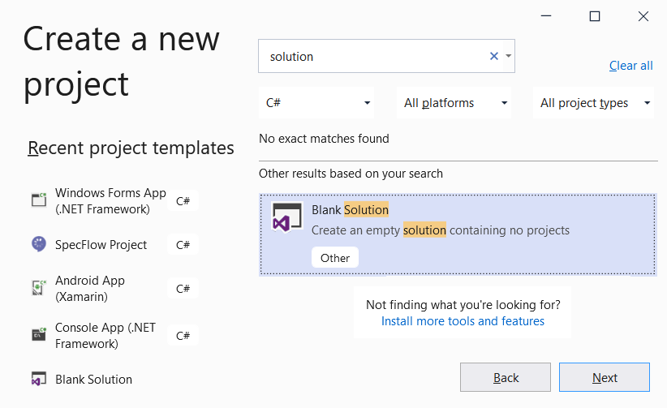
Creating a Blank Solution
Create a blank solution in Visual Studio
It will hold the project for testing
And the unit test project (tests)

Slide 14
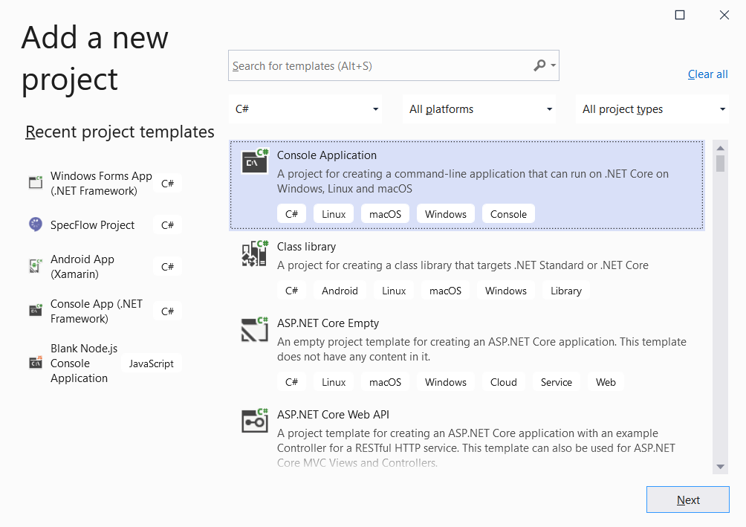
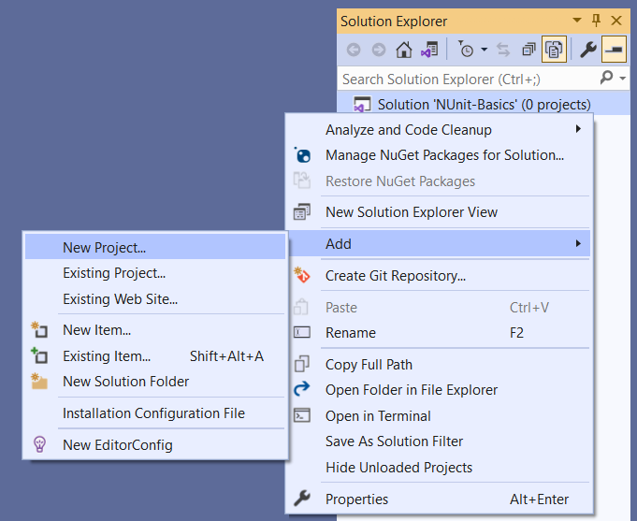
Creating a Project for Testing
Add a New Project in your Solution, to hold the code for testing

Slide 15
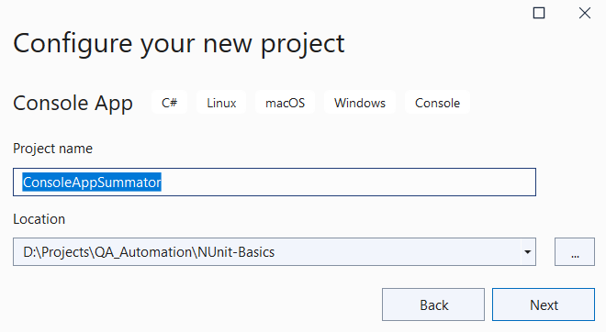
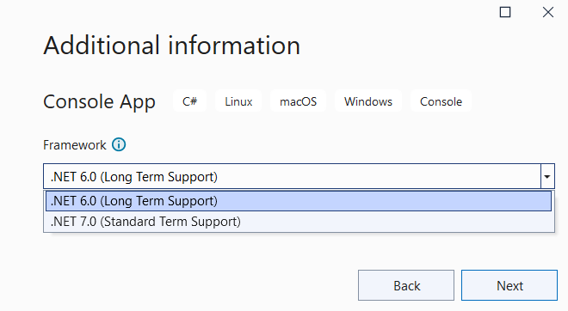
Creating a Project for Testing (2)
Choose a meaningful name for your project
Choose a place to store it
Use .NET 6.0
(Long term Support)

Slide 16
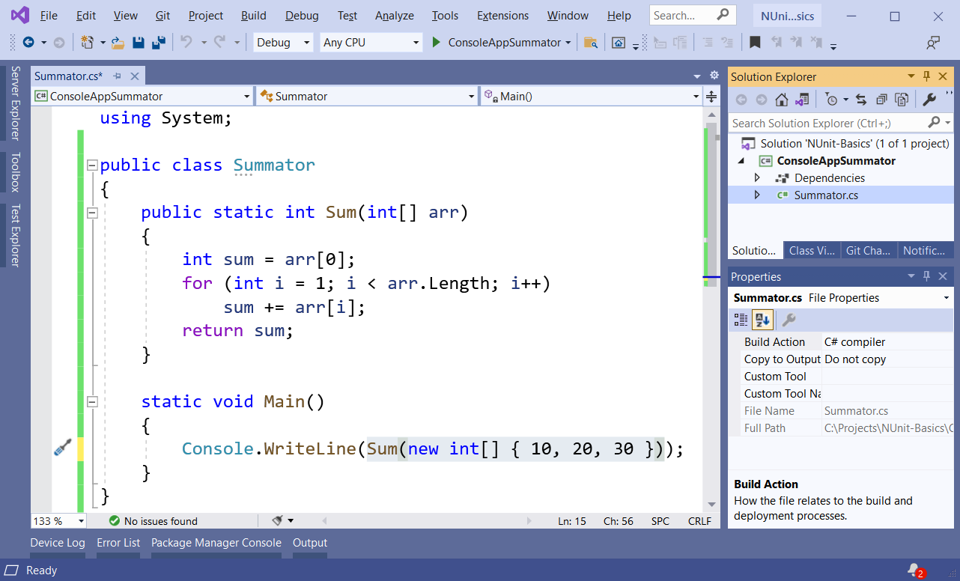
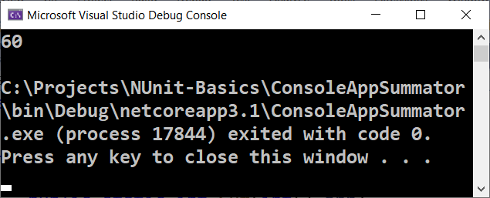
Creating a Project for Testing (3)

Slide 17
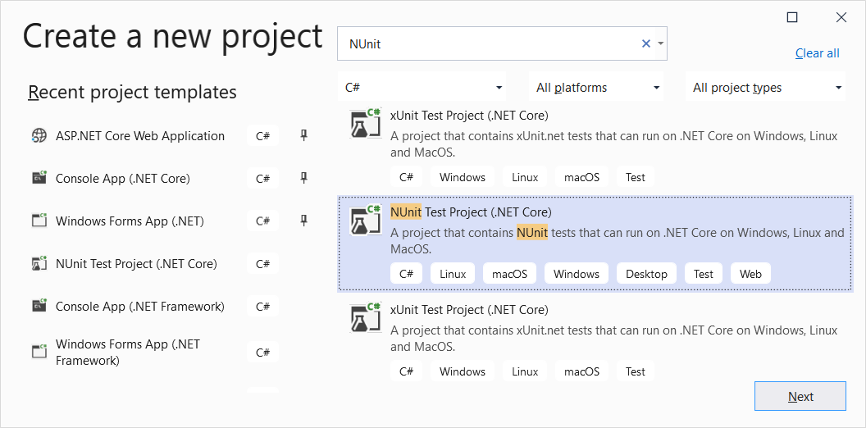
Creating a NUnit Project

Slide 18
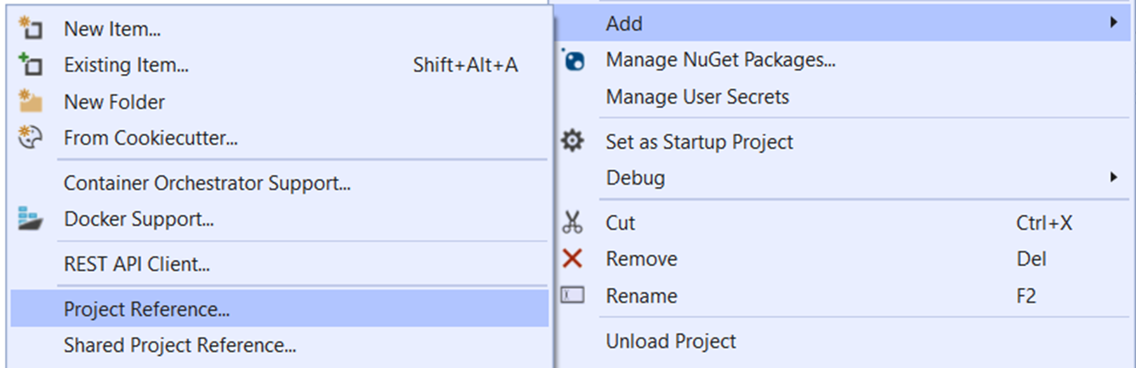
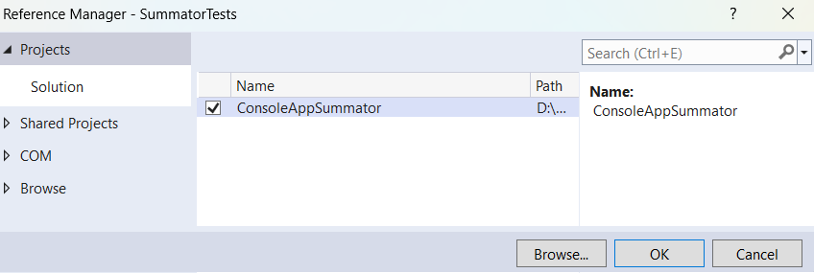
Adding Project Reference
Add Project Reference to target the project for testing:

Slide 19
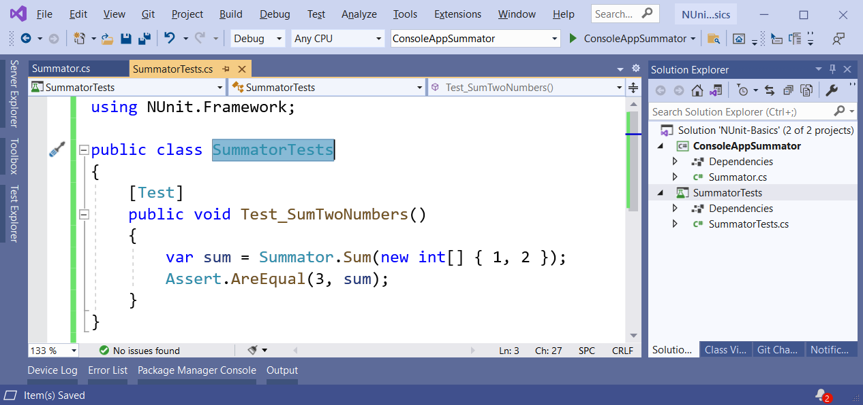
Writing the First Test
Writing the first NUnit test method:

Slide 20
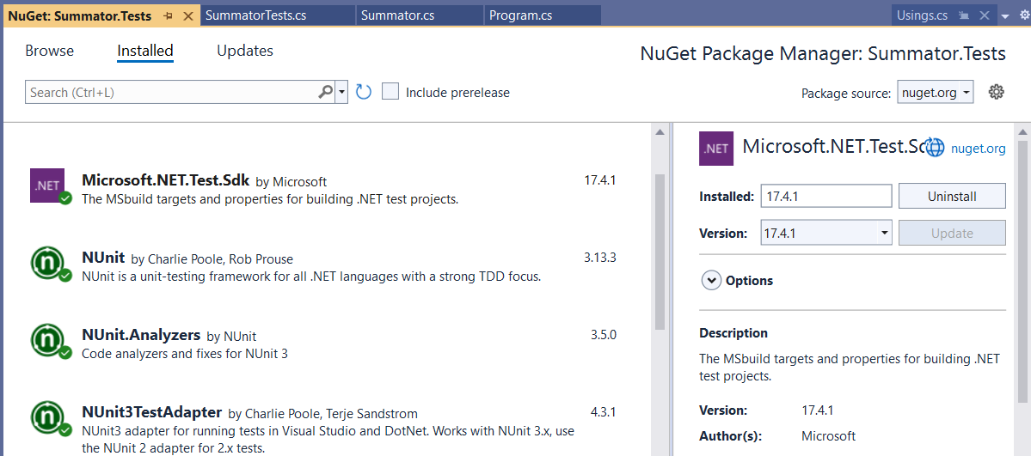
NUnit: NuGet Packages
NuGet packages, required to run NUnit tests in Visual Studio

Slide 21
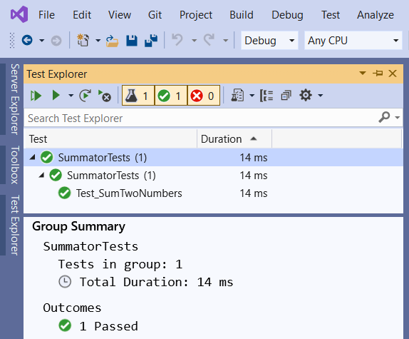
Test Explorer
The [Test Explorer] tool in Visual Studio
Show the [Test Explorer]:
[Ctrl + E] + T
Visualizes the hierarchy of tests
Executes tests
Reports results

Slide 22
NUnit: Basics
Test Classes and Test Methods

Slide 23
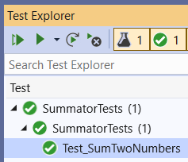
Test Classes and Test Methods
Test classes hold test methods:
Import NUnit
using NUnit.Framework;
[TestFixture]
public class SummatorTests
{
[Test]
public void Test_SumTwoNumbers() {
var sum = Sum(new int[] { 1, 2 });
Assert.AreEqual(3, sum);
}
}
Optional notation
Test class
Test method
Assertion

Slide 24
Initialization and Cleanup Methods
private Summator summator;
[SetUp] // or [OneTimeSetUp]
public void TestInitialize()
{
this.summator = new Summator();
}
[TearDown] // or [OneTimeTearDown]
public void TestCleanup()
{
// …
}
Executes before each test
Executes after each test

Slide 25
The "AAA" Pattern
AAA
Arrange → Act → Assert

Slide 26
The "AAA" Testing Pattern
Automated tests usually follow the "AAA" pattern
Arrange: prepare the input data and entrance conditions
Act: invoke the action for testing
Assert: check the output and exit conditions
[Test]
public void Test_SumNumbers()
{
// Arrange
var nums = new int[] {3, 5};
// Act
var sum = Sum(nums);
// Assert
Assert.AreEqual(8, sum);
}

Slide 27
Assertions
Checking the Results and Output Conditions

Slide 28
Two Models of Assertions
Constraint Model (Assert.That)
The logic necessary to carry out each assertion is embedded in the constraint object passed as the second parameter to that method.
Assert.That(object expected, Is.EqualTo(object actual));
Classic Model (Assert.AreEqual, Assert.True, Assert.False…)
The classic Assert model uses a separate method to express each individual assertion of which it is capable.
Assert.AreEqual(object expected, object actual);

Slide 29
Assertions
Assert that condition is true
Comparison (equal, greater than, less than or equal, …)
Range assertions
Assert.That(bool condition);
Assert.That(actual, Is.EqualTo(expected));
Assert.AreEqual(expected, actual);
double percentage = 99.95;
Assert.That(percentage, Is.InRange(80, 100));

Slide 30
Assertions (2)
String assertions
Assertions by regex matching
Assertions for expected exception
Assert.That(string actual,
Does.Contain(string expected));
string date = "7/11/2021";
Assert.That(date, Does.Match(@"^\d{1,2}/\d{1,2}/\d{4}$"));
Assert.That(() => { code },
Throws.InstanceOf<ArgumentOutOfRangeException>());

Slide 31
Assertions (3)
Collection assertions
Collection range assertions
File / directory assertions
Assert.That(IEnumerable expected,
Has.Member(object actual));
var percentages = new int[] { 10, 30, 50, 100 };
Assert.That(percentages, Is.All.InRange(0, 100));
Assert.That(string filePath, Does.Exist);
DirectoryAssert.Exists(string path);

Slide 32
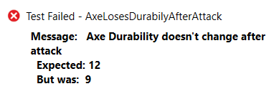
Assertion Messages
Assertions can show messages to helps with diagnostics
Assert.That(axe.DurabilityPoints, Is.EqualTo(12),
"Axe Durability doesn't change after attack");
Failure messages in the tests help finding the problem

Slide 33
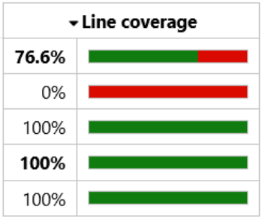
Code Coverage
Checking the Lines Covered by the Tests

Slide 34
Code Coverage
Code coverage tools measure how many lines of code (LOC) are covered by the test execution
Lines executed at least once are colored in green
Lines never executed (untested lines) are red
Partially executed lines are orange
The code coverage for the automated tests is an important metric in software engineering
Code coverage of 70 - 80% is a reasonable goal for most projects

Slide 35
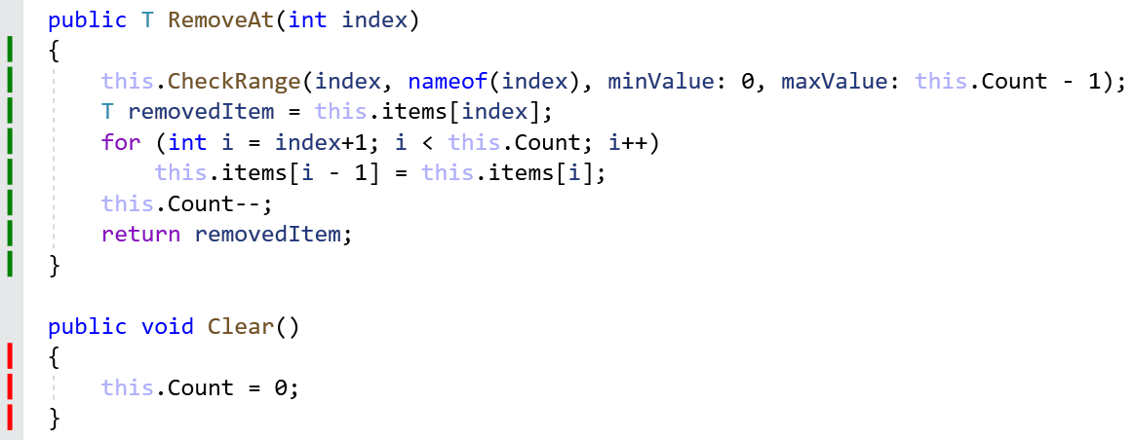
Code Coverage: Examples
This code was fully covered by the tests
This code was NOT covered by the tests

Slide 36
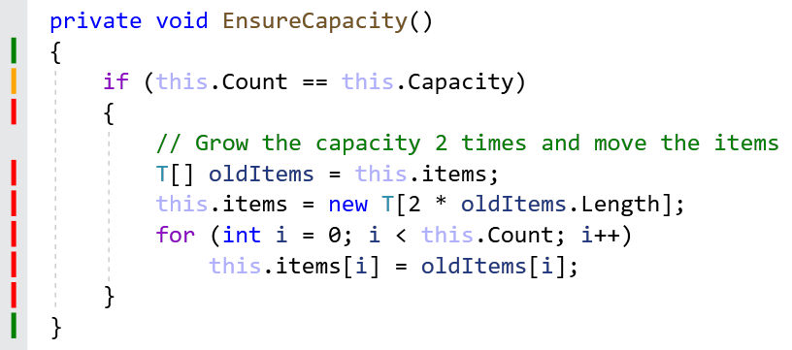
Code Coverage: Examples (2)
This code was only partially executed during the tests
We need a test for the "grow capacity" use case

Slide 37
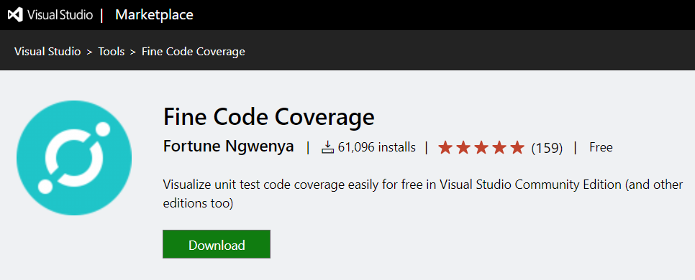
Code Coverage Tools for C#
Visual Studio supports code coverage for C# only in the Enterprise edition (paid product)
Alternative: the Fine Code Coverage free extension for VS
https://bit.ly/321wf8A

Slide 38
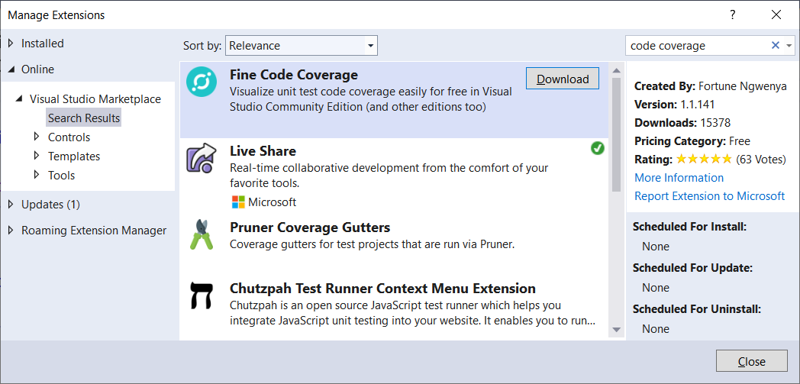

Installing "Fine Code Coverage" in VS

Slide 39
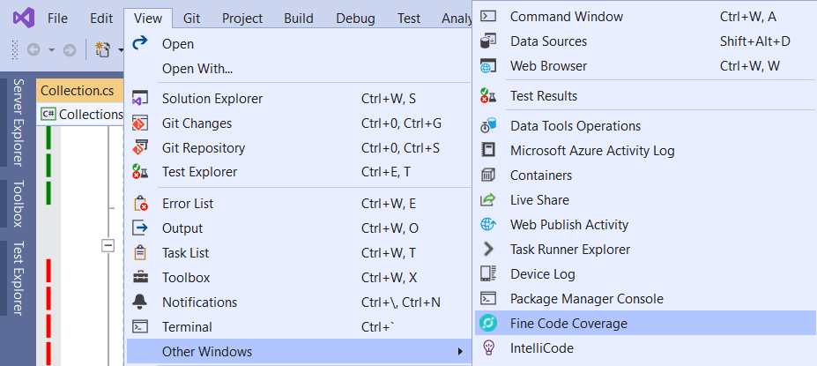
Activating "Fine Code Coverage" in VS
Run the unit tests to view the covered lines in green / red / orange (be patient, the coloring comes after a while)
View your code coverage report in the [Fine Code Coverage] window

Slide 40

Unit Testing Best Practices
Naming, Repeatable, No Dependencies

Slide 41


Naming the Test Methods
Test names should answer the question "what's inside?"
Should use business domain terminology
Should be descriptive and readable
IncrementNumber() {}
Test1() {}
TestTransfer() {}
Test_DepositAddsMoneyToBalance() {}
Test_DepositNegativeShouldNotAddMoney() {}
Test_TransferSubtractsFromSourceAddsToDestAccount() {}

Slide 42
Automation Tests: Good Practices
Test cases must be repeatable
Tests should behave the same if you run them many times
The expected results must be consistent and easily verified
Test cases should have no dependencies
The order of test execution should never be important
Input data and entrance conditions should be set in the test
Test cases may depend on the test initialization only: [SetUp]
Tests should cleanup properly any resources used

Slide 43
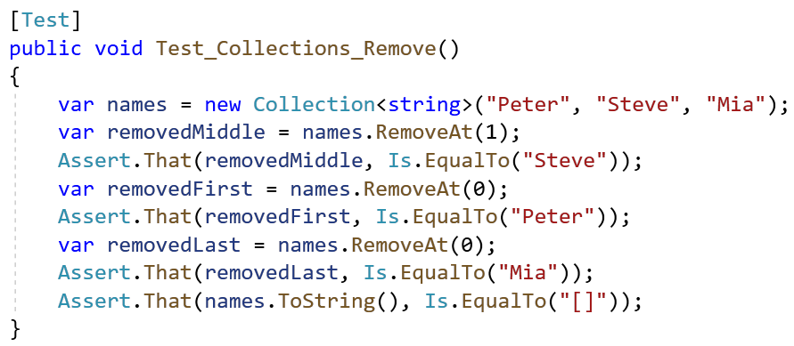
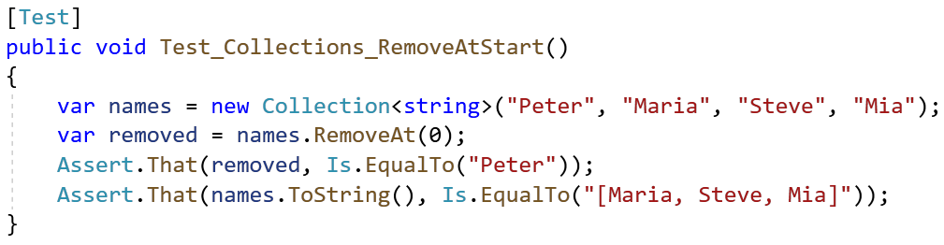

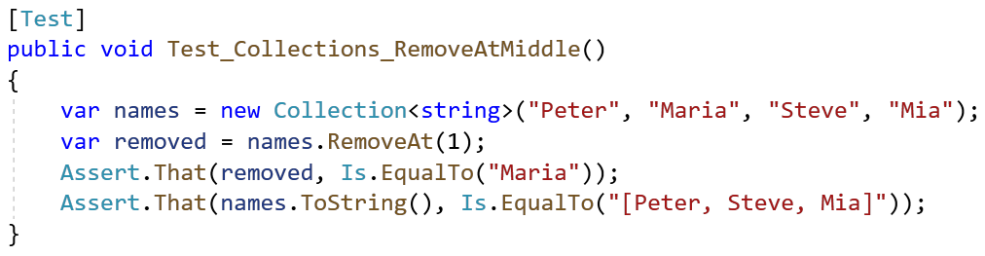

AutomationTests: Good Practices (2)
Single scenario per test case, not multiple

Slide 44
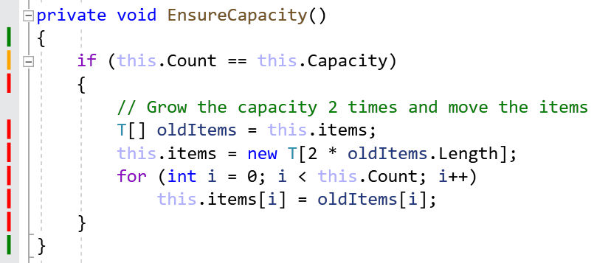
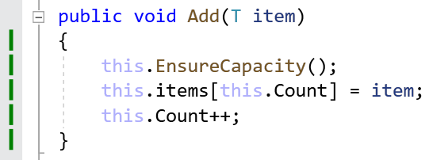
Testing Private Methods
Private methods should be tested indirectly
By testing the public methods with certain inputs and entrance conditions, that will invoke the target private methods
Check the code coverage to ensure all code is tested!
Example:

Slide 45

Summary
Unit testing - automated testing of single component (unit)
NUnit - automated testing framework for C#
The AAA pattern: Arrange, Act, Assert
Assertion - checking results / exit conditions
Code Coverage – Code lines covered
Best Practices - Conventions
Notes:
45

Slide 46
Questions?
Notes:
46

Slide 47














SoftUni Diamond Partners

Slide 48
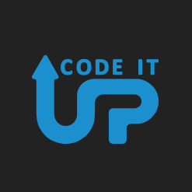
Educational Partners

Slide 49

License
This course (slides, examples, demos, exercises, homework, documents, videos and other assets) is copyrighted content
Unauthorized copy, reproduction or use is illegal
© SoftUni – https://about.softuni.bg/
© Software University – https://softuni.bg
Notes:
49

Slide 50
Trainings @ Software University (SoftUni)
Software University – High-Quality Education, Profession and Job for Software Developers
softuni.bg, about.softuni.bg
Software University Foundation
softuni.foundation
Software University @ Facebook
facebook.com/SoftwareUniversity
Software University Forums
forum.softuni.bg
Notes:
50

