Slide 1

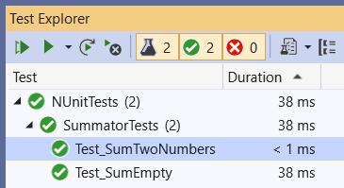
Unit Testing and NUnit Advanced
NUnit Exercise – Advanced and Data-Driven Tests, Code Coverage, Best Practices
SoftUni Team
Technical Trainers
Software University
https://softuni.bg

Slide 2
Table of Contents
Console input / output redirections
Implementing NUnit Test Cases
Data-Driven Testing Overview
Data-Driven Testing with Nunit
Executing tests using a set of test data
Comparing against the expected outputs
2

Slide 3

Console Input / Output Redirection
Unit Testing Console-Based Apps

Slide 4
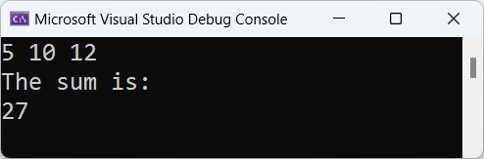
Unit Testing Console-Based Apps
To unit test console-based apps, you need to redirect the console input + output
Sample console-based app for testing (summator of integers):
static void Main()
{
var nums = Console.ReadLine()
.Split().Select(int.Parse);
Console.WriteLine("The sum is: ");
Console.WriteLine(nums.Sum());
}

Slide 5
Unit Testing Console-Based Apps (1)
[Test]
public void Test_SumNums()
{
// Arrange: prepare input
string input = "5 10 12";
}

Slide 6
Unit Testing Console-Based Apps (2)
var writer = new StringWriter();
Console.SetOut(writer); // Redirect Console.Out
// Act: redirect the console and run the app
var reader = new StringReader(input);
Console.SetIn(reader); // Redirect Console.In
SumNumbers.Main();

Slide 7
Unit Testing Console-Based Apps (3)
// Assert: compare expected and actual results
string actualResult = writer.ToString();
string expectedResult =
"The sum is: " + Environment.NewLine +
"27" + Environment.NewLine;
Assert.AreEqual(expectedResult, actualResult);
}

Slide 8
You Have Questions?
sli.do #QA-Auto-BackEnd

Slide 9

Implementing NUnit Test Cases

Slide 10
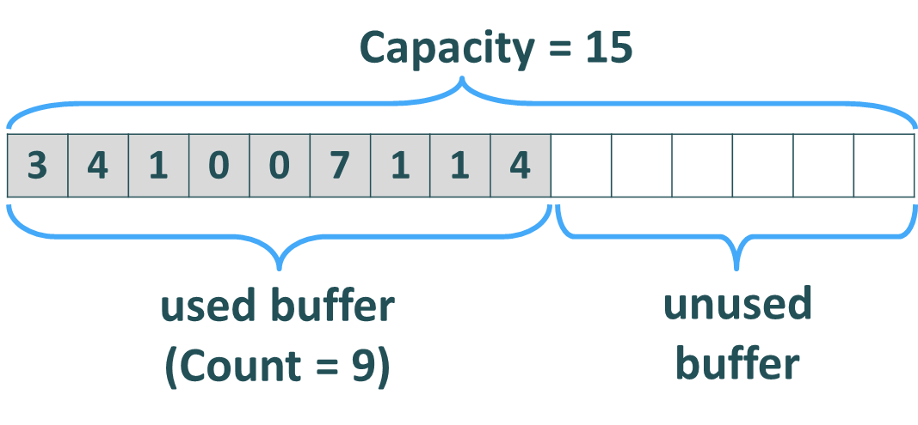
Implement Tests for the Collection<T> Class
public class Collection<T>
{
public int Capacity { … }
public int Count { … }
public Collection(params T[] items) { … }
public void Add(T item) { … }
public void AddRange(params T[] items) { … }
public T this[int index] { … }
public void InsertAt(int index, T item) { … }
public void Exchange(int index1, int index2) { … }
public T RemoveAt(int index) { … }
public void Clear() { … }
public override string ToString() { … }
}

Slide 11
Defining the Tests
public class CollectionTests
{
public void Test_Collection_EmptyConstructor() { … }
public void Test_Collection_ConstructorSingleItem() { … }
public void Test_Collection_ConstructorMultipleItems() { … }
public void Test_Collection_Add() { … }
public void Test_Collection_AddWithGrow() { … }
public void Test_Collection_AddRange() { … }
public void Test_Collection_GetByIndex() { … }
public void Test_Collection_GetByInvalidIndex() { … }
public void Test_Collection_SetByIndex() { … }
public void Test_Collection_SetByInvalidIndex() { … }
…

Slide 12
Defining the Tests (2)
…
public void Test_Collection_AddRangeWithGrow() { … }
public void Test_Collection_InsertAtStart() { … }
public void Test_Collection_InsertAtEnd() { … }
public void Test_Collection_InsertAtMiddle() { … }
public void Test_Collection_InsertAtWithGrow() { … }
public void Test_Collection_InsertAtInvalidIndex() { … }
public void Test_Collection_ExchangeMiddle() { … }
public void Test_Collection_ExchangeFirstLast() { … }
public void Test_Collection_ExchangeInvalidIndexes() { … }
public void Test_Collection_RemoveAtStart() { … }
public void Test_Collection_RemoveAtEnd() { … }
…

Slide 13
Defining the Tests (3)
…
public void Test_Collection_RemoveAtMiddle() { … }
public void Test_Collection_RemoveAtInvalidIndex() { … }
public void Test_Collection_RemoveAll() { … }
public void Test_Collection_Clear() { … }
public void Test_Collection_CountAndCapacity() { … }
public void Test_Collection_ToStringEmpty() { … }
public void Test_Collection_ToStringSingle() { … }
public void Test_Collection_ToStringMultiple() { … }
public void Test_Collection_ToStringNestedCollections() { … }
public void Test_Collection_1MillionItems() { … }
}

Slide 14
Test Cases: Empty Constructor
[Test]
public void Test_Collection_EmptyConstructor()
{
// Arrange
var nums = new Collection<int>();
// Assert
Assert.That(nums.ToString(), Is.EqualTo("[]"));
}

Slide 15
Test Constructor with Single / Multiple Items
[Test]
public void Test_Collection_ConstructorSingleItem()
{
var nums = new Collection<int>(5);
Assert.That(nums[0], Is.EqualTo(5));
}
[Test]
public void Test_Collection_ConstructorMultipleItems()
{
var nums = new Collection<int>(5, 10, 15);
Assert.That(nums.ToString(), Is.EqualTo("[5, 10, 15]"));
}

Slide 16
Implementing Test Cases: Add
public void Test_Collections_Add()
{
// Arrange
var nums = new Collection<int>();
// Act
nums.Add(5);
nums.Add(6);
// Assert
Assert.That(nums.ToString(), Is.EqualTo("[5, 6]"));
}

Slide 17
Implementing Test Cases: Add Range + Grow
[Test]
public void Test_Collection_AddRangeWithGrow()
{
var nums = new Collection<int>();
int oldCapacity = nums.Capacity;
var newNums = Enumerable.Range(1000, 2000).ToArray();
nums.AddRange(newNums);
string expectedNums = "[" + string.Join(", ", newNums) + "]";
Assert.That(nums.ToString(), Is.EqualTo(expectedNums));
Assert.That(nums.Capacity, Is.GreaterThanOrEqualTo(oldCapacity));
Assert.That(nums.Capacity, Is.GreaterThanOrEqualTo(nums.Count));
}

Slide 18
Test Cases: Get by Index
[Test]
public void Test_Collection_GetByIndex()
{
// Arrange
var names = new Collection<string>("Peter", "Maria");
// Act
var item0 = names[0];
var item1 = names[1];
// Assert
Assert.That(item0, Is.EqualTo("Peter"));
Assert.That(item1, Is.EqualTo("Maria"));
}

Slide 19
Test Cases: Get by Invalid Index
[Test]
public void Test_Collection_GetByInvalidIndex()
{
var names = new Collection<string>("Bob", "Joe");
Assert.That(() => { var name = names[-1]; },
Throws.InstanceOf<ArgumentOutOfRangeException>());
Assert.That(() => { var name = names[2]; },
Throws.InstanceOf<ArgumentOutOfRangeException>());
Assert.That(() => { var name = names[500]; },
Throws.InstanceOf<ArgumentOutOfRangeException>());
Assert.That(names.ToString(), Is.EqualTo("[Bob, Joe]"));
}

Slide 20
Test Cases: ToString() for Nested Collections
[Test]
public void Test_Collection_ToStringNestedCollections()
{
var names = new Collection<string>("Teddy", "Gerry");
var nums = new Collection<int>(10, 20);
var dates = new Collection<DateTime>();
var nested = new Collection<object>(names, nums, dates);
string nestedToString = nested.ToString();
Assert.That(nestedToString,
Is.EqualTo("[[Teddy, Gerry], [10, 20], []]"));
}

Slide 21
Performance Test with 1 Million Items
[Test]
[Timeout(1000)]
public void Test_Collection_1MillionItems()
{
const int itemsCount = 1000000;
var nums = new Collection<int>();
nums.AddRange(Enumerable.Range(1, itemsCount).ToArray());
Assert.That(nums.Count == itemsCount);
Assert.That(nums.Capacity >= nums.Count);
for (int i = itemsCount - 1; i >= 0; i--)
nums.RemoveAt(i);
Assert.That(nums.ToString() == "[]");
Assert.That(nums.Capacity >= nums.Count);
}

Slide 22
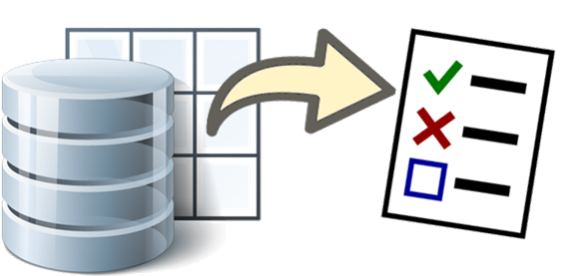
Data-Driven Testing
Overview

Slide 23
Data-Driven Testing
Data Driven Testing is a software testing method in which test data is stored in table or spreadsheet format
This could be an Excel document, an XML file, a MySQL database, etc.
It is also called table-driven testing or parameterized testing
The same test case can be run with as many different inputs as you like, thus getting better coverage from a single test

Slide 24

Data-Driven Testing Framework
Data-driven testing framework: code and data stored separately
Data File
Test
Data
Driver Script
App Under Test
Expected
Output
Test Result
(Compare)
Actual
Output

Slide 25
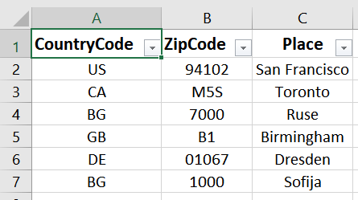
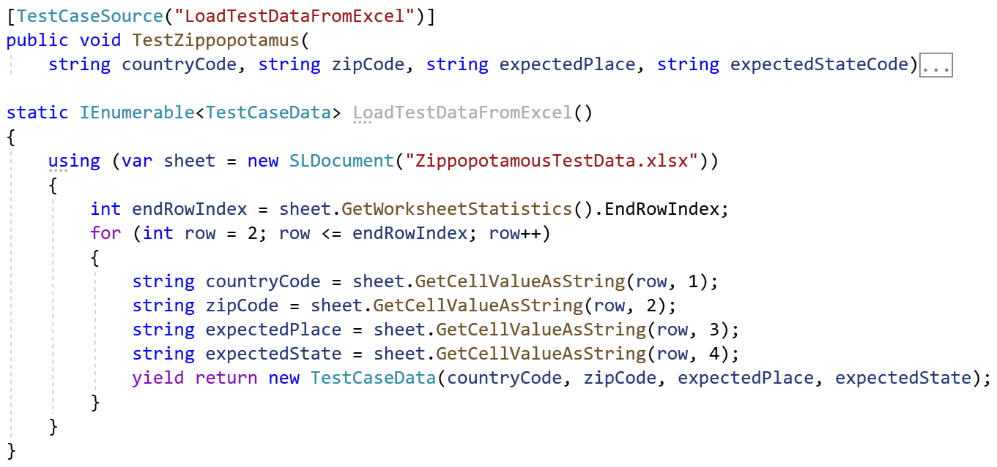
Data-Driven Testing Example
Data-driven testing == running the same test case with multiple data (e. g. datasets in the C# code / Excel spreadsheet)
Data Set
Testing Scripts

Slide 26
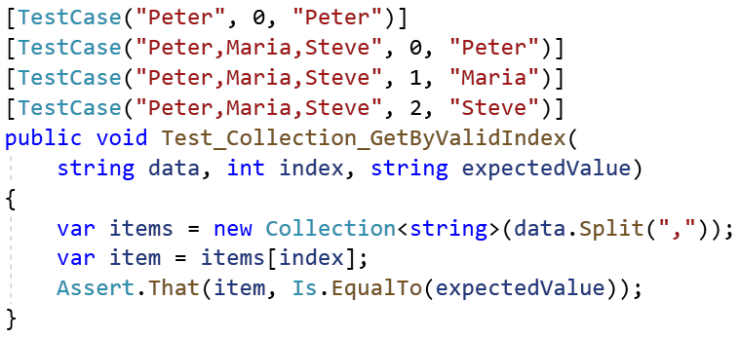
Data-Driven Testing with NUnit
Using [TestCase] to Assign Data to Tests

Slide 27
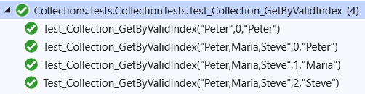
Data-Driven Testing with NUnit
The [TestCase] attribute in NUnit assigns multiple datasets in test method parameters

Slide 28
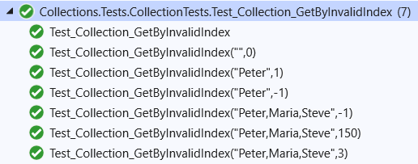
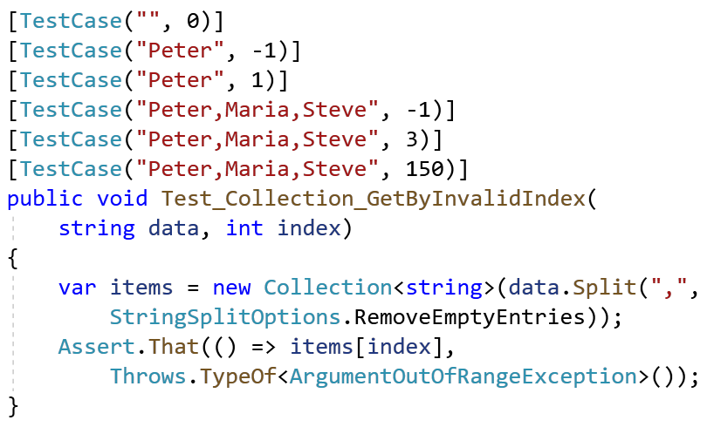
Data-Driven Testing with NUnit (2)
Another example

Slide 29

Summary
Console input / output redirections
Implementing NUnit Test Cases for generic collections
Data-Driven Testing Explained
Data-Driven Testing with NUnit – Executing tests using a set of test data, and comparing against the expected outputs
Notes:
29

Slide 30
Questions?
Notes:
30

Slide 31














SoftUni Diamond Partners

Slide 32

Educational Partners

Slide 33

License
This course (slides, examples, demos, exercises, homework, documents, videos and other assets) is copyrighted content
Unauthorized copy, reproduction or use is illegal
© SoftUni – https://about.softuni.bg/
© Software University – https://softuni.bg
Notes:
33

Slide 34
Trainings @ Software University (SoftUni)
Software University – High-Quality Education, Profession and Job for Software Developers
softuni.bg, about.softuni.bg
Software University Foundation
softuni.foundation
Software University @ Facebook
facebook.com/SoftwareUniversity
Software University Forums
forum.softuni.bg
Notes:
34

