Slide 1
DEVELOPMENT
OF A REAL-TIME
DATA STREAMING PIPELINE
Master Degree in Big Data Analytics
16/07/2020
Nerea Luna Picón

Slide 2
INDEX
Motivation
Objectives
Data Streaming Pipeline
3.1. Log Streaming Pipeline
3.2. Vacuum Data Streaming Pipeline
Conclusions

Slide 3


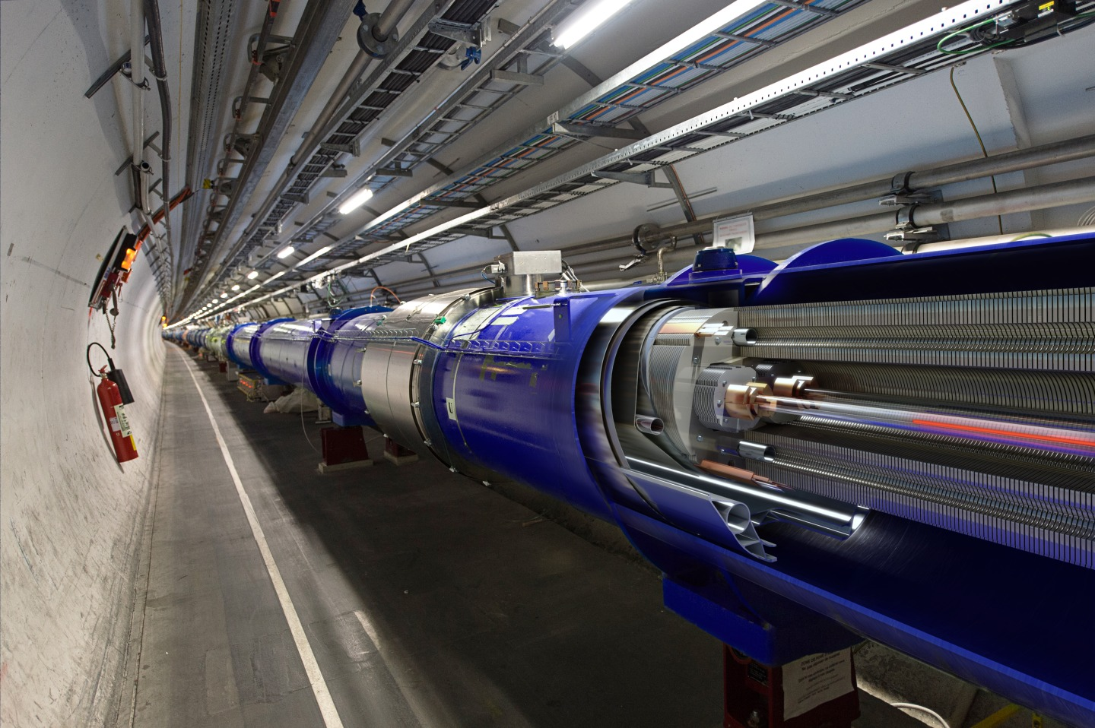
1. Motivation
Biggest particle physics laboratory of the world
LHC (Large Hadron Collider)
27 km ring
Buried 100 m underground
Speeding up particles in opposite directions

Slide 4
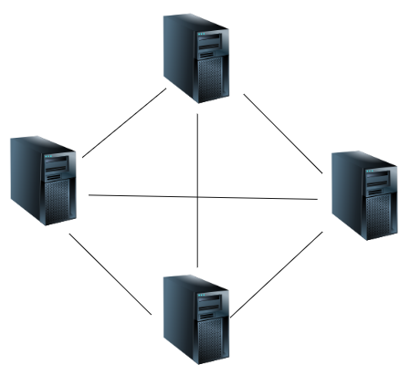
1. Motivation
Vacuum system at CERN Big Data producer
Large-scale distributed system
Independent servers
Producing DIFFERENT and huge amounts of data LOCALLY
Connecting external services and monitoring each machine independently is not a trivial task
Solution:
Data Streaming Pipeline

Slide 5
What is a pipeline?

Slide 6


“Set of data processing components connected in series, where the output of one component is the input of the next one”
servers
pipeline
…
2nd component
4th component
1st component
3rd component

Slide 7
2. Objectives
Streaming data in real-time
Collecting all data from the servers and place it into a common platform
Allowing external services subscribing to the data pipeline
Detecting unexpected situations in the monitoring process

Slide 8
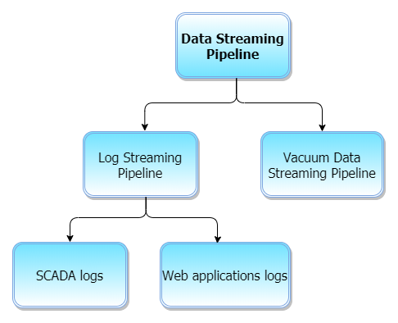
3. Data Streaming Pipeline

Slide 9
3.1. Log Streaming Pipeline

Slide 10




3.1. Log Streaming Pipeline
Filebeat
Logstash
Elasticsearch
Kibana
??
collector
processor
storage DB
visualize

Slide 11

3.1. Log Streaming Pipeline
??
LOGS
Why are logs useful?
They show the actual state/behaviour of the server in a specific moment in time

Slide 12
some message examples…
WCCOAs7 (2), 2020.05.22 14:42:31.715, SYS, SEVERE, 7/s7, No active connection for CFP_26_VOFFLINE2
WCCOAdip (12), 2020.05.22 15:42:50.560, CTRL, INFO, 0, Uninitialized DIP data received for :/Intensity/Beam1
WCCOAs7 (2), 2020.05.22 15:49:30.231, SYS, SEVERE, 24/s7, Timeout during IP read for S7_CFP_368_VPGFPS
WCCOActrl (22), 2020.07.16 07:01:36.914, SYS, INFO, 39, Connection lost, MAN:(-num 0) Connection closed

Slide 13
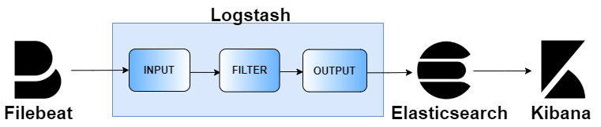
How to stream a message through the pipeline - Filebeat
ID
WCCOActrl (22), 2020.07.16 07:01:36.914, SYS, INFO, 39, Connection lost, MAN:(-num 0) Connection closed

Slide 14
How to stream a message through the pipeline - Logstash
ID
WCCOActrl (22), 2020.07.16 07:01:36.914, SYS, INFO, 39, Connection lost, MAN:(-num 0) Connection closed
ID
WCCOActrl (22), 2020.07.16 07:01:36.914, SYS, INFO, 39, Connection lost, MAN:(-num 0) Connection closed
manager
ID
timestamp
type
level
num
message

Slide 15

How Elasticsearch index the message
ID
WCCOActrl (22), 2020.07.16 07:01:36.914, SYS, INFO, 39, Connection lost, MAN:(-num 0) Connection closed
manager
ID
timestamp
type
level
num
message
Elasticsearch DB
index-July
index-April
index-May
index-June

Slide 16
How to stream a message through the pipeline - Kibana

Slide 17
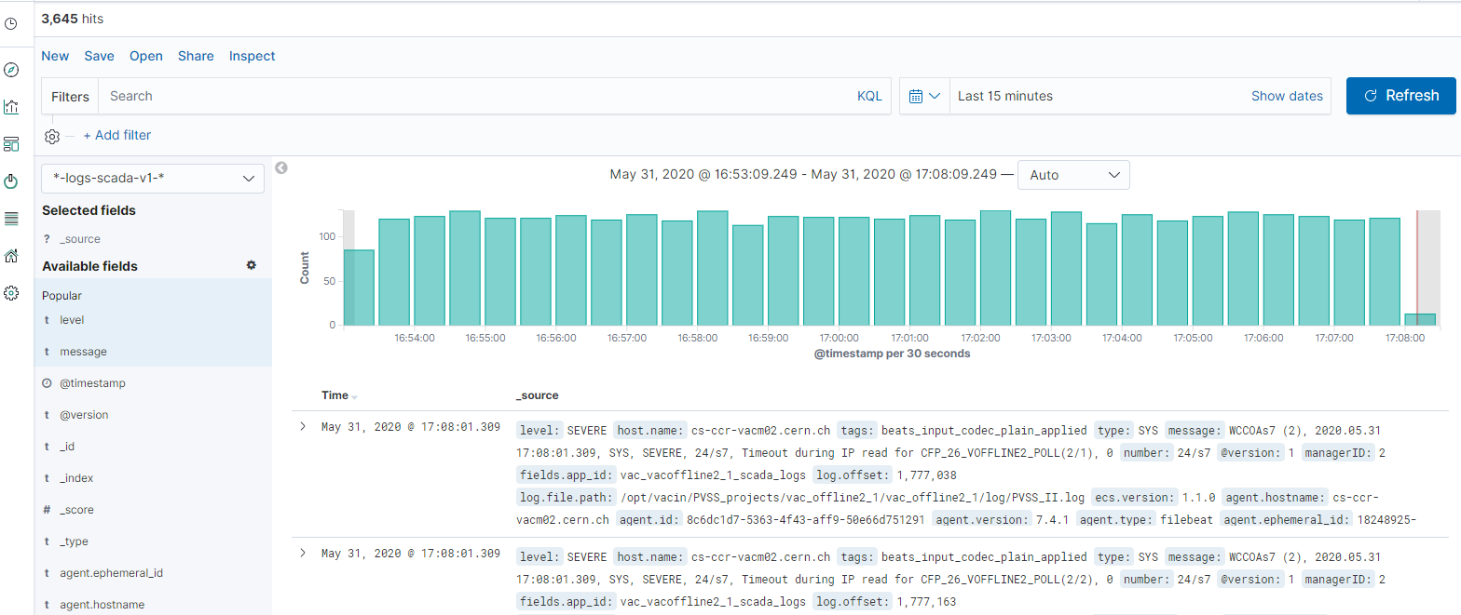
Kibana main view
Kibana results here

Slide 18
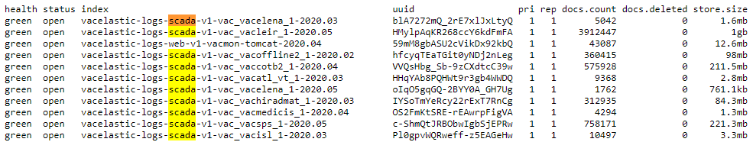
Kibana index search box

Slide 19
Kibana date search box
Kibana results here

Slide 20
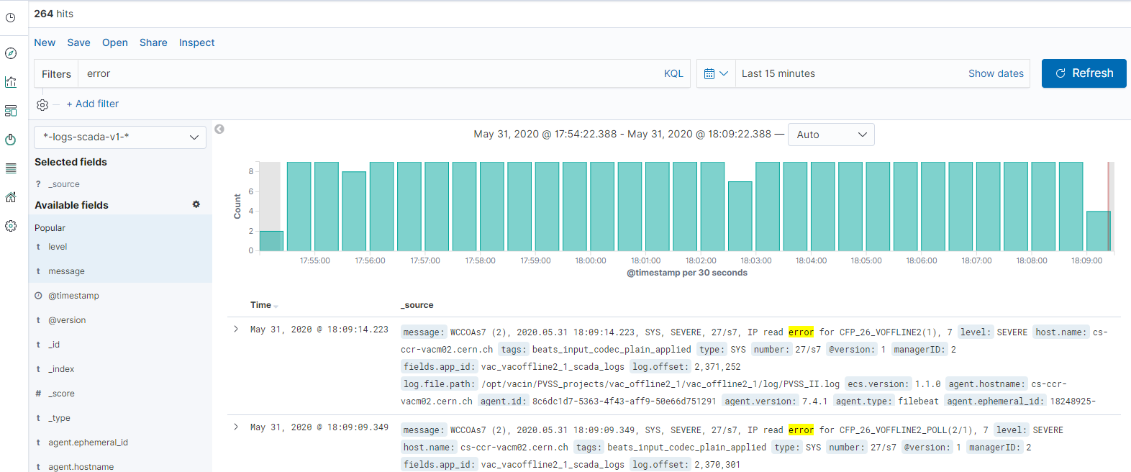
Kibana filter search box
Kibana results here

Slide 21
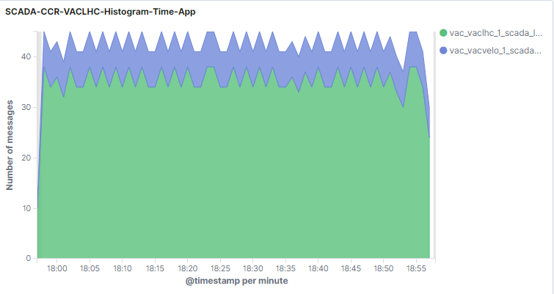
Example - Kibana histogram
vac_lhc_1
vac_velo_1

Slide 22
3.2. Vacuum Data Streaming Pipeline

Slide 23



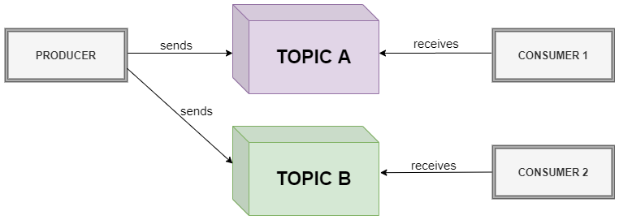
3.2. Vacuum Data Streaming Pipeline
WinCC-OA: tool used for supervision, control and monitoring of industrial processes
Implemented by Siemens
Platform for streaming/sending real-time data
Publish/subscribe messaging model

Slide 24
3.2. Vacuum Data Streaming Pipeline
Tested alternatives:
Kafka driver
Piece of software that allows you to send the data from WinCC-OA to Kafka
WinCC-OA CTRL Extension
Functionality to control the data within WinCC-OA

Slide 25
3.2. Vacuum Data Streaming Pipeline
1) Kafka driver
Kafka driver

Slide 26


1) Kafka driver
PLC: Programmable Logic Controller
PLC Data
Kafka Driver
SOURCE
VACUUM
DATA
TARGET
VACUUM
DATA
Configuration
CTRL
SCRIPT
message

Slide 27
3.2. Vacuum Data Streaming Pipeline
2) WinCC-OA CTRL extension
CTRL Extension

Slide 28
2) WinCC-OA CTRL Extension
PLC: Programmable Logic Controller
PLC Data
CTRL Extension
SOURCE
VACUUM
DATA
Configuration
CTRL
SCRIPT
message

Slide 29
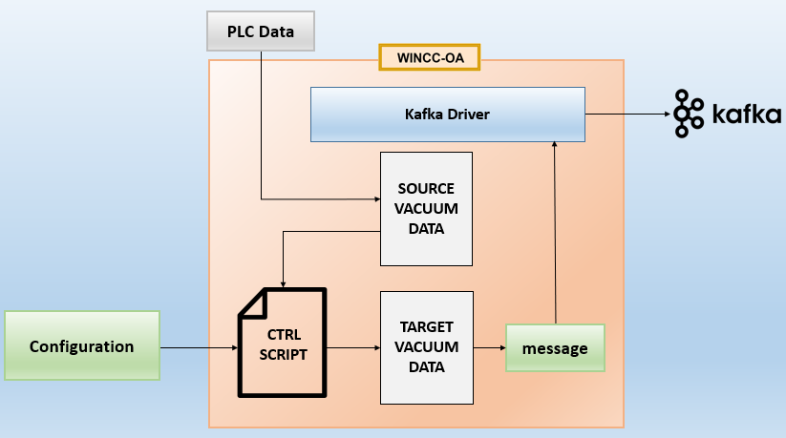
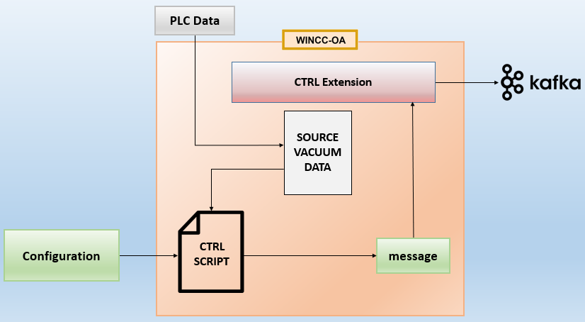
3.2. Vacuum Data Streaming Pipeline
1) Kafka Driver
2) WinCC-OA CTRL Extension

Slide 30
Evaluation
Which of the two alternatives is the safest one to use?
Metrics:
Average Delay (ms)
Time since each new data reaches WinCC-OA and the time Kafka receives that data
Average Memory (GB)

Slide 31
3.2. Vacuum Data Streaming Pipeline

Slide 32
3.2. Vacuum Data Streaming Pipeline

Slide 33
4. Conclusions
Data Streaming Pipeline
Built a common infrastructure to centralize the real-time data from different sources
Log Streaming Pipeline:
Currently being used by experts at vacuum to monitor/detect unexpected situations
Vacuum Data Streaming Pipeline:
WinCC-OA Ctrl Extension is better than using the Kafka driver

Slide 34
4. Conclusions
Future Work
Log Streaming Pipeline:
Performance evaluation with some other similar data streaming technologies
Vacuum Data Streaming Pipeline:
Connect Kafka to a database (Elasticsearch) and graphical interface (Kibana)
Application of Machine Learning techniques over the collected data

Slide 35
THANK YOU FOR YOUR ATTENTION!

