Slide 1
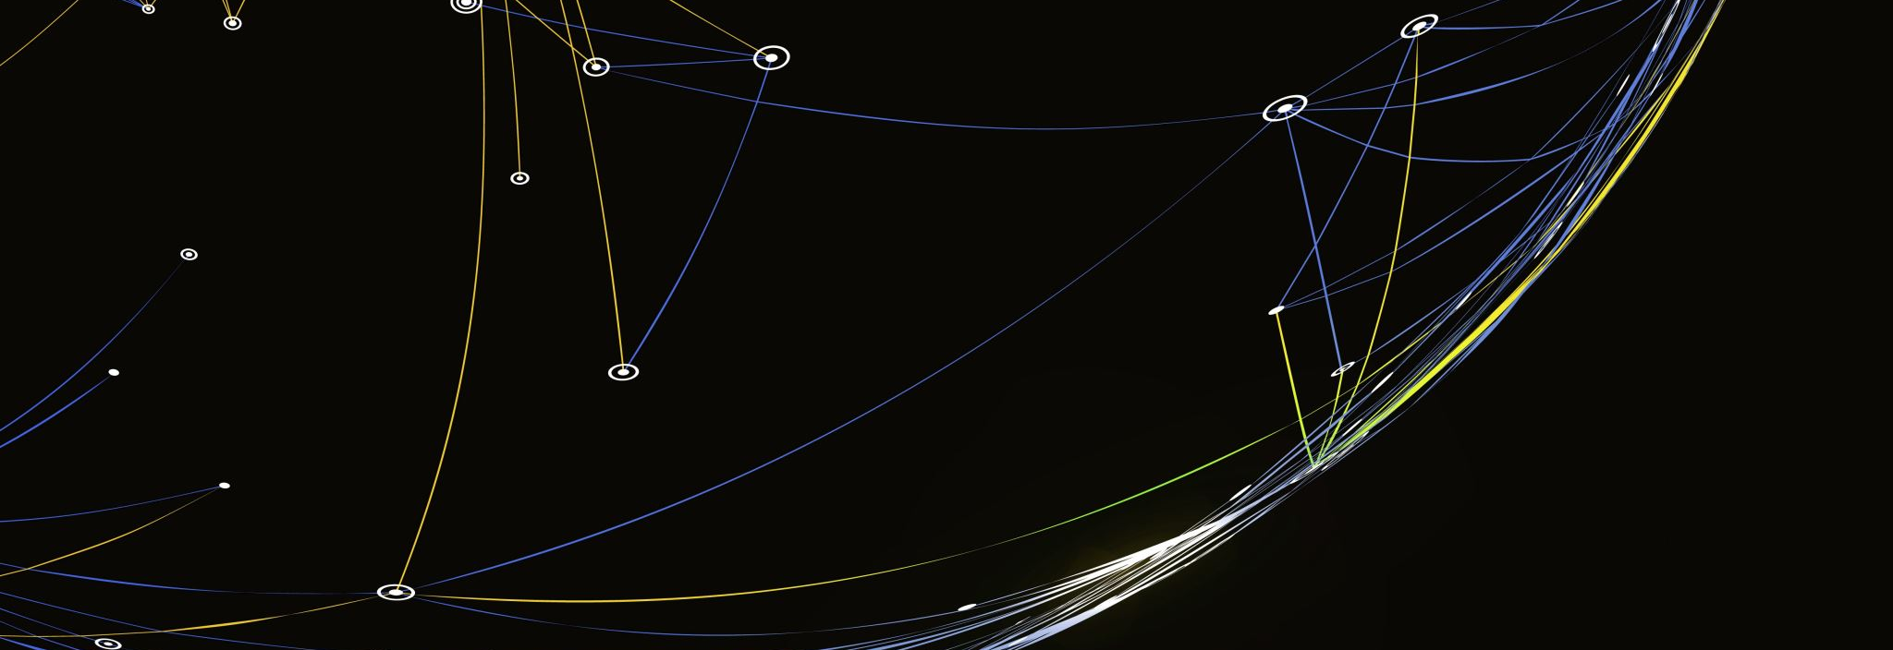
Exploratory Data Analysis & Natural Language Processing on PubMed Leukemia Abstracts
NLP Project Report
Nhi Luu
Translational Life Sciences Technology
BTEC 423 – Machine Learning Applications for Translational Bioinformatics
Professor: Dr. Jeffrey Robinson
Report Date: 04/13/2023

Slide 2
Data and References
A text file (“pubmed-leukemia-set”) comprised of roughly 1336 most recent abstracts related to Leukemia was obtained from PubMed in Medline format. The data was processed into PMID and abstract for further analysis in Python using Google Colab
The codes used to generate the following plots were based on the NLP walkthrough on Neptune.ai (ref: https://neptune.ai/blog/exploratory-data-analysis-natural-language-processing-tools)

Slide 3
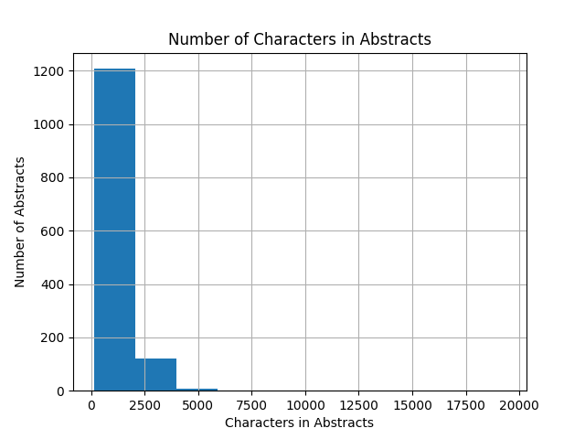

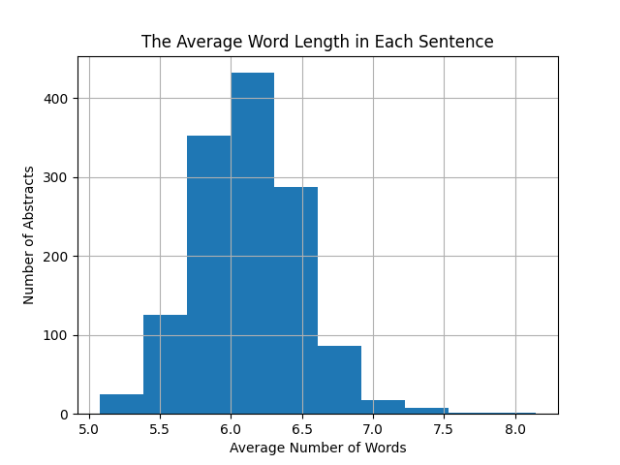
Fundamental Characteristics of the text data
The histogram shows that the number of words in the abstracts ranges from 125-625 words per abstracts, and mostly falls between 125-500.
The average word length in each sentence was shown to be between 5 – 7.5 words, with 6 to be roughly the common length.

Slide 4
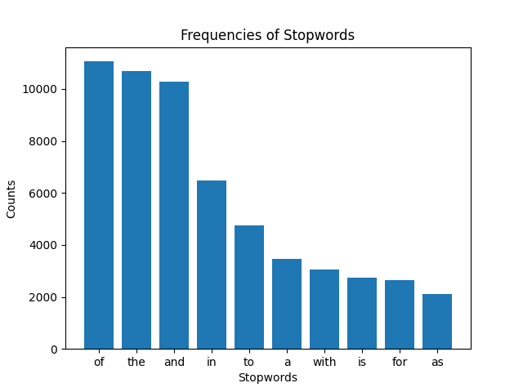
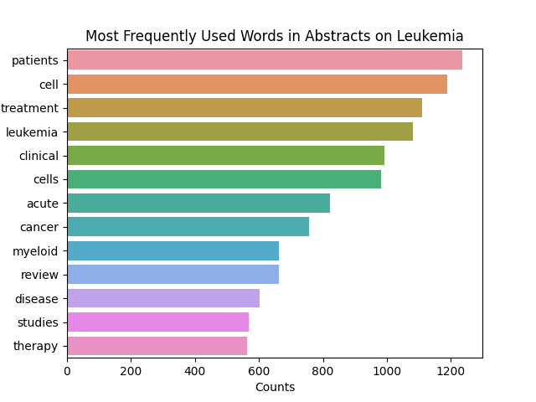
Fundamental Characteristics of the text data
Besides the most used stop words (left), the frequently most used words in abstracts on research related to leukemia are demonstrated (right)

Slide 5
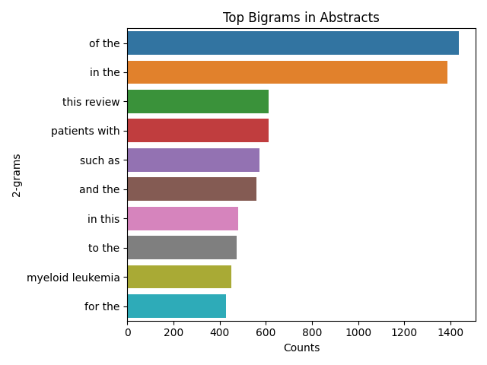
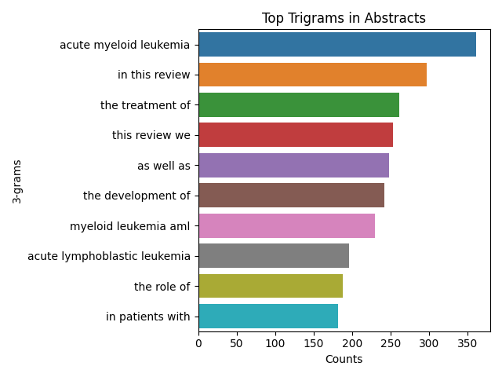
Ngram Exploration
N-grams are contiguous sequences of n number of words Charts below demonstrated the top bigrams (n=2) and trigrams (n=3) used in the abstracts

Slide 6
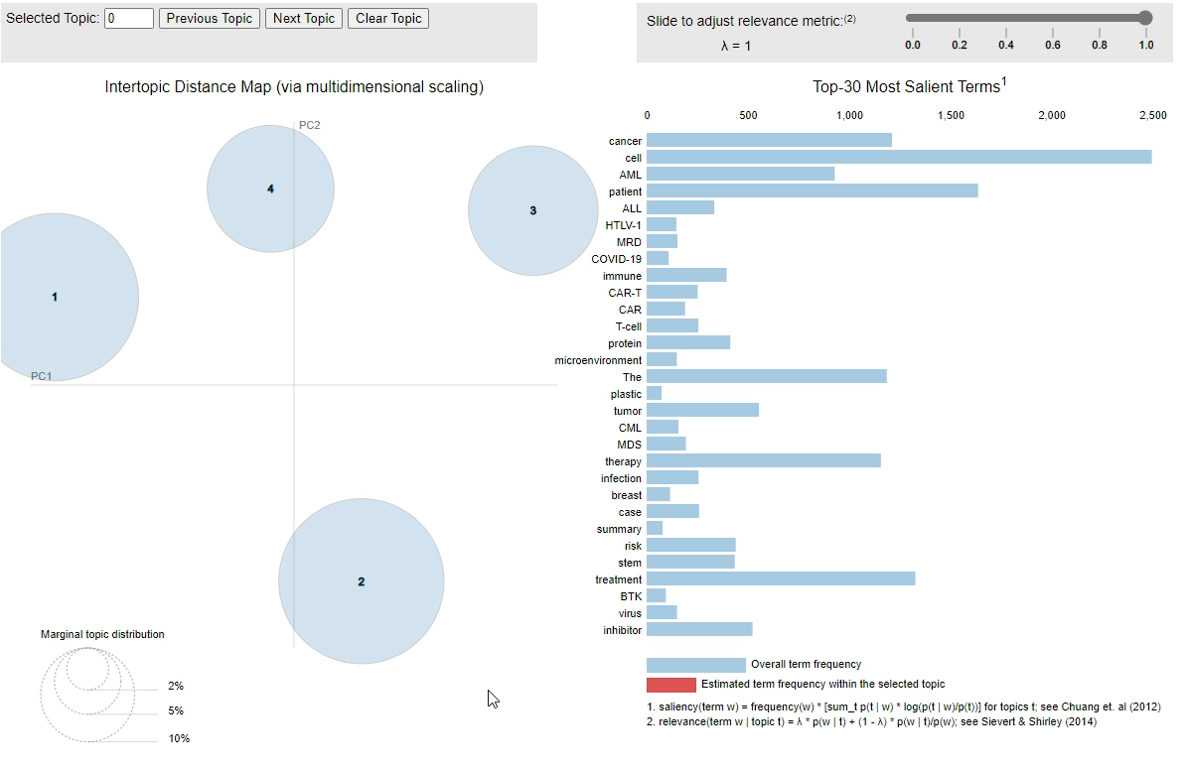
Topic Modeling exploration with pyldavis
Extract main topics that occur in a collection of Leukemia related abstracts using unsupervised learning from LDA topic modeling
For interactive plots, please download the “lda_plot.html” generated in Colab and view it locally

Slide 7
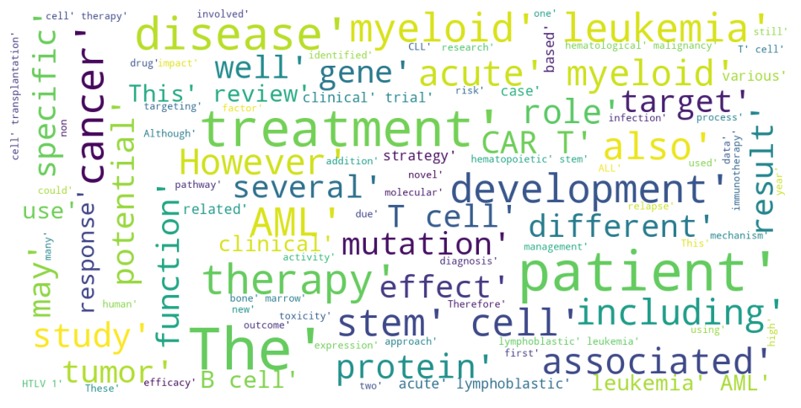
wordcloud
A word cloud to visualize text data from the abstracts. Words appear by color/size to indicate the frequency/importance

Slide 8
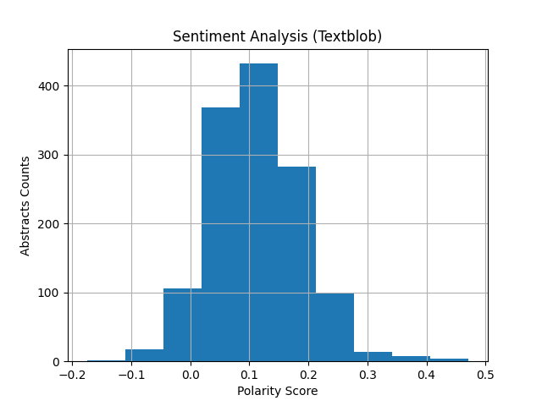
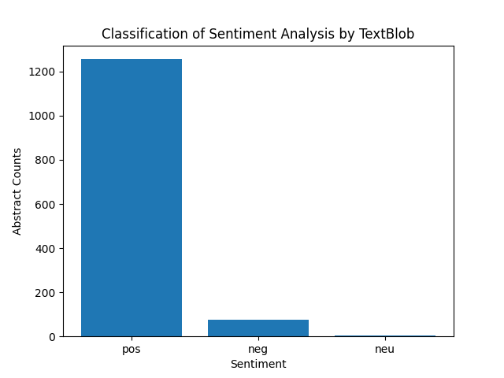
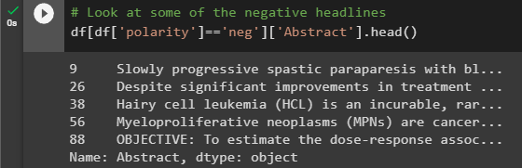
Sentiment analysis: textblob
A polarity score was calculated to determine if the abstracts were positive, negative, or neutral. This sentiment analysis was done using Textblob.
The code snippets below show some examples of a negative score abstract, which relies on negative adverbs/adjectives
The bar chart shows the sentiment analysis using Textblob based on calculated polarity score. Most abstracts were classified as positive.

Slide 9
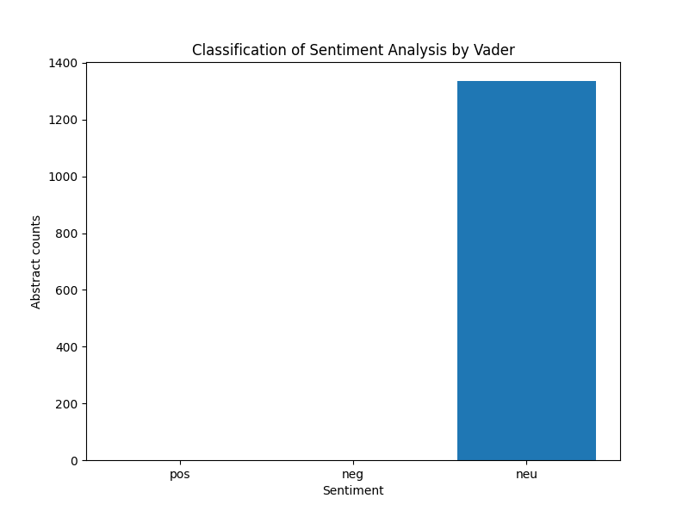
Sentiment analysis: vader
The bar chart shows the sentiment analysis using Vader based on score calculated by the SentimentIntensityAnalyzer(). In contrast to Textblob, all abstracts were classified as neutral.

Slide 10
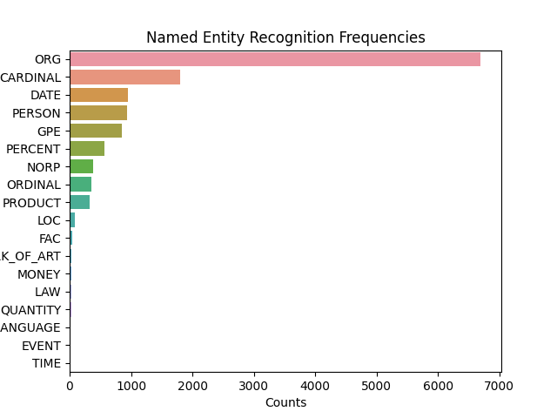
Named entity recognition (NER)
Utilizing Spacy, one of the NER tools, to visualize the recognized entity among the Leukemia abstracts
The most recognized entity were ORG, which are usually for companies, agencies, institutions, but in the abstracts, it was mostly for abbreviated words such as RNA, and so on. Let’s view the tokens of 4 entities ORG, CARDINAL, PERSON and GPE in the next slide

Slide 11
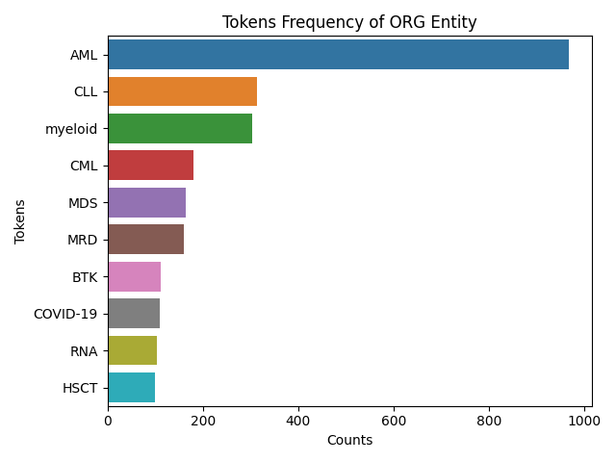
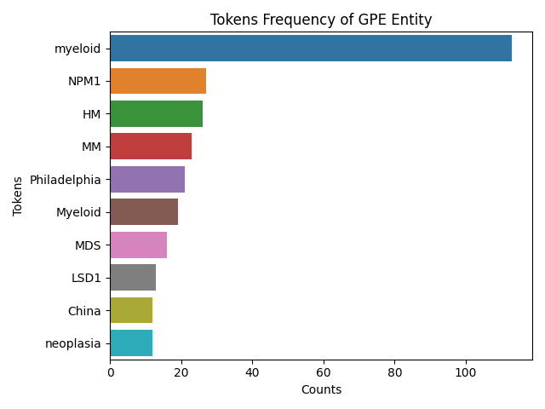
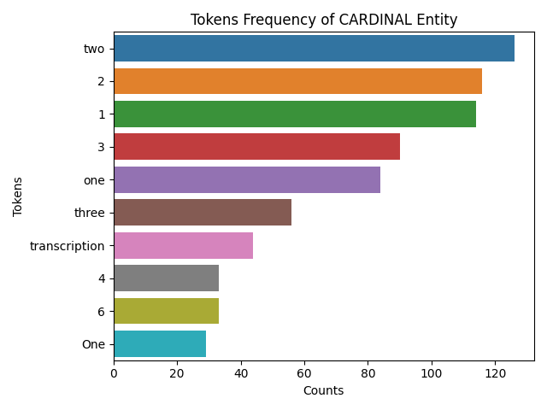
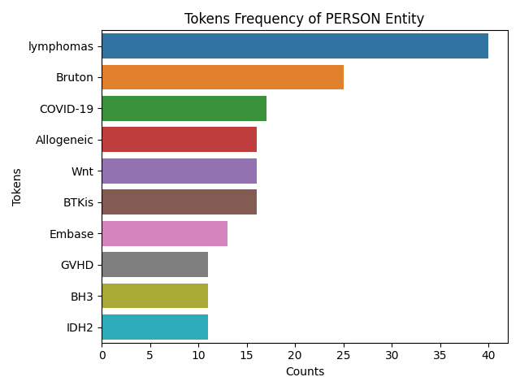
Named entity recognition: Tokens per entity

Slide 12
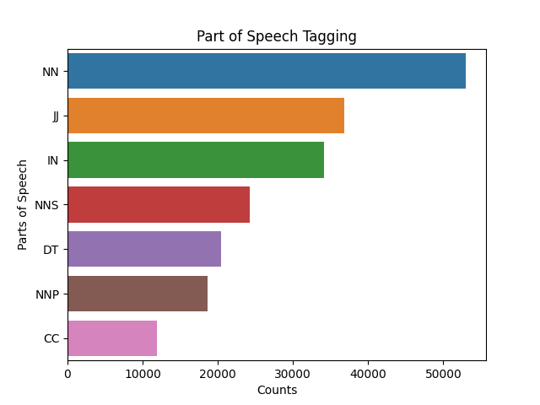
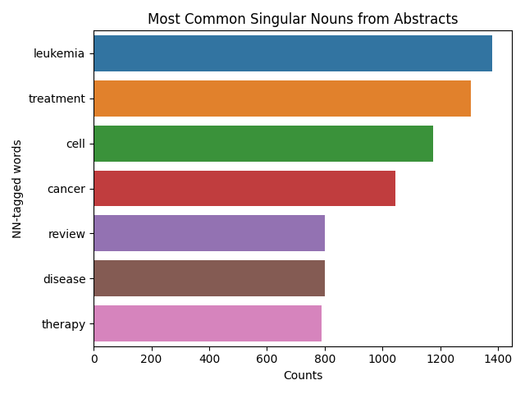
Part of speech tagging
Part of speech (POS) tagging aims to assign POS labels to words in a sentence (left). The right chart investigates the content of highest POS tag NN, which is the nouns.

Slide 13
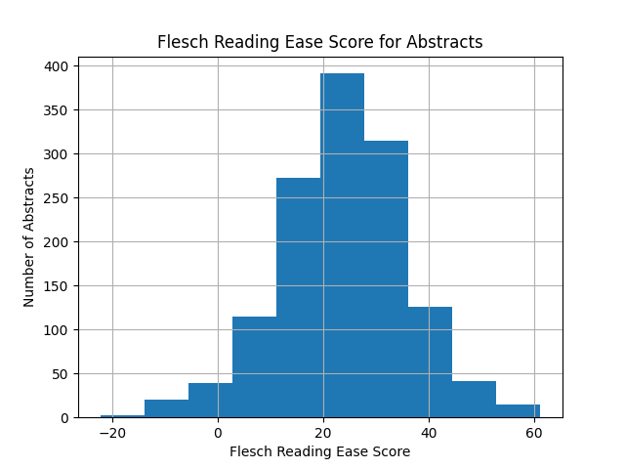
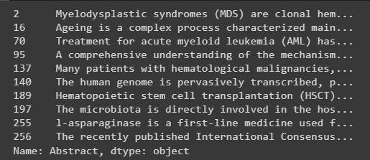
Exploring text complexity
There are several readability tests to quantitatively investigate text complexity for appropriate target audience. The histogram below shows the readability score using Flesch Reading Ease to observe whether the text is complex. The score falls most into the range 20-40, indicate that the content is appropriate for college students but entirely not for high school and younger.
An example of few abstracts with score below 5:

