Slide 1
SE TOOLKIT HOW TO CREATE A COURSE

Slide 2
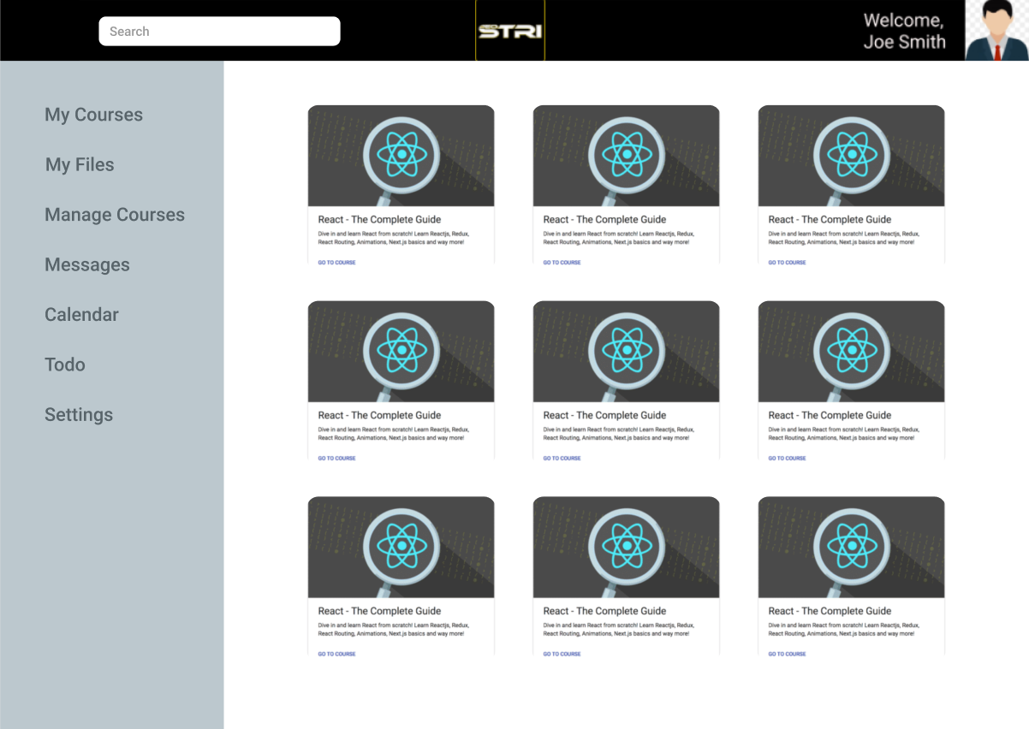
STEP 1:
Click on Manage courses

Slide 3
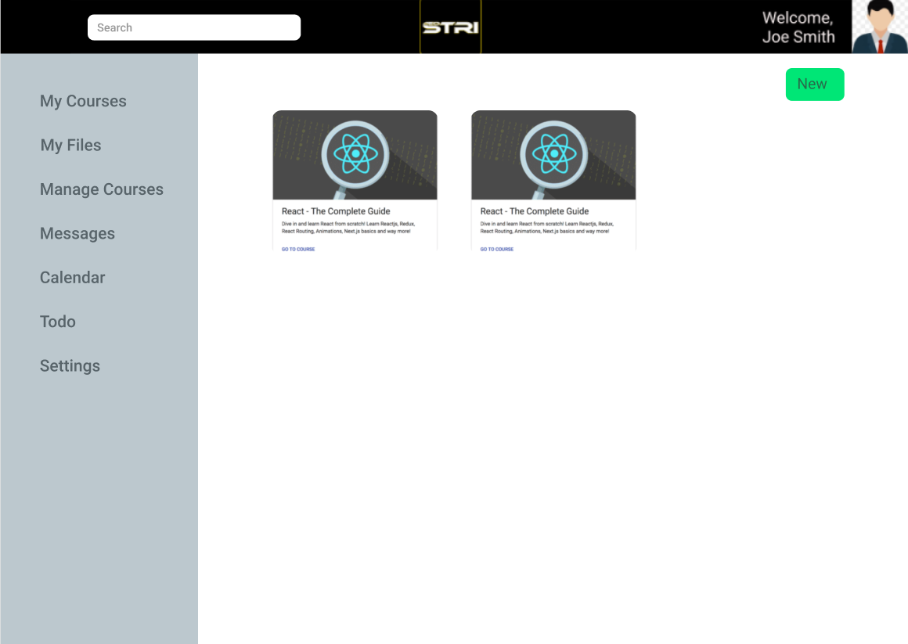
STEP 2:
Click on New

Slide 4
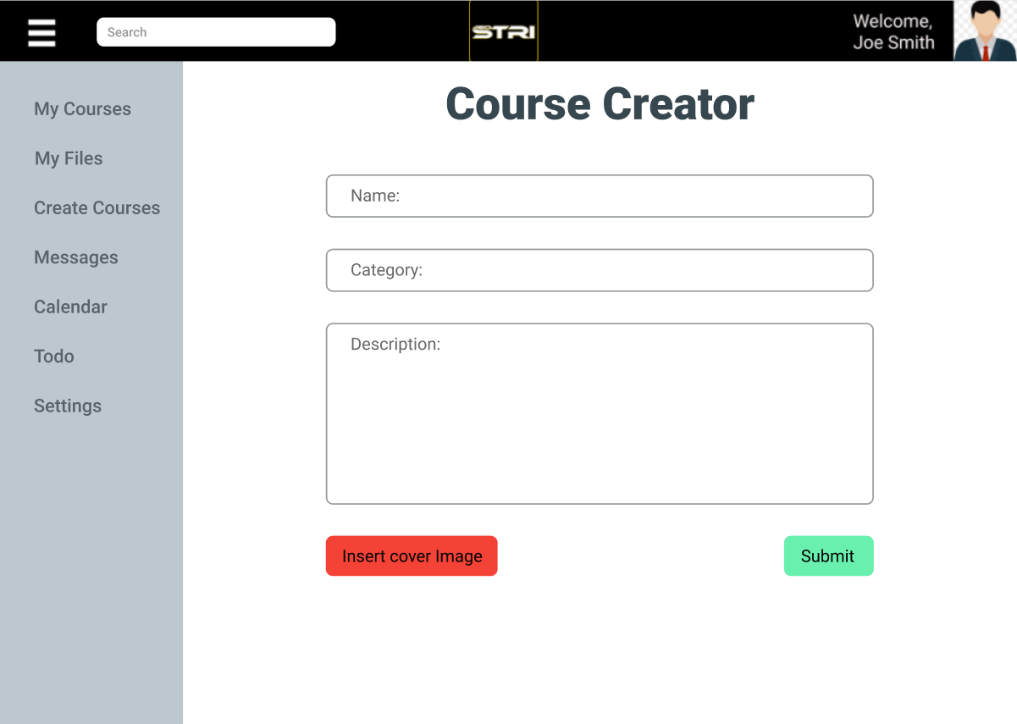
STEP 3:
Fill Name, category, description text boxes and insert a cover image.
Then click submit
(Category is a field where the course belong, Ex: sports is the category for soccer)

Slide 5
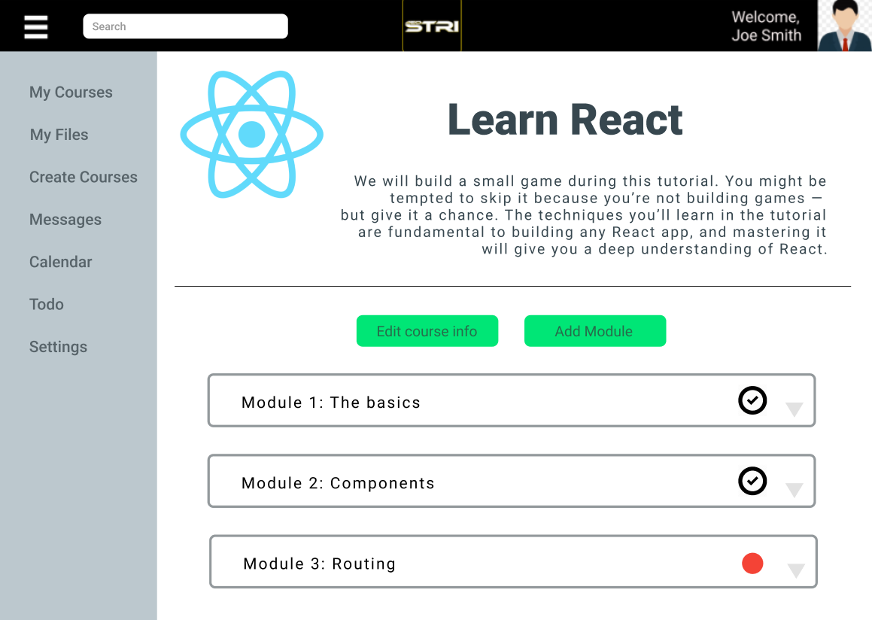
STEP 4:
Click on edit course info to change any information about the course.
Click Add module to create a module for the course
There can be as many modules as necessary.

Slide 6
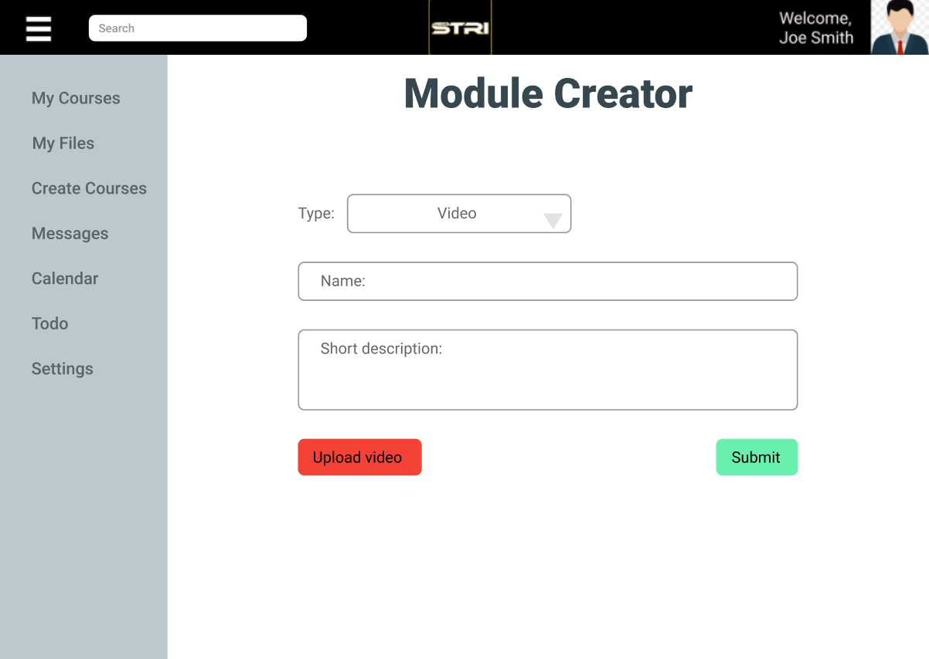
STEP 5:
Choose the type of module you need to create, there are presentation, video, text, quiz and more. depending on the type of module, you will need to fill the information asked.
The video, text, presentation and alternative are very similar, has a name, can upload a short description and upload a file, then click submit.
The alternative module is dedicated for files that can't be displayed inside of the website, this files will be downloaded by the students and then follow the instructions that the professor gave in the description.

Slide 7
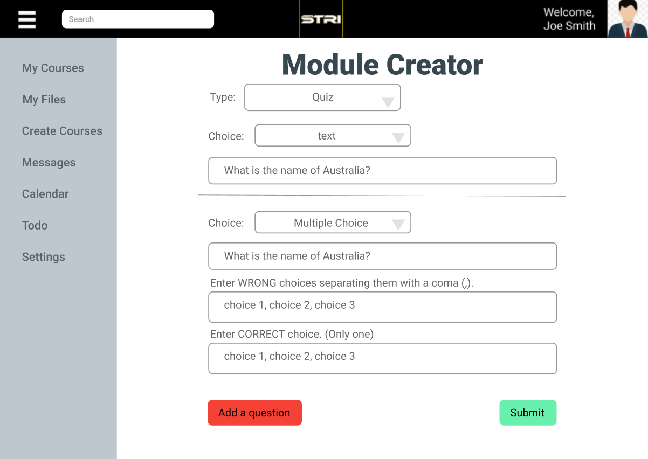
STEP 5:
The quiz module is intended to test its students and give the professor an idea of the quality of the course.
To create a quiz, first select the type quiz, this will automatically show a blank question to fill, then select the choice of the question, text, or multiple choice, finally fill the information depending on the type of question as the website asks.
Every time a new question is filled, the website will automatically add a new blank question on the bottom to fill if needed.

Slide 8
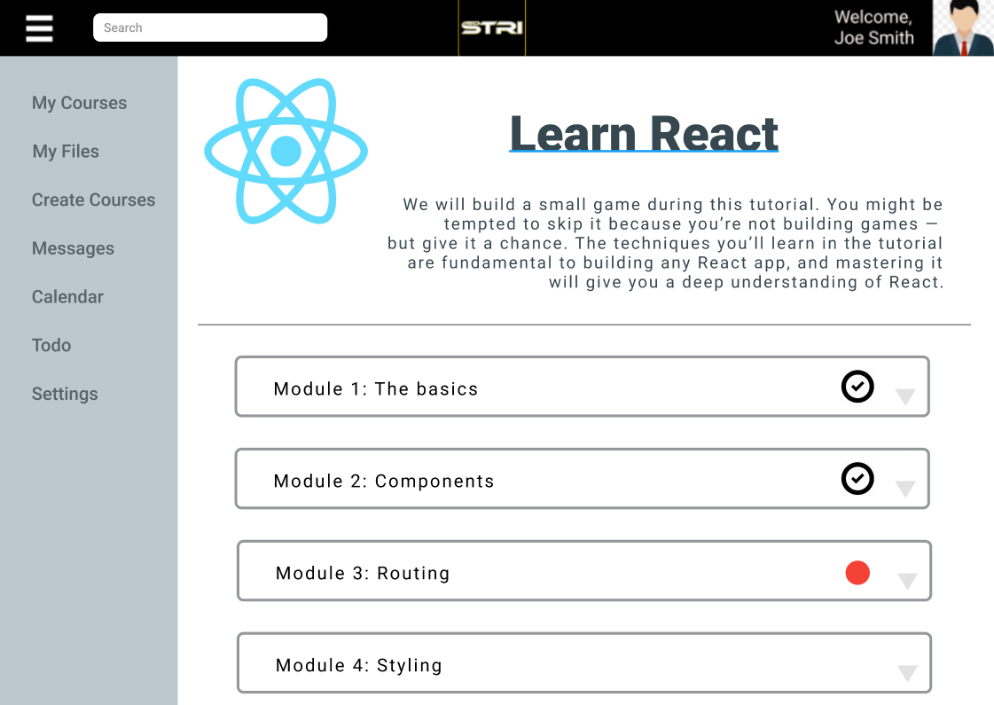
Done!
Preview of course
Now you need to make available the course so users will be able to access it, this option will be in the course main page.

