Slide 1


Website Development Asean Summit 2025

Slide 2




Core Technologies: Building the Foundation
HTML5
CSS3 & Tailwind CSS
Backbone for content structuring, ensuring semantic and accessible markup.
Modern styling, responsive, and mobile-first design system.
JavaScript
External Libraries
Powers all interactive elements and dynamic user experiences.
Leveraging efficient tools like Tailwind CDN for streamlined development.

Slide 3


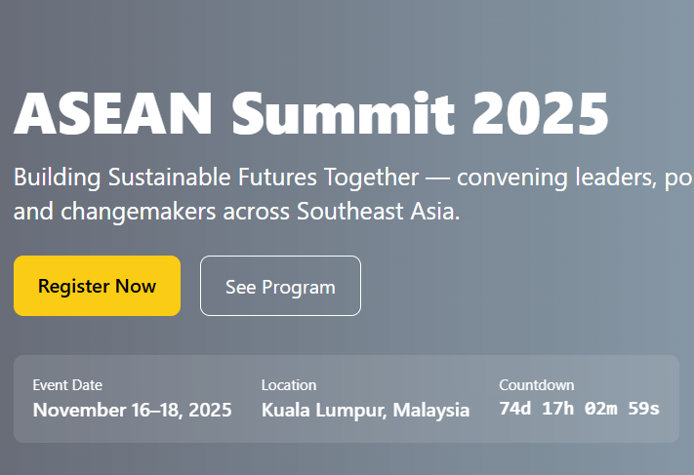
Engaging User Experiences
Crafting an intuitive and dynamic user journey for every visitor:
Countdown Timer
Builds anticipation for the Summit's commencement.
News Ticker Animation
Keeps visitors updated with real-time announcements.
Expand/Collapse Program Schedule
Simplifies navigation through the event agenda.
Lightbox Gallery Viewer
Showcases event visuals in an immersive way.

Slide 4




Design & Accessibility: Inclusive by Design
Dynamic Feedback
Subtle hover effects and smooth transitions enhance user interaction.
Adaptive Layout
Responsive design with Tailwind's grid ensures optimal viewing on any screen.
Universal Access
Incorporates keyboard focus and ARIA labels for users with diverse needs.
Considered Motion
Reduced motion support offers a comfortable experience for all.

Slide 5

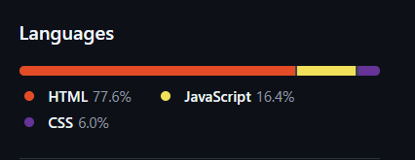
GitHub Workflow
Streamlined development and collaboration with robust version control:
Modular File Structure: Clear separation into index.html, style.css, and script.js for maintainability.
GitHub Pages Hosting: Leveraging a simple, serverless solution for quick and reliable online presence.
Effortless Deployment: Process designed for minimal overhead, allowing focus on development.
Robust Version Control: Git integration ensures collaborative development and easy rollback capabilities.

Slide 6


Future Enhancements: Evolving the Platform
Notification System
Calendar Sync
Real-time alerts for critical updates and schedule changes.
Direct integration with Google Calendar for personalized agendas.
Backend Integration
Advanced Theming
Enable dynamic content and secure form submissions.
Customizable visual styles and intricate animations.

Slide 7
Why a Dedicated Website?
"A central hub is crucial for seamless information dissemination and engagement."
Centralized Information
Global Reach & Accessibility
Enhanced Engagement
Single source of truth for all summit details.
Accessible worldwide, 24/7, across devices.
Interactive elements keep users informed and interested.
Reduces confusion and enhances clarity for attendees.
Supports diverse audience needs through inclusive design.
Builds anticipation and a sense of community.

Slide 8
Key Features in Detail
Dynamic Agenda
News & Announcements Hub
Filterable schedule, speaker bios, and session details at a glance. Real-time updates ensure attendees always have the latest information.
Live news feed, press releases, and official statements. Ensures immediate communication of critical updates and highlights.
Interactive Galleries
Attendee Resources
High-resolution photos and videos from previous summits and current events. Offers a visual journey and a glimpse into the summit's atmosphere.
Travel information, FAQs, venue maps, and contact details. Provides essential support for attendees' logistical needs.

Slide 9
Why Our Website Stands Out
User-Centric Design
Technical Robustness
Prioritizing intuitive navigation and a visually appealing interface for a superior user experience.
Built on a stable, secure, and scalable architecture ready for high traffic and future growth.
Agile Development
Commitment to Accessibility
Iterative process allows for rapid adaptation to feedback and evolving summit needs.
Ensuring universal access for all users, fostering inclusivity and broader participation.

Slide 10


Attribution & Next Steps
We extend our gratitude for the resources that shaped this presentation.
Media used from Freepik: Acknowledging the creative assets from Freepik.com, integral to our visual presentation.
Source Code: Available on GitHub for review and collaboration.
Feedback & Collaboration: We welcome your insights to refine and enhance the website further.
Deployment & Launch: Aiming for a seamless go-live experience well in advance of the Summit.

