Slide 1


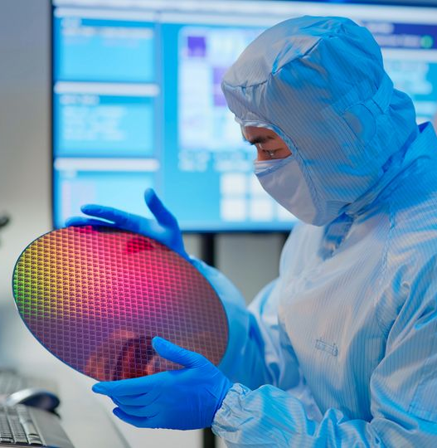
Extreme Ultraviolet (EUV) Lithography
Course: EEE 413
Course Title : Fundamentals of Nanotechnology
Semester: Spring 2026
Section:1
Group No: 02
Al Imran: ID: 2022-1-80-013
Md. Moshfiqur Rahman: ID: 2022-1-80-016
Faisal Hasan: ID: 2022-2-80-007
Niaz Morshed Razon: ID: 2022-2-80-008

Slide 2
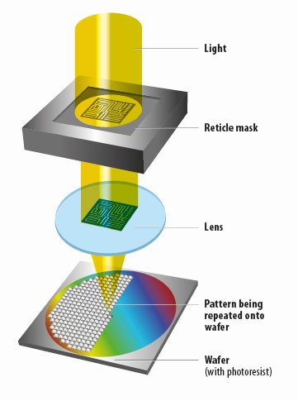
What is Lithography?
Lithography is a process used in semiconductor manufacturing to create intricate patterns on a silicon wafer. It involves projecting light through a mask to form patterns on a photosensitive material.
Relevance In Chip Manufacturing
Lithography is critical in semiconductor manufacturing because it determines how small and dense chip features can be. Advanced lithography enables smaller technology nodes, higher performance, and better power efficiency in modern processors.

Slide 3
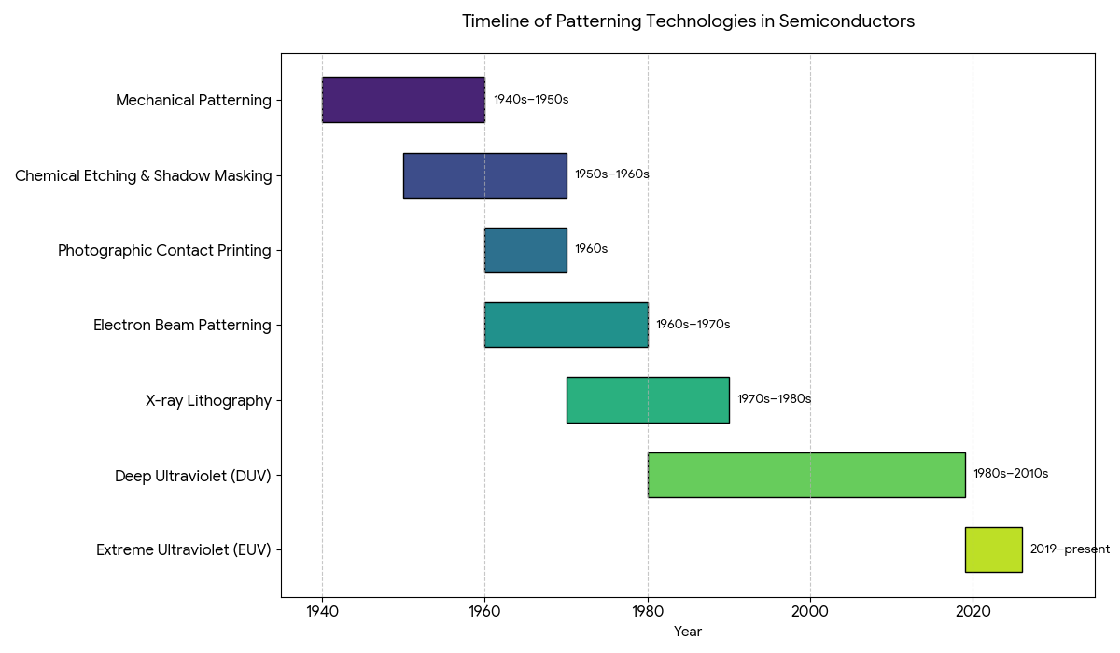
Technologies Before Modern Lithography
Early patterning methods lacked precision and scalability, leading to the adoption of optical lithography for modern semiconductor fabrication.

Slide 4
Technologies Before Modern Lithography
Mechanical Patterning (1940s–1950s):
Early electronic components were made using mechanical cutting, drilling, and metal masks. Feature sizes were large and precision was limited.
Chemical Etching & Shadow Masking (1950s–1960s):
Simple metal masks were placed over substrates, and unwanted material was removed using chemical etching. This method lacked accuracy for small features.
Photographic Contact Printing (1960s):
Borrowed from photography, light was used with photosensitive materials to transfer patterns by placing the mask directly on the wafer. This was the first step toward true lithography.
Electron Beam Patterning (1960s–1970s):
Electron beams were used to directly write patterns without masks. While very precise, the process was slow and not suitable for mass production.
X-ray Lithography (1970s–1980s):
X-rays enabled smaller features than visible light, but the systems were complex, expensive, and difficult to align.
Deep Ultraviolet (DUV) Lithography (1980s–2010s):
Uses 193 nm ArF or 248 nm KrF lasers. The optical system uses lenses and mirrors to project mask patterns. High-volume manufacturing allowed features down to about 7 nm with multi-patterning, but scaling below 7 nm required multiple exposures.
Extreme Ultraviolet (EUV) Lithography (2018–present):
Uses 13.5 nm EUV light with a fully reflective optical system in vacuum. Enables sub-7 nm features in a single exposure, offering higher resolution and fewer patterning steps, but is more expensive and requires extreme precision.

Slide 5
Recent Generations of Photolithography
Lithography Type | Basic Functional / Theoretical Description
DUV (193i) | Uses 193 nm ultraviolet light and standard dry optics to project mask patterns onto photoresist; limited resolution due to wavelength and numerical aperture.
DUV Immersion | Similar to DUV but adds a liquid (water) between lens and wafer to increase numerical aperture, improving resolution and allowing smaller feature sizes.
EUV | Uses extremely short 13.5 nm wavelength light generated by plasma; relies on reflective mirrors instead of lenses to print very small patterns for advanced nodes.

Slide 6
Recent Generations of Photolithography
Parameter | DUV (193i) | DUV Immersion | EUV
Years of use | ~2003–2010 | ~2010–2020 | ~2019–present
Wavelength | 193 nm | 193 nm | 13.5 nm
NA | ~0.93 | ~1.35 | ~0.33
Processor examples | 90–45 nm | 22–7 nm | 5–2 nm
Main limitation | Resolution | Multiple patterning | Source power

Slide 7
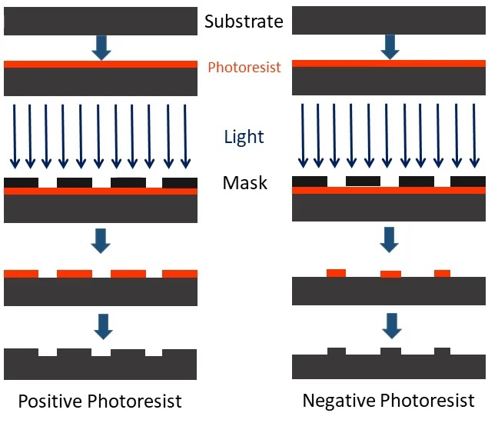
Steps in Photolithography
Substrate Cleaning
Photoresist Covering
Soft Bake
Mask Alignment
Exposure
Post-Exposure Bake
Development
Hard Bake
Etching or Implantation
Photoresist Stripping

Slide 8
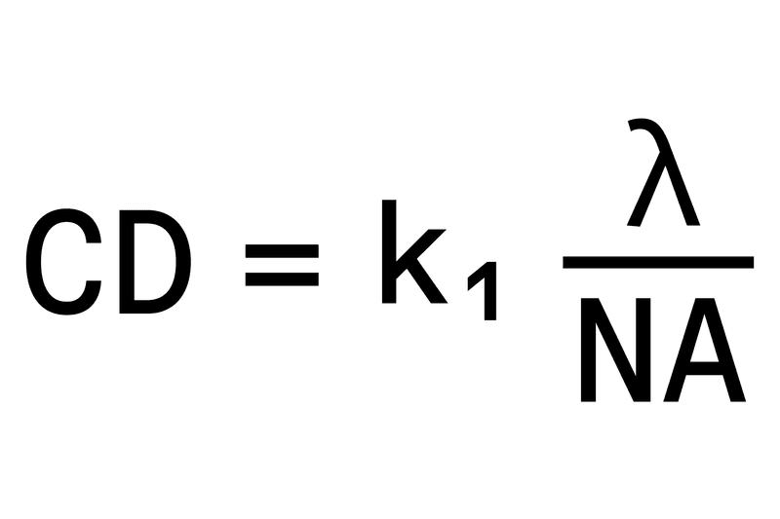
Parameters of EUV Lithography
Wavelength Of light (λ)
Numerical Apertures (NA)
Resolution / Rayleigh Criterion (CD)
Source power
Mask Technology
Resist Sensitivity & Line Edge Roughness (LER)
Overlay Accuracy
Throughput (Wafers per Hour)
13 nm
Higher NA means lower nodes.

Slide 9
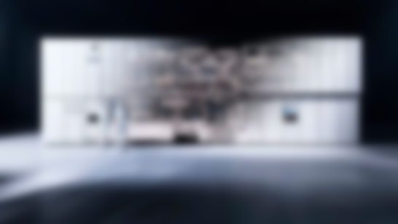
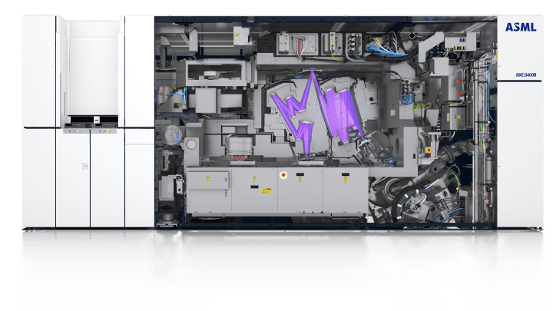
Working principal of Photolithography
EUV light source
Collector & Illumination optics
Reflective mask (reticle)
Projection optics
Wafer stage & photoresist

Slide 10
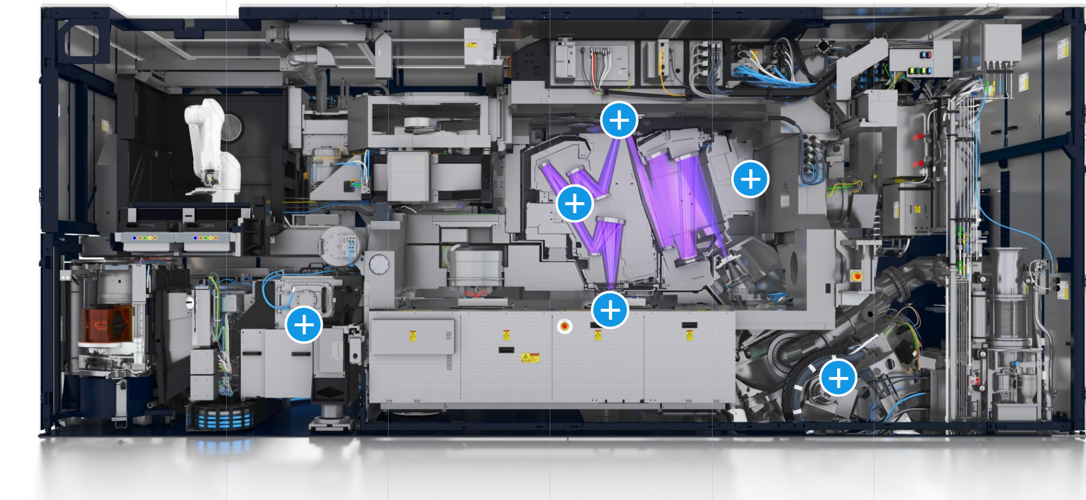
A Cross Section View of ASML Lithography Machine
HOW IT WORKS??

Slide 11
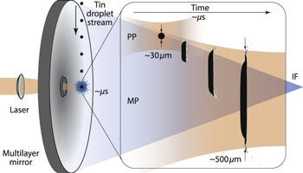
EUV Light Source
EUV light for lithography is generated using a Laser-Produced Plasma (LPP) technique, where a high-power CO2 laser strikes molten tin droplets 50,000 times per second in a vacuum chamber. This process heats the tin to 220,000°C, forming a plasma that emits 13.5 nm EUV light, which is then captured by specialized mirrors.

Slide 12
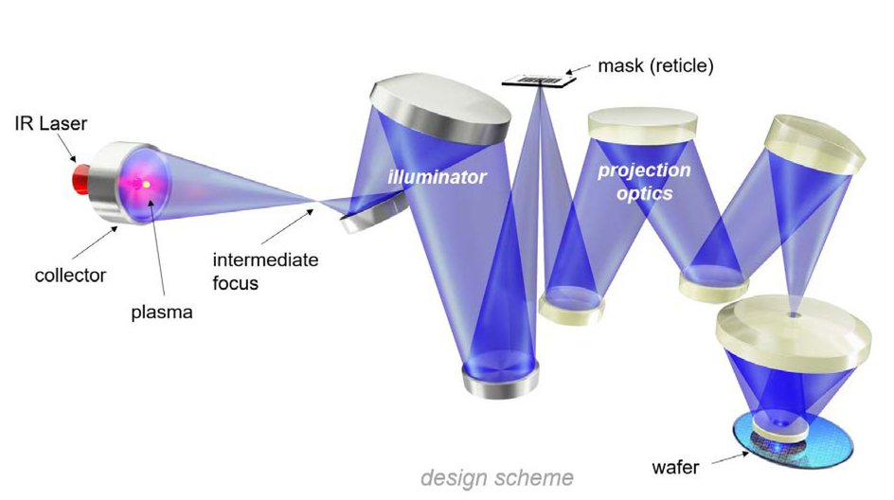
Generate EUV light → shape it → pattern it → transfer to the wafer
In an ASML EUV lithography machine, 13.5 nm radiation is generated by laser-produced tin plasma, collected and shaped using multilayer reflective optics, and patterned by a reflective mask. The image is demagnified and projected onto a photoresist-coated wafer under vacuum, enabling high-resolution patterning for advanced semiconductor nodes.
Reflectivity ~70% per mirror
System efficiency ~2% .

Slide 13
EUV Evolution: Low-NA to High-NA
Parameter | Low-NA EUV (NXE:3400B/C) | Advanced Low-NA EUV (NXE:3600D) | High-NA EUV (EXE:5000)
Years of Application | 2019–present (HVM ramp-up) | 2022–present (volume production) | 2025–present (initial shipments)
Numerical Aperture (NA) | 0.33 | 0.33 | 0.55
Resolution (half-pitch) | ~13 nm | ~13 nm (improved productivity) | ~8 nm
Throughput (wafers/hour) | ~125–170 | ~170–200 | ~185–220
Processor Examples | TSMC/Samsung 5 nm/3 nm (e.g., Apple A16, Snapdragon 8 Gen 2) | TSMC/Samsung 3 nm/2 nm (e.g., Apple A18, NVIDIA Blackwell) | Intel 14A/1.4 nm, TSMC 1.6 nm (sub-2 nm logic)

Slide 14
The EUV Light Source
The EUV Light Source Creating enough 13.5 nm photons to maintain high manufacturing throughput is one of the greatest engineering feats in history.
Construction: Laser Produced Plasma (LPP) The source functions like a high-speed firing range
Droplet Generator: A nozzle ejects tiny droplets of molten tin (Sn), about 30 microns wide, at a rate of 50,000 droplets per second.
Dual-Pulse Laser: A high-power CO2 laser fires twice at every droplet.
  Pre-pulse: Hits the droplet to flatten it into a "pancake" shape, increasing surface area.
  Main pulse: A massive blast of energy that ionizes the tin, turning it into a plasma hot enough to emit EUV light.

Slide 15
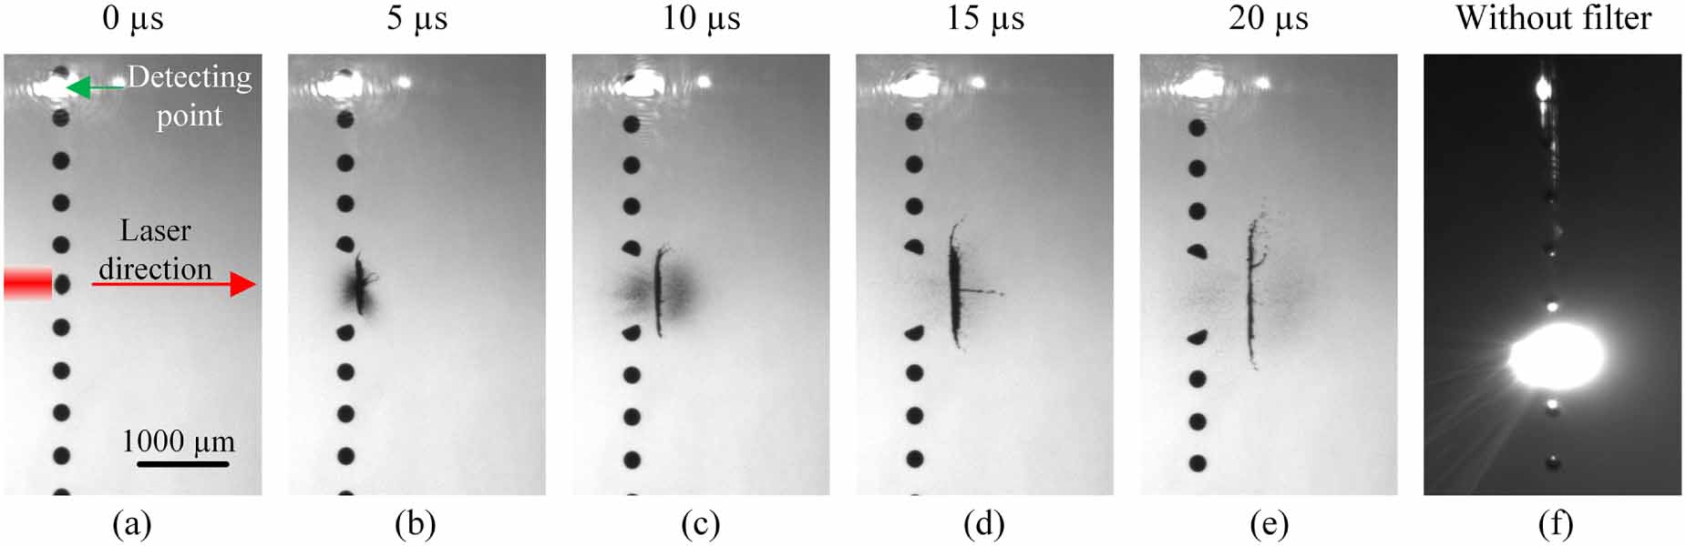
Challenges
Debris Control: The plasma explosion creates tin "shrapnel" that can ruin the expensive optics. Systems use a hydrogen gas curtain to deflect these particles.
Power Conversion: It takes an immense amount of electricity to generate a small amount of EUV light. Most of the energy is lost as heat.

Slide 16
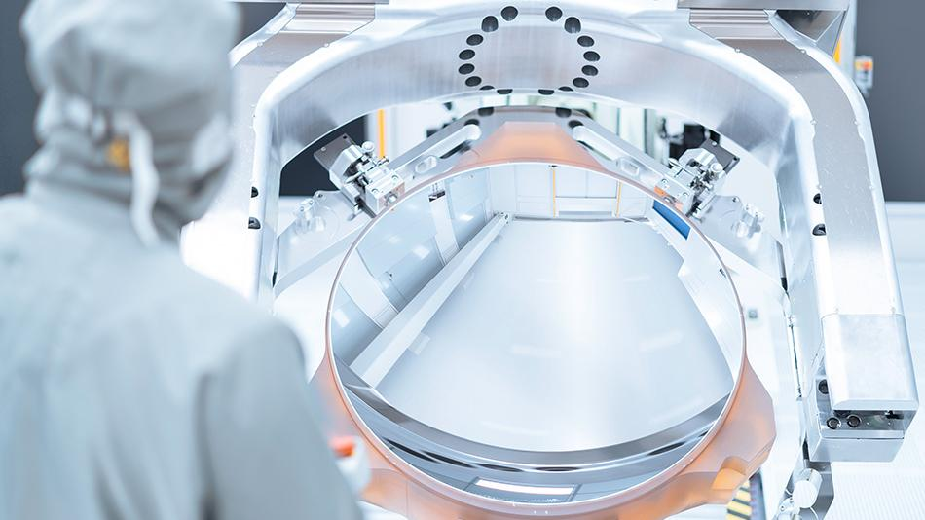
The Optical System
The Optical System (Illuminator and Projection) Because 13.5 nm light is absorbed by glass, traditional lenses are useless. EUV systems must use reflective optics (mirrors) housed in a high-vacuum environment.
Construction: Bragg Reflectors Standard mirrors aren't smooth enough for EUV. Instead, the system uses Multi-Layer (ML) Mirrors:
~40 pairs of alternating layers of Molybdenum (Mo) and Silicon (Si).
Each layer is precisely a few nanometers thick to create constructive interference.
Reflectivity: Even these "perfect" mirrors only reflect about 70% of the light. The rest is absorbed as heat.

Slide 17
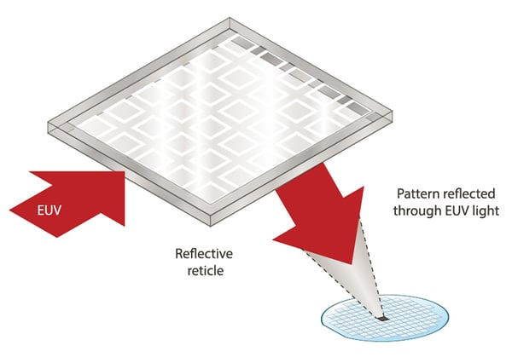
Operations of The Optical System
Collector: A large, bread-shaped mirror captures the EUV light from the plasma and focuses it into the scanner.
Illuminator: A series of mirrors shapes the beam and directs it toward the mask (reticle).
Mask: Unlike DUV masks (which are transparent), EUV masks are reflective. The pattern is etched into an absorber layer on top of a multi-layer mirror.
Projection Optics: A series of mirrors reduces the image (usually by 4x) and focuses it onto the silicon wafer.

Slide 18
Challenges of The Optical System
Challenge | Impact | Solution
Light Absorption | Light dies in air or glass. | The entire optical path is a near-total vacuum.
Thermal Expansion | Heat from absorbed light warps mirrors. | Mirrors are made of Ultra-Low Expansion (ULE) glass and actively cooled.
Surface Roughness | Atomic-scale bumps cause blur. | Mirrors are polished to a precision equivalent to "a bump the size of a marble on a road spanning from New York to San Francisco."
The Pellicle | Dust on the mask ruins the chip. | A specialized, ultra-thin silicon or carbon-nanotube membrane (pellicle) protects the mask while letting EUV pass.

Slide 19
Reference
[1] ASML, “EUV lithography systems – Products,” ASML. [Online]. Available: https://www.asml.com/en/products/euv-lithography-systems. [Accessed: Feb. 10, 2026]. ppl-ai-file-upload.s3.amazonaws
[2] ASML, “TWINSCAN EXE:5000 – EUV lithography systems,” ASML. [Online]. Available: https://www.asml.com/products/euv-lithography-systems/twinscan-exe-5000. [Accessed: Feb. 10, 2026]. dynotech-solutions
[3] ASML, “TWINSCAN NXE:3400C – EUV lithography,” ASML. [Online]. Available: https://www.asml.com/products/euv-lithography-systems/twinscan-nxe3400c. [Accessed: Feb. 10, 2026]. en.wikipedia
[4] World of Photonics, “EUV lithography—how does it work?,” World of Photonics. [Online]. Available: https://world-of-photonics.com/en/photonics-industry-portal/detail/euv-lithography.html. [Accessed: Feb. 10, 2026]. youtube
[5] imec, “High-NA EUV lithography: the next major step in lithography,” imec. [Online]. Available: https://www.imec-int.com/en/articles/high-na-euvl-next-major-step-lithography. [Accessed: Feb. 10, 2026]. stellarix
[6] imec, “Entering the High NA EUV Lithography era,” imec. [Online]. Available: https://www.imec-int.com/en/articles/entering-high-na-euv-lithography-era. [Accessed: Feb. 10, 2026]. linkedin
[7] Wikipedia, “Extreme ultraviolet lithography,” Wikipedia. [Online]. Available: https://en.wikipedia.org/wiki/Extreme_ultraviolet_lithography. [Accessed: Feb. 10, 2026]. asml
[8] Dynotech Solutions, “Innovations in Semiconductor Lithography Machines and Equipment,” Dynotech Solutions, Sep. 30, 2024. [Online]. Available: https://dynotech-solutions.com/blogs/innovations-in-semiconductor-lithography-machines-and-equipment/. [Accessed: Feb. 10, 2026]. oist

Slide 20
Thank You!

