Slide 1
EEE 413 – Fundamentals Nanotechnology
Assignment 02
Moore’s Law and Dennard Scaling
Presented by: Group 2
Niaz Morshed Razon (2022-2-80-008)
Md. Moshfiqur Rahman (2022-1-80-016)
Al Imran (2022-1-80-013)
Faisal Hasan (2022-2-80-007)
Instructor:
Dr. Ryyan Khan
Department of Electrical and Electronic Engineering
East West University
Spring 2026

Slide 2
Table of Content
1. Introduction: Importance of Integrated Circuits
2. Moore’s Law
• Concept and Historical Background
• Transistor Scaling Trend
• Key Innovations that Sustained Moore’s Law
• Current Status of Moore’s Law
3. Dennard’s Law
• Concept and Original Theory
• Scaling Principles
• Breakdown of Dennard Scaling
4. Conclusion

Slide 3
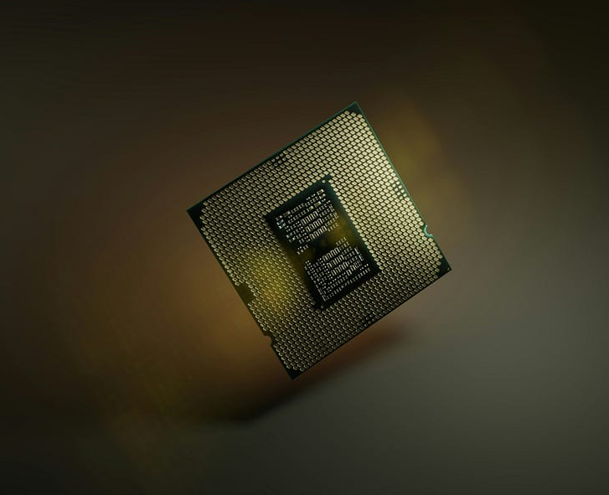
Modern electronic systems rely on Integrated Circuits (ICs)
As technology advances, users demand devices that can perform more complex computations and tasks.
IC performance improves by increasing the number of transistors on a chip[1].
Smaller transistors allow:
– Higher transistor density
– Faster computation
– Lower cost per function
– Improved energy efficiency

Slide 4
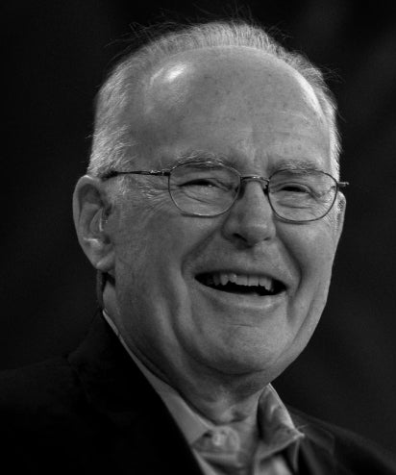
The Moore’s Law:
“The number of transistors on a microchip doubles approximately every two years[1]” – Gordon Moore
Moore’s Law was first proposed by Gordon Moore in 1965.
Published in Electronics Magazine: “Cramming More Components onto Integrated Circuits”[2].
Moore observed that the number of components per chip had doubled approximately every year.
In 1975, this prediction was revised to doubling approximately every two years.
Moore thought that this trend will last for a decade. But it has guided semiconductor technology development for more than five decades[2].
Gordon Moore (1929-2023)
Co-founder @ Intel & Fairchild Semiconductor

Slide 5
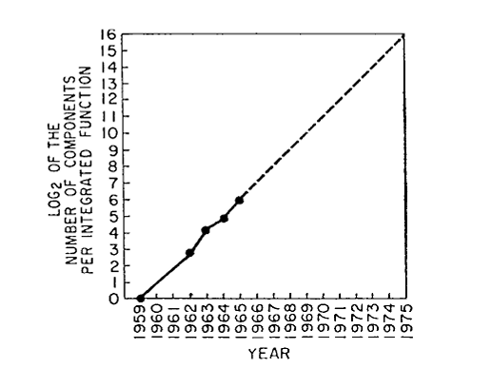
Moore’s Original Observation (1965)
As manufacturing technology improves, smaller transistors can be fabricated[2].
Smaller devices allow more components on the same chip area.
Moore showed that cost per component decreases when more components are integrated on one chip.
There exists an optimal complexity point where the cost per function becomes minimum[2].
Based on historical data and manufacturing trends, Moore predicted that the number of components per chip would double roughly every year[2].

Slide 6
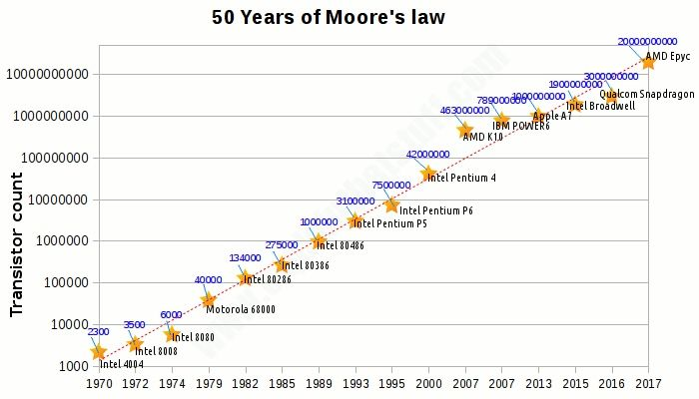
Moore’s Law and Transistor count over the years.
Moore’s Law predicts exponential growth in the number of transistors per chip.
When plotted on a logarithmic scale, the trend appears approximately linear.
This demonstrates that transistor density has doubled roughly every two years for several decades.

Slide 7
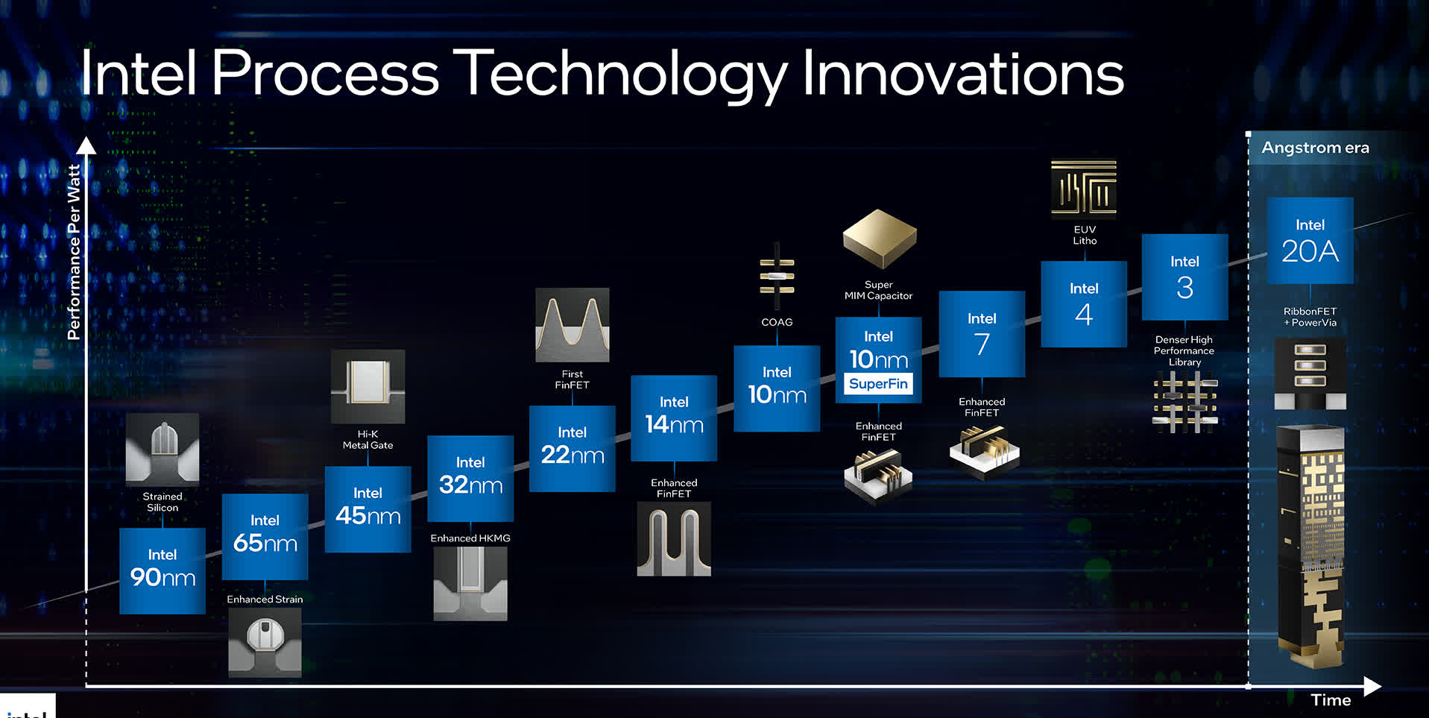
Key Innovations That Sustained Moore’s Law
Continuous improvements in semiconductor fabrication enabled Moore’s Law for several decades.

Slide 8
Is Moore’s Law Still Valid Today?
Moore’s Law remained accurate for nearly five decades.
However, transistor scaling is becoming increasingly difficult.
Physical limits: quantum tunneling, heat dissipation, and power density[3].
Economic limits: extremely high fabrication costs[3].
Today, performance improvements increasingly rely on new architectures such as parallel processing and specialized accelerators.

Slide 9
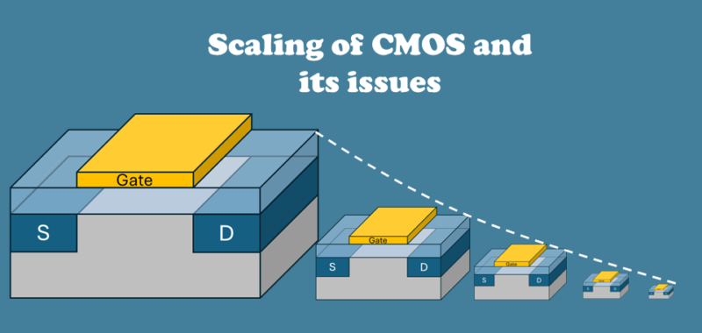
The Challenge of Scaling Transistors
Moore’s Law encouraged continuous scaling down of transistor to place more devices on a single chip.
However, simply shrinking transistor dimensions raises important physical challenges.
For example:
- Electric fields may increase
- Power may increase
- Device may break down
Engineers needed a scaling approach that would allow smaller transistors while maintaining proper operation.

Slide 10
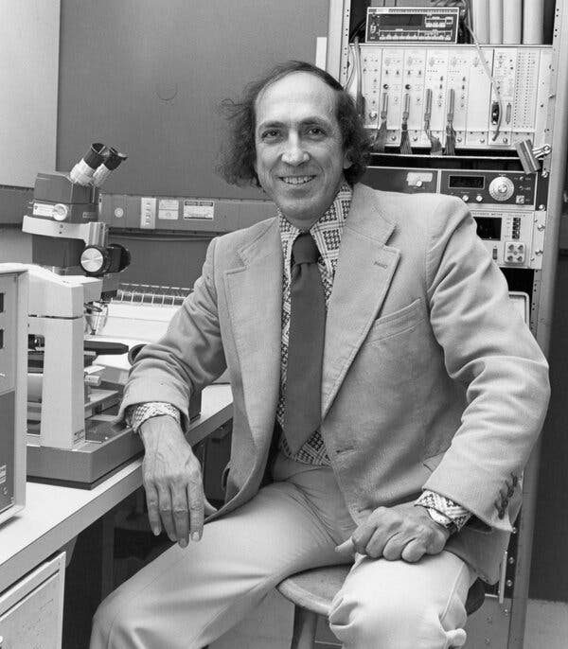
Dennard’s Law (Dennard Scaling)
Dennard’s Law was proposed by Robert Dennard in 1974.
It states that when transistor dimensions scale down,
voltage and current should also scale proportionally[4].
As a result, power density remains approximately constant[4].
This allowed chips to become faster without increasing power consumption.
Robert Heath Dennard (1932-2024) | Electrical Engineers | Inventor | Fellowship @ IBM

Slide 11
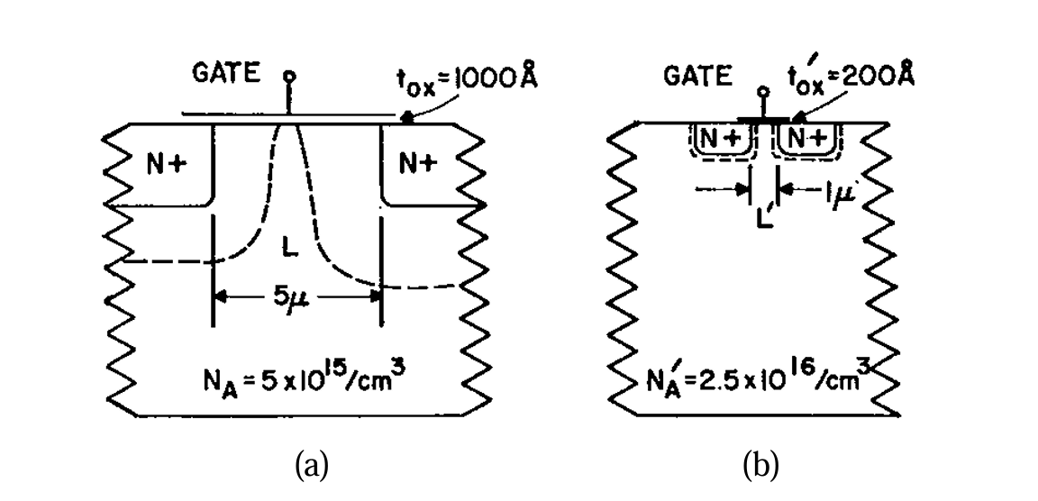
Original Idea Of Dennard Law
The original Idea was to shrink the distance between drain and source[5].
Assume we shrink the transistor dimensions by a factor k.
Example:
If k = 2, every dimension becomes half.
So:
Parameter | Scaling
Channel length | L → L/k
Channel width | W → W/k
Oxide thickness | tox → tox/k
Supply voltage | V → V/k
Threshold voltage | Vt → Vt/k

Slide 12
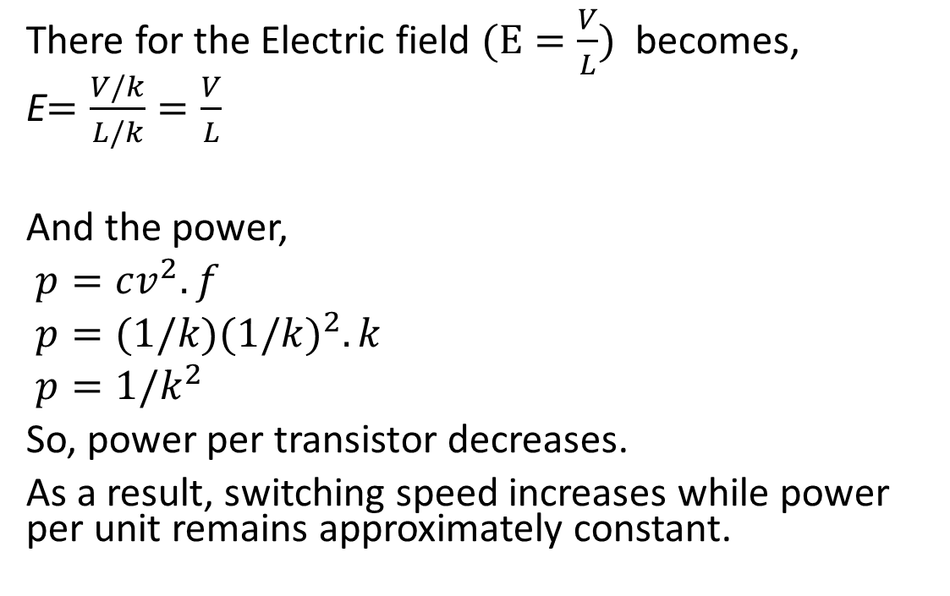
Dennard’s Law Scaling
There for the Electric field $(E=\frac{V}{L})$ becomes,
E$=\frac{V/k}{L/k}=\frac{V}{L}$
And the power,
$p=cv^{2}. f$
$p=(1/k){(1/k)}^{2}. k$
$p=1/k^{2}$
So, power per transistor decreases.
As a result, switching speed increases while power per unit remains approximately constant.

Slide 13
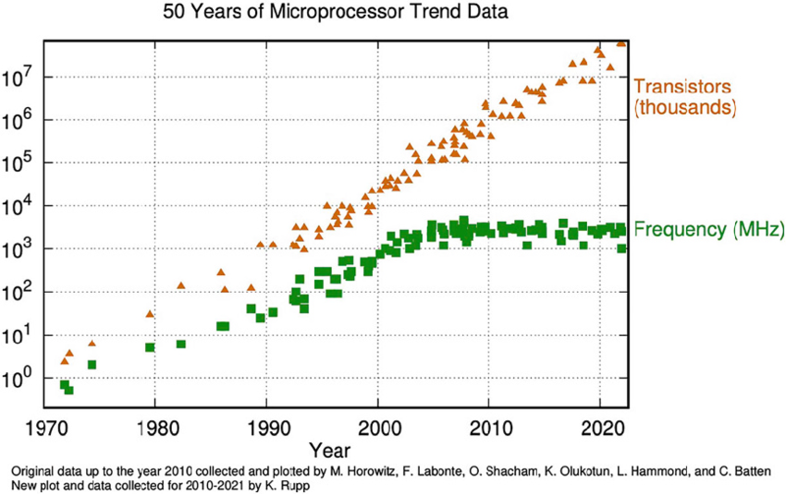
Breakdown of Dennard Scaling
Dennard scaling worked well until the early 2000s.
As transistor sizes became extremely small, voltage scaling stopped[5].
This caused power density to increase significantly.
The industry encountered the "Power Wall“ and "Thermal Limit“[5].
As a result, clock frequency growth slowed and processors shifted to multicore architectures.

Slide 14
Conclusion
Moore’s Law predicted the exponential growth of transistor density in integrated circuits.
Dennard’s Law explained how transistor scaling allowed higher performance without increasing power.
Moore’s Law enabled decades of rapid technological progress.
However, both scaling laws now face physical and economic limitations.
Future progress relies on new architectures, materials, and advanced fabrication technologies.

Slide 15
References
[1] Ö. Bırak, “The evolution of processor efficiency: A deep dive into transistor scaling and performance trends,” Medium, Feb. 2024. [Online]. Available: https://medium.com. . [Accessed: Mar. 14, 2026].
[2] G. E. Moore, “Cramming more components onto integrated circuits,” Electronics, vol. 38, no. 8, pp. 114–117, Apr. 19, 1965.
[3] Moore’s Law: The potential limits and breakthroughs,” ResearchGate, Oct. 2023. [Online]. Available: https://www.researchgate.net. . [Accessed: Mar. 14, 2026].
[4] R. H. Dennard, F. H. Gaensslen, H.-N. Yu, V. L. Rideout, E. Bassous, and A. R. LeBlanc, “Design of ion-implanted MOSFET’s with very small physical dimensions,” IEEE Journal of Solid-State Circuits, vol. 9, no. 5, pp. 256–268, Oct. 1974, doi: 10.1109/JSSC.1974.1050511.
[5] V. Sekar, “How Dennard Scaling Allowed Transistors to Shrink,” Vik’s Newsletter, Jan. 13, 2025. [Online]. Available: https://www.viksnewsletter.com. . [Accessed: Mar. 15, 2026].

Slide 16
Thank You!

