Slide 1


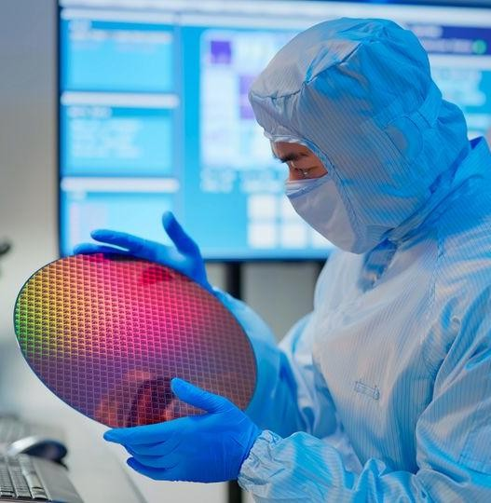
Extreme Ultraviolet (EUV) Lithography
Course: EEE 413
Course Title : Fundamentals of Nanotechnology Semester: Spring 2026
Section:1
Group No: 02
ID: 2022-1-80-013
Al Imran:
Md. Moshfiqur Rahman:
Faisal Hasan:
Niaz Morshed Razon:
ID: 2022-1-80-016
ID: 2022-2-80-007
ID: 2022-2-80-008
Presented On 22 Feb 2026

Slide 2
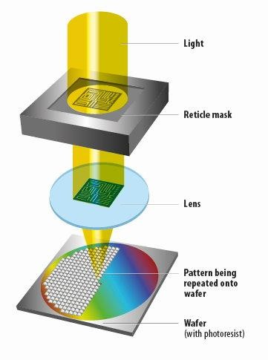
What is Lithography?
Lithography is a process used in semiconductor manufacturing to create intricate patterns on a silicon wafer. It involves projecting light through a mask to form patterns on a photosensitive material.
Relevance In Chip Manufacturing
Lithography is critical in semiconductor manufacturing because it determines how small and dense chip features can be. Advanced lithography enables smaller technology nodes, higher performance, and better power efficiency in modern processors.
1

Slide 3
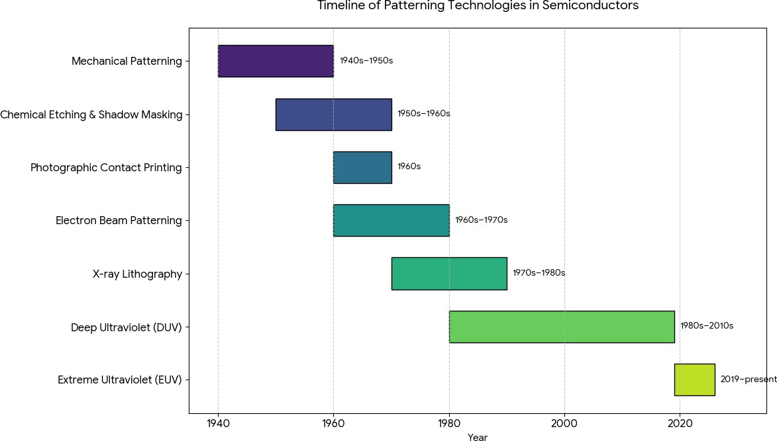
Technologies Used in Chip Manufacturing Over Time
Early patterning methods lacked precision and scalability, leading to the adoption of optical lithography for modern semiconductor fabrication.
2

Slide 4
Technologies Used in Chip Manufacturing
Mechanical Patterning (1940s–1950s):
Early electronic components were made using mechanical cutting, drilling, and metal masks. Feature sizes were large and precision was limited.
Chemical Etching & Shadow Masking (1950s–1960s):
Simple metal masks were placed over substrates, and unwanted material was removed using chemical etching. This method lacked accuracy for small features.
Photographic Contact Printing (1960s):
Borrowed from photography, light was used with photosensitive materials to transfer patterns by placing the mask directly on the wafer. This was the first step toward true lithography.
Electron Beam Patterning (1960s–1970s):
Electron beams were used to directly write patterns without masks. While very precise, the process was slow and not suitable for mass production.
X-ray Lithography (1970s–1980s):
X-rays enabled smaller features than visible light, but the systems were complex, expensive, and difficult to align.
Deep Ultraviolet (DUV) Lithography (1980s–2010s):
Uses 193 nm ArF or 248 nm KrF lasers. The optical system uses lenses and mirrors to project mask patterns. High-volume manufacturing allowed features down to about 7 nm with multi-patterning, but scaling below 7 nm required multiple exposures.
Extreme Ultraviolet (EUV) Lithography (2018–present):
Uses 13.5 nm EUV light with a fully reflective optical system in vacuum. Enables sub-7 nm features in a single exposure, offering higher resolution and fewer patterning steps, but is more expensive and requires extreme precision.
3

Slide 5
Recent Generations of Photolithography
Lithography Type | Basic Functional / Theoretical Description
DUV (193i) | Uses 193 nm ultraviolet light and standard dry optics to project mask patterns onto photoresist; limited resolution due to wavelength and numerical aperture.
DUV Immersion | Similar to DUV but adds a liquid (water) between lens and wafer to increase numerical aperture, improving resolution and allowing smaller feature sizes.
EUV | Uses extremely short 13.5 nm wavelength light generated by plasma; relies on reflective mirrors instead of lenses to print very small patterns for advanced nodes.
4

Slide 6
Recent Generations of Photolithography
Parameter | DUV (193i) | DUV Immersion | EUV
Years of use | ~2003–2010 | ~2010–2020 | ~2019–present
Wavelength | 193 nm | 193 nm | 13.5 nm
NA | ~0.93 | ~1.35 | ~0.33
Processor examples | 90–45 nm | 22–7 nm | 5–2 nm
Main limitation | Resolution | Multiple patterning | Source power
5

Slide 7
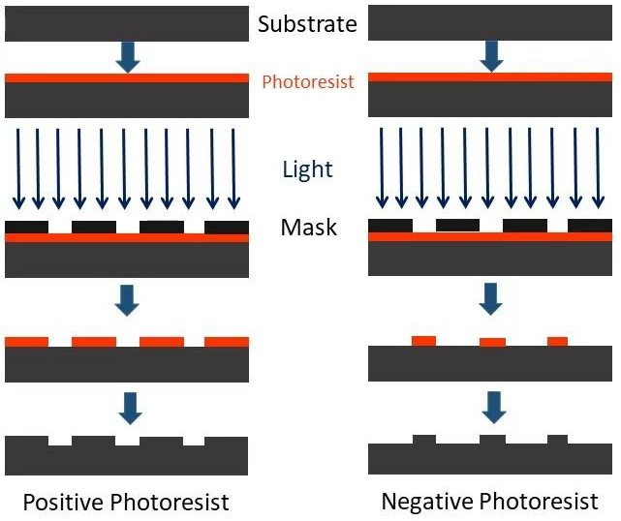
Steps in Photolithography
Substrate Cleaning
Photoresist Covering
Soft Bake
Mask Alignment
Exposure
Post-Exposure Bake
Hard Bake
Etching or Implantation
Photoresist Stripping
6

Slide 8
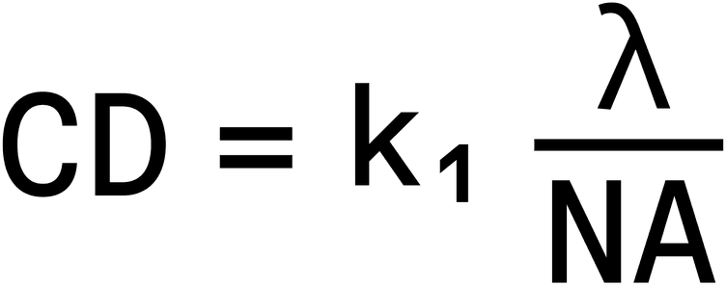
Parameters of EUV Lithography
13 nm
Wavelength Of light (λ)
Numerical Apertures (NA)
Processing Factor (K)
Resolution / Rayleigh Criterion (CD)
Source power
Overlay Accuracy
Throughput (Wafers per Hour)
Higher NA means lower nodes.
7

Slide 9
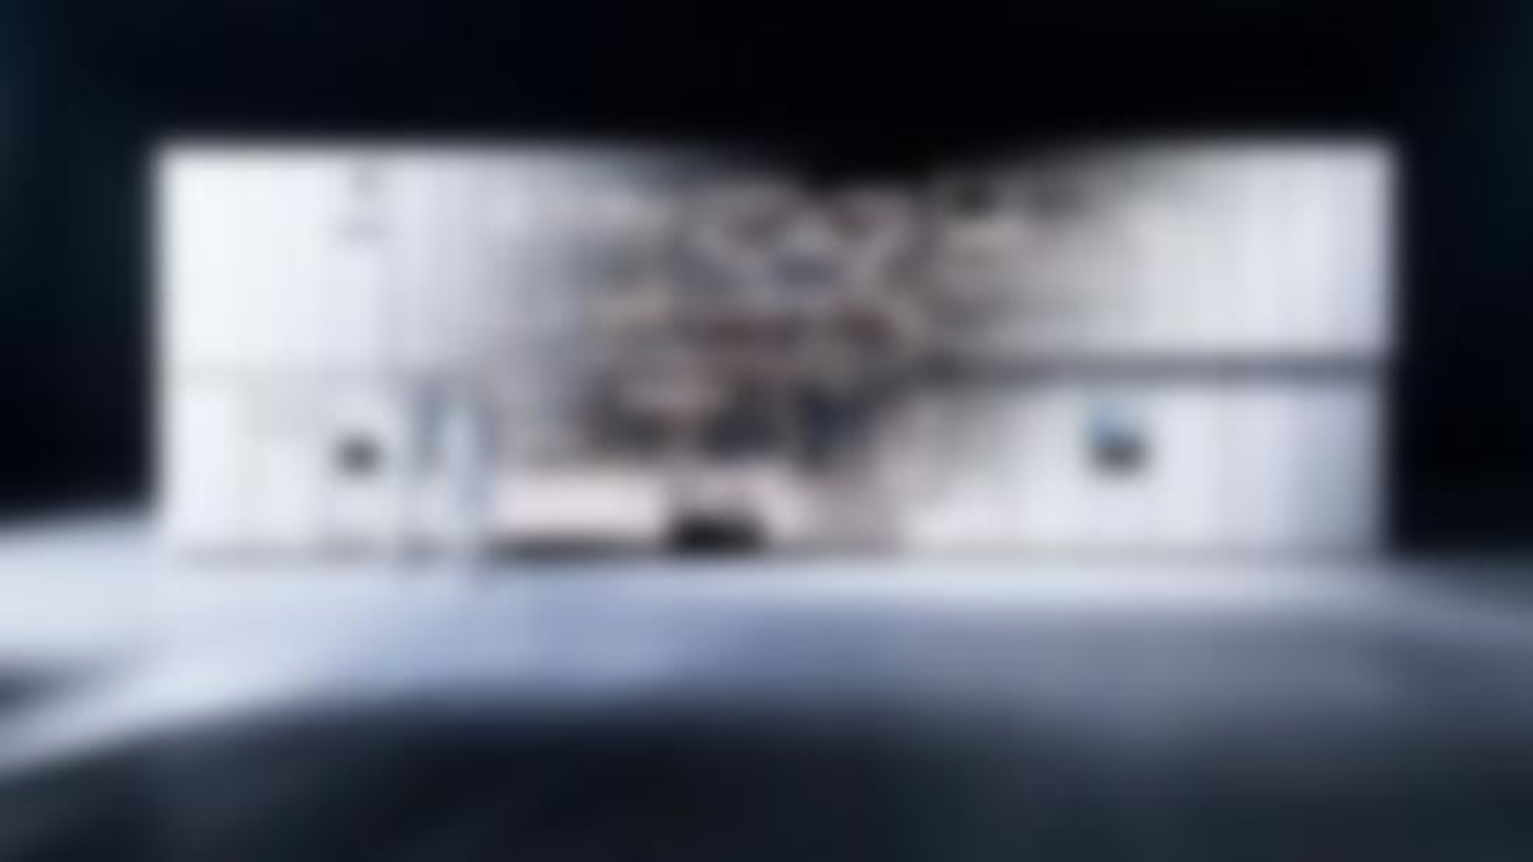
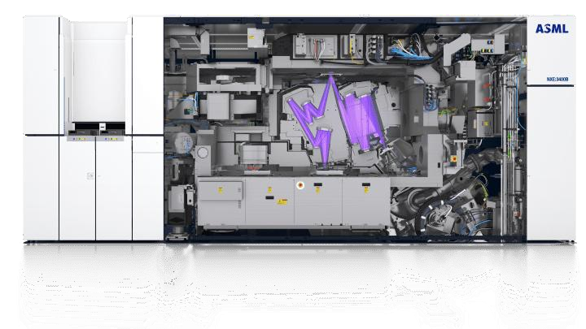
Working principal of Photolithography
First, a powerful light source (EUV) is used to produce light with a very small wavelength. This small wavelength helps to create fine details on the wafer.
EUV light source
Collector & Illumination optics
The light is collected by special optics. Then, illumination optics focus the light to ensure it shines directly onto the mask.
Reflective mask (reticle)
The mask has a pattern that reflects light onto the wafer to create the design.
Projection
optics
The light passes through optics that reduce and focus the pattern onto the wafer.
The wafer with photoresist hardens when exposed to light, forming the pattern.
Wafer stage & photoresist
8

Slide 10
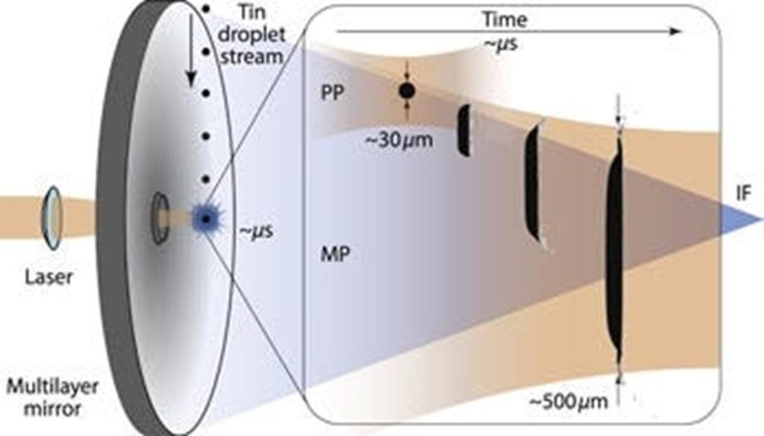
The EUV Light Source
The EUV Light Source Creating enough 13.5 nm photons to maintain high manufacturing throughput is one of the greatest engineering feats in history.
Construction: Laser Produced Plasma (LPP) The source functions like a high-speed firing range.
Droplet Generator: A nozzle ejects tiny droplets of molten tin (Sn), about 30 microns wide, at a rate of 50,000 droplets per second.
9

Slide 11
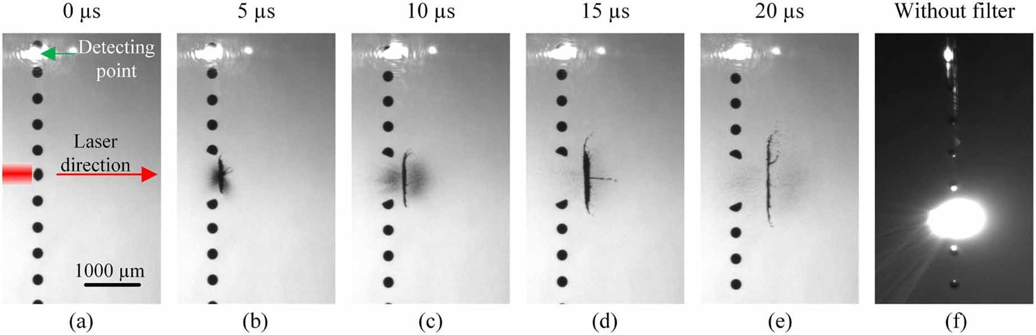
The EUV Light Source
Dual-Pulse Laser: A high-power CO2 laser fires twice at every droplet.
Pre-pulse: Hits the droplet to flatten it into a "pancake" shape, increasing surface area.
Main pulse: A massive blast of energy that ionizes the tin, turning it into a plasma hot enough to emit EUV light.
10

Slide 12

Challenges to Create 13.5 nm Light
Debris Control: The plasma explosion creates tin "shrapnel" that can ruin the expensive optics. Systems use a hydrogen gas curtain to deflect these particles.
Power Conversion: It takes a huge amount of electricity to generate a small amount of EUV light. Most of the energy is lost as heat.
11

Slide 13
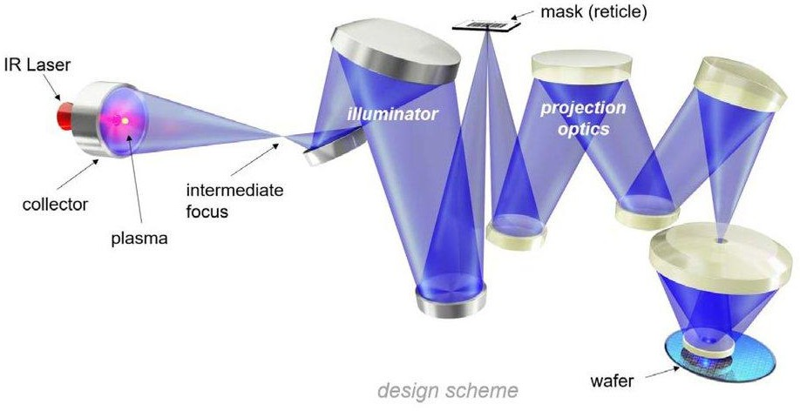
Illuminator and Projection
In an Extreme Ultraviolet (EUV) lithography machine,
the illuminator and projection optics are the two critical mirror- based systems that guide 13.5 nm light to create nanometer-scale circuit patterns. Because EUV light is absorbed by all materials, including air and glass, these systems consist entirely of ultra-precise, multilayer reflective mirrors called Bagger Reflectors.
All the process take place in a high-vacuum chamber
12

Slide 14
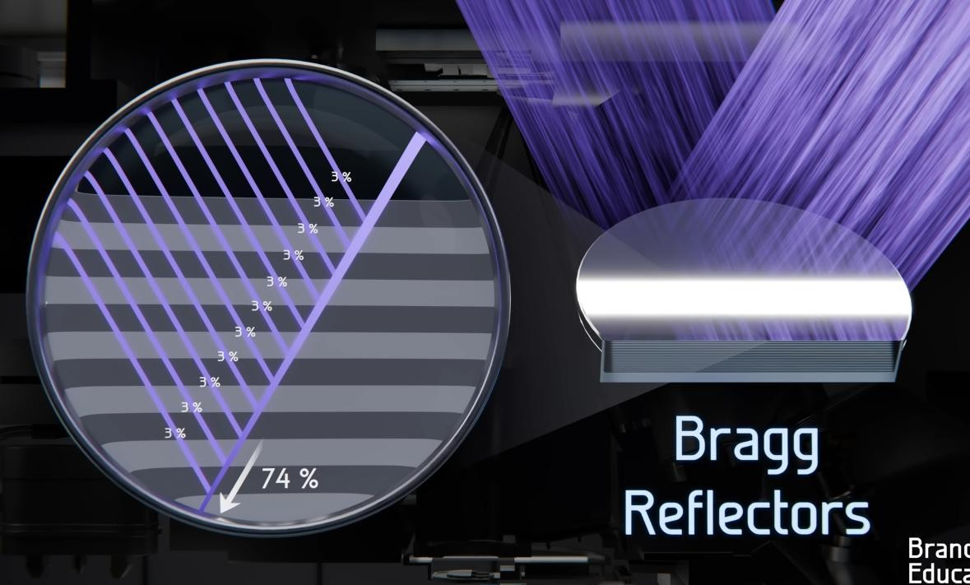
Construction: Bragg Reflectors
Bragg Reflectors Standard mirrors aren't smooth enough for EUV. Instead, the system uses Multi-Layer Mirrors:
~40 pairs of alternating layers of Molybdenum (Mo) and Silicon (Si).
Each layer is precisely a few nanometers thick to create constructive interference.
Reflectivity: Even these "perfect" mirrors only reflect about 70% of the light. The rest is absorbed as heat.
Reflectivity ~70% per mirror System efficiency ~2% .
13

Slide 15
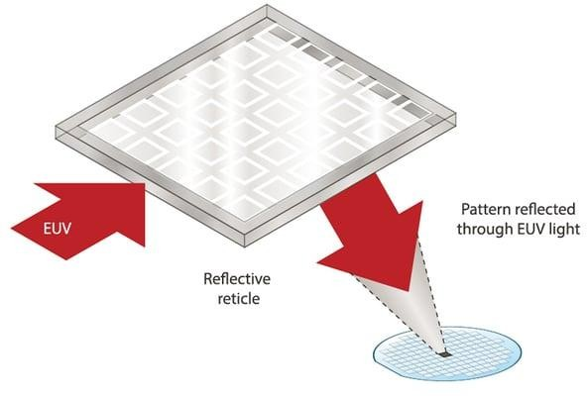
Operations of The Optical System
Mask: Unlike DUV masks (which are transparent), EUV masks are reflective. The pattern is etched into an absorber layer on top of a multi-layer mirror.
Projection Optics: A series of mirrors reduces the image (usually by 4x) and focuses it onto the silicon wafer.
14

Slide 16
Challenges of The Optical System
Challenge | Impact | Solution
Light Absorption | Light dies in air or glass. | The entire optical path is a near-total vacuum.
Thermal Expansion | Heat from absorbed light warps mirrors. | Mirrors are made of Ultra-Low Expansion (ULE) glass and actively cooled.
Surface Roughness | Atomic-scale bumps cause blur. | Mirrors are polished to a precision equivalent to "a bump the size of a marble on a road spanning from New York to San Francisco."
The Pellicle | Dust on the mask ruins the chip. | A specialized, ultra-thin silicon or carbon- nanotube membrane (pellicle) protects the mask while letting EUV pass.
15

Slide 17
EUV Evolution: Low-NA to High-NA
Parameter | Low-NA EUV (NXE:3400B/C) | Advanced Low-NA EUV (NXE:3600D) | High-NA EUV (EXE:5000)
Years of Application | 2019–present (HVM ramp-up) | 2022–present (volume production) | 2025–present (initial shipments)
Numerical Aperture (NA) | 0.33 | 0.33 | 0.55
Resolution (half-pitch) | ~13 nm | ~13 nm (improved productivity) | ~8 nm
Throughput (wafers/hour) | ~125–170 | ~170–200 | ~185–220
Processor Examples | TSMC/Samsung 5 nm/3 nm (e.g., Apple A16, Snapdragon 8 Gen 2) | TSMC/Samsung 3 nm/2 nm (e.g., Apple A18, NVIDIA Blackwell) | Intel 14A/1.4 nm, TSMC 1.6 nm (sub-2 nm logic)
16

Slide 18
References
[1] ASML, “EUV lithography systems – Products,” ASML. [Online]. Available: https://www.asml.com/en/products/euv-lithography-systems. [Accessed: Feb. 10, 2026]. ppl-ai-file-upload.s3.amazonaws
[2] ASML, “TWINSCAN EXE:5000 – EUV lithography systems,” ASML. [Online]. Available: https://www.asml.com/products/euv-lithography-systems/twinscan-exe-5000. [Accessed: Feb. 10, 2026]. dynotech-solutions
[3] ASML, “TWINSCAN NXE:3400C – EUV lithography,” ASML. [Online]. Available: https://www.asml.com/products/euv-lithography-systems/twinscan-nxe3400c. [Accessed: Feb. 10, 2026]. en.wikipedia
[4] World of Photonics, “EUV lithography—how does it work?,” World of Photonics. [Online]. Available: https://world-of-photonics.com/en/photonics-industry-portal/detail/euv-lithography.html. [Accessed: Feb. 10, 2026]. youtube
[5] imec, “High-NA EUV lithography: the next major step in lithography,” imec. [Online]. Available: https://www.imec-int.com/en/articles/high-na-euvl-next-major-step-lithography. [Accessed: Feb. 10, 2026]. stellarix
[6] imec, “Entering the High NA EUV Lithography era,” imec. [Online]. Available: https://www.imec-int.com/en/articles/entering-high-na-euv-lithography-era. [Accessed: Feb. 10, 2026]. linkedin
[7] Wikipedia, “Extreme ultraviolet lithography,” Wikipedia. [Online]. Available: https://en.wikipedia.org/wiki/Extreme_ultraviolet_lithography. [Accessed: Feb. 10, 2026]. asml
[8] Dynotech Solutions, “Innovations in Semiconductor Lithography Machines and Equipment,” Dynotech Solutions, Sep. 30, 2024. [Online]. Available: https://dynotech-solutions.com/blogs/innovations-in-semiconductor-lithography-machines-and-equipment/. [Accessed: Feb. 10, 2026]. oist
17

Slide 19
Thank You!

