Slide 1

EEE 400 A – Capstone Project
Supervisor: Dr. Ratil Hasnat
AUTONOMOUS PLASTIC WASTE COLLECTOR ROBOT
Present by
1.Md. Nahid Hasan 2022-1-80-037
2. Niaz Morshed Razon 2022-2-80-008
3. Faisal Hasan 2022-2-80-007
4. Md.Mainuddin Rhaman Eshan 2022-2-80-022
Date: 18th October, 2025

Slide 2
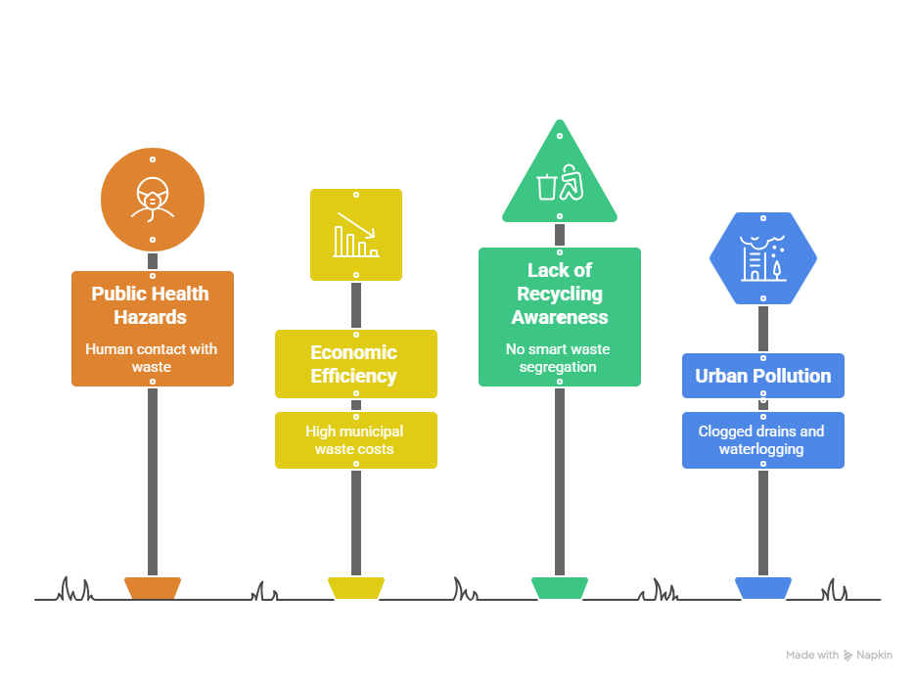
SOCIETAL RELEVANCE: Addressing the problem
2

Slide 3
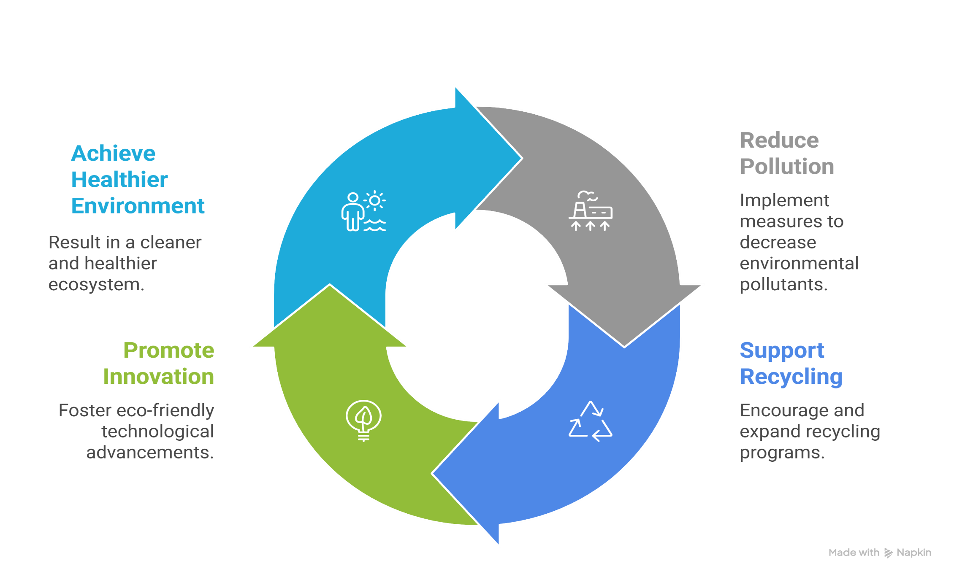
Societal Relevance and Motivation

Slide 4
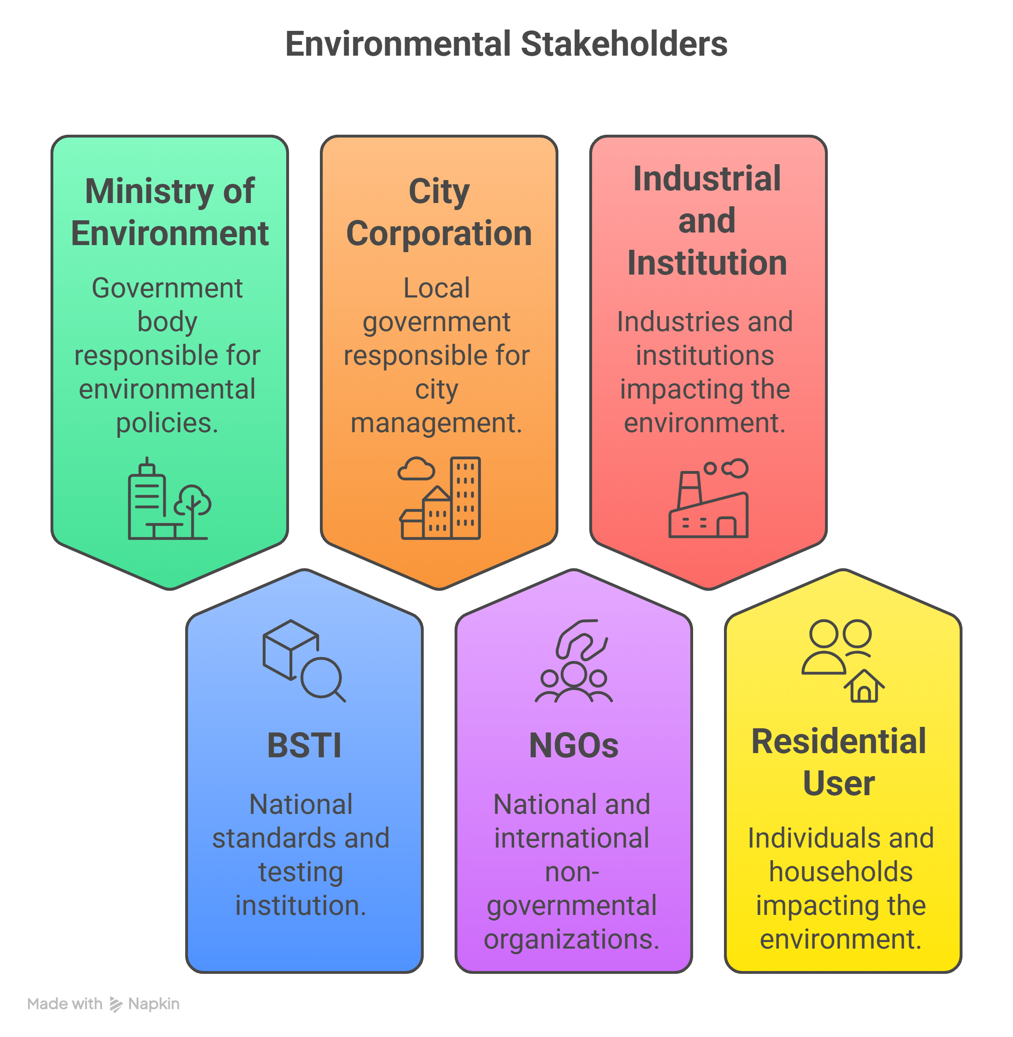

Stakeholders of Our Project

Slide 5
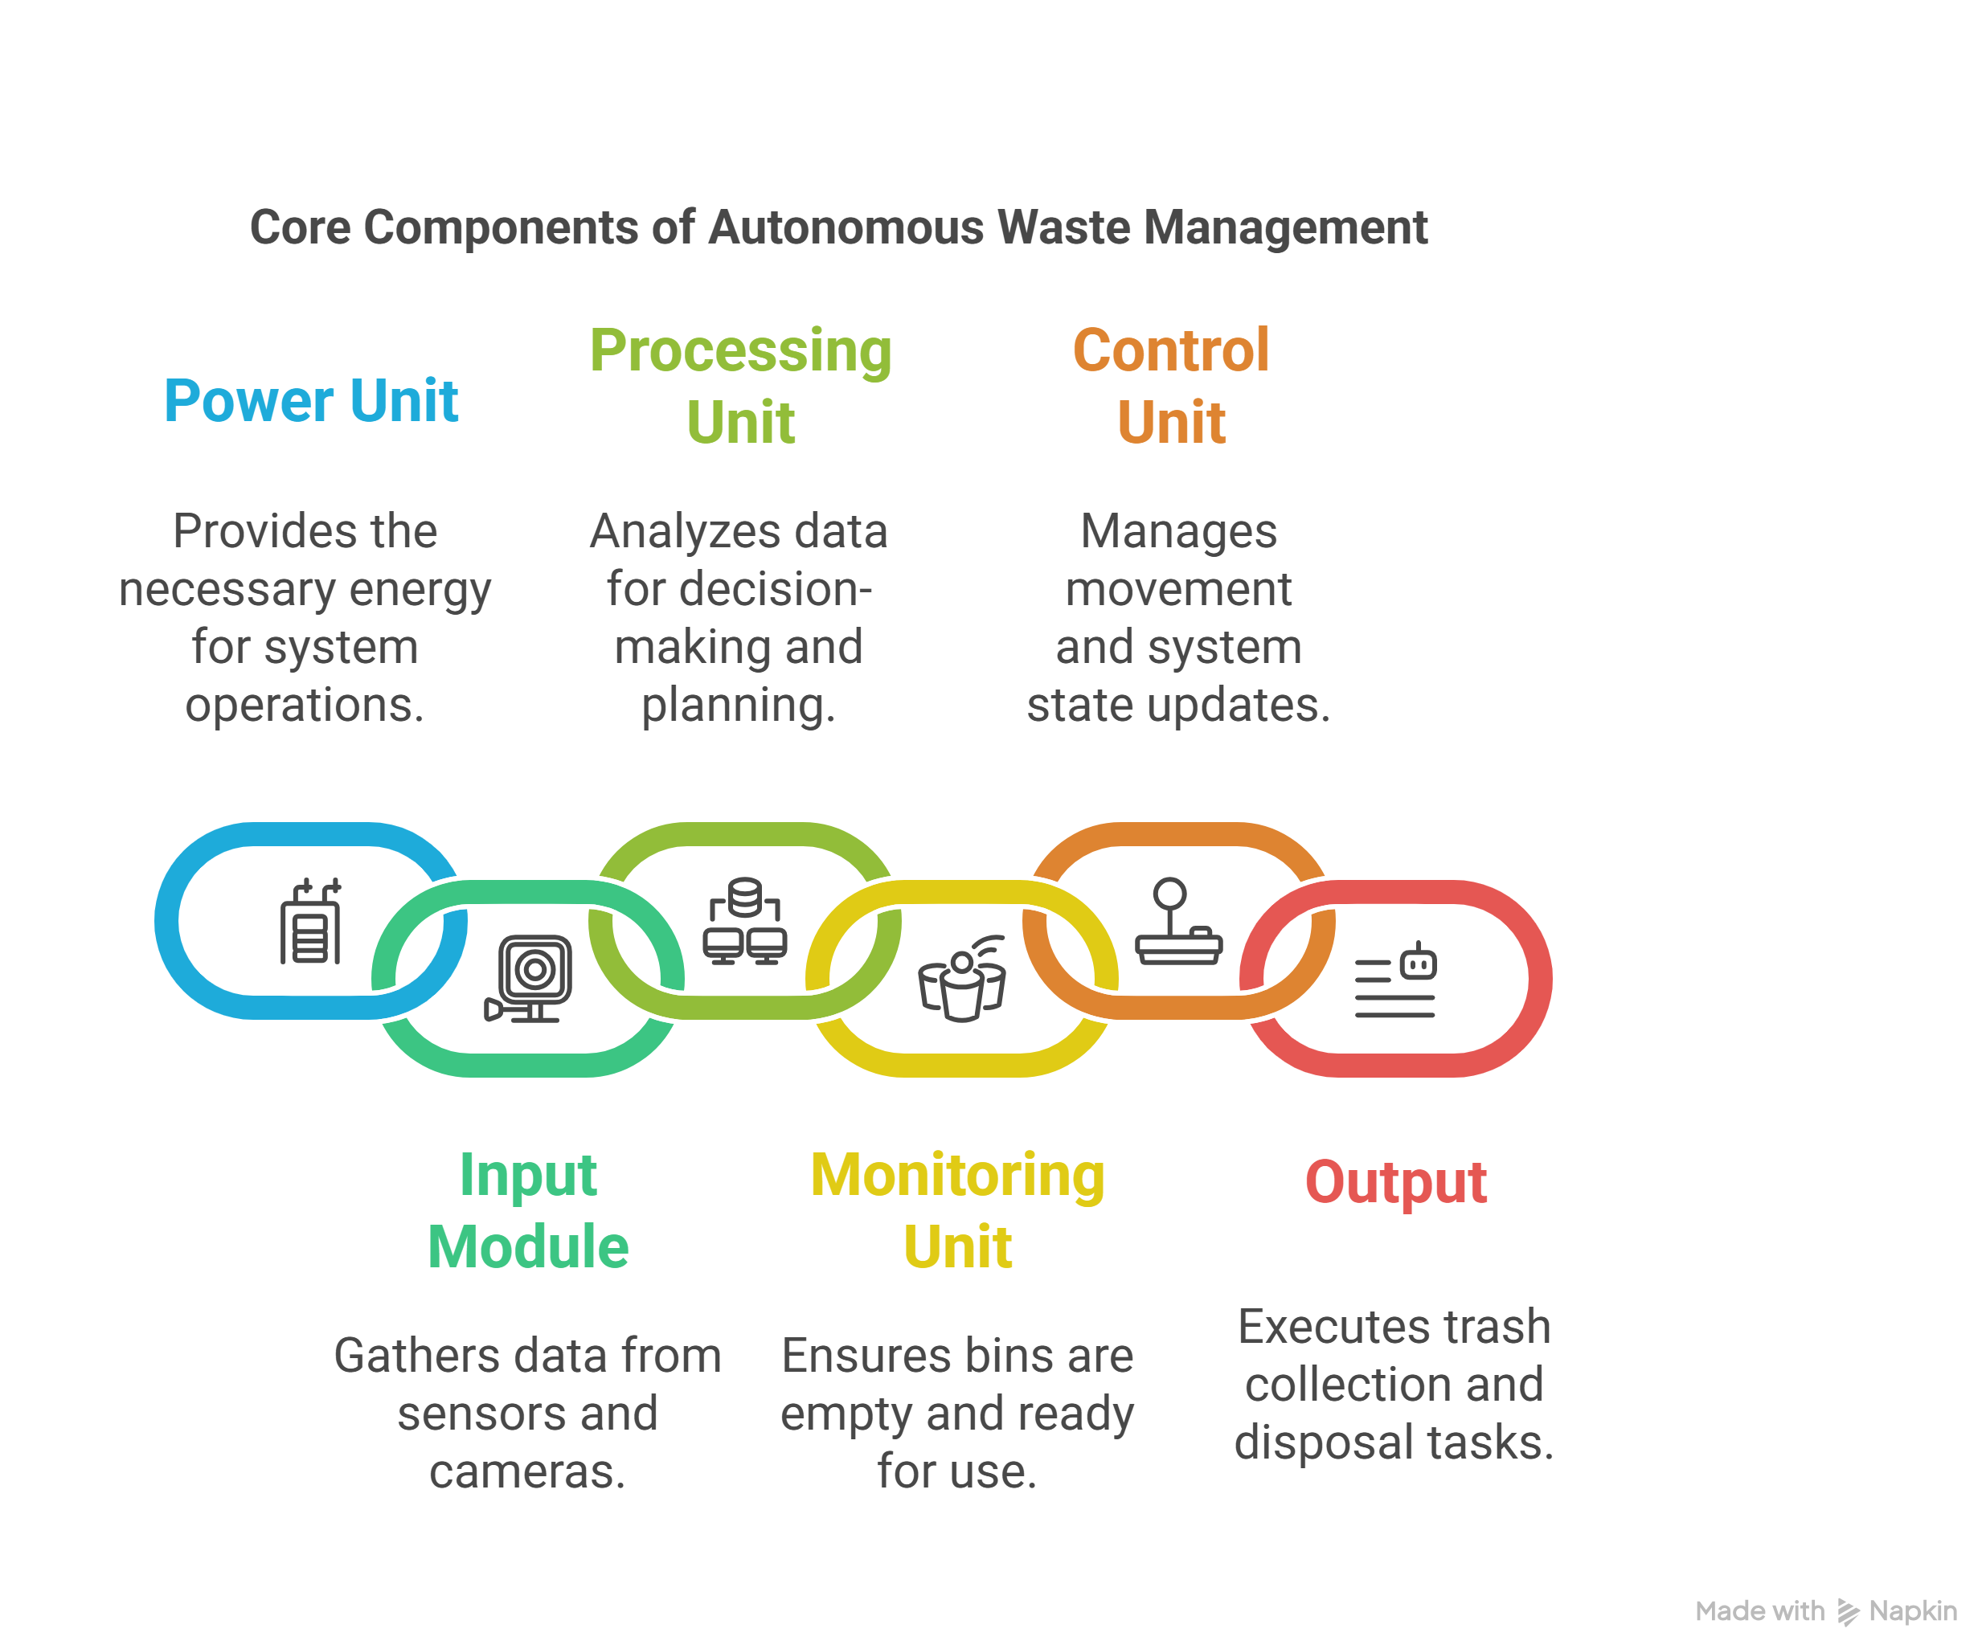
Block Diagram

Slide 6
Complex Engineering Problems
P1:Depth of knowledge required
Engineering fundamentals knowledge (K3)→
a) Knowledge of Electrical Circuits
b) Knowledge of Signals and Linear Systems c) Knowledge of IoT
Engineering specialist knowledge (K4)→
a) Knowledge of Machine Learning
b) Knowledge of Digital Signal Processing
c) Knowledge of Embedded Systems
Engineering design knowledge (K5)→
Knowledge of Control System
Knowledge of modern engineering tools (K6)→ : Microcontroller, Sensors, Proteus, Matlab
Research knowledge (K8)→ Literature Review

Slide 7



Complex Engineering Problems
P3: Depth of analysis required
Waste management
Microcontroller-based monitoring system.
Autonomous robot movement
Real time object detection
P6: Extent of stakeholder involvement and conflicting requirements
1.BSTI
2.Ministry of environment (forest and climate change )
3.City corporation and municipalities
P7. Interdependence
1. Microcontroller
2. Controls System
3.IoT System

Slide 8
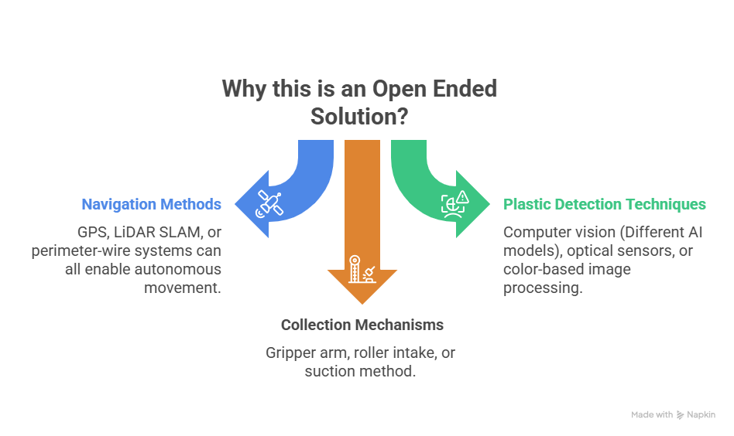

Slide 9


