Slide 1

King County, WA Housing Sales Data

Slide 2
How to maximize sales in King County, WA?
Pertinent questions:
Where are the houses with the highest sales price?
When to deploy more salespeople? (seasonality)
Which predictors/indicators to use to identify high value houses?

Slide 3
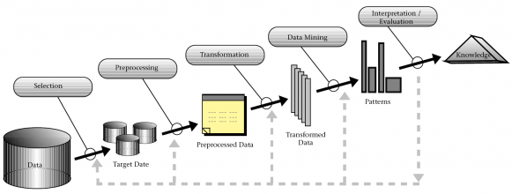
Data model - KDD
Notes:
Knowledge discovery in databases
Problem selection: How to help our company maximize sales?
Preprocessing: Cleaning data.
I realized that more than half of the data points in sqft_basement have the value of 0, and therefore I decided to drop that column entirely as it would be hard to work with.
I also dropped yr_renovated as only 651 data points are meaningful (e.g. non-zero).
And then I figured I could either fill all the NaNs in waterfront or drop the rows containing NaNs. Due to the concern of preserving data accuracy, I decided to drop the rows containing NaNs, since we only have about 2000 of them anyways.
Transformation: I started with checking the linearity of the discrete independent variables against our target variable price by plotting boxplots so I could decide which ones to bin and which ones I can straight up get dummy variables from. Creating dummies for discrete variables.
The continuous features all appear to be skewed and need transformation
Log transform all except for lat.
Log transform price
Then standardize all the continuous features.
Drop sqft_above due to multicollinearity
Data mining: using the multiple linear regression. Use recursive feature elimination from scikit learn feature_selection
And scikit learn linear_model, import linear regression
Data accuracy was 76%
Interpretation: recommendations

Slide 4
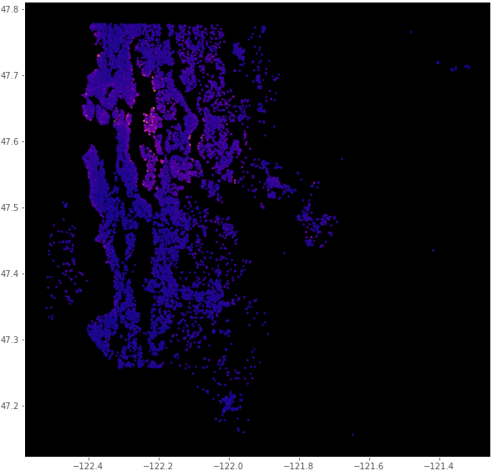
Where to deploy our top salespeople?

Slide 5
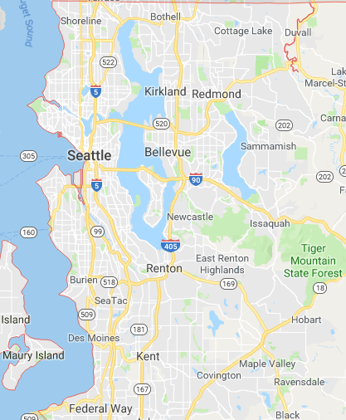

Slide 6
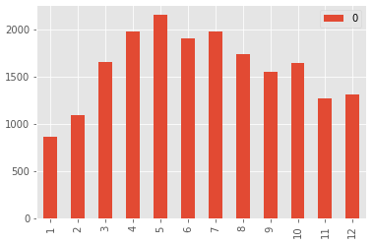
When do we need to deploy more salespeople in these areas?

Slide 7
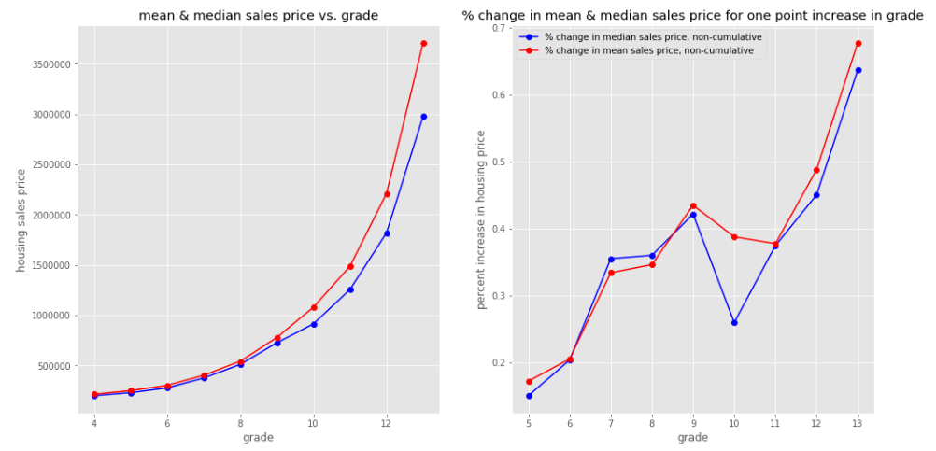
Grade as an indicator
Notes:
grade** - overall grade given to the housing unit, based on King County grading system

Slide 8
Further exploration
Explore waterfront and bathroom as predictors
Explore frequency of sales and seasonality in each price bucket separately
Bucket zip code more precisely for better prediction power
Find common characteristics of houses that sold for greater than the median or mean price of houses similar in size and location
Or in the same grade basket

