Slide 1
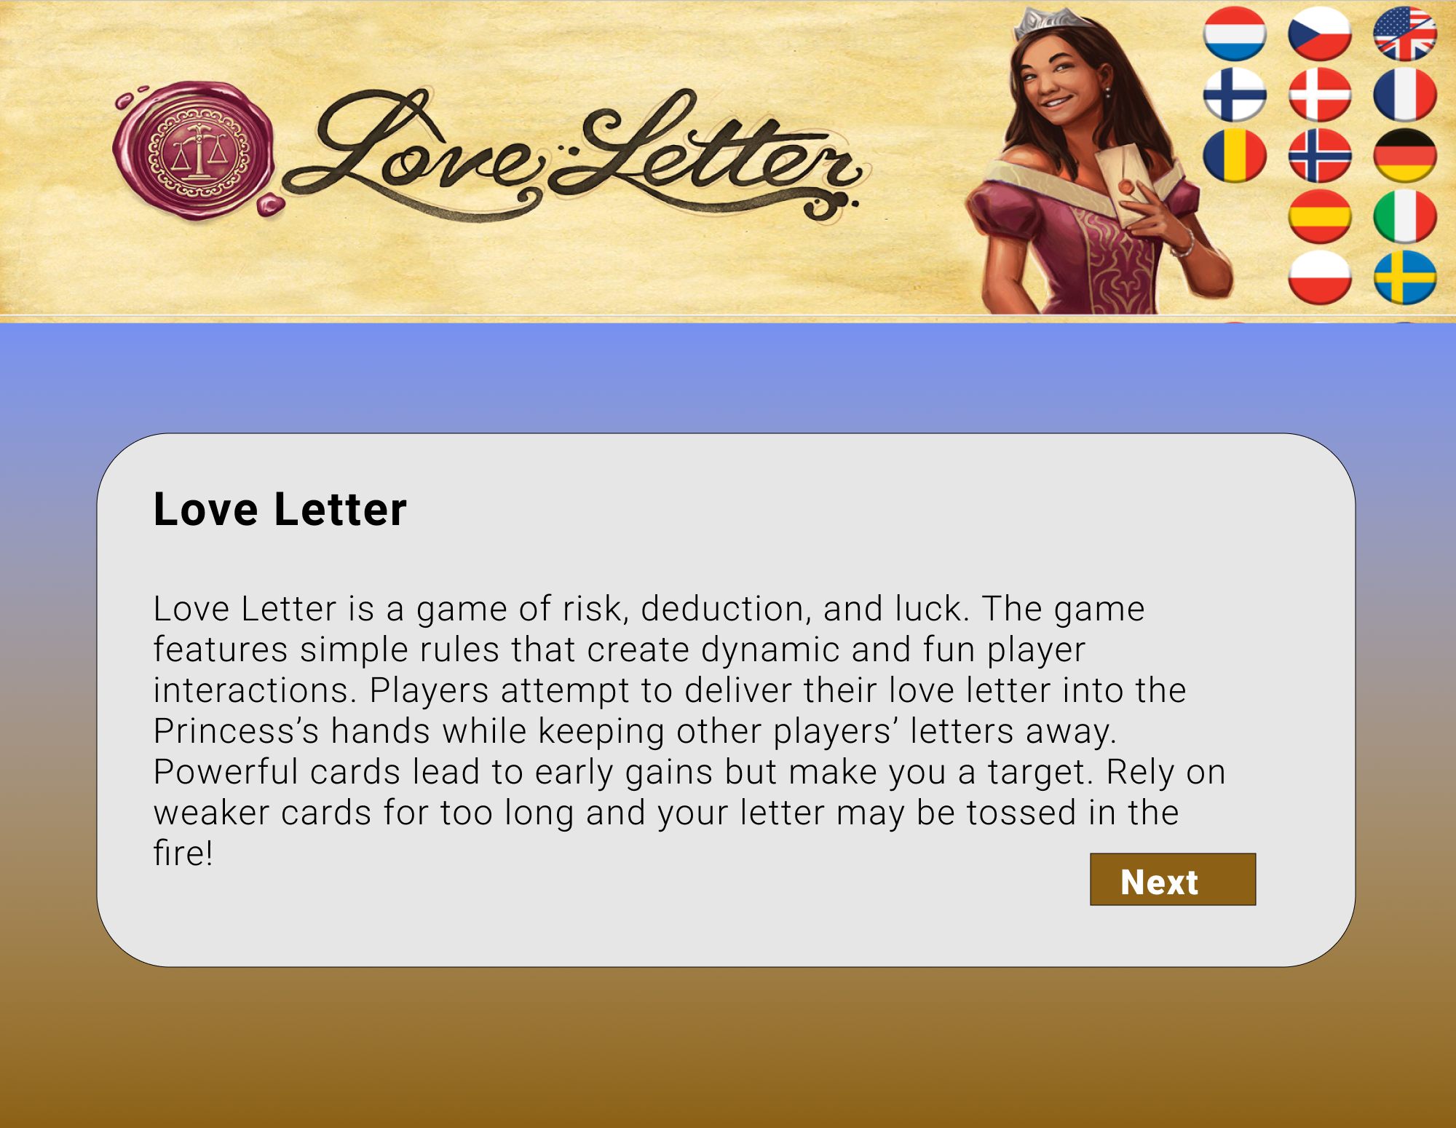
LoveLetter Game
Love Letter
1
Hello

