Slide 1
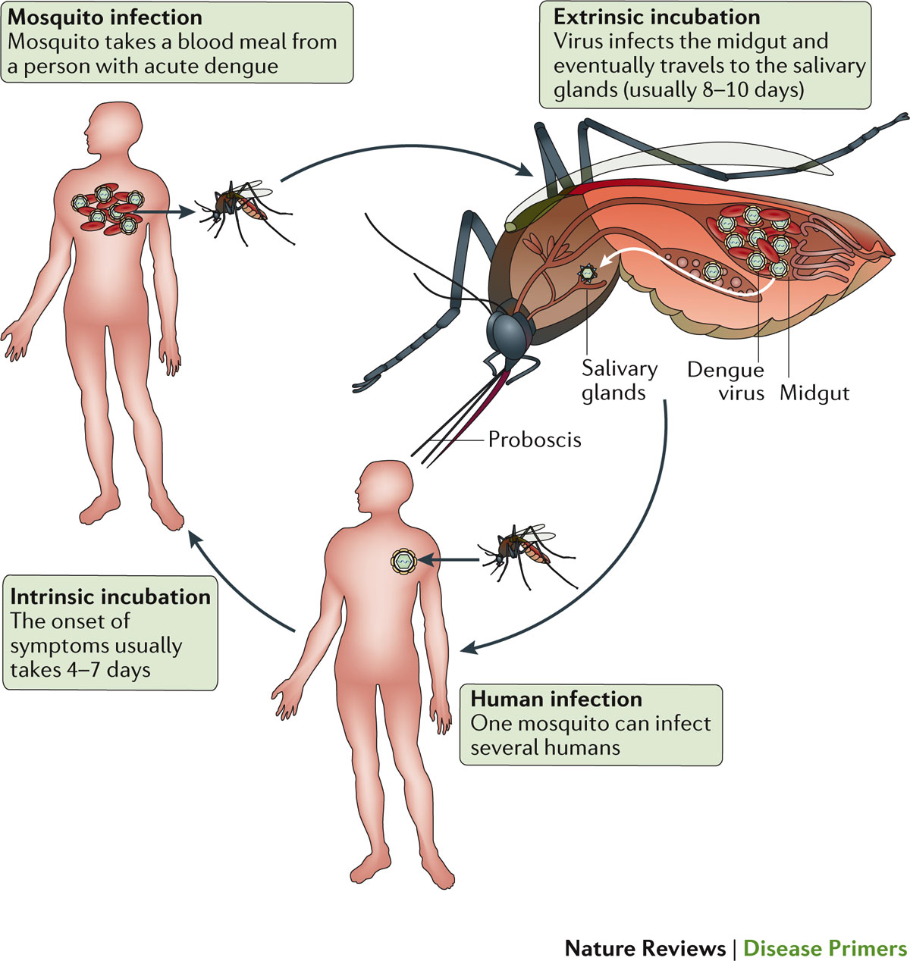
Figure 2 The urban dengue virus cycle in humans and mosquitoes
Guzman, M. G. et al. (2016) Dengue infection
Nat. Rev. Dis. Primers doi:10.1038/nrdp.2016.55

