Slide 1

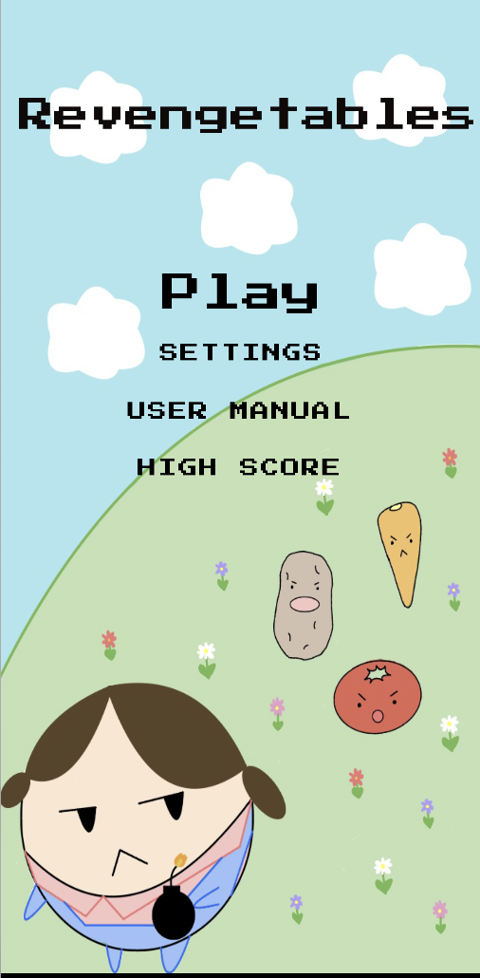
Revengetables
Harman Singh
Nicolas Malamug
Bennett Taylor
Joscelynn Palen
Maiko Lum
COMING SOON
Google Play

Slide 2
01
the inVASION…

Slide 3





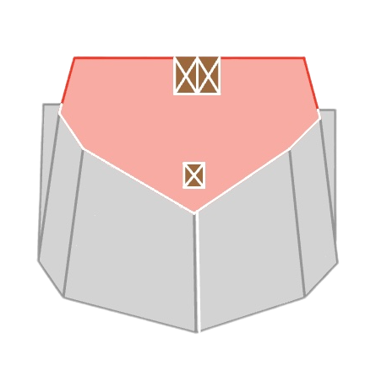
Infectious vegetables have infiltrated the farm and it is your responsibility to protect the crops and the farm!
You will have a variety of farmers to choose from that have their own special abilities :
DEBBIE is a farmer by day, and demolitions expert by night! In an instant, she can blow away hoards of vegetables via a dazzling explosion! Kaboom!
GERALDO was once a professional fencer, but he enjoys his retirement tending to his farm. A pitchfork pro, he dashes through battalions of vegetables with style! En Garde!

Slide 4
02
Requirements & Features

Slide 5
Requirements
Moving graphical pieces.
Farmer, Infected Vegetables
The ability of the user to control some of the moving pieces through input.
Farmer responds to an input from the user ⇒ touching and dragging
Include a score that is changed based on the user satisfying requirements.
Score is incremented based on
Time elapsed
Number and type of monsters killed
Features
High-score list that persists when the app is closed and then reopened.
Allow the user to tweak the rules of the game being played.
Types of Farmer Movements
the DASHING farmer
the EXPlOSIVE farmer
Difficulty
Easy, Medium, Hard
Music on/off
Integrated sound effects for
Home Screen
Lose Screen
Button Clicks
C++ Backend

Slide 6
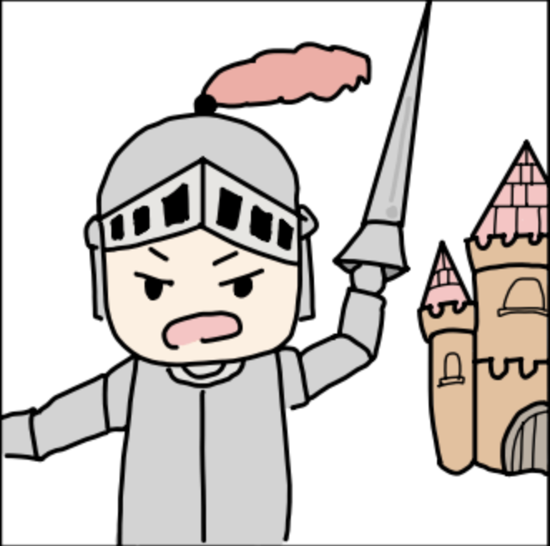
Design Development
We started with the concept of 'Knight's Labyrinth', where a brave knight defended a castle from attacking monsters.
However, we wanted to create a game that could appeal to a wider audience and decided to pivot towards a more universally loved game.
Thus, we developed a new concept that would provide an engaging and exciting experience for players of all ages and interests.
Original concept art for Knight’s Labyrinth

Slide 7
03
Project Demos

Slide 8
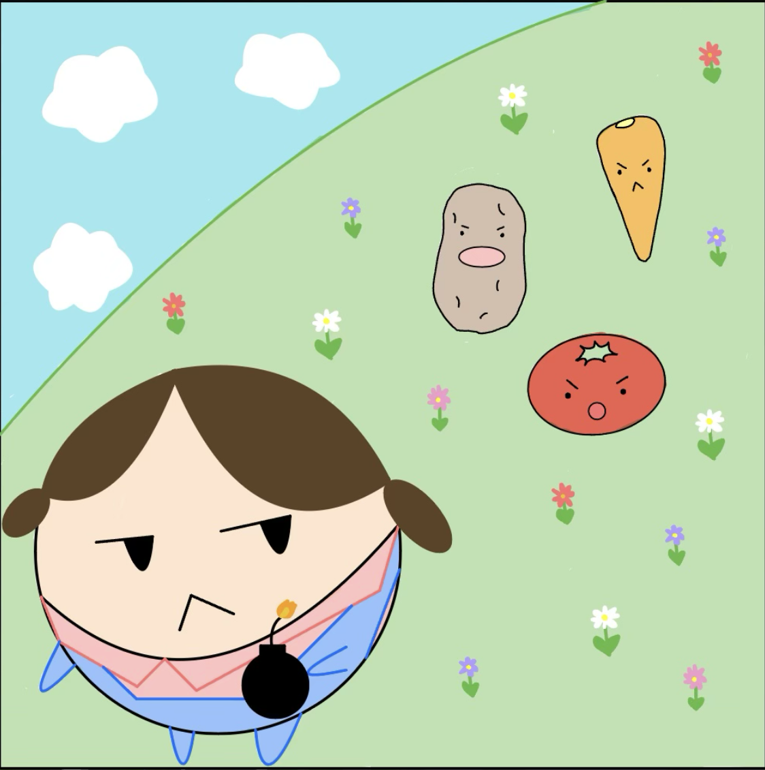
Put your app logo
Logo

Slide 9
LIVE DEMONSTRATIONS + GAMEPLAY

Slide 10
04
Obstacles and Future Implementations

Slide 11
As we navigated through this project, we came across numerous issues:
We had to adjust to the large scale of the project
Created a system to keep git repo organized
Learning the tools and levels of abstraction in Android Studio
Binding/fragments
Setting up SDK, NDK, and emulator
Gradle
Remaining Deliverables:
Unit Testing
Proper Documentation
Additional Features/Polishing of existing features to improve user experience
Improvements:
Use activities rather than fragments.
Create separate classes instead of switch statements for each monster rather than combining them into one case system.
More efficient - frontloads processing
Less chance of error
Use Gitlab for issues and documentation
Although we were able to accomplish all of the deliverables, we fell short in a few categories:
Sound effects were added, however, we did not incorporate any sound effects for the special ability of each farmer
The C++ backend did nearly all calculations
we had a few functions in Backend that were more compatible with Java than C++
The ScoreBoard could have used player names.

Slide 12
Thank You
Any Questions?

