Slide 1
AZ-400.2 Module 01: Implementing Continuous Integration in an Azure DevOps Pipeline

Slide 2
Lesson 01: Continuous Integration Overview

Slide 3
Lesson 1 Overview
Introduction to Continuous Integration
The Four Pillars of Continuous Integration
Benefits of Continuous Integration
Continuous Integration Implementation Challenges
Implementing Continuous Integration in Azure DevOps
Using Variables to Avoid Hard-coded Values
Build Number Formatting and Build Status
Build Authorizations, Timeouts, and Badges
Configuring Build Retention
Lab - Enabling Continuous Integration with Azure Pipelines

Slide 4
Video: Introduction to Continuous Integration
Continuous Integration (CI) is the process of automating the build and testing of code.
CI encourages developers to share their code and unit tests by merging their changes into the shared version control repository.
When a change is detected it triggers an automated build system. The code is built using a build definition. Developers respond to any issues or bugs.
CI keeps the master branch clean ensuring bugs are caught earlier in the development cycle, which makes them less expensive to fix.
Notes:
Introduction to Continuous Integration - https://www.youtube.com/watch?v=4gAe6JQi8L4

Slide 5
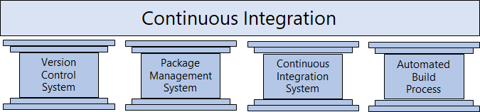
The Four Pillars of Continuous Integration
A Version Control System manages changes to your source code over time.
A Package Management System is used to install, uninstall and manage software packages.
A Continuous Integration System merges all developer working copies to a shared mainline several times a day.
An Automated Build Process creates a software build including compiling, packaging, and running automated tests.
Notes:
Cover the software examples shown in the student materials.

Slide 6
Benefits of Continuous Integration
Improving code quality based on rapid feedback
Triggering automated testing for every code change
Reducing build times for rapid feedback and early detection of problems (risk reduction)
Better management of technical debt and code analysis
Reducing long, difficult, and bug-inducing merges
Increasing confidence in codebase health long before production deployment
Rapid feedback to the developer
Notes:
✔️ Continuous integration also enables tracking metrics to assess code quality over time, such as unit test pass rates, code that breaks frequently, code coverage trends, and code analysis. It can be used to provide information on what has been changed between builds for traceability benefits, as well as for introducing evidence of what teams do in order to have a global view of build results.
For more information, you can see: What is Continuous Integration? - https://docs.microsoft.com/en-us/azure/devops/learn/what-is-continuous-integration

Slide 7
Discussion: Continuous Integration
Have you tried to implement continuous integration in your organization?
If you where successful, what lessons did you learn?
If you were not successful, what were the challenges?

Slide 8
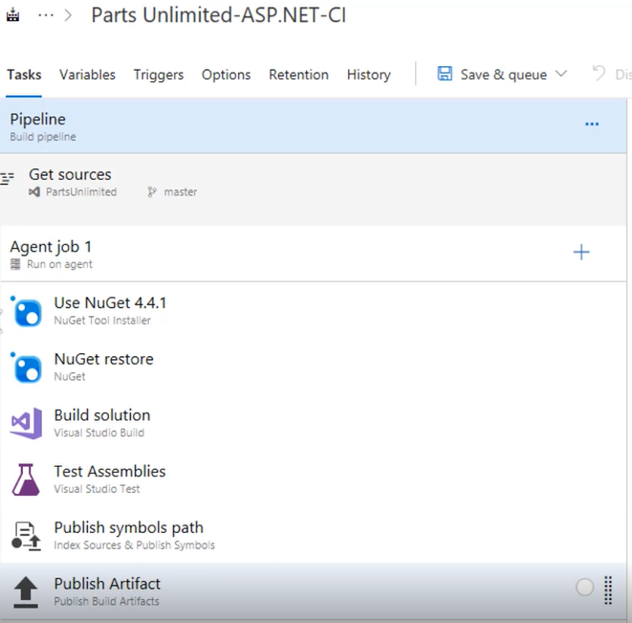
Demonstration: Implementating Continuous Integration in Azure DevOps
Notes:
Implementing Continuous Integration in Azure DevOps - https://www.youtube.com/watch?v=swd_0burbhI

Slide 9
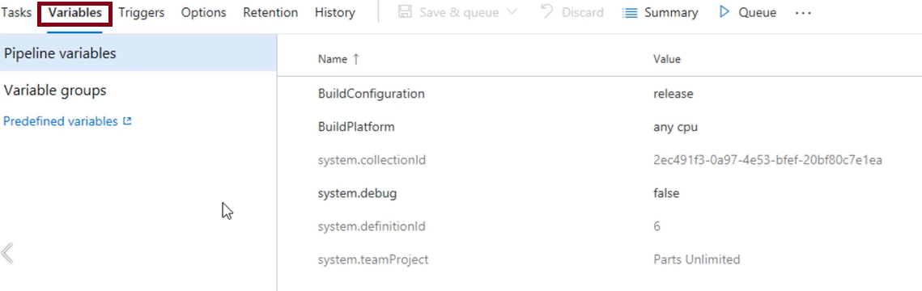
Demonstration: Using Variables to Avoid Hard-coded Values
Notes:
For more information, you can see: Predefined Build Variables - https://docs.microsoft.com/en-us/azure/devops/pipelines/build/variables?view=vsts
Using Variables to Avoid Hard-coded Values - https://www.youtube.com/watch?v=dRFgqaJDTlw

Slide 10
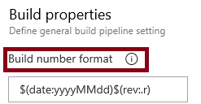
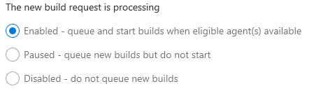
Build Number Formatting and Build Status
Build number formatting
Build status (enabled, paused, disabled)
Notes:
For more information, you can see:
Build Pipeline Options - https://docs.microsoft.com/en-us/azure/devops/pipelines/build/options?view=vsts&tabs=yaml

Slide 11
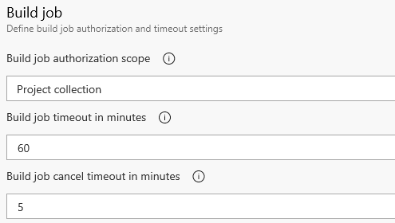

Authorization and Timeouts, and Badges
Authorization and Timeouts (scope, job timeout, cancel job timeout)
Badges
Notes:
For more information, you can see:
Build Pipeline Options - https://docs.microsoft.com/en-us/azure/devops/pipelines/build/options?view=vsts&tabs=yaml

Slide 12
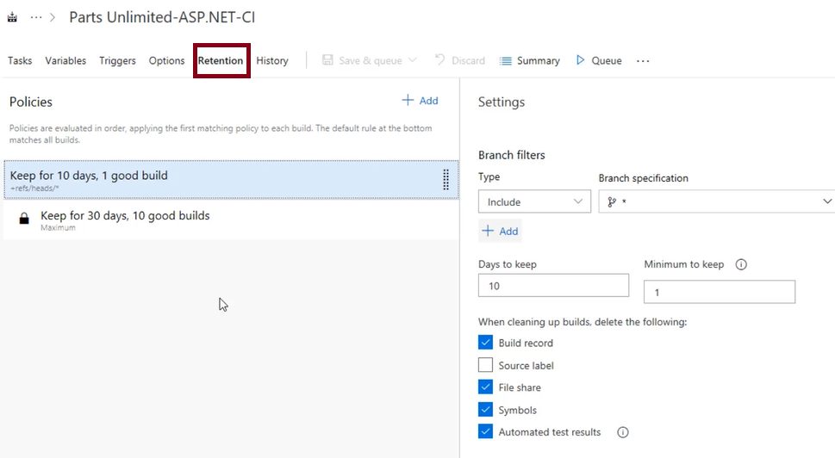
Video: Configuring Build Retention
Notes:
Configuring Build Retention - https://www.youtube.com/watch?v=q-HMPLwu8-0

Slide 13
Lab: Enabling Continuous Integration with Azure Pipelines
In this hands-on lab, you will learn how to configure continuous integration with Azure Pipelines. You will perform the following tasks:
Creating a basic build pipeline from a template
Tracking and reviewing a build
Invoking a continuous integration build
✔️ Note that you must have already completed the prerequisite labs in the Welcome section.
Notes:
✔️ Note that you must have already completed the prerequisite labs in the Welcome section.
Enabling Continuous Integration with Azure Pipelines - https://www.azuredevopslabs.com/labs/azuredevops/continuousintegration/

Slide 14
Lesson 02: Implementing a Build Strategy

Slide 15
Lesson 2 Overview
Automated Build Workflows
Implementing Build Triggers
Working with Hosted Agents
Implementing a Hybrid Build Process
Configuring Agent Demands
Implementing Multi-Agent Builds
Build-Related Tooling
Creating a Jenkins Build Job and Triggering CI

Slide 16
Video: Automated Build Workflows
Azure DevOps can automate a custom workflow that's as large and complex as you need
Agile teams normally require more than one type of build
Builds are typically triggered automatically when code is committed
Builds can also be scheduled – such as a daily build
Notes:
Automated Build Workflows - https://www.youtube.com/watch?v=wJKCI3zsQfY

Slide 17
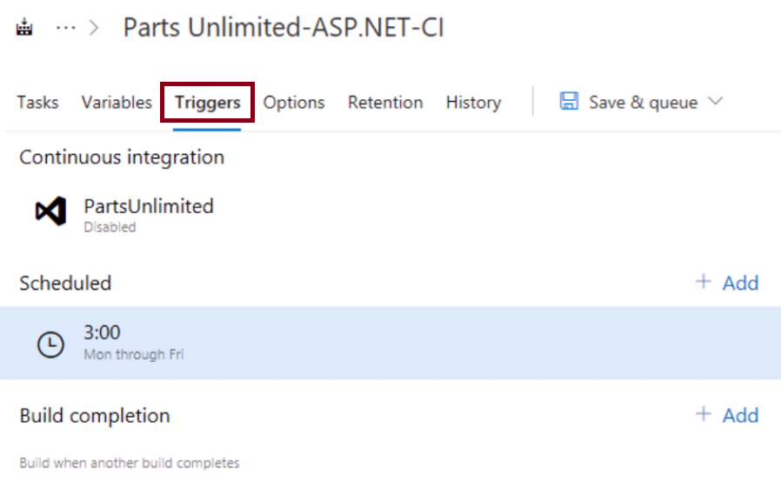
Video: Implementing Build Triggers
Notes:
Implementing Build Triggers -https://www.youtube.com/watch?v=3Bu7CLePL3E

Slide 18
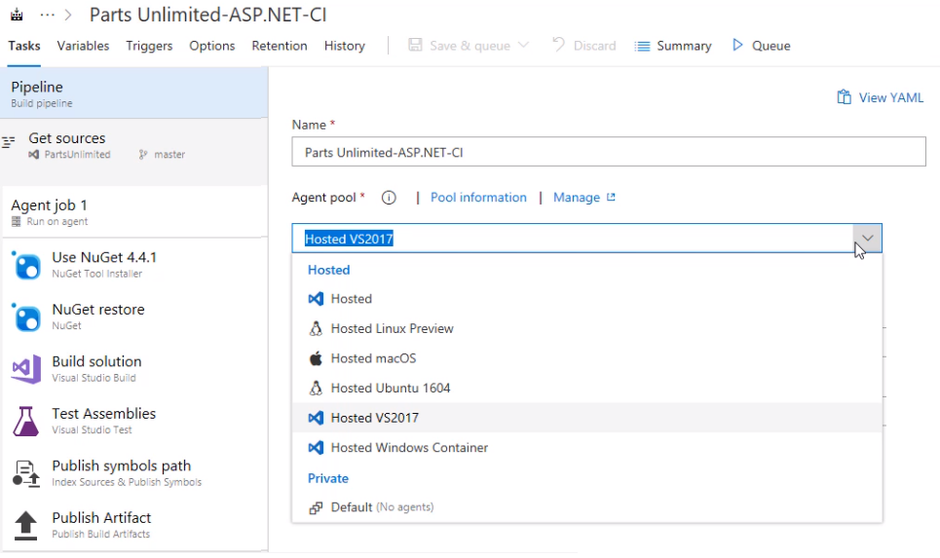
Video: Working with Hosted Agents
Notes:
Working with Hosted Agents - https://www.youtube.com/watch?v=yjZWPExCjE8

Slide 19
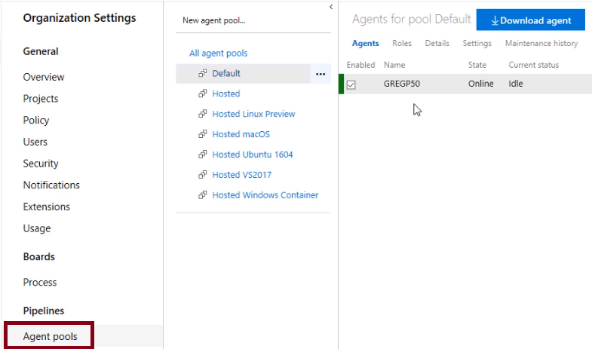
Video: Implementing a Hybrid Build Process
Notes:
Implementing a Hybrid Build Process - https://www.youtube.com/watch?v=DDcc7dpWMw8

Slide 20
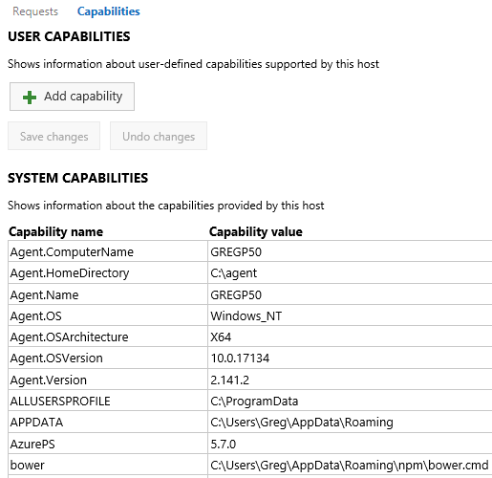
Configuring Agent Demands
User Capabilities
System Capabilities
Agents can have different authorization and timeout settings
Notes:
For more information, you can see: Capabilities - https://docs.microsoft.com/en-us/azure/devops/pipelines/agents/agents?view=vsts#capabilities

Slide 21
Implementing Multi-Agent Builds
Adding multiple jobs to a pipeline lets you:
Break your pipeline into sections that need different agent pools, or self-hosted agents
Publish artifacts in one job and consume them in one or more subsequent jobs
Build faster by running multiple jobs in parallel
Enable conditional execution of tasks
✔️ You can configure the number of parallel jobs
Notes:
✔️ You can define a build as a collection of jobs, rather than as a single job. Each job consumes one of these parallel jobs that runs on an agent. If there aren't enough parallel jobs available for your organization, the jobs will be queued and run sequentially.

Slide 22
Discussion: Build-Related Tooling
Azure DevOps can be integrated with a wide range of existing tooling that is used for builds or associated with builds.
Which build-related tools do you currently use?
What do you like or don't like about the tools?

Slide 23
Lab: Creating a Jenkins Build Job and Triggering CI
In this hands-on lab, you will learn how to create a build job in Jenkins and to enable continuous integration. You will learn how to:
Provision Jenkins on Azure VM using the Jenkins template available on the Azure Marketplace
Configure Jenkins to work with Maven and Azure DevOps
Create a build job in Jenkins
Configure Azure Pipeline to integrate with Jenkins
Configure a CD pipeline in Azure Pipelines to deploy the build artifacts
✔️ In this lab, you will try two approaches to triggering continuous integration
Notes:
Integrating Jenkins CI with Azure Pipelines -https://www.azuredevopslabs.com/labs/vstsextend/jenkins/

Slide 24
Module 1: Review Questions
What are the four pillars of continuous integration?
The build numbers that Azure DevOps generates for you are currently integers. If you would prefer the build to include the date, how would you change this?
You want to take your build server offline to make a configuration change. You want it to complete any build that it is currently processing, but you want to queue any new build requests. What should you do?
You want to set a maximum time that builds should not run for more than 5 minutes. What configuration change should you make?
The hands-on lab for Creating a Jenkins Build Job and Triggering CI described two methods that could be used to enable continuous integration for Jenkins. What were the two methods?
Notes:
Q1 Answer: The four pillars of continuous integration are: a Version Control System, Packet Management System, Continuous Integration System, and an Automated Build Process.
Q2 Answer: The Build Options tab for a build includes the format for build number generation.
Q3 Answer: You should pause the build. A paused build will not start new builds and will queue any new build requests.
Q4 Answer: You should change the build job timeout setting to 5 minutes. A blank value means unlimited.
Q5 Answer: In the hands-on lab, the two methods described were triggering the CI via a service hook in Azure DevOps, and wrapping the Jenkins job within Azure Pipelines.

