Slide 1
AZ-400.2 Module 02: Managing Code Quality and Security Policies

Slide 2
Lesson 01: Managing Code Quality

Slide 3
Lesson 1 Overview
Code Quality Defined
Sources and Impacts of Technical Debt
Using Automated Testing to Measure and Monitor Technical Debt
Configuring SonarCloud in a Build Pipeline
Reviewing SonarCloud Results and Resolving Issues
Integrating Other Code Quality Tools
Code Quality Tooling
Managing Technical Debt with Azure DevOps and SonarCloud

Slide 4
Video: Code Quality Defined
Short deadlines, a lack of coding standards, and poor technical skills can lead to code that is NOT:
Clear and readable
Documented
Efficient
Maintainable
Extensible
Secure
Notes:
Code Quality Defined - https://www.youtube.com/watch?v=PwF09SwNk90

Slide 5
Sources and Impacts of Technical Debt
Technical Debt describes the future penalty that you incur today by making easy or quick choices in software development practices.
Common sources of technical debt are:
Lack of coding style and standards
Lack of or poor design of unit test cases
Ignoring or not understanding object orient design principles
Monolithic classes and code libraries
Poorly envisioned use of technology, architecture and approach
Over-engineering code
Insufficient comments and documentation
Not writing self-documenting code
Taking shortcuts to meet deadlines
Leaving dead code in place

Slide 6
Using Automated Testing to Measure Technical Debt
Technical debt:
Adds problems during development that makes it more difficult to add customer value
Saps productivity and frustrates development teams
Makes code both hard to understand and fragile
Increases the time to make changes, and to validate those changes
Starts small and grows over time
✔️ One way to minimize the accumulation of technical debt, is to use automated testing and assessment
Notes:
For more information, you can see:
SonarCloud - https://sonarcloud.io/about

Slide 7
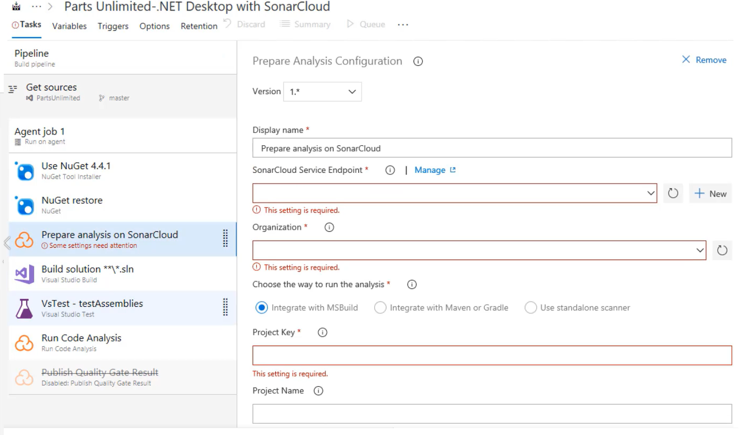
Demonstration: Configuring SonarCloud in a Build Pipeline
Notes:
Configuring SonarCloud in a Build Pipeline - https://www.youtube.com/watch?v=XhgNyF-TwDQ

Slide 8
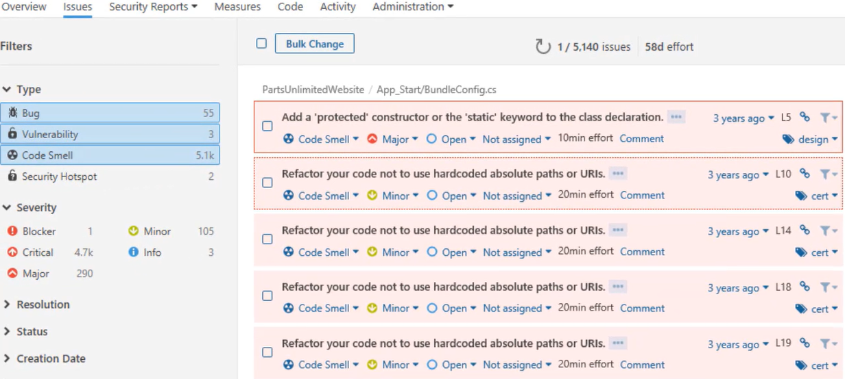
Demonstration: Reviewing SonarCloud Results and Resolving Issues
Notes:
Reviewing SonarCloud Results and Resolving Issues - https://www.youtube.com/watch?v=uOkCl3GzSOw

Slide 9
Integrating Other Code Quality Tools
NDepend is a Visual Studio extension that assesses the amount of technical debt that a developer has added during a recent development period, typically in the last hour
Resharper Code Quality Analysis is a command line tool and can be set to automatically fail builds when code quality issues are found
Notes:
For more information, you can see:
NDepend - https://www.ndepend.com
Visual Studio marketplace - https://marketplace.visualstudio.com/items?itemName=ndepend.ndependextension&targetId=2ec491f3-0a97-4e53-bfef-20bf80c7e1ea
Resharper Code Quality Analysis - https://marketplace.visualstudio.com/items?itemName=alanwales.resharper-code-analysis

Slide 10
Discussion: Code Quality Tooling
Azure DevOps can be integrated with a wide range of existing tooling that is used for checking code quality during builds.
Which code quality tools do you currently use (if any)?
What do you like or don't like about the tools?

Slide 11
Lab: Managing Technical Debt with Azure DevOps and SonarCloud
In this hands-on lab, you will learn how to manage and report on technical debt using SonarCloud integration with Azure DevOps. You will perform the following tasks:
Integrate SonarCloud with Azure DevOps and run an analysis
Analyze the results
Configure a quality profile to control the rule set used for analyzing your project
✔️ Note that you must have already completed the prerequisite labs in the Welcome section.
Notes:
✔️ Note that you must have already completed the prerequisite labs in the Welcome section.
Managing Technical Debt with Azure DevOps and SonarCloud -https://www.azuredevopslabs.com/labs/azuredevops/sonarcloud/

Slide 12
Lesson 02: Managing Security Policies

Slide 13
Lesson 2 Overview
Open Source Licensing Challenges
Avoiding the OWASP Top Ten
Detecting Open Source Issues with WhiteSource Bolt
Integrating Other Security Policy Tooling
Security Policy Tooling
Checking Vulnerabilities using WhiteSource Bolt and Azure DevOps

Slide 14
Video: Open Source Licensing Challenges
Open source software is code that everyone can read, modify, enhance, and share
Incorporating open source code is convenient but can cause issues:
Security
Quality
Old versions
Licensing
Minimize risk by implementing automated systems to manage the code
Notes:
Open Source Licensing Challenges – https://www.youtube.com/watch?v=XLrPryCen6U
For more information, you can see:
Common Vulnerabilities and Exposures - https://cve.mitre.org/about/

Slide 15
Video: Avoiding OWASP Top Ten
Injection Attacks
Broken Authentication
Sensitive Data Exposure
XML External Entities
Broken Access Control
Notes:
Avoiding OWASP Top Ten – https://www.youtube.com/watch?v=x_Z4_ap2BfY
For more information, you can see:
OWASP Top Ten - https://www.owasp.org/index.php/Category:OWASP_Top_Ten_Project

Slide 16
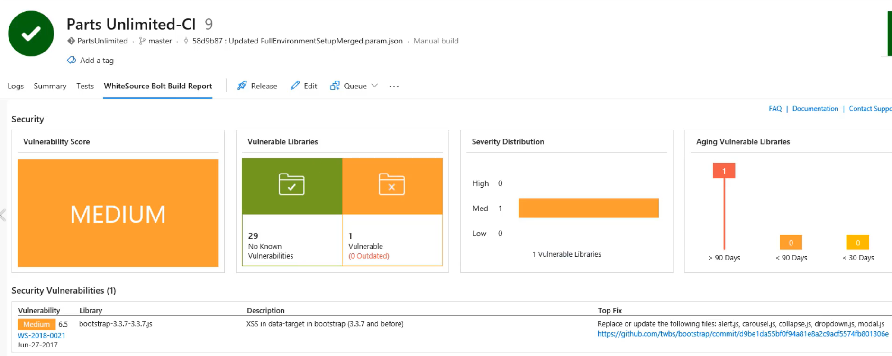
Demonstration: Detecting Open Source Issues with WhiteSource Bolt
Notes:
Detecting Open Source Issues with WhiteSource Bolt - https://www.youtube.com/watch?v=OhxCgZHPY_U

Slide 17
Integrating Other Security Policy Tooling
Micro Focus Fortify searches for violations of security-specific coding rules and guidelines
Checkmarx CxSAST is designed for identifying, tracking and fixing technical and logical security flaws
BinSkim is a static analysis tool that scans binary files
OWASP Zed Attack Proxy Scan is an open-source web application for professional penetration testers
Notes:
For more information, you can see:
Fortify - https://marketplace.visualstudio.com/items?itemName=fortifyvsts.hpe-security-fortify-vsts
Checkmarx CxSAST - https://marketplace.visualstudio.com/items?itemName=checkmarx.cxsast
OWASP Zed Attack Proxy Scan - https://marketplace.visualstudio.com/items?itemName=kasunkodagoda.owasp-zap-scan
BinSkim - https://blogs.msdn.microsoft.com/secdevblog/2016/08/17/introducing-binskim/

Slide 18
Discussion: Security Policy Tooling
Azure DevOps can be integrated with a wide range of existing tooling that is used for checking security policy during builds.
Which security policy tools do you currently use?
What do you like or don't like about the tools?

Slide 19
Lab: Checking Vulnerabilities using WhiteSource Bolt with Visual Studio Team Services
In this hands-on lab, you will learn how to check for open source vulnerabilities using WhiteSource Bolt in conjunction with Azure DevOps. You will learn how to:
Integrate WhiteSource Bolt with you Azure DevOps build process
Detect and remedy vulnerable open source components
Generate comprehensive open source inventory reports per project or build
Enforce open source license compliance, including licenses for dependencies
Identify outdated open source libraries with recommendations to update
✔️ Note that you must have already completed the prerequisite labs in the Welcome section.
Notes:
Checking Vulnerabilities using WhiteSource Bolt with Visual Studio Team Services - https://www.azuredevopslabs.com/labs/vstsextend/WhiteSource/
✔️ Note that you must have already completed the prerequisite labs in the Welcome section. Also, that at the time of writing, this lab refers to VSTS instead of Azure DevOps.

Slide 20
Module 2: Review Questions
You want to run a penetration test against your application. Which tool could you use?
What is code smells? Give an example of a code smell.
You are using Azure Repos for your application source code repository. You want to create an audit of open source libraries that you have used. Which tool could you use?
Name three attributes of high-quality code.
You are using Azure Repos for your application source code repository. You want to perform code quality checks. Which tool could you use?
Notes:
Q1 Answer: OWASP ZAP. OWASP ZAP is designed to run penetration testing against applications. Bolt is used to analyze open source library usage. The two Sonar products are for code quality and code coverage analysis.
Q2 Answer: Code smells are characteristics in your code that could possibly be a problem. Code smells hint at deeper problems in the design or implementation of the code. For example, code that works but contains many literal values or duplicated code.
Q3 Answer: WhiteSource Bolt is used to analyze open source library usage. OWASP ZAP is designed to run penetration testing against applications. The two Sonar products are for code quality and code coverage analysis.
Q4 Answer: High quality code should have well-defined interfaces. It should be clear and easy to read so self-documenting is desirable, as is short (not long) method bodies.
Q5 Answer: SonarCloud is the cloud-based version of the original SonarQube, and would be best for working with code in Azure Repos.

