Slide 1
WELCOME
TO THE LIVE DEMO
ON
ANGULAR-19
By
Mr. SANJAY KUMAR

Slide 2
Introduction
I am Sanjay Kumar
9+ years of corporate experience as a Full-Stack developer.
6+ years of experience as a trainer.
4+ years With NareshIT.

Slide 3
Training Roadmap
Course Duration : 2 months
Class Time : 1 hour daily 7.00 AM to 08.30 AM
Working days: Monday to Saturday (Sunday-off)
JavaScript - 2 weeks
Angular - 5 weeks
Others - 1 week(Resume, Interview, Project, Unit Testing)

Slide 4
JavaScript Content
Datatypes
Variables
Functions
String
Array
Object
OOPS
Closure
Prototypes
Call , bind , apply
Date & Time
setTimeout , setInterval
callBack , Promise , Async Await
REST Parameter
De-structuring
Modules

Slide 5
Angular Content
Angular Installation
Angular CLI
Component
Data binding
View Encapsulation
Inbuilt Directives
Custom Directives
Pipes
Custom Pipes
Component Communication
LifeCycle Methods / Hooks
Services
Dependency Injection
HttpClient / AJAX
Interceptors
Observables (RxJs)
Subject, BehaviourSubject, ReplaySubject
Form
Routing
Lazy Loading
Signals
NgRx (State management)
Build & Deploy
Angular Material
Unit testing (Jasmine + Karma)

Slide 6
Training Highlights
Designed for both beginners & experienced candidates.
Hands on exercises
Realtime examples on every topic.
Assignments
Mock Interview
Resume preparation
Placement Assistance
Class recordings (6 months)
Notes (GitHub)

Slide 7
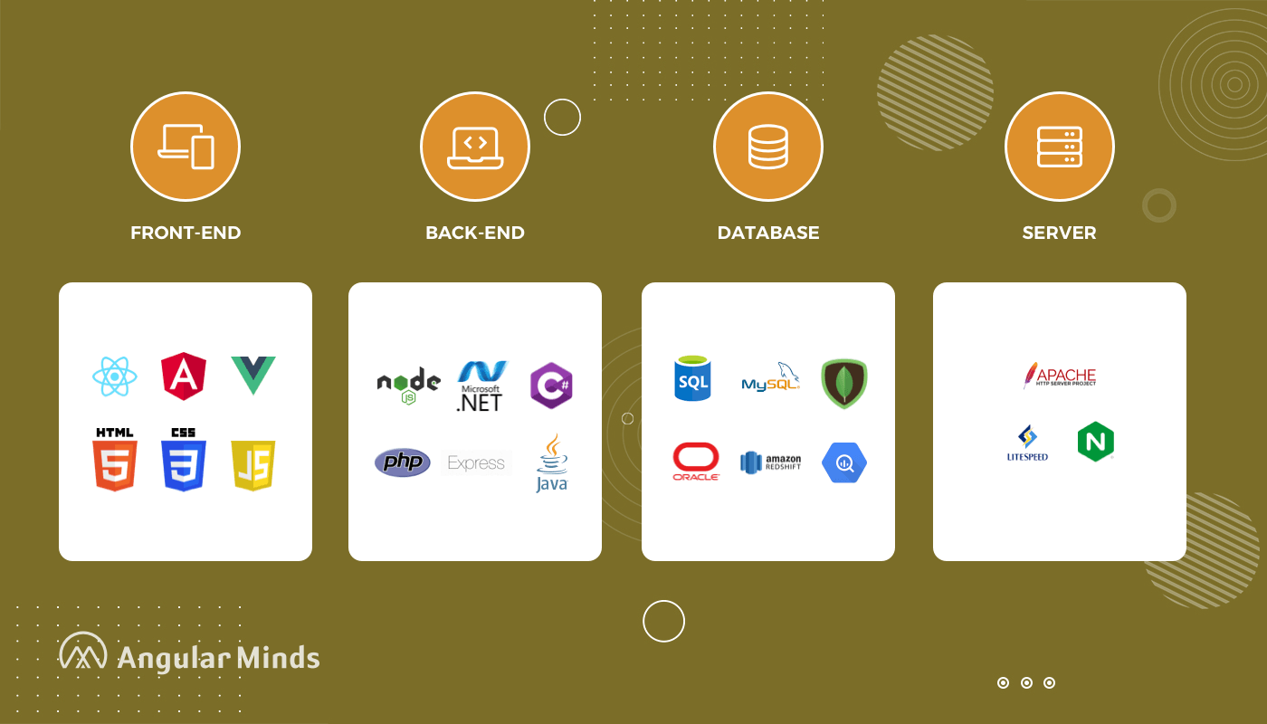
Web Development Stack

Slide 8
What is Web Development
Website Development
Front-End : User Interface (HTML, CSS, Javascript, Angular/React)
Back-End : Processing (Java, .NET, PHP, python, NodeJS)
Database : Data Storage (oracle, mysql, mongoDB)
Server : Apache Tomcat , WebLogic , Glassfish

Slide 9
Front-End Technologies
HTML | Content ( paragraph,image,table,list,audio,form,video)
CSS | Styling (color,border,width,height,background-color,positioning)
Bootstrap | predefined css , Responsiveness
Javascript | Behaviour
Angular/React/Vue | JavaScript Frameworks RAD - Rapid Application Development CLI - Command Line Interface A Template System Reusable components Synchronization of state and view Routing Form Validation Better AJAX

Slide 10
Commonly Asked Questions
Course Duration : 2 months
Class Time : 1 hour daily 7.00am to 8.30am
Working days: Monday to Saturday (Sunday-off)
Pre-Requisite - HTML , CSS
Mode of training – online
How Many Demo Sessions – 3/4 Sessions
Fee - NareshIT Admin/management
Notes - GitHub
Recording - google Classroom
Admin - 8179191999(office)
Mute: you are allowed to interact anytime during the session once actual class starts
Is it Free For FullStack Students : No
Course Completion Certificate - Yes

Slide 11
Commonly Asked Tech Questions
Why Angular?
AngularJS vs Angular

Slide 12
React Vs Angular
React Angular
===========================================================
1. Library-2013 1. Framework-2009
2. Light-weight 2. Heavy
3. JSX + Javascript 3. HTML + Typescript
4. Uni-Directional 4. two-way
5. Virtual DOM 5. Regular DOM
6. Axios 6. HttpClientModule
7. No 7. Dependency Injection
8. No 8. Form Validation
9. extra libraries needed 9. No additional libraries
10. UI heavy 10. Functionality heavy

Slide 13
AngularJs vs angular
AngularJs Angular
1. Javascript 1. Typescript
2. MVC 2. Component
3. CLI-No 3. CLI
4. filters 4. Pipes
5. Controller 5. Controller-No
6. $scope,$rootscope 6. NO-(component class)
7. Unit testing 7. Unit testing - better
8. mobile devices-No 8. mobile devices-yes

Slide 14


