Slide 1
Architecture

Slide 2
1-tier Architecture:
We all know software packages like ms access, ms excel etc. Some in common that they access file directly this means that the file you want to work with must be accessible from a local file.
This is simple of all the architecture but also least secure.
Since users have direct access to this file this could accidentally move, modify, delete the file by on purpose.
Multiple users access the same file at the same time.
Data can easily be lost if you are not carefully.

Slide 3
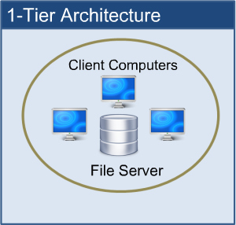

Slide 4
Two-Tier Architecture:
The two-tier architecture is like client server application.
When the client start it establishes a connection to the server and communicates as needed with the server while running the client.
The client computer usually can’t see the database directly and can only access the data by starting the client.
This means that the data on the server is much more secure.
Now users are unable to change the data etc.
This is also multiple users to access the data at the same time.
Client and server sharing the work load.

Slide 5
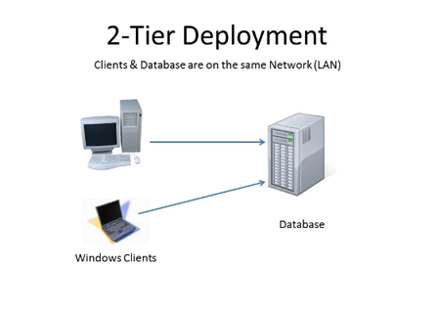

Slide 6
Advantages:
Understanding and maintenances is easier.
Disadvantages:
Performance will be reduced when there are more users.

Slide 7
Three-Tier Architecture:
The 3-tier system is a client-server architecture in which the computer data storage, user interface, functional process logic and data access are developed and maintained as independent module, often on separate platforms.
Three tier architecture client server application having three layers. They are
1.Presentation Layer
2.Business Logic Layer
3.Data Access Layer

Slide 8
1.Presentation Layer : Here we design the form using textbox, label etc.:
2.Business Logic Layer: It is the intermediate layer which has the functions for client layer and it is used to make communication faster between client and data layer. It provides the business processes logic and the data access.
3. Data Access Layer :: it has the database.

Slide 9
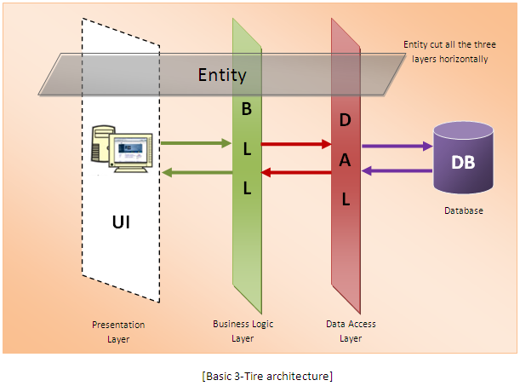

Slide 10
Advantages:
Easy to modify without affecting other modules
Fast communication
Performance will be good in three tier architecture.
To make application more understandable.
Easy to maintain, easy to modify application.
We can maintain good look of architecture.
We can reduce the network traffic.

Slide 11
N-Tier Architecture:
N-tier application architecture provides a model for developers to create a flexible and reusable application by breaking up an application into tier.
The n-tier is a client-server architecture in which presentation, data management functions and application processing are logically separate and can be represented simply on N tier architecture diagram
1. Presentation Layer
2. Business Logic Layer
3. Data Access Layer

Slide 12
The Presentation Layer: It is responsible for displaying the user interface to the end user. The programmer uses this layer for designing the user interface and to transfer data. In PHP, MYSQL, pages, user controls, server is used to support the presentation layer.

Slide 13
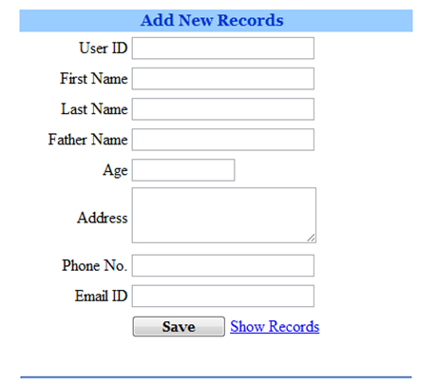

Slide 14
The Business Logic Layer: Business Logic Layer is the class in which we write functions that get data from Presentation Layer and send that data to database through Data Access Layer. The business layer works as a go-between to transfer the data from presentation layer. Its responsibility is to validate the business rules of the component and communicating with the Data Access Layer.

Slide 15
The Data Access Layer gets the data from the business layer and sends it to the database or vice versa. DAL is responsible for accessing data and forwarding it to BLL. In an PHP n-Tiered architecture, web pages do not make direct calls to the database. A given layer only communicates with its adjacent layers.

