Slide 1
SpecialLotsOccupancy
File created on: 2022-04-12 10:17:07 AM

Slide 2
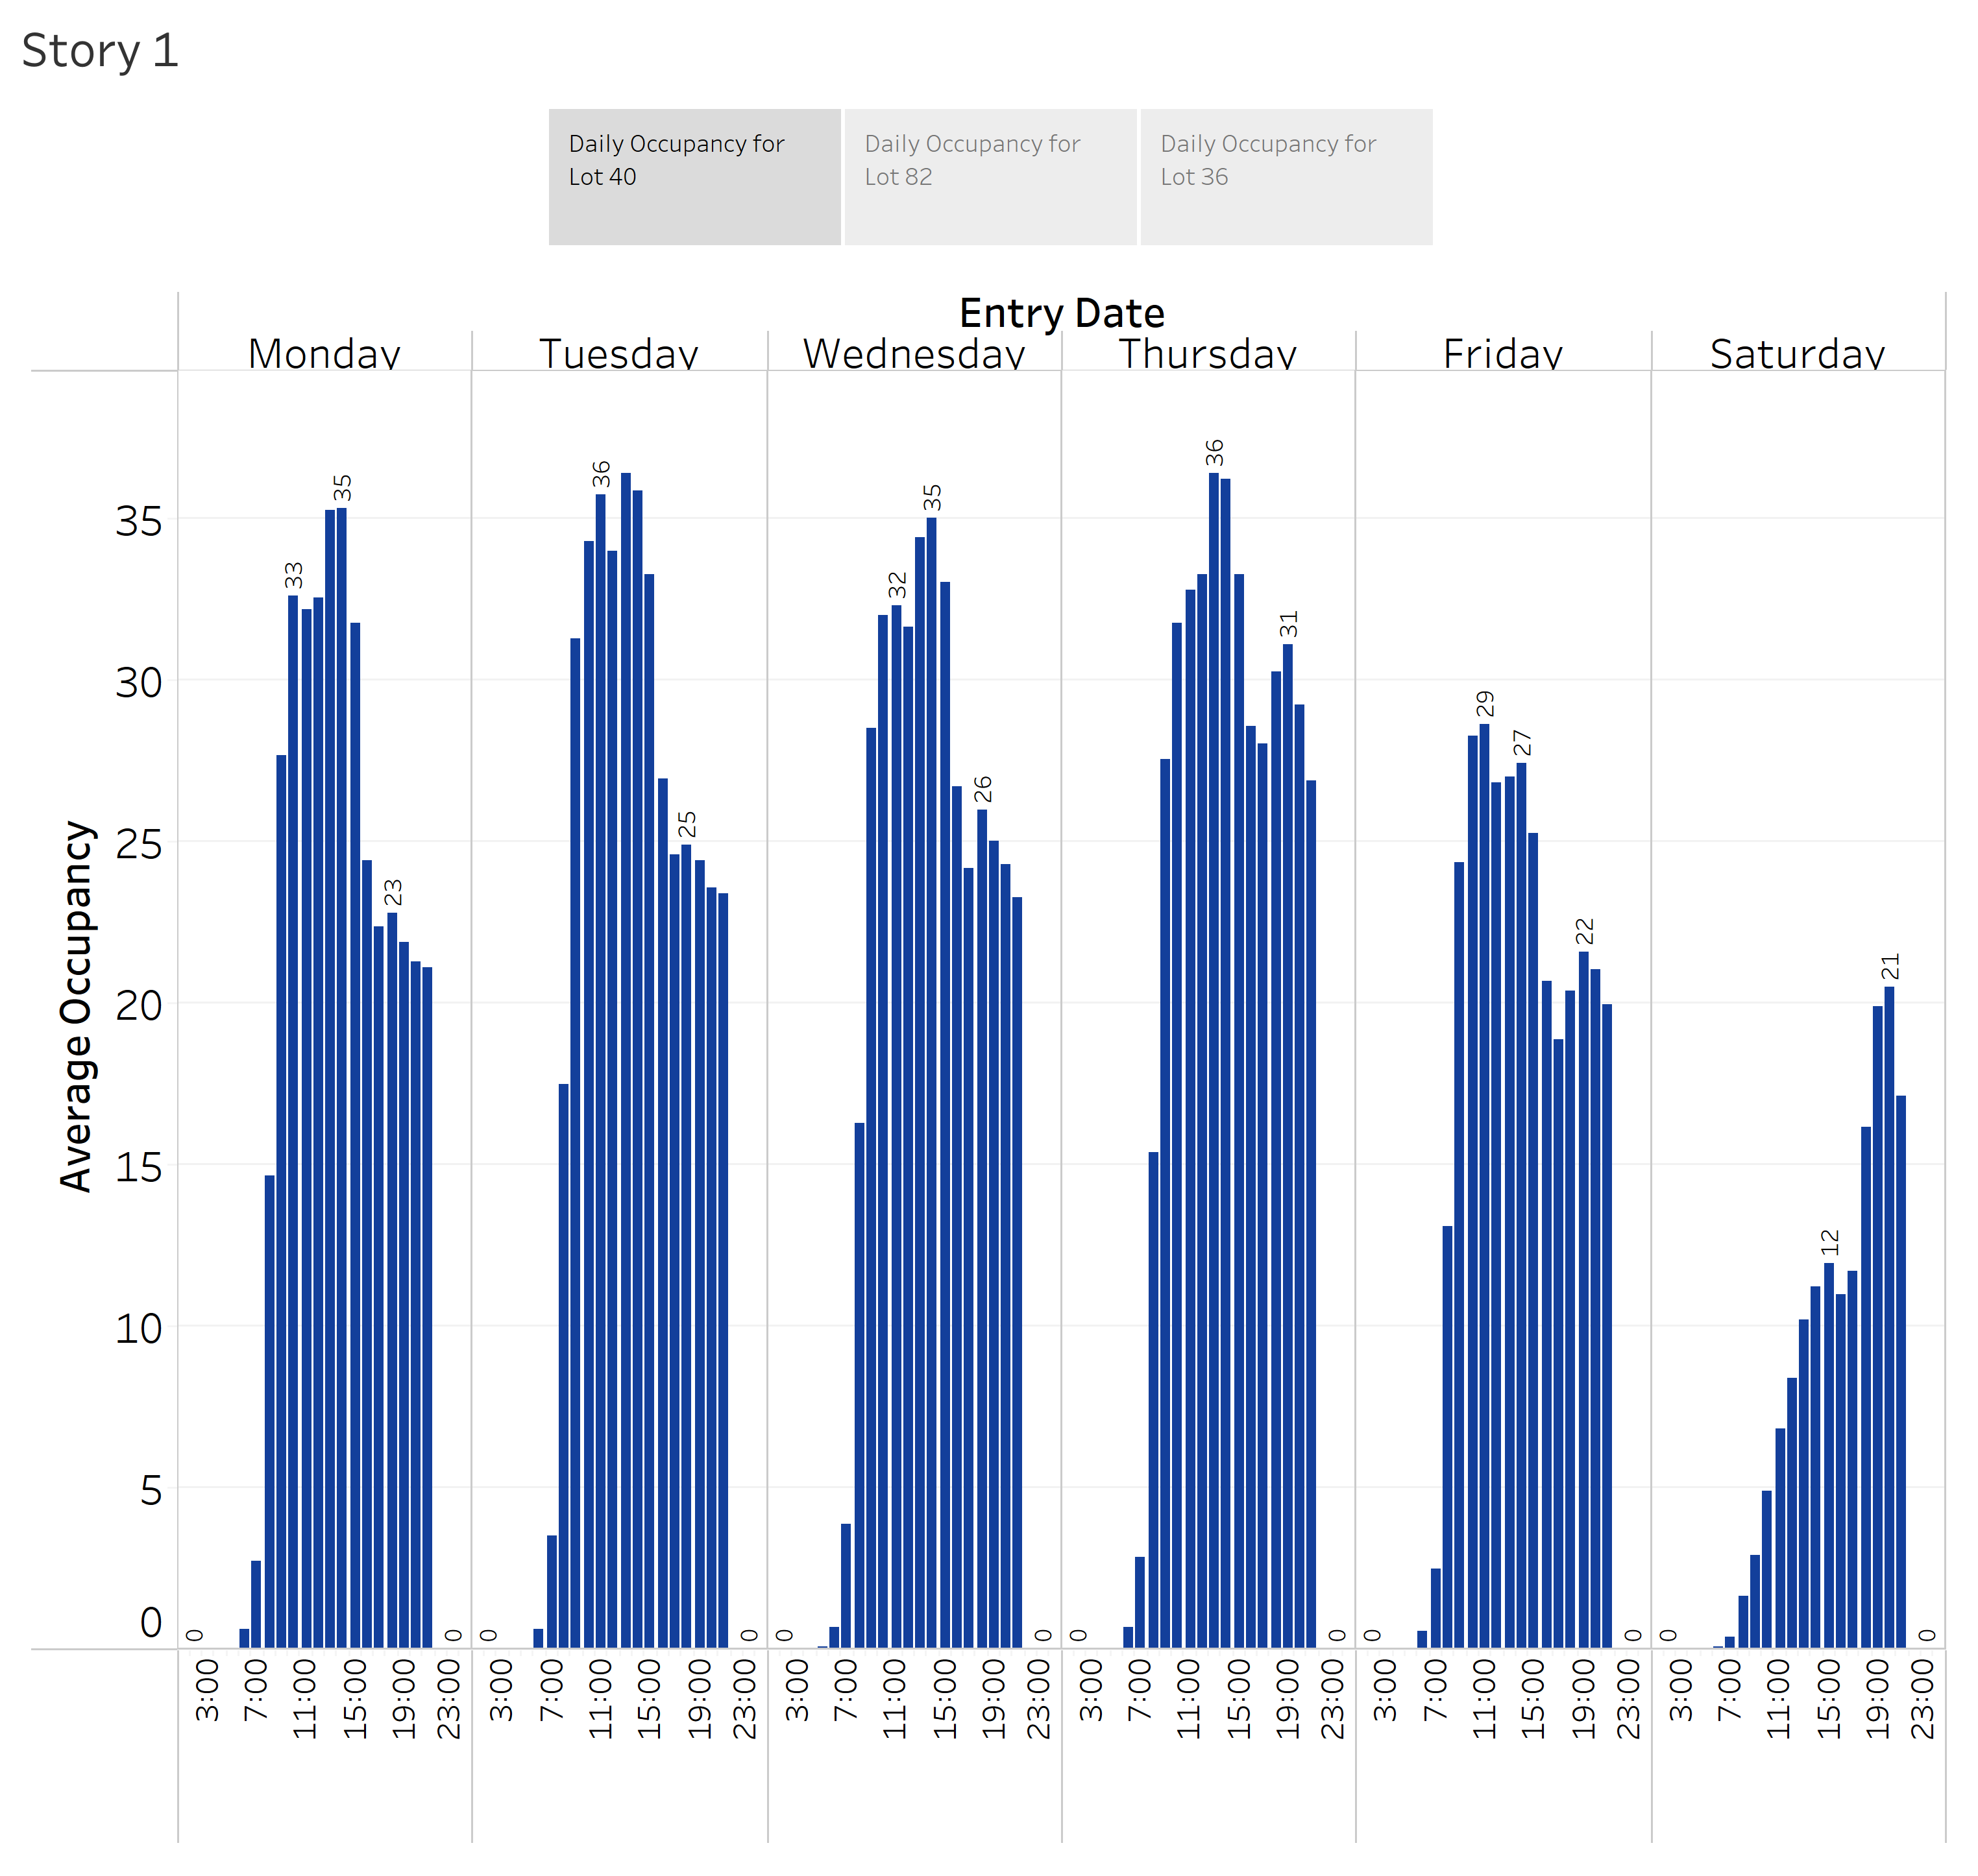

Slide 3
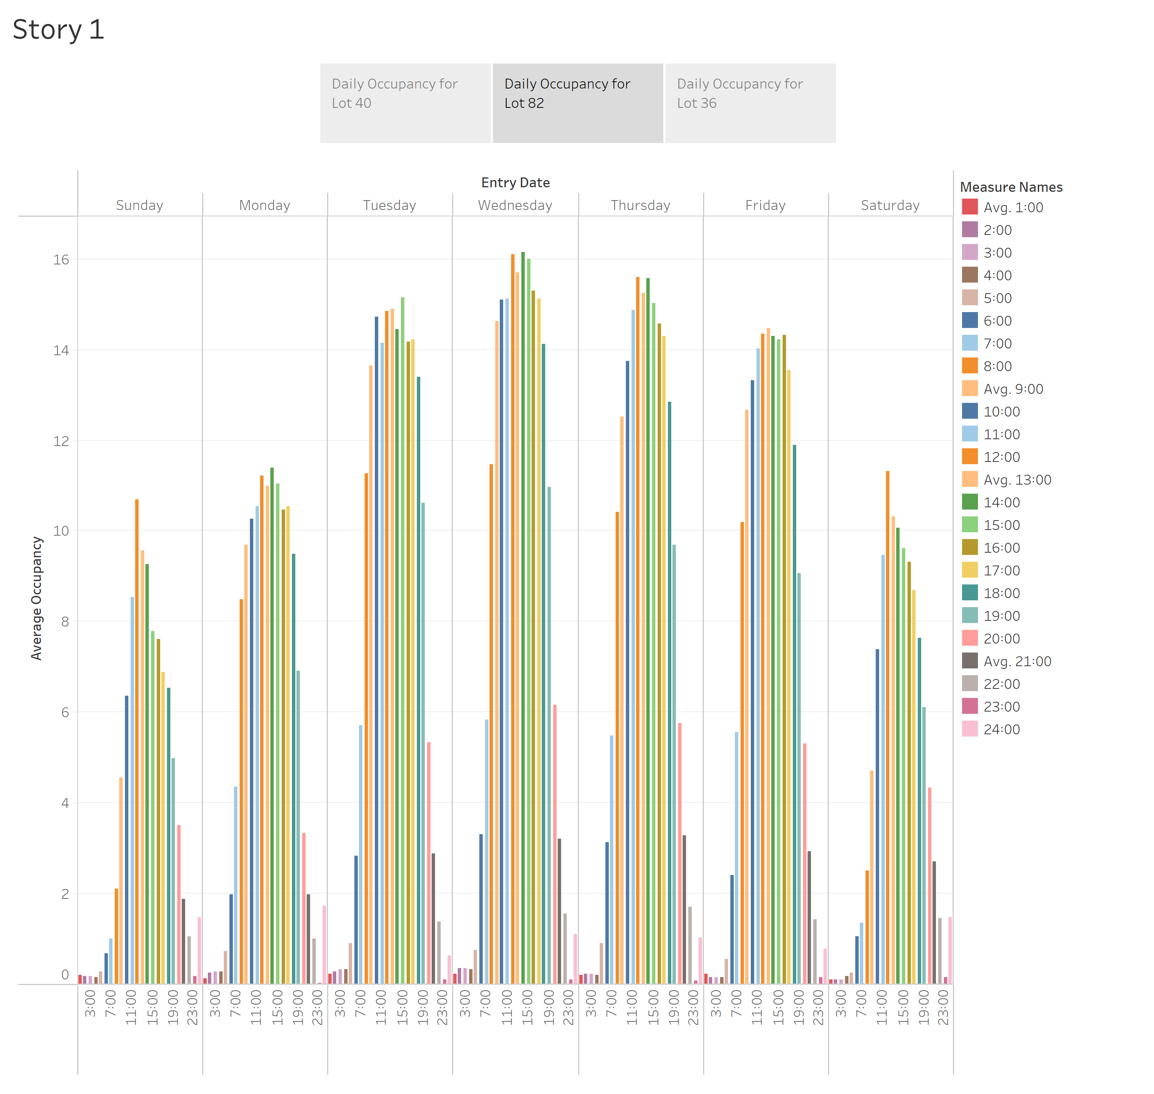

Slide 4
