Slide 1
Exploring Data in FDA OPEN Adverse Events Database
Natasha Markuzon
February 10, 2020

Slide 2
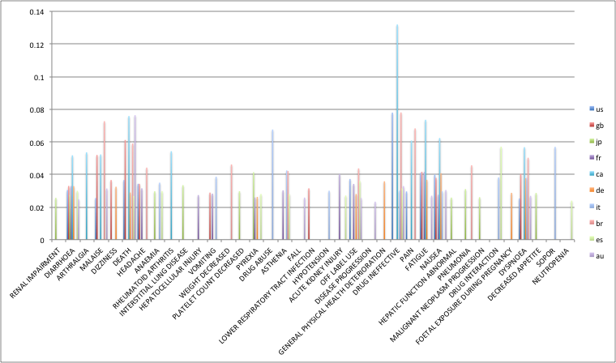
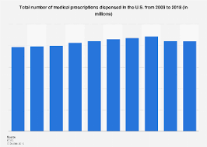
Adverse events per country, normalized by total per country
Are different adverse events reported in different countries?
The answer is yes. Looking at top 5 adverse events per country, one can observe a significant difference in most prevailing adverse events. Incidence of top 5 adverse events for 5 countries with the highest number of reports was normalized by the overall number of reported cases in the corresponding country (next slide).
Comparing incidence per prescription across countries is difficult, as the number of prescriptions is not always known (found for the US but not the other countries).
Also, multiple confounding factors affect the reporting. They include compliance and willingness to report, which can be dramatically different in different countries and which is hard to quantify. Also, prescription patterns are known to be very different in different countries, with a much more liberal policies in several countries (e.g. US) towards some medication, and more strict approach towards others
Total number of prescriptions in the US

Slide 3
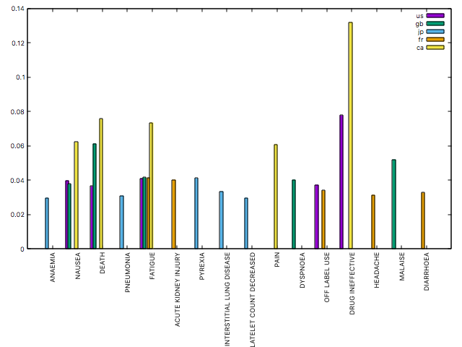
Top 5 adverse events per country, normalized by total per country

Slide 4
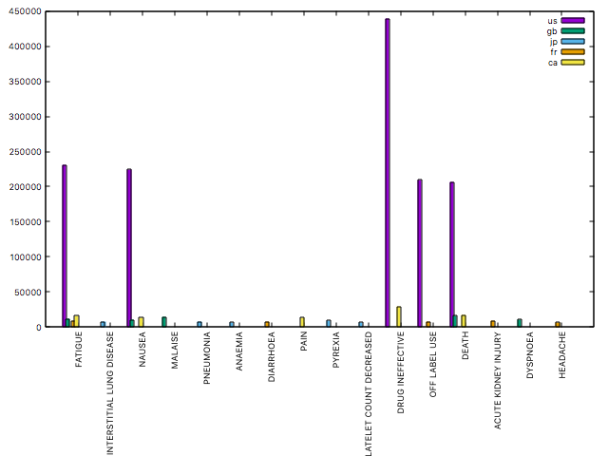
Top 5 adverse events per country, counts

Slide 5
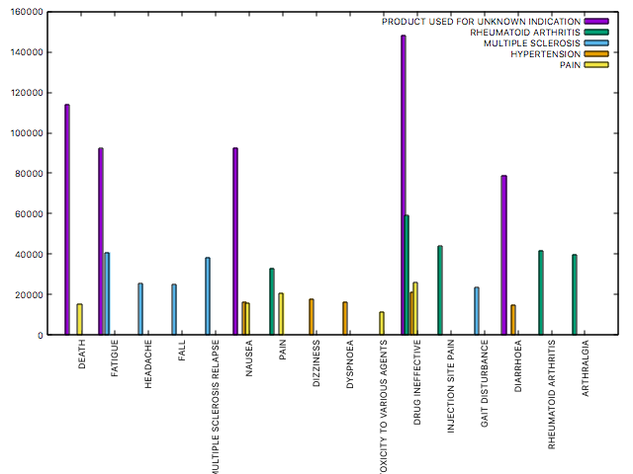
Top 5 adverse events associated with different disease areas

Slide 6
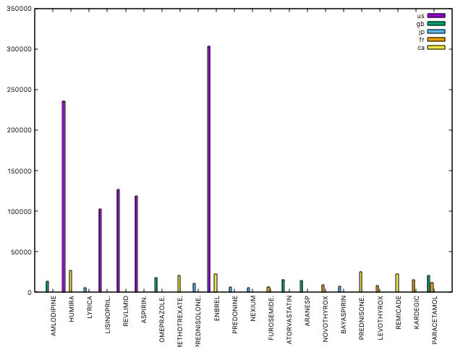
Most frequently used (top 5) medicinal products by country, count

Slide 7
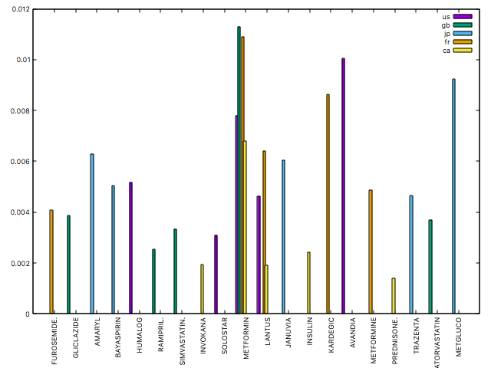
Most frequently used (top 5) diabetic medications, by country normalized by total per country

Slide 8
Understanding Temporal Patterns: Anomaly detection
Temporal patterns help better understand dynamics of the adverse events reporting and better detect increases in the number of adverse events
Requires analysis of confounders to better explain variations
There are observed local fluctuations that can be automatically detected using moving average and standard deviation analysis
Potential sources of anomalous increases in the number of reported cases may include
Problems with a new medication on the market
Media attention resulting in a more diligent reporting
Increase in self-reporting
….

Slide 9
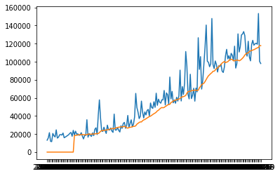
Temporal pattern of number of reported adverse events; monthly counts; 2004-2019

Slide 10
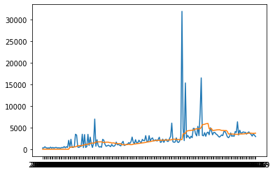
Number of reports for DIABETES Drug Indication per month; 2004-2019
Num reports
Date

Slide 11
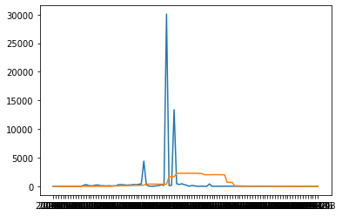
Number of reports for ﻿AVANDIA per month; 2004-2019
More detailed analysis revealed a staggering increase in the number of reports in April 2014, with over 30K cases, of which over 15K were associated with Myocardial Infarction. As the number of cases in the month before and after is more than 10 times less, one expects a recording anomaly during the month of April rather than actual rapid increase in adverse events. Other explanations are possible, , e.g. clinical trial report on its patients.

Slide 12
Potential applications
Retrospective analysis
Incidence of side effects between countries which use different combinations of medications to treat similar conditions
Identification of susceptible to severe side effects sub-populations (statistically significant increase in hospitalizations or death)
Analysis of fluctuations in the reporting in order to understand rout causes:
Medication became more broadly used
Media attention
Evaluation of the effects of country-level policies towards medication management versus
Understand influence of demographics on adverse events incidence
Quick test on diabetes medications has shown a significantly higher incidence of serious adverse events in males vs. females ( p-value < 2.2e-16)
Prospective analysis
Early detection of increase in the number of adverse events
Understanding of the causes
Predictive/clustering analysis
Describe patients’ cohorts most susceptible to a certain medication/treatment plan. Predict reaction to new regimen

