Slide 1

Value at Risk (VaR) Analysis
A Comparative Study: Historical, Parametric, and Monte Carlo Methods
US Equity Portfolio • AAPL • JPM • JNJ • XOM • WMT
Noah MARTINS DE PINA, Evrim ACER, Lenny MOUKAH, Syphax BOUARABA

Slide 2
Project Objective
Why measure risk?
Estimate the maximum expected loss of a portfolio over one trading day
Confidence level: 95% → we accept a 5% probability of exceeding the VaR
Compare three standard VaR methods: Historical, Parametric, Monte Carlo
Implement the entire workflow in Python (data download → calculation → charts)
Provide actionable risk insight for a real equity portfolio

Slide 3




Data Engineer
• Data collection (Yahoo Finance)
• Data cleaning and validation
Quant Analyst
• Return computation
• Portfolio construction (equal weighting)
Risk Analyst
• VaR modeling (Historical, Parametric, Monte Carlo)
• Results comparison
Data Visualization
• Charts and dashboard (Streamlit)
• Presentation and interpretation

Slide 4
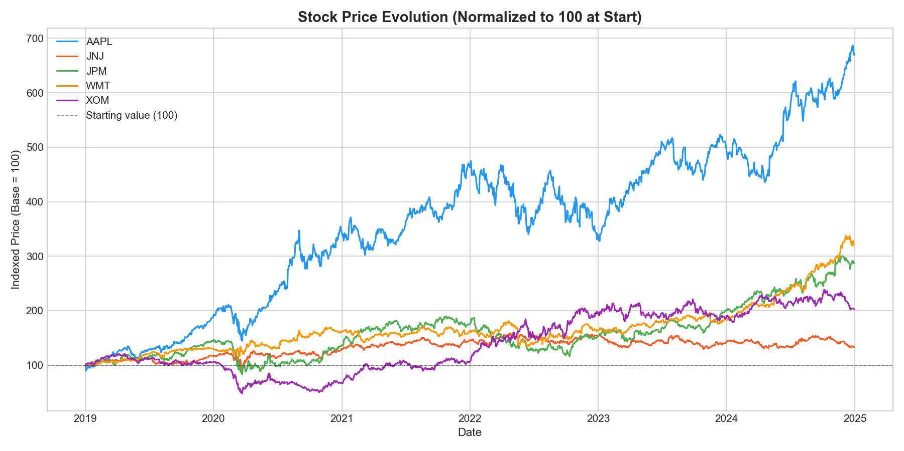
Data & Portfolio Construction
Data source: Yahoo Finance via the yfinance Python library
Period: January 2019 – December 2024 (≈ 1,500 daily observations)
Prices: Adjusted daily closing prices
5 stocks - equally weighted (20% each):
AAPL - Technology (Apple)
JPM - Financials (JPMorgan Chase)
JNJ - Healthcare (Johnson & Johnson)
XOM - Energy (ExxonMobil)
WMT - Consumer staples (Walmart)
Equal weighting ensures sector diversification

Slide 5
Methodology - Three Ways to Compute VaR
Historical VaR
Parametric VaR
Monte Carlo VaR
Uses actual past returns
No assumptions on distribution
Take the 5th percentile of observed returns
Simple but backward-looking
Assumes returns follow a Normal distribution
Uses mean and standard deviation
Applies the z-score: 1.645 at 95%
Fast - but sensitive to the normality assumption
Simulates 100,000 random return scenarios
Based on historical mean & volatility
Takes the 5th percentile of simulated returns
Most flexible - computationally intensive

Slide 6
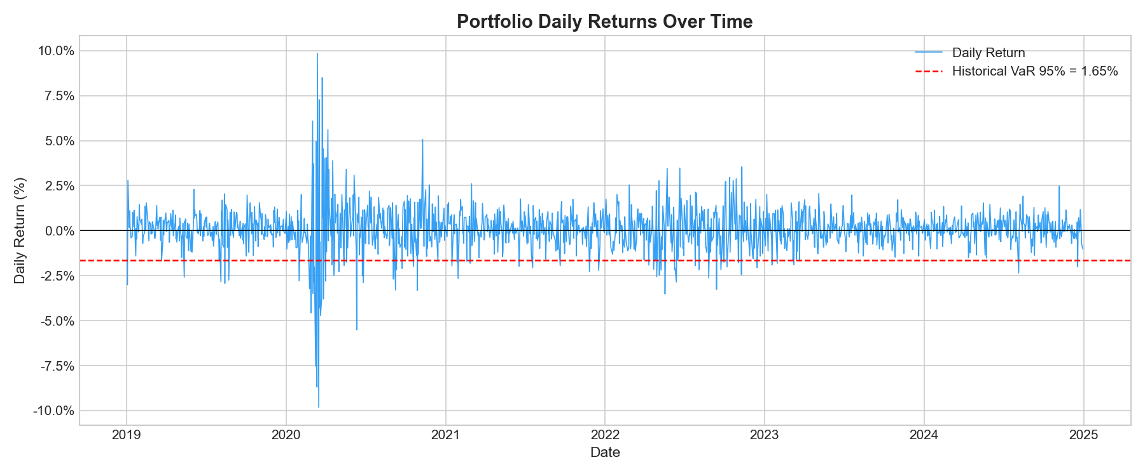
Portfolio Returns Over Time
Management team
Daily returns range roughly from -5% to +5%
Returns cluster around zero - typical for equities
Volatility spikes visible in 2020 (COVID-19 crash)
Portfolio appears relatively stable post-2021

Slide 7
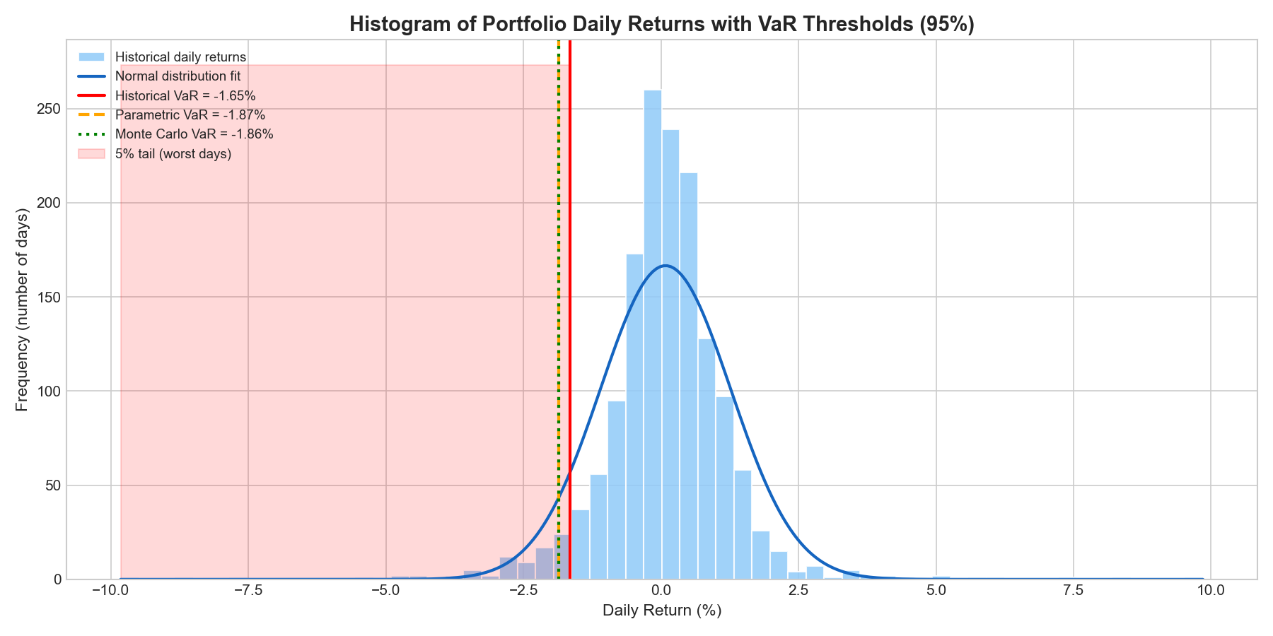
Return Distribution & VaR Threshold
Histogram of all daily portfolio returns
Red dashed line = Historical VaR at −1.65%
5% of returns fall to the left of this line
The distribution has a slight left tail (negative skew)
Not perfectly normal - justifies using multiple methods

Slide 8
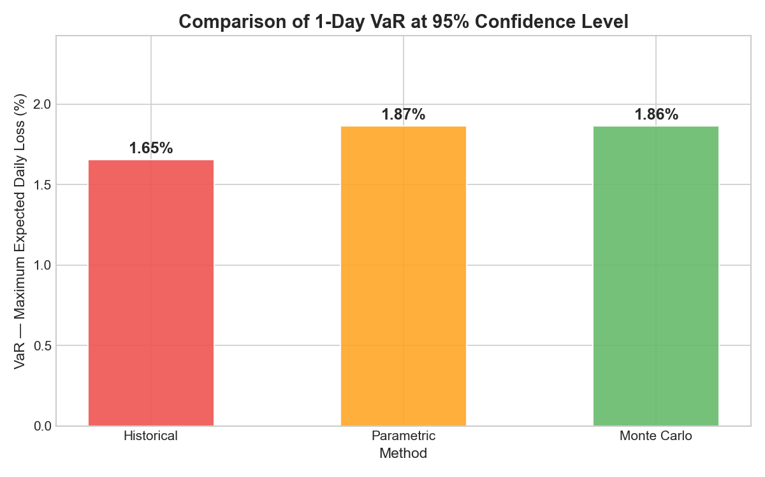
VaR Results - Comparison of Three Methods
Pricing strategy
Method | VaR (1-day, 95%) | Interpretation
Interpretation | −1.65% | Based on actual past returns
Interpretation | −1.87% | Assumes Normal distribution
Interpretation | −1.86% | 100,000 simulated scenarios
Key insight: All three methods converge around −1.65% to −1.87%, confirming the robustness of the risk estimate.

Slide 9
Conclusion & Limitations
Conclusions
Limitations & Extensions
Successfully computed 1-day VaR at 95% using Python
All three methods produce consistent estimates (~1.65–1.87%)
The portfolio shows moderate daily risk - typical for a diversified equity basket
Monte Carlo and Parametric agree closely, confirming the near-normality assumption
Python proved effective for end-to-end financial risk analysis
VaR does not tell us how large losses can be beyond the threshold (tail risk)
Parametric VaR assumes normality - real returns have fat tails
Historical method is backward-looking and misses future regime changes
Extension: Expected Shortfall (CVaR) - average of the worst 5% of losses
Extension: Longer horizons (10-day VaR, e.g. for Basel III compliance)
Extension: Dynamic volatility models (GARCH) for time-varying risk

Slide 10

Thank you for your attention Scan to access the interactive dashboard
https://var-iae-metz-project.streamlit.app/

