Slide 1
Value at Risk (VaR) Analysis
A Comparative Study: Historical, Parametric, and Monte Carlo Methods
US Equity Portfolio • AAPL · JPM · JNJ · XOM · WMT
Master 1 Finance | IAE Metz | April 10, 2026
Notes:
Good morning / afternoon everyone. My name is [your name] and today I will present my Python project on Value at Risk analysis. The goal was to measure the daily market risk of a US equity portfolio using three different statistical methods. Let me walk you through each step.

Slide 2
Project Objective
Why measure risk?
▸ Estimate the maximum expected loss of a portfolio over one trading day
▸ Confidence level: 95% → we accept a 5% probability of exceeding the VaR
▸ Compare three standard VaR methods: Historical, Parametric, Monte Carlo
▸ Implement the entire workflow in Python (data download → calculation → charts)
▸ Provide actionable risk insight for a real equity portfolio
Master 1 Finance | IAE Metz | 2026
Notes:
The main objective of this project is to measure risk quantitatively. Value at Risk answers a simple question: 'What is the worst loss I can expect on a typical bad day?' We chose a 95% confidence level, which is the industry standard. This means that on 95 out of 100 days, the actual loss should be smaller than our VaR estimate. The key contribution of this project is comparing three different methods to see if they agree.

Slide 3
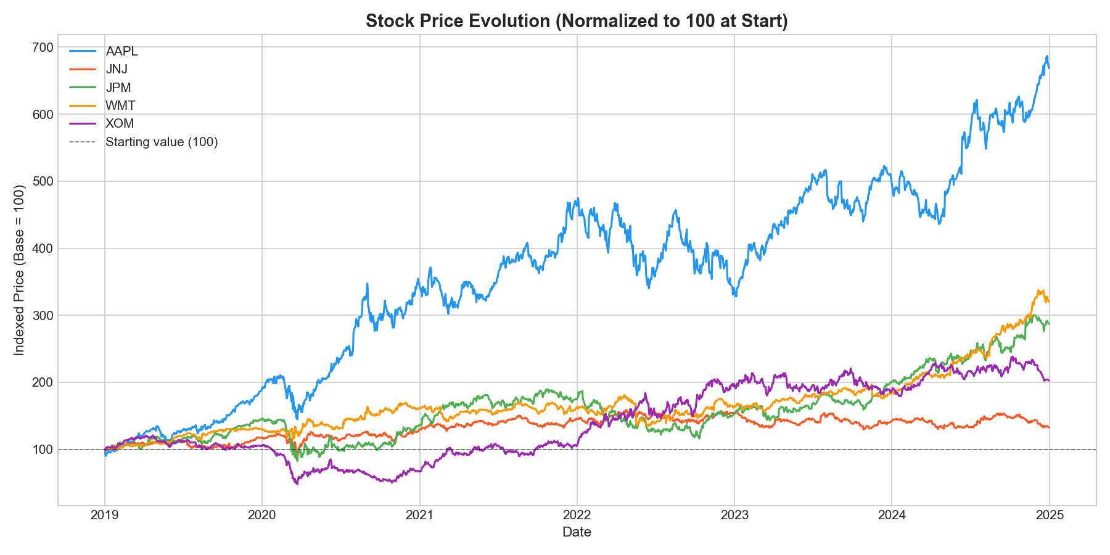
Data & Portfolio Construction
▸ Data source: Yahoo Finance via the yfinance Python library
▸ Period: January 2019 – December 2024 (≈ 1,500 daily observations)
▸ Prices: Adjusted daily closing prices
▸ 5 stocks — equally weighted (20% each):
▸ AAPL — Technology (Apple)
▸ JPM — Financials (JPMorgan Chase)
▸ JNJ — Healthcare (Johnson & Johnson)
▸ XOM — Energy (ExxonMobil)
▸ WMT — Consumer staples (Walmart)
▸ Equal weighting ensures sector diversification
Fig. 1 — Normalised stock prices (2019–2024)
Master 1 Finance | IAE Metz | 2026
Notes:
We downloaded five years of daily price data from Yahoo Finance using the yfinance library in Python. The portfolio is equally weighted across five stocks from different sectors: technology, financials, healthcare, energy, and consumer staples. This diversification is intentional — it reflects a realistic retail investor portfolio. The chart on the right shows how each stock performed over the period, normalised to 100 at the start.

Slide 4
Methodology — Three Ways to Compute VaR
Historical VaR
Parametric VaR
Monte Carlo VaR
▸ Uses actual past returns
▸ No assumptions on distribution
▸ Take the 5th percentile of observed returns
▸ Simple but backward-looking
▸ Assumes returns follow a Normal distribution
▸ Uses mean and standard deviation
▸ Applies the z-score: 1.645 at 95%
▸ Fast — but sensitive to the normality assumption
▸ Simulates 10,000 random return scenarios
▸ Based on historical mean & volatility
▸ Takes the 5th percentile of simulated returns
▸ Most flexible — computationally intensive
Master 1 Finance | IAE Metz | 2026
Notes:
We computed VaR using three methods. The Historical method simply looks at what happened in the past — if we sort all daily returns and find the 5th percentile, that is our VaR. No assumptions needed. The Parametric method assumes returns are normally distributed and uses the well-known formula with mean, standard deviation, and the z-score of 1.645 for 95% confidence. Finally, Monte Carlo simulates thousands of possible futures based on the historical statistics and picks the worst 5%. It is the most powerful method but requires more computation.

Slide 5
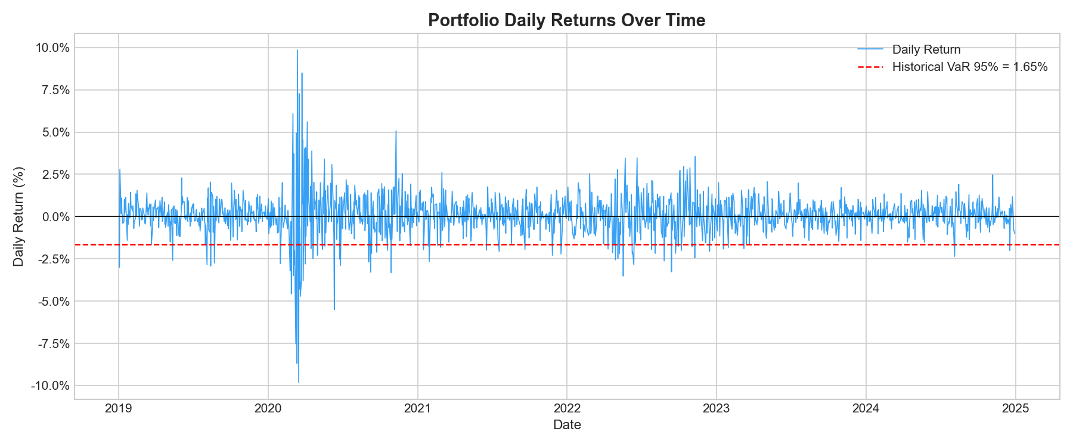
Portfolio Returns Over Time
▸ Daily returns range roughly from −5% to +5%
▸ Returns cluster around zero — typical for equities
▸ Volatility spikes visible in 2020 (COVID-19 crash)
▸ Portfolio appears relatively stable post-2021
Fig. 2 — Daily portfolio returns (2019–2024)
Master 1 Finance | IAE Metz | 2026
Notes:
This chart shows the daily return of our equally weighted portfolio over the five-year period. You can see that most daily moves are small — between minus two and plus two percent. However, in early 2020, when COVID-19 hit the markets, we see very large swings. This kind of volatility clustering — calm periods followed by turbulent ones — is a well-known feature of financial data. It is one reason why measuring risk is important and non-trivial.

Slide 6
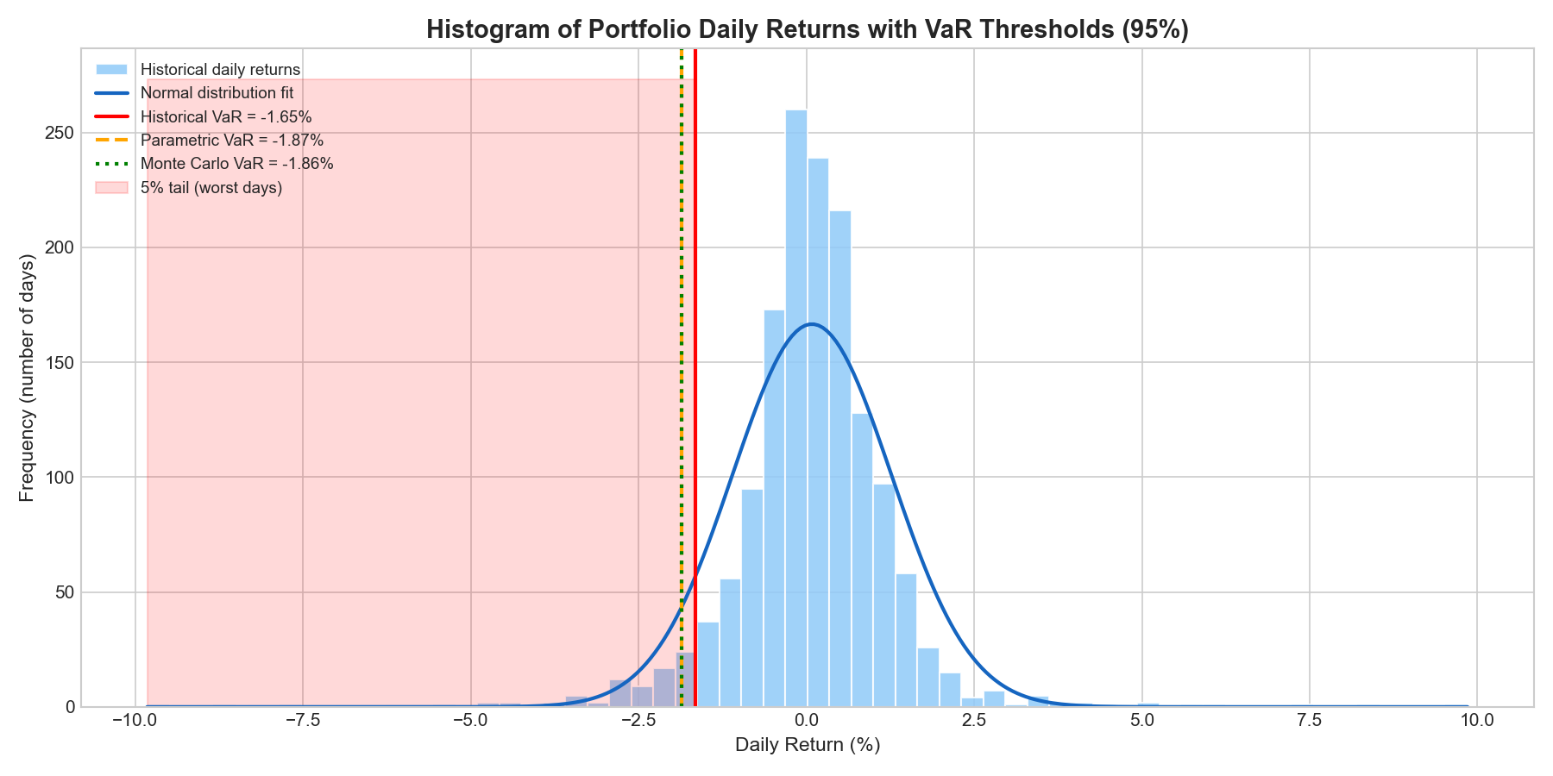
Return Distribution & VaR Threshold
▸ Histogram of all daily portfolio returns
▸ Red dashed line = Historical VaR at −1.65%
▸ 5% of returns fall to the left of this line
▸ The distribution has a slight left tail (negative skew)
▸ Not perfectly normal — justifies using multiple methods
Fig. 3 — Return histogram with Historical VaR threshold
Master 1 Finance | IAE Metz | 2026
Notes:
This histogram shows all the daily returns of the portfolio. The red dashed vertical line represents our Historical VaR: approximately minus 1.65%. Everything to the left of that line is in the worst 5% of days. Notice that the distribution has a slightly heavier left tail than a perfect normal distribution would. This is why the Parametric VaR, which assumes normality, gives a slightly different result than the historical approach.

Slide 7
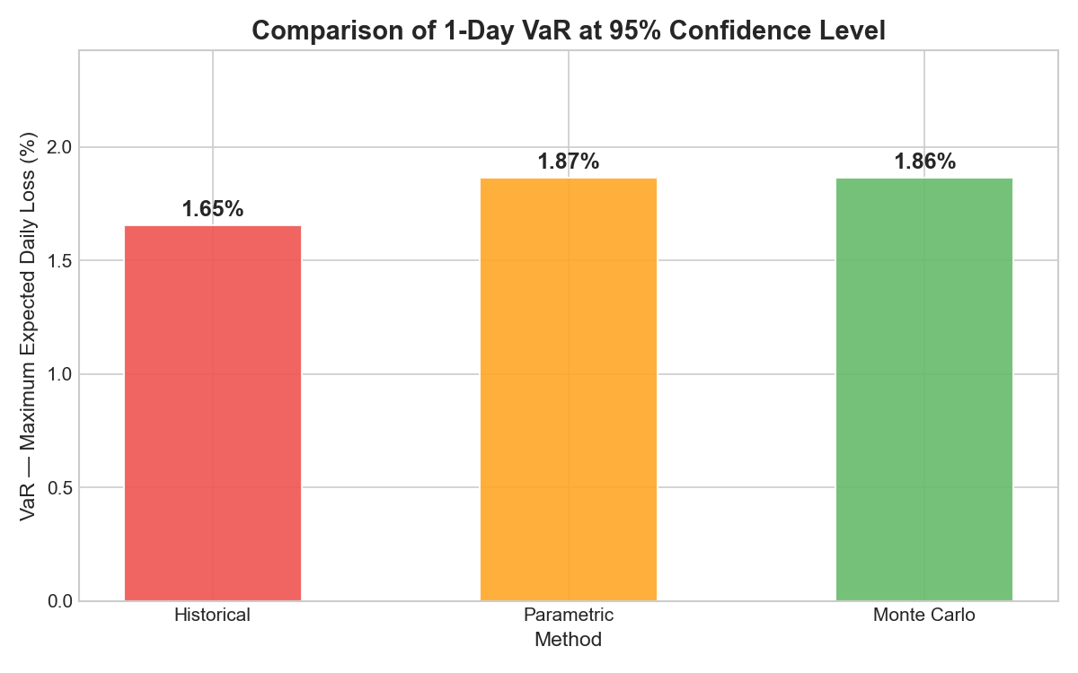
VaR Results — Comparison of Three Methods
Method
VaR (1-day, 95%)
Interpretation
Historical
−1.65%
Based on actual past returns
Parametric
−1.87%
Assumes Normal distribution
Monte Carlo
−1.86%
10,000 simulated scenarios
Key insight: All three methods converge around −1.65% to −1.87%, confirming the robustness of the risk estimate.
Fig. 4 — VaR comparison chart
Master 1 Finance | IAE Metz | 2026
Notes:
Here are the final results. The Historical method gives a VaR of minus 1.65%, the Parametric gives minus 1.87%, and the Monte Carlo gives minus 1.86%. In practical terms, this means that on any given day, we can say with 95% confidence that the portfolio will not lose more than about 1.7 to 1.9 percent of its value. The fact that all three methods give similar results is reassuring — it means our estimate is stable and not highly sensitive to the method chosen. The small difference between Historical and the other two comes from the slight non-normality of the actual return distribution.

Slide 8
Conclusion & Limitations
Conclusions
Limitations & Extensions
▸ Successfully computed 1-day VaR at 95% using Python
▸ All three methods produce consistent estimates (~1.65–1.87%)
▸ The portfolio shows moderate daily risk — typical for a diversified equity basket
▸ Monte Carlo and Parametric agree closely, confirming the near-normality assumption
▸ Python proved effective for end-to-end financial risk analysis
▸ VaR does not tell us how large losses can be beyond the threshold (tail risk)
▸ Parametric VaR assumes normality — real returns have fat tails
▸ Historical method is backward-looking and misses future regime changes
▸ Extension: Expected Shortfall (CVaR) — average of the worst 5% of losses
▸ Extension: Longer horizons (10-day VaR, e.g. for Basel III compliance)
▸ Extension: Dynamic volatility models (GARCH) for time-varying risk
Master 1 Finance | IAE Metz | 2026
Notes:
To conclude, this project achieved its goal: we successfully measured and compared the daily VaR of a diversified US equity portfolio using three methods in Python. The results are consistent across methods, which gives us confidence in the estimate. However, VaR has well-known limitations. Most importantly, it does not tell us what the loss will be on the 5% of bad days — it only tells us the threshold. A natural extension would be Expected Shortfall, also called CVaR, which measures the average loss in the worst cases. I am happy to take any questions. Thank you.

