Slide 1
Electric Transmission Data VLTTEAM-3102 Preparation for final Go/No-Go for Production Release
Classification: Internal / Confidential
Date: September 13, 2021

Slide 2
Contents
01 | Purpose | 03
02 | Quality Gate Short Definition | 05
03 | QG1: Acceptance Criteria | 07
04 | QG2: Acceptance Criteria | 09
05 | QG3: Acceptance Criteria | 11
06 | QG4: Acceptance Criteria | 13
07 | QG5: Acceptance Criteria | 15
08 | QG6: Acceptance Criteria | 17
09 | Production Release Plan | 19
10 | Application Architecture | 21
11 | Q&A | 23

Slide 3
01
Purpose

Slide 4
Purpose
The purpose of this user story is to ensure all Quality Gates have been completed and approved for the production release. The Quality Gates include the following:
Security Sign Off
Enterprise Architecture Sign Off
System Integration Test Sign Off
Data Quality Business Sign Off
Golden Data Business Sign Off
Dry Run Pre-Production Sign Off

Slide 5
02
Quality Gate Short Definition

Slide 6
Quality Gates – Short Description
Quality Gate | Description
QG1 | Security Sign Off – NG Security Architect for DET solution reviews and tracks closure of baseline security requirements for categories such as Server, Application, SaaS-PaaS, Database
QG2 | Enterprise Architecture Sign Off – Enterprise Architecture team reviews the referential architecture of the solution, its data model, data security requirements etc and approves CSA against it
QG3 | System Integration Test Sign off - SIT verification performed with NG stakeholder, Test Coverage and it results summarized
QG4 | Data Quality Business Sign Off – Business walk-through of Data Quality processes designed for National Grid’s Transmission Asset Data
QG5 | Golden Data Business Sign Off – Business walk-through of Golden Data Creation for Asset, Location & Work Order
QG6 | Dry Run Pre-Production Sign Off – PRE-Production validation of Production environment, application setup and execution of initial data load

Slide 7
03
QG1: Acceptance Criteria

Slide 8
Quality Gate 1 – Security Architect Sign Off
Status:
1) SIT BSR has been approved (09/02/2021)
2) Prod BSR has been approved (09/10/2021)
Approver(s):
1) Shahran Asim

Slide 9
04
QG2: Acceptance Criteria

Slide 10
Quality Gate 2 – Enterprise Architecture Sign Off
Status:
CSA document has been prepared and reviewed with the Enterprise Architecture Team (09/09/2021)
CSA document has been approved (09/13/2021)
Approver(s):
Svetlana Lyba
Nishit Ajwaliya
Delfin Sian

Slide 11
05
QG3: Acceptance Criteria

Slide 12
Quality Gate 3 – Data Quality Business Sign Off
Status:
Data quality process validation and sign off in SIT (08/20/2021)
Approver(s):
Preston Large
Omlata Kumar
Minu Abi

Slide 13
06
QG4: Acceptance Criteria

Slide 14
Quality Gate 4 – Golden Data Business Sign Off
Status:
Location Hierarchy Table and Location Golden Record has been reviewed and approved (08/24/2021)
Asset Golden Record has been reviewed and approved (06/30/2021)
Work Order Golden Record has been reviewed and approved (06/30/2021)
Approver(s):
Preston Large
Ben Binger
Joshua Carver-Brown
Jeffrey White

Slide 15
07
QG5: Acceptance Criteria

Slide 16
Quality Gate 5 – Pre-Production Dry Run Sign Off
Status:
Setup Pre-Production environment (09/06/2021)
Upload data files to SIT Azure Blob for dry-run (09/08/2021)
Deploy Application Objects and execute initial data loads (09/08/2021)
Validation of dry-run to confirm the scripts for PROD cut-over (09/09/2021)
Approver(s):
Omlata Kumar/Minu Abi
James Campbell

Slide 17
08
QG6: Acceptance Criteria

Slide 18
Quality Gate 6 – Testing Sign Off
Status:
Validate all solution components in SIT (08/31/2021)
Validation of End-to-End data flow in SIT for Asset (09/03/2021)
Validation of End-to-End data flow in SIT for Work Order (09/03/2021)
Validation of End-to-End data flow in SIT for Location (09/03/2021)
Approver(s):
Ben Binger
Omlata Kumar
Minu Abi

Slide 19
09
Production Release Plan

Slide 20
Production Release Plan
Production Deployment – 09/14/2021 to 09/17/2021
Business Handover Validation Meeting – 09/20/2021
Busines Perform Validation on Production – 09/20/2021 to 09/24/2021
User Notification for Production Go Live – 09/27/2021

Slide 21
10
Application Architecture

Slide 22
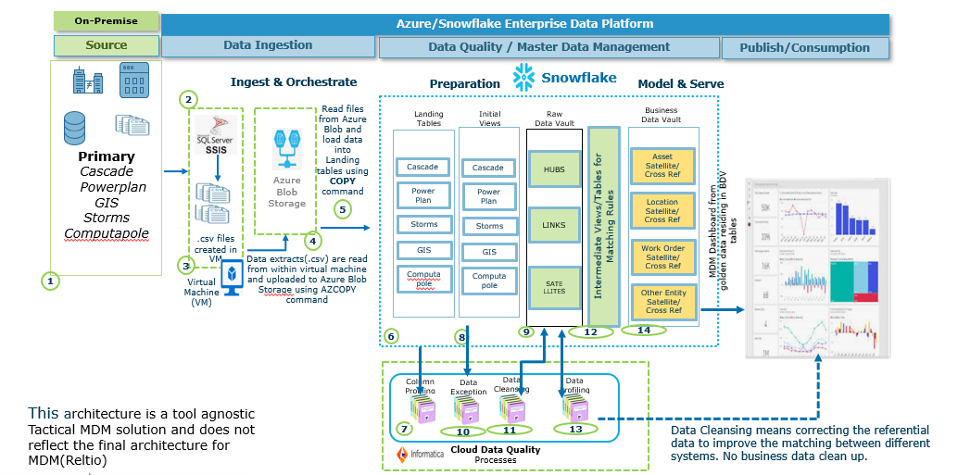
DET Application Architecture ( As of Sept 2021)

Slide 23


