Slide 1




GBE CRIS Integration Design
July, 2020

Slide 2
Overview of the Ask
Overview:
GBE <-> CRIS Solution scope made use of both Mulesoft and Oracle Fusion in the Integration
Going Forward MuleSoft will be the Middleware - Oracle Fusion can not be used.
The Completed GBE<->CRIS Proof of Concept Integration Solution tested MS/Fusion combination, and Not Mulesoft Only solution
Why:
NG Architectural Decision and Direction
Do Not use Oracle Fusion in any go forward designs/solutions
How:
Follow the slides
Expectations:
Have GBE working group Recommend a Solution that adheres to NG Architecture Guidelines
Questions:
How to ensure guaranteed delivery

Slide 3
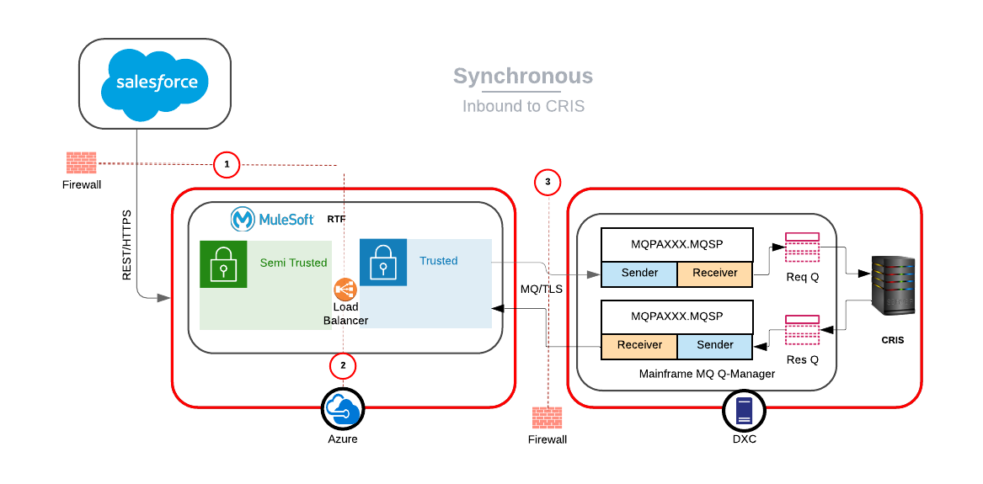
Scenario1: Synchronous, Inbound to CRIS
Failure Points
Remediation
1
2
3
Error response to user. No message storage & reprocessing. End user will re-initiate the request

Slide 4
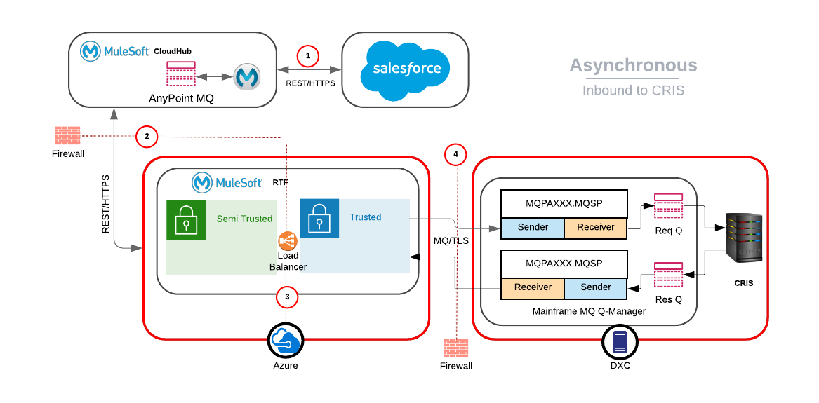
Scenario2: Asynchronous, Inbound to CRIS
Failure Points
Remediation
1
Message stays in SF
2
CloudHub & SF get 5xx error code. Message stays in SF for first 72 hours. Post 72 hours message persisted in Anypoint MQ
3
Mule semi trusted, CloudHub & SF get 5xx error code. Message stays in SF for first 72 hours. Post 72 hours message persisted in Anypoint MQ
4
Mule trusted, semi-trusted, CloudHub & SF get 5xx error code. Message stays in SF for first 72 hours. Post 72 hours message persisted in Anypoint MQ

Slide 5
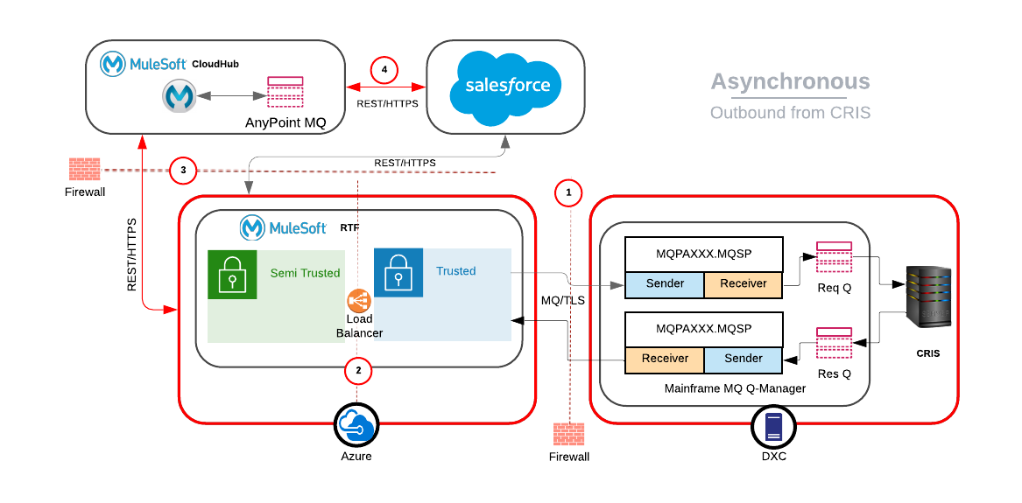
Scenario3: Asynchronous, Outbound from CRIS
Secondary path
Primary path
Failure Points
Remediation
1
Mule does not consume message, its persisted in DXC MQ
2
Trusted Mule get 5xx error code from Mule Semi trusted. Message persisted in DC MQ
3
Mule Semi trusted sends message directly to SF
SF response 200: Mule semi trusted sends 200 to DXC MQ, messages gets de-queued
SF response 5xx: Mule semi trusted sends messages to Mule CloudHub. Message gets persisted in Anypoint MQ and de-queued from IBM MQ. Mule CloudHub retires & resend to SF
4
Message persisted in AnyPoint MQ. CloudHub retries & resends

Slide 6
Use Cases: Raised, Reviewed & Commented
Critical use cases raised by CRIS, reviewed/commented by Sam Greco
1. Creating a Service Order within SF(really a request for CRIS to Create the SO) - A response will be expected from CRIS (Success with data payload, or Failure with a different payload). We call this Synchronous because it appears synchronous to the CSR.
SF -->MuleSoft ** --> MQ on Mainframe-->CRIS processes will Pull from GBE Inbound MQ Queue and execute business logic to create service order (happy path)
CRIS will place newly created SO Order(Response with Matching Correlation ID to the Request to Create from GBE) into a JSON object on Mainframe GBE Outbound MQ Queue-->MuleSoft **--> SF (Mulesoft will be responsible for a design to Get that Mainframe MQ Record (match the Correlation IDs) and to persist/protect it at hand-off, so that Mainframe MQ can be allowed to delete the record at time of the hand-off knowing that Mulesoft now has responsibility for the Message.
GRECO: We should discuss this a little. My understanding is a little different. I think we have 2 logical units of work here. If we are using the CFE architecture, 1) the CSR SF transaction would come to CRIS via MQ and a successful message with a minimal payload would go back to CSR SF. 2) CRIS would in parallel put a Order payload on MQ that currently goes out to MDSI/Advantex, that will now go back to SF.
- This use case can be aligned to Scenario1: Synchronous, Inbound to CRIS
2. A data synch from CRIS to SF (it just comes up to SF, as business events/ work is completed in CRIS, publishing of CRIS Data Object for data synch is done with other systems like MyAccount so that MyAccount can maintain its Local ODS
CRIS will place a Data Synch Object (Like Customer, Account , Asset or Premise/Service Point) into a JSON object on Mainframe MQ -->MuleSoft **--> SF Mulesoft will be responsible for a design to Get that Mainframe MQ Record (No Correlation ID) and to persist/protect it at hand-off, so that Mainframe MQ can be allowed to delete the record at time of the hand-off knowing that Mulesoft now has responsibility for the Message.
- Data synch should ideally be done by ETL. In case of Mule, it can be aligned to Scenario3: Asynchronous, Outbound from CRIS

Slide 7
Use Cases: Raised, Reviewed & Commented
Critical use cases raised by CRIS, reviewed/commented by Sam Greco
3. Service requests or Datagrams asynchronous communications used for critical enrollments(Budged. Deferred Payment Agreements, Paperless Billing and Auto-Bill Payment) and payments require the Guaranteed Deliver option. While MQ Queue Manager to MQ Queue Manager aka peer-to-peer communication option used Downstate in the past 20 years implements the Guaranteed Delivery automatically, the MQ Client alternative would require the partner applications that connect to MF Queue Manager using MQ Client connection to implement their own guaranteed delivery which is always dicey and fraught with many potential pitfalls
GRECO: Do the CSR CFE transactions act in this manner. I didn’t think they followed a asynch pattern like this. I knew that some MyAccount transactions worked this way since CRIS was not 24x7 but I thought the CSR transaction had to actually complete through the backend and return a response to the CSR. We should further discuss as “guaranteed delivery” may not apply as it must complete end to end immediately
- Aligned to Scenario2: Asynchronous, Inbound to CRIS
4. Every time there’s a business event taking place in CRIS like bill generation or a payment being processed, a Data Synch will be issued onto the My Account ODS which will require a Guaranteed Delivery option. In a currently used peer-to-peer setup, a data synch message would be placed on a remote queue on the MF Queue Manager which would be hooked with a local queue on the MyAccount Queue Manager. In a MQ Client Connection setup, a data synch message would be placed on a local queue and some kind of a Mulesoft process would have to be polling that local queue which would be very cumbersome and taxing given the fact that Mulesoft would likely be running in the Cloud.
- Similar case as of point 2 in previous slide

Slide 8
Backup
Appendix

Slide 9
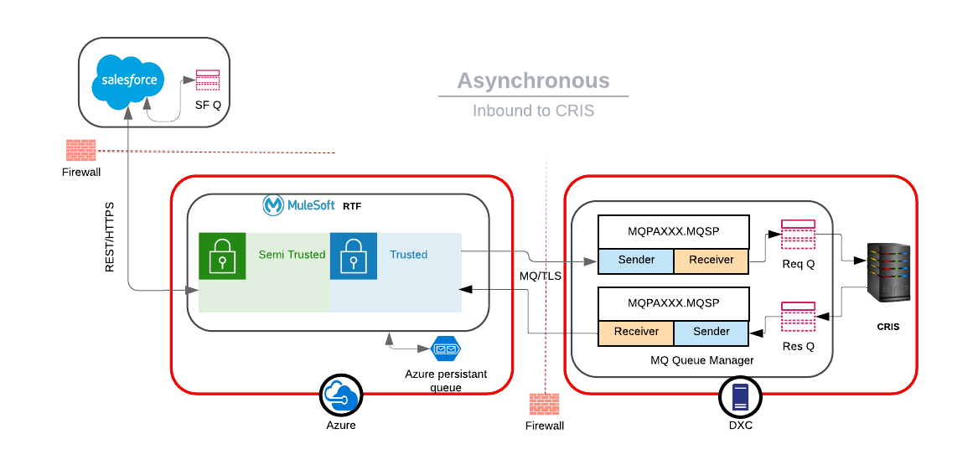
Scenario2: Asynchronous, Inbound to CRIS
Break Point
1
Break Point
2
Persistent Q at every layer
Encrypted channel for E2E request response
TLS enabled encrypted communication between Azure MuleSoft and DXC MQ
Failure scenarios and error handling for guaranteed delivery:
1
Messages gets persisted in Salesforce local Q
2
Messages gets persisted in Azure persistent Q. Retry & Reprocessing to CRIS post connection establishment

Slide 10
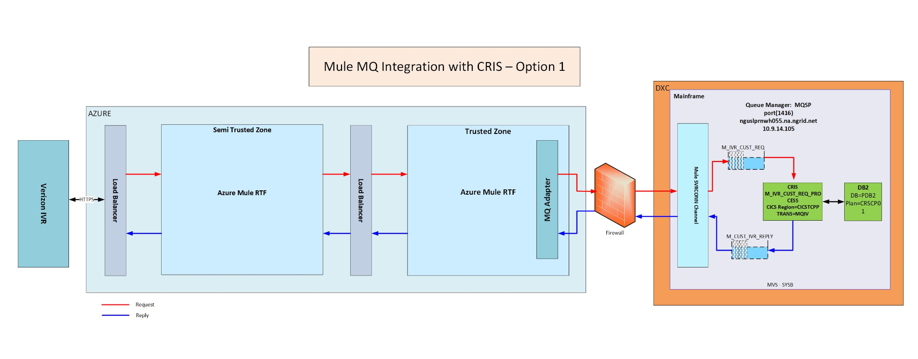
Option #1 – MQ Mainframe <-> Mulesoft MQ Adapter
Pros
One less Queue manager to be configured
Bi-directional Pro - Since channel goes both ways, so only one channel needs to be created/configured vs a pair of channels for option #2
I
Cons
Guaranteed delivery will need to be built outside of MQ (Definitely in Mule, and possibly in CRIS as well)
More changes in CRIS to replace CIS-Fusion configuration with Mule's new implementation (MQ configuration changes and CRIS internal rule and policy changes, plus any unknown changes)
B-directional Con- If the channel goes down, messages will be lost vs if channels go down for option #2, messages will be preserved in the transmit queue and messages will be transmitted once the channels are running again. – Why msg will be lost in option1?
Potential performance impact/Unknowns – Performance will in-fact be improved because of reduced Q set

Slide 11
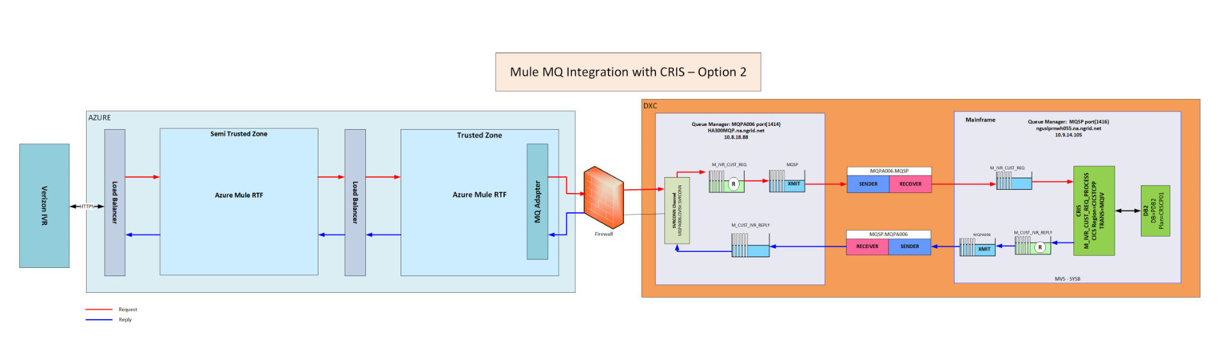
Option #2 – MQ Mainframe <-> MQ Distributed Instance
Pros
Proven methodology at National Grid
Guaranteed delivery is handled by MQ
Uni-directional
Minimal changes in CRIS to replace CIS-Fusion configuration with Mule's new implementation
Cons
None known at this time
Additional layer of Qs – increased maintenance, performance impact

