Slide 1
Data Governance Playbook
Establish the methodology for effective data governance and quality in an era of big data
Chief Data and Analytics Officer Research Team
Notes:
TEMPLATE UPDATED 8 MARCH 2019
Presenter's Name
Presenter's Name

Slide 2
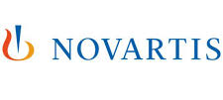






Profiled Practices
This collection of best practices profiled in this guide would not be possible without the willingness of companies to generously share their time, experiences, tools and templates with us.

Slide 3
Table of Contents
The Data Governance Playbook will allow you to define a data governance model that establishes governance processes, stewardship roles, and information health metrics to improve data quality.
Executive Summary
Common Pitfalls of Data Governance …………………Pg. 3
Data Governance Key Success Factors……………….Pg. 4
Using This Step-by-Step Guide…………………………Pg. 5
Introduction
The Cost of Poor Data Quality………………….……….Pg. 7
The Expanding Information Universe………….……….Pg. 8
Fundamental Capabilities to Strengthen IM…….……..Pg. 9
Defining Data Governance……………………….……..Pg. 10
Governance Foundation
Governance Change Management Model…….….…...Pg.12
Setting Governance Scope and Priorities……….….…Pg. 13
Data Governance Principles.……………………….…..Pg. 14
IM Framework Deliverables………………………….....Pg. 15
Project/Data Governance Interaction Process…….….Pg. 16
Project/Data Governance Interaction Checklist ……...Pg. 17
Data Stewardship
Data Stewardship Model………………………………...Pg. 19
Data Stewardship Responsibilities………………….….Pg. 20
Data Stewardship Escalation Path……………………..Pg. 21
Stewardship Roles and Business Intelligence………...Pg. 22
Task-Specialized Data Stewardship…………………...Pg. 23
Establish Stewardship Roles………………...…………Pg. 24
Aligning Accountability for Data Decisions………..…..Pg. 25
Stewardship Models by Data Type…………………….Pg. 26
V. Data Standardization
Data Standardization & Like-Minded Users…………….Pg. 28
Identify Demand for Data-Based Triggers………………Pg. 29
Balancing Local and Enterprise Data Needs…………...Pg. 30
Balancing Flexibility with Rigor………………...………...Pg. 31
VI. Master Data Management
Roles and Responsibilities in MDM……………………..Pg. 33
MDM Forum Charter……………………………………...Pg. 34
Classification Principles…………………………....……..Pg. 35
MDM Principles Checklist……………………….………..Pg. 36
MDM Governance and Decision Rights…………….......Pg. 37
MDM Maturity Model………………………………………Pg. 38
MDM as Means, Not Ends………………………………..Pg. 39
Focus on the Critical Few……………………....…...……Pg. 40
Ensure MDM Need in Project Selection……………...…Pg. 41
Maintain MDM Alignment…………………………………Pg. 42
VII. Data Quality
Resolving Data Standards and Quality Issues…….……Pg. 44
Contextualize Data Quality Issues……………………….Pg. 45
Data Quality Heat Map……………………….……….......Pg. 46
Dimensions of Data Quality……………………………….Pg. 47
VIII. Performance Improvement
Enterprise Data Maturity Path………….…………………Pg. 49
Data Management Maturity Scorecard…….…………….Pg. 50
Organizational Readiness Diagnostic………..…………..Pg. 51

Slide 4
Common Pitfalls of Data Governance
Inability to persuade business partners that data is a business concern, not an IT concern. While business partners conceptually agree on the importance of data quality, consistency, and access, they push back on taking direct ownership of data decisions, perceiving that data is an “IT thing.” Continued IT ownership puts a middleman between the ultimate beneficiaries of quality data and the strategic decisions involving that data and hinders progress toward accuracy and insight of reporting and analytics.
Difficulty to define and adopt consistent data governance processes and policies. Without a formal governing body with both business and IT representation and a targeted scope, governance processes will fail to be adopted and benefit will be diluted.
Failure to come to consensus on common enterprise data definitions. Business unit heads tend to view their data needs as unique rather than consistent with other areas of the enterprise. They are engrained in the particular uses and nomenclatures in their silo with nominal concern for enterprise standards, leading to a continuation of sub-optimal reporting capabilities and an inability to get a holistic view of basic customer, employee, and vendor data, for example.
Inconsistent approach to data across projects. An inconsistent approach across the enterprise risks project solutions at odds with one another and fails to achieve scalability, slowing down projects as tasks and documentation are reinvented for each project.
Difficulty to define and sustain a path toward a target state of data competency. Achieving data quality, accuracy and consistency is a vast and amorphous objective. Organizations struggle to identify a realistic target state of data competency and the interim milestones to reach in the near- and mid-term. Without a maturity path that delivers tangible value along the way, data initiatives risk being deferred due to time and resource intensity coupled with distant payoff.
Organizations encounter five challenges associated with data governance initiatives that are most likely to lead to failure.

Slide 5
Data Governance Key Success Factors
Clearly scope the data governance mandate and objectives. Clarity of purpose will provide the focus to apply scarce resources to the most important governance activities.
Apply varying degrees of governance depending on the data asset. Prioritize the highest level of rigor on the data assets with the highest business value and broadest enterprise use.
Tailor the stewardship model to data type characteristics. Analyze the characteristics of the data such as business value and volume to determine the appropriate data stewardship model.
Establish clear procedures to guide project interaction with data governance bodies. Outlining that interaction to include timely knowledge exchange of project details ensures data concerns are addressed consistently across projects and improves data solution quality.
Involve the business in data stewardship roles and tasks. Data is a business asset and needs to be managed as such by business owners. Ensure business representation on stewardship boards.
Target similar data users when initiating data standardization efforts. Identify cohorts of like-minded data users to establish consensus on data definitions and standards.
Take an opportunistic approach to data standardization. Pursue opportunities for data standardization and integration that are highlighted by events in the business environment, such as a merger or new senior executive, that would trigger new information requirements and needs.
Formalize the promotion of master data management standards and principles. Use a structured forum with a well-defined scope to define and advocate for enterprise-wide MDM solutions and reuse.
Prioritize data quality improvement based on the data’s quality gap relative to its importance to the organization. Highlight data quality concerns from multiple user perspectives and in varying contexts to ensure the right data is targeted for quality improvement.
Track progress toward data maturity goals. Define a specific set of maturity milestone indicators and monitor overall progress across data domains toward them.
10 Key Factors that ensure successful data governance

Slide 6
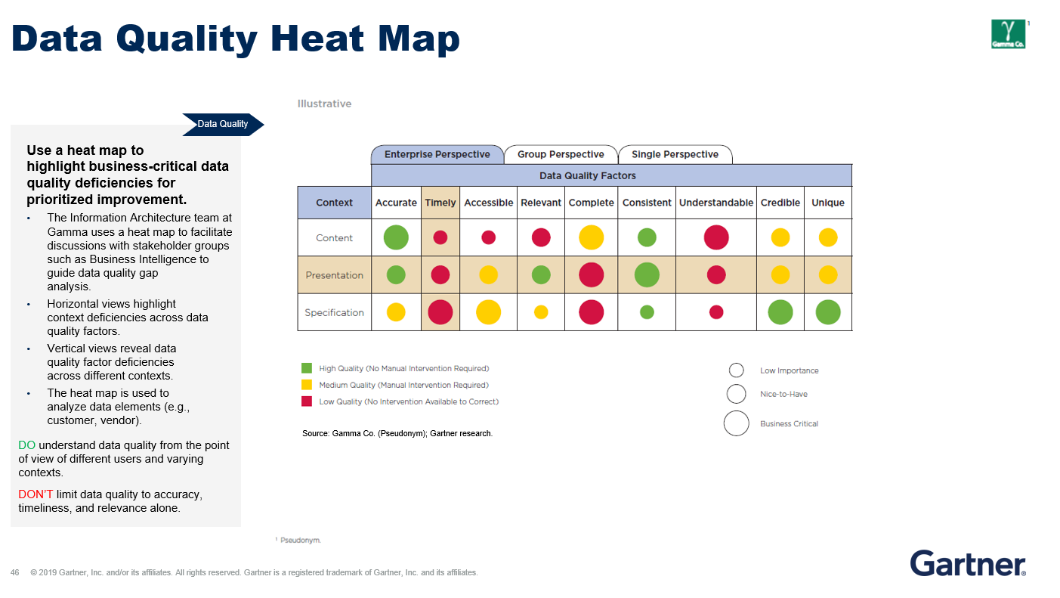
Using This Playbook
How to Read Slides in this Deck
This guide provides a step-by-step walkthrough of best practices across a data governance initiative. Use this guide to establish the scope and objectives for effective data governance in an era of big data.
1. Key components to guide practitioner implementation
3. Ready-to-use templates and frameworks
2. Prescriptive data governance Do’s and Don’ts

Slide 7
Roadmap For This Playbook
Introduction
Governance Foundation
Data Stewardship
Data
Standardization
Master Data Management
Data Quality
Performance Improvement

Slide 8
The Costs and Opportunity of Poor Data Quality
Introduction
Lacking precise, up-to-date data at critical points throughout the enterprise, companies face significant costs and lost business opportunities, resulting in significant bottom-line impact.
Data Most Susceptible to Quality Problems
Common Reasons for Poor Data Quality
Customer Data
Product Data
Financial Data
Sales Conduct Data
Data from ERP Systems
Employee Data
International Data Across a Multinational Company
Inconsistent definitions for common terms
Siloed or conflicting data sources
Multiple data touchpoints
Duplicative records
Changes to source systems
Gartner analysis.

Slide 9
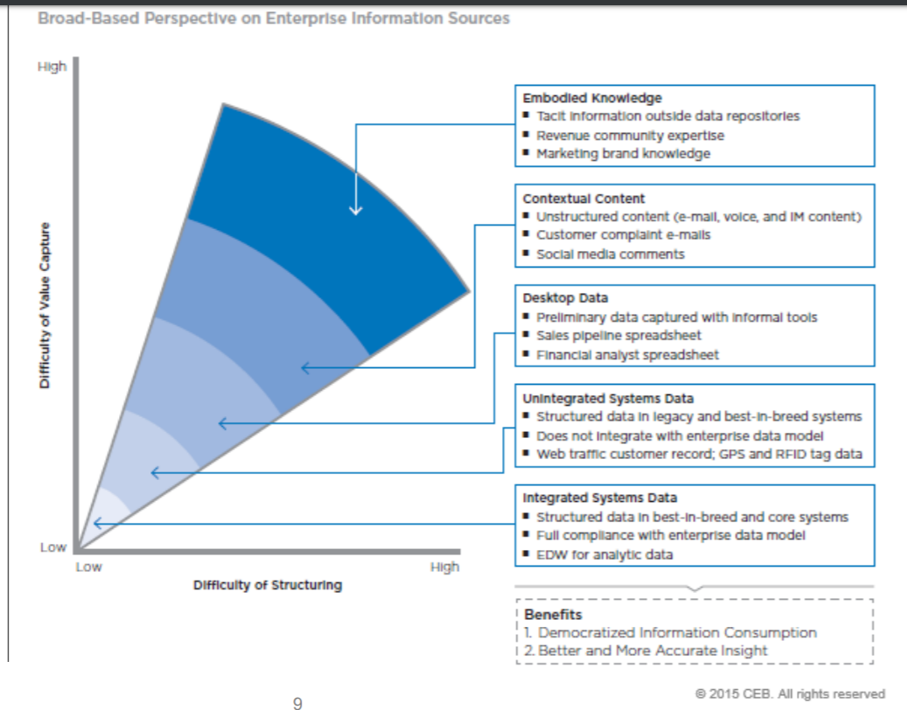
The Expanding Information Universe
Broad-Based Perspective on Enterprise Information Sources
Introduction
The universe of information sources continues to expand beyond the divide between structured and unstructured data.
Enabling access to multiple information sources and combining information types for business intelligence (BI) and analytics creates new opportunities for IT value delivery.

Slide 10
Foundation Capabilities Needed to Strengthen Information Management Processes
Introduction
1. Create an Information Management Strategy
2. Define an Information Ownership Model
Only 33% of organizations surveyed have formalized data governance structures with broad representation.
Align the Information Strategy with Business Goals: To ensure relevance, link the information management strategy directly to business goals and challenges.
Target the Right Level of Information Maturity: Don’t assume that all business units require the same information capabilities and maturity, but target individual business unit needs while incrementally building enterprise capabilities.
Discuss Ownership Roles with Business Partners: Design a collective data ownership model to ensure that information decisions address the interests of diverse business groups.
Centralize Resources: Allow information sources to remain close to employees by drawing information management and analytics teams into the center, not the information sources.
3. Define Enterprise Data Standards
4. Maintain Information Quality
Triage Information Standardization: Setting universal enterprise data standards is time and cost prohibitive. Identify information that needs to be standardized at the enterprise level by tracking usage patterns and common information needs.
Build Business Partner Cohorts for Standardization Efforts: Data standardization can easily turn into a theoretical exercise that ignores operating realities. Help business partners determine when standards make sense and when flexibility is paramount.
Establish Joint Ownership of Information Standards: Balance responsibilities for maintaining information integrity between IT and business leads to ensure that those using the information are also responsible for maintaining its quality.
Make Information Quality Transparent: Make quality transparent to improve employee trust in the information and spur business partner action for resolving data quality issues.

Slide 11

Data Governance Defined
Introduction
IT often takes a leadership role in establishing data governance. However, progressive organizations see data governance as a shared responsibility across the organization.
Data governance is the orchestration of people, processes, and technology to manage the company’s critical data assets by using roles, responsibilities, policies, and procedures to ensure the data is accurate, consistent, secure, and aligns with overall company objectives.
Source: Hallmark; Gartner analysis.

Slide 12
Roadmap For This Playbook
Introduction
Governance Foundation
Data Stewardship
Data
Standardization
Master Data Management
Data Quality
Performance Improvement

Slide 13

Governance Change Management Model
Get senior staff buy-in, embed information quality into workflow, and create information transparency to ensure information is treated as a company asset.
Governance Foundation
Use a change management model to help create a culture that regards information as a company asset.
Culture
Information is managed as a company asset.
Information quality is ingrained in all aspects of workflow..
Stewardship is widely recognized as an enabler of “OneMerck.”
Information access is transparent
Roles and Responsibilities
Define information stewardship roles and responsibilities for IT and business staff
Assess program success and quantify the value of quality data
Performance Measures
The business formalizes roles in information stewardship:
Executive steward
Information steward
Operational steward
Customer service measures include SLAs.
Process measures include cycle times and cost.
Scorecards measure data quality.
Skills and Knowledge
Organization Structure
These include the following:
Process excellence
Data analysis
Data standards, content, and business rules
Impact assessment
Customer interaction
New business organizations are responsible for owning process and data standards (e.g., MDM Center of Excellence).
DO take a holistic approach to managing data at your organization.
DON’T build a governance plan that overlooks the importance of company culture.
Build the necessary skills and knowledge in staff
Process and data governance councils formalize resources dedicated to data management
Source: Merck & Co., Inc.; Gartner analysis

Slide 14
Data Governance Scope and Priorities
Governance Foundation
The scope of our Governance…
…includes… | …for… | …that is used across…
Numbering schemes Definitions Hierarchy decisions | Master data objects Fields Terms Metrics | Two or more systems More than one business area More than one process team
Our governance priorities are…
Establishing procedures to ensure data is maintained as a strategic asset for Hallmark
Timely decisions to support the ERP implementation
Alignment of current / future projects and systems to Hallmark’s data governance principles
Settling an effective strategy for data governance requires clearly defined scope and priorities.

Slide 15
Data Governance Principles
Governance Foundation
An easy-to-understand set of principles helps to ensure consistency when considering data usage and impact.
Strategic | Standard
Data is a strategic Business asset for Hallmark and must be treated as such. Good data management leads to good decision making which leads to good business results. The data needs of the company overall will supersede the needs of individual businesses. The quality, integrity and accuracy of data is a critical and ongoing business issue. Business owns the data; I/T owns the system. | Align with industry leading practices. Utilize Industry Standards such as: US Postal United Nations/Center for Trade Facilitation and Electronic Business (UN/CEFACT) American National Standards Institute (ANSI) International Organization for Standardization (ISO) Create data in one system and establish a documented system of record. Align projects and systems with Hallmark’s ERP implementation.
Simple/Flexible | Secure
Anticipate the requirement to handle future growth or changing business situations. Enable integration of data across the business while reducing complexity. Remove embedded logic from Key Data Object fields whenever possible. Exceptions must be approved by Hallmark’s Data Governance Steering Committee | All standards, policies, and processes must comply with all applicable local, national, and international laws. Data must only be viewed and/or changed by authorized people for authorized purposes.

Slide 16

Information Management Framework
Data Touchpoints Across the Value Chain
Illustrative
Governance Foundation
Use a frame to capture and define the key areas of data governance for focus.
Each area of the framework is broken down into key deliverables with clearly designated owners in business and IT.
Framework Area | Deliverable
Strategy and Governance | Governance charter
 | Governance membership and kickoff
 | PLM touchpoints
 | PLM master data domain scope
 | Business case
 | Key performance indicators
 | PLM information architecture framework
 | PLM MDM Initiatives
 | PLM data stewardship
Data Model, Standards, Policies | PLM metadata
 | Data standards, policies, and procedures
 | Conceptual data models
 | Logical data models
 | Physical data models
 | PLM repository management
 | Glossary of terms
 | PLM master data maturity model
Data Access | PLM integration strategy and architecture
 | ETL strategy
 | Information services, messaging standards, and architecture
Data Administration and Security | Security policies and access control data
 | Storage change control process
Data Quality Management | Definition of data quality metrics
 | Master list of quality issues
 | Data quality audit process
Reporting and Analytics Requirements | PLM master data requirements for EDW PLM
 | Master data reporting requirements
 | Event management and alerts requirements
Information Lifecycle Management | Business objects lifecycle
 | Backup and archival strategy
Deliverables are identified based on data management needs of stakeholders across the value chain.
Legend
PLM
MDM
EDW
ETL
Product Lifecycle Management
Master Data Management
Enterprise Data Warehouse
Extract, Transfer, Load
Business
Business and IT
IT
Source: Hewlett-Packard Company; Gartner analysis.

Slide 17

Project/Data Governance Interaction Process
New Project Identified
Assign/ Confirm Liaisons
Project/ DG initial partnering meeting(s)
Project Execution
Key Object Process
Data Definition / Business Glossary Process
Business Issue or Data Conflict Resolution Process
Data Policy Process
Quality Metric Process
Communicate
Description | Identification of key project liaison from the business and data side of the Project, as well as the best person from Data Governance | Initial meetings between liaisons to build relationship and share expectations and knowledge Use Project / DG Interaction kickoff checklist and materials to facilitate | Project and Data Governance work together through the various processes that support a project with the DG expectations Project works on recommendations to DG Team liaison New project expectations to work cross company and project in making recommendations, led by the business leadership / involvement on the projects | Communication between DG and stakeholders is critical to operate effectively
Activities | Project Manager / Sponsor assigns business contact and data contact from projects DG Lead assigns team member to be liaison DG liaison gives access to DG / project interaction intranet site | Review / Learn Project side Review of DG Principles, forms, templates Access to DG / project interaction intranet site Business Glossary tool Data Governance Project Scope, Timeline, impact, Data objects and processes | Execute Key Object Process Most critical Master and Foundational Objects are paid special attention beyond just normal data definition and includes the importance of business process work on the these objects. Execute Business Glossary / Data Definition process Defining objects and metrics in a standard way across Hallmark. Relevant to all Data / fields and not just Master Data As Business Glossary is populated with standard definitions, process should evolve into processing only the exceptions Execute Business Issue or Data Conflict Resolution Process Projects are expected to make recommendations with a broad understanding / due diligence of impact / conflicts across Hallmark Data Governance team will help identify known interested stakeholders that the projects should work with to document conflict or options / recommendations Execute Data Governance Policy request / change process As projects are executed it is expected that data policies will be identified. Execute Quality Metric Process Identification of the key business quality metrics and the process for establishing (cleansing) and maintaining that quality Ongoing interaction and support Data Governance processes expect and require projects to look beyond just their process / application and understand the integrated impacts to Data and Data Processes. Working in collaboration with both IT and Business individuals, the Data Governance group is Accountable for establishing and enforcing data as a cross company strategic asset. | Decision summaries Business Glossary updated DG / Project intranet site updated Distribution list of key contacts created and forwarded all decisions once a month Ongoing interaction between Project / Business Liaisons and Data Governance Team
Outcomes | Clearly identified contacts and interaction point | Understanding of DG Processes / support for more information Project Access to DG Project Interaction site Scheduled ongoing interaction points Schedule cross High-level road shows (ie – Project to present to DGSC, and vice versa) | Business Glossary updated for project data objects Decisions / approvals made for key data objects Data Policies established Quality Data standards set and enforced by the business | Projects and Business up to date access with current Data Governance information
Responsible (R) Involved (I) | Project Sponsor (R) DG Lead (R)
Source: Hallmark; Gartner analysis.
Organization
Processes
Metrics

Slide 18
Project/Data Governance Interaction Kickoff Checklist
Governance Foundation
Key Topics to Cover | Agreement / Results / Due Date / Next steps
Introductions and explanation of roles
Sharing of Data Governance Principles, Processes, and Areas of Interest
Review Project Introduction to Data Governance Roadshow
Review of Project / Data Governance Interaction Process
Walk through of Data Governance / Project Interaction Intranet Site
Be sure to stress points of working together and responsibilities of Liaison role
Sharing of the Project’s Key Information
Project scope and business case
Project plan / High-level timelines / phases
Confirmation of key Liaison contacts (IT and Business)
Schedule regular touchpoints for the Liaisons
Schedule date for project to give overview to Data Governance Steering Committee
Schedule date for Data Governance Roadshow to project’s team
Confirm Agree to Communication process with the project (email to liaisons, liaisons through to project?)
Specify the items to address when projects interact with a data governance office.
Follow-up | Action | Due Date / Next Steps
Identify whom on the project needs access to Project / Data Governance Interaction Site | Project to complete “Project Access to Interaction Site Tracker”
Schedule time to review / follow-up questions on the various Data Governance Processes | Liaisons use the interaction site to get familiar with the Data Governance processes and then meet to discuss and begin Key Object Identification
Source: Hallmark; Gartner analysis.
Organization
Processes
Metrics

Slide 19
Roadmap For This Playbook
Introduction
Governance Foundation
Data Stewardship
Data
Standardization
Master Data Management
Data Quality
Performance Improvement

Slide 20
Data Stewardship Model Overview
What is a Stewardship Model?
A business-led model that directs and advises users across the enterprise to ensure that data-related work is performed according to policies and procedures as established through governance.
Common ways to define the data domains of an organization
By Subject Area / Data Domain By Systems By Organizational Unit
The Data Governance Office (DGO) has recommended:
“By Data Domain”
The DGO has identified the following data domains:
Item Vendor Individual | Customer Consumer Financial Data
Each “Data Domain” will consist of 3 roles:
Data Steward Data Expert(s) Data Partner(s)
What is a Data Steward?
An individual with formal accountability and responsibility to define, control and maintain data and business rules within their domain … responsible for guiding the effort to execute the policies and procedures as established by Data Governance.
Data
Stewardship
Define stewardship roles and scope to set expectations and establish ownership of data governance activities.
Hallmark focuses on six data domains to be managed by three distinct roles: Data Steward, Data Expert, and Data Partner.
Source: Hallmark; Gartner Analysis
Notes:
The data steward is a role that business leaders in each area hold to ensure that data is effectively governed, managed, and used within their domain. They are involved in defining standards and enforcing policies and procedures, acting as the champion with each are for the enterprise goals set by a governance committee and/or D&A function. The data steward is not an official title and is not a single role but rather a set of responsibilities held across multiple people across BUs to ensure effective data use. To ensure that the stewards are effective, the first step is to set the scope and expectations of the role.

Slide 21

Data Stewardship and Governance Bodies
Data
Stewardship
Leadership Teams
Responsibility
Create distinct stewardship bodies to oversee both strategic concerns as well as tactical data solution implementation.
Executive Sponsors
Enterprise data champions
Enterprise Data Strategy Executive Steering Committee
Priorities, funding, and endorsement
Enterprise Data Strategy Council
Collaboration, decision-making, alignment, and issue resolution
Enterprise Data Strategy Office
Administrative, oversight, and support
Systems Data Director Review Group
Information technology expertise and consulting
Strategic responsibility
Tactical responsibility
Source: State Farm; Gartner Analysis
Notes:
Once individual stewardship roles have been defined, the stewardship program has to delineate responsibilities between those roles and the central governance bodies. The Executive Sponsors/Executive Stewards form a leadership body with the CDO to champion data efforts overall and set the goals and guiding principles for the program. The steering committee helps define the policies and rules as well as setting priorities, allocating funding, and sponsoring specific investments. The enterprise data strategy council are the body for translating strategy into implementation, helping to resolve issues and make program-level decisions. The two groups enforcing execution are the data strategy office and the systems data director review group, which manage the oversight of the initiatives and the technology implications of data investments, respectively.

Slide 22
Data Stewardship Escalation Path
Leadership Teams
Responsibility
Data
Stewardship
Allocate issue resolution to the most appropriate governing role or body.
State Farm creates an issue escalation path with Source Data Stewards as the first line of inquiry.
Enterprise Data Strategy Executive Steering Committee
Priorities, funding, and endorsement
Enterprise Data Strategy Council
Collaboration, decision-making, alignment, and issue resolution
Data Stewardship Coordinator
Issue Escalation Path
Enterprise responsibility for one or more data subject areas
Subject Area Data Stewards
Business Area Data Coordinators
Enterprise management and coordination of data practices and Source Data Stewards within their business area
Source Data Stewards
Storage, maintenance, dissemination and use of data for the data source they steward
Strategic responsibility
Tactical responsibility
Day-to-day responsibility
Source: State Farm; Gartner Analysis
Notes:
When these teams are established, the source data stewards manage day-to-day maintenance and use of the data they steward. If there are issues, the escalation path goes through the data coordinators, who make sure groups are following proper data practices, and the subject area data stewards, who ensure that their subject areas are managed well across BUs. Any issues affecting the overall initiatives or policies set by the senior groups will be escalated to those groups, reaching the executive steering committee when issues require prioritization or funding to be adjusted. In this model, the CDO is the head of the steering committee and strategy council and organizes governance activities for escalated issues.

Slide 23
Analytics-Stewardship Relationship Model
Business Intelligence Network Model
Governance Organization
Data
Stewardship
Ensure coordination between business intelligence initiatives and data governance.
State Farm creates a virtual network of BI experts who collaborate on best practices and analytic needs across the organization.
BI Stewards interact directly with data governance counterparts to ensure tight governance.
Enterprise Data Strategy Executive Steering Committee
BI Steward
Enterprise Data Strategy Council
BI Steward
Enterprise Data Strategy Office
BI Steward
BI Steward
BI Steward
Analytics/Tools Coordinator
Data Stewardship Coordinator
Business Intelligence Network Core Team
Analytics Subject Area Data Steward
Subject Area Data Stewards
BI Steward
BI Steward
BI Stewards
Business Area Data Stewards
BI Steward
BI Practitioners
Source Data Stewards
Strategic responsibility
Tactical responsibility
Day-to-day responsibility
Source: State Farm; Gartner Analysis
Notes:
To coordinate the data governance with the analyses being performed, State Farm aligns its stewards with its BI team. BI stewards form a virtual network that collaborate on analytics being performed across teams to improve the organization’s maturity. As their analyses evolve, they work closely with the data stewards to inform emerging governance needs as well as ensuring that policies and rules are being followed. This side ensures that the technology and its use is in line with the data strategy.

Slide 24
Task-Specialized Data Stewardship
Data Stewardship Model
Data
Stewardship
Separate information ownership from information expertise to ensure effective use of resources in information management efforts and free time for senior information owners.
Data elements are owned by approximately 20 senior business leaders who provide leadership and authority to data architecture efforts.
Detailed up-front data definition, source identification, and quality management are delegated to junior subject-matter experts.
A central solutions group in IT, including database design, data warehousing, and BI, acts as day-to-day steward of data and forms a feedback loop by referring problems to SMEs.
Business Owners
Define criteria, access rights, permissions.
Classify data: public, internal, and confidential.
Approve changes to data elements definitions.
Subject Matter Experts
Analyze data elements and definitions.
Identify authoritative sources of data.
Establish processes to ensure data quality.
Sets Stewardship Criteria
Provides Data Definitions
Data-Quality Feedback Loop
Enterprise Information Solutions Group
Maintains data requirements and definitions
Controls data access and usage
Monitors data quality
Resolves data ownership conflicts
Source: RBC; Gartner Analysis

Slide 25

Stewardship Roles Across Business and IT
IT-Business Data Stewardship Model
Data
Stewardship
Stewardship Role
Responsibilities
Define stewardship roles and responsibilities across the business and IT that extend from strategic planners down to implementers.
Authorizes and empowers information stewards with decision rights
Determines who has input rights to the decisions made by the information stewards
Approves information policy and information quality goals
Initiates and sponsors quality improvement programs
Executive Steward
Defines information policies and rules
Possesses decision rights (granted by the executive steward) on data accessibility and appropriate usage guidelines
Sustains information quality
Communicates the business value of data quality efforts
Business Responsibility
Information Steward
Operational Steward
Creates and maintains master data records
Ensures that colleagues have timely access to master data
Interested
Form communities of interest to work with information stewards
Provide input into information stewards’ decisions
Stakeholders
DO clearly define data management roles and responsibilities for contribution from both the business and IT.
DON’T assume that data management is the sole responsibility of the CDO/IT.
Master Data Services Group
Creates and operates the MDM tools
Facilitates the execution and support of information stewardship processes
IT Responsibility
Maintain enterprise models and business term taxonomies
Provide foundational technologies and support of daily operations
Define and promote data standards
Information Architects and Support Services
Source: Merck & Co., Inc.; Gartner Analysis

Slide 26
Aligning Accountability for Data Decisions
Subject Area and Ownership Alignment
Data
Stewardship
Roll up data definitions into higher master data categories to designate ultimate data standard ownership.
Master Data Category
Product
Partner
Customer
Reference
Data Subject Areas
Products and Services
Parts
Bill of Materials
Vendors
Plants
Channel Partners
Consumer
Commercial
SMB
Federal
State and Local
Government
Chart of Accounts
Country Codes, Sites, etc.
Data Owners
PLM MDM Steering Team
Global Channel Partner Solution Partner Organization Volume Operations
Sales and Customer Operations
Finance Operations
DO assign ultimate ownership to senior executives by translating the impact of data quality on business outcomes.
DON’T disperse data category responsibility over multiple owners.
Source: Hewlett-Packard Company; Gartner analysis.

Slide 27
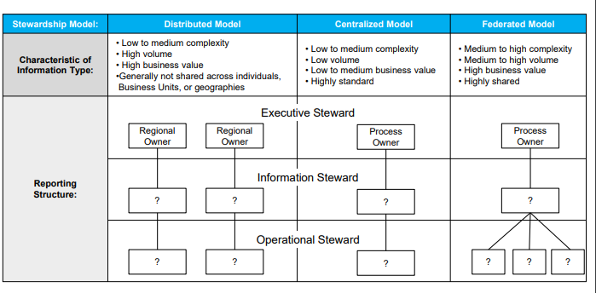
Matching Stewardship to Decision Rights
Organizational Options for Stewardship
Data
Stewardship
Roll up data definitions into higher master data categories to designate ultimate data standard ownership.
DO assign ultimate ownership to senior executives by translating the impact of data quality on business outcomes.
DON’T disperse data category responsibility over multiple owners.
Source: Merck & Co. Inc,; Gartner analysis.

Slide 28
Roadmap For This Step-by-Step Guide
Introduction
Governance Foundation
Data Stewardship
Data
Standardization
Master Data Management
Data Quality
Performance Improvement

Slide 29

Data Standardization Starts with Like-Minded Users
Sales Performance Management Cohort
Illustrative
Focus on groups of users that have similar data analysis and usage needs:
Use metrics that are linked on management dashboards (e.g., U.S. Sales, APAC Sales, Inventory Levels)
Similar titles (e.g., Head of Forecasting, Head of Pricing)
Typically 1-2 levels below C-level. Meet monthly with up to 25 users.
Create data definitions and standards and evaluate existing BI projects for potential pitfalls.
Data
Standardization
Create information consumer cohorts based on common data needs to establish consistent data definitions and standards.
Commonality of Data Usage
E.U. Sales
Marketing Analyst
Inventory Planner
Financial Analyst
APAC Sales
Avoid including business partners that have extremely technical requirements, lack of knowledge of the related business processes, or lack of time to participate.
Vaccine Sales
As the group builds consensus on data usage, introduce other business partners in similar roles to the cohort.
Benefits of Consumer-Driven Information Integration
Lightweight structure does not require top-down mandate or broad buy-in across multiple functions
Similar challenges and goals for applying information drive consensus on standards for and use of data across business groups
Improve visibility and execution of global BI products
IT shifts from dictating standards to facilitating solution
Novartis AG; Gartner analysis.

Slide 30


Identify Demand for Data Based Triggers
1. Scan for Bus Experiencing Changes in Data Usage
2. Develop an Integration Based Solution to Meet BU Need
Data
Standardization
Target business units experiencing significant operational changes that create new information needs and provide incentives to integrate their data.
Triggers of a Potential
Change in BU Data Usage
Trigger
New Head of Sales in North America
Drop in Sales/Profitability
Change in Organization Structure
New BU/Function Leadership
Increased Reliance on Cross-Functional Data
Major Business Process Change
Business
Liaisons
Information
Consumer
Cohorts
Executive
Committee
Business Need
New Head of Sales in North America needs increased visibility into production levels to calibrate volume commitments.
Targeted IT
Outreach
IT Solution
Integrate North American sales data with on-hand and work-in-progress inventory levels.
Potential Incentives for BU to Integrate Data
Access to analytical tools associated with centralized dataset
Increased access to cross-functional data
Ability to demonstrate BU performance by incorporating data into enterprise dashboard.
Visible contribution to an effort that generates enterprise-level benefits.
DO identify initial footholds for data standardization initiatives in opportunistic events that will specifically impact stakeholder data needs.
DON’T presume business partner urgency for data integration purely for the goal of data integration.
Novartis AG; Gartner analysis.

Slide 31
Balancing Local and Enterprise Data Needs
Data
Standardization
Local Data Integration Complexity Scale
Integration Approach Decision Matrix
Evaluate the complexity of integrating local data against its potential cross-functional value.
Identify new sources of information based on the data usefulness across Bus, current cross-BU demand for data, degree of data redundancy, and alignment of data to an enterprise-level integration strategy.
Weigh the cost and complexity of integration by considering the effort required to integrate, overall data quality, and level of alignment of the local data to enterprise data definitions.
Take a selective integration approach by focusing on valuable BU data with low integration complexity.
Level 4
Business processes would need substantial transformation to integrate data (e.g. new ERP implementation)
Level 4
Local Action:
Develop stand-alone tool to meet BU need
Enterprise Benefit:
None
Local Action:
Develop stand-alone too to meet BU need
Enterprise Benefit:
Immediate value; plan long-term integration
Level 3
Significant investment for ETL processes required; basic data governance lacking
Integration
Complexity
Level 2
Data not perfectly aligned with enterprise standards but no large-scale quality errors.
Local Action:
Opportunistic integration of selected data elements
Enterprise Benefit:
None
Local Action:
Immediate integration of information
Enterprise Benefit:
Increased access to new types of information across BUs
Level 1
Existing data aligned with enterprise standards and definitions and of good quality.
Level 1
Cross-Functional Usefulness Score
Local Data Valuation Scorecard
Criteria | Scoring Scale |  |  |  | Score
Usefulness of BU Data Across Multiple Functions | 1 pt. | Narrow applicability | 5 pts. | High degree of applicability for other Bus | 5
Existing Demand for BU Data | 1 pt. | No requests or queries for data | 5 pts. | Current requests for data from other BUs | 5
Redundancy of BU Data with Existing Enterprise Data | 1 pt. | Data already exists in the EDW | 3pts. | Data not currently captured in EDW | 1
Alignment of BU Data with Enterprise Data Strategy | 1 pt. | No projected future need for BU data | 3pts | BU data critical to enterprise data roadmap | 1
Cross-Functional Usefulness Score |  |  |  |  | 12
Novartis AG; Gartner analysis.

Slide 32
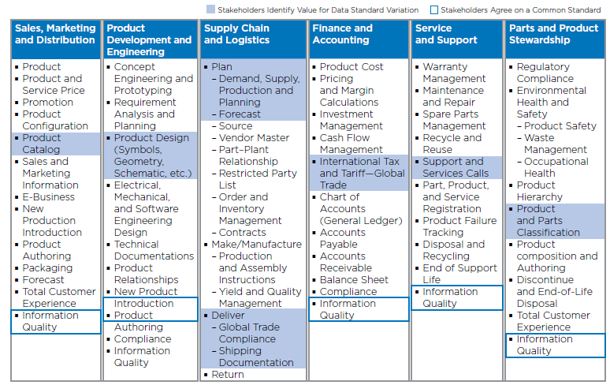
Balancing Flexibility with Rigor in Data Standards Requirements
Data
Standardization
Value Chain Analysis: Standardization Versus Flexibility
Identify data touch points across the value chain to determine commonly agreed data definitions.
Bring in stakeholders from across the value chain to collaboratively determine where standardization is beneficial and where flexibility is more valuable.
HP establishes common data definitions by determining the lowest level of granularity required by relevant stakeholders.
DO define levels of standardization to reduce redundancies but allow local variation where a standard definition will not suffice.
DON’T set an arbitrary number of data standards.
Source: Hewlett-Packard Company; Gartner analysis.

Slide 33
Roadmap For This Playbook
Introduction
Governance Foundation
Data Stewardship
Data
Standardization
Master Data Management
Data Quality
Performance Improvement

Slide 34


Roles and Responsibilities in MDM
Established Forum for MDM
MDM
Evaluate and Prioritize Issues
Issues selected and prioritized must be related to master data or the master data management process and require strategic input.
Use a structured forum to advocate for enterprise-wide MDM solutions and reuse.
A narrow definition of forum purpose and process enables efficient issue analysis and decision-making.
The forum meets bi-weekly, with smaller working teams meeting between sessions to prepare documents and deliverables for review and approval.
Standards and policies defined by the forum are governed by a separate data governance body.
4. Publish, Promote, and Govern Solutions
The enterprise standard is published for project adoption and MDM Forum members serve as a network of advocates for enterprise reuse.
MDM Forum
DO establish a formal mechanism to gain broad buy-in for enterprise MDM standards.
DON’T dilute governing body impact by pursuing too many objectives.
3. Review and Approve Proposals
Working group presents the proposed solution to the broader forum for approval as the enterprise standard approach.
2. Select Working Groups
Working group members are selected from the forum to design a solution that considers both business and IT requirements and interests.

Slide 35
MDM Forum Charter
MDM
The MDM Forum Charter documents the purpose, mandate, scope of control, and participating stakeholders.
Purpose
Enterprise-wide master data strategy leadership across business and technical teams in the areas of education, vision, principles, and best practices. Identify and prioritize MDM issues requiring cross-team strategic guidance. Advocate and disseminate MDM guidance to the organization and project teams. Collaborate with other data-focused teams to manage interdependencies and synergies in respective strategies (data governance, metadata, information security, etc.)
Mandate
Define master data domains Set the application of data alignment and future state and domain roadmaps Establish MDM architecture principles and guidelines Establish standards and policies Define and enforce the governance model for MDM principles, guidelines, and standards Draw upon additional resources beyond the forum as needed
Scope
Discussion and resolution of issues specific to defined master data domains: Item Vendor/Business Partner Location Customer Employee Chart of Accounts
Participants
Representatives from the following technology and business teams: Business Intelligence Services Corporate Systems Architecture Enterprise and Information Architecture Enterprise Business Intelligence Product Design and Development Online Business ERP Implementation Program Vendor Management and Maintenance
Organization
Processes
Metrics

Slide 36
Classification of Principles
MDM
Principles are classified into categories for context and clarity.
Classifications
Principles
Enterprise
Simplify IT Assets (Enterprise)
Data Architecture
Using existing authoritative source
Business Intelligence
Master Data Management
Data Design
Adhere to master data management architecture
Standards and Best Practices
Entity/Attribute naming conventions, Automated checking

Slide 37
MDM Principles Checklist
MDM
Principles drive to an enterprise perspective and increase focus on other data principles by adhering to scalability, reuse, and standardization.
The MDM solution must:
Provide the enterprise with an authoritative source for master data
Decouple the management of master data from transactional or analytical applications and processes
Control the standardized distribution of master data across the enterprise (i.e. common integration services)
The MDM solution must adhere to principles not exclusive to MDM:
Enable the addition of new master data (e.g. new data element, new content, new domain)
Provide the availability to incrementally implement a MDM solution (to demonstrate immediate value)
Leverage existing technologies within the enterprise
Align to industry-accepted open computing standards
Accommodate change to master data schema, business requirements, and regulations
Manage as a strategic asset for enterprise use

Slide 38
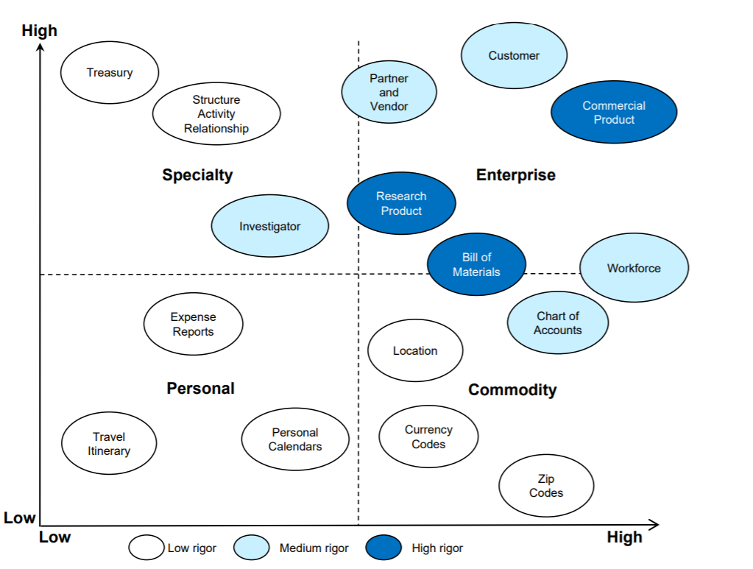
MDM Governance and Decision Rights
MDM
Determine data governance levels by assessing the shareability of the asset and its impact on the business.
DO focus the most rigor on assets that have the highest business value and the broadest use.
DON’T treat all data equally by applying a one-size-fits-all governance rule
Source: Merck & Co., Inc.; Gartner analysis

Slide 39
MDM Maturity Model
MDM Maturity Path
MDM
Create a master data maturity model to target and track capabilities for business units and the enterprise.
 | Stewardship and Governance | Data Definition | Harmonization | Quality Management
Stage 1: Uncertainty Ad Hoc Procedures | No roles are defined. | Data belong to a single system. | Data management is application specific. | Defects are addressed as encountered.
Stage 2: Awakening Repeatable Procedures | Individual roles are recognized in an informal manner. | Data are defined for single business unit need. | Data are managed in localized centers with no integration. | Potentially reusable defect reports are created when problems arise.
Stage 3: Enlightenment Defined Procedures | Some shareable business concepts are assigned owners. | Data are defined for multiple business needs but not enterprise needs. | Data are managed in localized centers but integrated with other systems. | Routines are in place for defect detection and remediation.
Stage 4: Wisdom Managed Procedures | Management assigns enterprise stewards. | Enterprise-wide semantics and syntax are defined. | Data are managed division-wide and integrated with other systems. | Defect prevention edits and periodic third-party audits take place.
Stage 5: Certainty Optimized Procedures | Formal enterprise-wide decision-making framework in place. | Enterprise-wide syntax, semantics, and pragmatics are defined. | Key data elements and identifiers are managed enterprise-wide. | Defect prevention is designed into business processes.
Source: Merck & Co., Inc.; Gartner analysis
Notes:
There are additional data management measures than definitions, sourcing, and measurement. In this example from Merck, stewardship and governance is important as well. Additionally, it is important to have an understanding what good/better/best maturity looks like. Merck identified a standard 5-point maturity scale to monitor gradual maturation from ad hoc data governance to optimal governance. In stewardship, for example, the organization can identify the data stewards and begin to set up formal processes before it establishes a formal, enterprise-wide stewardship program. Similarly, data needs to be well-defined and harmonized within each area for enterprise-wide harmonization efforts to be productive. Merck used this model to help each function appoint stewards, define its data, and improve its quality as it sought to reach mature enterprise-level MDM capabilities.

Slide 40

MDM as Means, Not Ends
Partial Root Cause of MDM Challenges
Challenge
Root Causes
Solutions
Components
MDM is not seen as a solution to anyone’s specific problem.
Focus on business critical master data domains.
1. Master Data Prioritization
MDM initiatives fail to receive funding or realize their specified benefits.
The payback period is too long.
Carefully filter projects to identify master data needs.
2. Principled Project Selection
Getting consensus across business units is difficult.
Use information and data architects to balance enterprise and BU needs.
3. Cross Project Coordination

Slide 41
Focus on the Critical Few
Master Data Prioritization Matrix
Illustrative
MDM
High
Monitor
Prioritize
Only a few master data domains require enterprise prioritization; base that decision on their business critically and system impact.
Townes* determines the business criticality of a master data domain by assessing its impact on the following six areas:
Financial
Media and reputation
Regulatory and legal
Customers
Staff
Time and problem management
Townes assigns a system impact rating to each master data term where:
Low = <20 systems
Medium = 20-50 systems
High => 50
Employee
Customer
Location
Business Criticality of Data Domain
Channel
Finance
Product
Change in business dynamics triggers a shift in the business criticality of “Product” data.
Product
Supplier
Low
Not Applicable
Monitor
Low
High
Number of Systems Touched by Data Domain

Slide 42
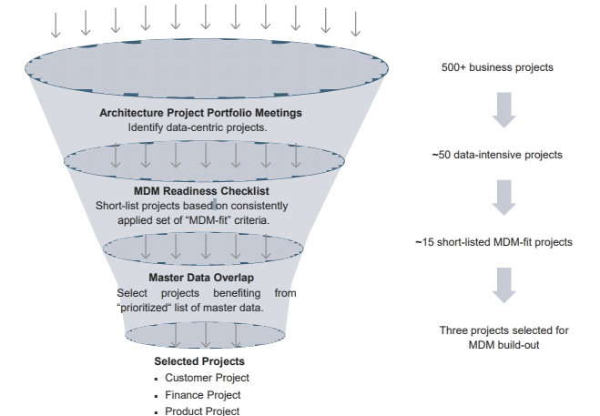
Ensure MDM Need in Project Solution
Project Screening Process
Illustrative
MDM
Don’t force-fit projects to an MDM objective, but instead use a rigorous set of project screens to ensure there is a real MDM need.
Townes deems a project data-intensive if an information architect indicates that the solution is data intensive, moves large amounts of data, or involves complex data structures.
Data-intensive projects require a data profiling strategy based on data governance guidelines and approval by the data governance committee.
Map the short-listed projects to the prioritized set of master data domains to arrive at a final set of projects.

Slide 43


Maintain MDM Alignment
MDM Roadmap with Data Dependencies
Illustrative
MDM
MDM projects require the involvement of both information and data architects to balance project and enterprise-wide needs.
Information architects and data architects meet every three weeks to review project designs in detail, focusing in particular on alignment to the enterprise data model.
Finance Project
Three steps for successful cross-project MDM coordination
Plan for near-concurrent completion of MDM elements within projects.
Identify formal data dependencies across projects.
Highlight dependencies to drive continued business support for projects.
Customer Project
Product Project Management
Indicates a data dependency.
 | Information Architect | Data Architect
Shared MDM Responsibility | Use project knowledge to inform and ensure that the enterprise data model evolves correctly.
Individual Responsibilities | Review all project designs and check project data models against enterprise data model. Ensure requirements are in line with strategy and target state architecture. | Act as the single point of contact between the central EA team and project teams. Translate high-level business requirements into data models.
Project Involvement | Involved at the program level Thirty percent chargeable on a pro-rata basis | Involved at the project level 100% chargeable to the specific project(s)
DO triage data issue resolution based on strategic impact.
DON’T burden senior executives with data quality resolution issues that can be resolved at lower levels of the organization.

Slide 44
Roadmap For This Playbook
Introduction
Governance Foundation
Data Stewardship
Data
Standardization
Master Data Management
Data Quality
Performance Improvement

Slide 45

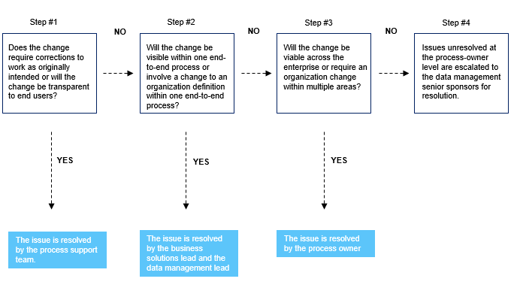
Resolving Data Standards and Quality Issues
Data Issue Escalation Process
Data Quality
Incorporate a change management decision tree to appropriately filter data quality issues for escalation.
Data quality and standards issue resolution occurs cooperatively between business process leads and data management leads
DO triage data issue resolution based on strategic impact.
DON’T burden senior executives with data quality resolution issues that can be resolved at lower levels of the organization.
Source: Weyerhaeuser; Gartner Analysis.

Slide 46
Contextualize Data Quality Issues
HP’s Information Management Framework
Illustrative
Data Quality
How does the data fit in our logical and physical data models and metadata approach?
HP uses a framework that puts data quality issues in a context that business partners can understand, elevates the importance of information management, and secures business buy-in for data quality investments.
HP developed its information management framework through reiterative conversations between business and IT partners.
Data Models, Standards, Policies, Processes, and Metadata Management
How will the data be managed throughout its full lifecycle?
Information Lifecycle Management
What are the integration needs for this data?
Data Access
Strategy and Governance
What is the context for the data within the overall information management approach?
What are the reporting requirements for this data?
Reporting and Analytics
Data Administration
What are the security requirements of this data?
Data Quality and Management
Source: Hewlett-Packard Company; CEB analysis.
How do we measure and assess the ongoing quality of this data?

Slide 47
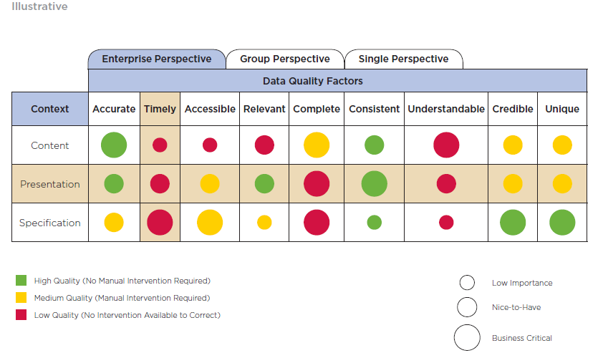
Data Quality Heat Map
Data Quality
Use a heat map to highlight business-critical data quality deficiencies for prioritized improvement.
The Information Architecture team at Gamma uses a heat map to facilitate discussions with stakeholder groups such as Business Intelligence to guide data quality gap analysis.
Horizontal views highlight context deficiencies across data quality factors.
Vertical views reveal data quality factor deficiencies across different contexts.
The heat map is used to analyze data elements (e.g., customer, vendor).
Illustrative
DO understand data quality from the point of view of different users and varying contexts.
DON’T limit data quality to accuracy, timeliness, and relevance alone.
Source: Gamma Co. (Pseudonym); Gartner research.
Notes:
When drilling down into data quality, there are multiple common attributes that organizations use to gauge it: accuracy, timeliness, accessibility, relevance, completeness, consistency, understandability, credibility, and uniqueness. To ensure that you are improving data quality from all perspectives, this heat map looks at these attributes from three altitudes: the enterprise, the function or department, and the individual. The dashboard also evaluates not just the content itself but how it is presented and how it is defined and managed by the organization. Together, this provides both a complete view of data quality as well as a means to identify specific areas of improvement. For example, data might be accurate and well-presented to senior leadership, but a knowledge worker within the function may not have access to that same data despite needing it to make day-to-day decisions. Finally, this heat map can help the organization prioritize improvements with both the quality score (denoted by the bubble color) as well as the importance score (denoted by the size of the bubble).

Slide 48
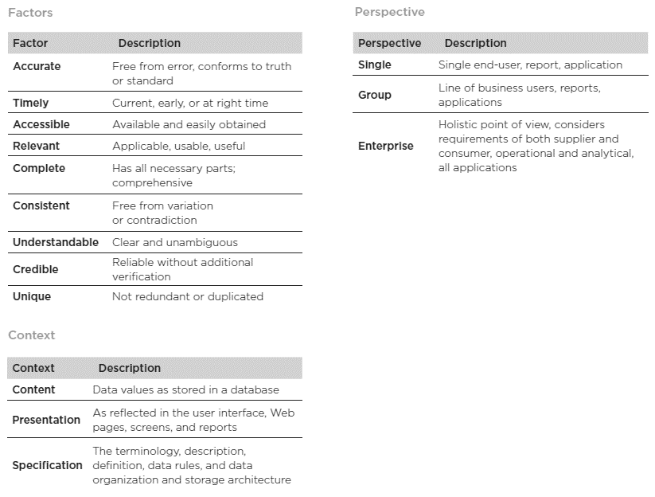
Dimensions of Data Quality
Illustrative
Data Quality
Define data quality dimensions for effective usage of the data quality heat map.
Notes:
These definitions are necessary to help the team understand the specific problems with data that the data quality heat map identifies. The definitions also help reviewers understand the different perspectives being evaluated as well as the way in which data may be inaccurate (i.e., the data itself, the way it is presented, or how it is defined and managed).

Slide 49
Roadmap For This Playbook
Introduction
Governance Foundation
Data Stewardship
Data
Standardization
Master Data Management
Data Quality
Performance Improvement

Slide 50
Enterprise Data Maturity Path
Enterprise Data Maturity Path
Performance Improvement
Define distinct levels of maturity to objectively assess data competency.
Foundational level of maturity focus on common data definitions and enterprise wide usage.
Higher level maturity includes ability to measure initial data quality improvement and ongoing maintenance.
Maturity Stage | Definition
Data Subject Approved as “Enterprise” | Specific data subject such (customer, vendor) targeted for common enterprise use
Enterprise Definition Established | High-level description for established as “single” meaning for company
Data Source Identified | Single origin defined as creation maintenance point from which data is shared
Detailed Data Definition Established | Full data definition description established—identification approach, characteristics, business rules, maintenance process, quality measures
Migration Plan Defined | Schedule to move from current state data subject management to target single-source state approved
Data Implemented in Source | Source configured and legacy data cleansed/converted to source per standards.
Data “Source” Published | Source system establishes “interchange” to which other systems connect and receive copies of standard instance data
Sustaining Data Management Process in Place | Processes and organization in place to maintain the data at source
Data Quality Assessment Performed | Approach identified and assessments performed to identify cleanliness of the data (not a rating of the quality results)
Legacy Data Compliance to Source Measured | Status reporting of progress on transition of “legacy” data collection points to enterprise standard
Increasing Data Maturity
Source: Weyerhaeuser; Gartner Analysis.

Slide 51

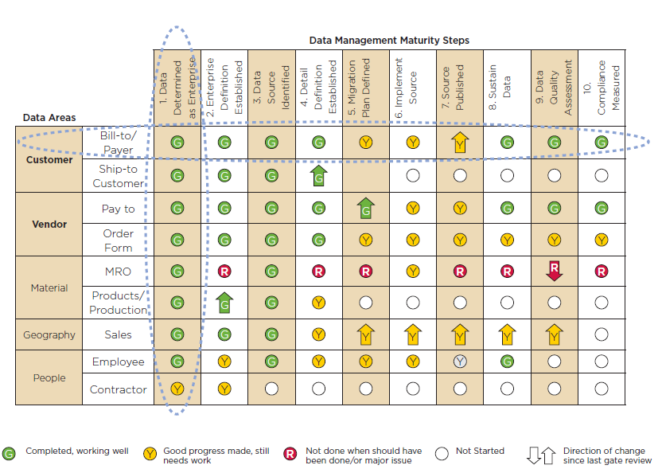
Data Management Maturity Scorecard
Performance Improvement
Weyerhaeuser tracks performance against maturity stages to obtain a holistic view of progress in data governance.
Rows track maturity progress for individual data areas.
Columns track comprehensive maturity attribute achievement across data categories.
Source: Weyerhaeuser; Gartner Analysis
Notes:
In addition to data and information health, which are the improvements necessary to make better decisions, the organization can track its ability to manage data and information. Improved data governance will lead to better data quality, so companies such as Weyerhaeuser are evaluating and monitoring the improvement of the maturity of these capabilities. On the left-hand side of the table, Weyerhaeuser lists the data areas being assessed for data management maturity. Across the top of the table are the components of effective data management: identifying enterprise data, establishing enterprise-wide definitions, knowing where the data is and where it should be, moving it from where it is to where it should be, and having effective quality and compliance measures. The red/yellow/green scoring tracks progress toward optimizing the management of the data, while the arrows indicate a change in the effectiveness since the last check-in. The goal is continuous improvement in the management of data over time.

Slide 52
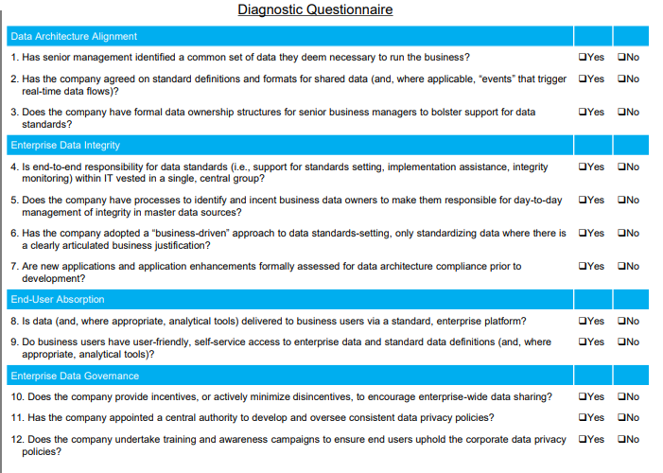
Organization Readiness for Data-Visibility Benefits Capture
Performance Improvement
Use a diagnostic to assess the ability to realize the business case of investments in enterprise data visibility.

