Slide 1
Data Management
Technology Roadmap
May 2021

Slide 2
Digital Transformation – Enterprise Information Capabilities Tools
Data Catalog & Governance
Data Quality
Master Data Management
(MDM)
BI & Self Service Analytics
Data Integration & Orchestration
Cloud Data Platform (CDP)
Data Modeling
ML/AI
Data Science
Idera ER/Studio
Informatica EDC and Axon
Informatica Cloud Data Quality (CDQ)
Matillion
MuleSoft
Striim GoAnywhere MFT
Reltio
Snowflake
Power BI
TBD
Business transformation alignment & enablement
New technology & architecture discovery and enablement – 6 month to 5 year event horizon
Global and regional consulting support at program and project scope

Slide 3
Information Capabilities Pillars - Definitions
Data Catalog & Governance
Data Quality
Master Data Management (MDM)
BI & Self Service Analytics
Data Integration & Orchestration
Cloud Data Platform (CDP)
Data Modeling
ML/AI Data Science
Automated or semi-automated examination of data (structured and unstructured) using sophisticated techniques and tools, typically beyond those of traditional analytics, to discover deeper insights, make predictions, or generate recommendations. Advanced analytic techniques include those such as data/text mining, machine learning, pattern matching, forecasting, visualization, semantic analysis, sentiment analysis, network and cluster analysis, multivariate statistics, graph analysis, simulation, complex event processing, neural networks.
Defines the blueprint for managing data assets by aligning with organizational strategy to establish strategic data requirements and designs to meet these requirements
Data Catalog is an organized inventory of the organization’s data assets, using metadata to help data discovery, understanding, trust and
Data Governance is a collection of practices and processes which help to ensure the formal management of data assets within an organization
Master Data Management (MDM) is the technology, tools and processes that ensure master data is coordinated across the enterprise. MDM provides a unified master data service that provides accurate, consistent and complete master data across the enterprise and to business partners.
Activities to measure and improve the condition of data based on factors such as accuracy, completeness, consistency, reliability and whether it's up to date. It is a critical measure of data to help improve its use across the organization to drive value and manage risk associated with data.
The automation of data-driven processes from end-to-end, including preparing data, making decisions based on that data, and taking actions based on those decisions. It's a core capability to enable the efficient utilization of data across the organization in the right way.
The integrated technology solution that allows data located in database(s) to be governed, accessed, and delivered to users, data applications, or other technologies for strategic business purposes.
The process of examining datasets to draw conclusions about the information they contain. Data analytic techniques enable you to take raw data and uncover patterns to extract valuable insights from it

Slide 4
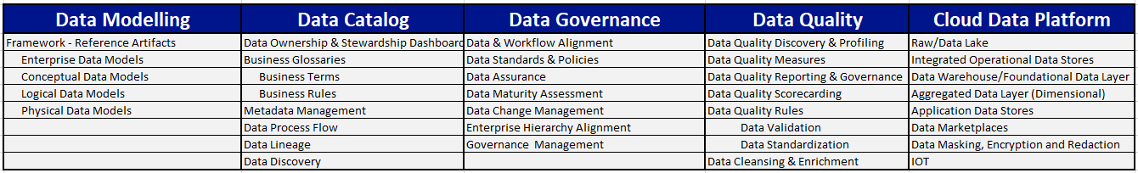
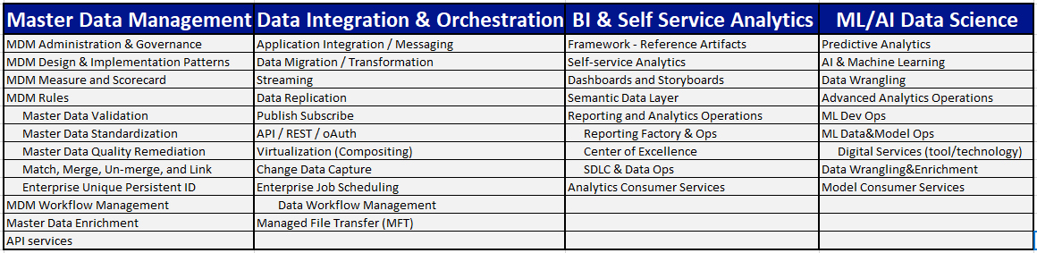
Information Capabilities Pillars – Sub-capabilities
All IT-capabilities are in
EnterpriseHub

Slide 5
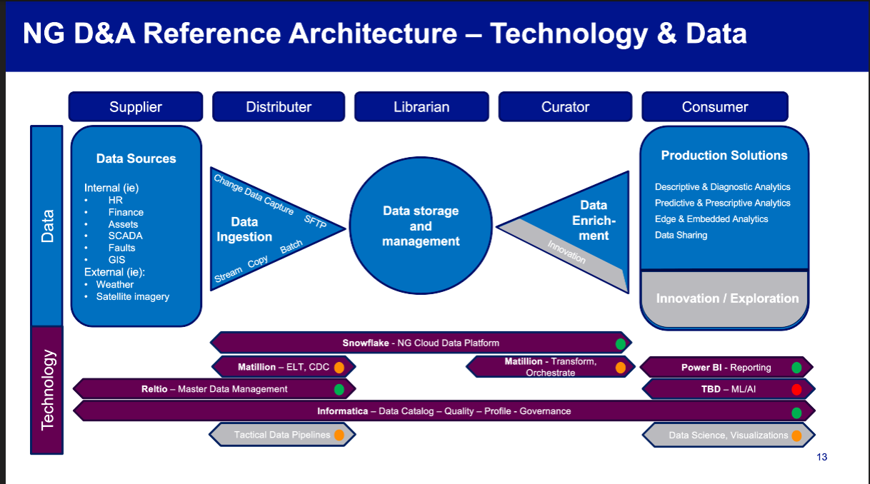
Bowtie

Slide 6
Cloud Data Platform Roadmap
Tools
FY21 | FY22 | FY23 | FY24
Prod Approval (BSR)
Snowflake
Certify US-UK Data
Row Level Policies
Snowpark Native Python
Tool Selection
Snowflake GA
US Customer
MVP Release 1B
MVP Release 2B
MVP Release 1W
MVP Release 2W
Global Workforce
NGV -
PI Historian (
UK-ET –
MVP Release 1A
MVP Release 2A
MVP Release 3A
US ET
Asset
NGV
MVP Release 1A
MVP Release 2A
MVP Release 3A

Slide 7

Master Data Management Roadmap
Tools
Disposition: Sanctioning is being finalized for the tool standup and business data domain implementation. Planning for Customer 1st MVP is under way.
FY21 | FY22 | FY23 | FY24
Complete Security Assessment, Contact & Get Funding
MDM Platform
Reltio
MDM patterns, guidelines, standards, and best practices
Tool Selection
MDM Platform
Available
MVP Release 1C
MVP Release 2C
MVP Release 3C
US Customer
Master Data
US Customer Pre-Work
Persistent ID (leverage UDM) , Key Customer Profile fields, Product, Account
Customer Contact,
Preference, Premise, Meter
Customer, Segments,
Customer Programs/Plans
MVP Release 1W
MVP Release 2W
Global Workforce
Master Data
Global Workforce Pre-Work
Worker Persistent ID, Key Worker fields, Position
Org hierarchy, Cost Center, Location, Union, Legal Entity,
Vendor, Work order
MVP Release 1A
MVP Release 2A
MVP Release 3A
US Asset
Master Data
US Asset/Location Pre-Work
Persistent Unique ID, Key Location and Asset fields
Additional Asset and Location Fields
Additional Asset and Location Fields
MVP Release 1A
MVP Release 2A
MVP Release 3A
UK Asset
Master Data
UK Asset/Location Pre-Work
Persistent Unique ID, Key Location and Asset fields
Additional Asset and Location Fields
Additional Asset and Location Fields

Slide 8
Data Modeling Roadmap
Tools
Disposition: Deployment completed; adoption across teams underway. Continued prioritization will be needed to progress scopes and maturity as depicted below.
FY21 | FY22 | FY23 | FY24
Enterprise Data Architect Tool
Tool Selection & Deployment
Tool Selection
Tool Actively Deployed
Tool FAQ
Tool Standards & Best Practices
Data Modeling COE
Tool Enhancements & Updates
Team Server Tool -
Model Consumption/Presentation, Data Dictionary, Global Reporting
Tool Selection
Tool Actively Deployed
Usage FAQ/Doc
Business Terms Customer Domain
Business Terms Workforce Domain
Cross-Model Reporting
Release 1 Data Domain Model
Release 2 Data Domain Model
Ongoing Data Domain Model Updates
Enterprise Data Models
Ongoing Enterprise Conceptual Data Model Updates
Release 1 Enterprise Conceptual Data Model
Release 2 Enterprise Conceptual Data Model
Customer & Workforce
Asset
Other Functional BU
Release 1 Enterprise Logical Data Model
Release 2 Enterprise Logical Data Model
Ongoing Enterprise Logical Data Model Updates

Slide 9
Enterprise Data Glossary, Data Quality & Data Governance Roadmap
Tools
Disposition: Tool Enablement finalized, Governance Foundational Approach completed, and Action Plan being finalized. Global roll out of this capability minimally resourced.
FY21 | FY22 | FY23 | FY24
Tool Enabled
Action Plan Updates, Implementation Guidelines, Standards, Best Practices
Enterprise Data Tools (EDC, CDQ, Axon)
Implementation Iterations
Action
Plan
Foundational
Approach
Start
Implementation
MVP 1 - Informatica, EHub, E/R Studio Integration
MVP 2 - Informatica, EHub, E/R Studio Integration
US Customer
Pre-
Work
MVP 1
MVP 2
MVP 3
MVP 4
Ongoing Releases
US Asset
Pre-
Work
MVP 1
MVP 2
MVP 3
MVP 4
Ongoing Releases
Global Workforce
Pre-
Work
MVP 1
MVP 2
MVP 3
MVP 4
Ongoing Releases
Other… ( UK Asset, Finance, Gas, Real Estate Etc.)
Pre-
Work
MVP 1
MVP 2
MVP 3
MVP 4
Ongoing Releases

Slide 10
Data Integration & Orchestration Roadmap
Tools
FY21 | FY22 | FY23 | FY24
Matillion ETL
BSR & Get Funding
Tool Selection
Matillion GA
Initial Release and Security Review
General Availability
Tool Selection
MVP Release 2C
MVP Release 3C
GoAnywhere
MFT
ADO(TO)
Pontoon, FieldGlass
Clifton Park / ESG
MVP Release 1W
MVP Release 2W
MuleSoft
Tool Selection
GridMod Integration
Salesforce
UK Asset
Master Data
MVP Release 1A
MVP Release 2A
MVP Release 3A
Striim
Tool Selection
Initial Load / CDC
Ongoing CDC
Transition to Matillion CDC

Slide 11
ML/AI Data Science Roadmap – Bryan to Finish
Tools
FY21 | FY22 | FY23 | FY24
Complete Security Assessment, Contact & Get Funding
MDM Platform
Tool Selection
MDM Platform
Ready to use
MVP Release 1C
MVP Release 2C
MVP Release 3C
US Customer
Master Data
Persistent ID (leverage UDM) , Key Customer Profile fields, Product, Account
Customer Contact,
Preference, Premise, Meter
Customer, Segments,
Customer Programs/Plans
MVP Release 1W
MVP Release 2W
Global Workforce
Master Data
Worker Persistent ID, Key worker fields, Position
Org hierarchy, Cost Center, Location, Union, Legal Entity,
Vendor, Work order
MVP Release 1A
MVP Release 2A
MVP Release 3A
US Asset
Master Data
US Asset/Location Pre-Work
Persistent Unique ID, Key Location and Asset fields
Additional Asset and Location Fields
Additional Asset and Location Fields
MVP Release 1A
MVP Release 2A
MVP Release 3A
UK Asset
Master Data
US Asset/Location Pre-Work
Persistent Unique ID, Key Location and Asset fields
Additional Asset and Location Fields
Additional Asset and Location Fields
The plan for US and UK Asset Master Data is yet to be finalized.

Slide 12
Enterprise Information Platform – Tech Status
Tools
FY21 | FY22 | FY23
ER/Studio
Data Modelling
Snowflake
CDP
Reltio
MDM Platform
Data Modelling
Data Integration & Orchestration
ML/AI

Slide 13
Research Initiated
Tool(s) Selected
ITGC Approved
Capability available
Expected GA
Actively Deployed
2020
2021
Q1
Q2
Q3
Q4
Jan
Feb
Mar
Q2
Q3
Q4
Data Analytics & Reporting – Power BI
Data Modeling - ER/Studio
Enterprise Data Analytics Platform – Snowflake
Master Data Management – Finalized end of Feb
Data Quality, Data Catalog, Data Governance - Informatica
Data Integration & Orchestration – Matillion in final vetting
Advanced Analytics, Machine Learning & AI - TBD

Slide 14
Appendix
[3:53 AM] Robertson, Daniell ooking good. I think an extra slide should be added to call out 'new technology assessment' - something to highlight that this space is constantly moving and we recognise that, but have no budget for it...
​
[5:14 AM] Robertson, Daniel
what about areas that are still TBC from a requirements perspective (we can use this to highlight that the BU roadmaps don't go to a level of detail that allows us to identify additional areas and therefore request budget in advance): data virtualisation, AI/ML data cleansing?, AI ethics (bandwagon alert!), ML model management/training etc...

Slide 15
Fred’s Text
GridMod – PI Historian and Corporate PI initiative, starting June'21. Robust, interactive, secure analytics for real time SCADA data replicated to Snowflake
NGV – Neil Lall requires real time/near time ingestion of data into Snowflake via REST or SFTP, scheduled to start Q1'2022
Audit – Audit group needs a platform to securely ingest text files supplied by groups and apps being audited. Shibu Prabha and Paula Webb leading project to use Snowflake + PowerBI and create system to detect violations of Benford's Law starting Q2'2022
App Insight – CXP has a fully funded project to shift/archive web logs currently stored on Azure App Insights over to Snowflake for long range analysis. They've committed to using Snowflake and starting project immediately after General Availability.

Slide 16
To do
Roadmap – Colibri 8/10
Headings Arial 36 (32 when needed)
Order
CDP, MDM, DM, D&IO, DQ, BI, DC/G, ML/AI
Key milestone
What data capability tool procured and when?
Funded??
Patterns, Base architecture, L2 list and def, guidelines, standards and best practices, Governance model (
Operationalize and usage
Bryan – Team Milestones
Nishit – Format L2
Nishit – Definitions Nishit - ML/AI -
Bryan – UK/ET Deck
Fred – Snowflake format – final Draft
Fred – DI&O
Maria - Model
Maria – DQ, DC – final draft
Nishit – MDM Slide
Maria – URL for DG deck

Slide 17
Business Drivers (CIO Lens)
US Customer Transformation
Domains: Customer B2C, Workforce, Vendor, Product, Reference
FY2022 Business case includes MDM license cost
AMI
Domains: Customer, Asset, Location, Workforce, Reference
Allocated MDM license cost in FY2022 approved budget
Required by Jul 2021
GridMod
Domains: Asset, Location, Workforce, Reference
Allocated MDM license cost in FY2022 approved budget
Required by Jul 2021
IAM
Domains: Workforce, Reference
Workforce Data Domain
Domains: Workforce, Reference
FY2022 Business case has included MDM license cost
Digital Enablement – Leverages / Consumes
Domains: Customer, Workforce, Asset, Location, Reference
Programs: OnMyWay, FutureNow, VMO, Smart Target etc.
RIO based UK-ET and UK-GT initiatives
Domains: Customer B2B, Workforce, Asset, Location, Vendor, Product, Reference
ESO
Domains: Customer B2B, Workforce, Asset, Location, Reference
Energy Efficiency/Clean Energy initiative
Domains: Customer, Workforce, Reference

Slide 18
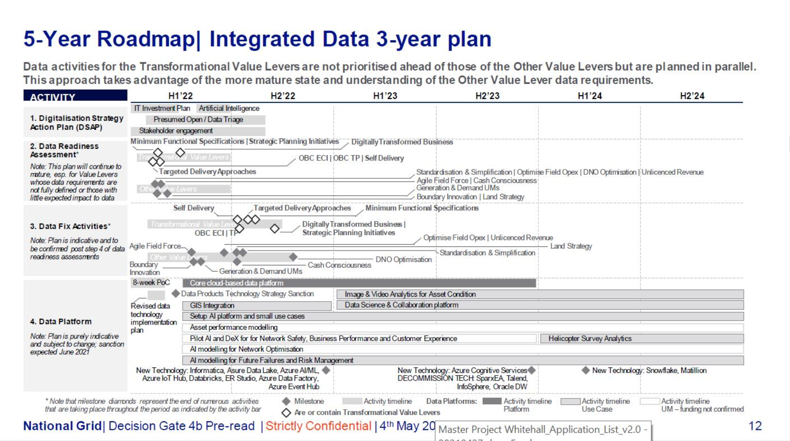

Slide 19
Data Management Capability Roadmap (1 of 2)
 | FY21 | FY22 | FY23 | FY24
Data Catalog & Governance
Data Quality
Data Modelling
◆
IDQ
Deployed
◆
CDQ
deployed
◆
EBU DQ
Scorecards
created
◆
GBU DQ
Scorecards
created
◆
Workforce DQ
Scorecards
created
◆
Tool deployed
◆
50% Canonical
Models completed
◆
Customer
Logical Model
◆
Asset
Logical Model
◆
Enterprise
Repository
Created
◆
Workforce
Logical Model
◆
Enterprise Model repository
fully populated

Slide 20
Data Management Capability Roadmap (3 of 3)
 | FY21 | FY22 | FY23 | FY24
Data Science
Data Visualization
◆
IDQ
Deployed
◆
CDQ
deployed
◆
EBU DQ
Scorecards
created
◆
GBU DQ
Scorecards
created
◆
Workforce DQ
Scorecards
created

Slide 21
Helping Digital unlock new value with agile WoW Target data landscape:
Digital Product 1
Digital Product 2
Digital Product 3
Digital Product 4
Data Product
Self-Serve Insight
Vertical teams can leverage NG Data Cloud data/tools/infra for apps, but also have options to add application specific capabilities
Verticals = Value
NG Data Cloud
Data is trusted and democratised, value from data is enabled with agility
Democratised
Customer Data
Employee/Workforce Data
Asset Data
External Data
I know where the data is
I have permission to access the data
Data is catalogued
Enriched/curated data is democratised
Quality of data is transparent
Capabilities
API’s
Data Integration
MDM
Data Governance
Data Quality
Analytics
Advanced Analytics
Data Ingest/Stage
Data Lake
Operational
Foundational Curated
Aggregated
Curated
Infrastructure
Horizontals = Value Enablers | focus; scalability, maintainability, reliability etc

Slide 22
BI & Self Service Analytics Roadmap – Give to Tom T
Tools
FY21 | FY22 | FY23 | FY24
Complete Security Assessment, Contact & Get Funding
MDM Platform
Tool Selection
MDM Platform
Ready to use
MVP Release 1C
MVP Release 2C
MVP Release 3C
US Customer
Master Data
Persistent ID (leverage UDM) , Key Customer Profile fields, Product, Account
Customer Contact,
Preference, Premise, Meter
Customer, Segments,
Customer Programs/Plans
MVP Release 1W
MVP Release 2W
Global Workforce
Master Data
Worker Persistent ID, Key worker fields, Position
Org hierarchy, Cost Center, Location, Union, Legal Entity,
Vendor, Work order
MVP Release 1A
MVP Release 2A
MVP Release 3A
US Asset
Master Data
US Asset/Location Pre-Work
Persistent Unique ID, Key Location and Asset fields
Additional Asset and Location Fields
Additional Asset and Location Fields
MVP Release 1A
MVP Release 2A
MVP Release 3A
UK Asset
Master Data
US Asset/Location Pre-Work
Persistent Unique ID, Key Location and Asset fields
Additional Asset and Location Fields
Additional Asset and Location Fields

