Slide 1
Create a Data Strategy to Ensure Success in Machine Learning Initiatives
Downloadable Figures
Georgia O’Callaghan
Notes:
Presenter's Name
Presenter's Name

Slide 2
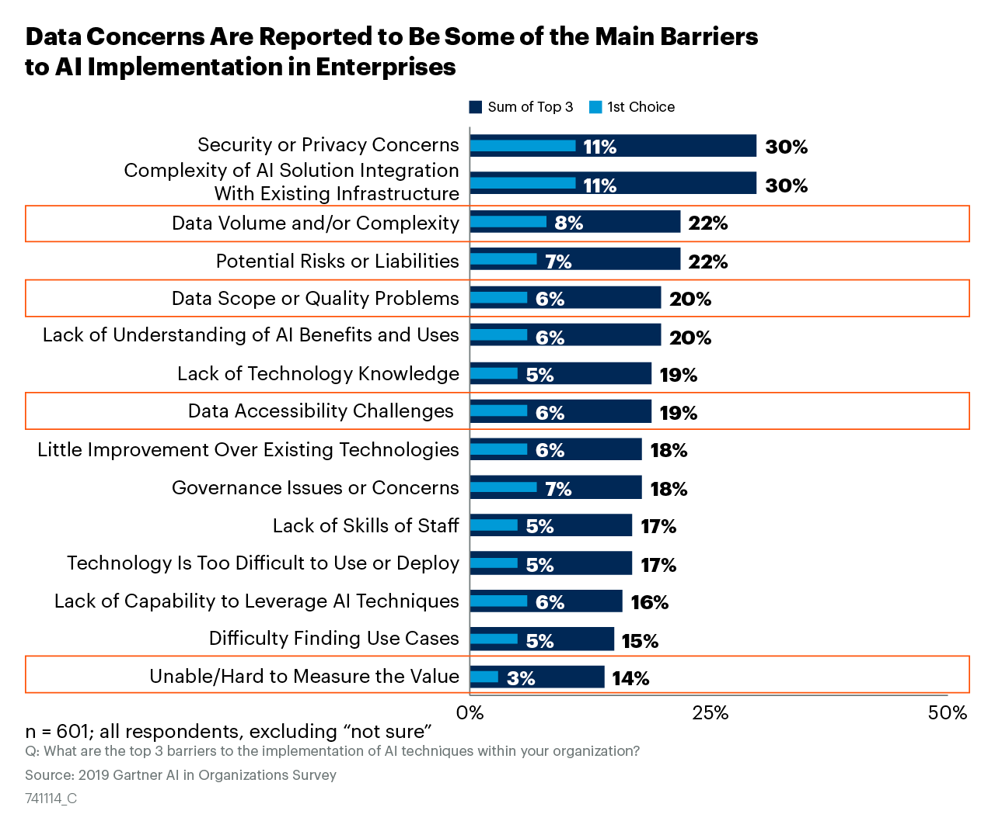
Figure 1

Slide 3
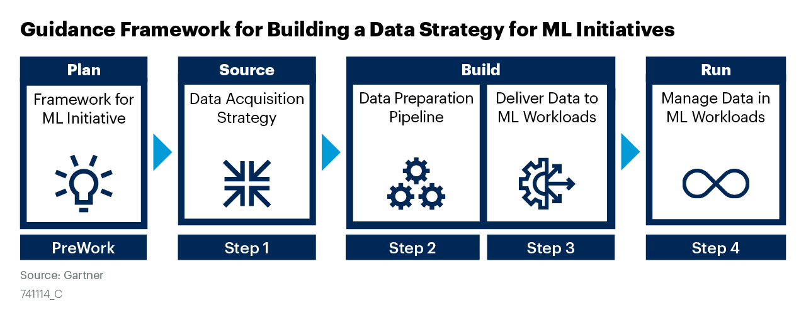
Figure 2

Slide 4
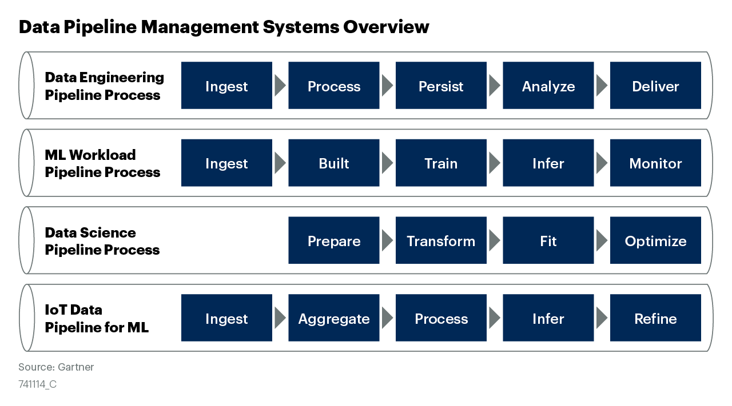
Figure 3

Slide 5
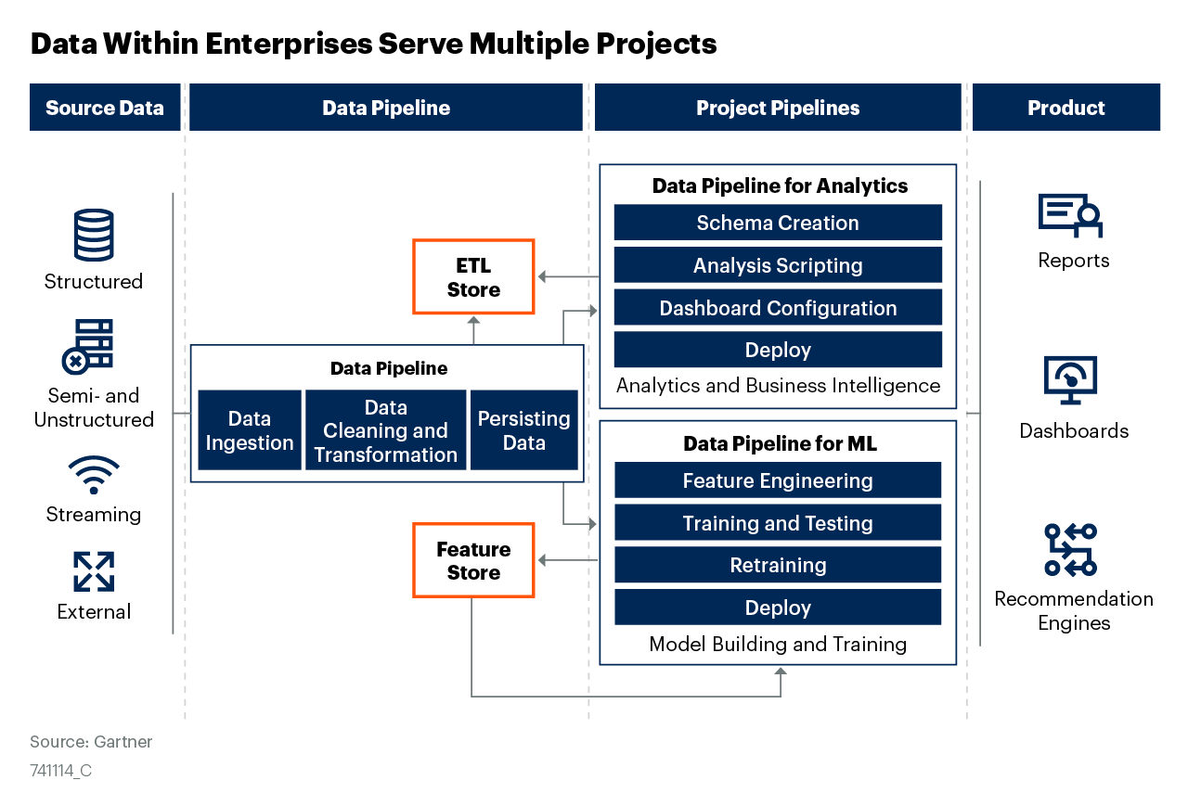
Figure 4

Slide 6
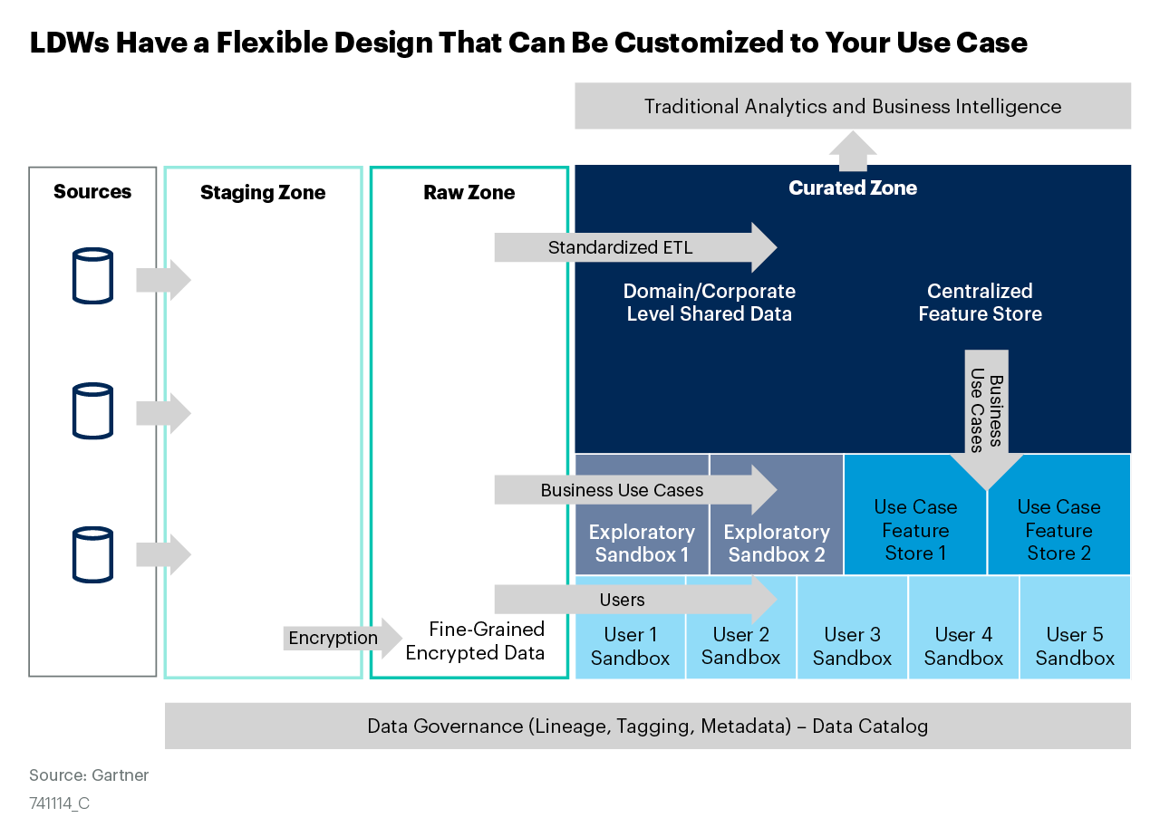
Figure 5

Slide 7
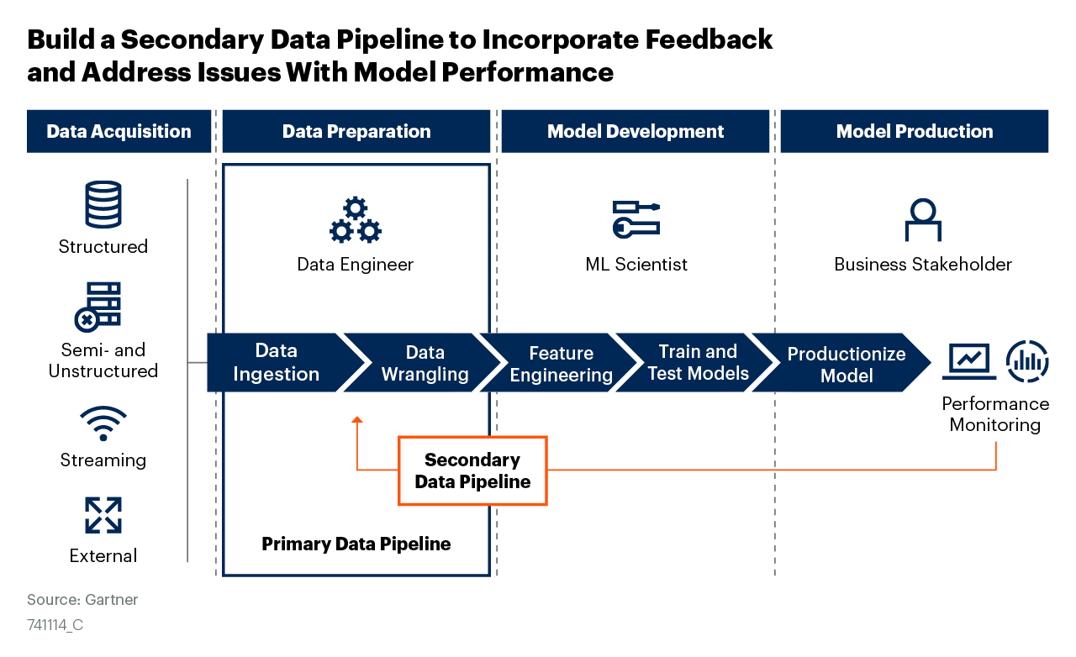
Figure 6

