Slide 1
But how does the machine learn?
Ernesto Mori
Vandana Ramakrishnan
Nathan Matare
Patrick Miller
Jordan Bell-Masterson

Slide 2




Motivation
Explosion of interest since mid-2000s
High quality/quantity data
Prediction & analysis
Lots of monies!

Slide 3
Data Description
Aggregated player and team statistics, matchup information, court atmospherics, analyst reports, and player information
4259 total features; 97,866 observations over 2013 – 2016 NBA seasons; 650+ league players
Each observation(row) is nth player game time appearance
Feature Type | Time Period | Type | Example
Player statistics | t-1 to t-10 | Continuous | Points, rebounds, fouls, assists
Players team statistics | t-1 to t-10 | Continuous | Team points, team rebounds
Opposing teams statistics | t-1 to t-10 | Continuous | Team points, team rebounds
Player biography information | t-0 | Mixed | Height, weight, position, experience
Player injury statistics | t-0 to t-10 | Categorical | Head, Achilles, Quad, Illness
Game atmospherics | t-0 | Mixed | Game time, venue, broadcast network
Analyst/Text reports | Between games | Bag of Words/n-gram | “great game”, “hot-streak”, topic 1:10
Matchup information | t-0 | Binary | 1 players team, 0 not on court, -1 opposing team

Slide 4
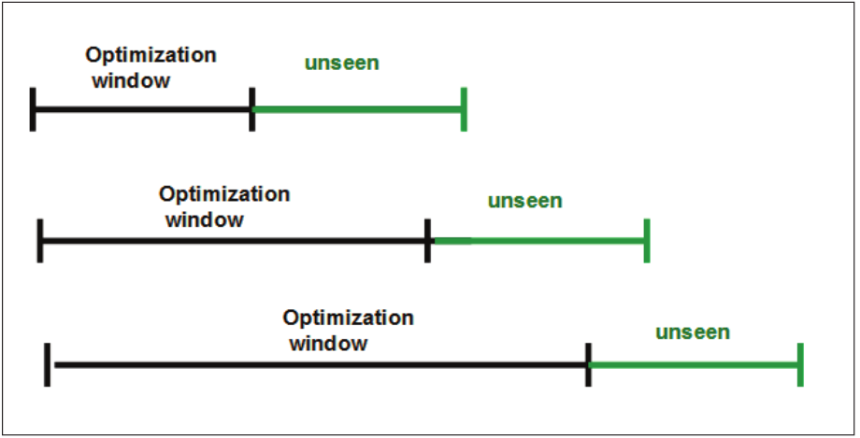
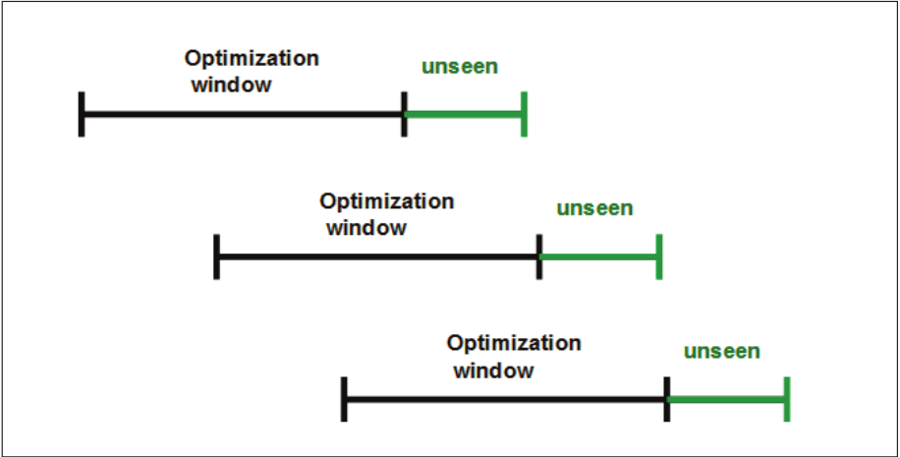
Time Series Cross Validation
Time series dependency among lagged variables t-0 through t-10
Anchored Window
Rolling Window

