Slide 1
Scripting Web Attacks with Python
Matt Brown (nmatt)

Slide 2
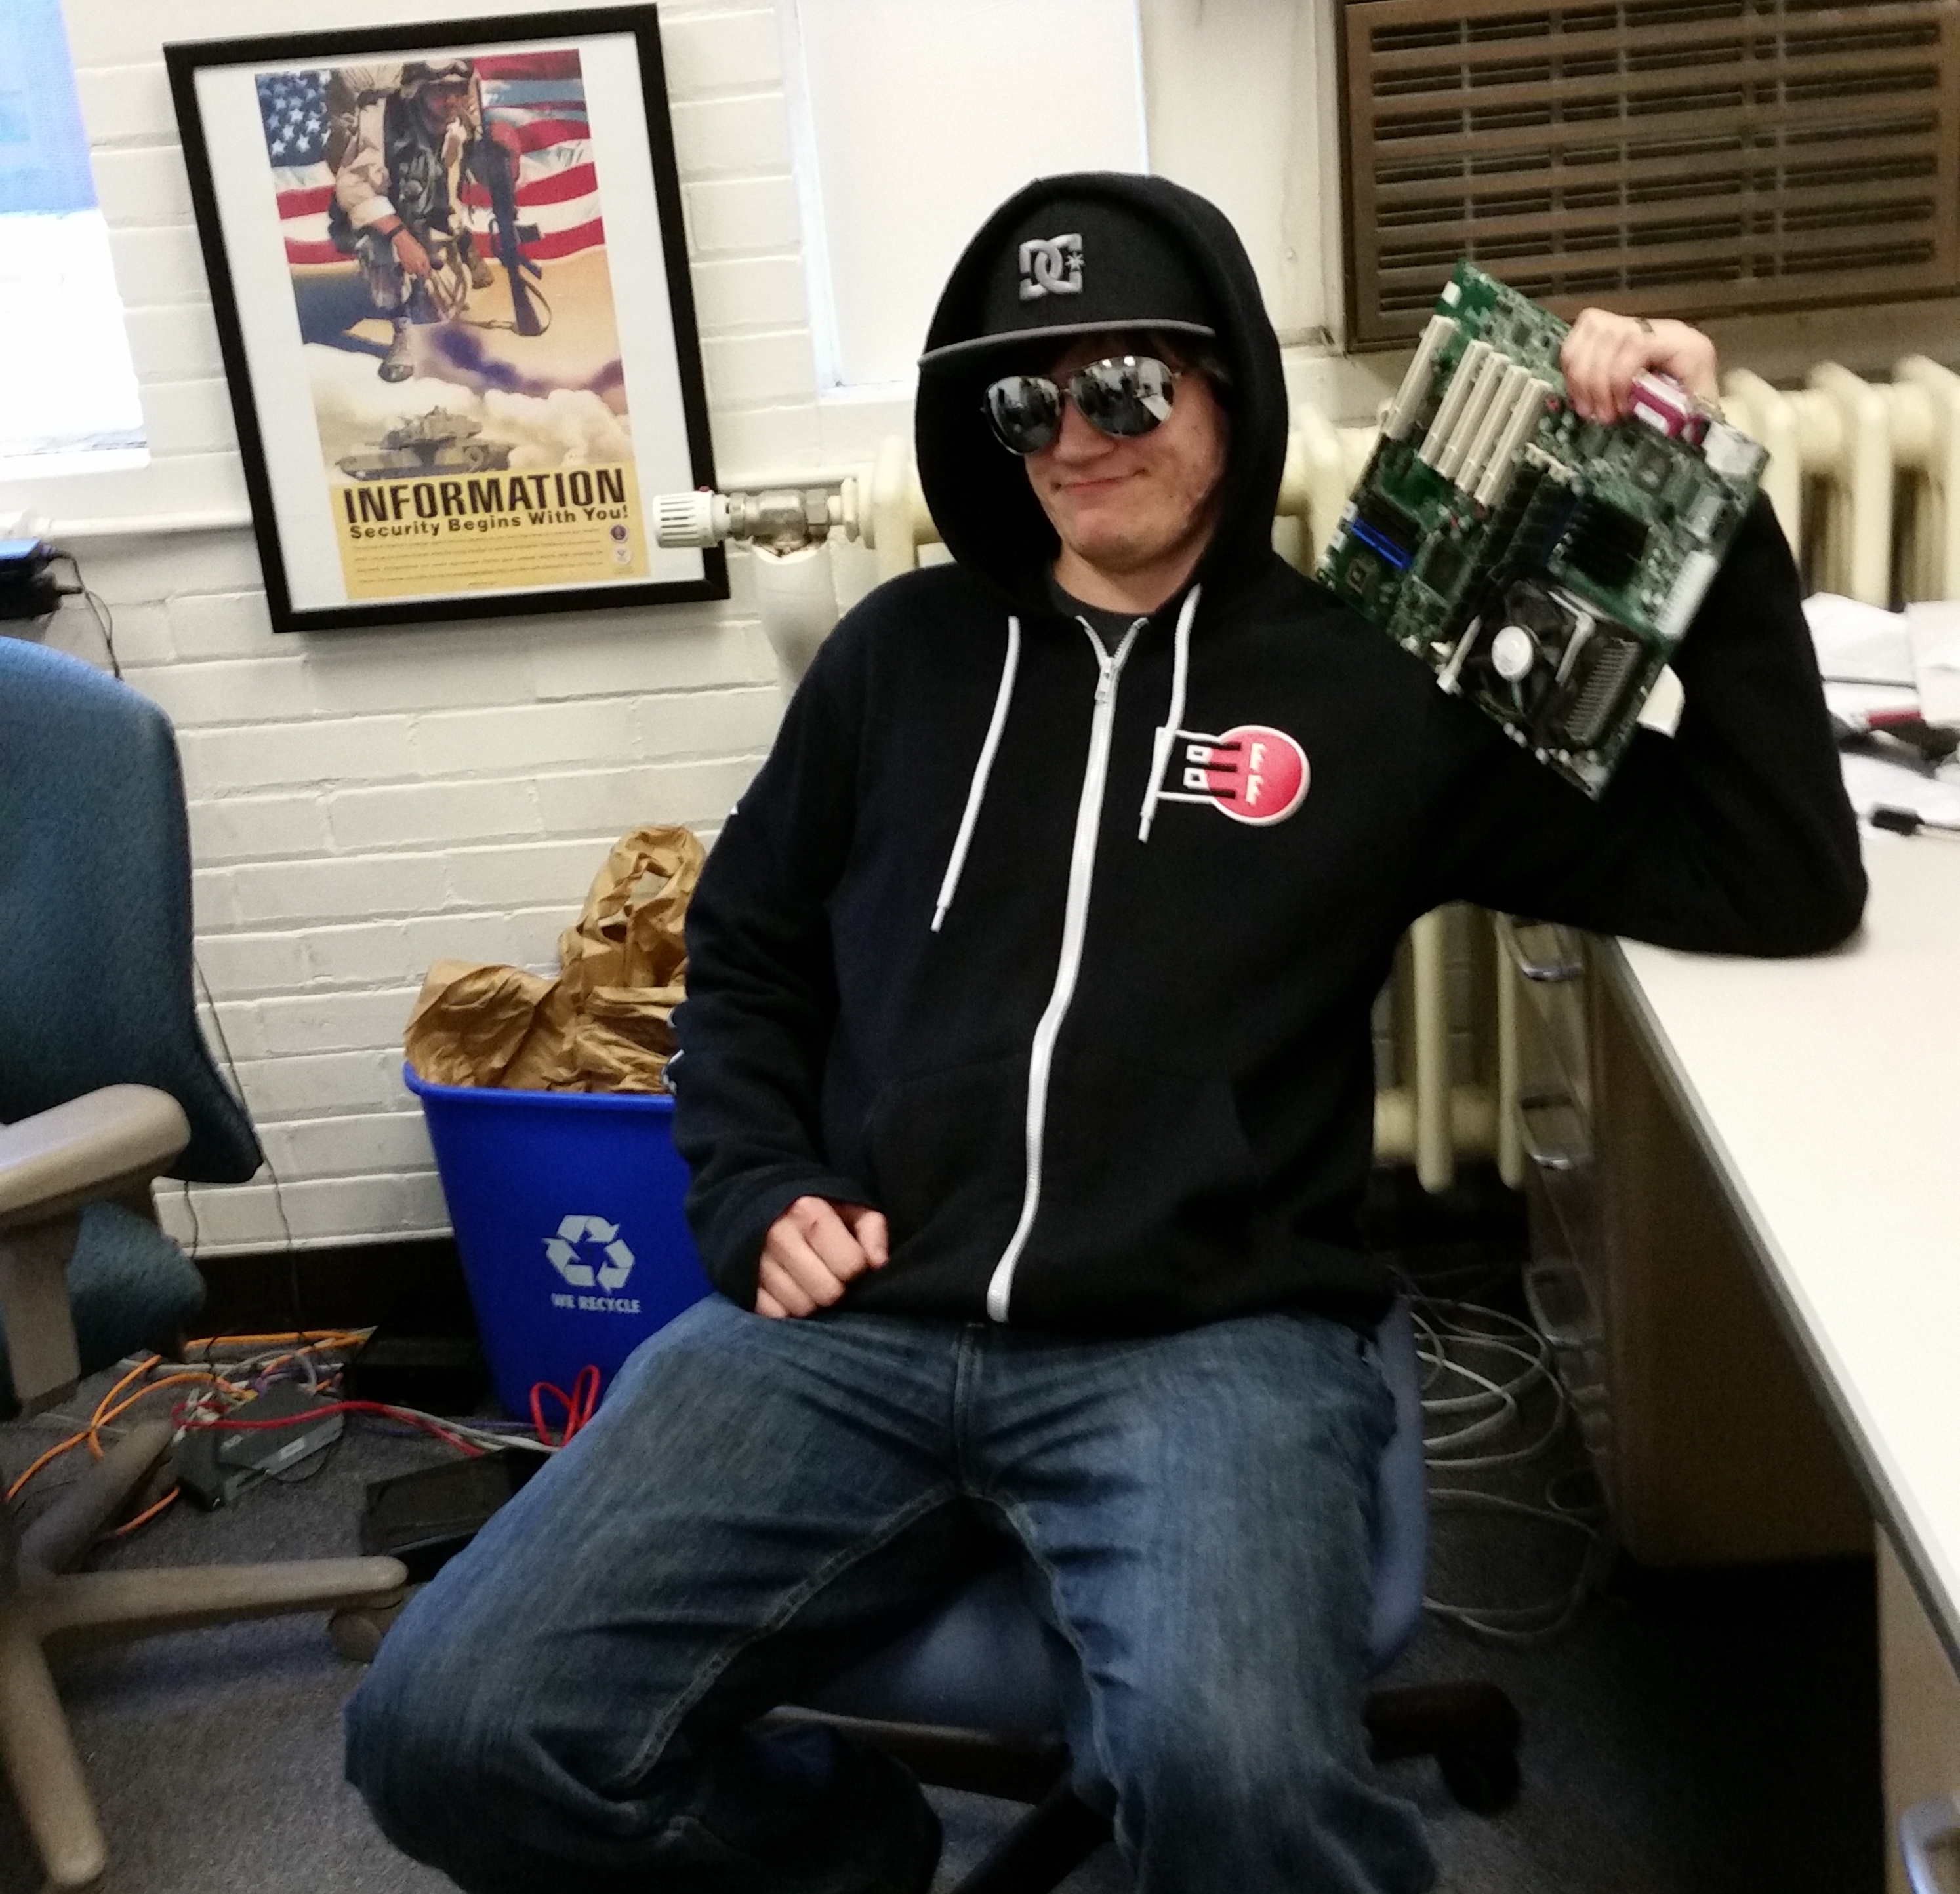
Whoami
Hacker handle: nmatt
Day Job: Security Engineer
Other Interests/Passions:
  CTFing
  Gaming on a Windows VM
    (See: PCI passthrough via OVMF)
  Philosophy/Theology

Slide 3
Agenda
Intro to HTTP
Browser Dev Tools Walkthrough
Get Python setup and ready
Write Python scripts to attack vulnerable webapp code

Slide 4
Intro to HTTP
HTTP = Hypertext Transfer Protocol
  Lets you transfer files to/from a web server
  Clients make requests and Servers give responses
  Text-based Protocol
Request
Client
Server
Response

Slide 5
Intro to HTTP – Requests and Responses
Request
Response
GET /index.html HTTP/1.1
Host: example.com
User-Agent: curl/7.61.0
HTTP/1.1 200 OK
Server: ECS (dca/53DB)
Content-Length: 1270
<html>
………….
Request
Client
Server
Response

Slide 6
Intro to HTTP – GET Request
HTTP GET
  Used to request data from a web server
  Example: http://example.com/index.html?var1=value1&var2=value2
GET /index.html?var1=value1&var2=value2 HTTP/1.1
Host: example.com
User-Agent: Mozilla/5.0 (Windows NT 10.0; Win64; x64) AppleWebKit/537.36 (KHTML, like Gecko) Chrome/68.0.3440.106 Safari/537.36

Slide 7
Intro to HTTP – POST Request
HTTP POST
  Used to send data to a web server
  Example: POST to http://example.com/index.html
    With data payload: var1=value1&var2=value2
POST /index.html HTTP/1.1
Host: example.com
User-Agent: Mozilla/5.0 (Windows NT 10.0; Win64; x64) AppleWebKit/537.36 (KHTML, like Gecko) Chrome/68.0.3440.106 Safari/537.36
Content-Length: 23
var1=value1&var2=value2

Slide 8
Intro to HTTP – Hands On Example
Browser Dev Tools
  This demo works best in Firefox or Chrome
Browse to http://ctf.nmatt.com/example.php
  Observe GET request and response
Submit FAKE username and password to the login form
  Observe POST request and response

Slide 9


Slide 10
Scripting Web Attacks w/ Python
Why Python?
  Easy to learn
  Great HTTP library: Requests
Getting things setup
  Install Requests library
    apt-get install python3 python3-requests or pip3 install requests
  Have the following open:
    Text editor of choice
    Shell to execute python scripts

Slide 11
Scripting Web Attacks w/ Python
DEMO 1
http://ctf.nmatt.com/demo1.php
Write a python script that will:
send a GET request to the target page
Modify the script to pass the user agent check

Slide 12
Scripting Web Attacks w/ Python
DEMO 2
http://ctf.nmatt.com/demo2.php
Write a python script that will:
Send a GET request to the target page
Set the correct cookie name and value

Slide 13
Scripting Web Attacks w/ Python
DEMO 3
http://ctf.nmatt.com/demo3.php
Write a python script that will:
Send a POST request to the target page
Set the “username” and “password” in the data payload

Slide 14
Scripting Web Attacks w/ Python
DEMO 4
http://ctf.nmatt.com/demo4.php
Write a python script that will:
Send a POST request to the target page
Set the “cmd” field in the data payload
Read the flag off the filesystem of the web server: “/flag.txt”

Slide 15


Scripting Web Attacks w/ Python
Questions?
Link to webapp and attack scripts:
https://gitlab.com/nmatt0/WebAttackDemos

