Slide 1
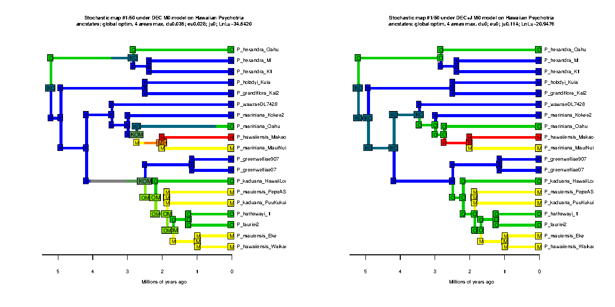
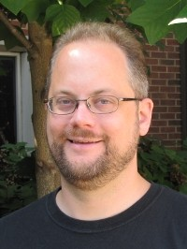
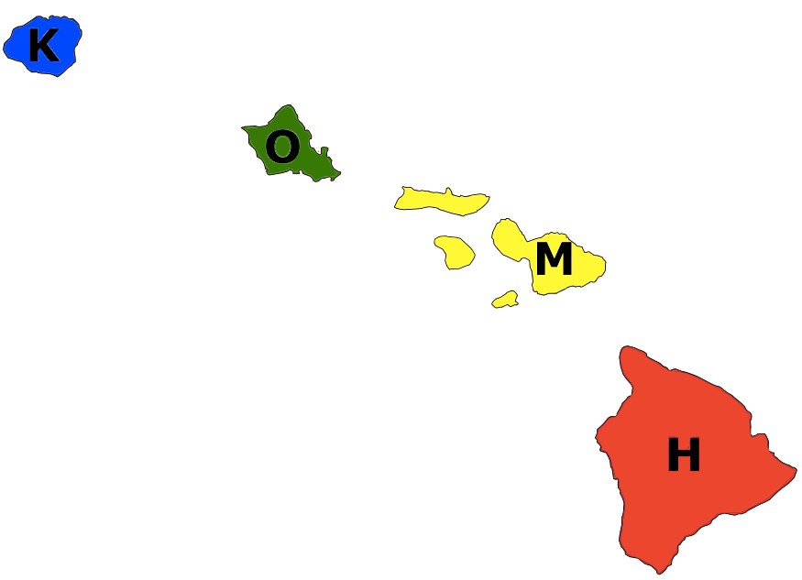







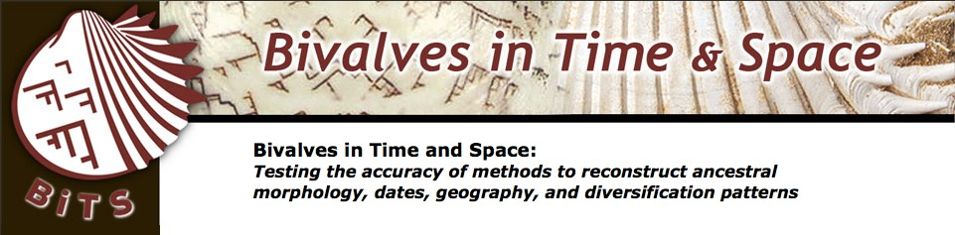
Improving realism: distance, connectivity, & traits in phylogenetic biogeography: theory and application in ants, crocs, lizards and kauri
Nicholas J. Matzke Senior Lecturer, SBS
School of Biological Sciences,
University of Auckland
phylo.wikidot.com/nicholas-j-matzke
possible histories (DEC model)
possible histories (DEC+J model)
Hawaiian Psychotria
e.g. hawaiiensis
https://commons.wikimedia.org/wiki/File:Psychotria_hawaiiensis_var._hillebrandii_(5516131161).jpg
Thanks for support from:

Slide 2
Improving realism: distance, connectivity, & traits in phylogenetic biogeography: theory and application in ants, crocs, lizards and kauri
Nicholas J. Matzke Senior Lecturer, SBS
School of Biological Sciences,
University of Auckland
phylo.wikidot.com/nicholas-j-matzke
possible histories (DEC model)
possible histories (DEC+J model)
Hawaiian Psychotria
e.g. hawaiiensis
https://commons.wikimedia.org/wiki/File:Psychotria_hawaiiensis_var._hillebrandii_(5516131161).jpg
Thanks for support from:

Slide 3
Historical biogeography methods

Slide 4
Historical biogeography methods
1. Estimate a dated phylogeny

Slide 5
Historical biogeography methods
Estimate a dated phylogeny
Put the geographic ranges at the tips

Slide 6
Historical biogeography methods
Estimate a dated phylogeny
Put the geographic ranges at the tips
Assume some process(es)

Slide 7
Historical biogeography methods
Estimate a dated phylogeny
Put the geographic ranges at the tips
Assume some process(es)
Conduct inference

Slide 8
Historical biogeography methods
Estimate a dated phylogeny
Put the geographic ranges at the tips
3. Assume some process(es)
4. Conduct inference

Slide 9
Summary of previous lectures:
Different authorities have different assumptions about what processes matter!
Your inferences will depend on your assumptions
Vicariance: deterministic vision where geology determines ranges
Dispersal: “unpredictable” “chance events”
Me: “Unpredictable” doesn’t mean intractable – we can address using probabilistic models

Slide 10
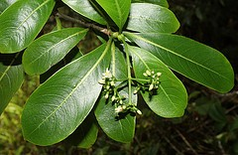
Results of different biogeography models on same dataset:
K=Kauai
O=Oahu
M=Maui-Nui
H=Hawai’i
Psychotria hexandra
http://farm8.static.flickr.com/7446/9252634315_0ecf0ba853_m.jpg

Slide 11
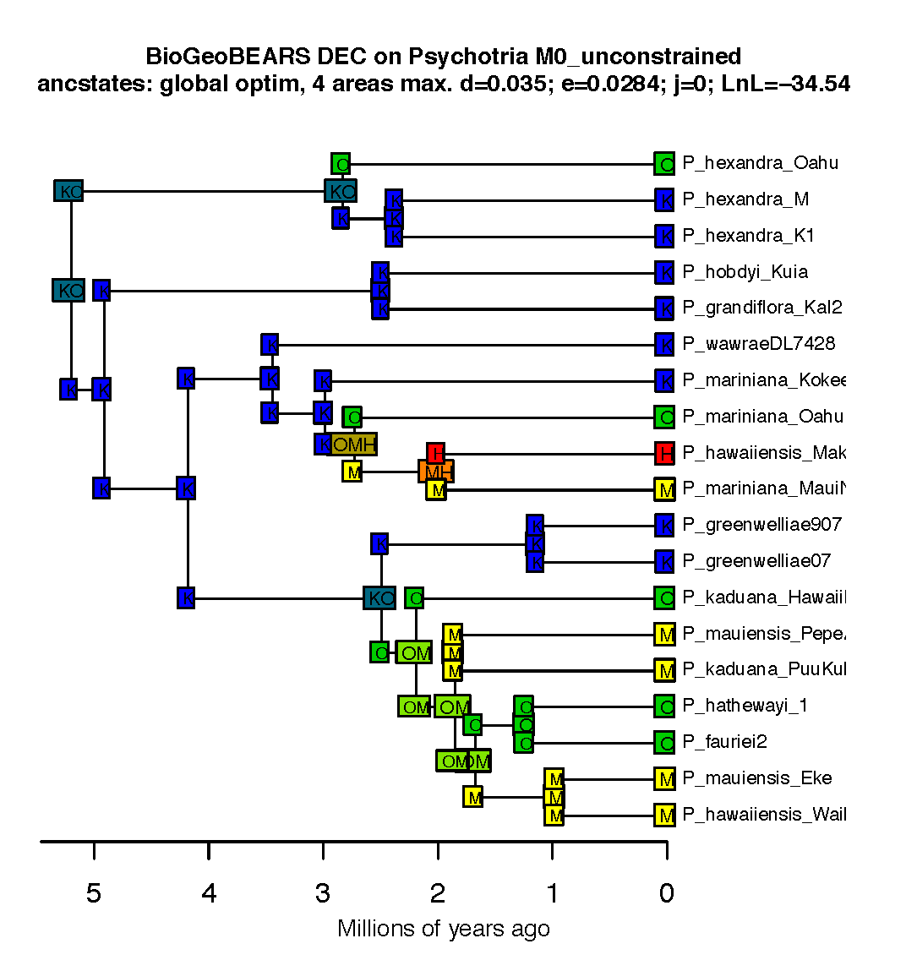
Example of biogeographic history:
Psychotria
Model: DEC
K=Kauai
O=Oahu
M=Maui-Nui
H=Hawai’i
Psychotria hexandra
http://farm8.static.flickr.com/7446/9252634315_0ecf0ba853_m.jpg

Slide 12
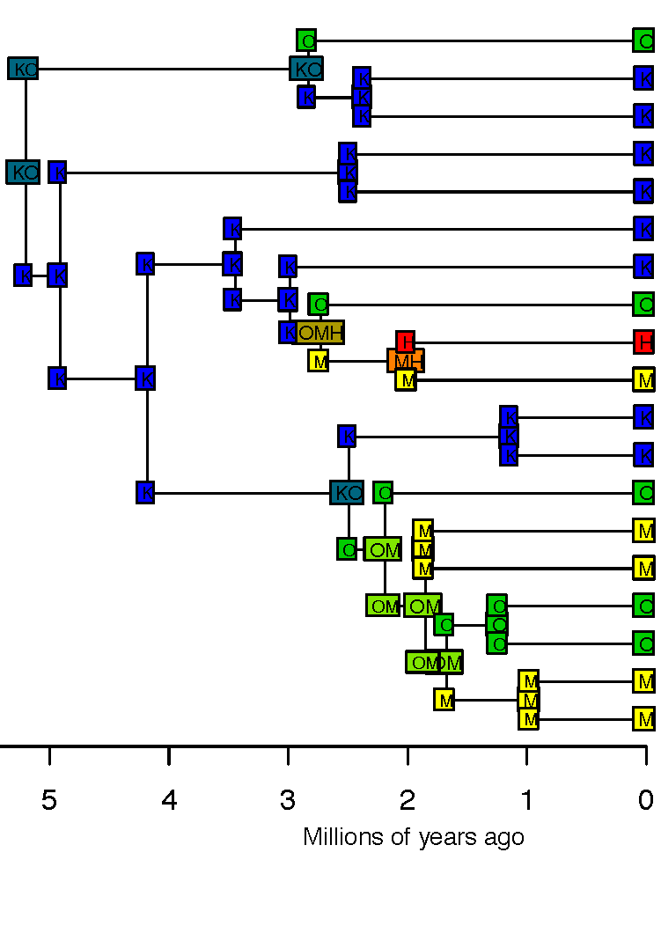
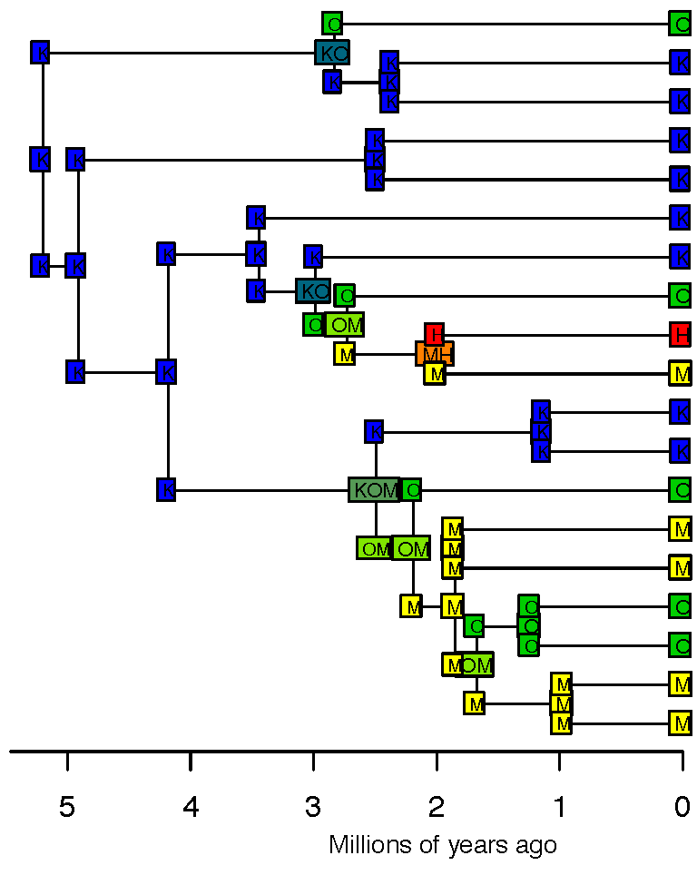
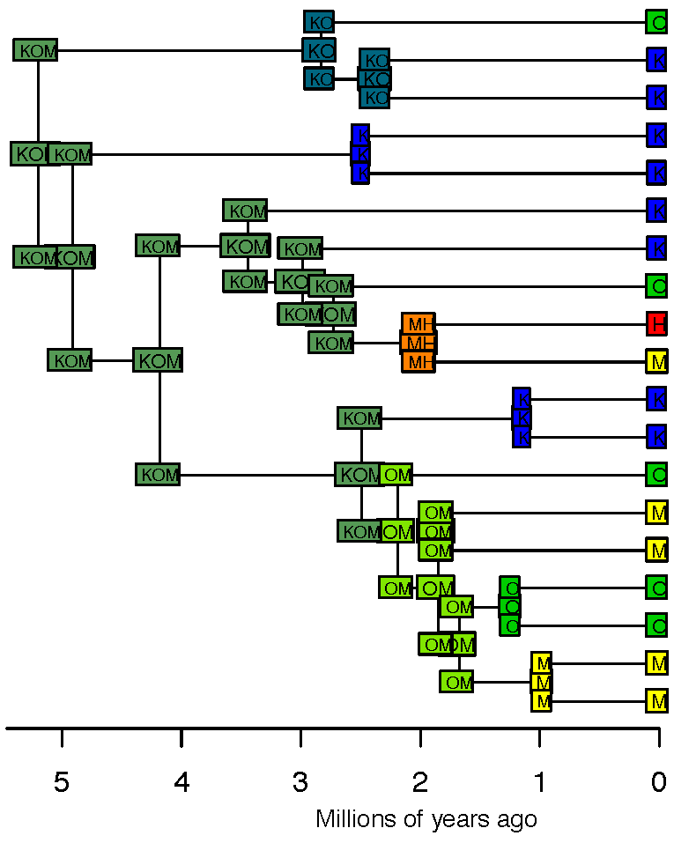
Comparison: 3 models
Model: DEC
Model: DIVA Model: BayArea
K=Kauai
O=Oahu
M=Maui-Nui
H=Hawai’i
Psychotria hexandra
http://farm8.static.flickr.com/7446/9252634315_0ecf0ba853_m.jpg

Slide 13
I think we should use statistical model choice in biogeography
Comparison of two models:
model without founder-event speciation
model with founder-event speciation

Slide 14
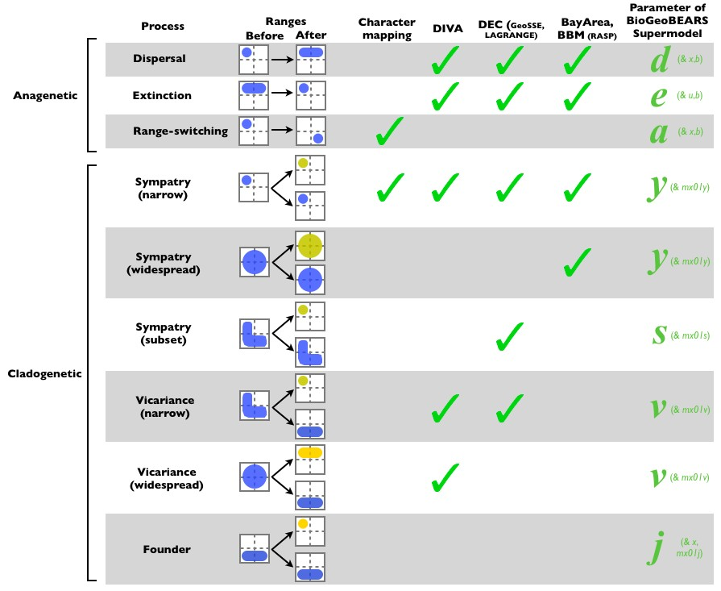


DEC (LAGRANGE)
Which model should we use?
What about founder- event speciation?
Figure 1, Matzke 2013, Frontiers of Biogeography

Slide 15





Founder-event speciation
“jump” event
•
In founder-event speciation, a rare dispersal event “instantaneously” establishes a geographically isolated new lineage with one or a few individuals
Widely discussed in population genetics, speciation literature, island biogeography
However, ignored in traditional historical biogeography computer models
•
area A
area B
•

Slide 16
Example stochastic map
ML DEC model
ML DEC+J model
(under model M0: no geology)
Biogeographical stochasCc mapping published in: Dupin, Matzke et al. (2016), J. Biogeography.

Slide 17
Example stochastic map
ML DEC model
ML DEC+J model
(under model M0: no geology)
Biogeographical stochasCc mapping published in: Dupin, Matzke et al. (2016), J. Biogeography.

Slide 18
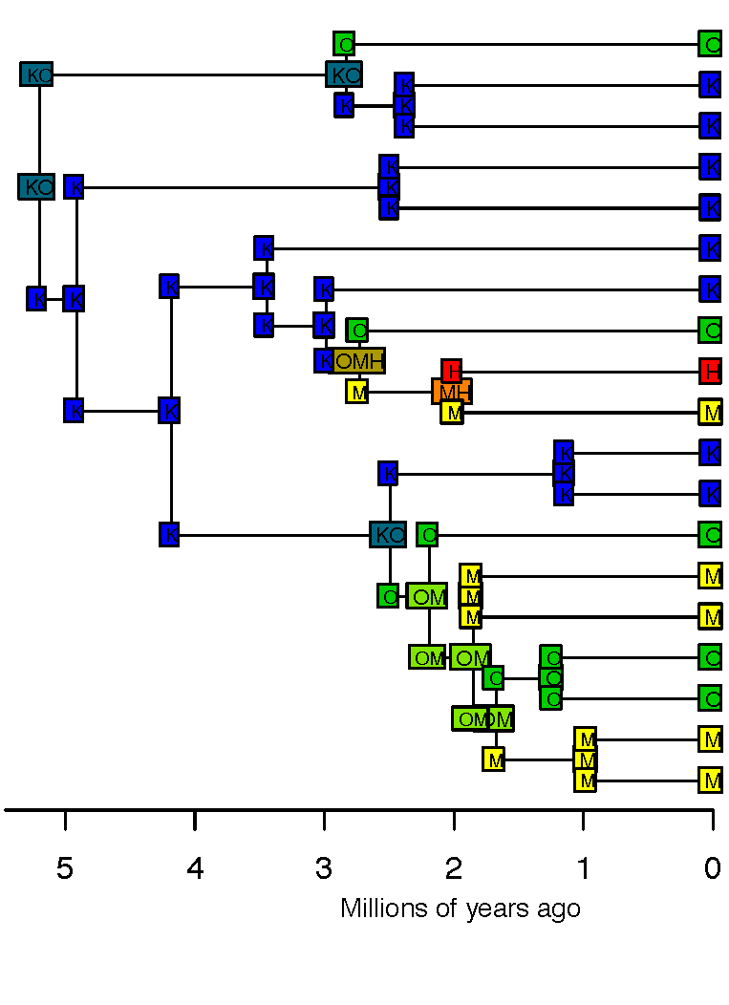
Historical biogeography methods
Estimate a dated phylogeny
Put the geographic ranges at the tips
3. Assume some process(es)
4. Conduct inference
DEC
DIVA
BayArea

Slide 19
Review: Models, parameters, and data
Simulated/
Predicted Data
Parameters
“Simulation” or Prediction
Probabilistic model
Parameters
(mean, standard deviation, etc.)
“Inference”
Data
(observations)

Slide 20
Review: Models, parameters, and data
Simulated/
Predicted Data
Parameters
“Simulation” or Prediction
Probabilistic model
Parameters
(mean, standard deviation, etc.)
“Inference”
Data
(observations)
Major way to do inference: likelihood

Slide 21
Likelihood: the key concept
Likelihood = probability of the data, given a model
Likelihood = P(data | model)
L = P(D | M)
lnL = log(P(D|M))
lnL = natural logarithm of the likelihood

Slide 22
What is likelihood?
Likelihood = Prob(data|model)
  A conditional probability
Likelihood is a fundamental concept in statistics and inference
The inference method of Maximum Likelihood is ubiquitous in parametric statistics
Statistics like the mean, or linear regression, can be justified through ML

Slide 23
Key concepts
Likelihood = Prob(data|model)
  A conditional probability
Data: some observations (numbers) you have collected – considered unchanging for the purposes of your statistical analysis
Model: some process that you postulate could have produced the data; it is an equation giving the likelihood
“Models put probabilities on data.”
Parameters: Numbers in the model that can be changed / learned (e.g., the probability of heads, the rate of change)

Slide 24
Maximum Likelihood
Inference
Likelihood = probability of the data, assuming a model
Maximum Likelihood (ML): find the parameter values that maximize the probability of the data

Slide 25
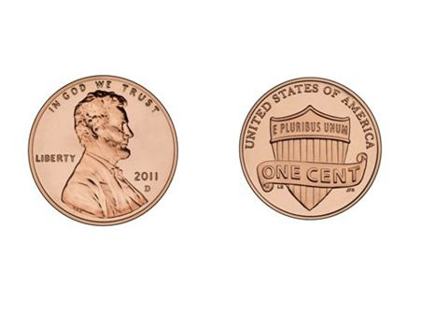
Maximum Likelihood
Inference
Likelihood = probability of the data, assuming a model
Maximum Likelihood (ML): find the parameter values that maximize the probability of the data
  For example: coin-flipping
  Data: HHHHHHHTTT -- 7 Heads, then 3 Tails

Slide 26
Maximum Likelihood
Inference
Likelihood = probability of the data, assuming a model
Maximum Likelihood (ML): find the parameter values that maximize the probability of the data
  For example: coin-flipping
  Data: HHHHHHHTTT -- 7 Heads, then 3 Tails

Slide 27
Maximum Likelihood
Inference
Likelihood = probability of the data, assuming a model
Maximum Likelihood (ML): find the parameter values that maximize the probability of the data
  For example: coin-flipping
  Data: HHHHHHHTTT -- 7 Heads, then 3 Tails
Model | Parameter | Calculation | Prob(data) | Ln(prob) | Prob. ratio | ML says
Fair coin
Biased coin

Slide 28
Maximum Likelihood
Inference
Likelihood = probability of the data, assuming a model
Maximum Likelihood (ML): find the parameter values that maximize the probability of the data
  For example: coin-flipping
  Data: HHHHHHHTTT -- 7 Heads, then 3 Tails
Model | Parameter | Calculation | Prob(data) | Ln(prob) | Prob. ratio | ML says
Fair coin | prob(Heads)=0.5
Biased coin

Slide 29
Maximum Likelihood
Inference
Likelihood = probability of the data, assuming a model
Maximum Likelihood (ML): find the parameter values that maximize the probability of the data
  For example: coin-flipping
  Data: HHHHHHHTTT -- 7 Heads, then 3 Tails
Model | Parameter | Calculation | Prob(data) | Ln(prob) | Prob. ratio | ML says
Fair coin | prob(Heads)=0.5
Biased coin | prob(Heads)=0.7

Slide 30
Maximum Likelihood
Inference
Likelihood = probability of the data, assuming a model
Maximum Likelihood (ML): find the parameter values that maximize the probability of the data
  For example: coin-flipping
  Data: HHHHHHHTTT -- 7 Heads, then 3 Tails
Model | Parameter | Calculation | Prob(data) | Ln(prob) | Prob. ratio | ML says
Fair coin | prob(Heads)=0.5 | 0.5⁷x0.5³
Biased coin | prob(Heads)=0.7

Slide 31
Maximum Likelihood
Inference
Likelihood = probability of the data, assuming a model
Maximum Likelihood (ML): find the parameter values that maximize the probability of the data
  For example: coin-flipping
  Data: HHHHHHHTTT -- 7 Heads, then 3 Tails
Model | Parameter | Calculation | Prob(data) | Ln(prob) | Prob. ratio | ML says
Fair coin | prob(Heads)=0.5 | 0.5⁷x0.5³
Biased coin | prob(Heads)=0.7 | 0.7⁷x0.3³

Slide 32
Maximum Likelihood
Inference
Likelihood = probability of the data, assuming a model
Maximum Likelihood (ML): find the parameter values that maximize the probability of the data
  For example: coin-flipping
  Data: HHHHHHHTTT -- 7 Heads, then 3 Tails
Model | Parameter | Calculation | Prob(data) | Ln(prob) | Prob. ratio | ML says
Fair coin | prob(Heads)=0.5 | 0.5⁷x0.5³ | 0.000977
Biased coin | prob(Heads)=0.7 | 0.7⁷x0.3³ | 0.00222

Slide 33
Maximum Likelihood
Inference
Likelihood = probability of the data, assuming a model
Maximum Likelihood (ML): find the parameter values that maximize the probability of the data
  For example: coin-flipping
  Data: HHHHHHHTTT -- 7 Heads, then 3 Tails
Model | Parameter | Calculation | Prob(data) | Ln(prob) | Prob. ratio | ML says
Fair coin | prob(Heads)=0.5 | 0.5⁷x0.5³ | 0.000977 | -6.93
Biased coin | prob(Heads)=0.7 | 0.7⁷x0.3³ | 0.00222 | -6.11

Slide 34
Maximum Likelihood
Inference
Likelihood = probability of the data, assuming a model
Maximum Likelihood (ML): find the parameter values that maximize the probability of the data
  For example: coin-flipping
  Data: HHHHHHHTTT -- 7 Heads, then 3 Tails
Model | Parameter | Calculation | Prob(data) | Ln(prob) | Prob. ratio | ML says
Fair coin | prob(Heads)=0.5 | 0.5⁷x0.5³ | 0.000977 | -6.93 | 1
Biased coin | prob(Heads)=0.7 | 0.7⁷x0.3³ | 0.00222 | -6.11 | 2.28

Slide 35
Maximum Likelihood
Inference
Likelihood = probability of the data, assuming a model
Maximum Likelihood (ML): find the parameter values that maximize the probability of the data
  For example: coin-flipping
  Data: HHHHHHHTTT -- 7 Heads, then 3 Tails
Model | Parameter | Calculation | Prob(data) | Ln(prob) | Prob. ratio | ML says
Fair coin | prob(Heads)=0.5 | 0.5⁷x0.5³ | 0.000977 | -6.93 | 1 | worse
Biased coin | prob(Heads)=0.7 | 0.7⁷x0.3³ | 0.00222 | -6.11 | 2.28

Slide 36
Maximum Likelihood
Inference
Likelihood = probability of the data, assuming a model
Maximum Likelihood (ML): find the parameter values that maximize the probability of the data
  For example: coin-flipping
  Data: HHHHHHHTTT -- 7 Heads, then 3 Tails
Model | Parameter | Calculation | Prob(data) | Ln(prob) | Prob. ratio | ML says
Fair coin | prob(Heads)=0.5 | 0.5⁷x0.5³ | 0.000977 | -6.93 | 1 | worse
Biased coin | prob(Heads)=0.7 | 0.7⁷x0.3³ | 0.00222 | -6.11 | 2.28 | better

Slide 37
We can calculate likelihood or lnL for many different possible parameter values
Data/observations are fixed: we observed 7 Heads, 3 Tails. Which parameter value is best?

Slide 38
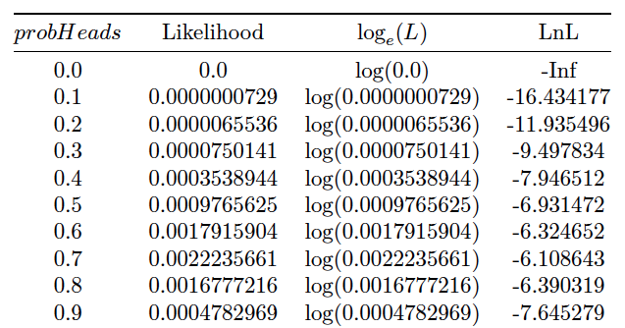
We can calculate likelihood or lnL for many different possible parameter values
Data/observations are fixed: we observed 7 Heads, 3 Tails. Which parameter value is best?

Slide 39
We can calculate likelihood or lnL for many different possible parameter values
Data/observations are fixed: we observed 7 Heads, 3 Tails. Which parameter value is best?
Parameter values to try

Slide 40
We can calculate likelihood or lnL for many different possible parameter values
Data/observations are fixed: we observed 7 Heads, 3 Tails. Which parameter value is best?
Name of free parameter is “ProbHeads”
Parameter values to try

Slide 41
We can calculate likelihood or lnL for many different possible parameter values
Data/observations are fixed: we observed 7 Heads, 3 Tails. Which parameter value is best?
Name of free parameter is “ProbHeads”
“raw likelihood”
Parameter values to try

Slide 42
We can calculate likelihood or lnL for many different possible parameter values
Data/observations are fixed: we observed 7 Heads, 3 Tails. Which parameter value is best?
Name of free parameter is “ProbHeads”
log-likelihood
“raw likelihood”
Parameter values to try

Slide 43
We can calculate likelihood or lnL for many different possible parameter values
Data/observations are fixed: we observed 7 Heads, 3 Tails. Which parameter value is best?
Name of free parameter is “ProbHeads”
log-likelihood
“raw likelihood”
Parameter values to try
Plot a likelihood curve from these

Slide 44
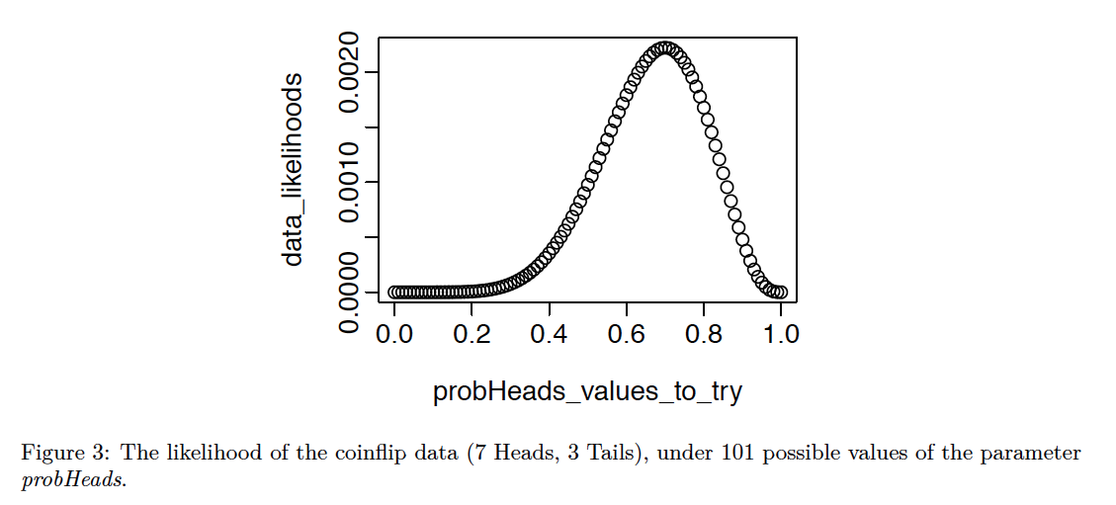
Likelihood profile curve

Slide 45
Log-likelihood (lnL)
The log-likelihood (always the NATURAL log) is
1. An easy way to represent very small numbers
2. Helps the computers avoid numeric underflow problems
- Multiplication in becomes addition in log-space
(also makes calculus easier)
- E.g., in R, 0.1 times itself 300 times: 0.1^300 = 1e-300
But (0.1^300)*(0.1^300) = 0.0 , which is wrong (underflow rounds down to 0.0)
- In log space: log(0.1^300) = 300*log(0.1) = 300*-2.3026 = -690.78
log((0.1^300)*(0.1^300) ) = 300*log(0.1) + 300*log(0.1) = 600*log(0.1) =
= 1381.55 = 2 * -690.78
3. Important in Information Theory
4. Maximizing the lnL finds the same parameters as maximizing the likelihood
Note: reverse the log() operation with exp(): log(0.1) = -2.3026, exp(-2.3026) = 0.1
exp(1) = 2.718282..., which is known as Euler’s number, e, the base of the natural log

Slide 46
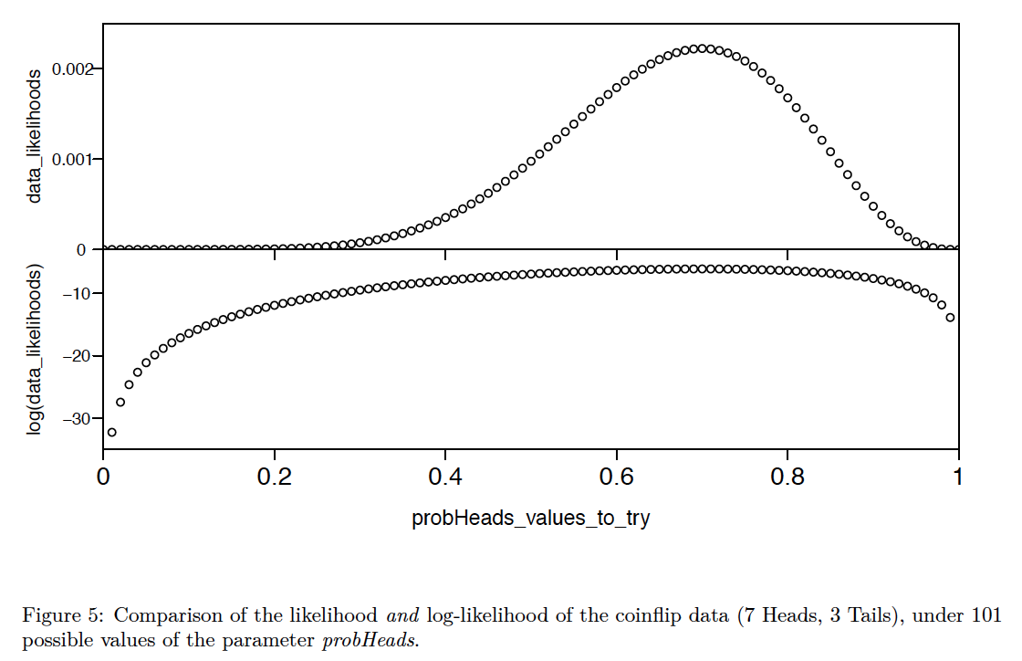
The maximum likelihood and log-likelihood (lnL) give the same parameter estimate

Slide 47
What is our best estimate of the parameter?

Slide 48
What is our best estimate of the parameter?

Slide 49
What is our best estimate of the parameter?

Slide 50
What is our best estimate of the parameter?
The parameter value that Maximizes the Likelihood (ML)

Slide 51
How to find the maximum of the likelihood?
Several possible methods:
Intuition
Calculus to get an analytic solution
Exhaustive search “grid search”
Optimization / hill-climbing

Slide 52
How to find this maximum?
Method 1: intuition
In very simple cases, like coin-flipping, you can guess that the average of your data provides the best estimate.
(But: your intuition can betray you, e.g. if you think about your prior experience that most coins are fair)

Slide 53
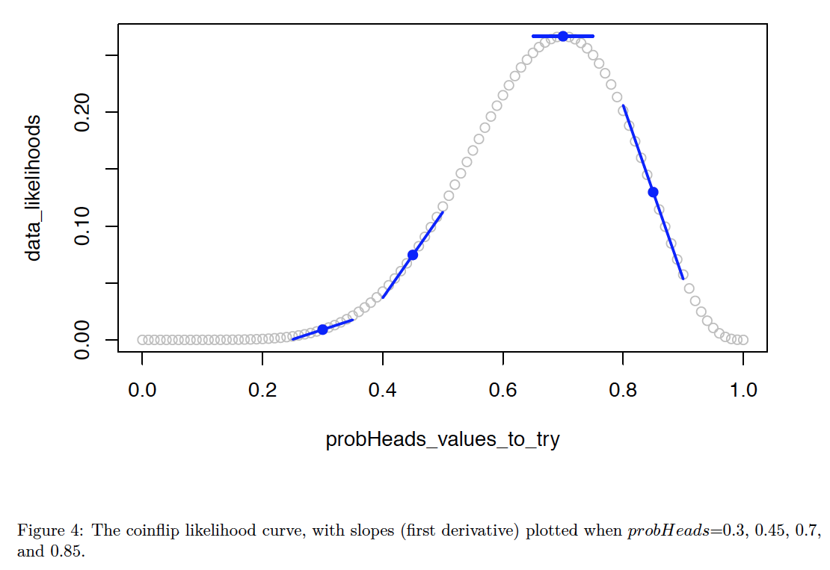
The parameter value that Maximizes the Likelihood (ML)
Method 2: calculus
Short-short version:
Taking the first derivative of a function provides an equation giving the slope at each point
The slope will be 0.0 at the maximum of the curve
Setting the derivative to 0.0 and
solving gives a formula for the
Maximum Likelihood.
This is known as an
“analytic solution”.
Analytic solutions are very fast,
and are the basics of a lot of the
“cookbook” formulas that get
taught.
But they often aren’t available for complex models.

Slide 54
The parameter value that Maximizes the Likelihood (ML)
Method 2: calculus
E.g., here’s the proof (not examinable) showing that the likelihood is maximized at
(Number of Heads) / (Total number of coinflips)
https://stats.stackexchange.com/questions/181035/how-to-derive-the-likelihood-function-for-binomial-distribution-for-parameter-es
(not examinable)

Slide 55
How to find this maximum?
Method 3: exhaustive search (or “gridded search”).
(1) pick a bunch of parameter values that cover the parameter space
(2) choose the parameter value that maximizes the likelihood
Problem: can only be done easily for 1 or 2 parameters.
More parameters = more “dimensions” = explosion of number of calculations

Slide 56
How to find this maximum?
Method 4: optimization, i.e. use the computer to iteratively search
Very flexible, works on very complex models
Involves some heuristic “hill-climbing” algorithm
We use the “optim()”, in R
Known as a “numerical solution” or “numerical optimization”, instead of an “analytic
solution”

Slide 57
How to find this maximum?
Method 4: optimization, i.e. use the computer to iteratively search
Very flexible, works on very complex models
Involves some heuristic “hill-climbing” algorithm
We use the “optim()”, in R
Known as a “numerical solution” or “numerical optimization”, instead of an “analytic
solution”
Starting guess at parameter

Slide 58
How to find this maximum?
Method 4: optimization, i.e. use the computer to iteratively search
Very flexible, works on very complex models
Involves some heuristic “hill-climbing” algorithm
We use the “optim()”, in R
Known as a “numerical solution” or “numerical optimization”, instead of an “analytic
solution”

Slide 59
How to find this maximum?
Method 4: optimization, i.e. use the computer to iteratively search
Very flexible, works on very complex models
Involves some heuristic “hill-climbing” algorithm
We use the “optim()”, in R
Known as a “numerical solution” or “numerical optimization”, instead of an “analytic
solution”

Slide 60
How to find this maximum?
Method 4: optimization, i.e. use the computer to iteratively search
Very flexible, works on very complex models
Involves some heuristic “hill-climbing” algorithm
We use the “optim()”, in R
Known as a “numerical solution” or “numerical optimization”, instead of an “analytic
solution”

Slide 61
How to find this maximum?
Method 4: optimization, i.e. use the computer to iteratively search
Very flexible, works on very complex models
Involves some heuristic “hill-climbing” algorithm
We use the “optim()”, in R
Known as a “numerical solution” or “numerical optimization”, instead of an “analytic
solution”

Slide 62
How to find this maximum?
Method 4: optimization, i.e. use the computer to iteratively search
Very flexible, works on very complex models
Involves some heuristic “hill-climbing” algorithm
We use the “optim()”, in R
Known as a “numerical solution” or “numerical optimization”, instead of an “analytic
solution”

Slide 63
How to find this maximum?
Method 4: optimization, i.e. use the computer to iteratively search
Very flexible, works on very complex models
Involves some heuristic “hill-climbing” algorithm
We use the “optim()”, in R
Known as a “numerical solution” or “numerical optimization”, instead of an “analytic
solution”

Slide 64
How to find this maximum?
Method 4: optimization, i.e. use the computer to iteratively search
Very flexible, works on very complex models
Involves some heuristic “hill-climbing” algorithm
We use the “optim()”, in R
Known as a “numerical solution” or “numerical optimization”, instead of an “analytic
solution”

Slide 65
How to find this maximum?
Method 4: optimization, i.e. use the computer to iteratively search
Very flexible, works on very complex models
Involves some heuristic “hill-climbing” algorithm
We use the “optim()”, in R
Known as a “numerical solution” or “numerical optimization”, instead of an “analytic
solution”

Slide 66
How to find this maximum?
Advantage of optimization/hill-climbing: extremely flexible, can be used on all sorts of complex models
Disadvantages of optimization/hill-climbing: much slower than analytic solutions; no absolute guarantee the search will actually find the true peak

Slide 67
Can we measure the importance of distance in biogeography?

Slide 68
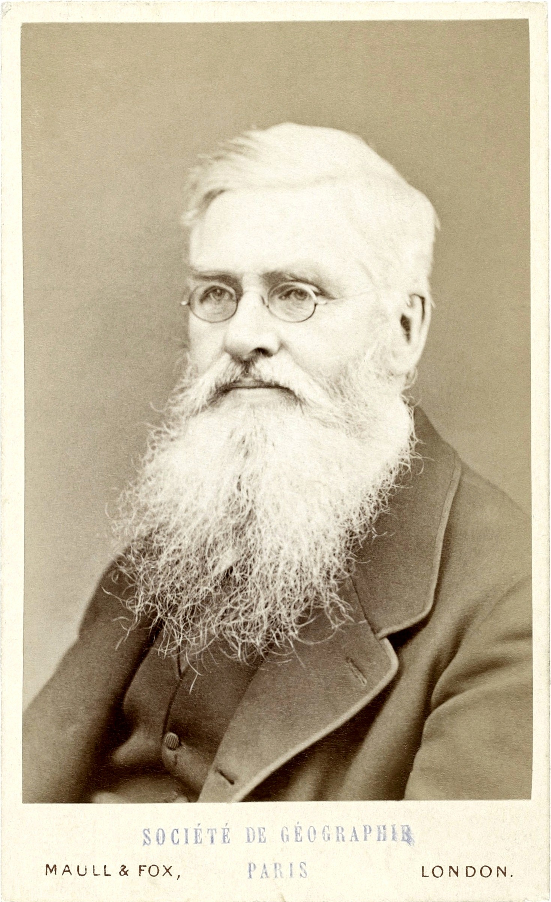
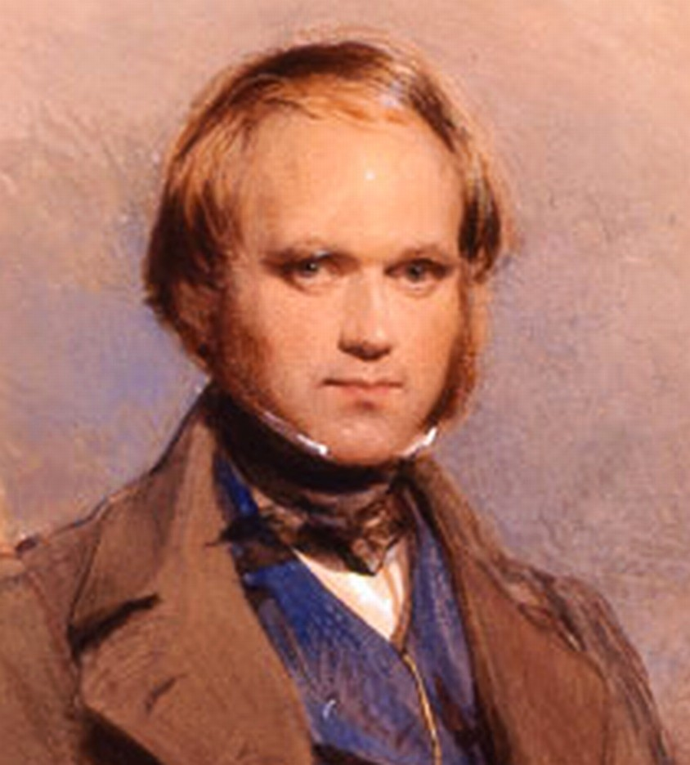
Historical biogeography: Wallace and Darwin
Wallace (1855): “Every species has come into existence coincident both in space and time with a pre- existing closely allied species.”
Darwin (1859): “the more nearly any two forms are related in blood, the nearer they will generally stand to each other in time and space”.

Slide 69
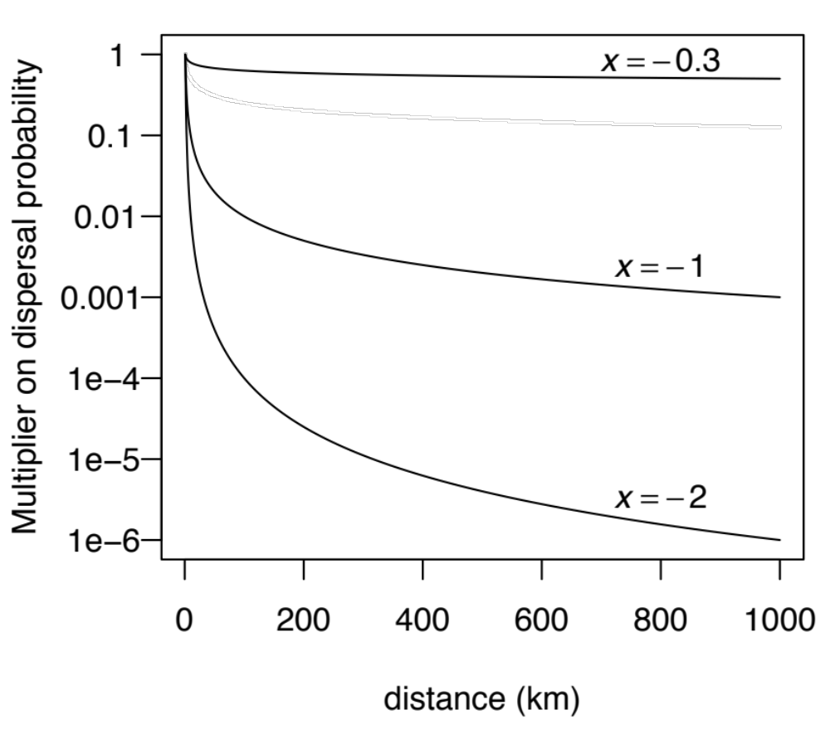
The “+x” model: modify dispersal probability by distance^x

Slide 70


Journal of Biogeography (J. Biogeogr.) (2017) 44, 887-899
Bayesian estimation of the global biogeographical history of the Solanaceae
Julia Dupin¹*,Nicholas J. Matzke², Tiina Sarkinen³ Sandra Knapp⁴
, ,
Richard G. Olmstead⁵ Lynn Bohs⁶ and Stacey D. Smith¹
,

Slide 71
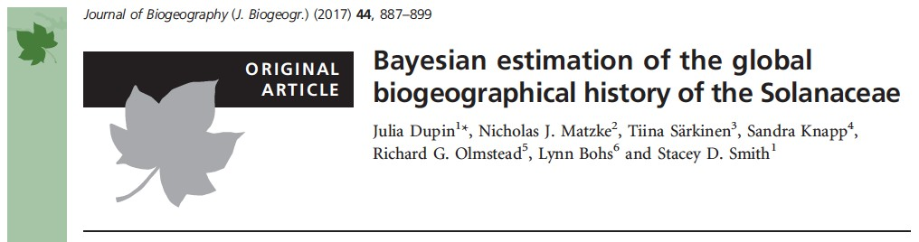
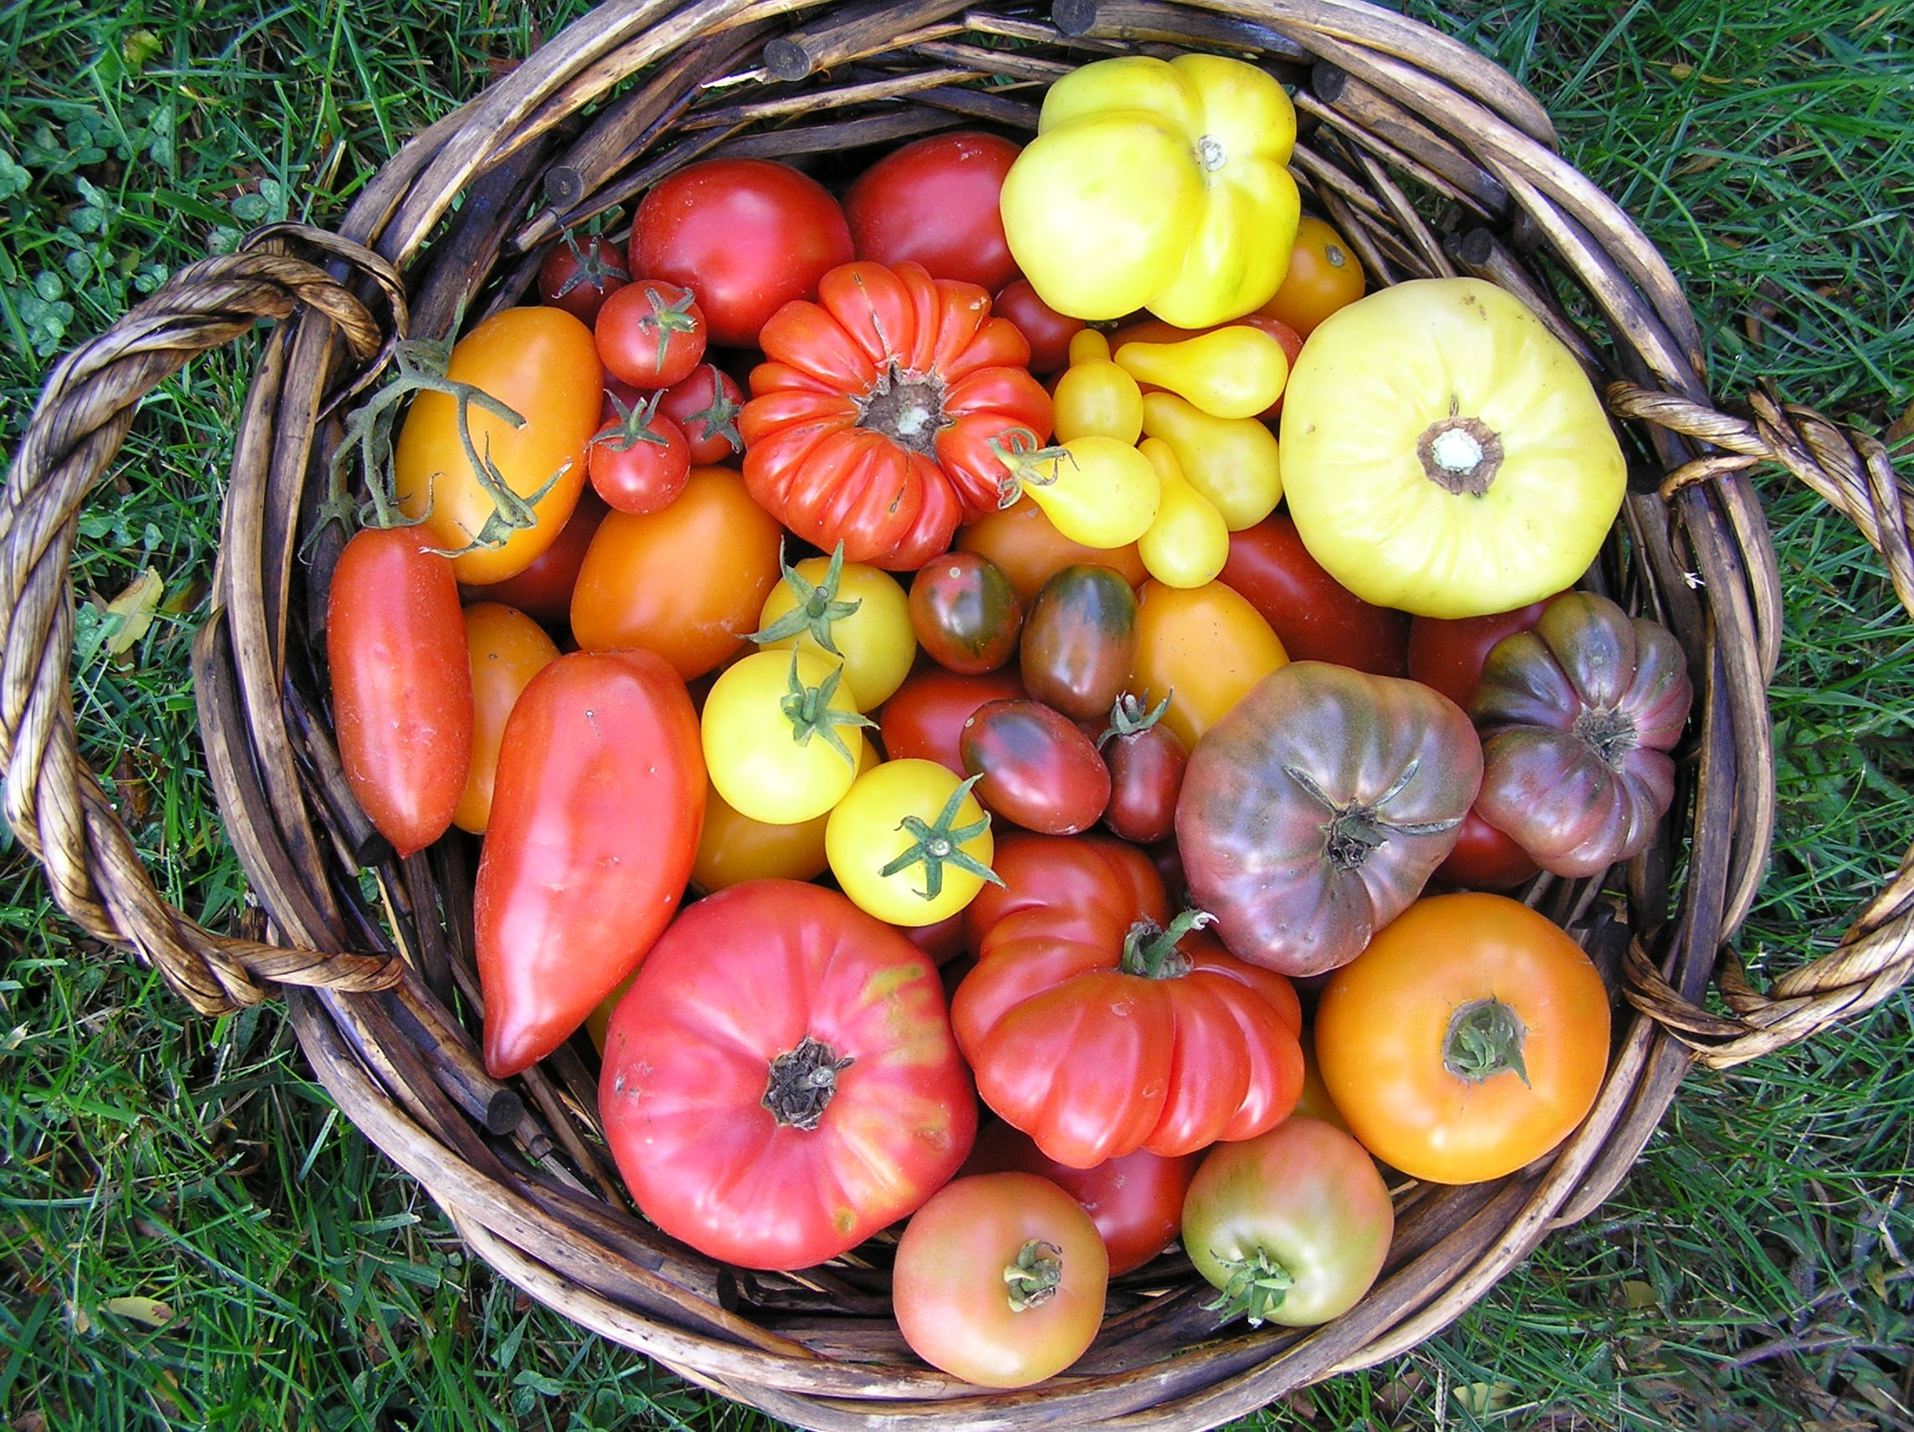
http://solcap.msu.edu/img/germplasm2.jpg

Slide 72
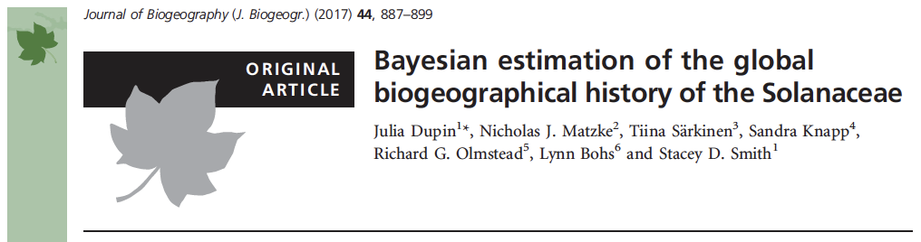
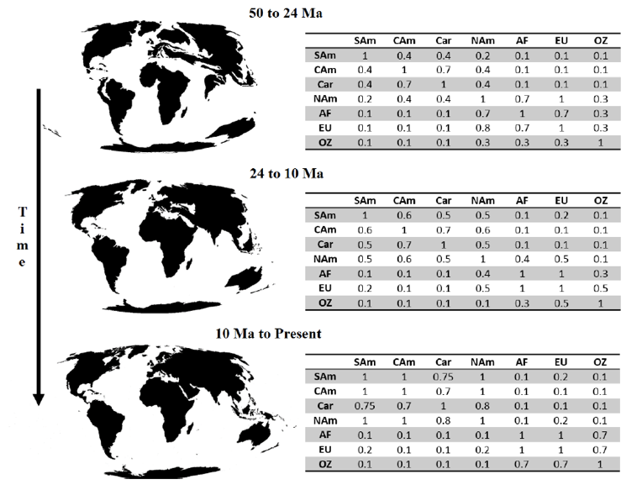

Slide 73
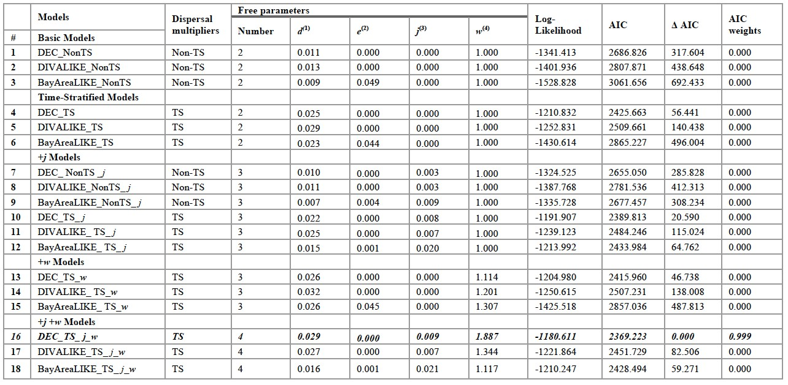
Global Solanaceae:
distance, Biogeographical Stochastic Mapping

Slide 74
Global Solanaceae:
distance, Biogeographical Stochas3c Mapping

Slide 75
Akaike Information Criterion

Slide 76
Akaike Information Criterion “True model”

Slide 77
Akaike Information Criterion “True model”

Slide 78
Akaike Information Criterion “True model”
distance from truth

Slide 79
Akaike Information Criterion “True model”
Better fit
distance from truth

Slide 80
Akaike Information Criterion “True model”
Better fit
distance from truth
Worse fit

Slide 81
Akaike Information Criterion
“True model”
Better fit
distance from truth
AIC =
estimator of relative distance from true model
Worse fit

Slide 82
Akaike Information Criterion
“True model”
Better fit
lower AIC = lower distance
distance from truth
AIC =
estimator of relative distance from true model
Worse fit

Slide 83
Akaike Information Criterion
“True model”
Better fit
lower AIC = lower distance
distance from truth
AIC =
estimator of relative distance from true model
Worse fit
higher AIC = higher distance

Slide 84
Akaike Information Criterion
“True model”
Better fit
lower AIC = lower distance
distance from truth
AIC =
estimator of relative distance from true model
Akaike Information Criterion (AIC) =
-2(LnL - # of parameters)
Worse fit
higher AIC = higher distance

Slide 85
Akaike Information Criterion
“True model”
Better fit
higher data log-likelihood (LnL)
lower AIC = lower distance
distance from truth
AIC =
estimator of relative distance from true model
Akaike Information Criterion (AIC) =
-2(LnL - # of parameters)
Worse fit
higher AIC = higher distance

Slide 86
Akaike Information Criterion
“True model”
Better fit
higher data log-likelihood (LnL)
lower AIC = lower distance
distance from truth
AIC =
estimator of relative distance from true model
Akaike Information Criterion (AIC) =
-2(LnL - # of parameters)
lower data log-likelihood (LnL)
Worse fit
higher AIC = higher distance

Slide 87
Akaike Information Criterion
“True model”
Better fit
higher data log-likelihood (LnL)
fewer free
parameters
lower AIC = lower distance
distance from truth
AIC =
estimator of relative distance from true model
Akaike Information Criterion (AIC) =
-2(LnL - # of parameters)
lower data log-likelihood (LnL)
Worse fit
higher AIC = higher distance

Slide 88
Akaike Information Criterion
“True model”
Better fit
higher data log-likelihood (LnL)
fewer free
parameters
lower AIC = lower distance
distance from truth
AIC =
estimator of relative distance from true model
Akaike Information Criterion (AIC) =
-2(LnL - # of parameters)
lower data log-likelihood (LnL)
more free
parameters
Worse fit
higher AIC = higher distance

Slide 89
Global Solanaceae:
distance, Biogeographical Stochastic Mapping

Slide 90

Global Solanaceae:
distance, Biogeographical Stochastic Mapping
Best model: 99.9% of AIC weight DEC
+ J (jump dispersal)
+ changing geography (distances)
+ parameter weighting distance

Slide 91
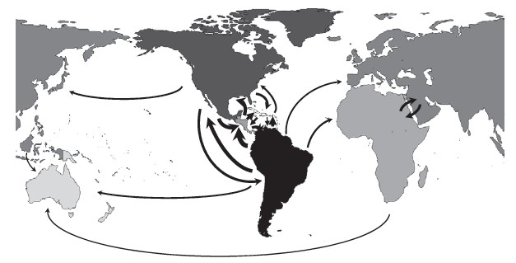
Global Solanaceae:
distance, Biogeographical Stochastic Mapping

Slide 92
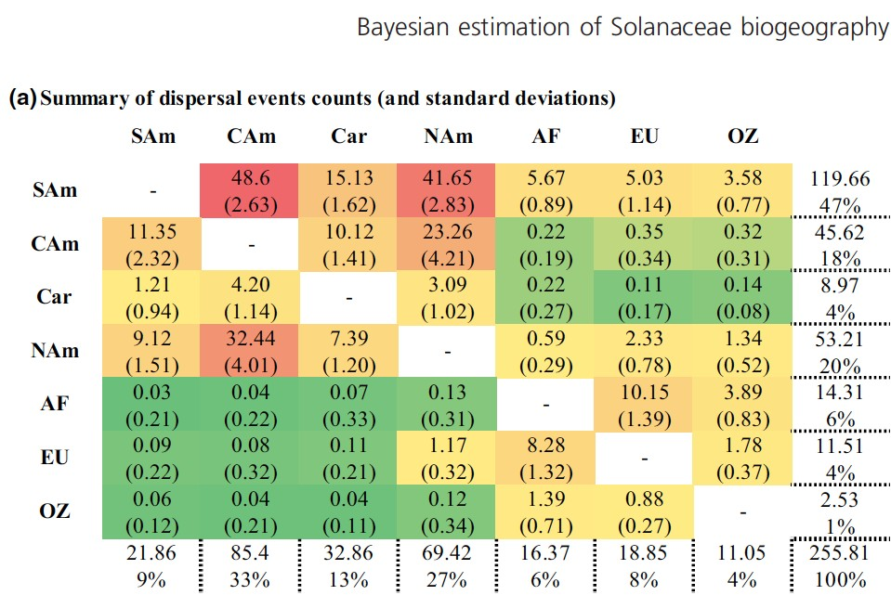
Global Solanaceae:
distance, Biogeographical Stochastic Mapping

Slide 93
What if dispersal ability depends on an evolving trait?

Slide 94
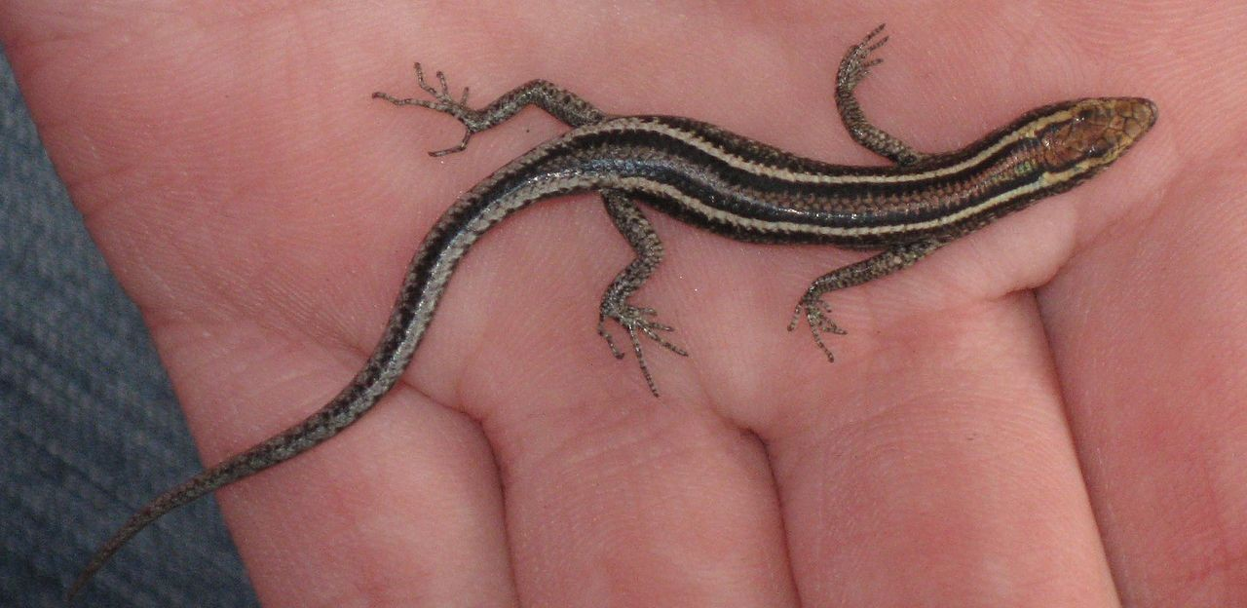
What if dispersal ability depends on an evolving trait?
Fence or snake-eyed skink (Cryptoblepharus virgatus) photographed in Sydney, Australia. https://en.wikipedia.org/wiki/Cryptoblepharus_virgatus#/media/File:Cryptoblepharus_virgatus.jpg

Slide 95
Cryptoblepharus lizards (with Moos Blom, ANU)
Fence or snake-eyed skink (Cryptoblepharus virgatus) photographed in Sydney, Australia. https://en.wikipedia.org/wiki/Cryptoblepharus_virgatus#/media/File:Cryptoblepharus_virgatus.jpg

Slide 96
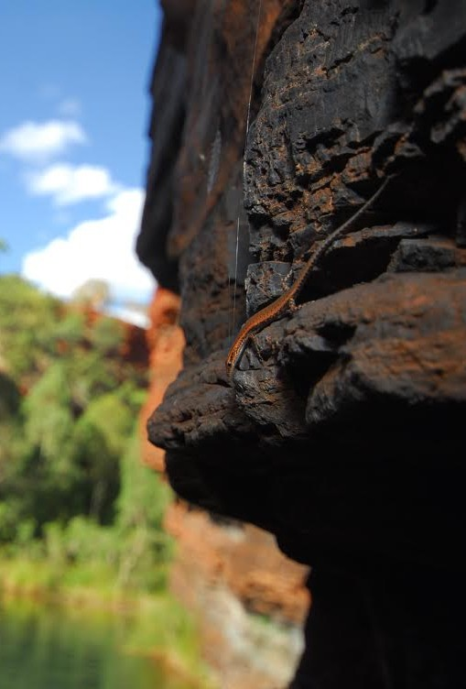
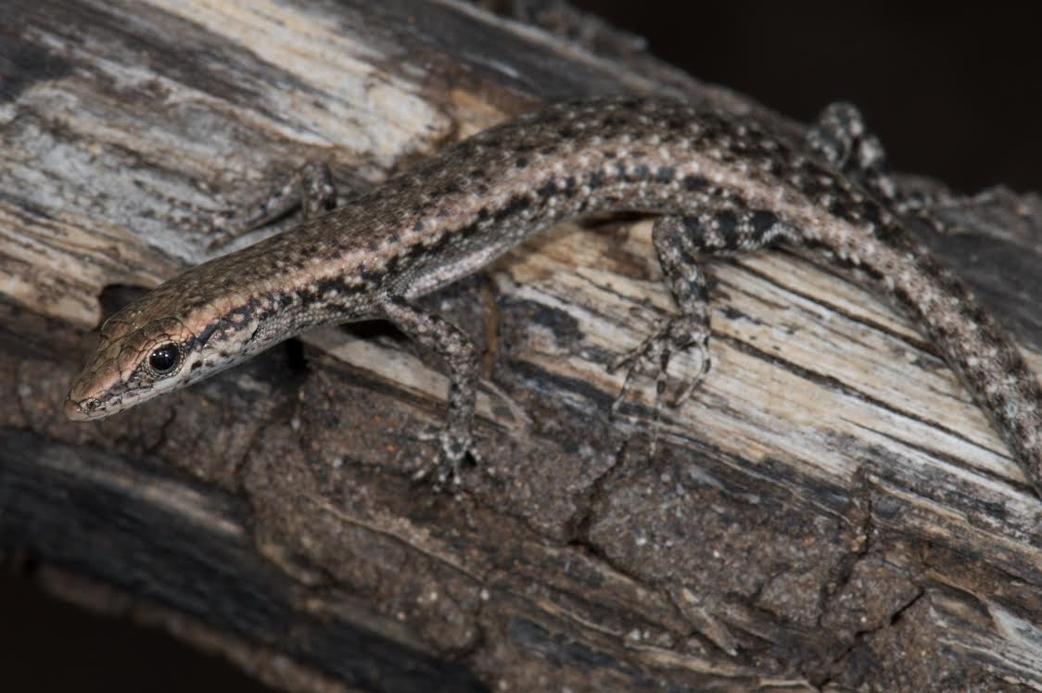
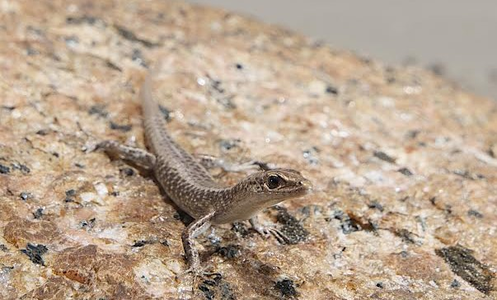
Cryptoblepharus lizards (with Moos Blom, ANU)
arboreal species
littoral (beach) species
rock-dwelling species
Photos by Stewart Macdonald, provided by Moos Blom

Slide 97
N C_egeriae
N C_juno_kimb N C_juno_keep N C_daedalos N C_cygnatus N C_wulbu
N C_ruber_A1A3 N C_ruber_A2
N C_megastictus N C_buchanani
N C_metallicus N C_australis
N C_leschenault_D
N C_leschenault_C N C_leschenault_B N C_renschi
N C_leschenault_A N C_yulensis
N C_rutilus
N C_novaeguineae N C_keiensis
N C_intermedius_B N C_intermedius_A N C_pannosus
N C_zoticus N C_mertensi N C_tytthos
N C_ustulatus
N C_plagiocephalus N C_exochus
C_nigropunctatus C_litoralis_horneri C_litoralis_litoralis C_litoralis_Sideia
C_poecilopleurus_G
C_novohebridicus C_novocaledonicus
C_poecilopleurus_S
C_poecilopleurus C_eximius C_cursor C_burdeni_B C_burdeni_A C_gurrmul C_boutonii_seychel
C_boutonii_africanu
N C_xenikos N C_virgatus N C_fuhni
N C_pulcher_pulcher N C_pulcher_clarus
N C_adamsi
C_boutonii
L L L L L L L L L L L L L L L L L
0
L L
_{L}L
L
L
L
L L
L
L
N N
L
L
L
L
N
L L
L
L L
L
N
N
L
N
L L
L L
L LL L
L
L
L L LL
L
L
L
N
NN
N
L
N N
N
_{N} N
N
L
N
N NN NNN
N
N
N
N
N _{N} N
N
N
NN ^{N}
L L
L L
L
N
N
N
N
N
N
N N
NN N L
N N
N
_{N}N
N
L
N
N
N
N
N
N
N
N N N
N N N
N
N N
N
N N
N NN N
N
N
N
N N N
N
N N
N
N
N
N
N
N
N NN N
5
N
NN
N
N
N
N
N
N
N
N
N
N
N
10
15
Cryptoblepharus traits:
L: littoralN: non-littoral
20

Slide 98
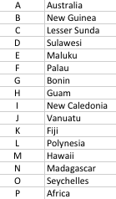
A C_egeriae
A C_juno_kimb A C_juno_keep A C_daedalos A C_cygnatus A C_wulbu
A C_ruber_A1A3 A C_ruber_A2
A C_megastictus A C_buchanani A C_metallicus
A C_australis
C C_leschenault_D C C_leschenault_C C C_leschenault_B C C_renschi
C C_leschenault_A B C_yulensis
B C_novaeguineae B C_keiensis
E C_intermedius_B E C_intermedius_A A C_pannosus
A C_zoticus A C_mertensi A C_tytthos
A C_ustulatus
A C_plagiocephalus A C_exochus
G C_nigropunctatus A C_litoralis_horneri A C_litoralis_litoralis B C_litoralis_Sideia H C_poecilopleurus_
C_novohebridicus
C_novocaledonicus
C_poecilopleurus_
LMC_poecilopleurus KLC_eximius
D C_cursor
C C_burdeni_B C C_burdeni_A A C_gurrmul
NOC_boutonii_seyche NPC_boutonii_african N C_boutonii
B C_xenikos A C_virgatus A C_fuhni
A C_pulcher_pulcher A C_pulcher_clarus A C_adamsi
C_rutilus
F
J I L
0
L L
_{L}L
L
N N N
J
L
N
N
I
E E
I _{I}
L L
L
C C
N
C
C
E
C
C
A B
D C
A A N
_{A}A
AH H
C
C
A
C
CC
C
A
H
A
A A
C
_{A} A
A
A
A
F BB BBB
B
E
A
A A
A
A _{A} A
C
B
A
AA
A
A
A
_{A}A_{A} A
A A
A
A
A
A
AA A G
A
B A
A
A
A
A
_{A}A
AA
A
A
C C C
B B B
A A
A
A A
A AA
A
A
A
A
A A A
A
A A
A
C
B
B
A
A
A AA A
5
A
AA
A
A
A
A
A
B
AB
A
A
AB
AB
10
15
Cryptoblepharus geography
20

Slide 99


Trait-dependent DEC model
Traditional:
Dispersal-Extinction (on branches)
d = rate of “dispersal” (range expansion)
e = rate of “extinction” (range contraction / local extirpation)
A B
A
A B
B
Rate matrix:
descendant range
A
A B
 | null | A | B | AB
null | -
A | e | - |  | d
B | e |  | - | d
AB |  | e | e | -
A
ancestor range

Slide 100
Trait-dependent DEC model
Traditional:
Trait-dependent:
Rate matrix:
Dispersal-Extinction (on branches)
d = rate of “dispersal” (range expansion)
e = rate of “extinction” (range contraction / local extirpation)
A B
A
A B
B
Rate matrix:
descendant range
A
A B
 | null | A | B | AB
null | -
A | e | - |  | d
B | e |  | - | d
AB |  | e | e | -
A
ancestor range

Slide 101
Trait-dependent DEC model
Traditional:
Trait-dependent:
Dispersal-Extinction (on branches)
d = rate of “dispersal” (range expansion)
e = rate of “extinction” (range contraction / local extirpation)
A B
Rate matrix:
 | FLY | NOT
FLY | - | t12
NOT | t21 | -
A
A B
B
Rate matrix:
descendant range
A
A B
 | null | A | B | AB
null | -
A | e | - |  | d
B | e |  | - | d
AB |  | e | e | -
A
ancestor range

Slide 102
Trait-dependent DEC model
Traditional:
Trait-dependent:
Dispersal-Extinction (on branches)
d = rate of “dispersal” (range expansion)
e = rate of “extinction” (range contraction / local extirpation)
A B
Rate matrix:
 | FLY | NOT
FLY | - | t12
NOT | t21 | -
A
A B
B
Rate matrix:
descendant range
A
A B
descendant range
 | null | A | B | AB
null | -
A | e | - |  | d
B | e |  | - | d
AB |  | e | e | -
A
 | null | A | B | AB
null | -
A | e | - |  | d
B | e |  | - | d
AB |  | e | e | -
ancestor range
ancestor range

Slide 103
Trait matrix
Geography transition matrix (anagenetic):
descendant range
(anagenetic):
descendant trait
 | state 1 | state 2
state 1 | - | t12
state 2 | t21 | -
 | null | A | B | AB
null | -
A | e | - |  | d
B | e |  | - | d
AB |  | e | e | -
ancestor trait
ancestor range
+
=
descendant trait+geographic range
 | 1,null | 1,A | 1,B | 1,AB | 2,null | 2,A | 2,B | 2,AB
1,null | - |  |  |  | t12
1,A | e | - |  | m1d |  | t12
1,B | e |  | - | m1d |  |  | t12
1,AB |  | e | e | - |  |  |  | t12
2,null | t21 |  |  |  | -
2,A |  | t21 |  |  | e | - |  | m2d
2,B |  |  | t21 |  | e |  | - | m2d
2,AB |  |  |  | t21 |  | e | e | -
ancestor trait+geographic range
Combined trait + geography matrix (anagenetic):

Slide 104
Table D. Statistical model comparison with sample-size corrected AIC (AICc).
Model
_{LnL} # of free parameters ^{AICc} 106.5 5 224.2 |  |  | AICc model weight | Percentage model weight
 |  |  | 0.000 | 0.00%
-98.8 | 6 | 211.5 | 0.000 | 0.01%
-95.5 | 6 | 204.8 | 0.002 | 0.22%
-88.0 | 7 | 192.6 | 0.998 | 99.77%
1. DEC+J, with trait transitions
-
2. DEC+J+x (distance-based
dispersal), with trait transitions
3. DEC+J, with trait transitions, and
dispersal multiplier for trait 'littoral' 4. DEC+J+x (distance-based dispersal), with trait transitions, and dispersal multiplier for trait 'littoral'

Slide 105
Table D. Statistical model comparison with sample-size corrected AIC (AICc).
Model
_{LnL} # of free _{AICc} parameters 106.5 5 224.2 |  |  | AICc model weight | Percentage model weight
 |  |  | 0.000 | 0.00%
-98.8 | 6 | 211.5 | 0.000 | 0.01%
-95.5 | 6 | 204.8 | 0.002 | 0.22%
-88.0 | 7 | 192.6 | 0.998 | 99.77%
1. DEC+J, with trait transitions
-
DEC+J+x (distance-based
dispersal), with trait transitions
DEC+J, with trait transitions, and
dispersal multiplier for trait 'littoral'
DEC+J+x (distance-based dispersal), with trait transitions, and dispersal multiplier for trait 'littoral'

Slide 106
Table B. Maximum-likelihood estimates of parameters inferred with BioGeoBEARS for the DEC+J model, with and without distance-based dispersal (+x) and trait-based dispersal (+m2).
Parameters (defined)
x t12
d
e
j
t21
m1
m2
dispersal/range gain (anagenetic)
jump dispersal/found
dispersal probability
transition rate from nonlittoral to littoral
transition rate multiplier on multiplier on from littoral to dispersal when dispersal when
nonlittoral nonlittoral littoral
Model
range loss (anagenetic)
er-event weight multiplied by (cladogenetic) distance^x
1. DEC+J, with trait transitions | 0.0017 | 0 | 0.012 | 0 | 0.0071 | 0 | 1 | 1
2. DEC+J+x (distance-based dispersal), with trait transitions | 0.0244 | 0 | 0.174 | -1.23 | 0.0071 | 0 | 1 | 1
3. DEC+J, with trait transitions, and dispersal multiplier for trait 'littoral' | 0.0007 | 0 | 0.005 | 0 | 0.0070 | 0 | 1 | 8.51
4. DEC+J+x (distance-based dispersal), with trait transitions, and dispersal multiplier for trait 'littoral' | 0.0125 | 0 | 0.095 | -1.23 | 0.0070 | 0 | 1 | 6.12
(parameter is fixed to this value)

Slide 107
Table B. Maximum-likelihood estimates of parameters inferred with BioGeoBEARS for the DEC+J model, with and without distance-based dispersal (+x) and trait-based dispersal (+m2).
Parameters (defined)
x t12
d
e
j
t21
m1
m2
dispersal/range gain (anagenetic)
jump dispersal/found er-event weight (cladogenetic)
dispersal probability multiplied by distance^x
transition rate from nonlittoral to littoral
transition rate from littoral to nonlittoral
multiplier on dispersal when nonlittoral
multiplier on dispersal when littoral
Model
range loss (anagenetic)
1. DEC+J, with trait transitions | 0.0017 | 0 | 0.012 | 0 | 0.0071 | 0 | 1 | 1
2. DEC+J+x (distance-based dispersal), with trait transitions | 0.0244 | 0 | 0.174 | -1.23 | 0.0071 | 0 | 1 | 1
3. DEC+J, with trait transitions, and dispersal multiplier for trait 'littoral' | 0.0007 | 0 | 0.005 | 0 | 0.0070 | 0 | 1 |  | 8.51
4. DEC+J+x (distance-based dispersal), with trait transitions, and dispersal multiplier for trait 'littoral' | 0.0125 | 0 | 0.095 | -1.23 | 0.0070 | 0 | 1 |  | 6.12
(parameter is fixed to this value)

Slide 108

e B. Maximum-likelihood estimates of parameters inferred with BioGeoBEARS for the DEC+J model, with and without distance-based dispersal (+x) and trait-based ersal (+m2).
Parameters (defined)
d e j x t12 t21 m1 m2
jump dispersal transition rate
dispersal/range range loss dispersal/found probability from transition rate multiplier on multiplier on
^{Model gain} (anagenetic) er-event weight multiplied by nonlittoral to from littoral to dispersal when dispersal whe (anagenetic) (cladogenetic) distance^x littoral nonlittoral nonlittoral littoral
EC+J, with trait transitions 0.0017 0 0.012 0 0.0071 0 1 1
EC+J+x (distance-based
_{ersal), with trait transitions} 0.0244 0 0.174 -1.23 0.0071 0 1 1
EC+J, with trait transitions, and
ersal multiplier for trait 'littoral' 0.0007 0 0.005 0 0.0070 0 1 8.51
EC+J+x (distance-based
ersal), with trait transitions, and 0.0125 0 0.095 -1.23 0.0070 0 1 6.12
ersal multiplier for trait 'littoral'
(parameter is fixed to this value)
Tabl
Cryptoblepharus lizards: littoral species have a dispersal rate ~6 times higher over evolutionary time
disp
n
1. D
littoral (beach)
2. D disp
D disp
D disp disp
species

Slide 109
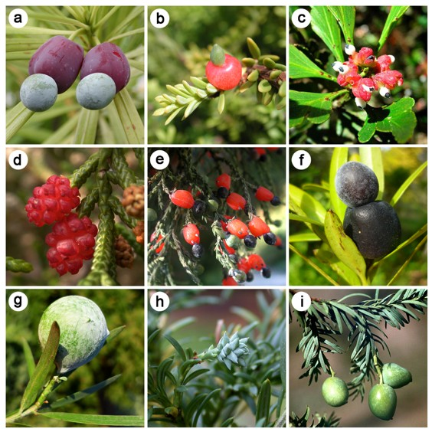
Trait-dependent dispersal in Podocarpaceae+Araucariaceae
(with Kristina Klaus, Univ. of Bochum)
Figure 1. Seed cone variability in the Podocarpaceae. a Podocarpus macrophyllus, b Podocarpus nivalis, c Phyllocladus asplenifolius, d Microcachys tetragona, e Dacrycarpus dacrydioides f Podocarpus elatus, g Afrocarpus falcatus, h Saxegothaea conspicua, i Prumnopitys amara.
Kristina Klaus, Nick Matzke, Systematic Biology, 2020

Slide 110
Trait-dependent dispersal in Podocarpaceae+Araucariaceae
(with Kristina Klaus, Univ. of Bochum)
Hypothesis:
fleshy cones will be better dispersers
Figure 1. Seed cone variability in the Podocarpaceae. a Podocarpus macrophyllus, b Podocarpus nivalis, c Phyllocladus asplenifolius, d Microcachys tetragona, e Dacrycarpus dacrydioides f Podocarpus elatus, g Afrocarpus falcatus, h Saxegothaea conspicua, i Prumnopitys amara.
Kristina Klaus, Nick Matzke, Systematic Biology, 2020

Slide 111
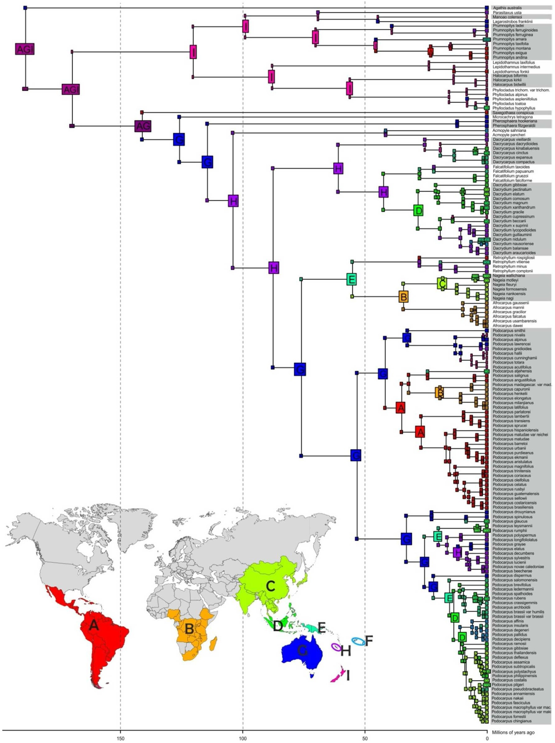
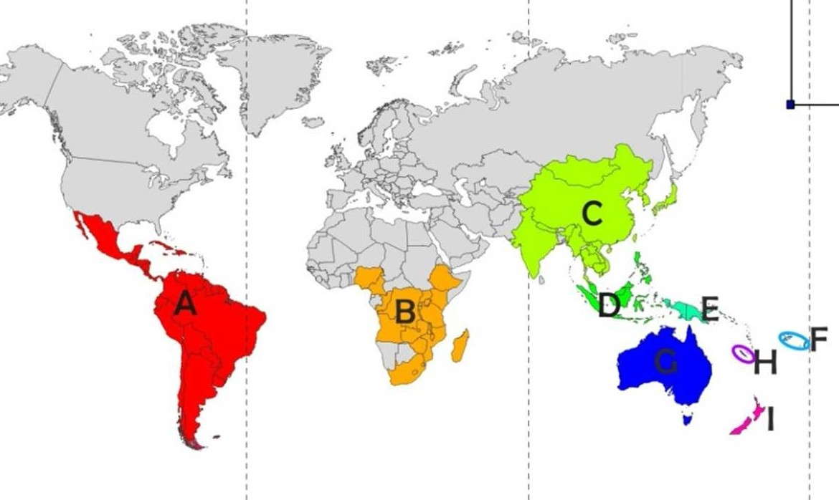
Podocarpaceae DEC+j+x+traits model:
Biogeography
Kristina Klaus, Nick Matzke, Systematic Biology, 2020

Slide 112
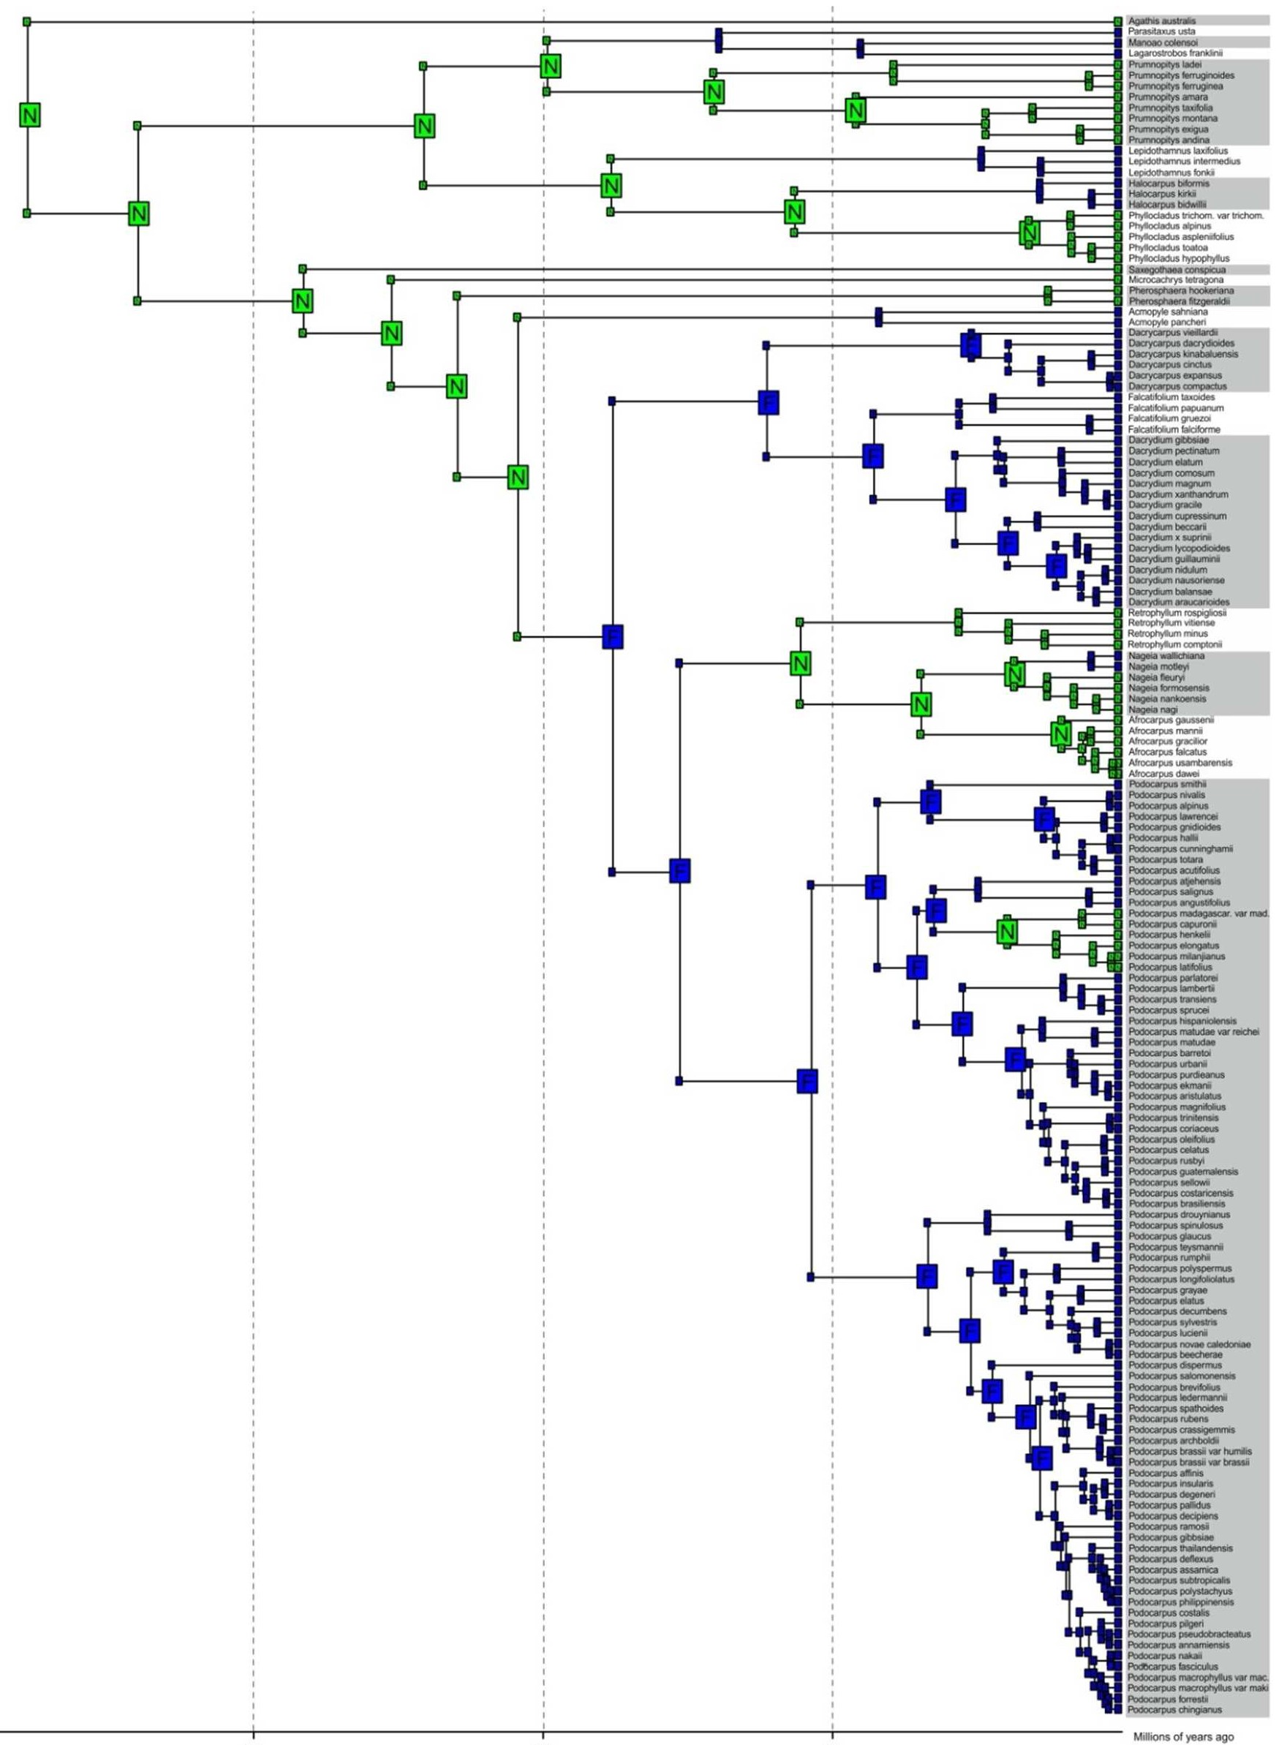


Podocarpaceae DEC+j+x+traits model:
Traits
Fleshy cones
- Dispersal multiplier m1 fixed to 1
Non-fleshy cones
- Dispersal multiplier m2 = 0.5
Kristina Klaus, Nick Matzke, Systematic Biology, 2020

Slide 113
Trait-dependent model results
Kristina Klaus, Nick Matzke, Systematic Biology, 2020

Slide 114
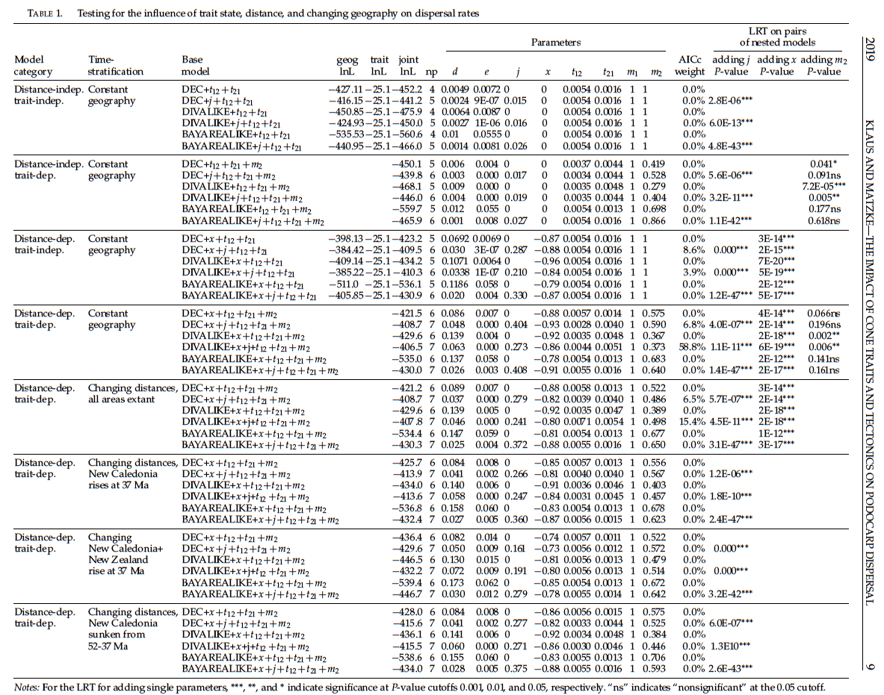
Trait-dependent model results

Slide 115
Trait-dependent model results

Slide 116
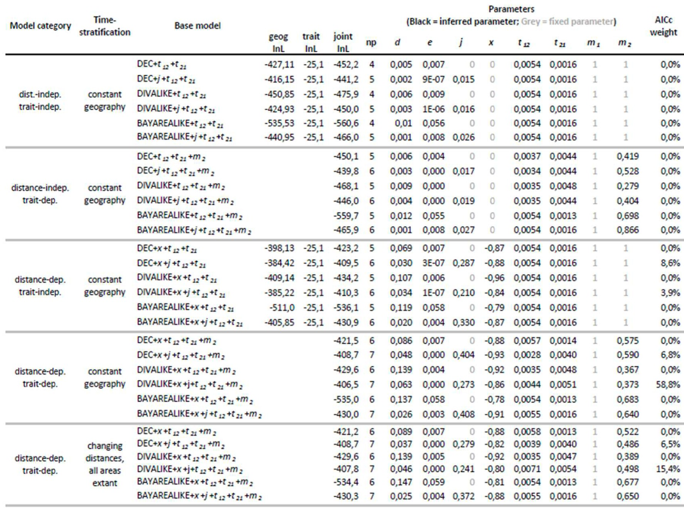
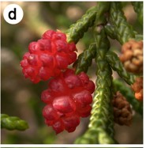
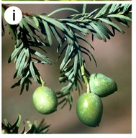
Trait-dependent model results
87.5% AICc weight for trait-dependent models
Lineages with nonﬂeshy cones have a dispersal rate about m2=0.49 lower than ﬂeshy cone lineages
Distance eﬀect: x=-0.86
Trait-dispersal modiﬁers:
m1=1.0
m2=0.49

Slide 117
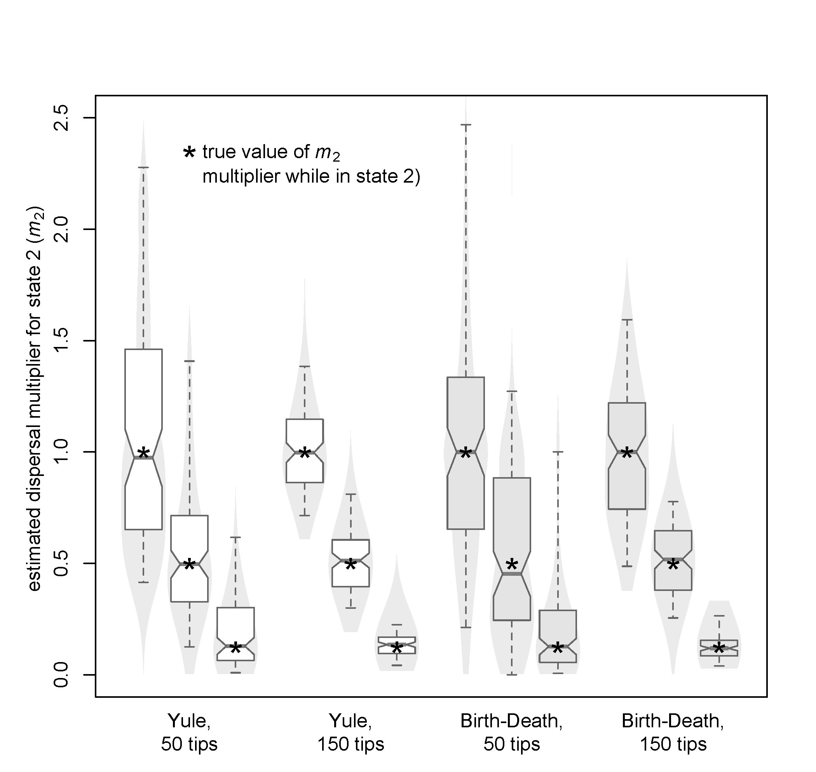
Simulation test for inference of m2:
strong vs. weak effects
dataset size

Slide 118
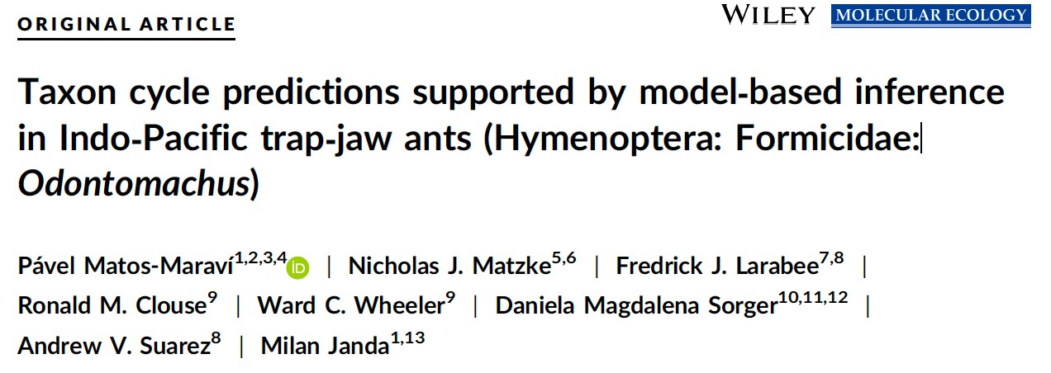
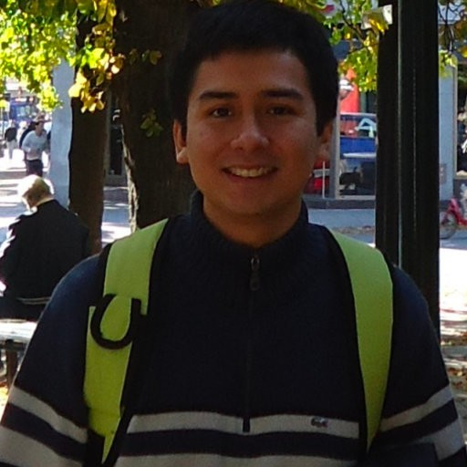
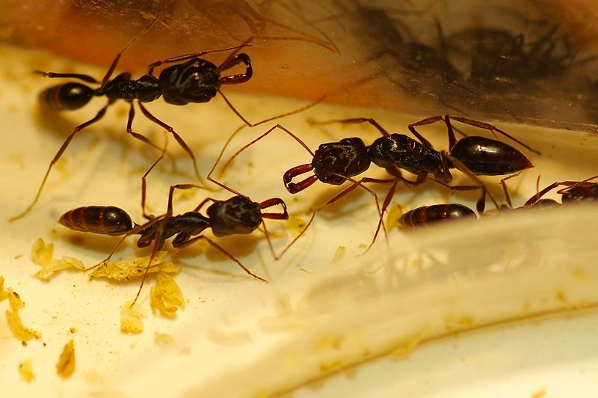
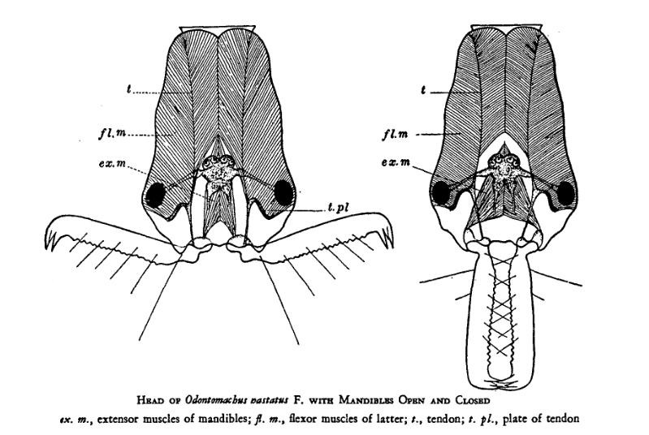
Ecology-dependent dispersal in
Indo-Pacific trap-jaw ants (Odontomachus)
With:
Pavel Matos-Maravi
https://en.wikipedia.org/wiki/File:Odontomachus_monticola.jpg
Wheeler, W.M. (1927): The physiognomy of insects. Quarterly Review of Biology 2: 1-36. https://en.wikipedia.org/wiki/File:OdontomachusHeadWheeler.jpg
Matos-Maravi, Matzke, et al. 2018, Molecular Ecology

Slide 119
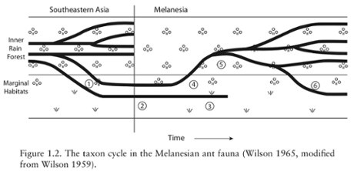
The Taxon Cycle Hypothesis
http://www.ourdailyread.com/2015/04/island-biogeography-revisited-online-book-club-chapter-one/
Matos-Maravi, Matzke, et al. 2018, Molecular Ecology

Slide 120
The Taxon Cycle Hypothesis
http://www.ourdailyread.com/2015/04/island-biogeography-revisited-online-book-club-chapter-one/
Our biogeographical models don’t test all aspects of the Taxon Cycle idea
(which is quite complex)
Matos-Maravi, Matzke, et al. 2018, Molecular Ecology

Slide 121
The Taxon Cycle Hypothesis
http://www.ourdailyread.com/2015/04/island-biogeography-revisited-online-book-club-chapter-one/
Our biogeographical models don’t test all aspects of the Taxon Cycle idea
(which is quite complex)
But: we can test the dispersal part of it: do marginal-habitat ants have a higher dispersal rate?
Matos-Maravi, Matzke, et al. 2018, Molecular Ecology

Slide 122
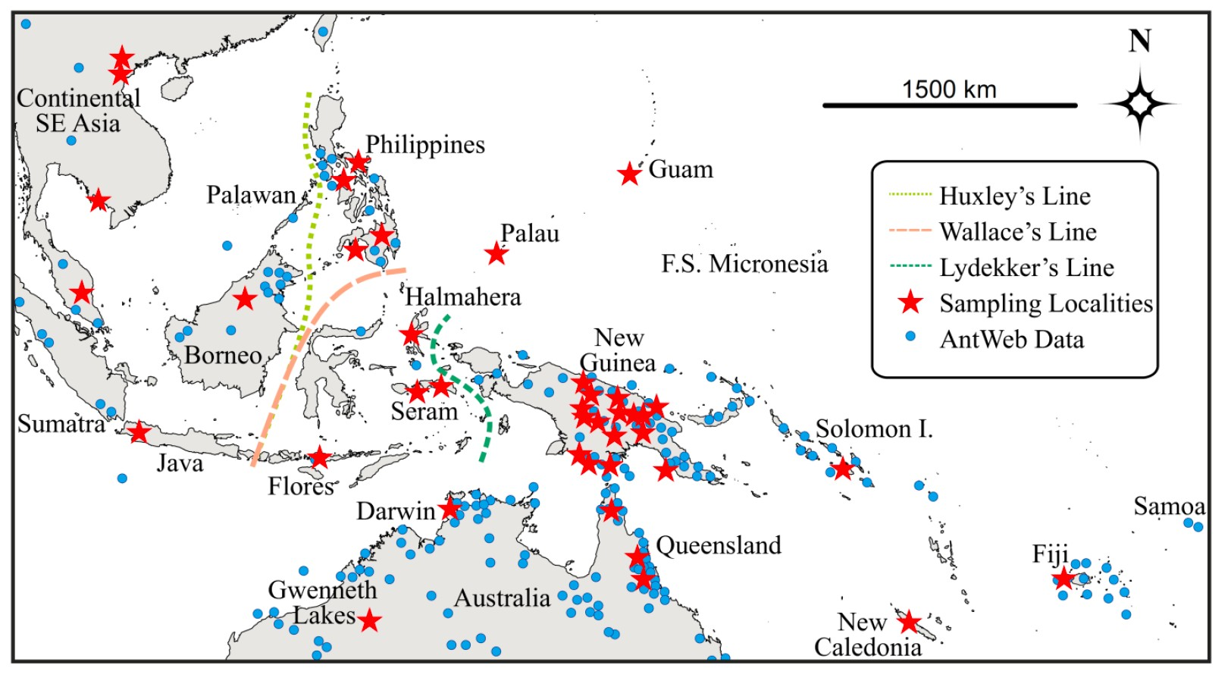
Odontomachus in the Indo-Pacific
Matos-Maravi, Matzke, et al. 2018, Molecular Ecology

Slide 123
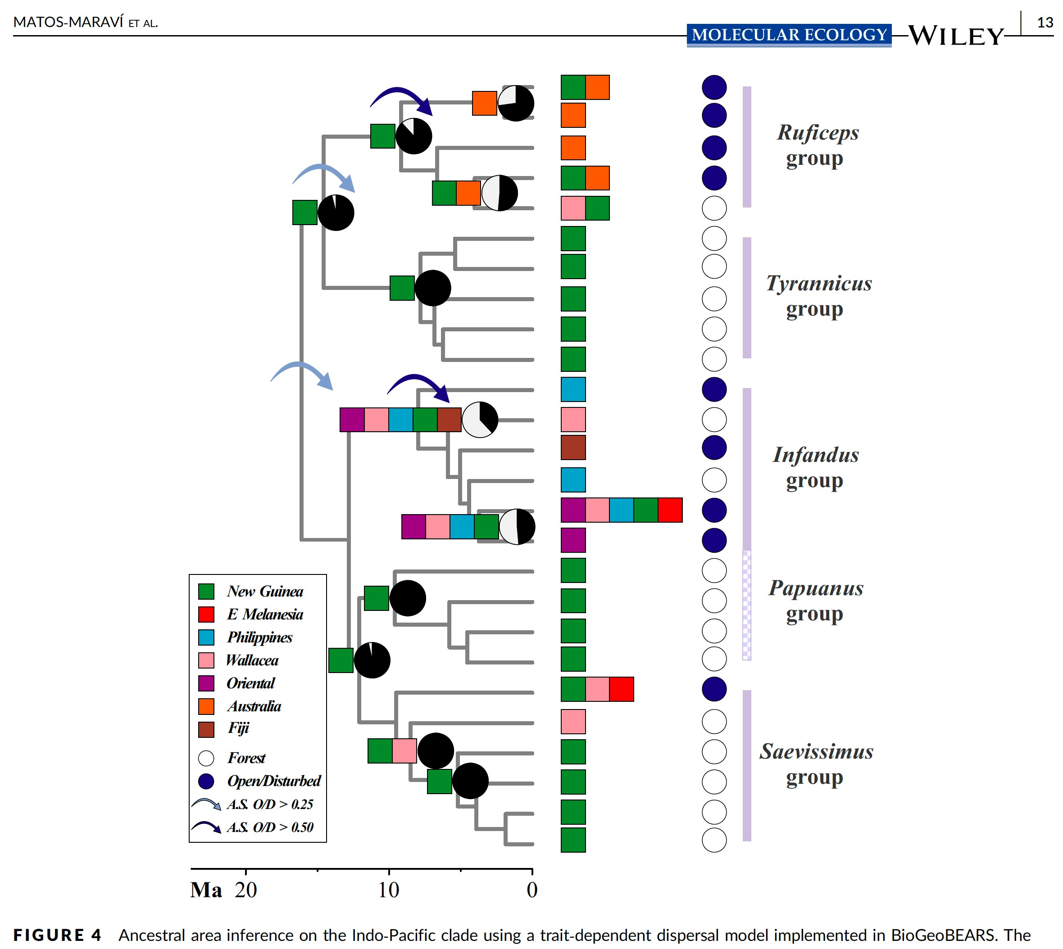
Odontomachus in the Indo-Pacific
vi, Matzke, et al. 2018, Molecular Ecology
Matos-Mara

Slide 124
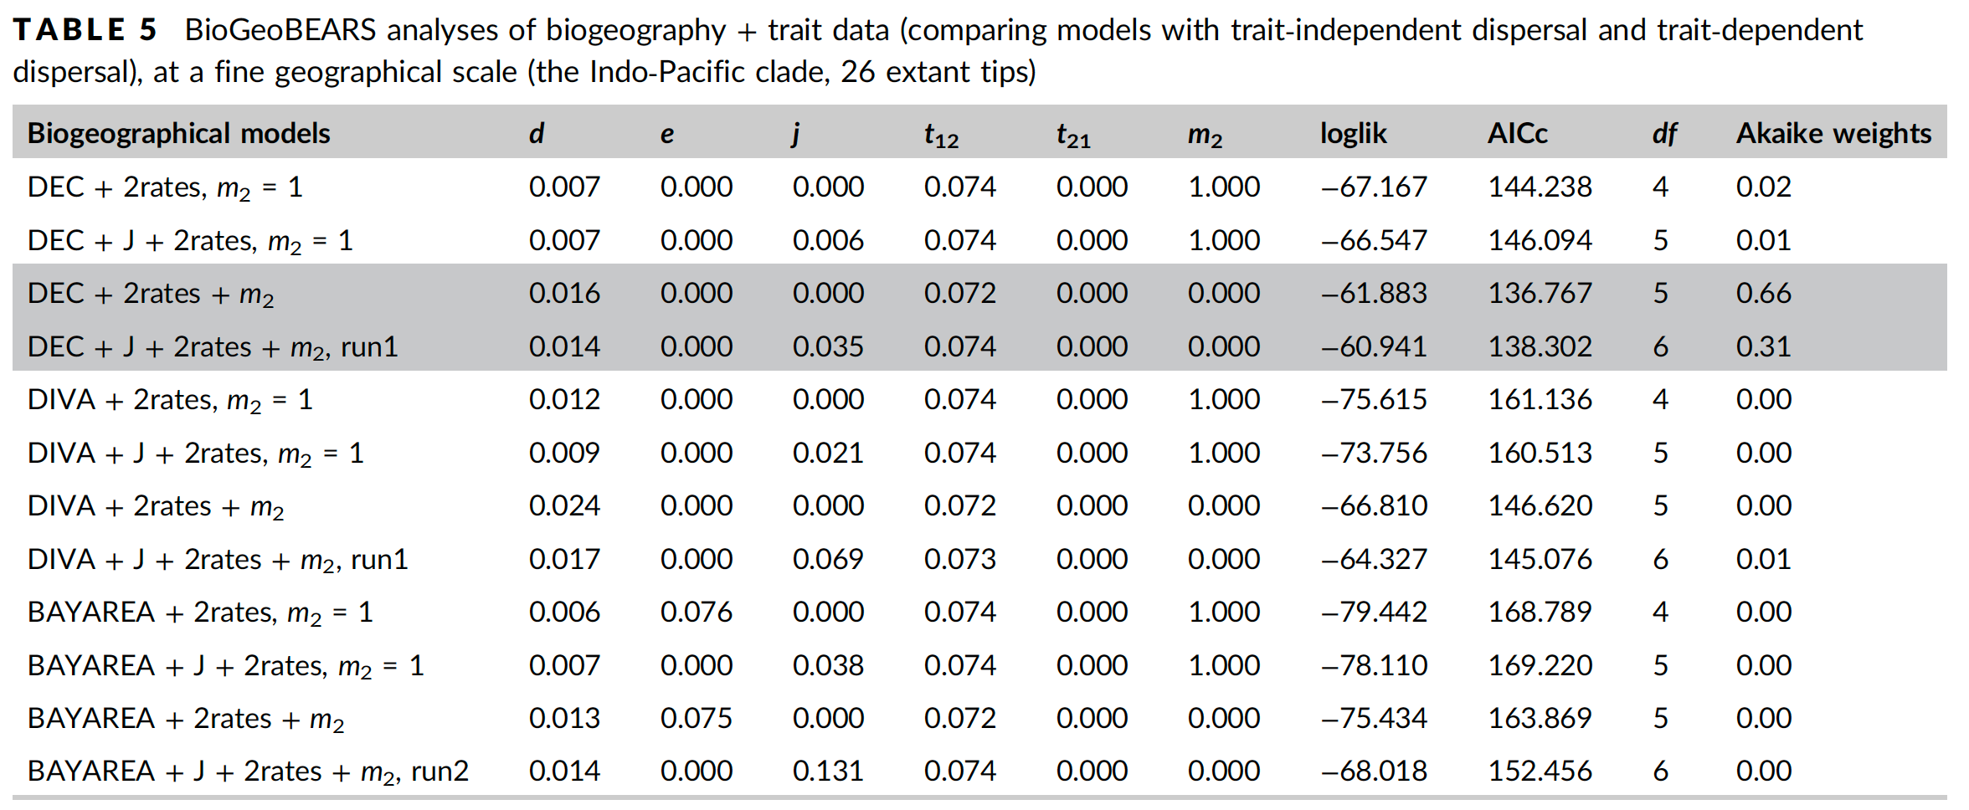
Odontomachus in the Indo-Pacific
Matos-Maravi, Matzke, et al. 2018, Molecular Ecology

Slide 125

Odontomachus in the Indo-Pacific
Indo-Paciﬁc Odontomachus (26 species)
* Lineages in closed forest habitat are inferred to have 0 dispersal in this dataset
m1=1.0
Trait-dispersal modiﬁers: m2=0.0
Matos-Maravi, Matzke, et al. 2018, Molecular Ecology

Slide 126
Odontomachus in the Indo-Pacific
The dataset size is very small for such a complex model
Check on simulated 25-species datasets, for sanity:
Matos-Maravi, Matzke, et al. 2018, Molecular Ecology

Slide 127
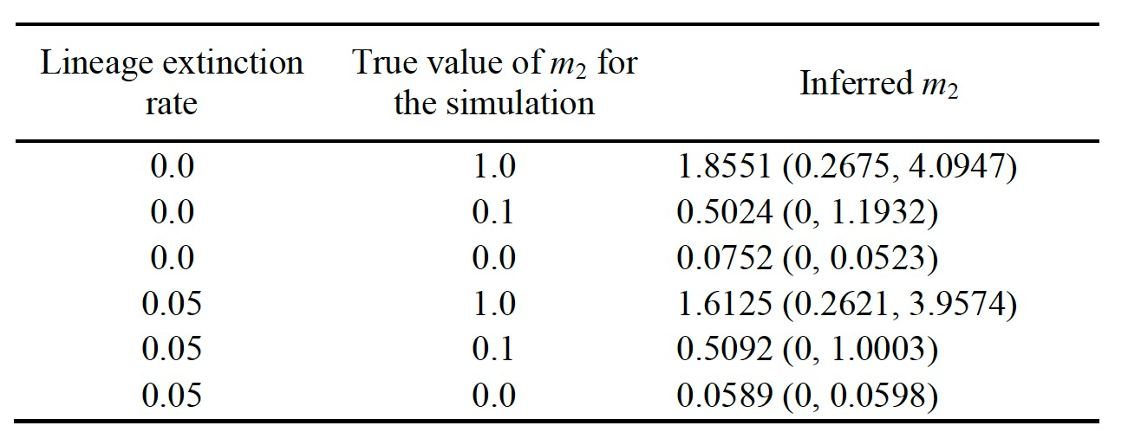
Odontomachus in the Indo-Pacific
The dataset size is very small for such a complex model
Check on simulated 25-species datasets, for sanity:
Matos-Maravi, Matzke, et al. 2018, Molecular Ecology

Slide 128
Odontomachus in the Indo-Pacific
The dataset size is very small for such a complex model
Check on simulated 25-species datasets, for sanity:
Matos-Maravi, Matzke, et al. 2018, Molecular Ecology

Slide 129
Conclusions and cautions
Computational challenges
Model limitations
Matos-Maravi, Matzke, et al. 2018, Molecular Ecology

Slide 130
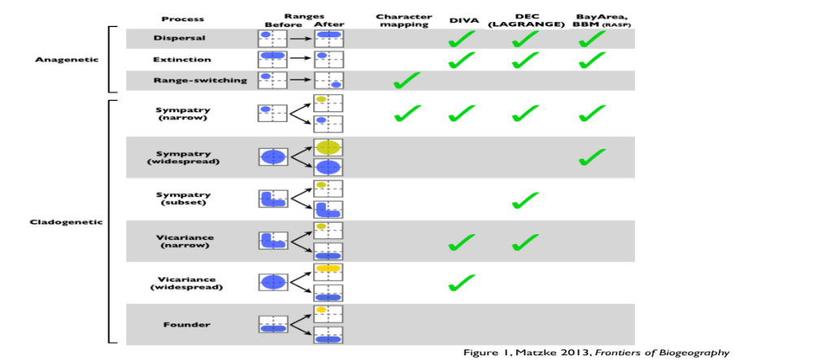
Computation speed problem:
(number of of ranges) = 2^{(number of areas)}
2 areas = 4 states
4 areas = 16 states
10 areas = 1024 states
11 areas = 2048

Slide 131


Slide 132


Slide 133


Slide 134


Slide 135


Slide 136


Slide 137


Slide 138


Slide 139


Slide 140

Q Matrices are sparse

Slide 143
Anagenetic Problem:
# of ranges=2^{(# of areas)}
2 areas = 4 states
4 areas = 16 states
10 areas = 1024 states
11 areas = 2048

Slide 144
Cladogenetic Problem:
# of transitions =
(# ranges)³
2 areas = 4 states = 64 triplets
4 areas = 16 states = 4096 triplets
10 areas = 1024 states = 1 billion+
11 areas = 2048 states = 8.6 billion+

Slide 145

Cladogenetic range change
transition matrix

Slide 146
Cladogenetic range change
transition matrix
(mostly 0s)

Slide 147
Tricks to speed things up:
1. Sparse representations (exclude 0s)
2. C++ backend
3. Parallel processing
4. Exclude unlikely ranges

Slide 148
More complex problems:
1. Trait-linked dispersal
2. Include speciation/extinction

Slide 149
Trait-linked dispersal

Slide 150

Trait-linked dispersal

Slide 151
Trait-linked dispersal

Slide 152
Biggest problem with all of these biogeography models: EXTINCTION

Slide 153

Biggest problem with all of these biogeography models: EXTINCTION

Slide 154
Biggest problem with all of these biogeography models: EXTINCTION
In biogeography: missing speciation events might change ranges!

Slide 155
Biggest problem with all of these biogeography models: EXTINCTION
Possible solution:
ClaSSE model, but it is slow!

Slide 156



observed ranges,
phylogeny (data)
A
AB
A
DEC-type
models
A
AB
A
estimated
estimated
estimated
ClaSSE:
Cladogenetic
State-
dependent
Speciation/
Extinction
estimated
inference
d, e, j &
cladogenesis
assumptions
(weights)
Rate
parameters:
Speciation: λ_{A➔A,A}, etc.
Extinction: μ_{A}, μ_{AB}, etc.
Anagenetic transitions:
q_{A➔A,AB}, etc.
simulation
DEC-type models:
Weights for various cladogenetic transitions
Phylogeny (given, or Yule-simulated)
(Phylogeny and ranges jointly evolve)
Base frequencies:
parameter values,
ancestral ranges
 A B AB
0
1
1
1
/
/
/
3
3
3
DEC-type models as special cases of ClaSSE:
1. Set all λ to either 0, or to
λ_{Yule}*P(scenario|speciation), partial example below:
2. Set all μ to 0: Yule process, excludable constant in lnL
3. Set q transition rates to match DEC Q matrix
4. Set b.f.s to equal = excludable constant in lnL

Slide 157
observed ranges,
phylogeny (data)
A
AB
A
DEC-type
models
A
AB
A
estimated
estimated
estimated
ClaSSE:
Cladogenetic
State-
dependent
Speciation/
Extinction
estimated
inference
d, e, j &
cladogenesis
assumptions
(weights)
Rate
parameters:
Speciation: λ_{A➔A,A}, etc.
Extinction: μ_{A}, μ_{AB}, etc.
Anagenetic transitions:
q_{A➔A,AB}, etc.
simulation
ClaSSE:
Cladogenetic
State-dependent Speciation/Extinction model
Phylogeny (given, or Yule-simulated)
(Phylogeny and ranges jointly evolve)
Base frequencies:
parameter values,
ancestral ranges
 A B AB
0
1
1
1
/
/
/
3
3
3
DEC-type models as special cases of ClaSSE:
1. Set all λ to either 0, or to
λ_{Yule}*P(scenario|speciation), partial example below:
2. Set all μ to 0: Yule process, excludable constant in lnL
3. Set q transition rates to match DEC Q matrix
4. Set b.f.s to equal = excludable constant in lnL
Speciation rate for every (anc, left, right) combination
Extinction rate for every state
Q transition matrix
Numeric integration used

Slide 158
observed ranges,
phylogeny (data)
A
AB
A
DEC-type
models
A
AB
A
estimated
estimated
estimated
ClaSSE:
Cladogenetic
State-
dependent
Speciation/
Extinction
estimated
inference
d, e, j &
cladogenesis
assumptions
(weights)
Rate
parameters:
Speciation: λ_{A➔A,A}, etc.
Extinction: μ_{A}, μ_{AB}, etc.
Anagenetic transitions:
q_{A➔A,AB}, etc.
simulation
Phylogeny (given, or Yule-simulated)
(Phylogeny and ranges jointly evolve)
Base frequencies:
parameter values,
ancestral ranges
 A B AB
0
1
1
1
/
/
/
3
3
3
DEC-type models as special cases of ClaSSE:
1. Set all λ to either 0, or to
λ_{Yule}*P(scenario|speciation), partial example below:
2. Set all μ to 0: Yule process, excludable constant in lnL
3. Set q transition rates to match DEC Q matrix
4. Set b.f.s to equal = excludable constant in lnL

Slide 159
observed ranges,
phylogeny (data)
A
AB
A
DEC-type
models
A
AB
A
estimated
estimated
estimated
ClaSSE:
Cladogenetic
State-
dependent
Speciation/
Extinction
estimated
inference
d, e, j &
cladogenesis
assumptions
(weights)
Rate
parameters:
Speciation: λ_{A➔A,A}, etc.
Extinction: μ_{A}, μ_{AB}, etc.
Anagenetic transitions:
q_{A➔A,AB}, etc.
simulation
Phylogeny (given, or Yule-simulated)
(Phylogeny and ranges jointly evolve)
Base frequencies:
parameter values,
ancestral ranges
 A B AB
0
1
1
1
/
/
/
3
3
3
DEC-type models as special cases of ClaSSE:
1. Set all λ to either 0, or to
λ_{Yule}*P(scenario|speciation), partial example below:
2. Set all μ to 0: Yule process, excludable constant in lnL
3. Set q transition rates to match DEC Q matrix
4. Set b.f.s to equal = excludable constant in lnL

Slide 160
observed ranges,
phylogeny (data)
A
AB
A
DEC-type
models
A
AB
A
estimated
estimated
estimated
ClaSSE:
Cladogenetic
State-
dependent
Speciation/
Extinction
estimated
inference
d, e, j &
cladogenesis
assumptions
(weights)
Rate
parameters:
Speciation: λ_{A➔A,A}, etc.
Extinction: μ_{A}, μ_{AB}, etc.
Anagenetic transitions:
q_{A➔A,AB}, etc.
simulation
Phylogeny (given, or Yule-simulated)
(Phylogeny and ranges jointly evolve)
Base frequencies:
parameter values,
ancestral ranges
 A B AB
0
1
1
1
/
/
/
3
3
3
DEC-type models as special cases of ClaSSE:
1. Set all λ to either 0, or to
λ_{Yule}*P(scenario|speciation), partial example below:
2. Set all μ to 0: Yule process, excludable constant in lnL
3. Set q transition rates to match DEC Q matrix
4. Set b.f.s to equal = excludable constant in lnL

Slide 161
observed ranges,
phylogeny (data)
A
AB
A
DEC-type
models
A
AB
A
estimated
estimated
estimated
ClaSSE:
Cladogenetic
State-
dependent
Speciation/
Extinction
estimated
inference
d, e, j &
cladogenesis
assumptions
(weights)
Rate
parameters:
Speciation: λ_{A➔A,A}, etc.
Extinction: μ_{A}, μ_{AB}, etc.
Anagenetic transitions:
q_{A➔A,AB}, etc.
simulation
Phylogeny (given, or Yule-simulated)
(Phylogeny and ranges jointly evolve)
Base frequencies:
parameter values,
ancestral ranges
 A B AB
0
1
1
1
/
/
/
3
3
3
DEC-type models as special cases of ClaSSE:
1. Set all λ to either 0, or to
λ_{Yule}*P(scenario|speciation), partial example below:
2. Set all μ to 0: Yule process, excludable constant in lnL
3. Set q transition rates to match DEC Q matrix
4. Set b.f.s to equal = excludable constant in lnL

Slide 162
observed ranges,
phylogeny (data)
A
AB
A
DEC-type
models
A
AB
A
estimated
estimated
estimated
ClaSSE:
Cladogenetic
State-
dependent
Speciation/
Extinction
estimated
inference
d, e, j &
cladogenesis
assumptions
(weights)
Rate
parameters:
Speciation: λ_{A➔A,A}, etc.
Extinction: μ_{A}, μ_{AB}, etc.
Anagenetic transitions:
q_{A➔A,AB}, etc.
simulation
Phylogeny (given, or Yule-simulated)
(Phylogeny and ranges jointly evolve)
Base frequencies:
parameter values,
ancestral ranges
 A B AB
0
1
1
1
/
/
/
3
3
3
DEC-type models as special cases of ClaSSE:
1. Set all λ to either 0, or to
λ_{Yule}*P(scenario|speciation), partial example below:
2. Set all μ to 0: Yule process, excludable constant in lnL
3. Set q transition rates to match DEC Q matrix
4. Set b.f.s to equal = excludable constant in lnL

Slide 163
Biogeography models are just special cases of ClaSSE:
Extinction = 0 (Yule process)
Flat root state frequencies
State-dependent range-change at cladogenesis

Slide 164


Slide 165
Problem with ClaSSE:
Numeric integration used to approximate the likelihood
Even slower than matrix exponentiation!

Slide 166

Problem with ClaSSE:

Slide 167

Julia to the rescue?
Julia 1.0 released in early 2019, after many years <1.0
Core developers at MIT
Aims to have R/Python-like usage
But compiles to C-like speeds
KEY advantage: DifferentialEquations.jl library

Slide 168

Julia to the rescue?
Julia 1.0 released in early 2019, after many years <1.0
Core developers at MIT
Aims to have R/Python-like usage
But compiles to C-like speeds
KEY advantage: DifferentialEquations.jl library

Slide 169
Julia to the rescue?
KEY advantage: DifferentialEquations.jl library
by Chris Rackauckas
https://github.com/JuliaDiffEq/DifferentialEquations.jl

Slide 170

Julia to the rescue?
KEY advantage: DifferentialEquations.jl library
https://github.com/JuliaDiffEq/DifferentialEquations.jl

Slide 171

Julia to the rescue?
KEY advantage: DifferentialEquations.jl library
by Chris Rackauckas
https://github.com/JuliaDiffEq/DifferentialEquations.jl

Slide 172
ClaSSE model in Julia
Methods:
1. Made basic calculation as fast as possible in Julia
- fully used sparsity
- all parameter arrays & indexing pre-allocated
- minimized Garbage Collection with @benchmark
& advice from DifferentialEquations
help forum (including Rackauckas)
2. Precalculate “Es” (conditional extinction
probabilities) once, then interpolate for “Ds”
(observed data probabilities)
https://github.com/JuliaDiffEq/DifferentialEquations.jl

Slide 173
ClaSSE model in Julia
Methods:
3. Compare Julia’s many available differential
equation solvers with Work-Precision diagrams
- from 2-11 areas
- i.e. from 4-2048 states (geographic ranges)
- i.e. systems of 8-4048 differential equations
https://github.com/JuliaDiffEq/DifferentialEquations.jl

Slide 174


Slide 175


Slide 176


Slide 177


Slide 178


Slide 179


Slide 180


Slide 181


Slide 182


Slide 183


Slide 184
How far could we push this?
Preliminary data
? (28 days & counting)
15 min.

Slide 185
Serial vs. Parallel - speeding up SSE calculations
Calculations on branches, in parallel
Calculations on branches, serial on 1 core

Slide 186


Future work: add Louca-Pennell method

Slide 187



Comparison of model features
BioGeoJulia: complexifying biogeography
Integrate BioGeoJulia with GPlates for continuous palaeogeography
This Proposal
(BioGeoJulia)
GPlates animation: Zealandia crustal thickness
Müller, Sahirovic et al. (2018), U. Sydney "Modelling and visualising distributed crustal deformation of Australia and Zealandia using GPlates 2.0." https://www.youtube.com/watch?v=iKkCIdZ6oaE
BioGeoJulia: extract & use continuous estimates of areas, distances
Sabin Zahirovic, GPlates coauthor, U. Sydney

Slide 188
Comparison of model features
BioGeoJulia: complexifying biogeography
Integrate BioGeoJulia with GPlates for continuous palaeogeography
This Proposal
(BioGeoJulia)
GPlates animation: Zealandia crustal thickness
Müller, Sahirovic et al. (2018), U. Sydney "Modelling and visualising distributed crustal deformation of Australia and Zealandia using GPlates 2.0." https://www.youtube.com/watch?v=iKkCIdZ6oaE
BioGeoJulia: extract & use continuous estimates of areas, distances
Sabin Zahirovic, GPlates coauthor, U. Sydney

Slide 189
Comparison of model features
BioGeoJulia: complexifying biogeography
Integrate BioGeoJulia with GPlates for continuous palaeogeography
This Proposal
(BioGeoJulia)
GPlates animation: Zealandia crustal thickness
Müller, Sahirovic et al. (2018), U. Sydney "Modelling and visualising distributed crustal deformation of Australia and Zealandia using GPlates 2.0." https://www.youtube.com/watch?v=iKkCIdZ6oaE
BioGeoJulia: extract & use continuous estimates of areas, distances
Sabin Zahirovic, GPlates coauthor, U. Sydney

Slide 190
Comparison of model features
BioGeoJulia: complexifying biogeography
Integrate BioGeoJulia with GPlates for continuous palaeogeography
This Proposal
(BioGeoJulia)
GPlates animation: Zealandia crustal thickness
Müller, Sahirovic et al. (2018), U. Sydney "Modelling and visualising distributed crustal deformation of Australia and Zealandia using GPlates 2.0." https://www.youtube.com/watch?v=iKkCIdZ6oaE
BioGeoJulia: extract & use continuous estimates of areas, distances
Sabin Zahirovic, GPlates coauthor, U. Sydney

Slide 191
Conclusions
Large ClaSSE models will probably never be super-fast – but Julia versions should be fast enough for e.g. Maximum Likelihood
The number of free parameters explodes to meaninglessness quickly. So model (parametric) complexity has to be carefully controlled by carefully thinking about, and designing, meaningful models controlled by a small number of parameters (as in e.g. standard biogeography models)
Julia’s DifferentialEquations solvers are very flexible, suggesting that more interesting models could be designed in this framework (regional carrying capacity, interpolating in the impact of external forcers
like changing geography & climate, etc.)
Acknowledgements: Marsden grant no. 18-UOA-34

Slide 192

Cautions
“All models are wrong, but some models are useful.”
-- George Box
George E. P. Box (1919-2013)
I say: we’ll never know the usefulness / misleading qualities unless we do statistical model comparison.

Slide 193
Cautions
“All models are wrong, but some models are useful.”
-- George Box
George E. P. Box (1919-2013)
Current grant proposals to:
Include lineage extinction
Include GPlates (open-source plate tectonics)
Do calculations in reasonable time

Slide 194
Summary
Model choice matters in historical biogeography! We should always do it!
Distance matters in historical biogeography! We should always test distance!
Traits also often matter! We should test for this wherever possible!
We can test models by comparing log-likelihoods, or penalized log-likelihoods (AIC)

Slide 195



Interested in evolution & biogeography? Come work with me! Questions/comments/ collaborations at: n.matzke@auckland.ac.nz
TRY BioGeoBEARS AT:
http://phylo.wikidot.com/biogeobears
Nicholas J. Matzke Senior Lecturer
University of Auckland
phylo.wikidot.com/nicholas-j-matzke
Funding: NIMBioS
University of Auckland
Marsden Fast-Start
Thanks for support from:

