Slide 1
Nicholas J. Matzke
Senior Lecturer,
Rutherford Discovery Fellow
School of Biological Sciences
University of Auckland
Model-based statistical inference in evolutionary biogeography
Transmitting Science workshop, Oct. 12, 2026

Slide 2
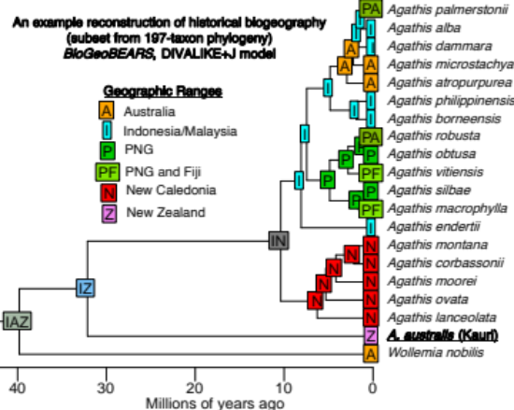
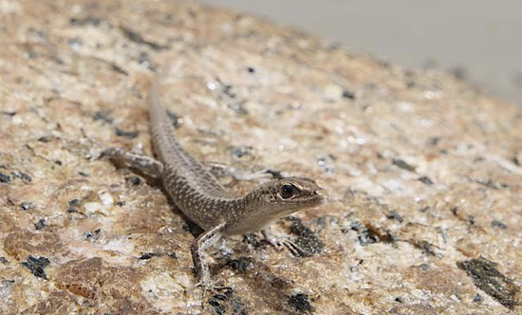
Example papers:
Historical biogeography with new models
2019: Cryptoblepharus lizards, littoral ~13x more dispersal
2021: Polyploidy in NZ plants; flightlessness in Pacific rails
2020: Fleshy cones have 2x dispersal rate
2019: Dispersal syndrome in crocs
2019: Red fruits ~20x more dispersal

Slide 3
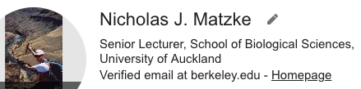

Matzke key product: Biogeographical software
2019: 450+ usages
2023: ~1800 usages
Biogeography Workshops:
24
International symposia
Non-U.S. talks
* 46 peer-reviewed
articles
* AE, Systematic
Biology

Slide 4
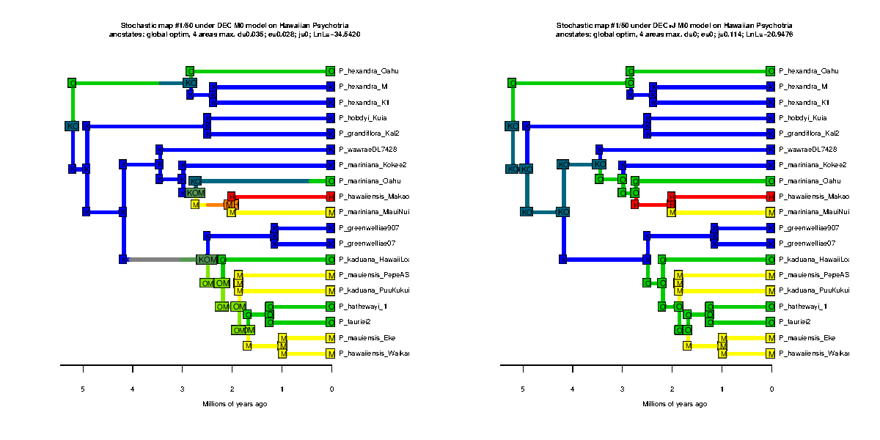
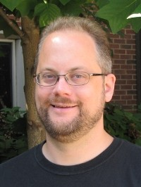
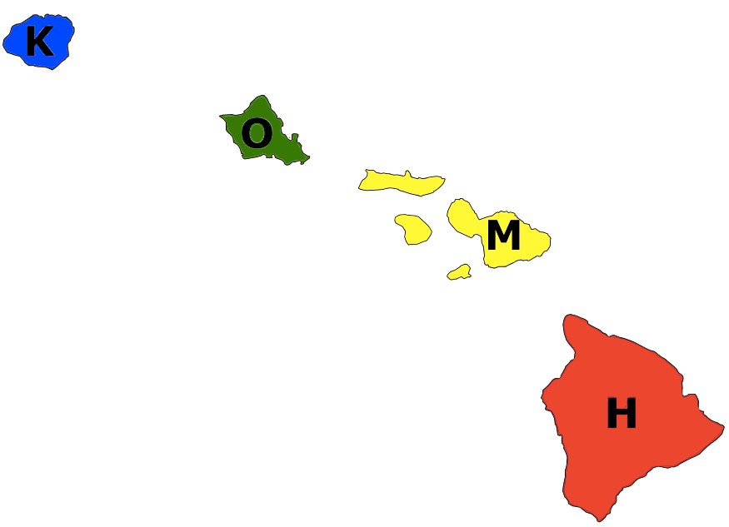







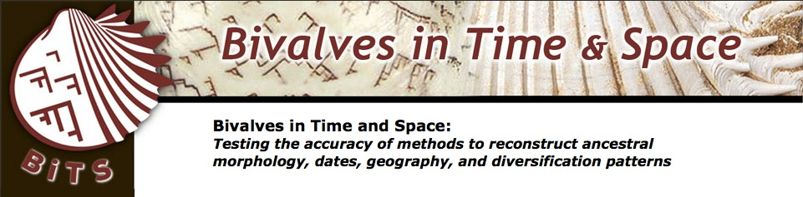
Trait-dependent dispersal models in phylogenetic biogeography: theory and application in ants, crocs, lizards and kauri
Nicholas J. Matzke Senior Lecturer, SBS
School of Biological Sciences,
University of Auckland
phylo.wikidot.com/nicholas-j-matzke
possible histories (DEC model)
possible histories (DEC+J model)
Hawaiian Psychotria shrubs
Thanks for support from:

Slide 5
Historical biogeography methods

Slide 6
Historical biogeography methods
1. Estimate a dated phylogeny

Slide 7
Historical biogeography methods
Estimate a dated phylogeny
Put the geographic ranges at the tips

Slide 8
Historical biogeography methods
Estimate a dated phylogeny
Put the geographic ranges at the tips
Assume some process(es)

Slide 9
Historical biogeography methods
Estimate a dated phylogeny
Put the geographic ranges at the tips
Assume some process(es)
Conduct inference

Slide 10
Historical biogeography methods
Estimate a dated phylogeny
Put the geographic ranges at the tips
3. Assume some process(es)
4. Conduct inference

Slide 11
Summary of previous lectures:
Different authorities have different assumptions about what processes matter!
Your inferences will depend on your assumptions
Vicariance: deterministic vision where geology determines ranges
Dispersal: “unpredictable” “chance events”
Me: “Unpredictable” doesn’t mean intractable – we can address using probabilistic models

Slide 12
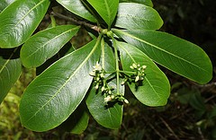
Results of different biogeography models on same dataset:
K=Kauai
O=Oahu
M=Maui-Nui
H=Hawai’i
Psychotria hexandra
http://farm8.static.flickr.com/7446/9252634315_0ecf0ba853_m.jpg

Slide 13
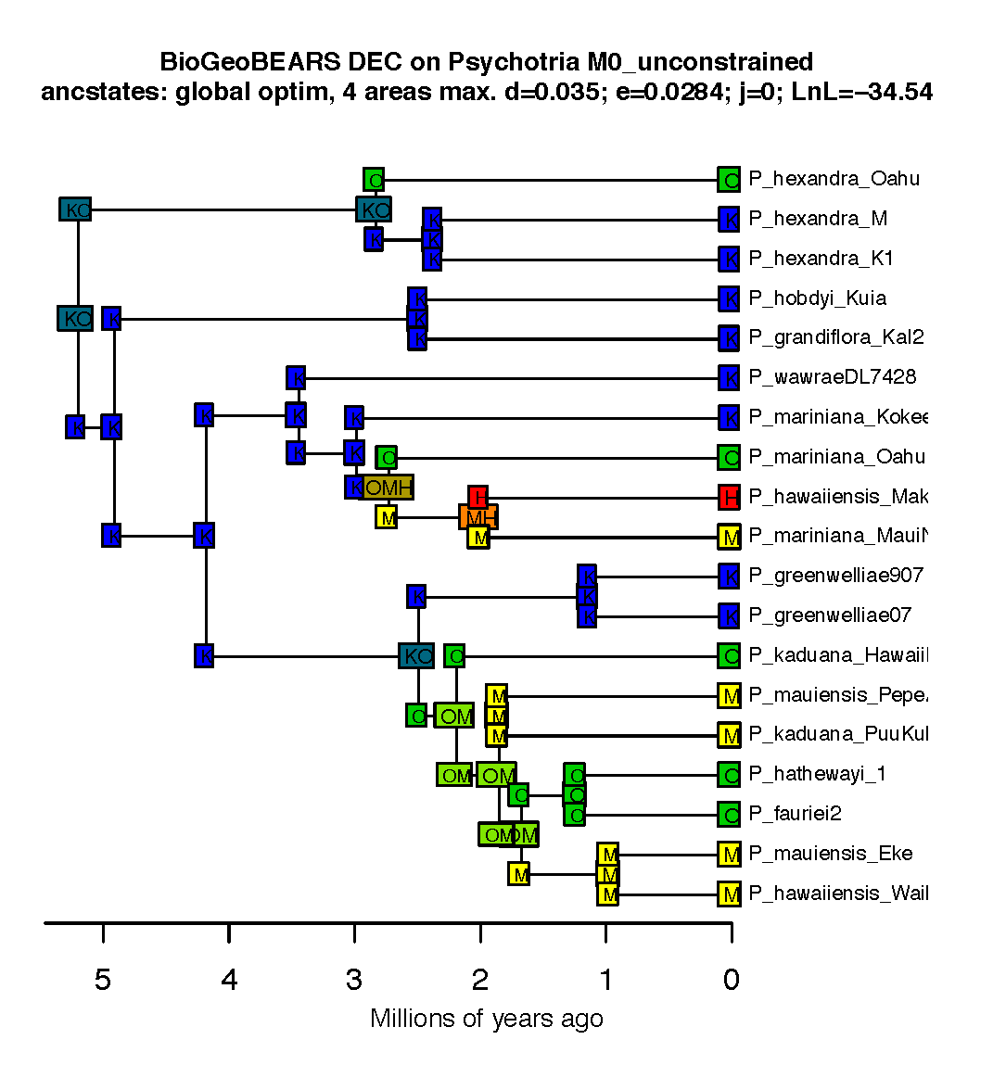
Example of biogeographic history:
Psychotria
Model: DEC
K=Kauai
O=Oahu
M=Maui-Nui
H=Hawai’i
Psychotria hexandra
http://farm8.static.flickr.com/7446/9252634315_0ecf0ba853_m.jpg

Slide 14
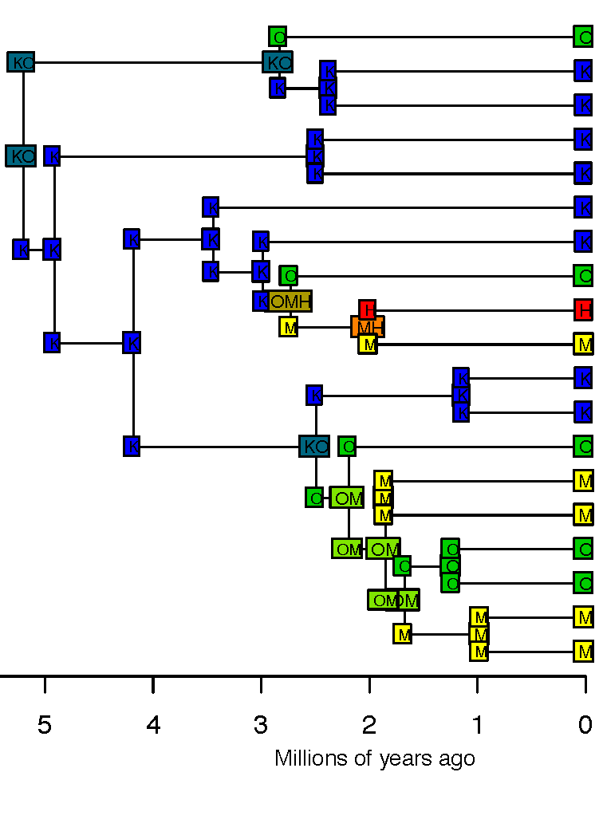
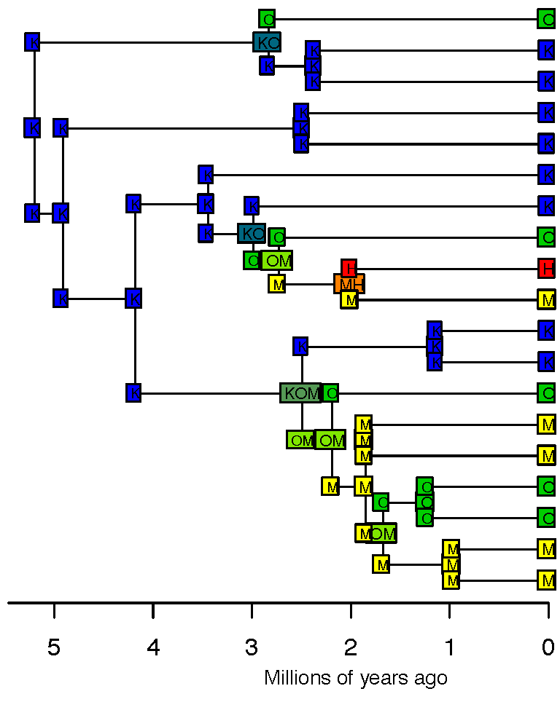
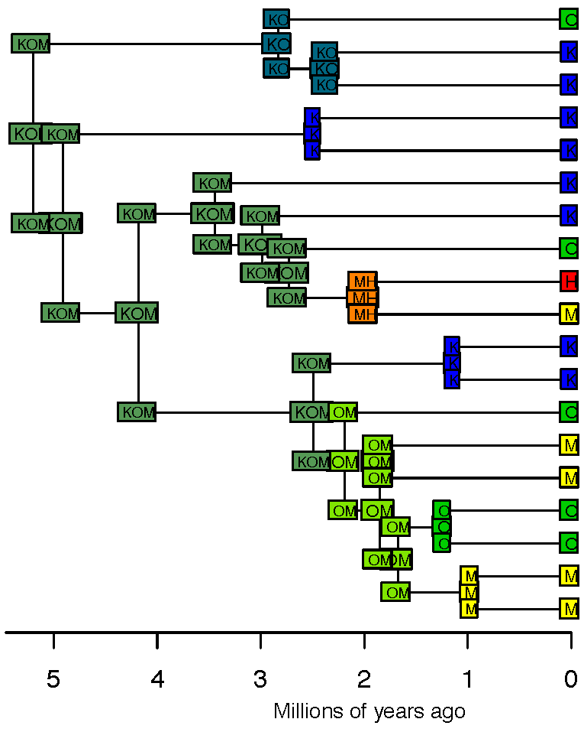
Comparison: 3 models
Model: DEC
Model: DIVA Model: BayArea
K=Kauai
O=Oahu
M=Maui-Nui
H=Hawai’i
Psychotria hexandra
http://farm8.static.flickr.com/7446/9252634315_0ecf0ba853_m.jpg

Slide 15
I think we should use statistical model choice in biogeography
Comparison of two models:
model without founder-event speciation
model with founder-event speciation

Slide 16
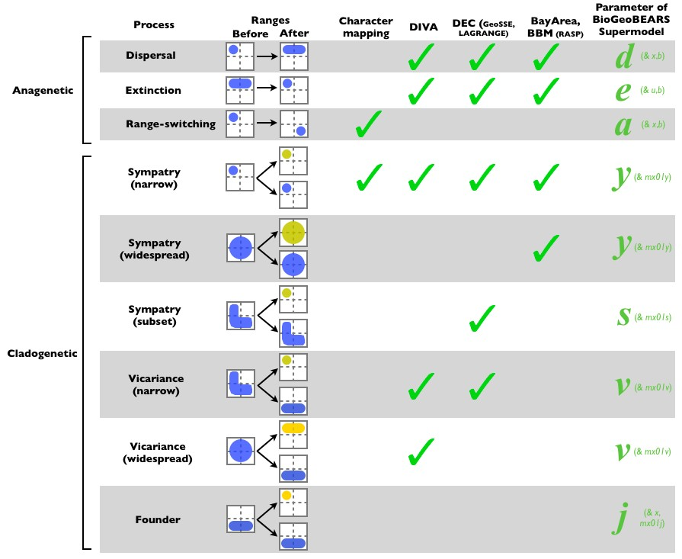


DEC (LAGRANGE)
Which model should we use?
What about founder- event speciation?
Figure 1, Matzke 2013, Frontiers of Biogeography

Slide 17





Founder-event speciation
In founder-event speciation, a rare dispersal event “instantaneously” establishes a geographically isolated new lineage with one or a few individuals
Widely discussed in population genetics, speciation literature, island biogeography
However, ignored in traditional historical biogeography computer models
“jump” event
area A
area B

Slide 18
Example stochastic map
ML DEC model
ML DEC+J model
(under model M0: no geology)
Biogeographical stochasCc mapping published in: Dupin, Matzke et al. (2016), J. Biogeography.

Slide 19
Example stochastic map
ML DEC model
ML DEC+J model
(under model M0: no geology)
Biogeographical stochasCc mapping published in: Dupin, Matzke et al. (2016), J. Biogeography.

Slide 20
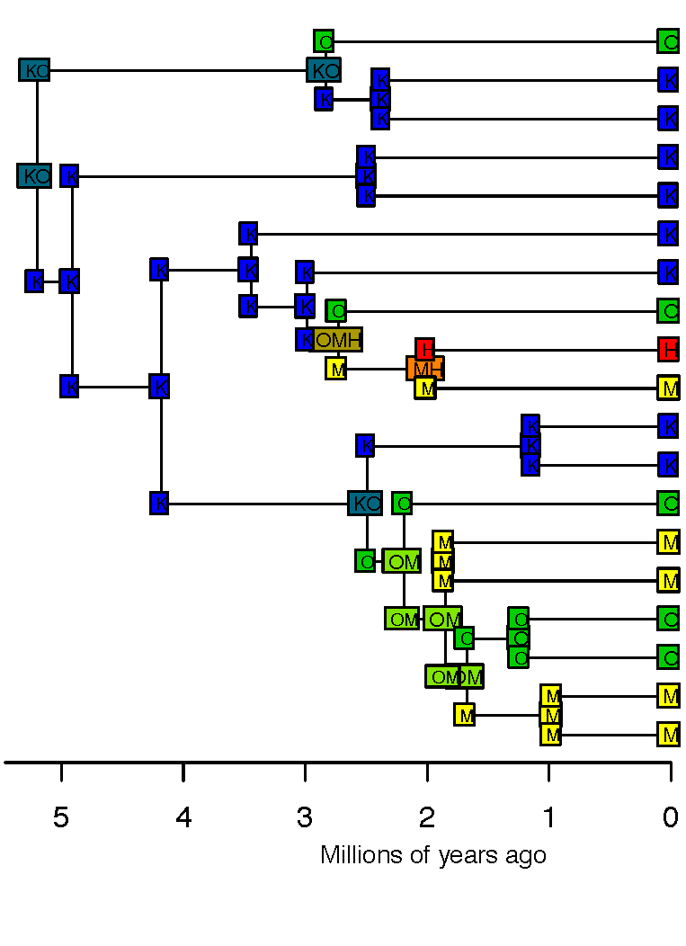
Historical biogeography methods
Estimate a dated phylogeny
Put the geographic ranges at the tips
3. Assume some process(es)
4. Conduct inference
DEC
DIVA
BayArea

Slide 21
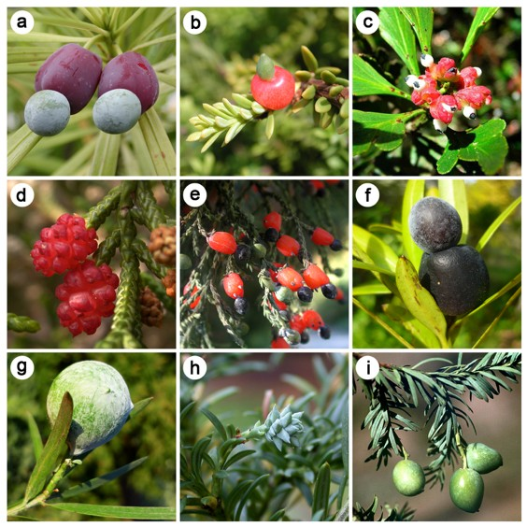
Trait-dependent dispersal in Podocarpaceae+Araucariaceae
(with Kristina Klaus, Univ. of Bochum)
Figure 1. Seed cone variability in the Podocarpaceae. a Podocarpus macrophyllus, b Podocarpus nivalis, c Phyllocladus asplenifolius, d Microcachys tetragona, e Dacrycarpus dacrydioides f Podocarpus elatus, g Afrocarpus falcatus, h Saxegothaea conspicua, i Prumnopitys amara.
Kristina Klaus, Nick Matzke, Systematic Biology, 2020

Slide 22
Trait-dependent dispersal in Podocarpaceae+Araucariaceae
(with Kristina Klaus, Univ. of Bochum)
Hypothesis:
fleshy cones will be better dispersers
Figure 1. Seed cone variability in the Podocarpaceae. a Podocarpus macrophyllus, b Podocarpus nivalis, c Phyllocladus asplenifolius, d Microcachys tetragona, e Dacrycarpus dacrydioides f Podocarpus elatus, g Afrocarpus falcatus, h Saxegothaea conspicua, i Prumnopitys amara.
Kristina Klaus, Nick Matzke, Systematic Biology, 2020

Slide 23
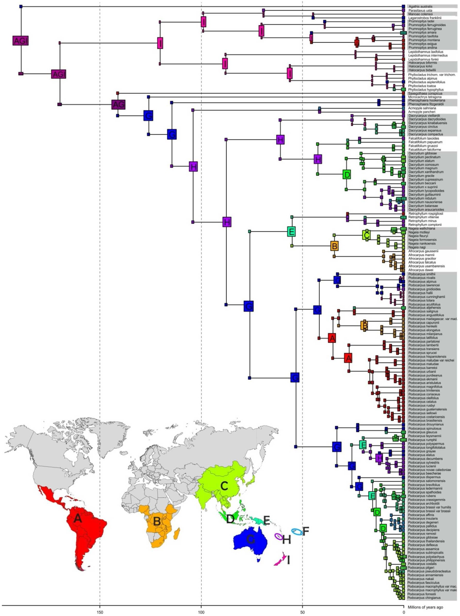
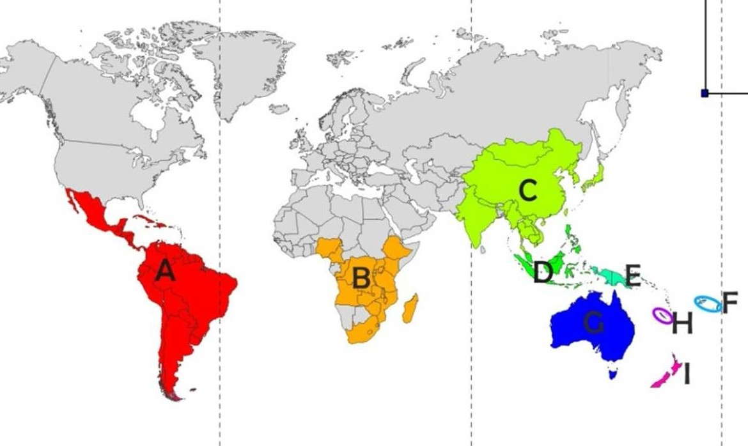
Podocarpaceae DEC+j+x+traits model:
Biogeography
Kristina Klaus, Nick Matzke, Systematic Biology, 2020

Slide 24
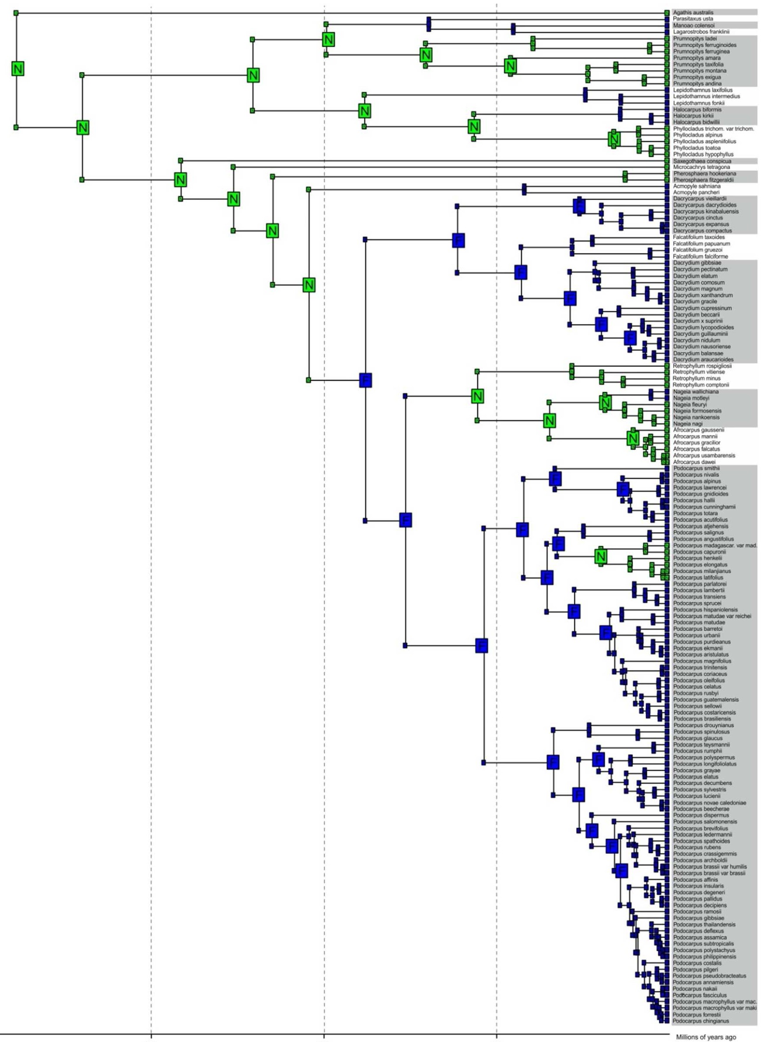


Podocarpaceae DEC+j+x+traits model:
Traits
Fleshy cones
- Dispersal multiplier m1 fixed to 1
Non-fleshy cones
- Dispersal multiplier m2 = 0.5
Kristina Klaus, Nick Matzke, Systematic Biology, 2020

Slide 25
Trait-dependent model results
Klaus & Matzke 2020

Slide 26
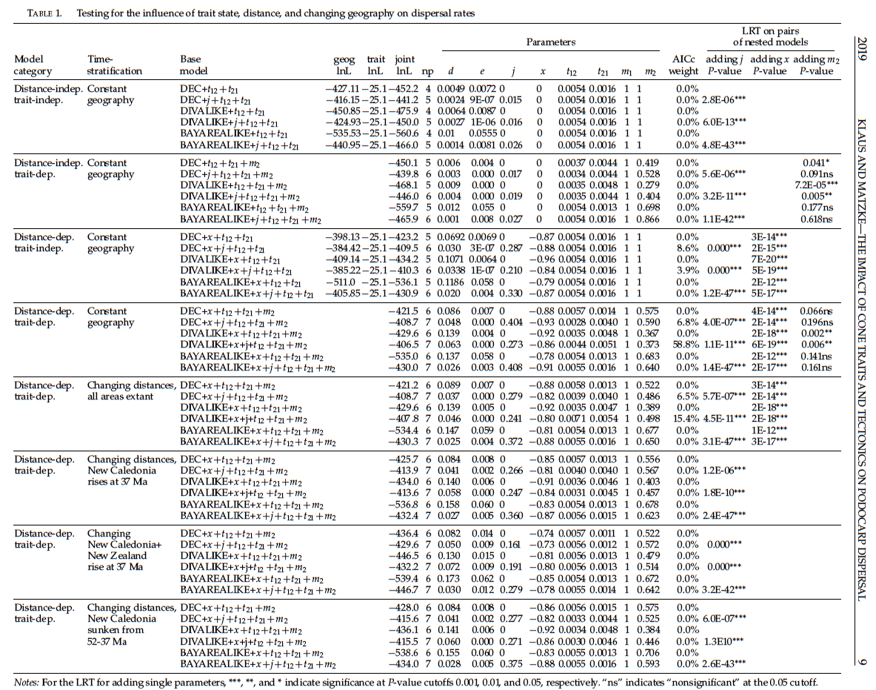
Trait-dependent model results

Slide 27
Trait-dependent model results

Slide 28

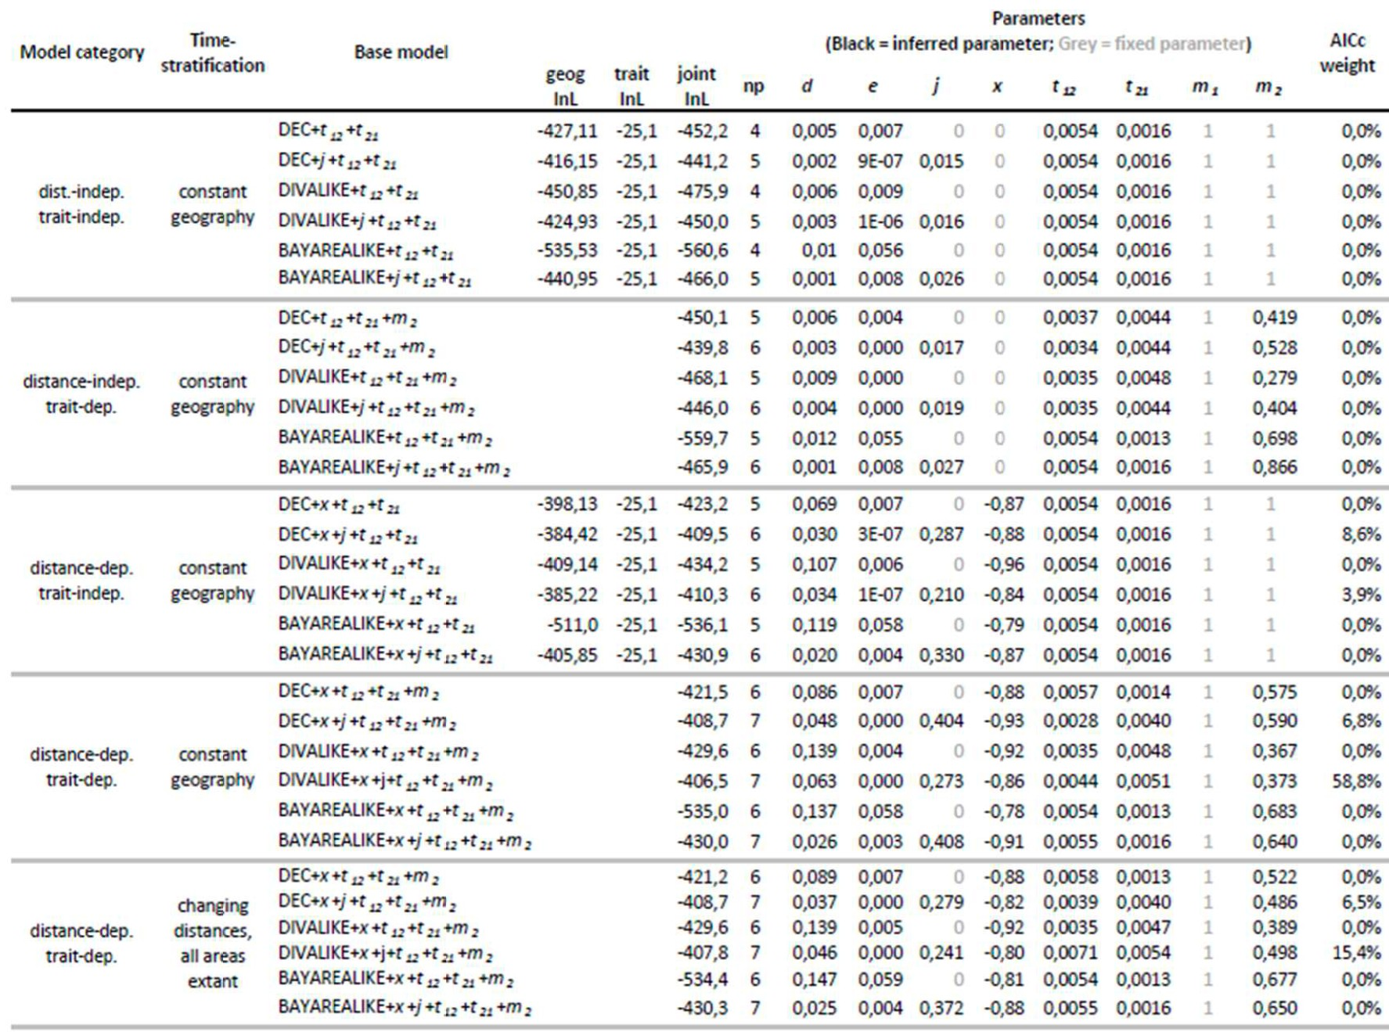
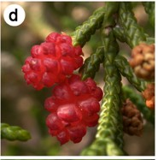
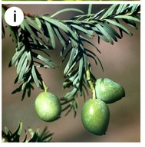
Trait-dependent model results
87.5% AICc weight for trait-dependent models
Lineages with nonﬂeshy cones have a dispersal rate about m2=0.49 lower than ﬂeshy cone lineages
Distance eﬀect: x=-0.86
Trait-dispersal modiﬁers:
m1=1.0
m2=0.49

Slide 29
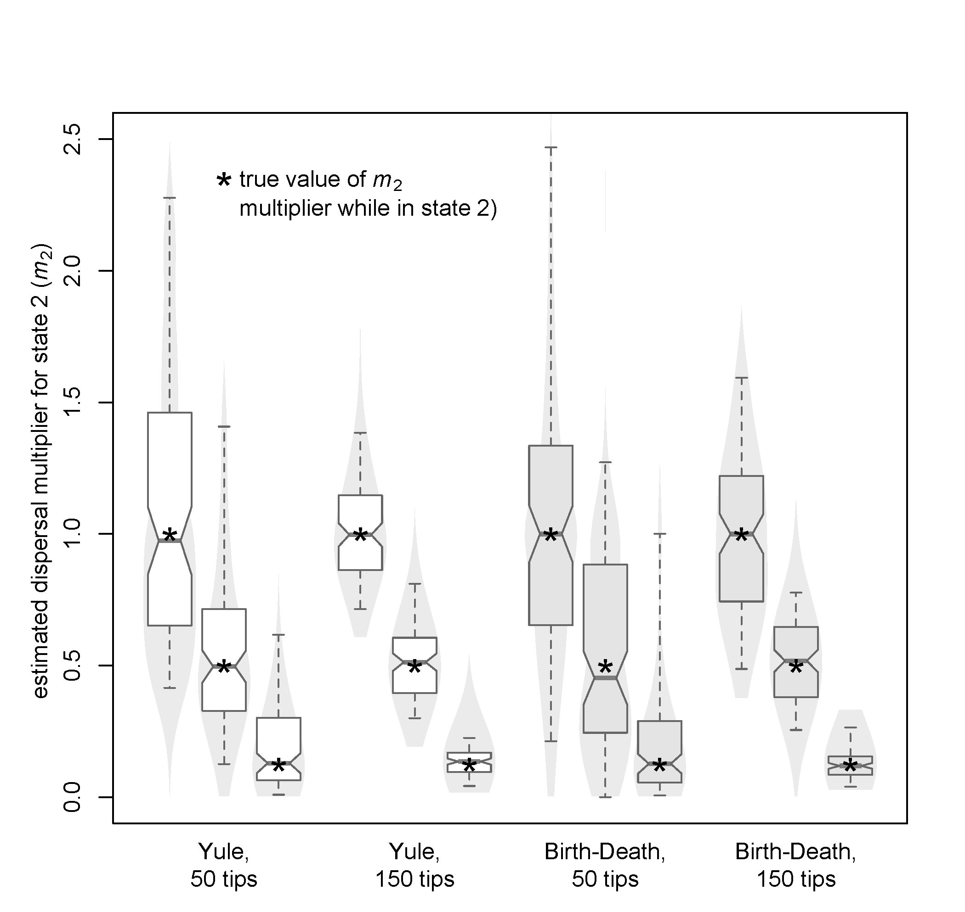
Simulation test for inference of m2:
strong vs. weak effects
dataset size

Slide 30
Historical biogeography methods
Estimate a dated phylogeny
Put the geographic ranges at the tips
3. Assume some process(es)
4. Conduct inference
DEC
DIVA
BayArea

Slide 31
Review: Models, parameters, and data
Simulated/
Predicted Data
Parameters
“Simulation” or Prediction
Probabilistic model
Parameters
(mean, standard deviation, etc.)
“Inference”
Data
(observations)

Slide 32
Review: Models, parameters, and data
Simulated/
Predicted Data
Parameters
“Simulation” or Prediction
Probabilistic model
Parameters
(mean, standard deviation, etc.)
“Inference”
Data
(observations)
Major way to do inference: likelihood

Slide 33
Likelihood: the key concept
Likelihood = probability of the data, given a model
Likelihood = P(data | model)
L = P(D | M)
lnL = log(P(D|M))
lnL = natural logarithm of the likelihood

Slide 34
What is likelihood?
Likelihood = Prob(data|model)
  A conditional probability
Likelihood is a fundamental concept in statistics and inference
The inference method of Maximum Likelihood is ubiquitous in parametric statistics
Statistics like the mean, or linear regression, can be justified through ML

Slide 35
Key concepts
Likelihood = Prob(data|model)
  A conditional probability
Data: some observations (numbers) you have collected – considered unchanging for the purposes of your statistical analysis
Model: some process that you postulate could have produced the data; it is an equation giving the likelihood
“Models put probabilities on data.”
Parameters: Numbers in the model that can be changed / learned (e.g., the probability of heads, the rate of change)

Slide 36
Maximum Likelihood
Inference
Likelihood = probability of the data, assuming a model
Maximum Likelihood (ML): find the parameter values that maximize the probability of the data

Slide 37
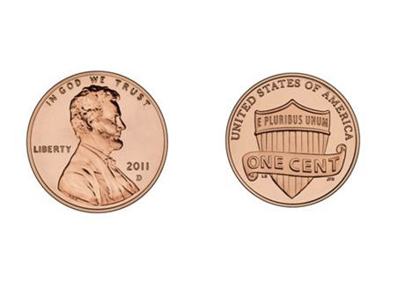
Maximum Likelihood
Inference
Likelihood = probability of the data, assuming a model
Maximum Likelihood (ML): find the parameter values that maximize the probability of the data
  For example: coin-flipping
  Data: HHHHHHHTTT -- 7 Heads, then 3 Tails

Slide 38
Maximum Likelihood
Inference
Likelihood = probability of the data, assuming a model
Maximum Likelihood (ML): find the parameter values that maximize the probability of the data
  For example: coin-flipping
  Data: HHHHHHHTTT -- 7 Heads, then 3 Tails

Slide 39
Maximum Likelihood
Inference
Likelihood = probability of the data, assuming a model
Maximum Likelihood (ML): find the parameter values that maximize the probability of the data
  For example: coin-flipping
  Data: HHHHHHHTTT -- 7 Heads, then 3 Tails
Model | Parameter | Calculation | Prob(data) | Ln(prob) | Prob. ratio | ML says
Fair coin
Biased coin

Slide 40
Maximum Likelihood
Inference
Likelihood = probability of the data, assuming a model
Maximum Likelihood (ML): find the parameter values that maximize the probability of the data
  For example: coin-flipping
  Data: HHHHHHHTTT -- 7 Heads, then 3 Tails
Model | Parameter | Calculation | Prob(data) | Ln(prob) | Prob. ratio | ML says
Fair coin | prob(Heads)=0.5
Biased coin

Slide 41
Maximum Likelihood
Inference
Likelihood = probability of the data, assuming a model
Maximum Likelihood (ML): find the parameter values that maximize the probability of the data
  For example: coin-flipping
  Data: HHHHHHHTTT -- 7 Heads, then 3 Tails
Model | Parameter | Calculation | Prob(data) | Ln(prob) | Prob. ratio | ML says
Fair coin | prob(Heads)=0.5
Biased coin | prob(Heads)=0.7

Slide 42
Maximum Likelihood
Inference
Likelihood = probability of the data, assuming a model
Maximum Likelihood (ML): find the parameter values that maximize the probability of the data
  For example: coin-flipping
  Data: HHHHHHHTTT -- 7 Heads, then 3 Tails
Model | Parameter | Calculation | Prob(data) | Ln(prob) | Prob. ratio | ML says
Fair coin | prob(Heads)=0.5 | 0.5⁷x0.5³
Biased coin | prob(Heads)=0.7

Slide 43
Maximum Likelihood
Inference
Likelihood = probability of the data, assuming a model
Maximum Likelihood (ML): find the parameter values that maximize the probability of the data
  For example: coin-flipping
  Data: HHHHHHHTTT -- 7 Heads, then 3 Tails
Model | Parameter | Calculation | Prob(data) | Ln(prob) | Prob. ratio | ML says
Fair coin | prob(Heads)=0.5 | 0.5⁷x0.5³
Biased coin | prob(Heads)=0.7 | 0.7⁷x0.3³

Slide 44
Maximum Likelihood
Inference
Likelihood = probability of the data, assuming a model
Maximum Likelihood (ML): find the parameter values that maximize the probability of the data
  For example: coin-flipping
  Data: HHHHHHHTTT -- 7 Heads, then 3 Tails
Model | Parameter | Calculation | Prob(data) | Ln(prob) | Prob. ratio | ML says
Fair coin | prob(Heads)=0.5 | 0.5⁷x0.5³ | 0.000977
Biased coin | prob(Heads)=0.7 | 0.7⁷x0.3³ | 0.00222

Slide 45
Maximum Likelihood
Inference
Likelihood = probability of the data, assuming a model
Maximum Likelihood (ML): find the parameter values that maximize the probability of the data
  For example: coin-flipping
  Data: HHHHHHHTTT -- 7 Heads, then 3 Tails
Model | Parameter | Calculation | Prob(data) | Ln(prob) | Prob. ratio | ML says
Fair coin | prob(Heads)=0.5 | 0.5⁷x0.5³ | 0.000977 | -6.93
Biased coin | prob(Heads)=0.7 | 0.7⁷x0.3³ | 0.00222 | -6.11

Slide 46
Maximum Likelihood
Inference
Likelihood = probability of the data, assuming a model
Maximum Likelihood (ML): find the parameter values that maximize the probability of the data
  For example: coin-flipping
  Data: HHHHHHHTTT -- 7 Heads, then 3 Tails
Model | Parameter | Calculation | Prob(data) | Ln(prob) | Prob. ratio | ML says
Fair coin | prob(Heads)=0.5 | 0.5⁷x0.5³ | 0.000977 | -6.93 | 1
Biased coin | prob(Heads)=0.7 | 0.7⁷x0.3³ | 0.00222 | -6.11 | 2.28

Slide 47
Maximum Likelihood
Inference
Likelihood = probability of the data, assuming a model
Maximum Likelihood (ML): find the parameter values that maximize the probability of the data
  For example: coin-flipping
  Data: HHHHHHHTTT -- 7 Heads, then 3 Tails
Model | Parameter | Calculation | Prob(data) | Ln(prob) | Prob. ratio | ML says
Fair coin | prob(Heads)=0.5 | 0.5⁷x0.5³ | 0.000977 | -6.93 | 1 | worse
Biased coin | prob(Heads)=0.7 | 0.7⁷x0.3³ | 0.00222 | -6.11 | 2.28

Slide 48
Maximum Likelihood
Inference
Likelihood = probability of the data, assuming a model
Maximum Likelihood (ML): find the parameter values that maximize the probability of the data
  For example: coin-flipping
  Data: HHHHHHHTTT -- 7 Heads, then 3 Tails
Model | Parameter | Calculation | Prob(data) | Ln(prob) | Prob. ratio | ML says
Fair coin | prob(Heads)=0.5 | 0.5⁷x0.5³ | 0.000977 | -6.93 | 1 | worse
Biased coin | prob(Heads)=0.7 | 0.7⁷x0.3³ | 0.00222 | -6.11 | 2.28 | better

Slide 49
We can calculate likelihood or lnL for many different possible parameter values
Data/observations are fixed: we observed 7 Heads, 3 Tails. Which parameter value is best?

Slide 50
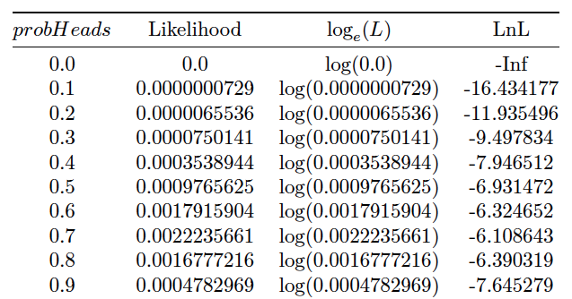
We can calculate likelihood or lnL for many different possible parameter values
Data/observations are fixed: we observed 7 Heads, 3 Tails. Which parameter value is best?

Slide 51
We can calculate likelihood or lnL for many different possible parameter values
Data/observations are fixed: we observed 7 Heads, 3 Tails. Which parameter value is best?
Parameter values to try

Slide 52
We can calculate likelihood or lnL for many different possible parameter values
Data/observations are fixed: we observed 7 Heads, 3 Tails. Which parameter value is best?
Name of free parameter is “ProbHeads”
Parameter values to try

Slide 53
We can calculate likelihood or lnL for many different possible parameter values
Data/observations are fixed: we observed 7 Heads, 3 Tails. Which parameter value is best?
Name of free parameter is “ProbHeads”
“raw likelihood”
Parameter values to try

Slide 54
We can calculate likelihood or lnL for many different possible parameter values
Data/observations are fixed: we observed 7 Heads, 3 Tails. Which parameter value is best?
Name of free parameter is “ProbHeads”
log-likelihood
“raw likelihood”
Parameter values to try

Slide 55
We can calculate likelihood or lnL for many different possible parameter values
Data/observations are fixed: we observed 7 Heads, 3 Tails. Which parameter value is best?
Name of free parameter is “ProbHeads”
log-likelihood
“raw likelihood”
Parameter values to try
Plot a likelihood curve from these

Slide 56
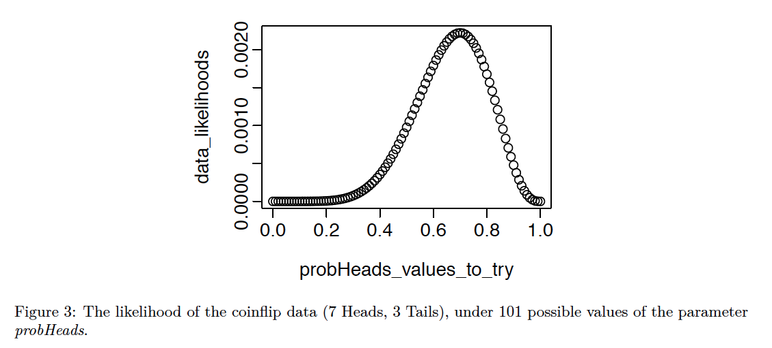
Likelihood profile curve

Slide 57
Log-likelihood (lnL)
The log-likelihood (always the NATURAL log) is
1. An easy way to represent very small numbers
2. Helps the computers avoid numeric underflow problems
- Multiplication in becomes addition in log-space
(also makes calculus easier)
- E.g., in R, 0.1 times itself 300 times: 0.1^300 = 1e-300
But (0.1^300)*(0.1^300) = 0.0 , which is wrong (underflow rounds down to 0.0)
- In log space: log(0.1^300) = 300*log(0.1) = 300*-2.3026 = -690.78
log((0.1^300)*(0.1^300) ) = 300*log(0.1) + 300*log(0.1) = 600*log(0.1) =
= 1381.55 = 2 * -690.78
3. Important in Information Theory
4. Maximizing the lnL finds the same parameters as maximizing the likelihood
Note: reverse the log() operation with exp(): log(0.1) = -2.3026, exp(-2.3026) = 0.1
exp(1) = 2.718282..., which is known as Euler’s number, e, the base of the natural log

Slide 58
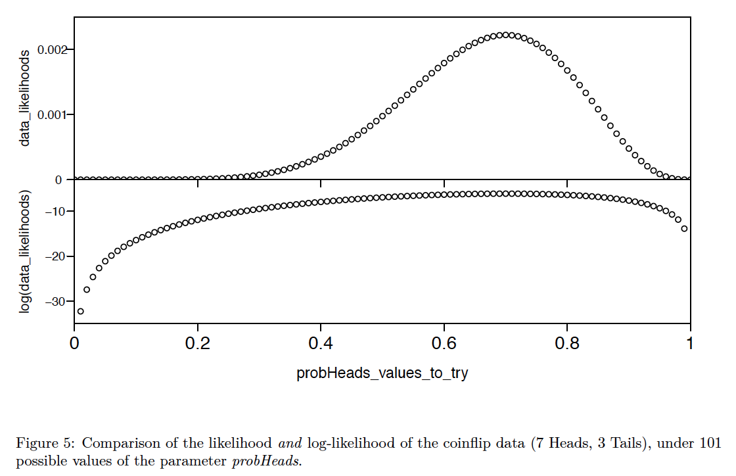
The maximum likelihood and log-likelihood (lnL) give the same parameter estimate

Slide 59
What is our best estimate of the parameter?

Slide 60
What is our best estimate of the parameter?

Slide 61
What is our best estimate of the parameter?

Slide 62
What is our best estimate of the parameter?
The parameter value that Maximizes the Likelihood (ML)

Slide 63
How to find the maximum of the likelihood?
Several possible methods:
Intuition
Calculus to get an analytic solution
Exhaustive search “grid search”
Optimization / hill-climbing

Slide 64
How to find this maximum?
Method 1: intuition
In very simple cases, like coin-flipping, you can guess that the average of your data provides the best estimate.
(But: your intuition can betray you, e.g. if you think about your prior experience that most coins are fair)

Slide 65
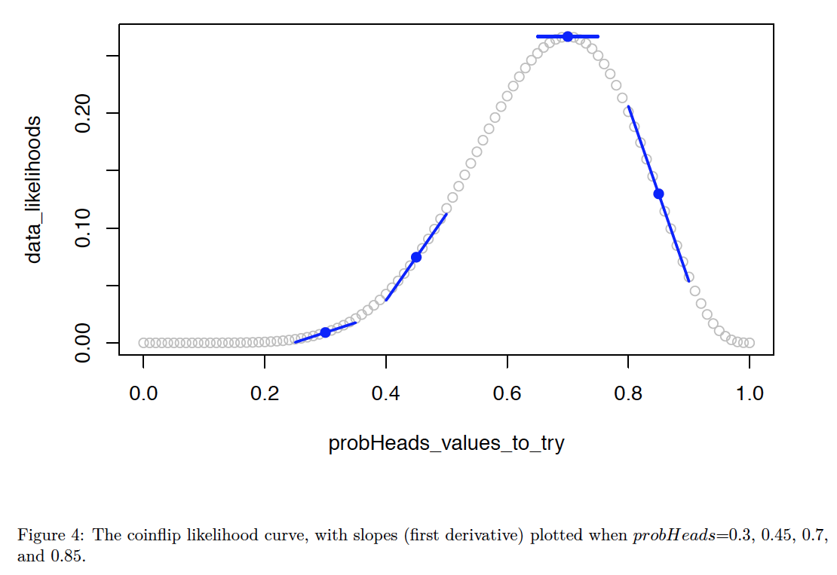
The parameter value that Maximizes the Likelihood (ML)
Method 2: calculus
Short-short version:
Taking the first derivative of a function provides an equation giving the slope at each point
The slope will be 0.0 at the maximum of the curve
Setting the derivative to 0.0 and
solving gives a formula for the
Maximum Likelihood.
This is known as an
“analytic solution”.
Analytic solutions are very fast,
and are the basics of a lot of the
“cookbook” formulas that get
taught.
But they often aren’t available for complex models.

Slide 66
The parameter value that Maximizes the Likelihood (ML)
Method 2: calculus
E.g., here’s the proof (not examinable) showing that the likelihood is maximized at
(Number of Heads) / (Total number of coinflips)
https://stats.stackexchange.com/questions/181035/how-to-derive-the-likelihood-function-for-binomial-distribution-for-parameter-es
(not examinable)

Slide 67
How to find this maximum?
Method 3: exhaustive search (or “gridded search”).
(1) pick a bunch of parameter values that cover the parameter space
(2) choose the parameter value that maximizes the likelihood
Problem: can only be done easily for 1 or 2 parameters.
More parameters = more “dimensions” = explosion of number of calculations

Slide 68
How to find this maximum?
Method 4: optimization, i.e. use the computer to iteratively search
Very flexible, works on very complex models
Involves some heuristic “hill-climbing” algorithm
We use the “optim()”, in R
Known as a “numerical solution” or “numerical optimization”, instead of an “analytic
solution”

Slide 69
How to find this maximum?
Method 4: optimization, i.e. use the computer to iteratively search
Very flexible, works on very complex models
Involves some heuristic “hill-climbing” algorithm
We use the “optim()”, in R
Known as a “numerical solution” or “numerical optimization”, instead of an “analytic
solution”
Starting guess at parameter

Slide 70
How to find this maximum?
Method 4: optimization, i.e. use the computer to iteratively search
Very flexible, works on very complex models
Involves some heuristic “hill-climbing” algorithm
We use the “optim()”, in R
Known as a “numerical solution” or “numerical optimization”, instead of an “analytic
solution”

Slide 71
How to find this maximum?
Method 4: optimization, i.e. use the computer to iteratively search
Very flexible, works on very complex models
Involves some heuristic “hill-climbing” algorithm
We use the “optim()”, in R
Known as a “numerical solution” or “numerical optimization”, instead of an “analytic
solution”

Slide 72
How to find this maximum?
Method 4: optimization, i.e. use the computer to iteratively search
Very flexible, works on very complex models
Involves some heuristic “hill-climbing” algorithm
We use the “optim()”, in R
Known as a “numerical solution” or “numerical optimization”, instead of an “analytic
solution”

Slide 73
How to find this maximum?
Method 4: optimization, i.e. use the computer to iteratively search
Very flexible, works on very complex models
Involves some heuristic “hill-climbing” algorithm
We use the “optim()”, in R
Known as a “numerical solution” or “numerical optimization”, instead of an “analytic
solution”

Slide 74
How to find this maximum?
Method 4: optimization, i.e. use the computer to iteratively search
Very flexible, works on very complex models
Involves some heuristic “hill-climbing” algorithm
We use the “optim()”, in R
Known as a “numerical solution” or “numerical optimization”, instead of an “analytic
solution”

Slide 75
How to find this maximum?
Method 4: optimization, i.e. use the computer to iteratively search
Very flexible, works on very complex models
Involves some heuristic “hill-climbing” algorithm
We use the “optim()”, in R
Known as a “numerical solution” or “numerical optimization”, instead of an “analytic
solution”

Slide 76
How to find this maximum?
Method 4: optimization, i.e. use the computer to iteratively search
Very flexible, works on very complex models
Involves some heuristic “hill-climbing” algorithm
We use the “optim()”, in R
Known as a “numerical solution” or “numerical optimization”, instead of an “analytic
solution”

Slide 77
How to find this maximum?
Method 4: optimization, i.e. use the computer to iteratively search
Very flexible, works on very complex models
Involves some heuristic “hill-climbing” algorithm
We use the “optim()”, in R
Known as a “numerical solution” or “numerical optimization”, instead of an “analytic
solution”

Slide 78
How to find this maximum?
Advantage of optimization/hill-climbing: extremely flexible, can be used on all sorts of complex models
Disadvantages of optimization/hill-climbing: much slower than analytic solutions; no absolute guarantee the search will actually find the true peak

Slide 79
Can we measure the importance of distance in biogeography?

Slide 80
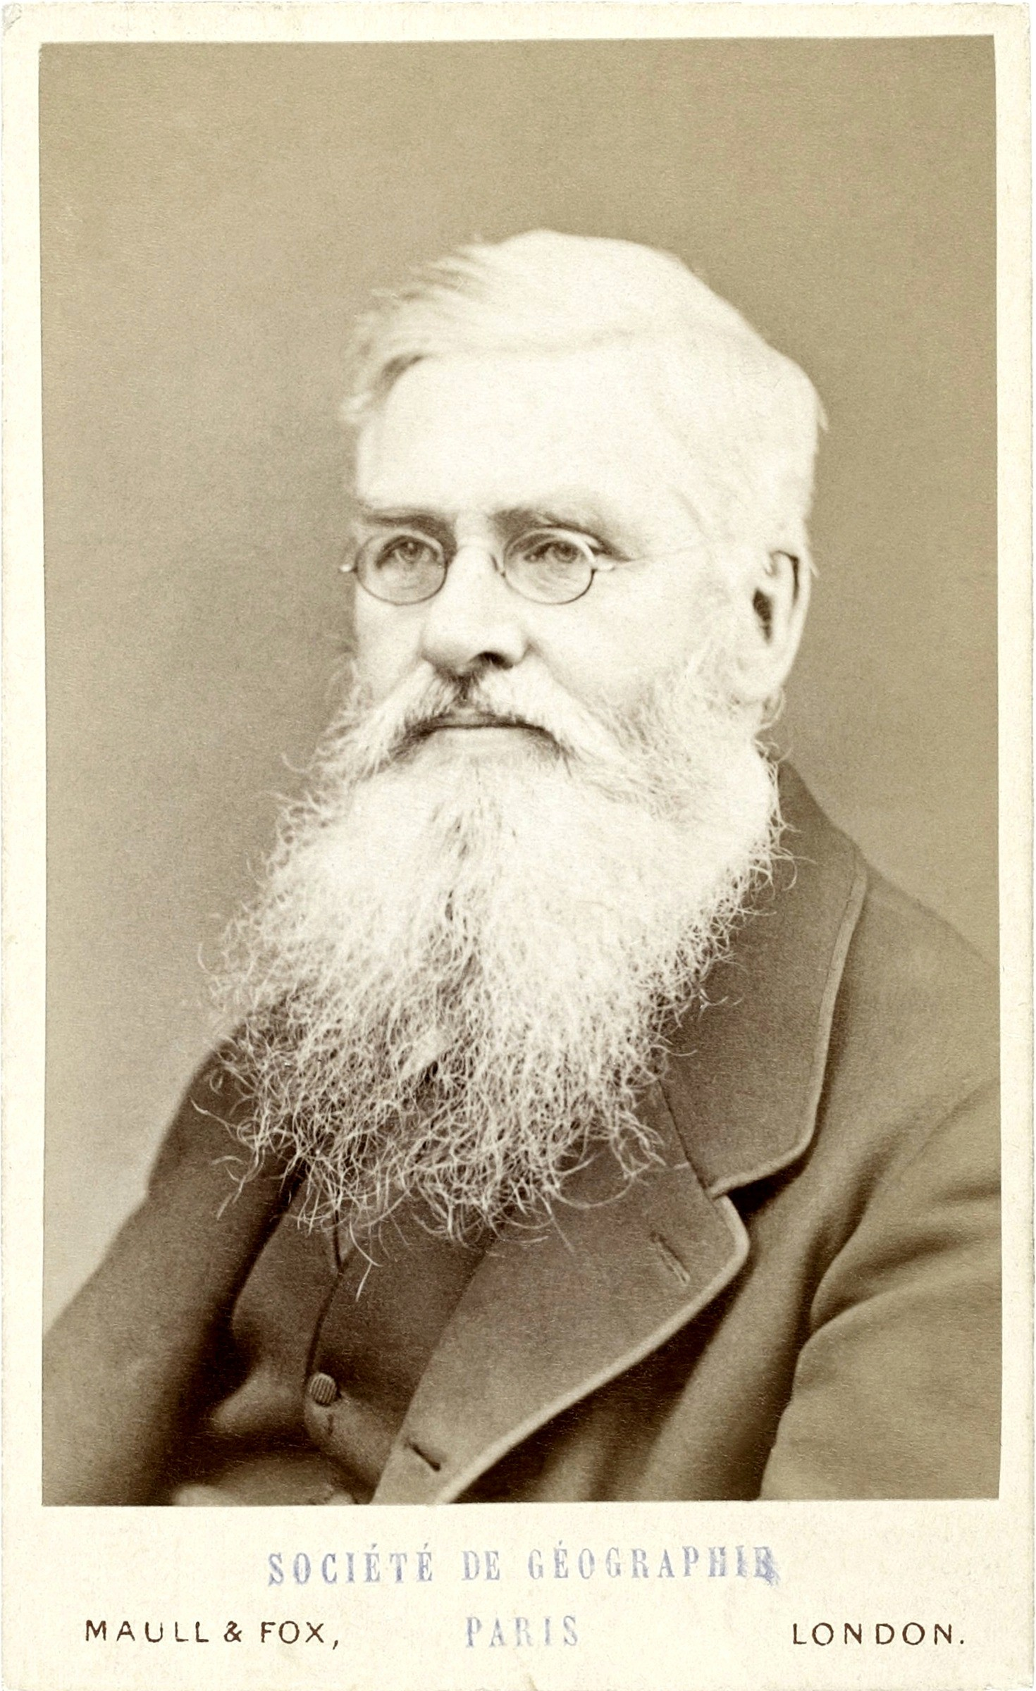
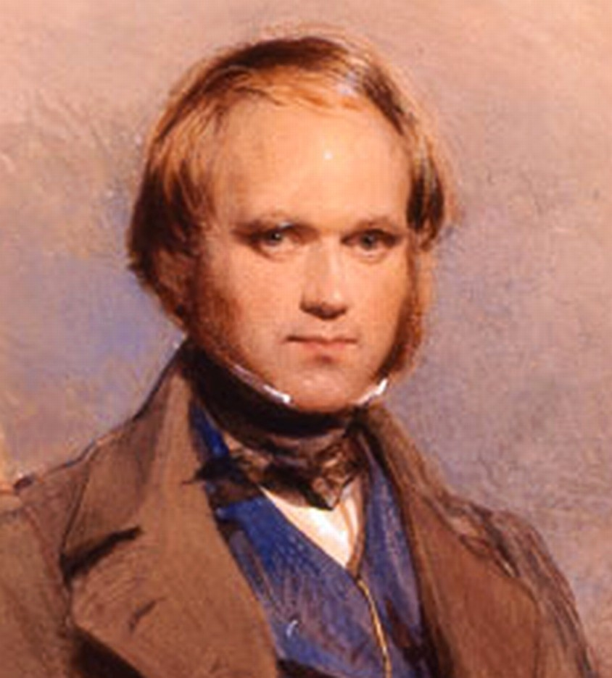
Historical biogeography: Wallace and Darwin
Wallace (1855): “Every species has come into existence coincident both in space and time with a pre- existing closely allied species.”
Darwin (1859): “the more nearly any two forms are related in blood, the nearer they will generally stand to each other in time and space”.

Slide 81
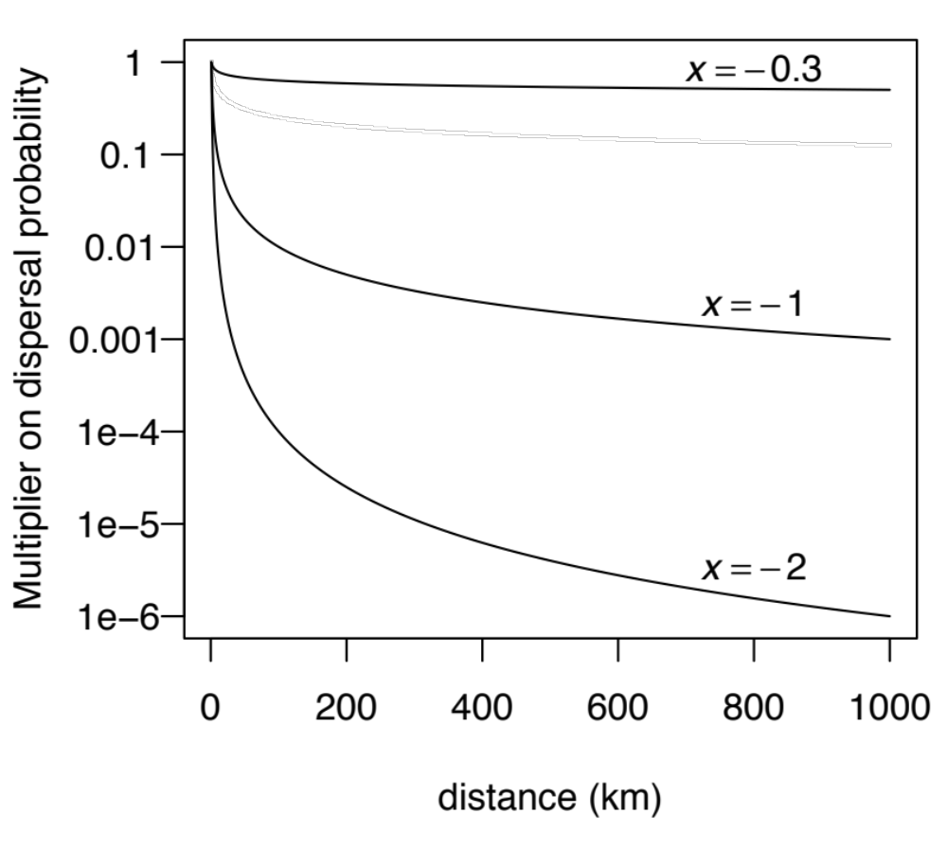
The “+x” model: modify dispersal probability by distance^x

Slide 82


Journal of Biogeography (J. Biogeogr.) (2017) 44, 887-899
Bayesian estimation of the global biogeographical history of the Solanaceae
Julia Dupin¹*,Nicholas J. Matzke², Tiina Sarkinen³ Sandra Knapp⁴
, ,
Richard G. Olmstead⁵ Lynn Bohs⁶ and Stacey D. Smith¹
,

Slide 83

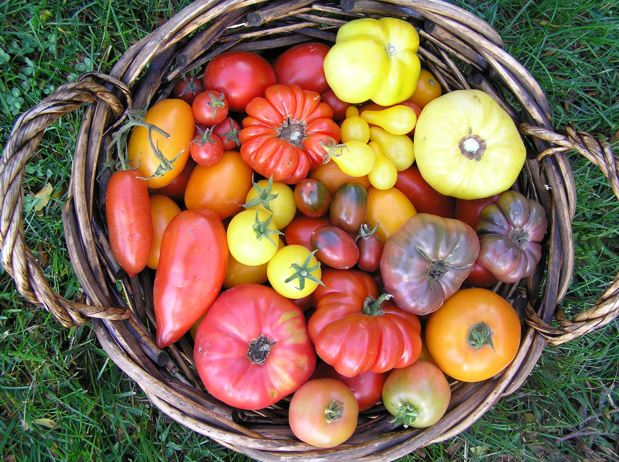
http://solcap.msu.edu/img/germplasm2.jpg

Slide 84

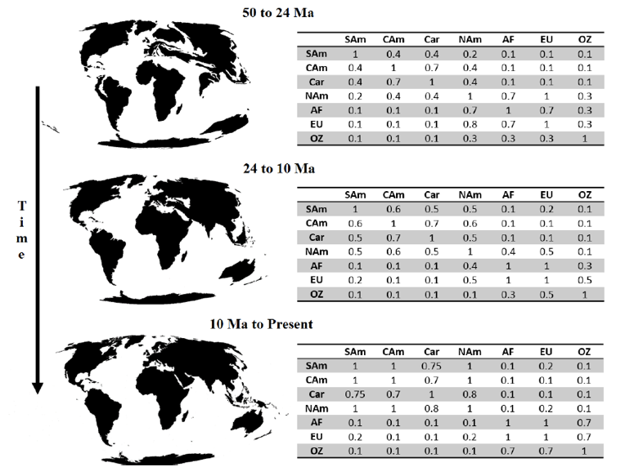

Slide 85
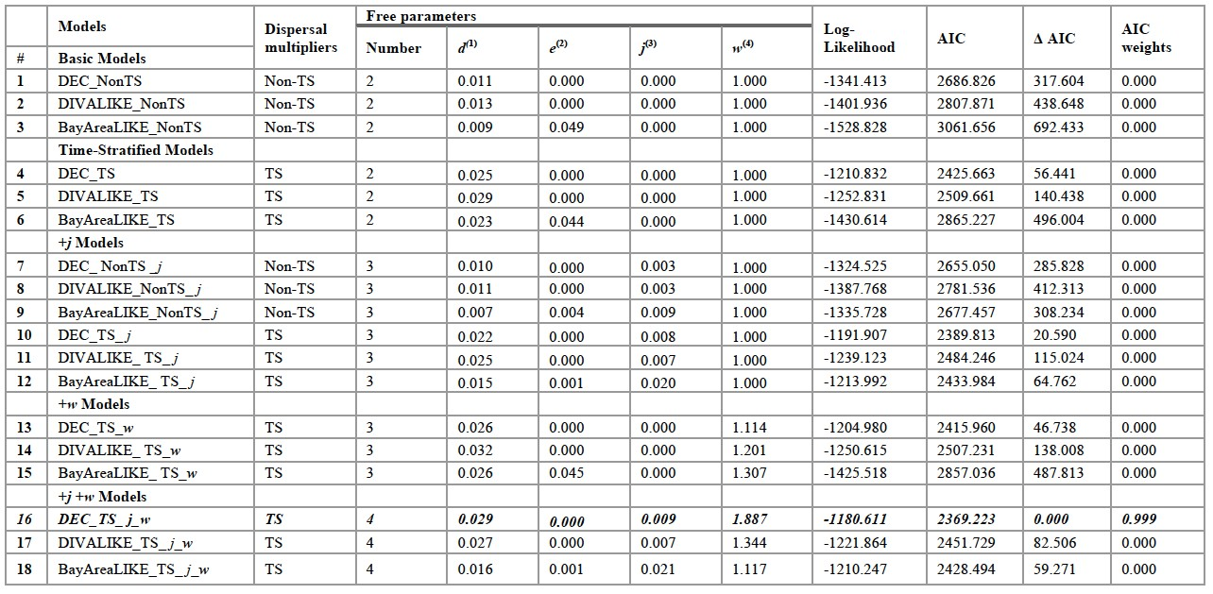
Global Solanaceae:
distance, Biogeographical Stochastic Mapping

Slide 86
Global Solanaceae:
distance, Biogeographical Stochas3c Mapping

Slide 87
Akaike Information Criterion

Slide 88
Akaike Information Criterion “True model”

Slide 89
Akaike Information Criterion “True model”

Slide 90
Akaike Information Criterion “True model”
distance from truth

Slide 91
Akaike Information Criterion “True model”
Better fit
distance from truth

Slide 92
Akaike Information Criterion “True model”
Better fit
distance from truth
Worse fit

Slide 93
Akaike Information Criterion
“True model”
Better fit
distance from truth
AIC =
estimator of relative distance from true model
Worse fit

Slide 94
Akaike Information Criterion
“True model”
Better fit
lower AIC = lower distance
distance from truth
AIC =
estimator of relative distance from true model
Worse fit

Slide 95
Akaike Information Criterion
“True model”
Better fit
lower AIC = lower distance
distance from truth
AIC =
estimator of relative distance from true model
Worse fit
higher AIC = higher distance

Slide 96
Akaike Information Criterion
“True model”
Better fit
lower AIC = lower distance
distance from truth
AIC =
estimator of relative distance from true model
Akaike Information Criterion (AIC) =
-2(LnL - # of parameters)
Worse fit
higher AIC = higher distance

Slide 97
Akaike Information Criterion
“True model”
Better fit
higher data log-likelihood (LnL)
lower AIC = lower distance
distance from truth
AIC =
estimator of relative distance from true model
Akaike Information Criterion (AIC) =
-2(LnL - # of parameters)
Worse fit
higher AIC = higher distance

Slide 98
Akaike Information Criterion
“True model”
Better fit
higher data log-likelihood (LnL)
lower AIC = lower distance
distance from truth
AIC =
estimator of relative distance from true model
Akaike Information Criterion (AIC) =
-2(LnL - # of parameters)
lower data log-likelihood (LnL)
Worse fit
higher AIC = higher distance

Slide 99
Akaike Information Criterion
“True model”
Better fit
higher data log-likelihood (LnL)
fewer free
parameters
lower AIC = lower distance
distance from truth
AIC =
estimator of relative distance from true model
Akaike Information Criterion (AIC) =
-2(LnL - # of parameters)
lower data log-likelihood (LnL)
Worse fit
higher AIC = higher distance

Slide 100
Akaike Information Criterion
“True model”
Better fit
higher data log-likelihood (LnL)
fewer free
parameters
lower AIC = lower distance
distance from truth
AIC =
estimator of relative distance from true model
Akaike Information Criterion (AIC) =
-2(LnL - # of parameters)
lower data log-likelihood (LnL)
more free
parameters
Worse fit
higher AIC = higher distance

Slide 101
Global Solanaceae:
distance, Biogeographical Stochastic Mapping

Slide 102

Global Solanaceae:
distance, Biogeographical Stochastic Mapping
Best model: 99.9% of AIC weight DEC
+ J (jump dispersal)
+ changing geography (distances)
+ parameter weigh3ng distance

Slide 103
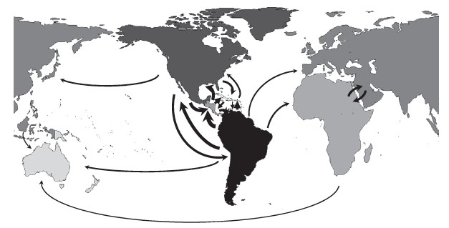
Global Solanaceae:
distance, Biogeographical Stochastic Mapping

Slide 104
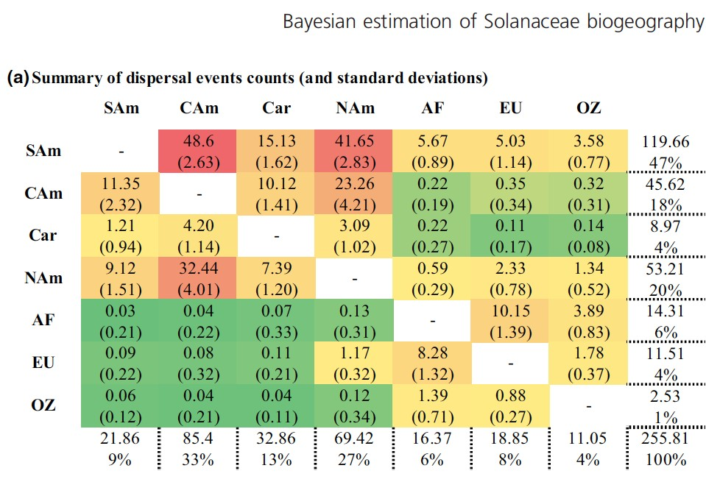
Global Solanaceae:
distance, Biogeographical Stochastic Mapping

