Slide 1
Nicholas J. Matzke
Senior Lecturer,
Rutherford Discovery Fellow
School of Biological Sciences
University of Auckland
Model-based statistical inference in evolutionary biogeography
Transmitting Science workshop, Oct. 12, 2026

Slide 2
Controversy! Are these models any good?
A critique of the BioGeoBEARS model-comparison approach was published…
My 2021 rebuttal in the Journal of Biogeography:

Slide 3
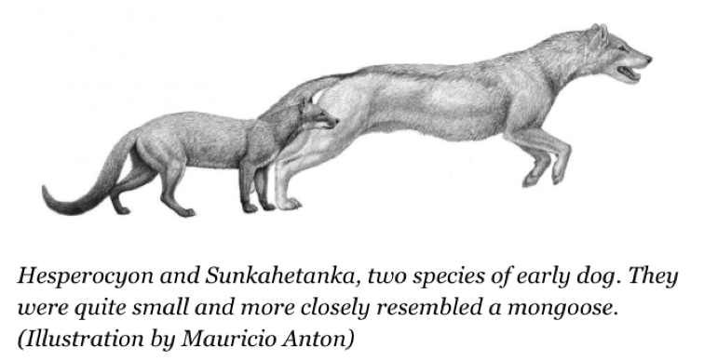
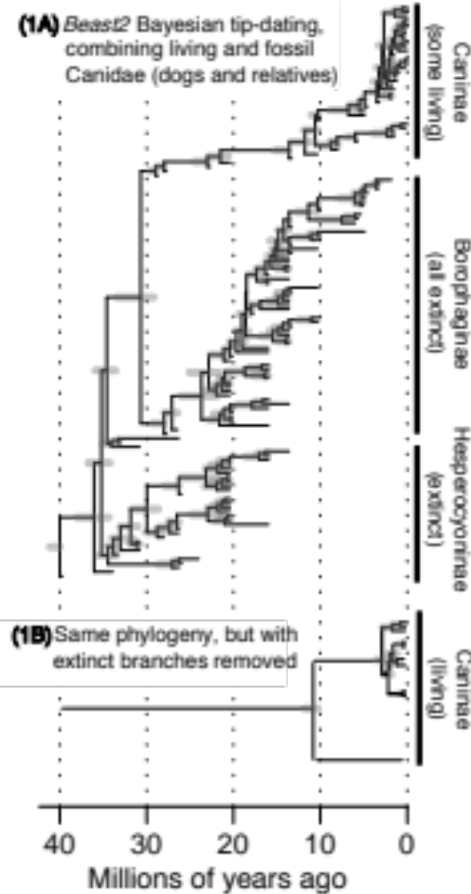
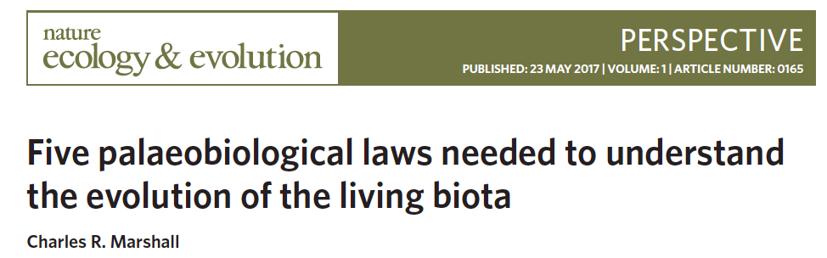
The real challenge to our models: extinction
There are 3 HUGE problems with routine biogeographic models:
Extinction is missing
(and diversity-dependence)
Fossils not used
Palaeogeography not used
Example: fossil “dogs”
(wolves, foxes, etc.)
(Matzke & Wright 2016, Biology Letters)
Source: http://www.forbes.com/sites/shaenamontanari/2015/08/18/old-dogs-learned-new-tricks-for-hunting-as-climate-changed/
DNA-only phylogeny misses most species
“[M]olecular phylogenetic analyses that yield zero or low extinction…are almost certainly wrong […] they fail to take into account the origin of extinct species.”
(Charles Marshall, 2017, Nature Ecology & Evolution)

Slide 4
Summary of key issues:
Most biogeographical inference methods ignore extinction. This is a big problem
There are models (SSE: State-dependent Speciation/Extinction models) that take into account extinction, but they require large systems of Ordinary Differential Equations (ODEs) which are computationally challenging.
Part of modern evolutionary biology, and evolutionary biogeography, is thus highly computational: designing solvers that will allow realistic inference to occur fast enough for biologists to use routinely for their research studies.
This Marsden Project solved these computational problems with the Julia package, PhyBEARS.jl, available at: https://github.com/nmatzke/PhyBEARS.jl

Slide 5
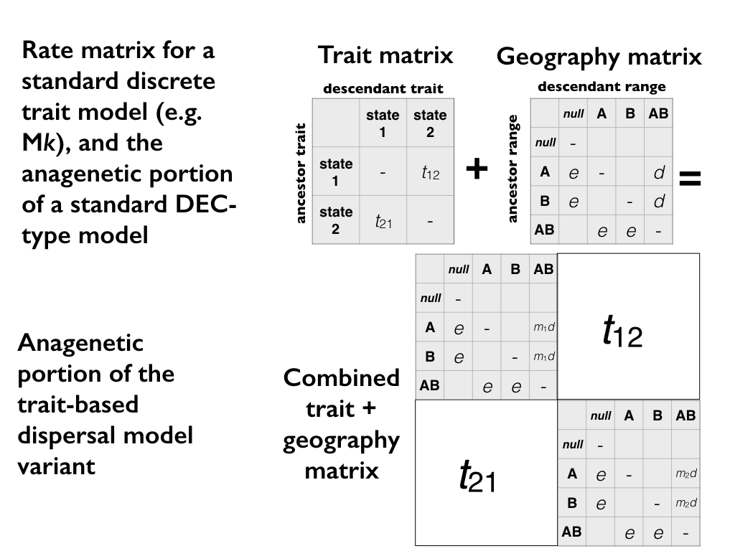
Q

Slide 6
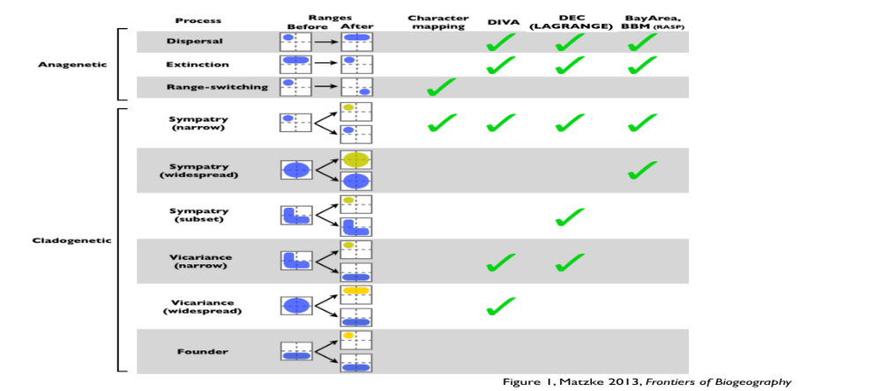

Slide 7
Problem:
# of ranges=2^{(# of areas)}
2 areas = 4 states
4 areas = 16 states
10 areas = 1024 states
11 areas = 2048 states

Slide 8
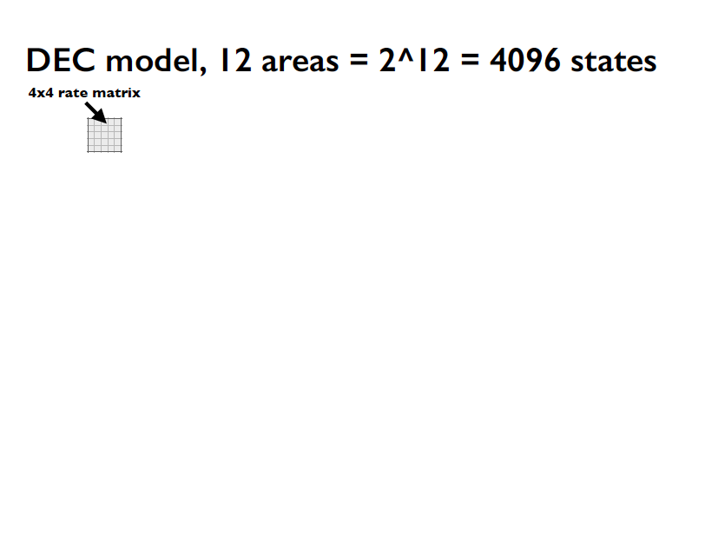

Slide 9
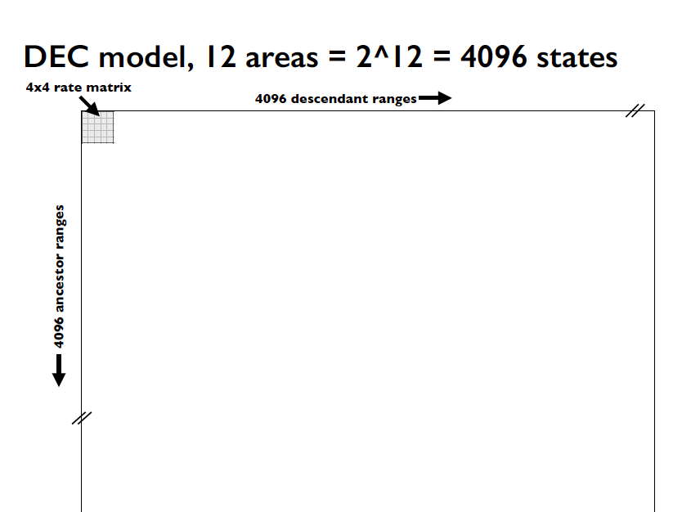

Slide 10
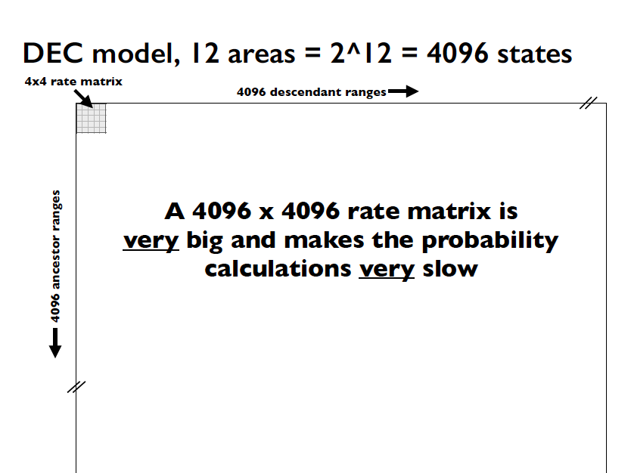

Slide 11
Motivation
Faster likelihood calculations for State-dependent Speciation-Extinction (SSE) models using Julia
Nicholas J. Matzke, Senior Lecturer, SBS, U. Auckland
Some evolutionary models naturally have large state spaces
E.g., biogeography…
It gets worse when you add traits:
…every binary trait doubles the state space

Slide 12
Motivation
Faster likelihood calculations for State-dependent Speciation-Extinction (SSE) models using Julia
Nicholas J. Matzke, Senior Lecturer, SBS, U. Auckland
Some evolutionary models naturally have large state spaces
E.g., biogeography…
It gets worse when you add traits:
…every binary trait doubles the state space

Slide 13
Motivation
Faster likelihood calculations for State-dependent Speciation-Extinction (SSE) models using Julia
Nicholas J. Matzke, Senior Lecturer, SBS, U. Auckland
Some evolutionary models naturally have large state spaces
E.g., biogeography…
It gets worse when you add traits
Even these slow models ignore extinction (!!)

Slide 14
State-dependent speciation-extinction (SSE) models
include extinction…
We have to integrate 2N differential equations for N biogeographic states:
And,
ClaSSE models have:
N extinction rates
N²-N anagenetic
transition rates
N³ cladogenetic
transition rates

Slide 15
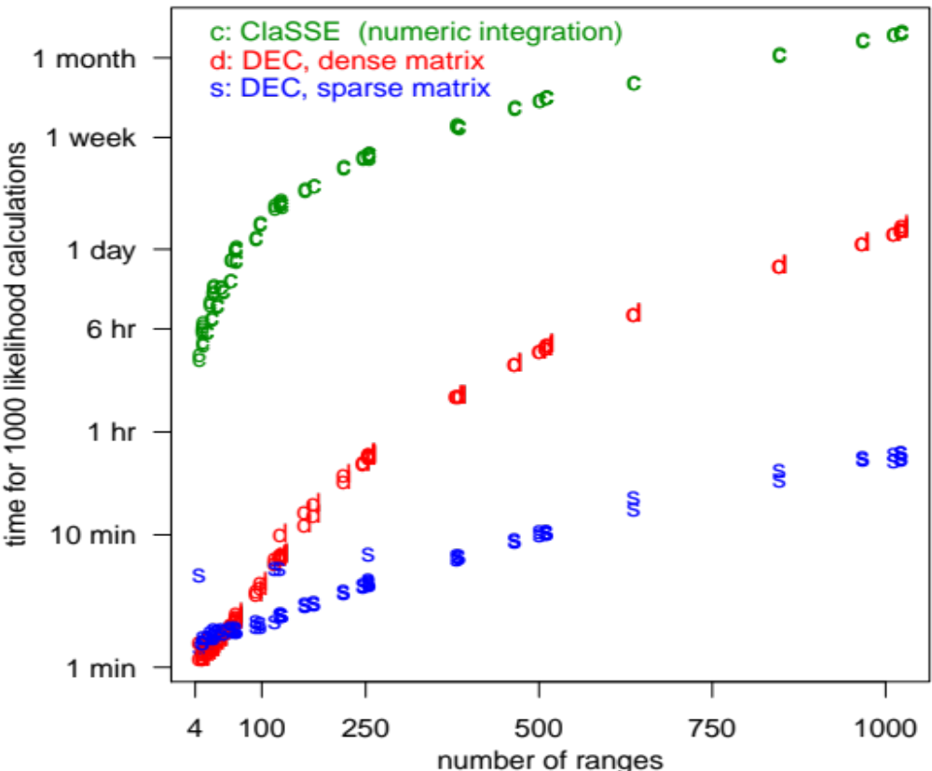
State-dependent speciation-extinction models are slooooow
My first attempt – in R, but making full use of sparsity etc. to reduce ClaSSE calculations, and using
R’s deSolve library

Slide 16

Julia to the rescue?
Julia 1.0 released in early 2019, after many years <1.0
Core developers at MIT
Aims to have R/Python-like usage
But compiles to C-like speeds
KEY advantage: DifferentialEquations.jl library

Slide 17
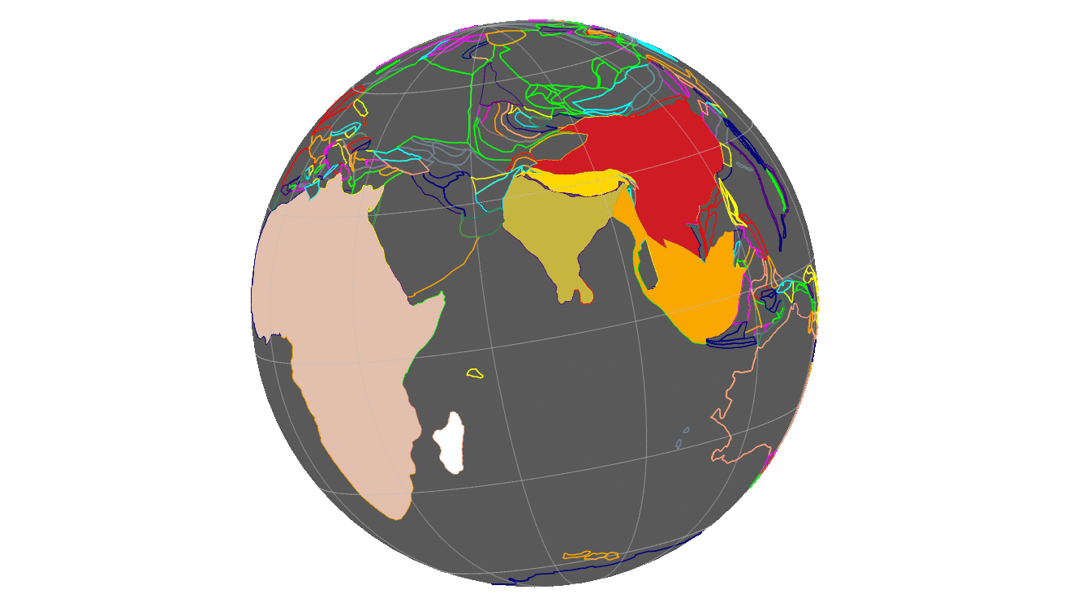

Additional progress
Ph.D. student Wallis Bland
Integrating
Gplates and
PhyBEARS
Simulation-
Inference
tests
of PhyBEARS
Wallis Bland

Slide 18
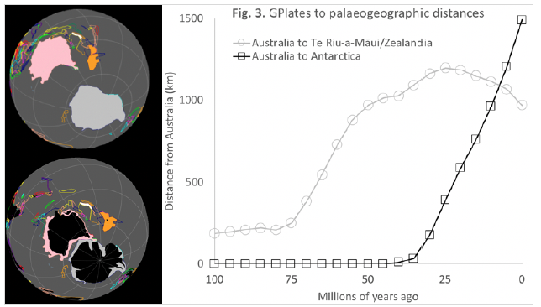
Additional progress
Ph.D. student Wallis Bland
Integrating
Gplates and
PhyBEARS
Simulation-
Inference
tests
of PhyBEARS
Wallis Bland

Slide 19
Additional progress: Inference under changing geog.
Using Julia’s amazing capabilities for including interpolators in ODEs:
A=dG
matrix
GPlates->
Paleodistances
Dispersal
rates
Changing
area sizes
Changing
extinction rates
ODEs for “Es”
(extinction probs.)
ODEs for “Ds”
(data probs.)
Gflow
matrix
Time
LnL: Log-likelihood

Slide 20
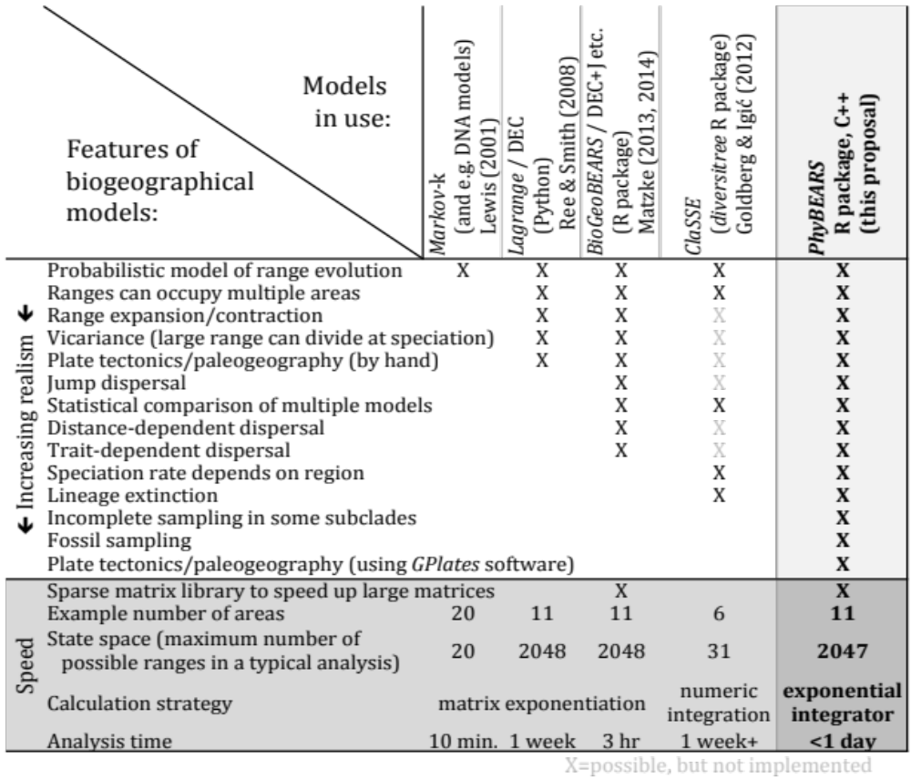
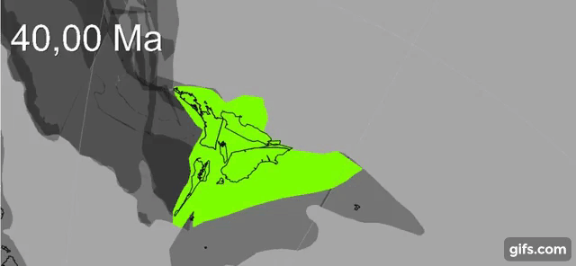
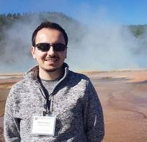
Comparison of model features
PhyBEARS: complexifying biogeography
Summary:
Integrated PhyBEARS with GPlates for continuous palaeogeography
This Proposal
(BioGeoJulia)
GPlates animation: Zealandia crustal thickness
Müller, Sahirovic et al. (2018), U. Sydney "Modelling and visualising distributed crustal deformation of Australia and Zealandia using GPlates 2.0." https://www.youtube.com/watch?v=iKkCIdZ6oaE
PyGPlates: extract & use continuous estimates of areas, distances
Sabin Zahirovic, GPlates coauthor, U. Sydney

Slide 21
Conclusions
Large ClaSSE models will probably never be super-fast – but Julia versions should be fast enough for e.g. Maximum Likelihood
The number of free parameters explodes to meaninglessness quickly. So model (parametric) complexity has to be carefully controlled by carefully thinking about, and designing, meaningful models controlled by a small number of parameters (as in e.g. standard biogeography models)
Julia’s DifferentialEquations solvers are very flexible, suggesting that more interesting models could be designed in this framework (regional carrying capacity, interpolating in the impact of external forcers
like changing geography & climate, etc.)
Acknowledgements: Marsden grant no. 18-UOA-34

