Slide 1
Improving realism in biogeographic simulation and inference with state-dependent speciation and extinction models using GPlates palaeogeography and the Julia programming language
Wallis Bland

Slide 2
Outline
Background
  Biogeography and Models
  Previous limitations - Realism and Speed
GPlates for Biogeographers
Julia Speed for Complex ODEs
Testing Accuracy of Distance Based SSE Models
Conclusions

Slide 3
Outline
Background
  Biogeography and Models
  Previous limitations - Realism and Speed
GPlates for Biogeographers
Julia Speed for Complex ODEs
Testing Accuracy of Distance Based SSE Models
Conclusions

Slide 4
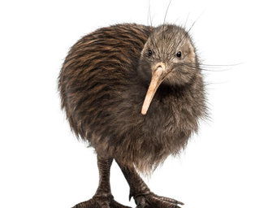
Background
Phylogenetic Biogeography allows us to understand how species have dispersed over millions of years
We combine phylogenies and biogeographic models to estimate these histories
Inferring the way species have dispersed and survived in the past helps scientists the future of species as humans impact the environment
This is particularly important in New Zealand, which has a large number of endemic and unique species

Slide 5
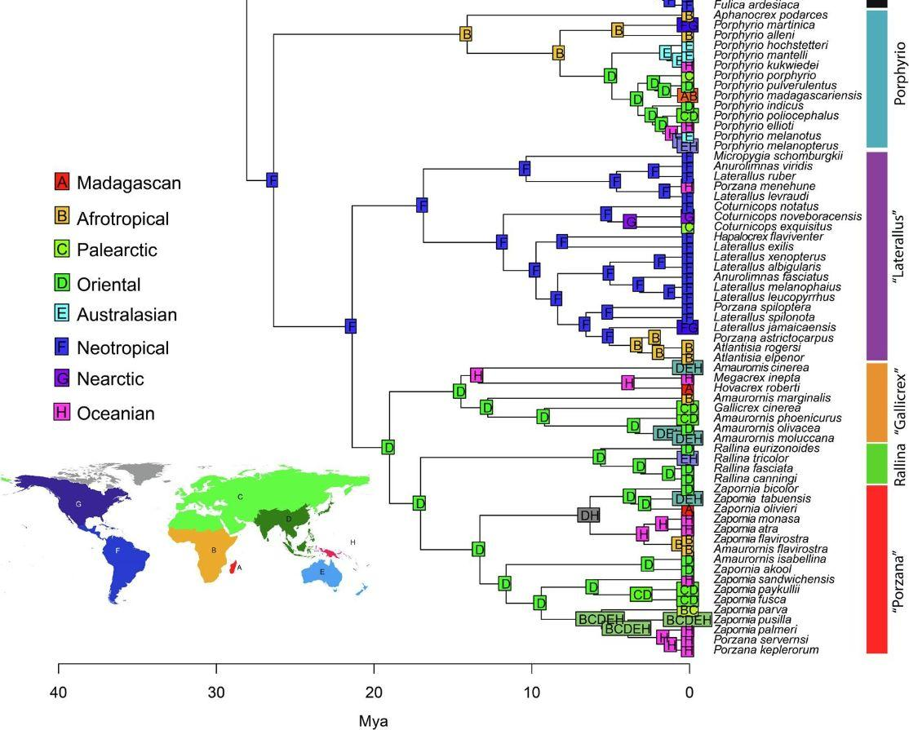
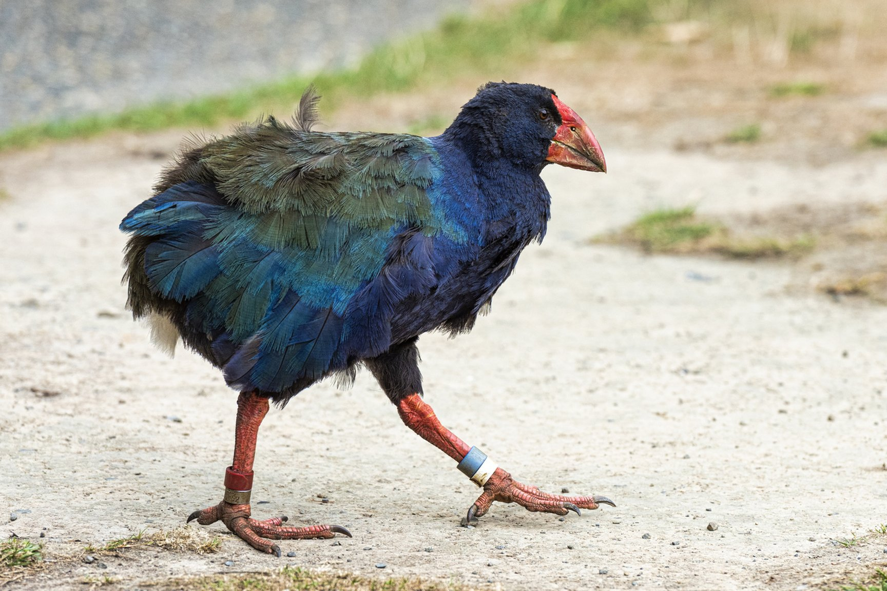
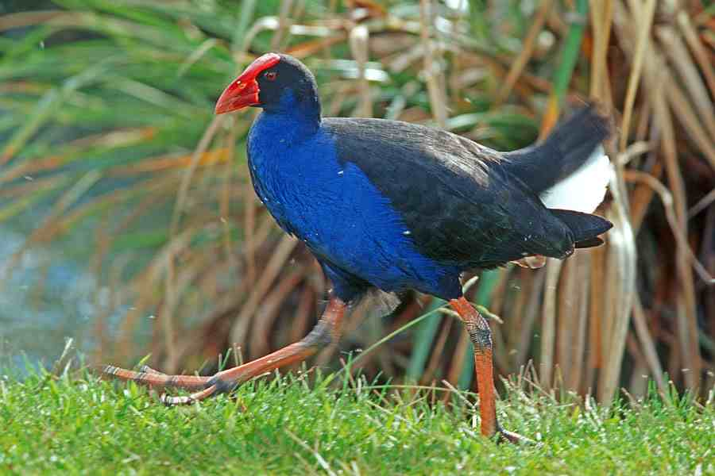
Example - Pacific Rails
Garcia-R, Juan C.; Matzke, Nicholas J. (2021). Trait-dependent dispersal in rails (Aves: Rallidae): Historical biogeography of a cosmopolitan bird clade. Molecular Phylogenetics and Evolution, 159: 107106.

Slide 6
Models and Software
BiogeoBEARS
R Package
Calculates likelihoods with:
  Matrix Exponentiation
Ignores:
  Changing Palaeogeography
  Area Size
  Extinction
PhyBEARS.jl
Julia Package
Calculates likelihoods with:
  Ordinary Differential Equation (ODE) Solvers
Includes
  Changing Palaeogeography
  Area Size
  Extinction
  AND MORE
Allowed through time varying State-Based Speciation and Extinction Models (SSEs)

Slide 7
Outline
Background
  Biogeography and Models
  Previous limitations - Realism and Speed
GPlates for Biogeographers
Julia Speed for Complex ODEs
Testing Accuracy of Distance Based SSE Models
Conclusions

Slide 8
How can we incorporate palaeogeography into phylogenetic Biogeography?
But how do we biologists get distances from GPlates?
Old System:
Rulers and Paper palaepgeographic maps
New System:
Graphical Information Systems (GIS) within a 3D* system
*or 4D with time!
Notes:
How might the inclusion of additional ecological or environmental factors impact the performance and accuracy of your models?
Stick in Gplates graphic from website and a picture of Sabine

Slide 9
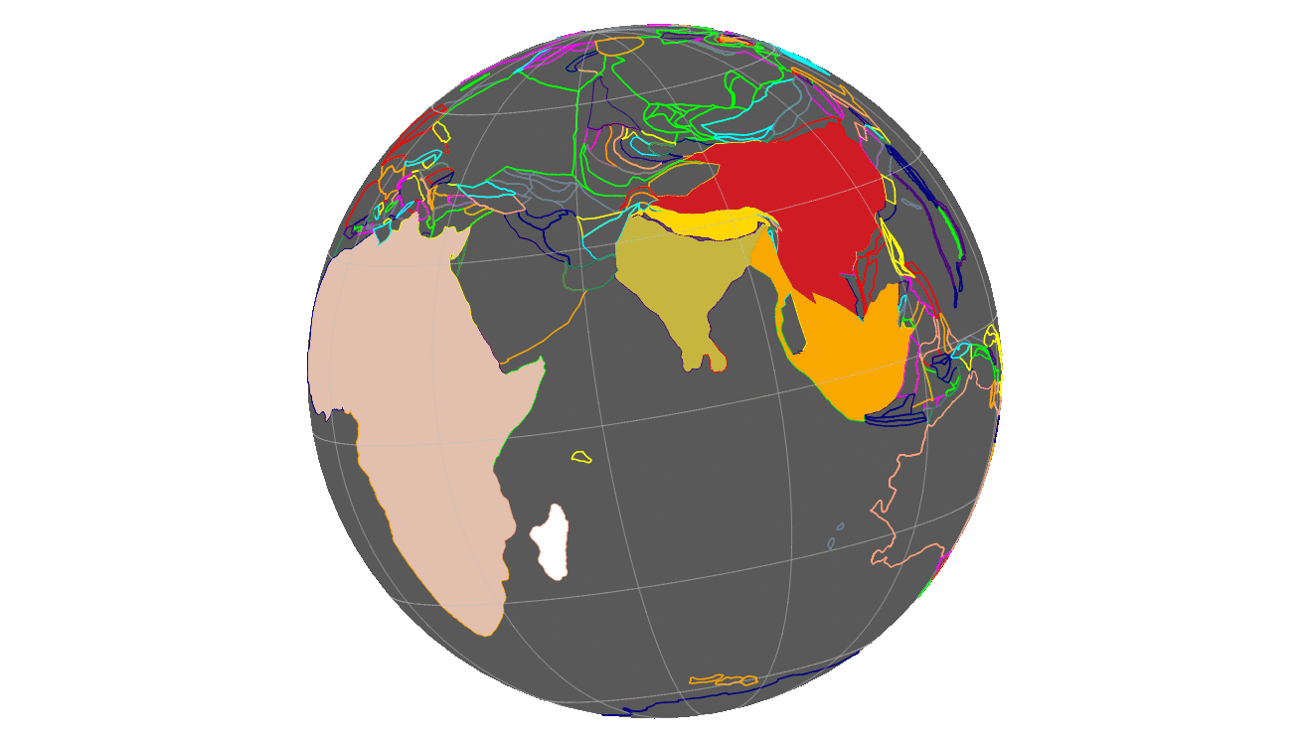
Using GPlates in a
Biological Context
Challenge:
Biologists-defined-areas
can be made of many plate areas
Notes:
How might the inclusion of additional ecological or environmental factors impact the performance and accuracy of your models?

Slide 10
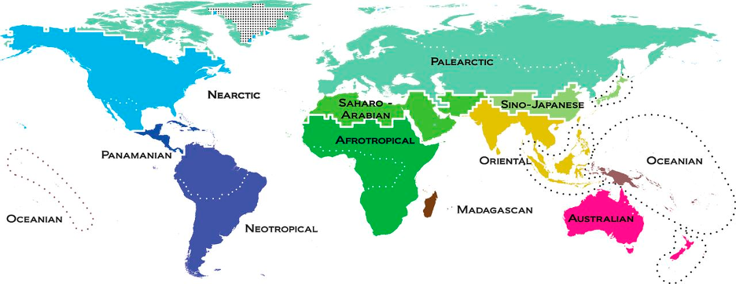
Holt, B. G., Lessard, J.-P., Borregaard, M. K., Fritz, S. A., Araújo, M. B., Dimitrov, D., . . . Rahbek, C. (2013). An Update of Wallace’s Zoogeographic Regions of the World. Science, 339(6115), 74-78. doi:doi:10.1126/science.1228282
Antarctica | South East Asia | Australia | Africa | New Zealand
New Caledonia | Gondwana | North America | South America | Eurasia
Madagascar | Sundaland | Himalaya
Shapefiles currently used for testing
Notes:
Even since the development of these shapefiles and samples, GPlates has updated their information on plate movement. Geographic reconstructions are continuously improving.
Within the sample GUI from GPlates, you can create shapefiles based on their existing world file, must go through timestamps though
Taking Wallace’s new biogeographic regions, I handbuilt shapefiles for individual regions over various timestamps over millions of years combining multiple tectonic plates. Tectonic landmasses are left the same labeled number as the original rotational file so as to not lose their modeled movement, but grouped together under a single name so the user can define borders.

Slide 11
Holt, B. G., Lessard, J.-P., Borregaard, M. K., Fritz, S. A., Araújo, M. B., Dimitrov, D., . . . Rahbek, C. (2013). An Update of Wallace’s Zoogeographic Regions of the World. Science, 339(6115), 74-78. doi:doi:10.1126/science.1228282
*Nearctic | *Sino-Japanese | *Australia | Africa | New Zealand
*Panamanian | *Oriental | *Afrotropical | Indonesia | Indian Subcontinent
*Oceanian | *Palearctic | North-Western Asia | North America | Antarctica
*Neotropical | *Saharo-Arabian | South-Western Asia | South America | Arab Peninsula
*Madagascar | Eurasia

Slide 12
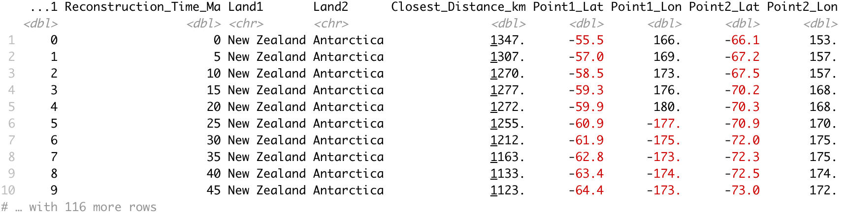
PyGplates Printer
Python script
Using pyGPlates package as base
Inputs:
  Individual area shapefiles (any number of files)
  Chosen rotational file
  Chosen timestamps
Outputs:
  Table of distances between closest points for every shapefile pairing

Slide 13
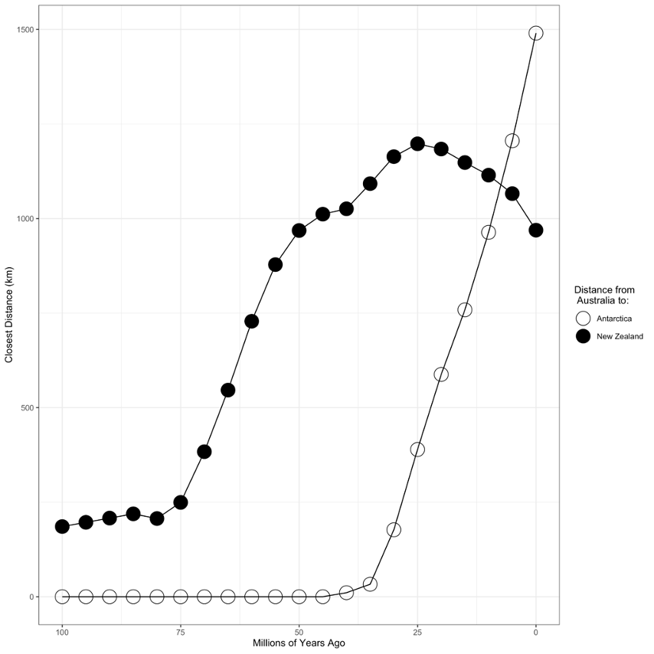
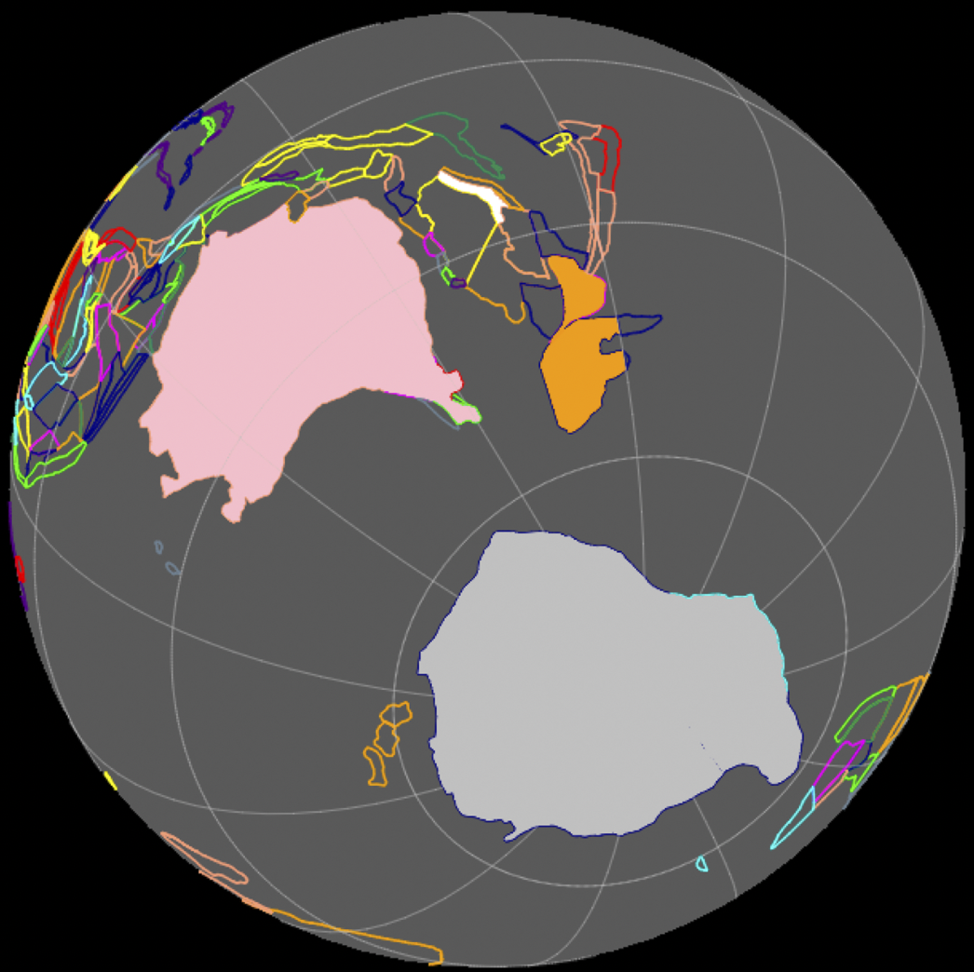
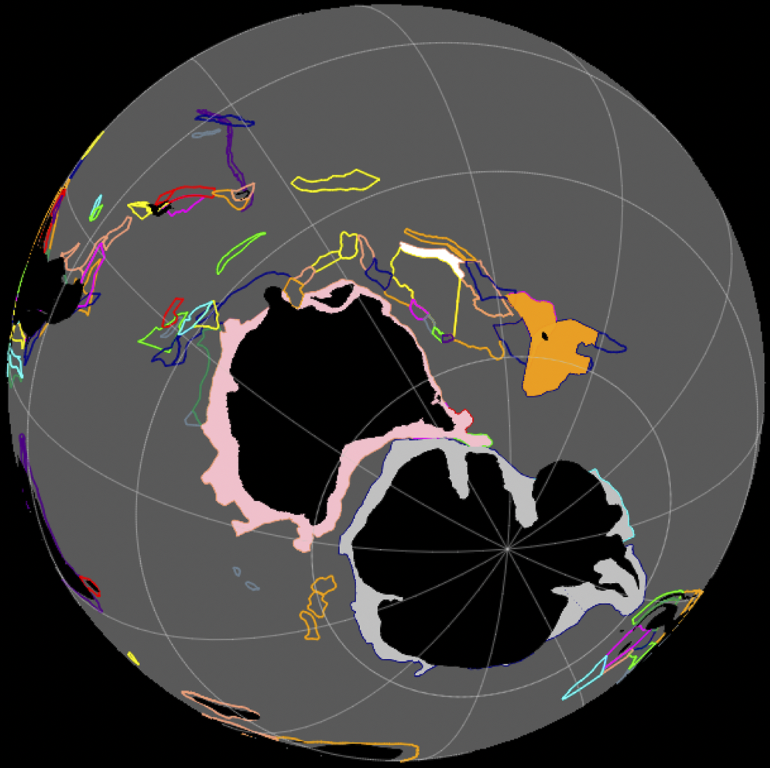
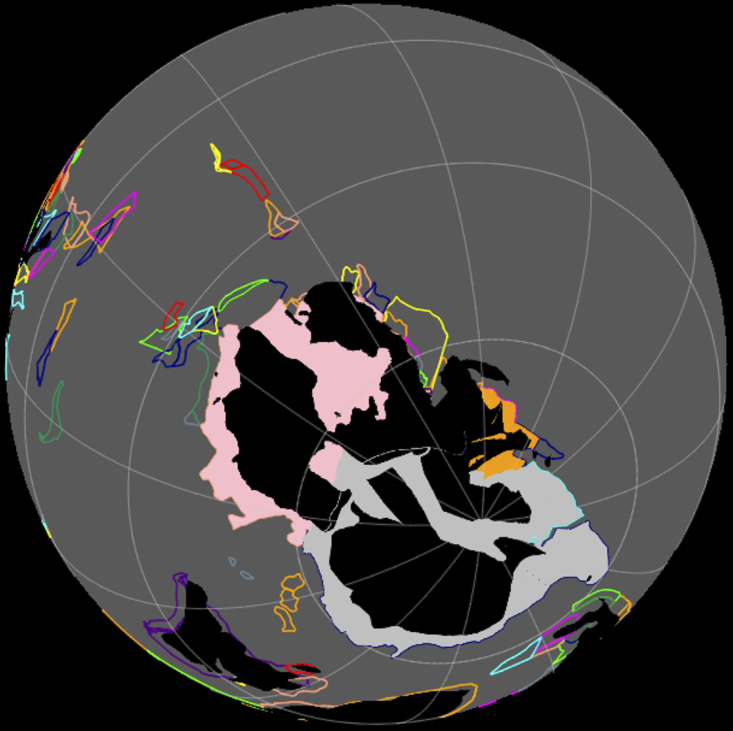
100 Time (mya) 0
Closest Distance (Km)
Time (mya)

Slide 14
Outline
Background
  Biogeography and Models
  Previous limitations - Realism and Speed
GPlates for Biogeographers
Julia Speed for Complex ODEs
Testing Accuracy of Distance Based SSE Models
Conclusions

Slide 15
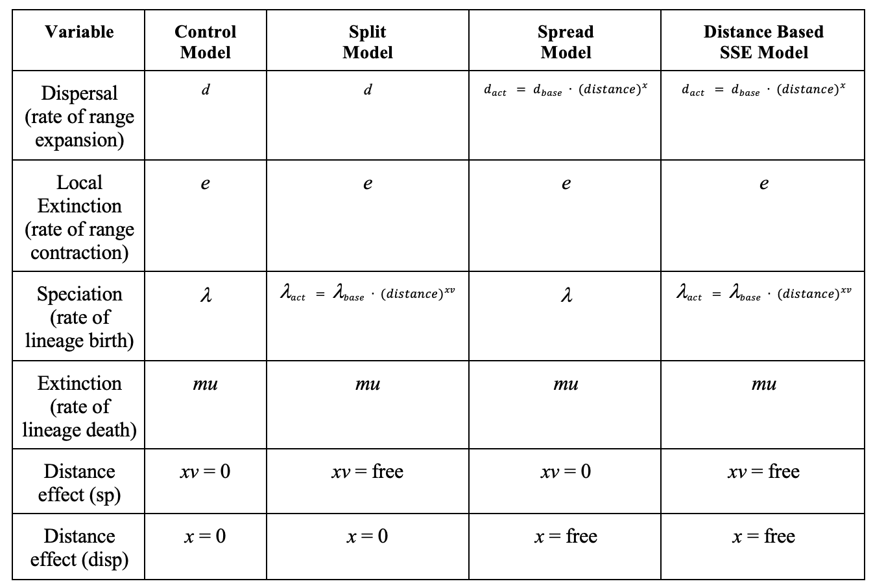
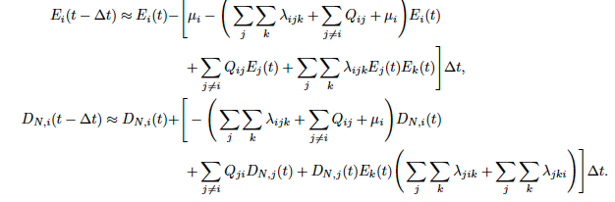
Julia for Biogeographic Phylogenetics
Improved biogeographic models will require better computation speeds
As our models get more complex and our datasets larger, we handle
an amount of data that is almost overwhelming to previous systems
Freyman and Höhna. 2017. The tempo of evolutionary decline in self-compatible plant lineages. Systematic Biology. 68: 505-519. 10.1093/sysbio/syy078
Notes:
2x2
4x4
10x10
Table:
Number of Areas (2) number
Number of Ranges (4) n^2
Number of Interacting ODEs (8) n^2 x2

Slide 16
Julia for Biogeographic Phylogenetics
# of Areas n | # of Ranges 2^n | # of Interacting ODES (E + D)
2 3 4 5 10 25 | 4 8 16 32 1024 33554432 | 8 16 32 64 2048 67108864
Notes:
Our number of ODE interactions get exponentionally larger
And our matrices of interactions grows

Slide 17
Julia for Biogeographic Phylogenetics
# of Areas n | # of Ranges 2^n | # of Interacting ODES (E + D)
2 3 4 5 10 25 | 4 8 16 32 1024 33554432 | 8 16 32 64 2048 67108864
Putting all of that
Through this
Notes:
Our number of ODE interactions get exponentially larger
And our matrices of interactions grows

Slide 18
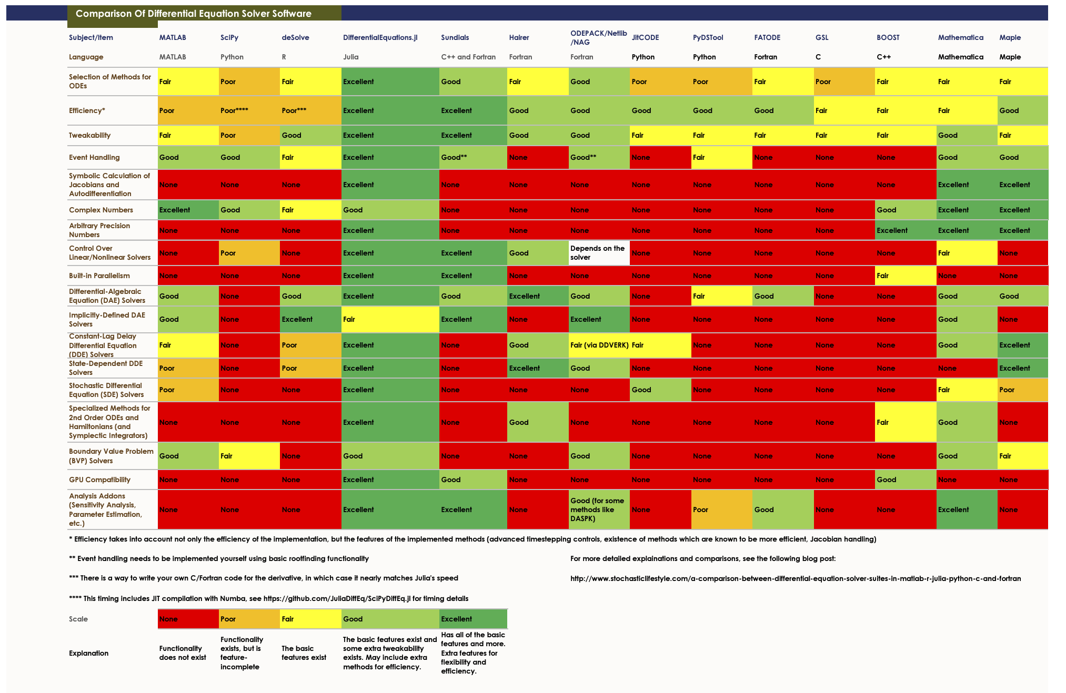
https://www.stochasticlifestyle.com/comparison-differential-equation-solver-suites-matlab-r-julia-python-c-fortran/
Notes:
Julia optimizers in blue - nice and green and speedy
R in pink -a couple are okay, but most are poop

Slide 19
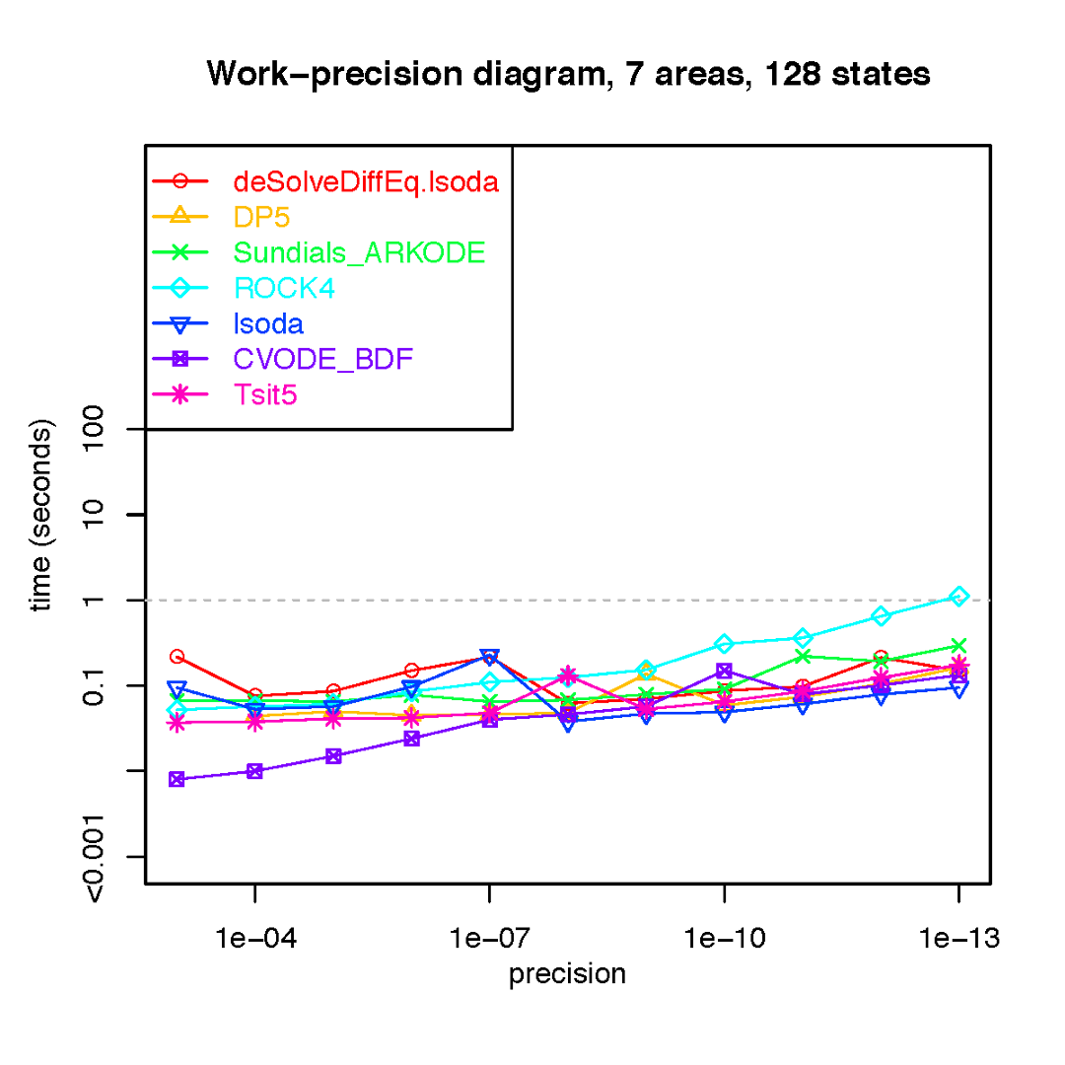
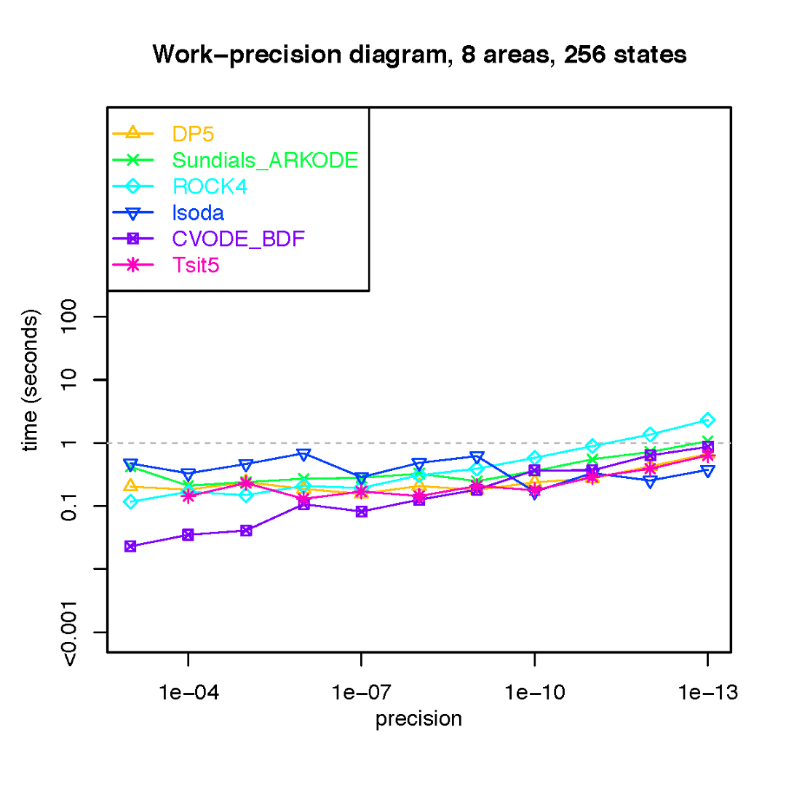
Julia Speed Testing
Old vs New
Previous testing of ODEs* within Julia and R suggested that Julia’s increased speed would allow for us to work with higher precision at faster rates
DeSolveDiffEq.lsoda is R’s main solver. This dropped out at 8 states in previous tests
Notes:
R Poops are 7 areas
Sucks to suck

Slide 20
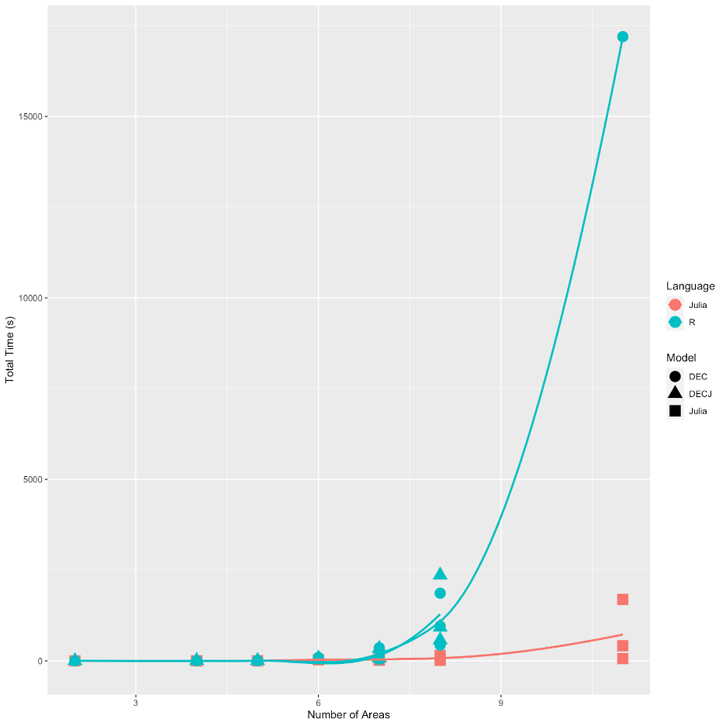
Julia Speed Testing
Old vs New
Ran from 2 - 11 areas on 20 datasets
  BiogeoBEARS vs PhyBEARS
Similar to previous test -
Slower speeds (exponentially)
DECj in R failed 11 state test
Total Time (s)
Number of Areas
Notes:
Datasets Nareas 2 - 11 (4 states to 2048 states)
DECj Failed on the 11 state dataset

Slide 21
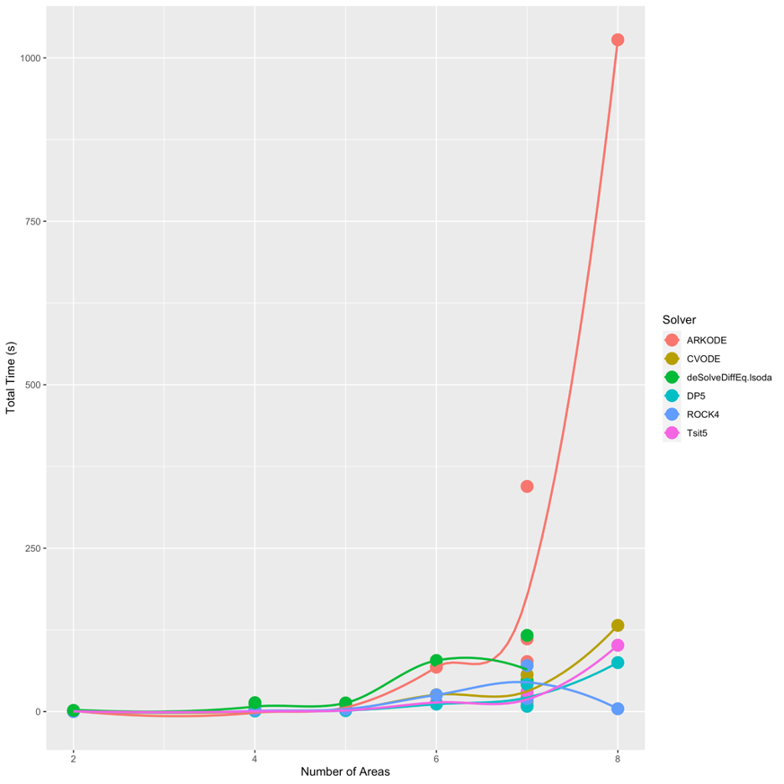
Various Solvers:
Julia vs R equivalent models
Similar models, but Julia runs
with ODES
ARKODE (R solver) slower
than all other solvers
Total Time (s)
Julia consistently runs faster when run on the same data
Number of Areas
Notes:
Arkode is R solver
Maybe if we run Julia solvers in R we would get Julia Performance?
CVODE is good with precision even though it appeared to be ever so slightly slower

Slide 22
Outline
Background
  Biogeography and Models
  Previous limitations - Realism and Speed
GPlates for Biogeographers
Julia Speed for Complex ODEs
Testing Accuracy of Distance Based SSE Models
Conclusions

Slide 23
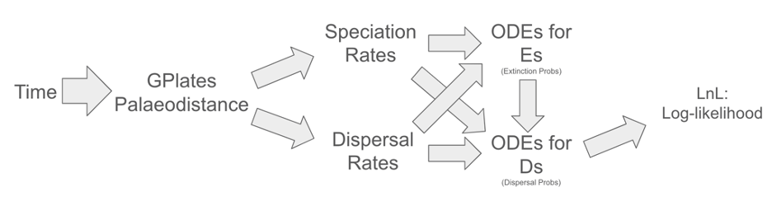
Incorporating Changing Palaeodistance into a time-varying SSE likelihood calculation
Notes:
Realistic biogeographic model uses Speciation and Dispersal rates that change continuously
We insert GPlates changing palaeodistances here, which impact both S and D rates, which impact the main ODEs within our analysis.
Using hillclimbing optimization (stepped) to calculate maximum likelihood

Slide 24
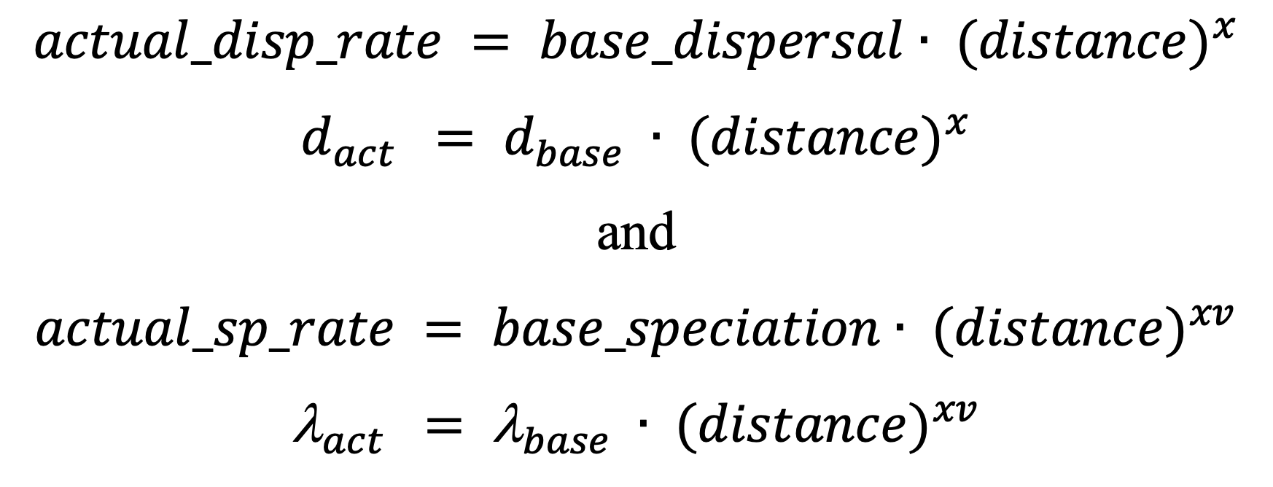
Initial Model:
How distance affects speciation and dispersal

Slide 25
Testing 3 Possible Palaeodistance Based SSE Models
Split - Distance on Speciation Rates
Spread - Distance influences dispersal rates
Distance Based - SSE (Combined Model)
Methods:
Simulation - Inference Testing
SImulation: 7 Start States - 600 Simulations per start state (total 4,200)
Inference: Control + Test model (total 8,400)
For Distance Based SSE, Split and Spread inference were additionally run for comparison (+ 8,400)

Slide 26
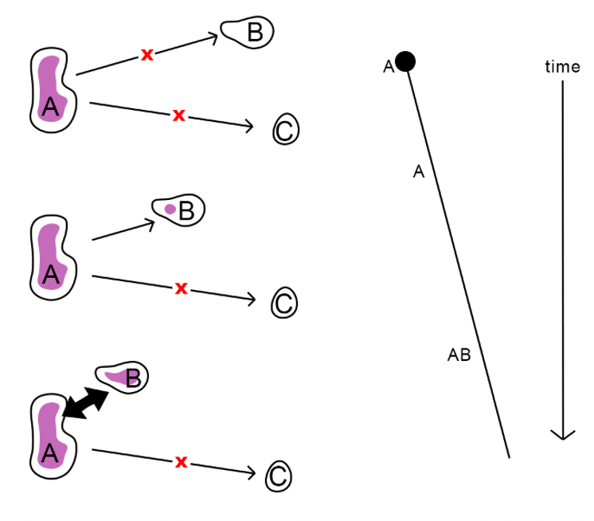
Split Model
As land masses get closer together
species disperse to cover more areas

Slide 27
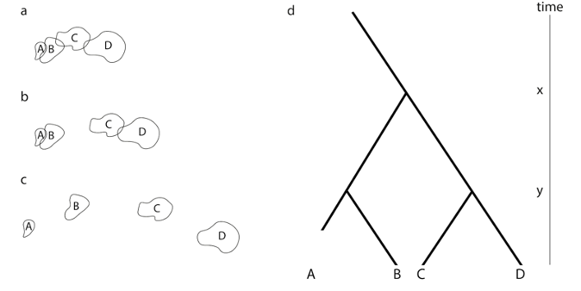
Split Model
As land masses get further apart
species ranges split

Slide 28
How do the models differ
Later inclusion of area on extinction

Slide 29
Spread
Anagenetic
 | NULL | A | B | C | AB | AC | BC | ABC
NULL | 0 | 0 | 0 | 0 | 0 | 0 | 0 | 0
A | 0.028 | -0.218 | 0 | 0 | 0.095 | 0 | 0.095 | 0
B | 0.028 | 0 | -0.218 | 0 | 0.095 | 0.095 | 0 | 0
C | 0.028 | 0 | 0 | -0.218 | 0 | 0.095 | 0.095 | 0
AB | 0 | 0.028 | 0.028 | 0 | -0.151 | 0 | 0 | 0.095
AC | 0 | 0 | 0.028 | 0.028 | 0 | -0.151 | 0 | 0.095
BC | 0 | 0.028 | 0 | 0.028 | 0 | 0 | -0.151 | 0.095
ABC | 0 | 0 | 0 | 0 | 0.028 | 0.028 | 0.028 | -0.084
Distances are input into a series of timestamped anagenetic tables which are then iterated over during inference
 | NULL | A | B | C | AB | AC | BC | ABC
NULL | 0 | 0 | 0 | 0 | 0 | 0 | 0 | 0
A | 0 | -0.0874 | 0 | 0 | 0.0595333 | 0 | 0.0278667 | 0
B | 0 | 0 | -0.1507333 | 0 | 0.0595333 | 0.0912 | 0 | 0
C | 0 | 0 | 0 | -0.119067 | 0 | 0.0912 | 0.0278667 | 0
AB | 0 | 0 | 0 | 0 | -0.0912 | 0 | 0 | 0.0912
AC | 0 | 0 | 0 | 0 | 0 | -0.059533 | 0 | 0.0595333
BC | 0 | 0 | 0 | 0 | 0 | 0 | -0.0912 | 0.0912
ABC | 0 | 0 | 0 | 0 | 0 | 0 | 0 | 0

Slide 30
Split
Cladogenetic
i | j | k | prob
1 | 1 | 1 | 1
2 | 2 | 2 | 1
3 | 3 | 3 | 1
4 | 4 | 4 | 1
5 | 2 | 3 | 0.3333333
5 | 2 | 5 | 0.3333333
5 | 3 | 5 | 0.3333333
5 | 5 | 5 | 0
6 | 3 | 4 | 0.3333333
6 | 3 | 6 | 0.3333333
6 | 4 | 6 | 0.3333333
6 | 6 | 6 | 0
7 | 2 | 4 | 0.3333333
7 | 2 | 7 | 0.3333333
7 | 4 | 7 | 0.3333333
7 | 7 | 7 | 0
8 | 5 | 4 | 0.1666667
8 | 6 | 2 | 0.1666667
8 | 7 | 3 | 0.1666667
8 | 8 | 5 | 0.1666667
8 | 8 | 6 | 0.1666667
8 | 8 | 7 | 0.1666667
8 | 8 | 8 | 0
i | j | k | prob
1 | 1 | 1 | 1
2 | 2 | 2 | 1
3 | 3 | 3 | 1
4 | 4 | 4 | 1
5 | 2 | 3 | 0.03225806
5 | 2 | 5 | 0.48387097
5 | 3 | 5 | 0.48387097
5 | 5 | 5 | 0
6 | 3 | 4 | 0.01639344
6 | 3 | 6 | 0.49180328
6 | 4 | 6 | 0.49180328
6 | 6 | 6 | 0
7 | 2 | 4 | 0.0625
7 | 2 | 7 | 0.46875
7 | 4 | 7 | 0.46875
7 | 7 | 7 | 0
8 | 5 | 4 | 0.02040816
8 | 6 | 2 | 0.04081633
8 | 7 | 3 | 0.02040816
8 | 8 | 5 | 0.30612245
8 | 8 | 6 | 0.30612245
8 | 8 | 7 | 0.30612245
8 | 8 | 8 | 0
Distances are input into a series of timestamped cladogenetic tables which are then iterated over during inference

Slide 31
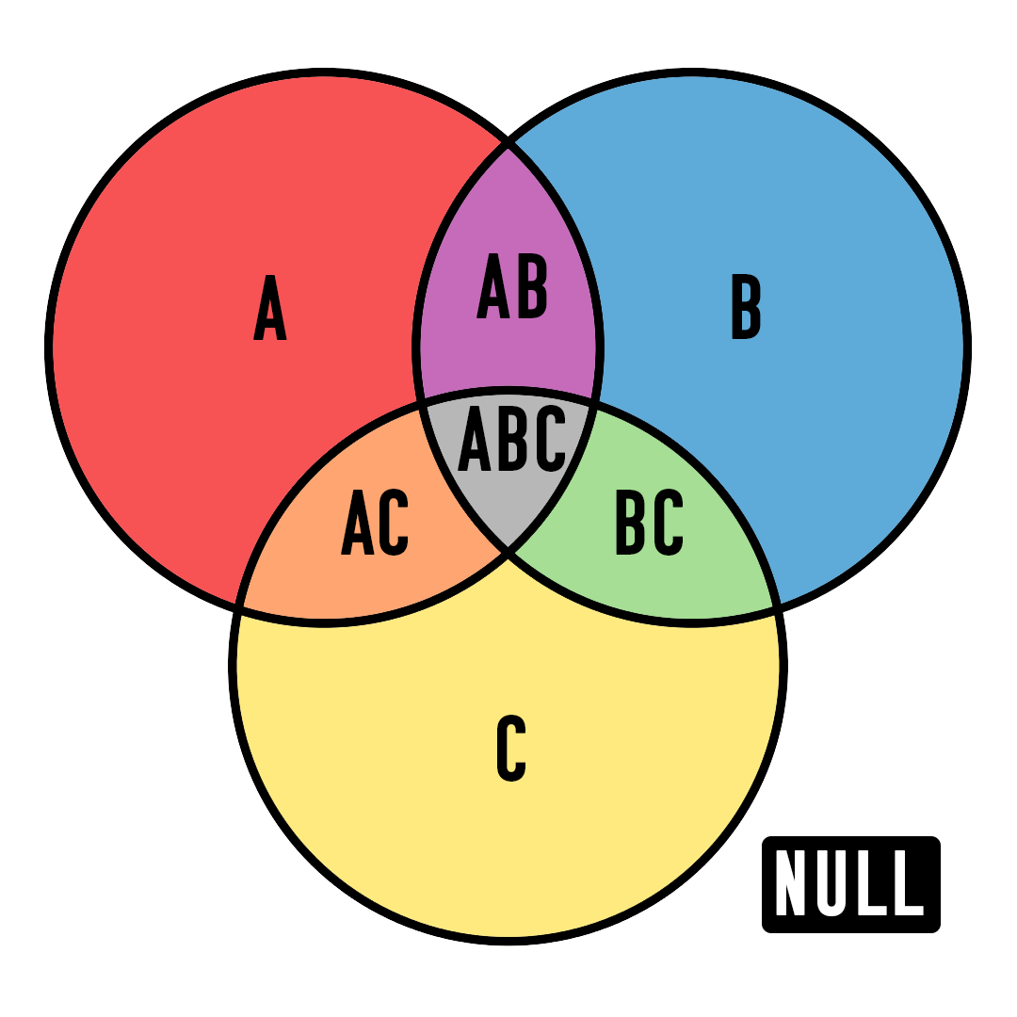
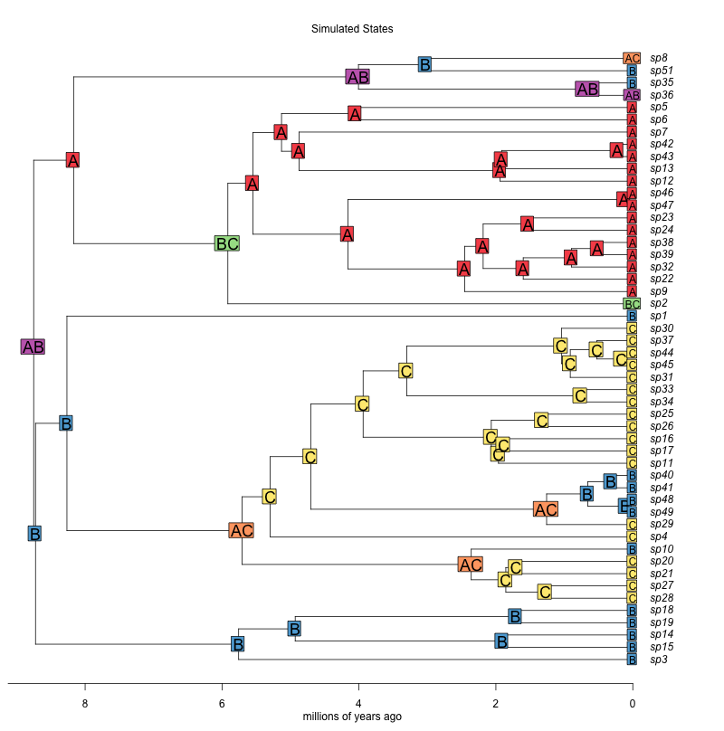
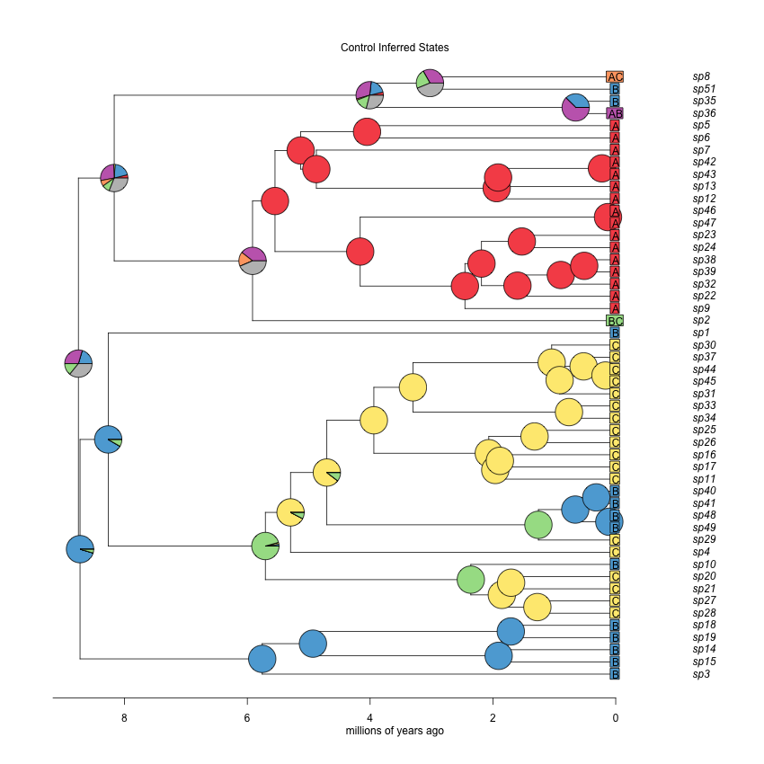
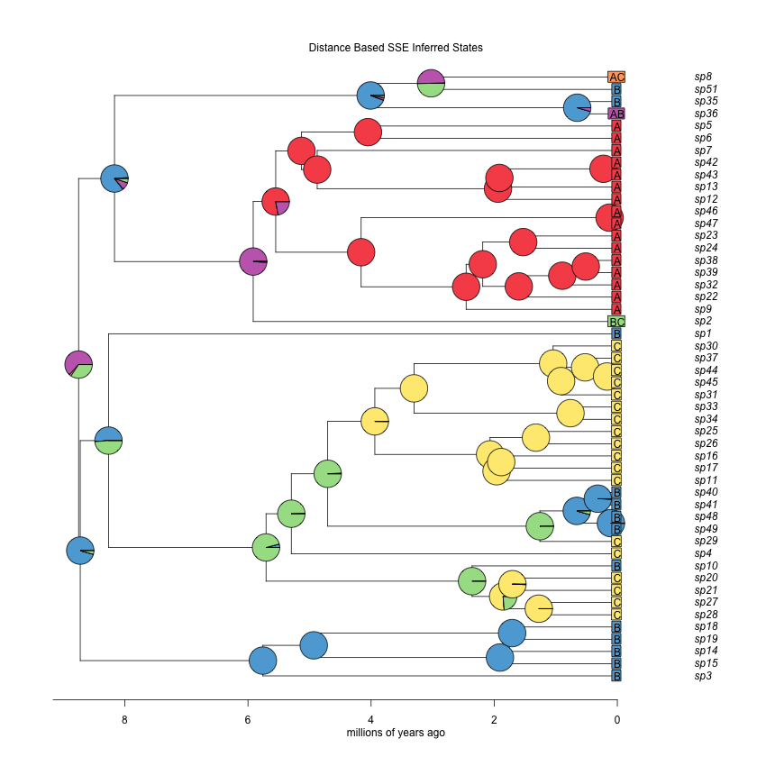
Results!
Simulated
States
Control Inferred States
Distance Based SSE Inferred States

Slide 32
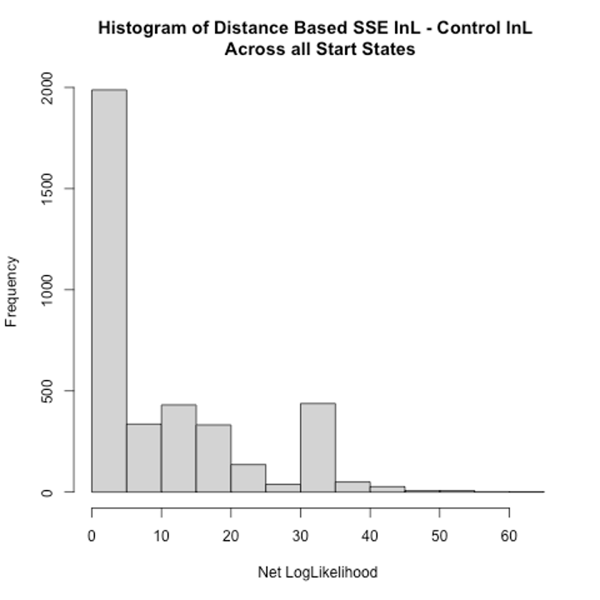
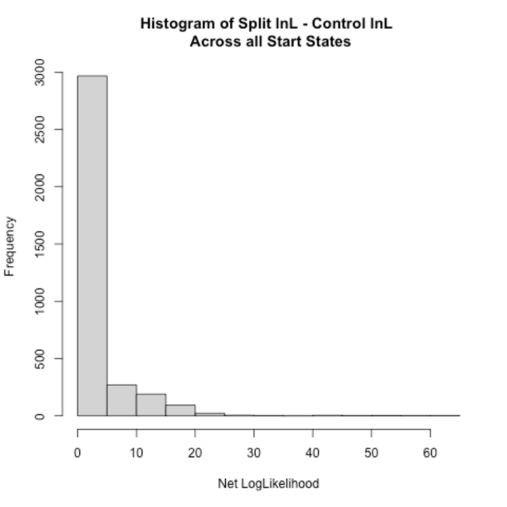
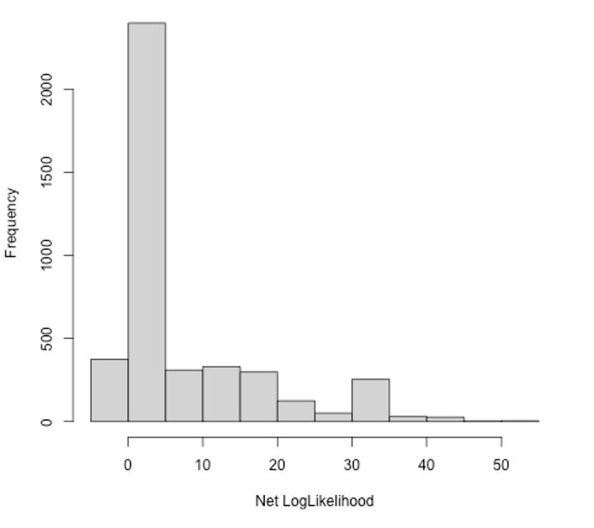
Results 1: Lnls - Significantly Higher
Histogram: Distance Based SSE - Control
Histogram: Spread - Control
Histogram: Split - Control
Net Log Likelihood
51.14% above 1.92
25.76% above 1.92
47.1% above 3.84
Notes:
Split again was the worst
Distance based SSE had the highest net Lnls
Again Split did better when using the DBSSE simulations than it’s own simulations
50.71% DBSSE vs Spread
21% vs Split

Slide 33
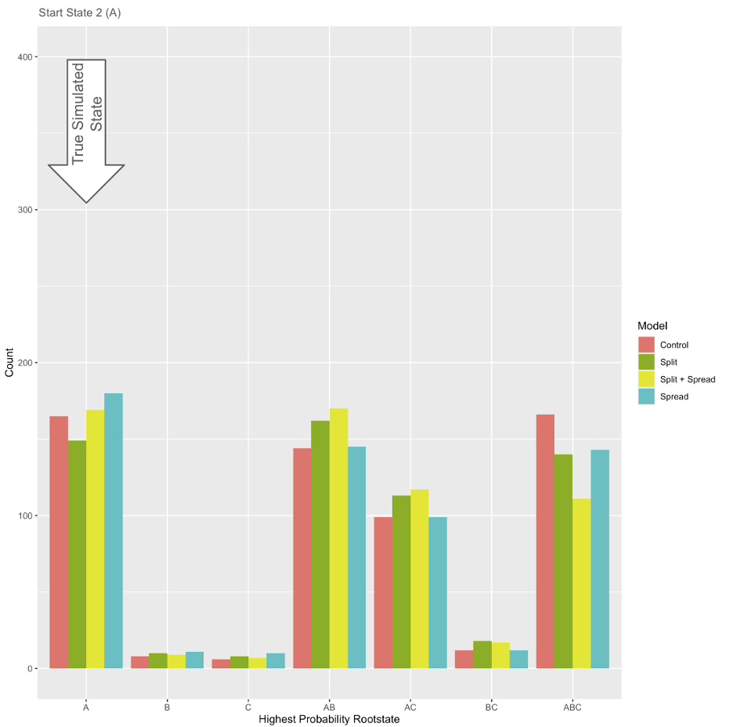
Results 2:
Inference
Correlated
with True
Root State
Start State 2 (A)
Count
Highest Probability Rootstate

Slide 34
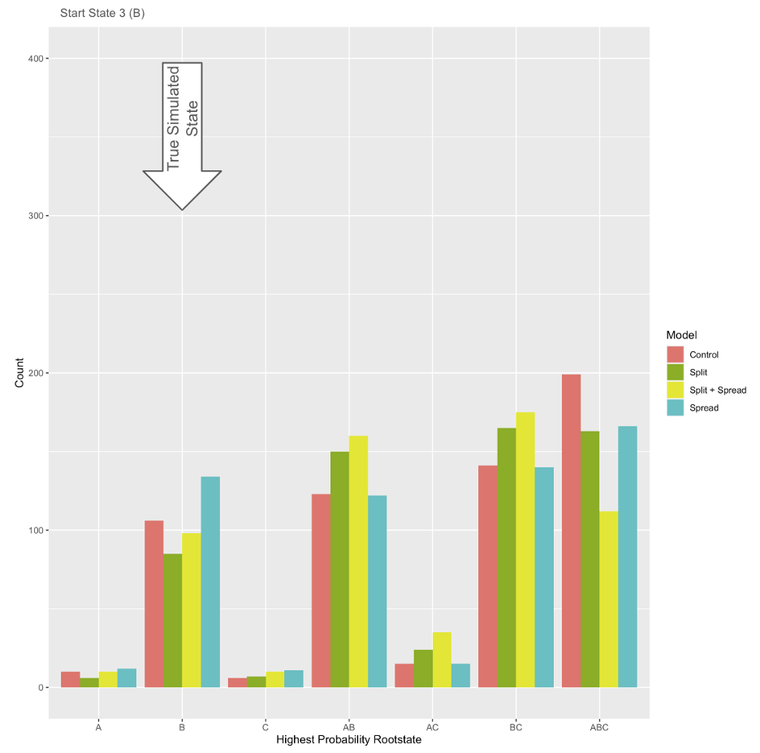
Results 2:
Inference
Correlated
with True
Root State
Start State 3 (B)
Count
Highest Probability Rootstate

Slide 35
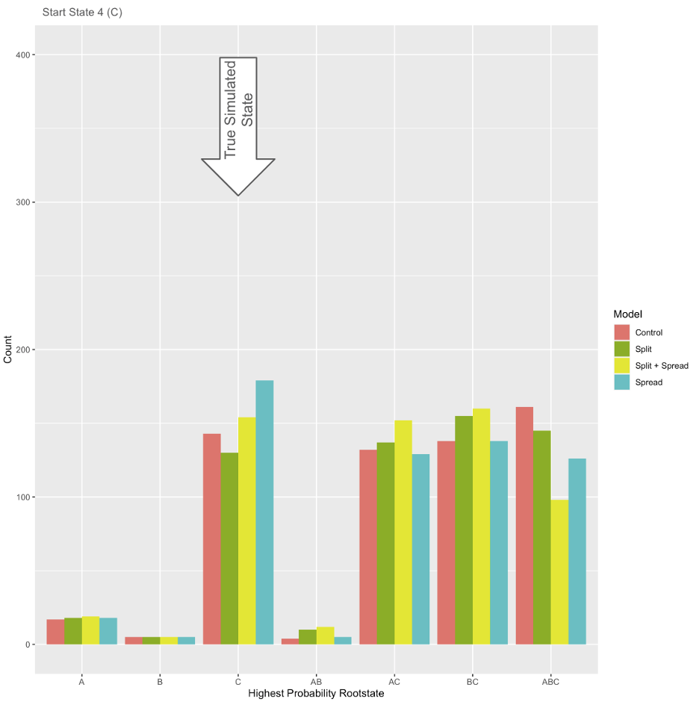
Results 2:
Inference
Correlated
with True
Root State
Start State 4 (C)
Count
Highest Probability Rootstate

Slide 36
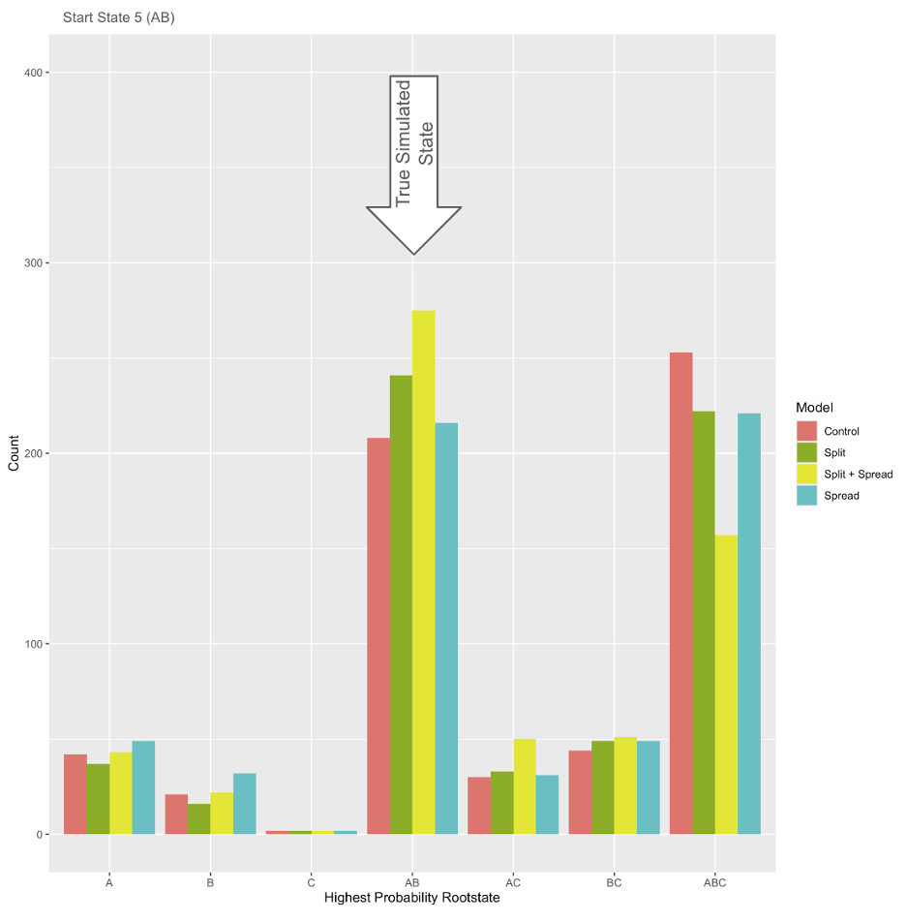
Results 2:
Inference
Correlated
with True
Root State
Start State 5 (AB)
Count
Highest Probability Rootstate

Slide 37
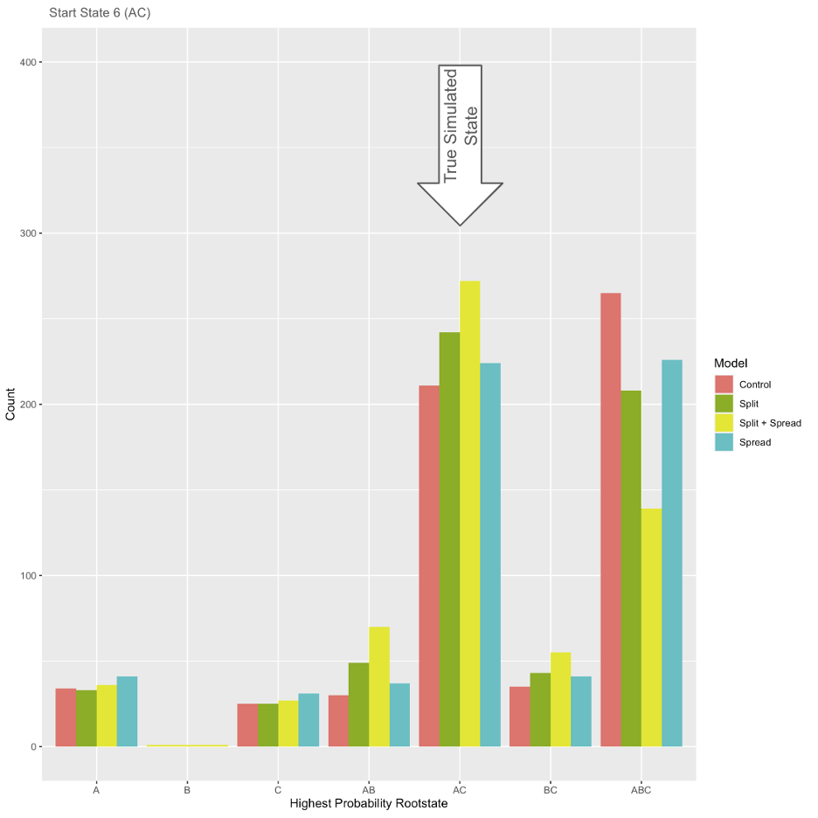
Results 2:
Inference
Correlated
with True
Root State
Start State 6 (AC)
Count
Highest Probability Rootstate

Slide 38
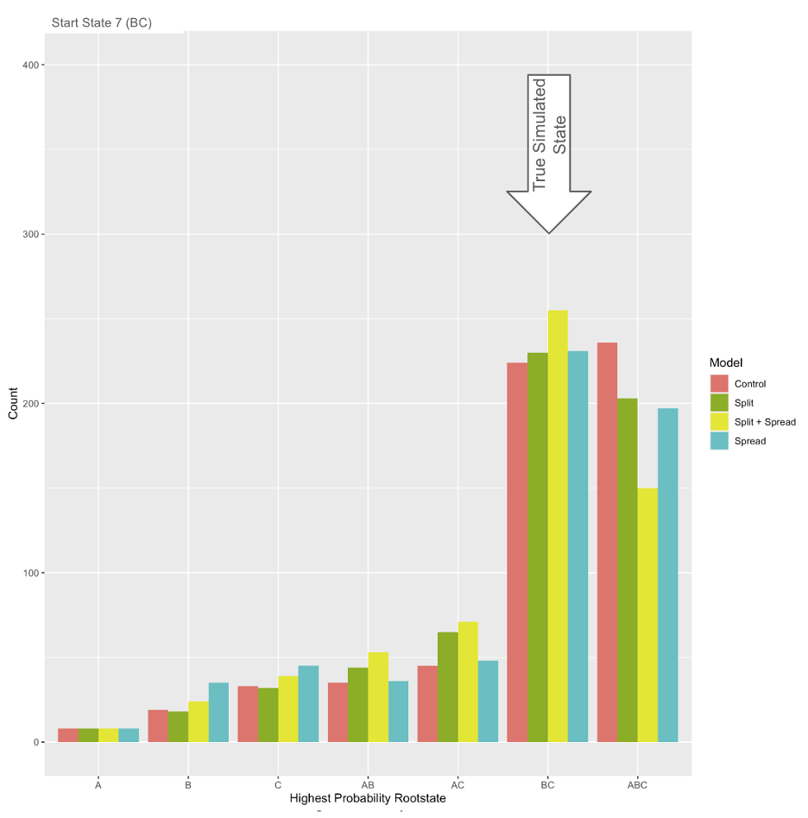
Results 2:
Inference
Correlated
with True
Root State
Start State 7 (BC)
Count
Highest Probability Rootstate

Slide 39
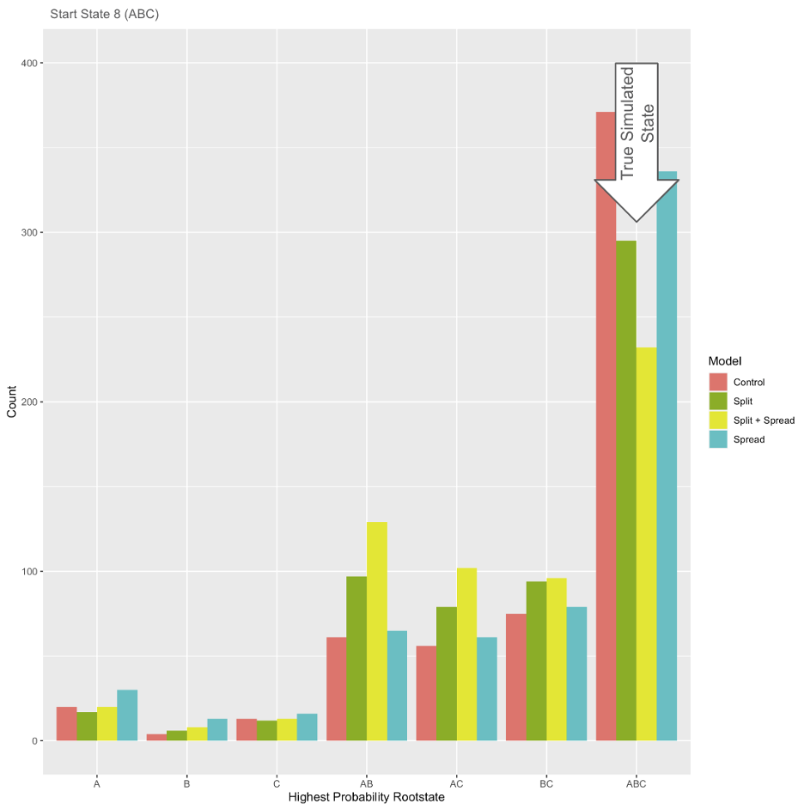
Results 2:
Inference
Correlated
with True
Root State
Start State 8 (ABC)
Count
Highest Probability Rootstate
Notes:
We saw high rates of ABC rootstate assumption by the Control Model across all start states (lower, but still present assumptions by the other models for ABC. So to see Control as the highest correct model for ABC start state was not a huge surprise)

Slide 40
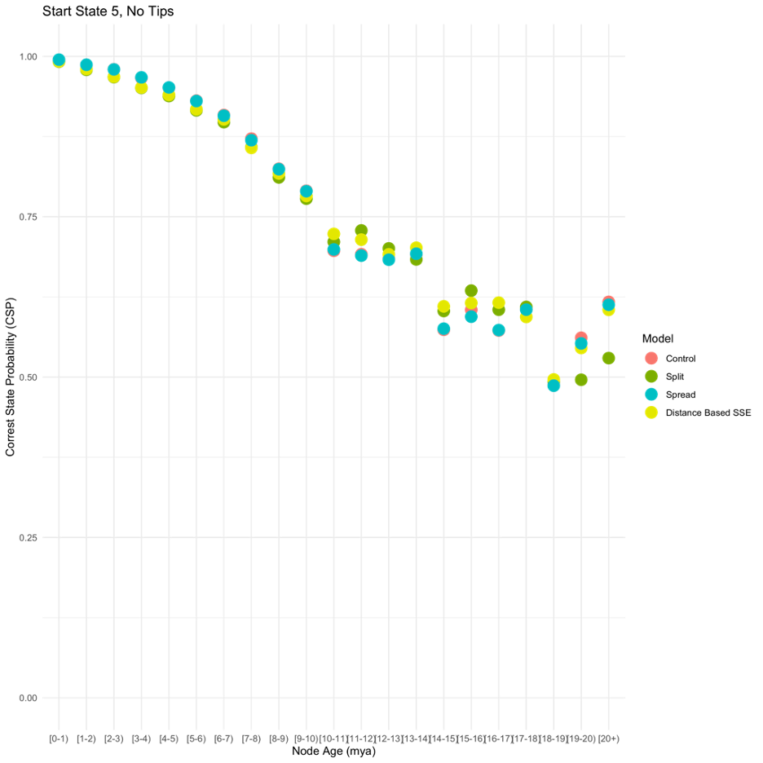
Results 3: Average
Accuracy of all 3 Models
Vs
Control Model
Accuracy declines, but not at equal rates
Notes:
Correct State Probabilities for control were still

Slide 41
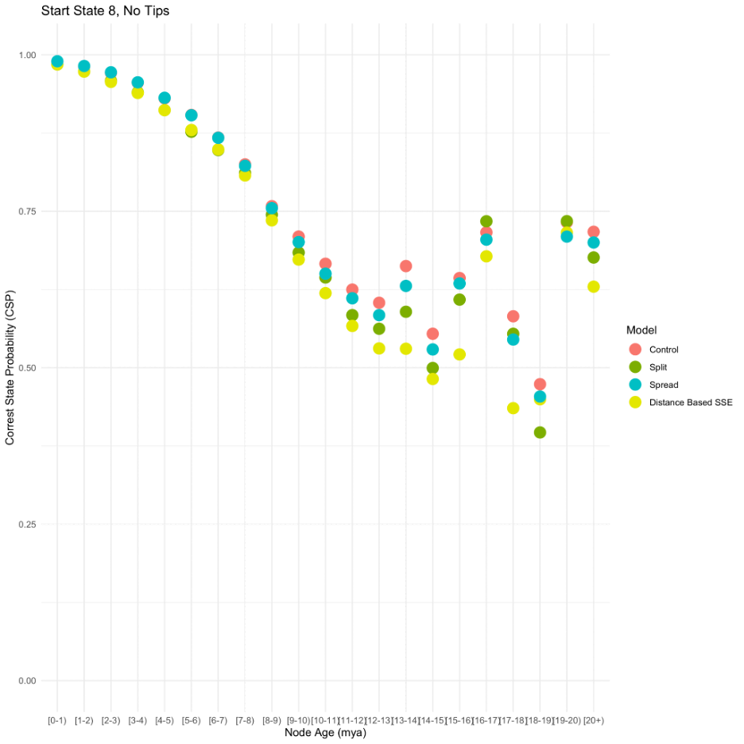
Results 3: Average
Accuracy of all 3 Models
Vs
Control Model
True Start State - ABC
showed a different pattern.
Why?
Notes:
We saw high rates of ABC rootstate assumption by the Control Model across all start states (lower, but still present assumptions by the other models for ABC. So to see Control as the highest correct model for ABC start state was not a huge surprise)

Slide 42
Overall Conclusions
Gplates:
pyGPlates printer allows extraction of palaeodistances a desired timepoints
Julia vs R:
We see a large improvement in speed after running our models in Julia instead of R for problems with many states
Simulation-Inference Tests of Distance Based SSE:
Lnls suggest an overall improvement from the control
Root state was correlated with True state across all models
Decline in accuracy the further back in time, as expected
High Rate of ABC assumed by control model across all startstates

Slide 43
Future Work
Using changing area size to explain changes in extinction rates
Different forms of distance
  How might elevation or climates interact with distance, as opposed to tectonic movement?
Different rotational models or GMT maps/models

Slide 44
Potential Questions
You have a lot of supplemental analyses in the thesis, what are these for?
Mostly just answering questions I came across while I ran these tests.
Notes:
Changing speciation and extinction changed the way the trees formed
Removing easily inferred nodes - 100% node removal compensated for our concern that a tree might be ‘easy to solve’. Were our inferences more accurate amongst the ‘contested’ nodes? In short! Yes! (But weirdly the split model was actually the best model? Was the worst model against it’s own simulations…
Lower Geographic Isolation (higher population connectivity) - In reality we do not know what the geographic isolation threshold would be, so do our models still work even if the isolation threshold is slightly off?

Slide 45
Potential Questions
For researchers not familiar with Julia, what methods are available to integrate your Julia-based models with existing tools using R, Python, and other languages?
If you want to run Julia from R there are already existing packages!
Otherwise these are example codes, and the code included only requires minimal understanding of Julia to run.

Slide 46
Potential Questions
How might the inclusion of additional ecological or environmental factors impact the performance and accuracy of your models?
You can include other types of distance within the model (ecological distance, trait based distance) and it’s just another variable to be added. We just didn’t explore it in the bounds of this thesis.
Temperature
Climate
Altitude
Connectivity
(you can define what the areas are and can have several matrices at once)
You can define what distance is, which means you can change it

Slide 47
Potential Questions
Could you elaborate on how your models account for the uncertainty inherent in paleogeographic reconstructions?
The change in geographic isolation threshold / connectivity was an attempt to explore this
Otherwise:
Inference can be run multiple times using multiple trees!
We can use different rotational models to look at different paleogeographic reconstructions

Slide 48
Potential Questions
If a biologist wanted to use GPlates data, roughly what steps would they need to do? (I ask this because, IIRC, the hard step is the coding-of-plates-by-modern-areas. It would be fine to mention this if it comes up.)

Slide 49
Potential Questions
If a biologist wanted to use PhyBEARS, or incorporate it into other software (one of your reviewers was the RASP guy, he likes to do this this kind of thing), roughly what would they need to do? (roughly: it’s all open source on GitHub, many test scripts are available, once they get those working users are free to modify as they like)

Slide 50
Potential Questions
Could I use this on my study clade X? (answer is always yes, then inquire about the geographic region & time, and what might be appropriate in terms of # of areas, etc.)

Slide 51
Questions for Reviewers
The author may want to mention the work by M. Landis.
In chapter 3 (spread model alone), why do you think the true rootstate of A and B were the hardest for the models to infer correctly?
It would be beneficial to include a comparison of memory consumption alongside the speed tests, as this can be a critical factor in computational efficiency, especially for large-scale simulations.
The potential application of these models and tools in conservation biology or epidemiology could be explored, as this could broaden the impact of the research.
For researchers not familiar with Julia, what methods are available to integrate your Julia-based models with existing tools using R, Python, and other languages?
How might the inclusion of additional ecological or environmental factors impact the performance and accuracy of your models?
Could you elaborate on how your models account for the uncertainty inherent in paleogeographic reconstructions?

Slide 52
General Questions
What direction do you think this kind of research could go in the future? (e.g. new models, overcoming limitations of current work, making tools easier to use)
What do you wish you had learned earlier in doing this research project?
What publication plans do you have? (let’s talk about this one – minimally, you are a coauthor on PhyBEARS and any publications that come from that)
What are your next steps, and what have you gained from your PhD experience? (even if you are going in another direction, you’ve learned some things, eg new programming languages, model-based inference, data visualization etc.)

Slide 53
Questions slides

