Slide 1
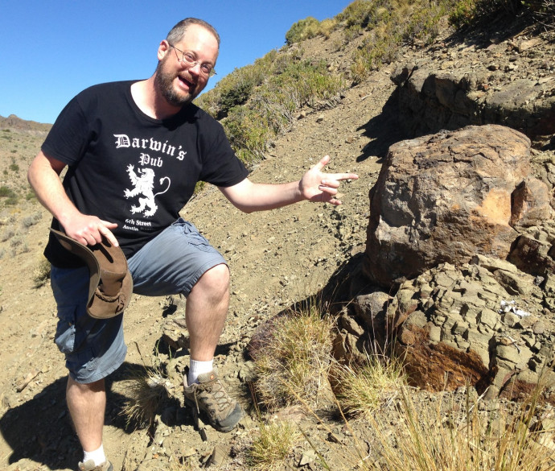
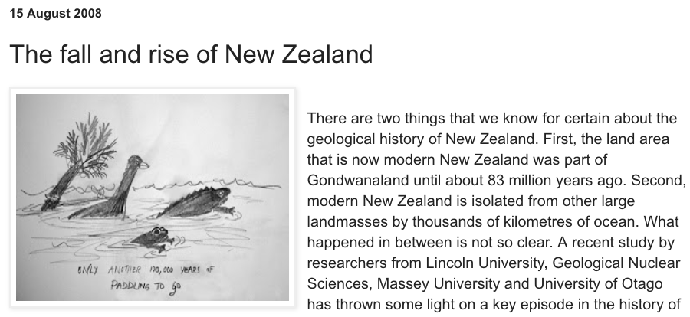
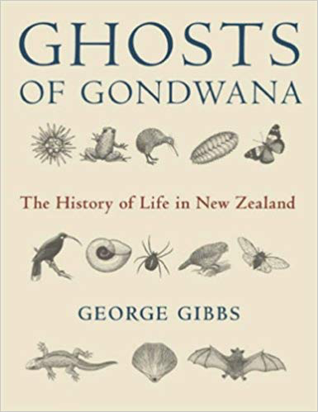
Module 1: Zealandia Controversies
Zealandia Controversies (with Nick Matzke, July 31, August 7)
Key questions:
How much of New Zealand’s biota has rafted on the Zealandia tectonic block “Moa’s Ark”, versus dispersed here after separation?
Was New Zealand “drowned” in the Oligocene?
How does the dispersal/vicariance debate influence our interpretation of NZ, and vice versa?
How do phylogenetic dating studies play into these questions? What are their strengths & weaknesses?

Slide 2
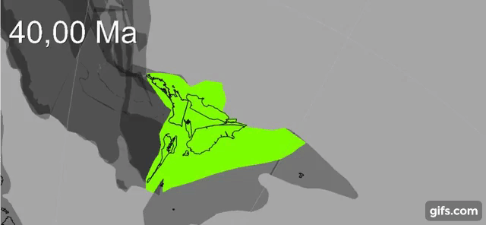
The puzzle of NZ biogeography
“…explain New Zealand and the
world falls into place around it.”
--JRSNZ (2021), call for papers, Evolutionary Biogeography of Aotearoa New Zealand; citing Gareth Nelson (1975).
GPlates animation: Zealandia crustal thickness
Müller, Sahirovic et al. (2018), U. Sydney "Modelling and visualising distributed crustal deformation of Australia and Zealandia using GPlates 2.0." https://www.youtube.com/watch?v=iKkCIdZ6oaE

Slide 3
The puzzle of NZ biogeography
What was the “New Zealand School of Biogeography”?
NZ School was an attempt to combine Croizat’s panbiogeography & cladistic biogeography
Essentially using vicariance as the core explanation
Short-lived
NZ biogeographer Michael Heads is a representative of this tradition
Ebach (2018) on NZ in 1980s:

Slide 4
Summary of previous lectures:
Different authorities have different assumptions about what processes matter!
Your inferences will depend on your assumptions
Vicariance: deterministic vision where geology determines ranges
Dispersal: “unpredictable” “chance events”
Me: “Unpredictable” doesn’t mean intractable – we can address using probabilistic models

Slide 5
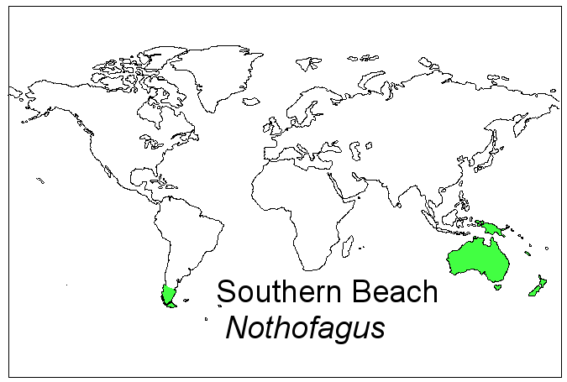
Evolution solved one biogeographical problem, but created new puzzles
Southern Beech
Nothofagus
http://bioteaching.wordpress.com/2012/03/28/modes-of-speciation/

Slide 6
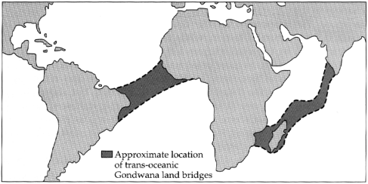
Evolution solved one biogeographical problem, but created new puzzles
Land bridges?
Southern Beech
Nothofagus
http://www.geo.arizona.edu/Antevs/ecol438/lect02.html

Slide 7
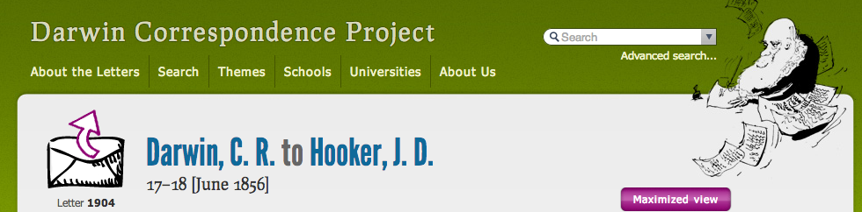
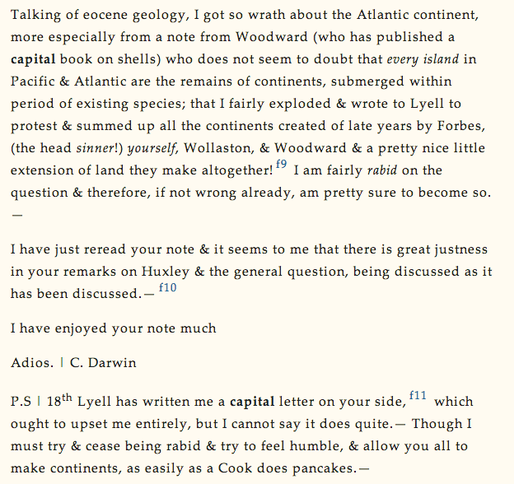
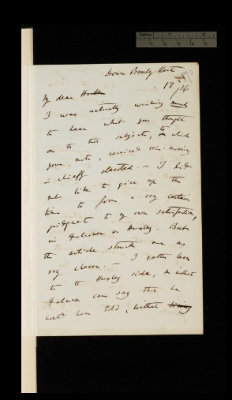
http://www.darwinproject.ac.uk/letter/entry-1904

Slide 8
http://www.darwinproject.ac.uk/letter/entry-1904

Slide 9
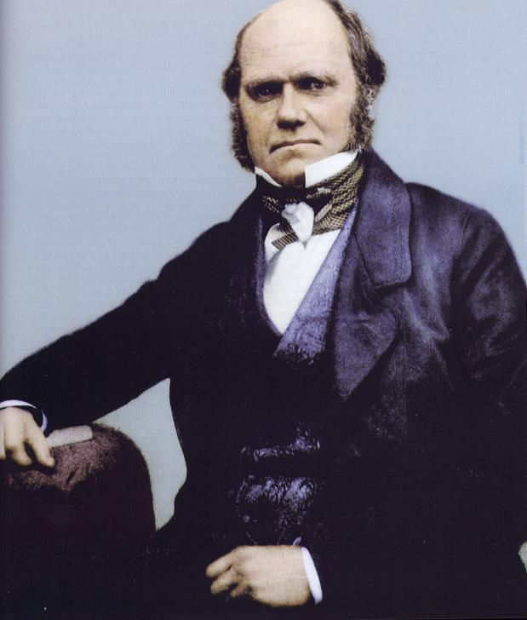
“I must try & cease being rabid & try to feel humble, & allow you all to make continents, as easily as a Cook does pancakes.”
-- Darwin to Hooker, June 1856
http://www.darwinproject.ac.uk/letter/entry-1904

Slide 10
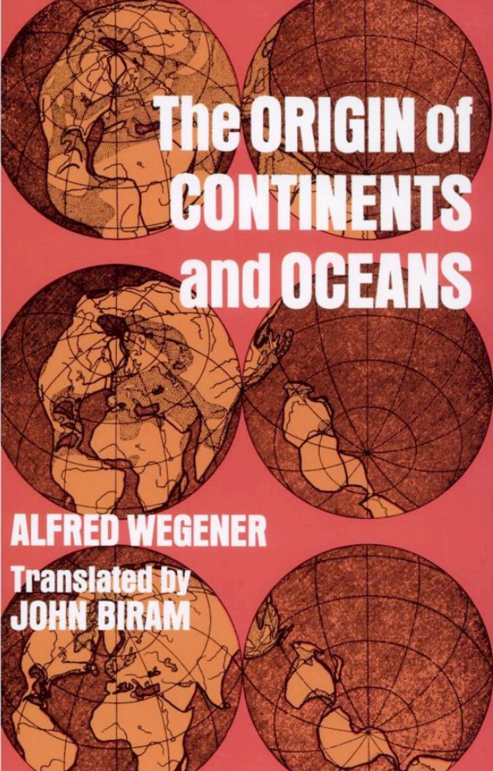
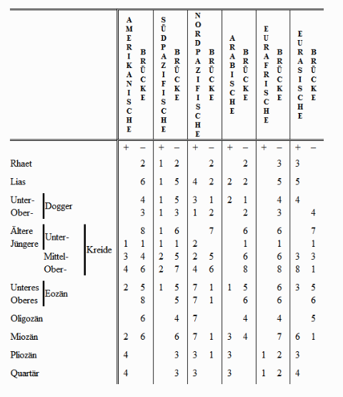
Wegener, continental drift

Slide 11
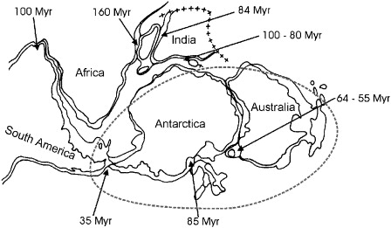
Plate tectonics led many to favor vicariance
Southern Beech
Nothofagus
Posadasa et al. (2006). "Historical biogeography: A review of its basic concepts and critical issues." Journal of Arid Environments, 66(3), 389–403.

Slide 12
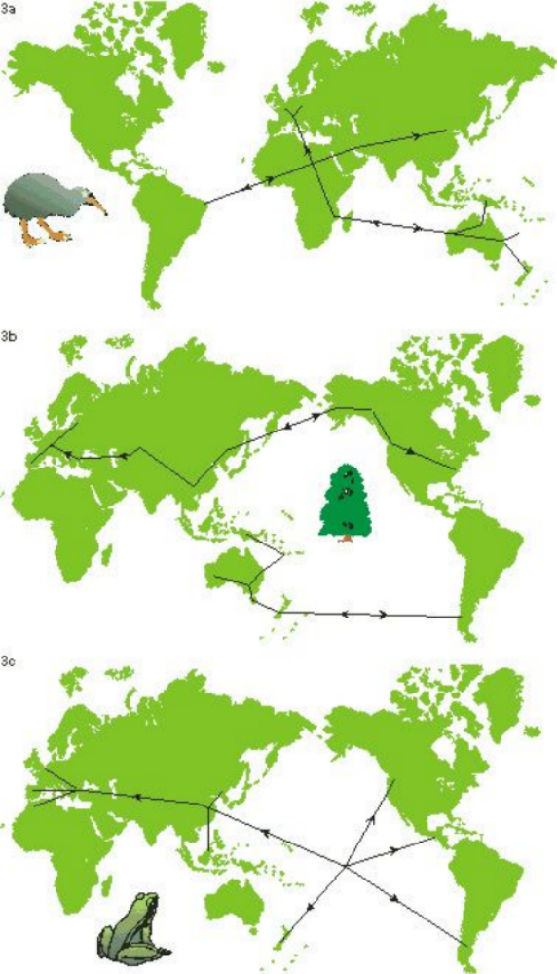
1950s-1980s: panbiogeography
Look for “tracks” connecting members of a taxon; look for shared patterns in tracks
Leon Croizat
anti-dispersalist
focused on pattern rather than process
polemical & ideological
taxonomy- rather than phylogenetically based; huge polyphyly/paraphyly problems
seen by some to support plate tectonics

Slide 13
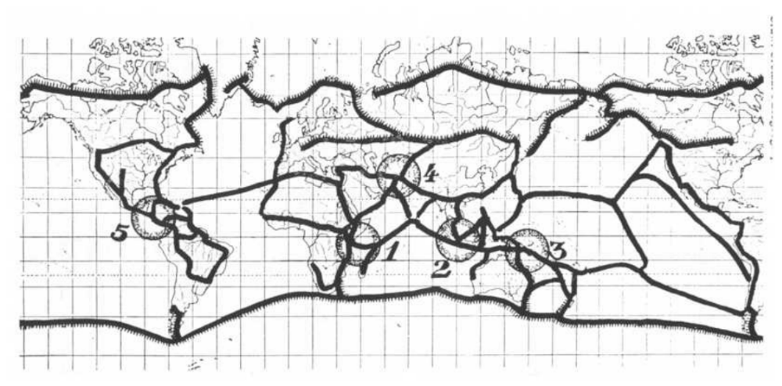
1950s-1980s: panbiogeography
Methodology unclear…
Croizat’s summary diagram of global tracks from his (1958) Panbiogeography

Slide 14
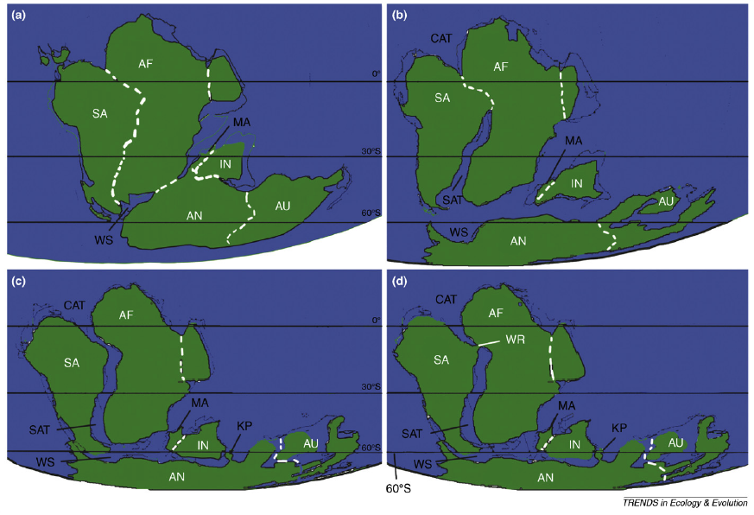
1960s-1990s: plate tectonics & cladistic biogeography
Different scenarios for breakup of Gondwanaland

Slide 15
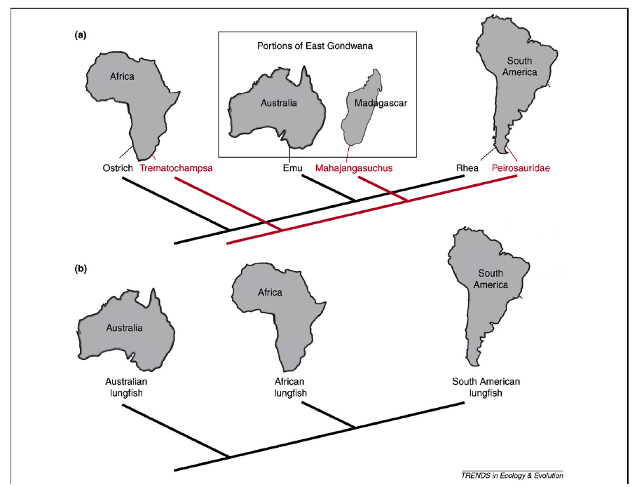
1960s-1990s: plate tectonics & cladistic biogeography
Congruence or pseudocongruence?

Slide 16
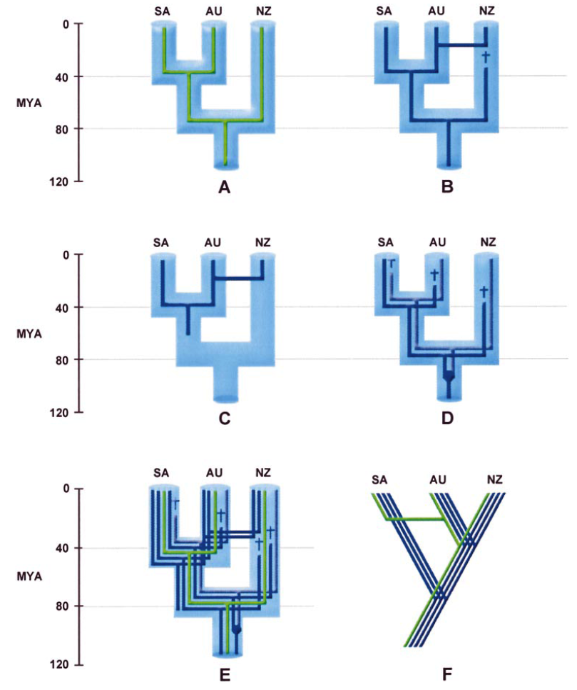
1960s-1990s: plate tectonics & cladistic biogeography
Donoghue & Moore (2003)

Slide 17
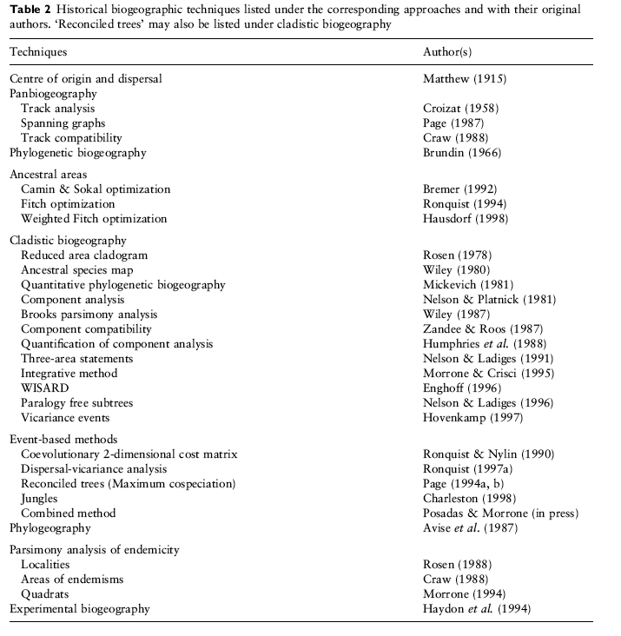
1980s-2000s: diversity of methods in use

Slide 18
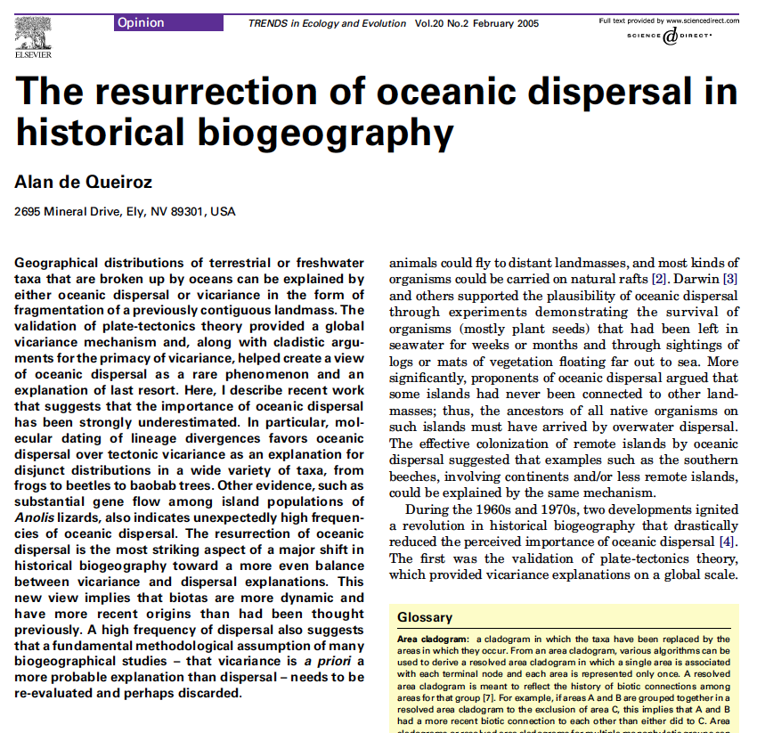
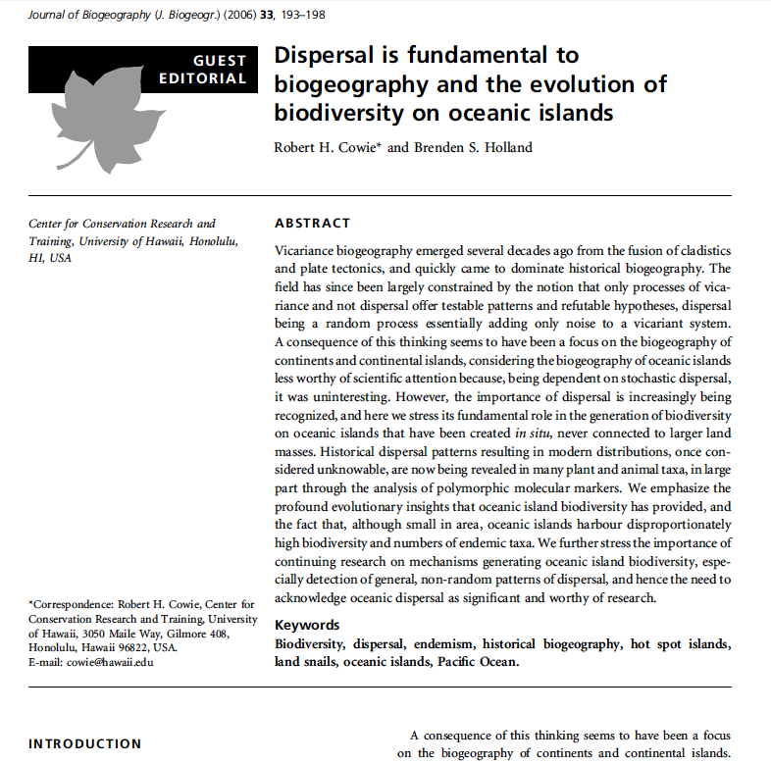
D versus V
  “A high frequency of dispersal also suggests that a fundamental methodological assumption of many biogeographical studies -- that vicariance is a priori a more probable explanation than dispersal -- needs to be re-evaluated and perhaps discarded."
  de Queiroz, A. (2005). "The resurrection of oceanic dispersal in historical biogeography." TREE, 20(2).
  “We hope, therefore, that the trend identified by de Queiroz (2005) – the resurrection of oceanic dispersal as important in historical biogeography – is real and that the straightjacket of strict vicariance biogeography is being loosened to include once again the plurality of mechanisms and processes..."
  p. 197 of: Cowie, R.H.; Holland, B.S. (2006). "Dispersal is fundamental to biogeography and the evolution of biodiversity on oceanic islands." Journal of Biogeography, 33, 193-198. Emphasis added.

Slide 19
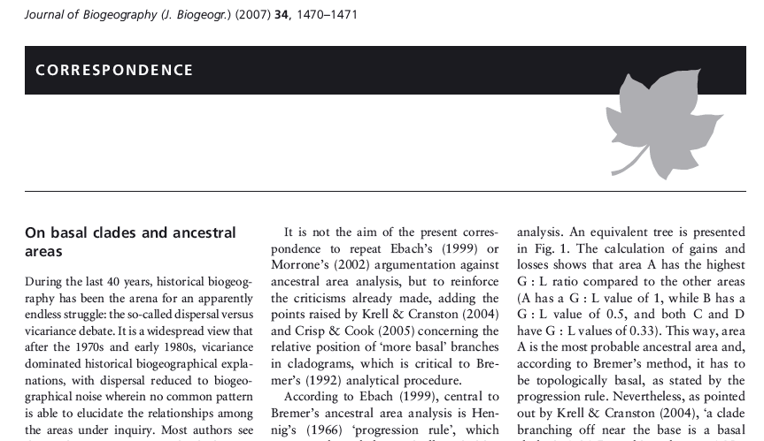
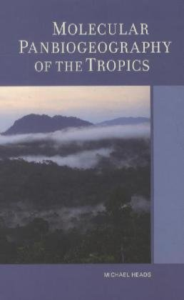
D versus V
  “During the last 40 years, historical biogeography has been the arena for an apparently endless struggle: the so-called dispersal versus vicariance debate.”
  “The resurrection of dispersalism, as de Queiroz (2005) has envisioned, is reactionary and with little (or even no) empirical foundation.”
  Santos, C.M.D. (2007). “On basal clades and ancestral areas.” Journal of Biogeography, 34, 1470-1469.
  “Most modern biogeographers follow Mayr...in accepting that allopatry can be found by vicariance (dichopatry) or by founder dispersal (peripatry), but only vicariance is accepted here.”
  “founder dispersal...is controversial and may not exist.”
  p. 15 in: Heads, M.J. (2012) Molecular panbiogeography of the tropics. University of California Press, Berkeley, CA.

Slide 20
Summary: dispersal versus vicariance

Slide 21

Summary: dispersal versus vicariance

Slide 22
Molecular phylogenetics and biogeographical inference methods

Slide 23
How do we put geological dates on molecular phylogenies?
Oversimplified, but:
1. Start with a molecular tree
Sp. A
Sp. B
Sp. C
Here, the branches represent the estimated percentage of DNA change on each branch, e.g.
Sp. A and Sp. B have 99% identical DNA
Sp. C is 98% identical to A & B

Slide 24
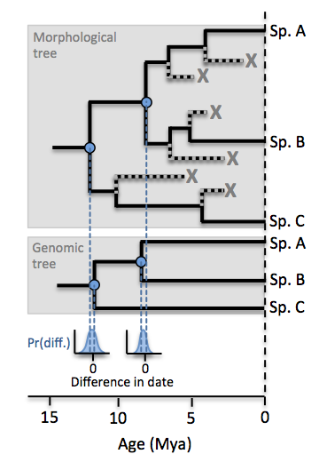
How do we put geological dates on molecular phylogenies?
Oversimplified, but:
1. Start with a molecular tree
2. Construct a morphological tree of living & fossil (X) species, using skeletal characters
Sp. A
Sp. B
Sp. C
Here, the branches represent the estimated percentage of DNA change on each branch, e.g.
Sp. A and Sp. B have 99% identical DNA
Sp. C is 98% identical to A & B

Slide 25
How do we put geological dates on molecular phylogenies?
Oversimplified, but:
1. Start with a molecular tree
2. Construct a morphological tree of living & fossil (X) species, using skeletal characters
3. The fossils imply minimum ages. Construct a prior probability distribution (blue) on the node age
Sp. A
Sp. B
Sp. C
Here, the branches represent the estimated percentage of DNA change on each branch, e.g.
Sp. A and Sp. B have 99% identical DNA
Sp. C is 98% identical to A & B
Prior probability distributions on dates
Summary: Dating information from fossils is used to constrain node dates, converting undated molecular phylogenies (phylograms) into dated molecular phylogenies (dendrograms)

Slide 26
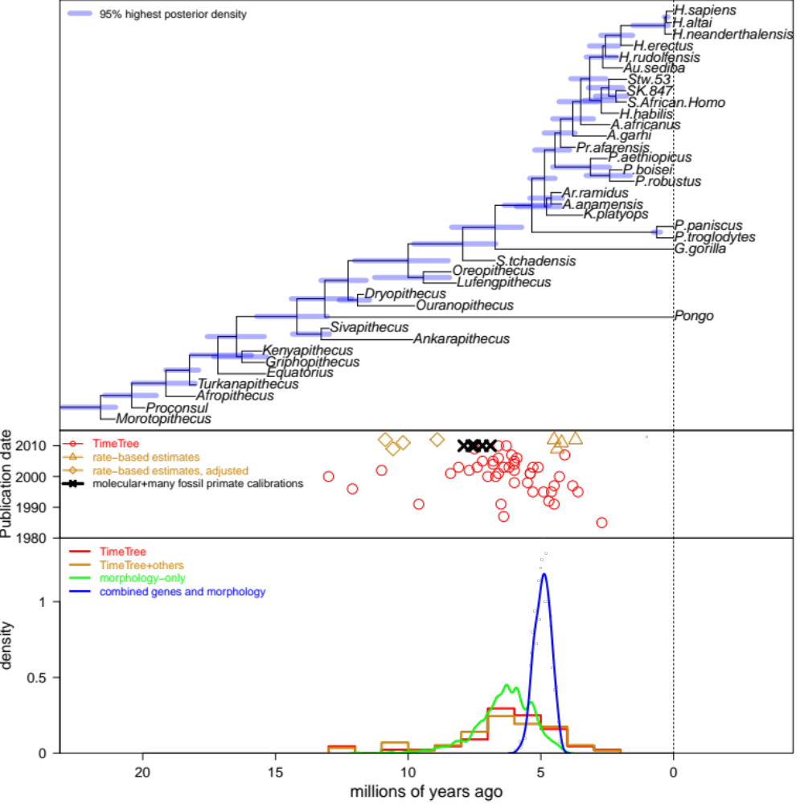
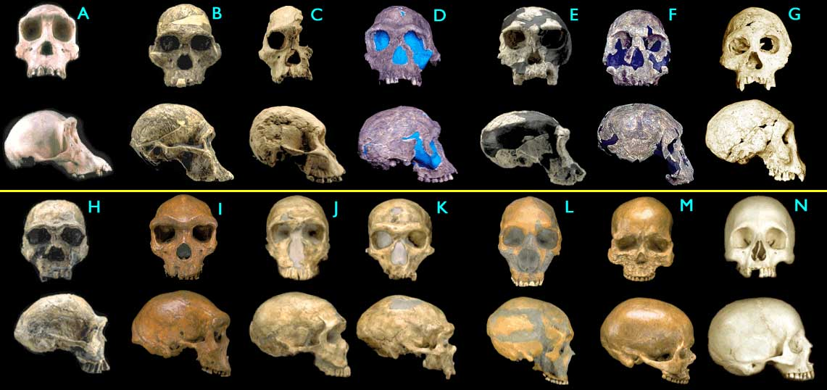
How do we put geological dates on molecular phylogenies? (Joint fossils & molecules approach)
A poster doing this for hominins, by Matzke et al:

Slide 27
How do we put geological dates on molecular phylogenies? (Joint fossils & molecules approach)
A poster doing this for hominins, by Matzke et al:

Slide 28
How do we put geological dates on molecular phylogenies? (Joint fossils & molecules approach)
A poster doing this for hominins, by Matzke et al:
Purple bars represent the 95% uncertainty around each node date.
The blue line, at bottom, represents the full posterior probability distribution of the human-chimp node date
(Other colors: other estimates)

Slide 29
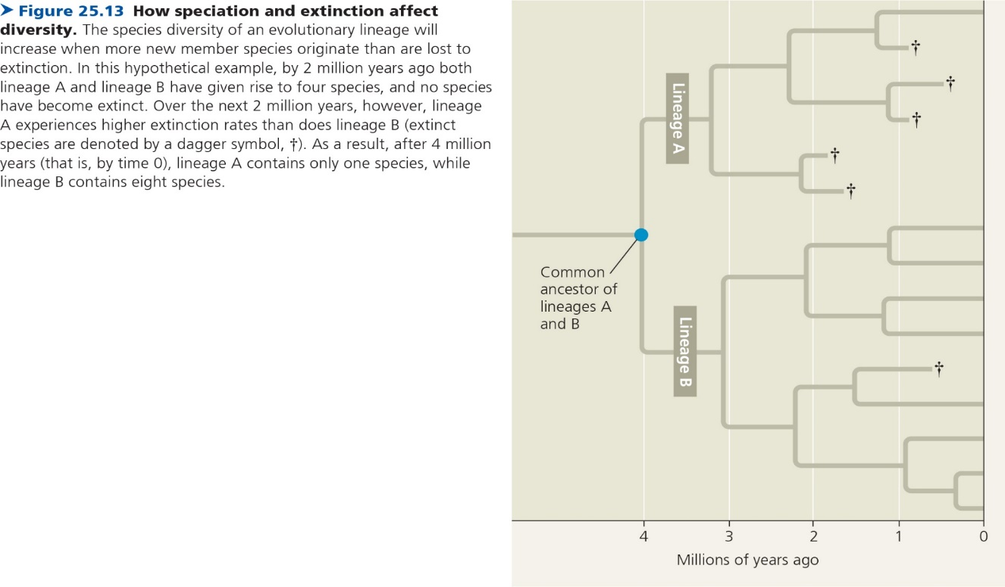
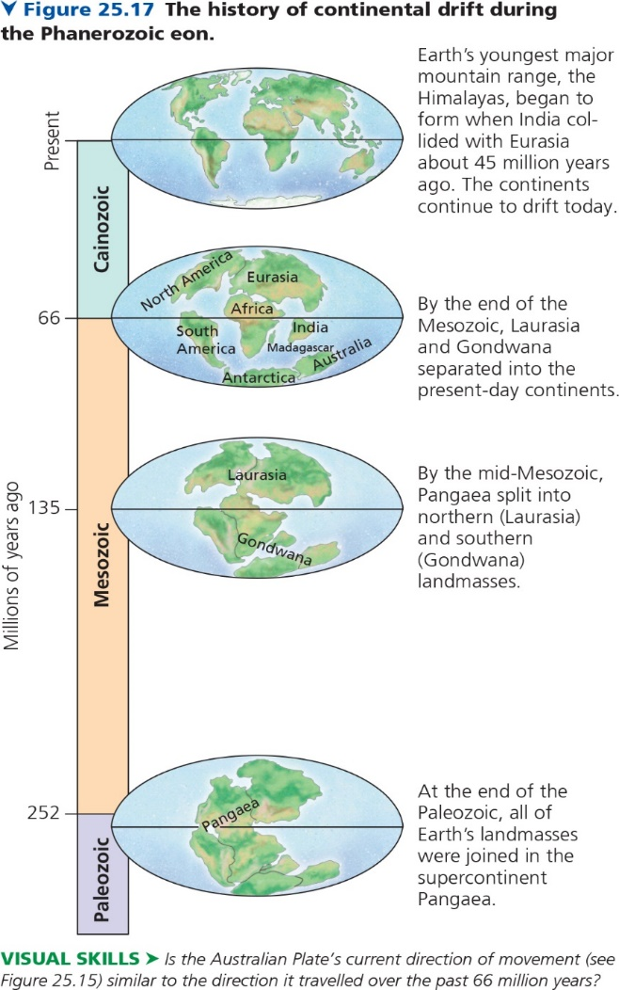
Large molecular phylogenies & biogeography

Slide 30
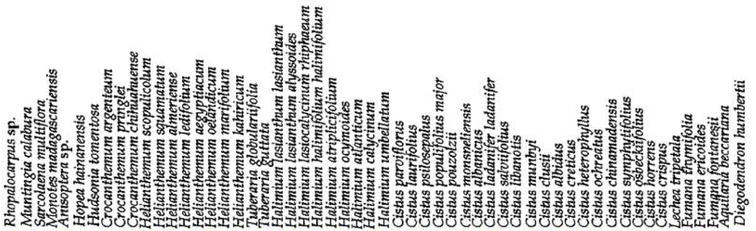
Event-based method #1
Treat biogeography as any other discrete character
Guzman B, Vargas P (2009). "Historical biogeography and character evolution of Cistaceae (Malvales) based on analysis of plastid rbcL and trnL-trnF sequences." Organisms, Diversity & Evolution 9, 83–99.

Slide 31
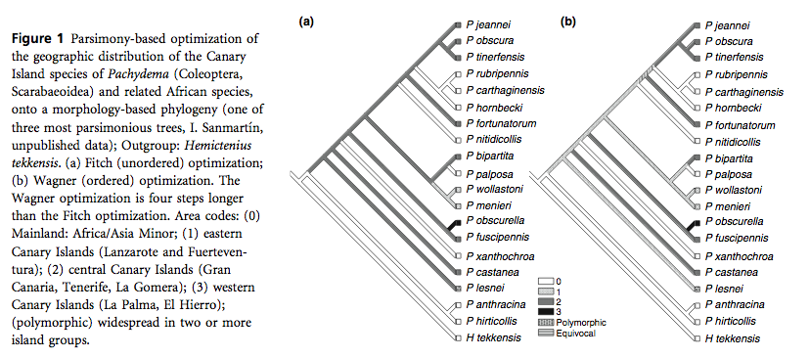
1980s-2000s: parsimony methods

Slide 32
Event-based method #2:
DIVA: Dispersal-vicariance analysis
Ronquist F, Sanmartin I (2011). "Phylogenetic Methods in Biogeography." Annu Rev Ecol Evol Syst. 2011. 42:441–64

Slide 33
Event-based method #2:
DIVA: Dispersal-vicariance analysis
Ronquist F, Sanmartin I (2011). "Phylogenetic Methods in Biogeography." Annu Rev Ecol Evol Syst. 2011. 42:441–64

Slide 34
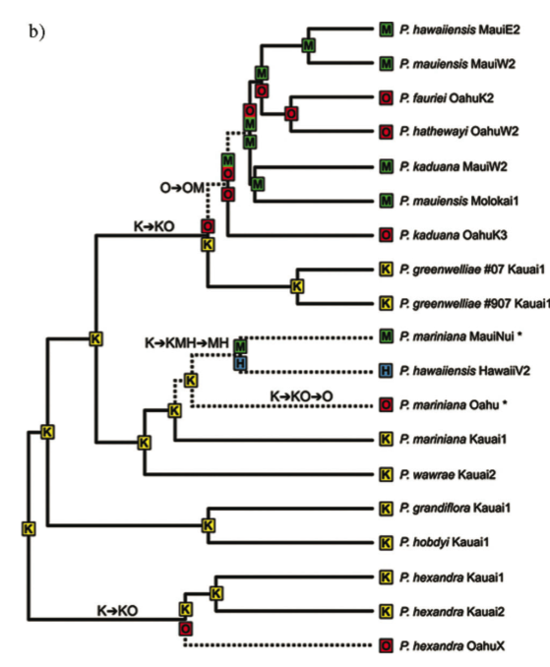
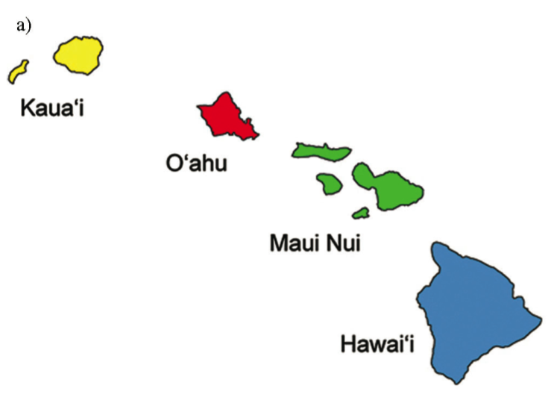
Event-based method #3:
DEC: Dispersal-extinction cladogenesis
Program: “LAGRANGE”
e.g., Ree & Smith (2008) Hawaiian
Psychotria

Slide 35




Event-based method #3:
DEC: Dispersal-extinction cladogenesis
Cladogenesis -- range evolution at speciation events (LAGRANGE model)
  Probabilites per speciation event:
  sympatric
  subset
  vicariance

Slide 36
Event-based method #3:
DEC: Dispersal-extinction cladogenesis
d = “dispersal” = range extension
e = “extinction” = range loss
cladogenesis process
  Implemented in the program LAGRANGE
  (Likelihood Analysis of Geographic RANGe Evolution)
  by Rick Ree & Stephen Smith (2008)

Slide 37
DEC: Dispersal-extinction cladogenesis
+B
“dispersal” event
(really, range expansion)
A
AB
“extinction” event
(really, extirpation or
range contraction)
-B
AB
A

Slide 38
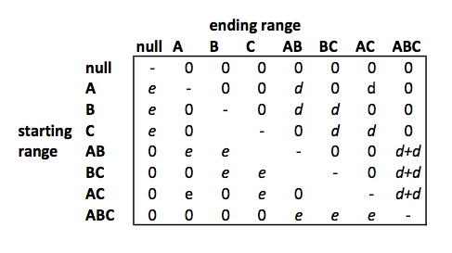
DEC: Dispersal-extinction cladogenesis
d = “dispersal” = range extension
e = “extinction” = range loss
  Instantaneous rate matrix:

Slide 39
Problems with the state-of-the-art analysis
Complete range data is assumed
“true” vicariance is not allowed
  new species always start out at rangesize=1
Species always start inside their ancestral range
In LAGRANGE, this cladogenesis model is
fixed and unchangeable

Slide 40
Unresolved fundamental issues
  What is the right model?
“Vicariance vs. dispersal”
Range extension / contraction
Cladogenic vs. anagenic change
Founder-event speciation

Slide 41
Unresolved fundamental issues
  What is the right model?
“Vicariance vs. dispersal”
Range extension / contraction
Cladogenic vs. anagenic change
Founder-event speciation

Slide 42
Summary of previous lectures:
Different authorities have different assumptions about what processes matter!
Your inferences will depend on your assumptions
Vicariance: deterministic vision where geology determines ranges
Dispersal: “unpredictable” “chance events”
Me: “Unpredictable” doesn’t mean intractable – we can address using probabilistic models

Slide 43
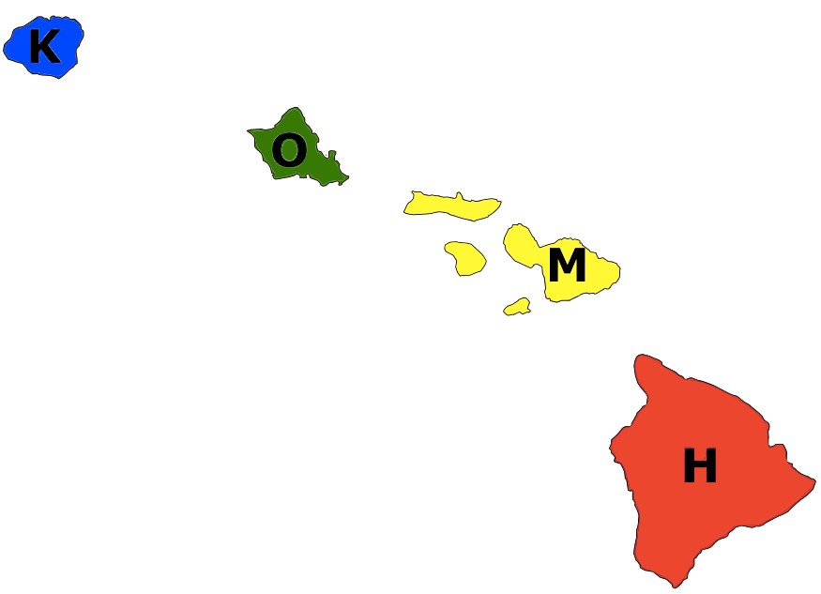
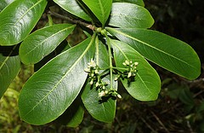
Results of different biogeography models on same dataset:
K=Kauai
O=Oahu
M=Maui-Nui
H=Hawai’i
Psychotria hexandra
http://farm8.static.flickr.com/7446/9252634315_0ecf0ba853_m.jpg

Slide 44
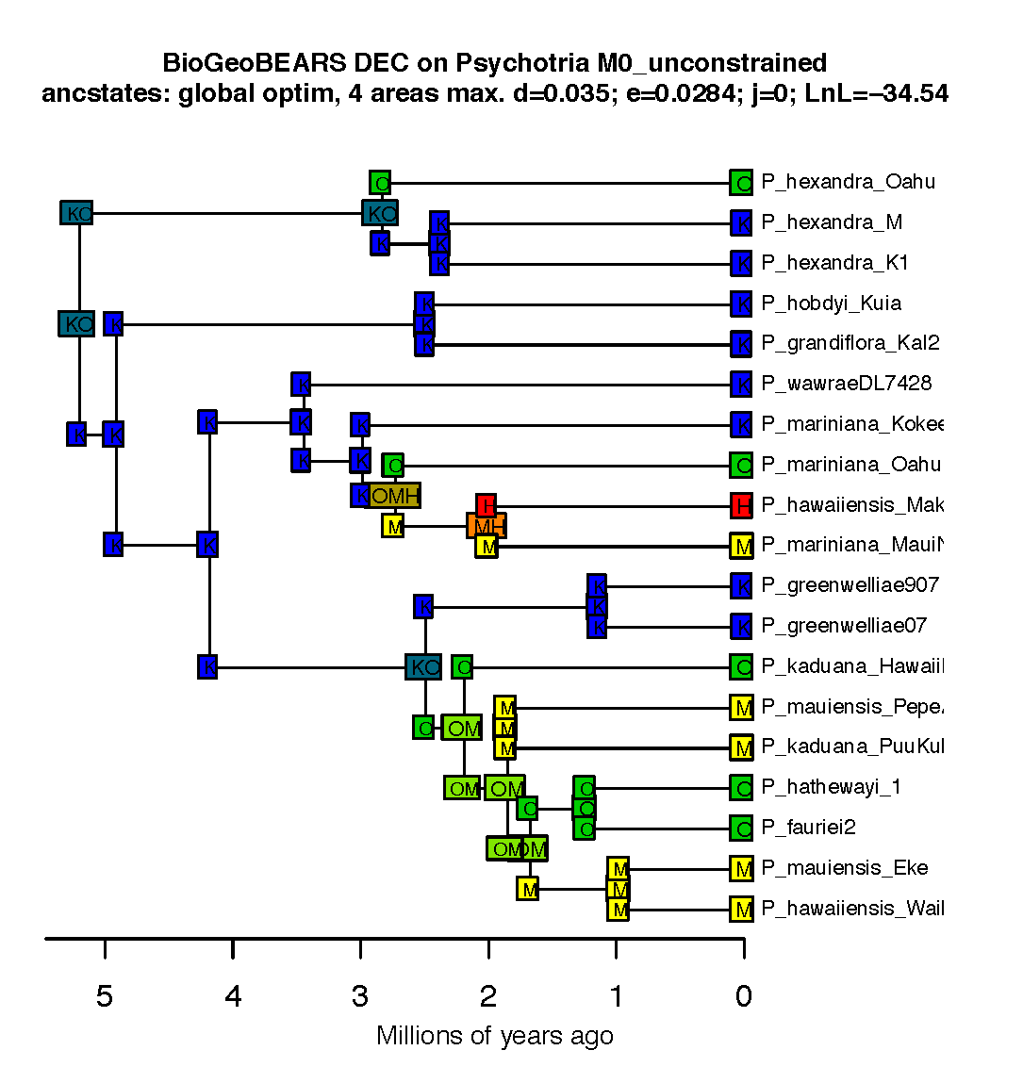
Example of biogeographic history:
Psychotria
Model: DEC
K=Kauai
O=Oahu
M=Maui-Nui
H=Hawai’i
Psychotria hexandra
http://farm8.static.flickr.com/7446/9252634315_0ecf0ba853_m.jpg

Slide 45
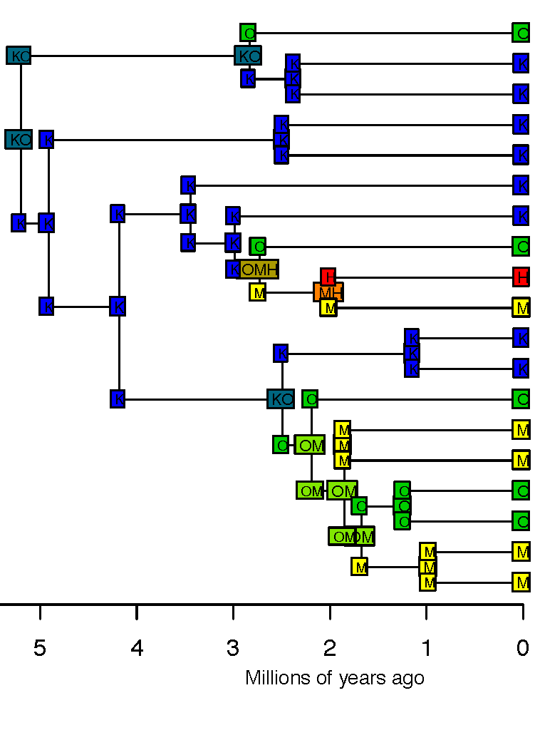
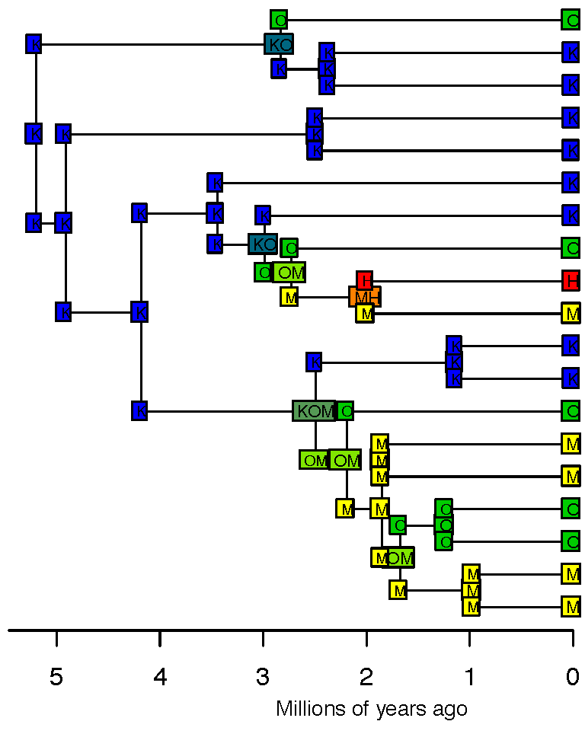
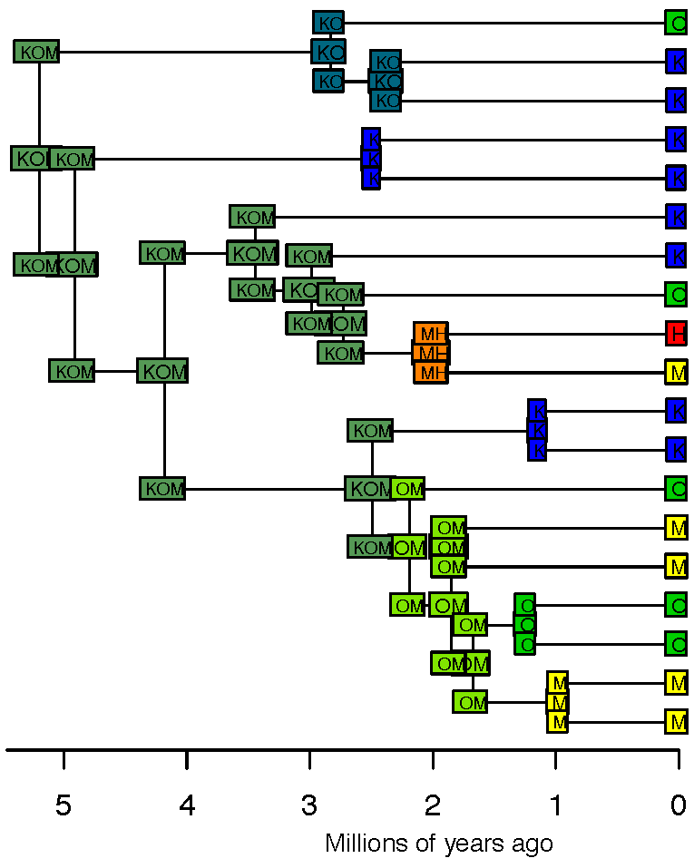
Comparison: 3 models
Model: DEC
Model: DIVA Model: BayArea
K=Kauai
O=Oahu
M=Maui-Nui
H=Hawai’i
Psychotria hexandra
http://farm8.static.flickr.com/7446/9252634315_0ecf0ba853_m.jpg

Slide 46
I think we should use statistical model choice in biogeography
Comparison of two models:
model without founder-event speciation
model with founder-event speciation

Slide 47
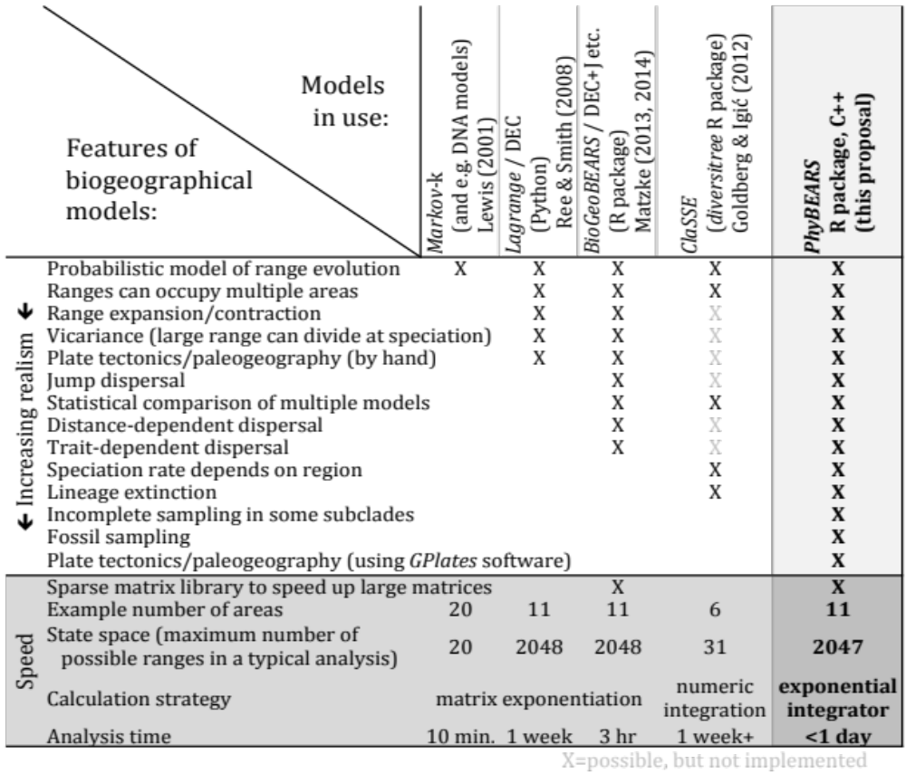
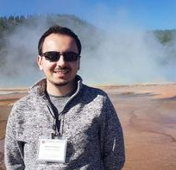
Comparison of model features
PhyBEARS: complexifying biogeography
Integrate BioGeoJulia with GPlates for continuous palaeogeography
This Proposal
(BioGeoJulia)
GPlates animation: Zealandia crustal thickness
Müller, Sahirovic et al. (2018), U. Sydney "Modelling and visualising distributed crustal deformation of Australia and Zealandia using GPlates 2.0." https://www.youtube.com/watch?v=iKkCIdZ6oaE
BioGeoJulia: extract & use continuous estimates of areas, distances
Sabin Zahirovic, GPlates coauthor, U. Sydney

Slide 48
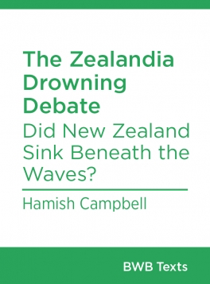
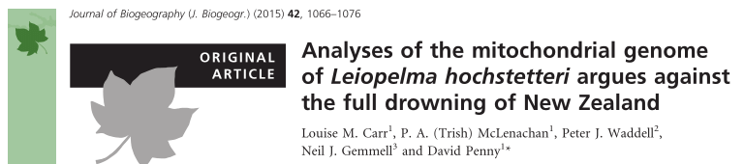
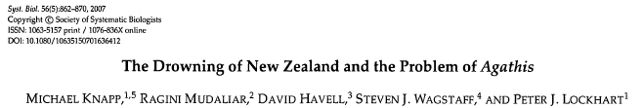
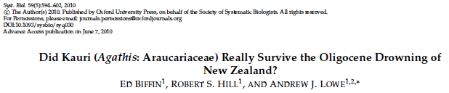
The puzzle of NZ biogeography
Debated origins of NZ’s flora and fauna – and their fate, under anthropogenic disturbance
How much of NZ biota is Gondwanan remnant?
How much more recent dispersal?
The “drowning”, if it happened, would have
wiped out all NZ biota, thus everything dispersed
back

Slide 49
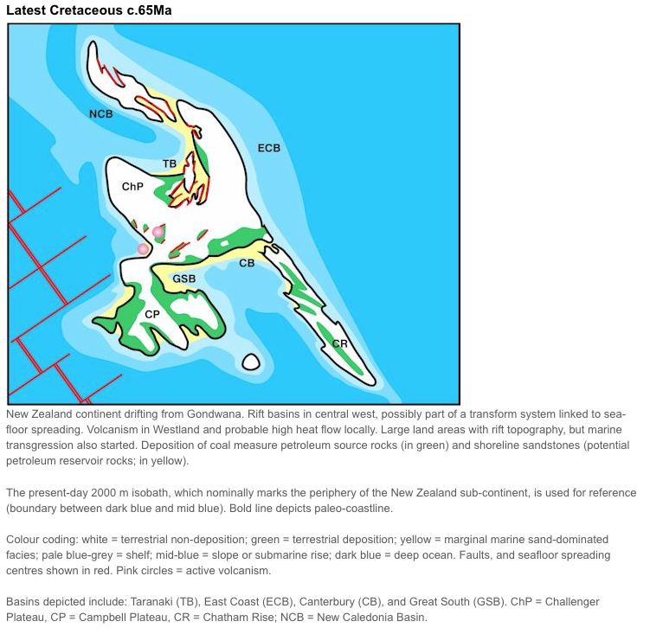
GNS maps
https://www.gns.cri.nz/Home/Our-Science/Energy-Futures/Oil-and-Gas/NZs-Sedimentary-Basins/Paleogeographic-maps/Present

Slide 50
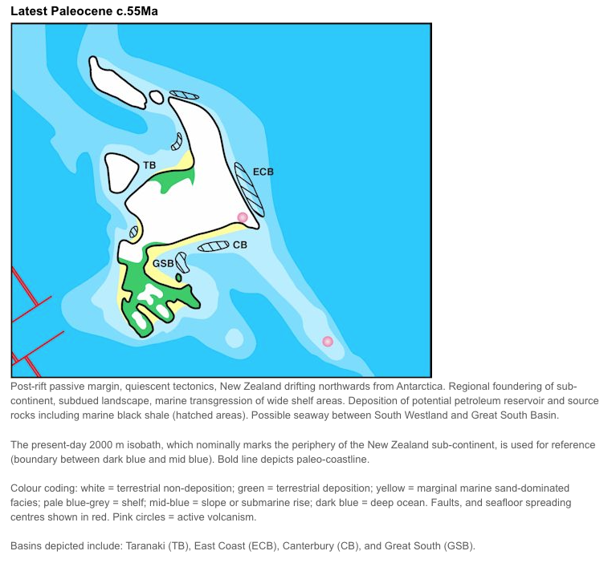
GNS maps
https://www.gns.cri.nz/Home/Our-Science/Energy-Futures/Oil-and-Gas/NZs-Sedimentary-Basins/Paleogeographic-maps/Present

Slide 51
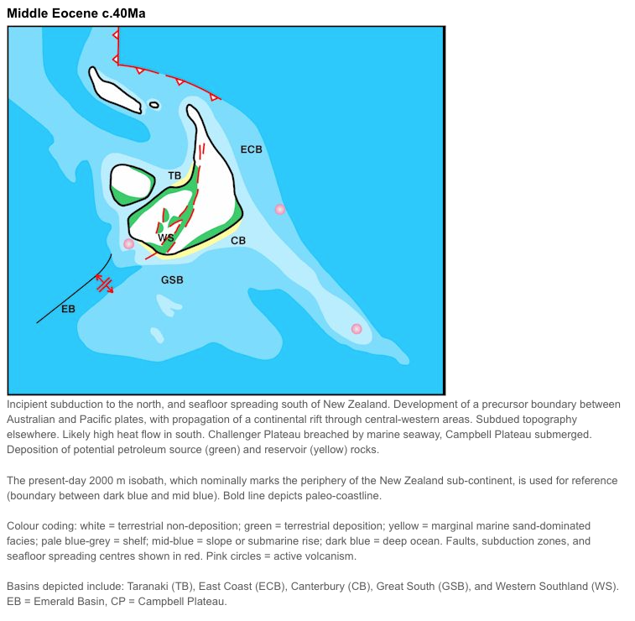
GNS maps
https://www.gns.cri.nz/Home/Our-Science/Energy-Futures/Oil-and-Gas/NZs-Sedimentary-Basins/Paleogeographic-maps/Present

Slide 52
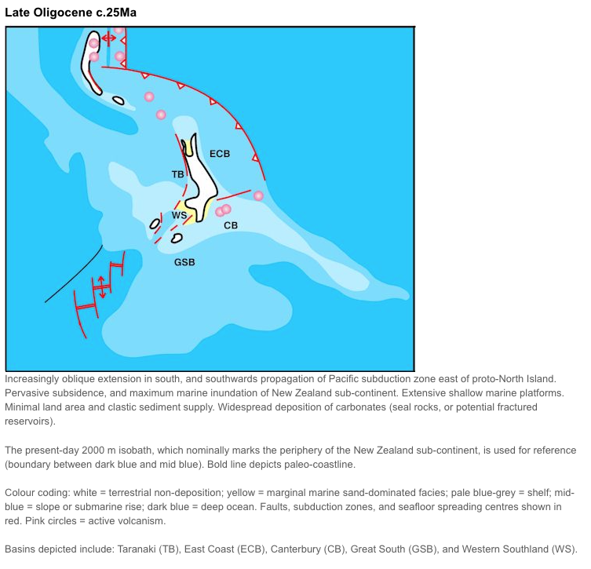
GNS maps
https://www.gns.cri.nz/Home/Our-Science/Energy-Futures/Oil-and-Gas/NZs-Sedimentary-Basins/Paleogeographic-maps/Present

Slide 53
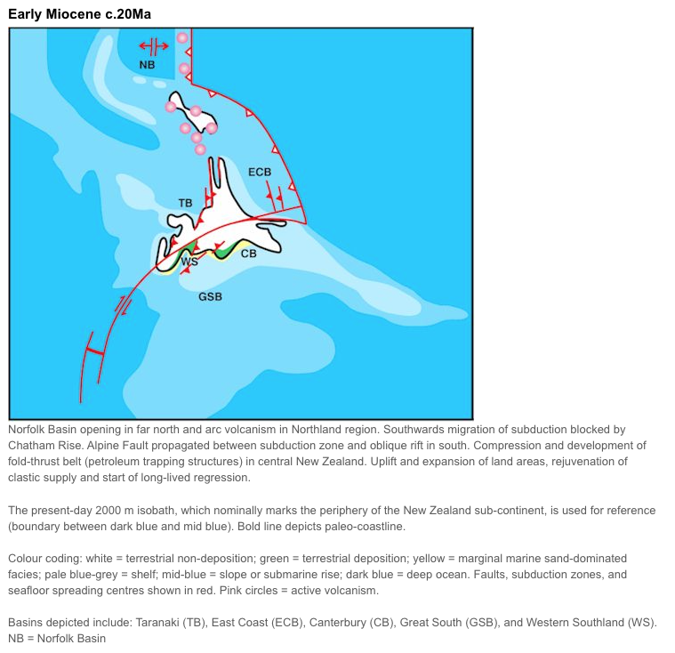
GNS maps
https://www.gns.cri.nz/Home/Our-Science/Energy-Futures/Oil-and-Gas/NZs-Sedimentary-Basins/Paleogeographic-maps/Present

Slide 54

GNS maps
https://www.gns.cri.nz/Home/Our-Science/Energy-Futures/Oil-and-Gas/NZs-Sedimentary-Basins/Paleogeographic-maps/Present

Slide 55

GNS maps
https://www.gns.cri.nz/Home/Our-Science/Energy-Futures/Oil-and-Gas/NZs-Sedimentary-Basins/Paleogeographic-maps/Present

Slide 56


Strogen et al. (2022)

Slide 57


Strogen et al. (2022)

Slide 58

Strogen et al. (2022)

Slide 59

Strogen et al. (2022)

Slide 60

Strogen et al. (2022)

Slide 61

Strogen et al. (2022)

Slide 62

Strogen et al. (2022)

Slide 63

Strogen et al. (2022)

Slide 64

Strogen et al. (2022)

Slide 65

Strogen et al. (2022)

Slide 66

Strogen et al. (2022)

Slide 67

Strogen et al. (2022)

Slide 68

Strogen et al. (2022)

Slide 69

Strogen et al. (2022)

Slide 70

Strogen et al. (2022)

Slide 71

Strogen et al. (2022)

Slide 72

Strogen et al. (2022)

Slide 73

Strogen et al. (2022)

Slide 74
The puzzle of NZ biogeography
“…explain New Zealand and the
world falls into place around it.”
--JRSNZ (2021), call for papers, Evolutionary Biogeography of Aotearoa New Zealand; citing Gareth Nelson (1975).
GPlates animation: Zealandia crustal thickness
Müller, Sahirovic et al. (2018), U. Sydney "Modelling and visualising distributed crustal deformation of Australia and Zealandia using GPlates 2.0." https://www.youtube.com/watch?v=iKkCIdZ6oaE
JRSNZ special issue: Evolutionary biogeography of Aotearoa (2023):
https://www.royalsociety.org.nz/news/jrsnz-special-issue-evolutionary-biogeography-of-aotearoa/

Slide 75

Putting it all together for Zealandia

Slide 76
Wallis & Jorge 2018

Slide 77

Wallis & Jorge 2018

Slide 78

Wallis & Jorge 2018

Slide 79

Wallis & Jorge 2018

Slide 80


Wallis & Jorge 2018

Slide 81


Wallis & Jorge 2018

Slide 82


Wallis & Jorge 2018

Slide 83


Wallis & Jorge 2018
https://www.pnas.org/content/103/51/19419

Slide 84

Wallis & Jorge 2018
https://www.pnas.org/content/103/51/19419

Slide 85

Wallis & Jorge 2018
https://www.pnas.org/content/103/51/19419

Slide 86
Other processes need to be considered-e.g. extinction

Slide 87

Extinction cascade in New Zealand
Rawlence et al. (2022). Reconstructing the Impact of Humans on Aotearoa New Zealand's Biodiversity. In Historical Ecology, G. Decocq (Ed.). https://doi.org/10.1002/9781394169764.ch18
LO4

Slide 88
Causes of mass extinctions
Some HUGE perturbation
E.g.:
Meteor impact
Mass volcanism
Icehouse earth
…etc.
LO2
LO3

Slide 89

Detour: Nature of Science and the ‘end’ of the dinosaurs
Recommended reading:
Understanding Science (2007). Asteroids and dinosaurs: Unexpected twists and an unfinished story. Understanding Science website at UC Berkeley. This is a good deep dive into the process that led the father-son Alvarez team to the impact theory for the extinction of the dinosaurs. https://undsci.berkeley.edu/lessons/pdfs/alvarez_woflow.pdf

Slide 90
K-Pg tsunami in NZ?
A Mega-Tsunami Deposit at the KT Boundary
https://www.youtube.com/watch?v=3RI1QtF-Tuk
NZ Geographic: https://www.nzgeo.com/stories/the-day-the-earth-stood-still/

Slide 91



Extinction as macroevolution:
Biases in mass extinctions
LO3
LO4

Slide 92
The puzzle of NZ biogeography
“…explain New Zealand and the
world falls into place around it.”
--JRSNZ (2021), call for papers, Evolutionary Biogeography of Aotearoa New Zealand; citing Gareth Nelson (1975).
GPlates animation: Zealandia crustal thickness
Müller, Sahirovic et al. (2018), U. Sydney "Modelling and visualising distributed crustal deformation of Australia and Zealandia using GPlates 2.0." https://www.youtube.com/watch?v=iKkCIdZ6oaE

Slide 93
Conclusions – for review
Clearly, no one explanation/paradigm will fully explain NZ
Oligocene drowning was partial, not total
Dispersal important throughout, but likely some deep
Gondwanan “ghosts”
Some fossils controversial (St. Bathans mammal)
I’d like to move this area to a model-based discussion,
where we include e.g. extinction, climate change in our
probabilistic weighing of different hypotheses

Slide 94
Remaining time
Discuss papers in zipfile; what’s behind the dispersal/vicariance debate?
Assign 6 clades for next week.

