Slide 1
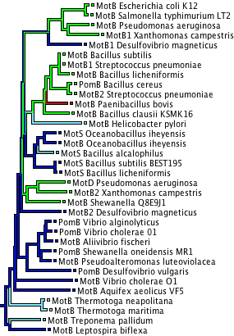
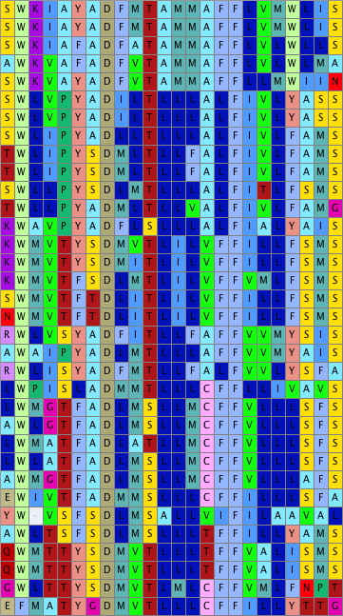
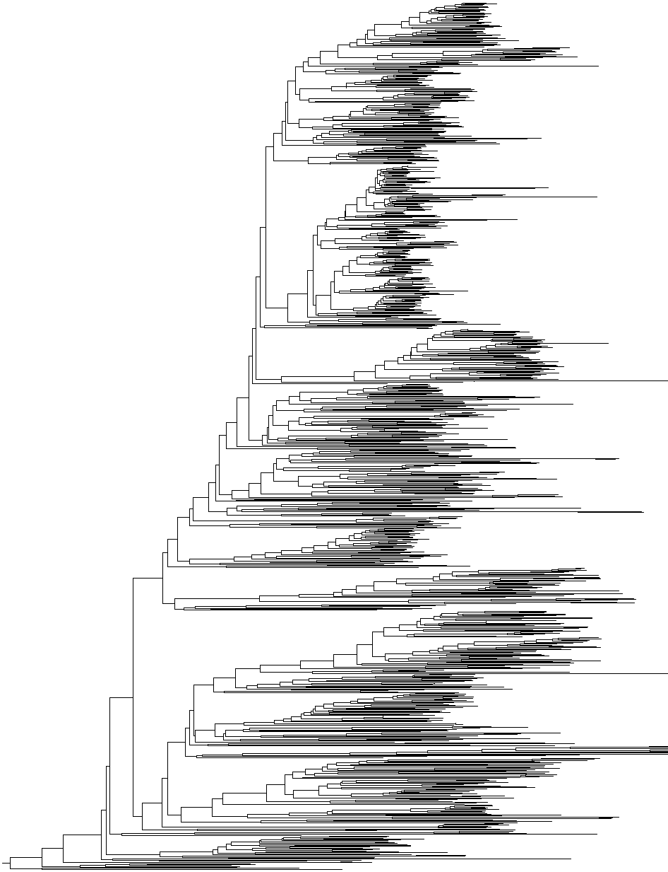
Figure X. Preliminary data demonstrating phylogenetic conservation of key region of motor protein MotB. Alignment shows significant conservation even between phyla.
Phylogeny of 948 MotB homologs
Reconstruction for position 43
Residues:
D32
43
48
25
Multiple sequence alignment corresponds to E. coli MotB residues 25-48. D32 is a universally conserved aspartic acid that binds incoming
H⁺/Na⁺. Transitions between V
(green) and L (dark blue) at
position 43 were hypothesized
To be important for ion select-
-ivity by Fujinami et al (2009)
Methods: Sequences from UniProt90 database, with key study taxa added. Alignment with Clustal-Omega, phylogeny with Quicktree. These are fast heuristic methods; so deeper branches and rooting should be considered uncertain.
(subset to common study taxa)

