Slide 1
Overview: Structural variation in the light of phylogeny
193 genomes spanning bacterial diversity, yielding
379 homologs of MotAB/ExbBD/TolQR
Beast2 tree distributions for:
MotA/ExbB/TolQ
MotB/ExbD/TolR
Both together
Phylogeny
Ancestral Sequence Reconstruction
PAML: reconstruct ancestral sequences and gaps
AlphaFold structure reconstructions
Classification of MotAB/ExbBD/TolQR into: GIT (CCD2, CCD3), FIT (TGI4, TGI5)
Quantification of structural diversity, phylogenetic mapping of major conserved structural variations
Ancestral Structure Reconstruction
Experiment: removing TGI5-specific structural element abolishes motility
Functional characterization

Slide 2
Overview: Structural variation in the light of phylogeny
193 genomes
↓
379 stator homologs
↓
Beast2 trees
Reconstruct ancestral sequences,
and gaps (PAML)
Reconstruct ancestral structural features (AlphaFold), map on phylogeny
Experiment:knockout of conserved structural element
Analyses
Outputs
Phylogeny
Classification: - GIT (CCD2, CCD3) - FIT (TGI4, TGI5)
Sample of possible ancestral sequences
Quantified structural diversity
Mapping of conserved structural variants
Removing TGI5-specific structural element abolishes motility

Slide 3
Older stuff

Slide 4
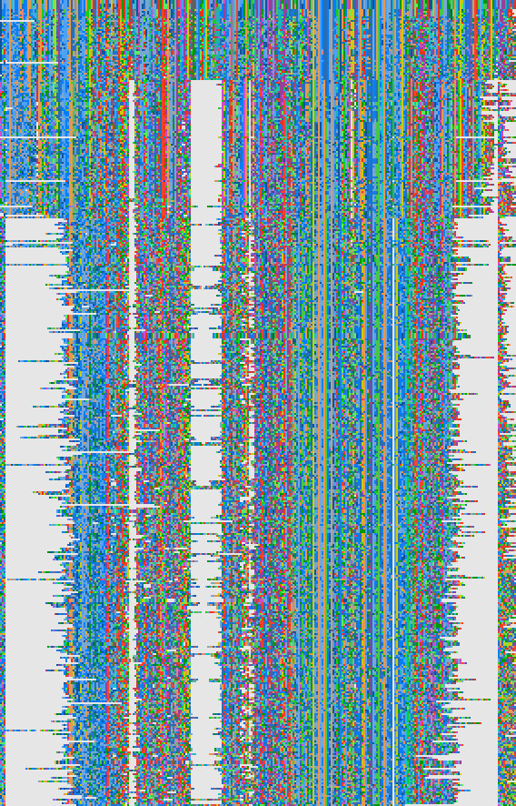
“FIT” or “FITO” (FIT=flagellar ion transporter oligomer) Flagellar proteins: motA
Other “MotAB” motors:
PomAB (Polar motors, usually sodium/Na+ powered)
LafTU (Lateral flagellar)
MotCD
MotPS (high PH motors I think)
TGI-5 motA
TGI-4 motA
”GIT” or “GITO” (General Ion transporter oligomer)
Or UNFIT: “(mostly) Uncharacterized Nonflagellar relatives of Flagellar Ion Transporters”
Non-flagellar proteins:
ExbBD, TolQR (ion transporters)
AglRS (Adventitious Gliding in Myxococcus)
AQB = Nick Matzke’s shorthand for “MotA/TolQ/ExbB superfamily”

Slide 5
Crassus motA
Flagellar proteins: motA
Non-flagellar proteins:
ExbB, TolQ, AQB

