Slide 1
CSD 310 Willson Financial Module 12.2 July 19, 2022
Created By:
Kelly Bordonhos Kyle Emory Nathan Mausbach Jessica Phan

Slide 2
INTRODUCTION
Case study: Willson Financial
Team members :
Kelly Bordonhos
Kyle Emory
Nathan Mausbach
Jessica Phan

Slide 3
Case Study
Jake and Ned WiIlson are the owners of Willson Financial, a financial company that serves the well-known ranchers and farmers of a small community in New Mexico. An increase in the number of retirees in the area has also brought in additional business. Due to the increase in business, Jake and Ned realized that the client list had developed quickly throughout the last year and they needed to reevaluate the billing structure to ensure their clientele were receiving the best services. In order to do this they needed to acquire data to answer the following questions:
How many clients have been added for each of the past six months?
What is the average amount of assets (in currency) for the entire client list?
How many clients have a high number (more than 10 a month) of transactions?
Notes:
*Additional to the slide if needed: - What are the number of clients have been added for each over the most recent six months? - What is the typical number of resources (in cash) for the whole rundown of clients?

Slide 4
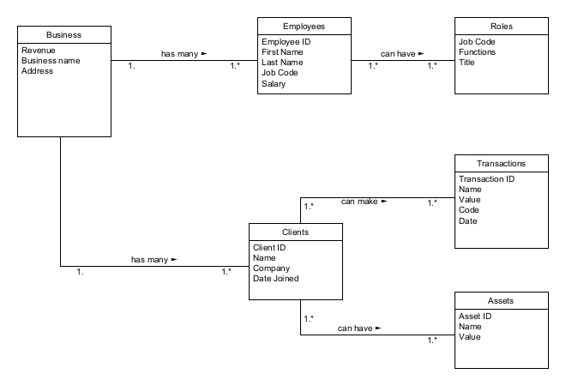
ORD

Slide 5
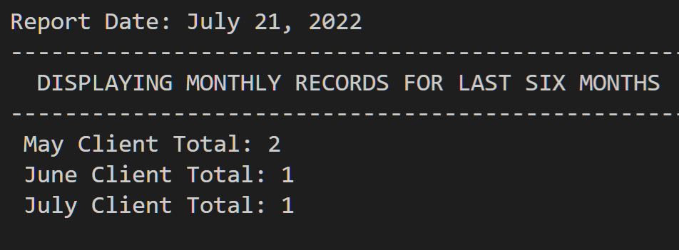
Report #1
“How many clients have been added for each of the past six months?”
For this report, data was queried to show how many clients were added for each month within the past 6 months. This was performed through several queries from the clients table, where the COUNT(*) function was used and an alias was created and the total number of clients between selected dates was calculated and output. This shows there is more activity during the month of May than in other months.

Slide 6
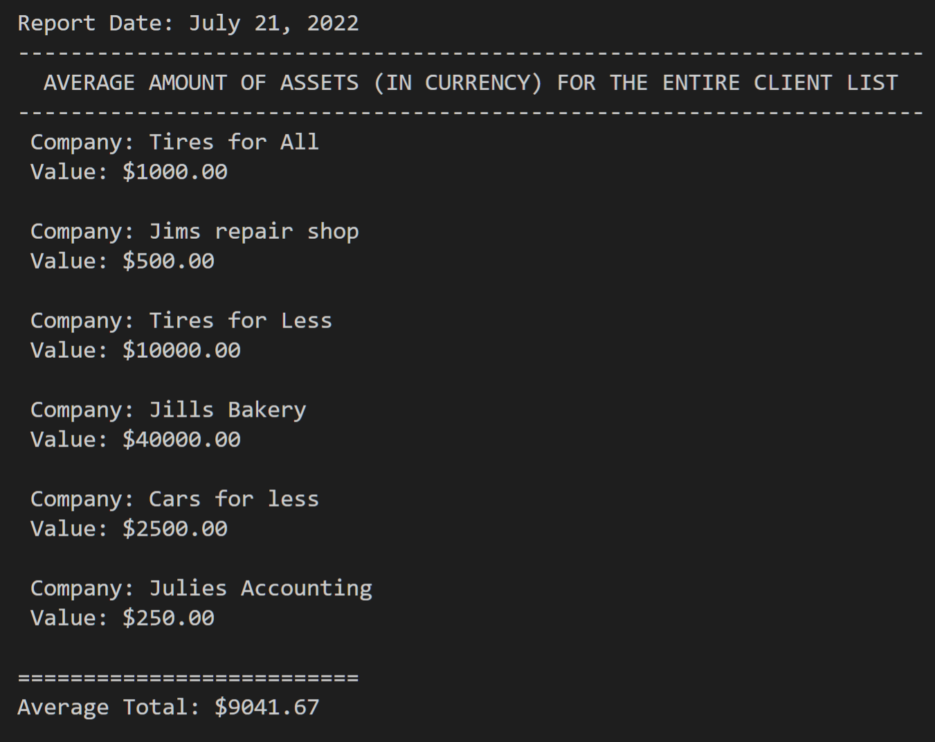
Report #2
“What is the average amount of assets (in currency) for the entire client list? ”
To find the average amount of assets for the entire client list, an initial query was performed to pull data from the company and value columns in the clients table and join this data to the left on asset id. The second query then calculated the average using the combined values.
From this report, you can see which company holds the highest and lowest assets as well as the average of them all.

Slide 7
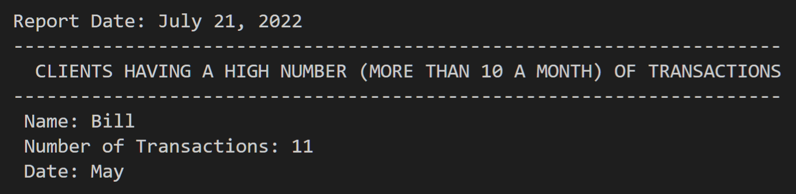
Report #3
“How many clients have a high number (more than 10 a month) of transactions?”
For the last report, we found only one client made more than 10 transactions in one month. This was done by selecting the name, their number of transactions as code, the date from the client table, and having the transaction left join on client id where that is grouped by having 10 or more transactions.

Slide 8
Assumptions
Billing structures are determined by high transaction clients more than the other clients
No other employees were hired
Assets came from clients, not business’
No two clients have the exact same assets

