Slide 1
Self-Efficacy and Mathematics
By Natalie Bahr, ENTITY Academy x WozU
Research By Dr. David W. Putwain

Slide 2

About the Analyst
My name is Natalie Bahr.
I am an aspiring data analyst and former teacher.
I taught elementary and middle school mathematics for 6 years.
I continue to be interested in education, especially math education.

Slide 3
Why Mathematics?
I personally am passionate about the subject…
…but many people are math-avoidant.
My analysis is my first step to figuring out:
When does this avoidance begin?
What can we do to reverse it?

Slide 4
What is Self-Efficacy?
According to positivepsychology.com, self-efficacy is defined as “the belief we have in our own abilities, specifically our ability to meet the challenges ahead of us and complete a task successfully”.
The research and analysis presented here relate to upper elementary students’ belief in their mathematics ability.

Slide 5
The Research
Dr. David W. Putwain published his project and data with the following title: “Mathematics Emotions in the Primary Classroom”.
He designed and distributed a survey to collect information about students’ self-reporting in the following areas:
The emotions of boredom, enjoyment, and anxiety.
Control-value appraisals: intrinsic value, attainment value, utility value, and perceived control.
Academic buoyancy
Classroom engagement
Then, about one week after students took the survey, they took a mathematics test.
He repeated this process about six months later with the same students, the same survey, and a similar mathematics test.
Note: This survey was conducted in England and involved 1,242 students from 24 schools.

Slide 6
Preparing My Analysis
The first thing I did to prepare was meet over Zoom with Dr. Putwain.
I asked him questions about how he structured the dataset, how he carried out his research, and what basic conclusions he reached with the data.
He pulled up a multivariate correlation, looking at how the variables were correlated with each other. However, I wanted to go further.
I came up with three questions:
“Are students’ self-reported scores in any of the following questions of intrinsic value, utility value, attainment value, and perception of control good predictors of mathematical achievement?”
“Is there a relationship between students’ self-reported anxiety scores and engagement scores? Put differently, does a student’s perception of their anxiety level affect how well they engage with math class/content?”
“Is there a significant difference between students’ self-reported engagement scores in January and June?”

Slide 7
Data Manipulation
I had a lot of work to do to “manipulate” the data Dr. Putwain collected and make it usable to answer the questions.
First, I wanted to remove rows that were incomplete (e.g. a student was absent during the test or the survey).
There were 1,242 students involved from start to finish, but only 466 of them completed all four parts of the process.
First question:
I used the complete dataset and created columns that were the average student responses for the control-value categories. (Ex: Student entered 4, 5, 4, 4; the new column value for that student would be 4.25.)
Then, I did two subsets of the data: students whose average was above 3, and students whose average was 3 or less.
I chose to do a series of independent t-tests to see how the self-reported scores related to achievement on the following test.
Second question:
I created a new column and ”recoded” the variable of average anxiety level to four levels: “High”, “Moderate”, “Mild”, and “Low”.
I did the same thing with three levels of engagement scores: “High”, “Medium”, and “Low”.
I used the original dataset and had information in these areas for 1,177 students.
I chose to do an independent Chi-square test to see how the breakdown of students into both categories varied from what would be expected.
I omitted the third question in order to focus my attention on analyzing the first wave.

Slide 8
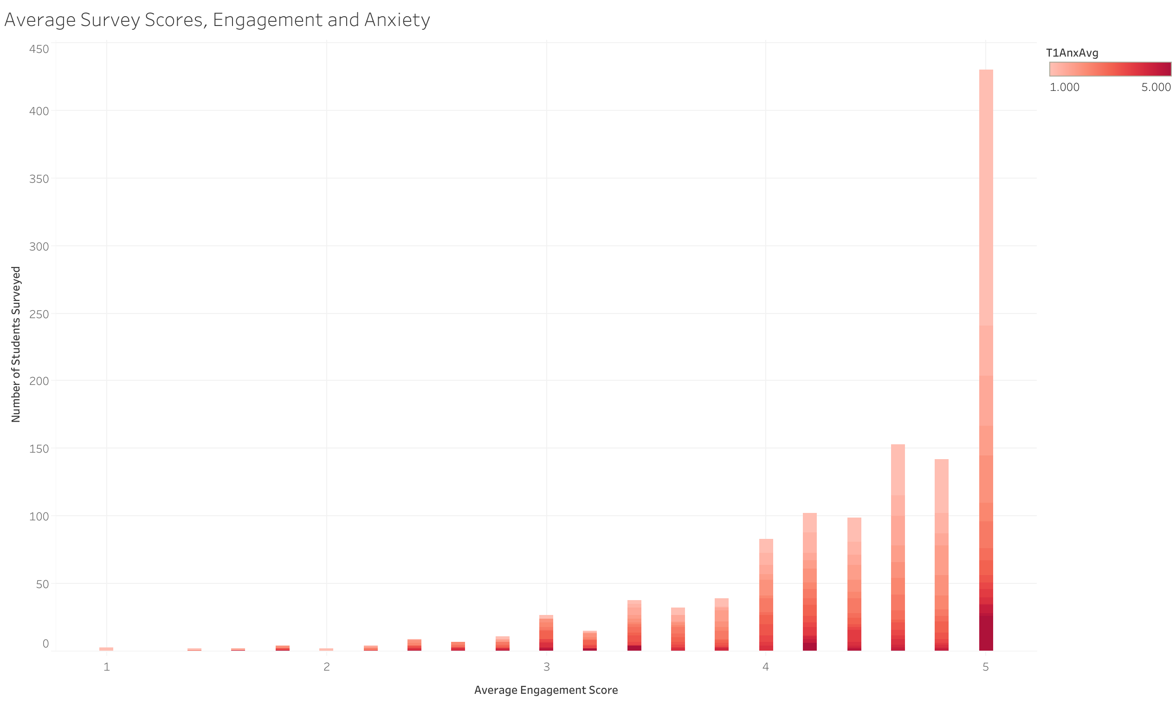
How Engaged Were The Students?
Students in this study, ages 9-11, were very engaged on the whole. Almost 450 students surveyed reported being highly engaged.
Note in shades of red is the self-reported anxiety score. Only a small portion of students in the highest engagement group also reported high anxiety. This proportion grows as the engagement score decreases.

Slide 9
Control-Value Appraisals: Survey Questions Asked
Intrinsic Value:
I am interested in learning maths
I find maths lessons interesting
I find doing maths interesting
Maths is not interesting (R)
Attainment Value:
I want to show how good I am at maths
Getting good marks on maths tests is important to me
I want to get good marks in maths
Getting a good mark in maths is important to me
Utility Value:
Maths will help me later in life
Maths can help with things in everyday life
Maths is a good skill to have outside of school
Being good at maths will help me get in a good set in secondary school
Perceived Control:
If I get a maths question wrong I can work out why I went wrong
I have always done well in maths lessons
I can learn things quickly in maths lessons
Work in maths is easy for me

Slide 10
Control-Value Appraisals Compared with Test Scores: Utility Value
I started with “utility value” to begin to answer my first question. I wanted to see if a student’s self-reported beliefs about the usefulness of math would be a good predictor of mathematics achievement.
Result: there was a distinct difference in the mean test score of those who answered with an average of 3 in the “utility value” section of the survey.
The mean score was 5.65 for those who have a high view of the usefulness of math, whereas the mean score for those who have a lower view was 3.76.
Note: The score is out of a total of 19 possible marks, or points. This may seem low because the students were taking a test based on the exit exam for England’s Year 5, or the transition from elementary to middle school. Students were in the beginning to middle of their Year 5.

Slide 11
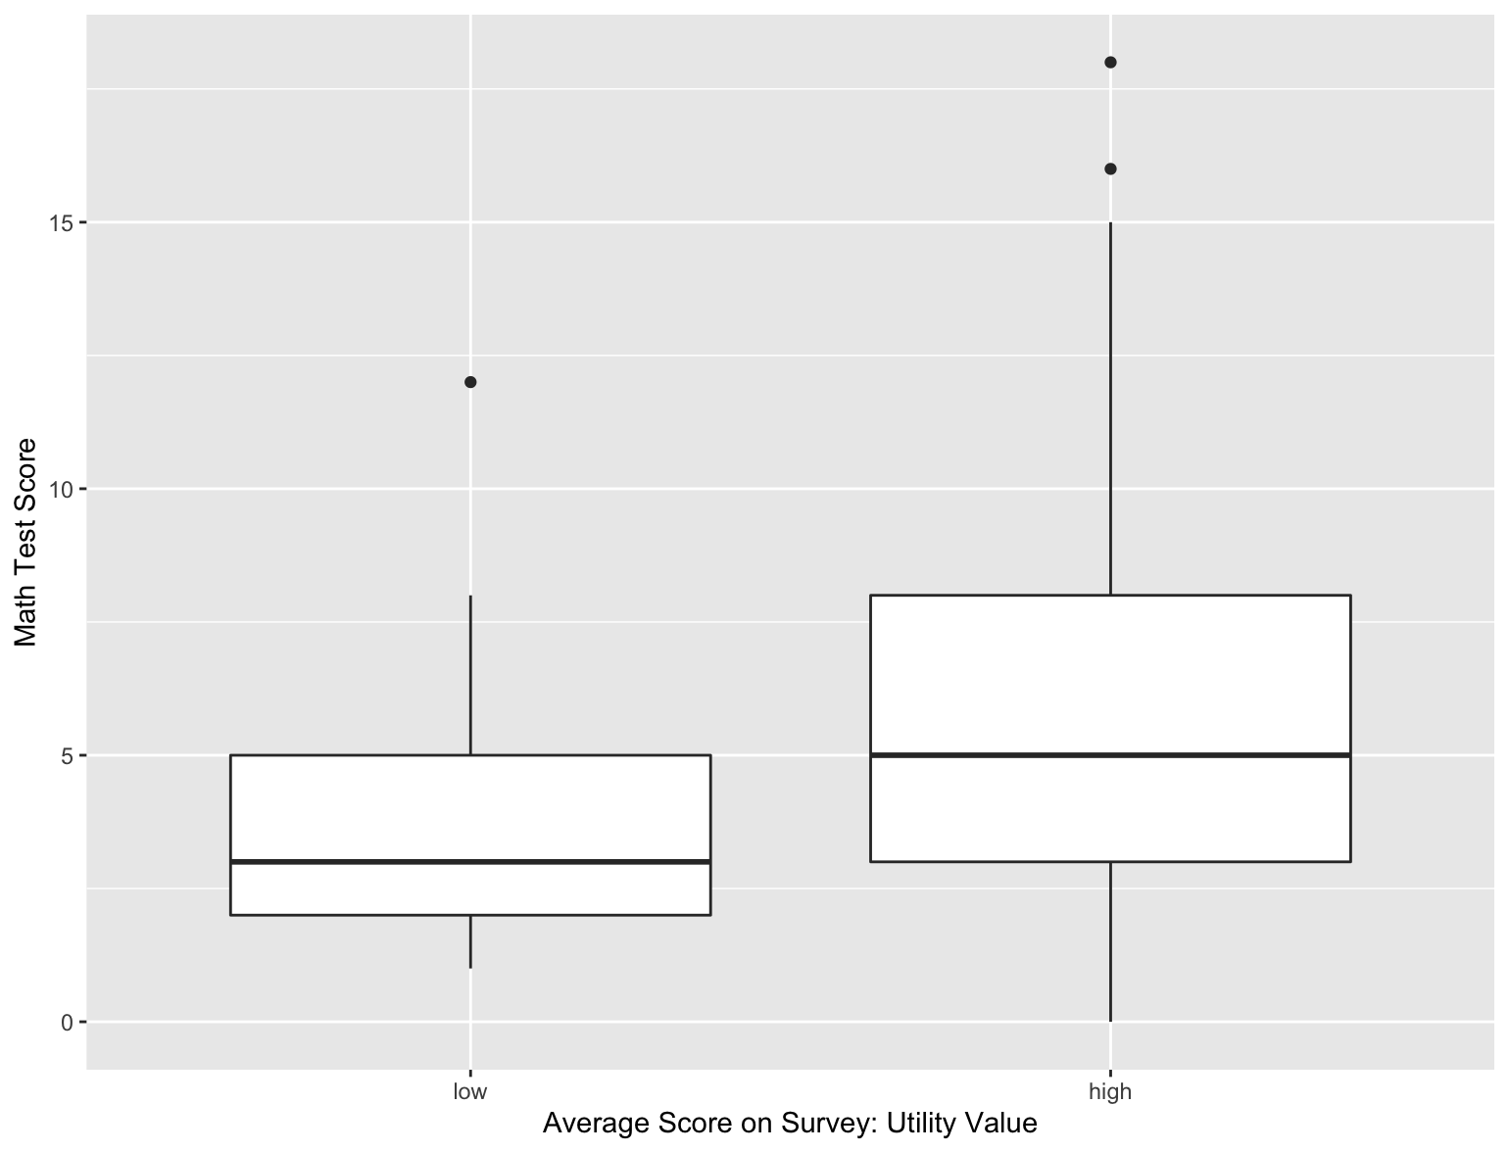
Utility Value and Test Score
As you can see, not only is the mean score of the high value group almost 2 points higher than the low group, the only outliers above 15 points on this test were in the high utility value group.
This result shows that a student’s belief in the usefulness of math leads them to perform better in math class.

Slide 12
Control-Value Appraisals Compared with Test Scores: Attainment Value
With this analysis done, I continued by asking the same question for the other control-value appraisals.
Attainment value means a student’s desire to get good grades in math. Would scoring highly on this section lead to higher mathematics achievement?
I used the same cutoff point of 3 out of 5 on the scale of 1-5.
Result: There was no significant difference in the mean score of the group who answered favorably in the attainment value section compared with those who answered unfavorably.
The mean score of the higher group was 5.62 and the mean score of the lower group was 4.74.

Slide 13
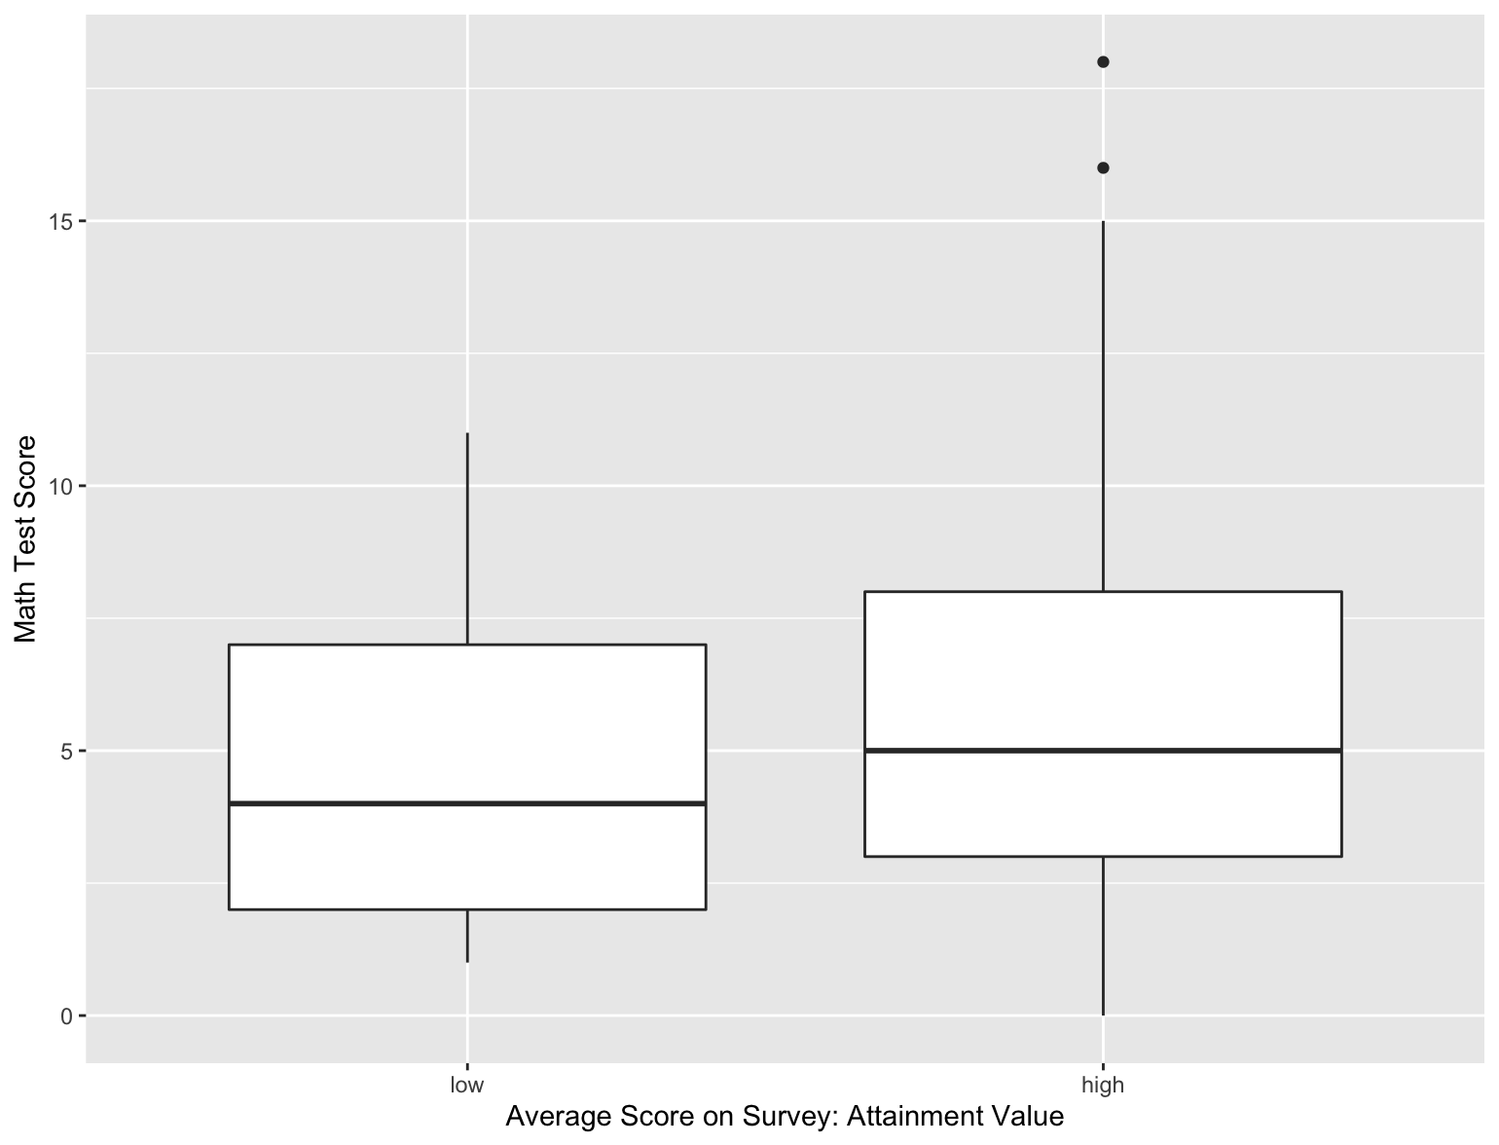
Attainment Value and Test Score
You can see here that the spread of the data in both groups, those who self-reported attainment value highly for themselves and those who did not, is very similar. (It can be noted, though, that the outliers who scored almost perfectly on the test are only in the high value group.)
This result shows that a student’s perception of the importance of attaining good grades in math does NOT necessarily lead them to perform better in math class.

Slide 14
Summary
Survey questions denoting “attainment value”, students’ desire to attain good grades in mathematics, did not show a direct impact on students’ test scores.
Survey questions denoting “utility value”, students’ perception of the usefulness of mathematics, DID show a direct impact on test scores.
Students’ responses to survey questions related to anxiety did correlate strongly to their responses to questions regarding engagement in class. They were much more likely to report being highly engaged in class if they had low amounts of anxiety.

Slide 15
Conclusion
While my work is far from done, and not all work is included here, you can see that these insights can be used to directly inform mathematics instruction.
When mathematics classes are more engaging and fun, students may increase in desire to do their best- and start to believe that they can be mathematicians!
When teachers are more aware of math anxiety and test anxiety in their classroom, they can address this, and help students become more positively engaged in class.
When students are taught all of the ways in which math is useful in everyday life, in every profession…test scores are sure to rise.

Slide 16
Thank You for Attending!
Any questions?
Feel free to reach out directly via email: nataliembahr@gmail.com

