Slide 1
Subreddit Differentiation
Nick Calow

Slide 2

Overview
Two subreddits, one machine.
Can a model be trained to adequately differentiate the two?

Slide 3
TIFU
Today I Fucked up.
Every post must start with TIFU
Every post must have at least 750 characters of content
Must be a story that contains a "fuckup", not a death/injury

Slide 4
NoStupidQuestions
No Stupid Questions.
No repeat questions
No joke questions
No questions relating to suicide or sexuality(was I raped/harassed? etc.)
No self-promotion
No illegal/unethical/disturbing material

Slide 5
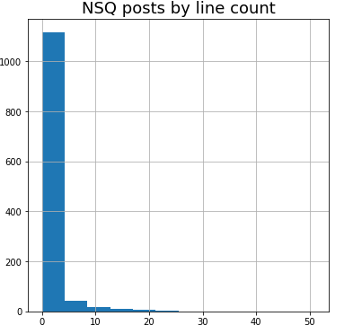
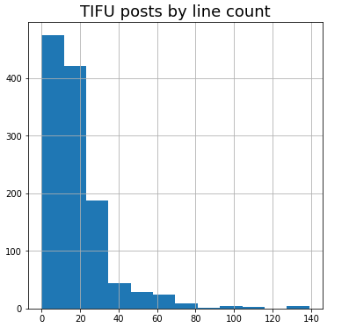
EDA
Line Count
Post Length
Content

Slide 6
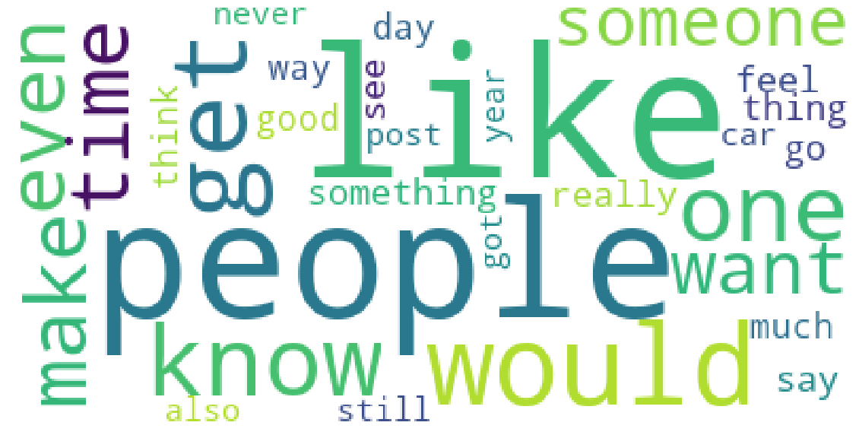
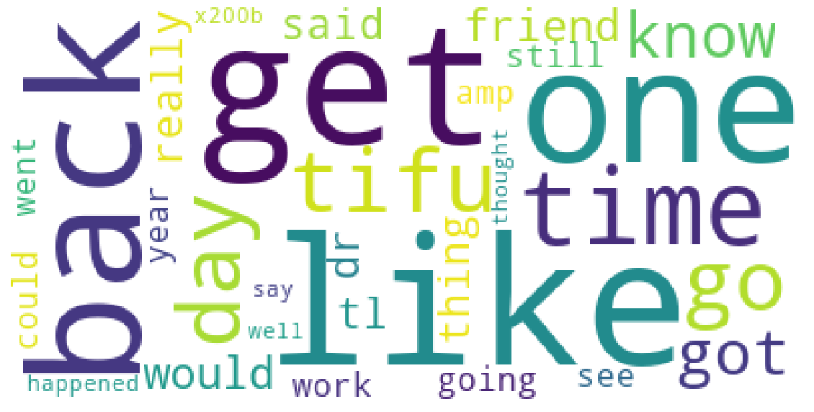
NoStupidQuestions
TIFU
Wordclouds are great
Limitation: Like
  TIFU: 1989
  NSQ: 390

Slide 7

Model 1: DecisionTreeClassifier
Turns out, having TIFU at the beginning of every post makes it too easy
100% Accuracy

Slide 8

Model 2: DecisionTreeClassifier(2)
I took out all version of TIFU and ran it again
Tuned my parameters more closely, still not bad
97.8% Accuracy

Slide 9

Model 3: Bernoulli Bayesian
Decided to try another model to compare
Designed for discrete features
Probabilistic instead of tree-like
96.8% Accuracy

Slide 10
Conclusions
The indicator really helped. Too much
Even without it, model was still strong. Very different kinds of subreddits
Future rooms for improvement:
  More involved models
  More posts
  Comments

