Slide 1
High School Standardized Testing
Nick Calow
Data Science Problem to be answered: How does one get more test participation in their state?

Slide 2
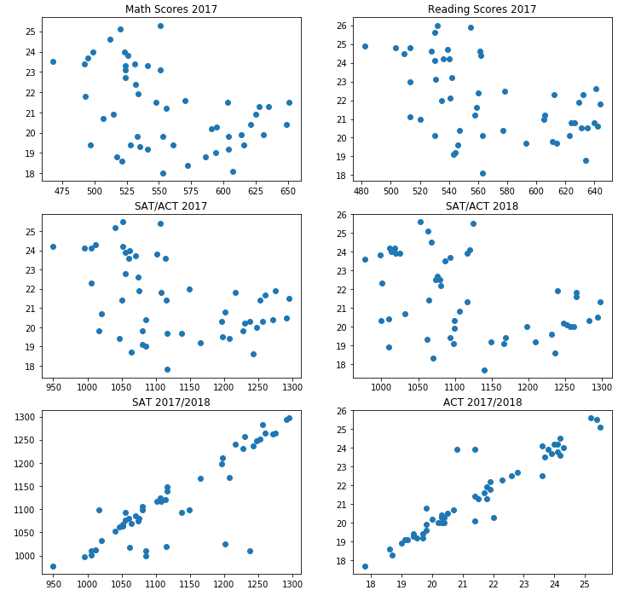
Overview
Good students
General Consistency

Slide 3
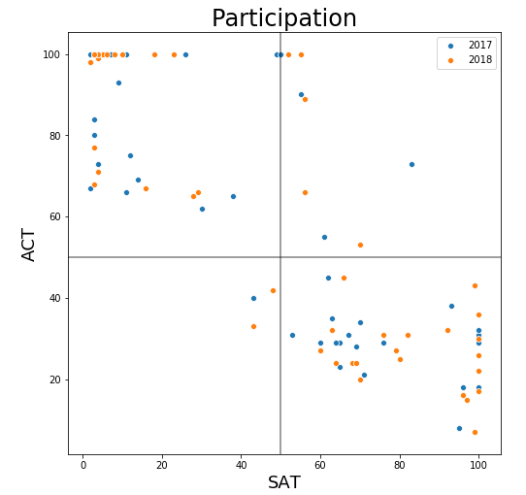

Slide 4
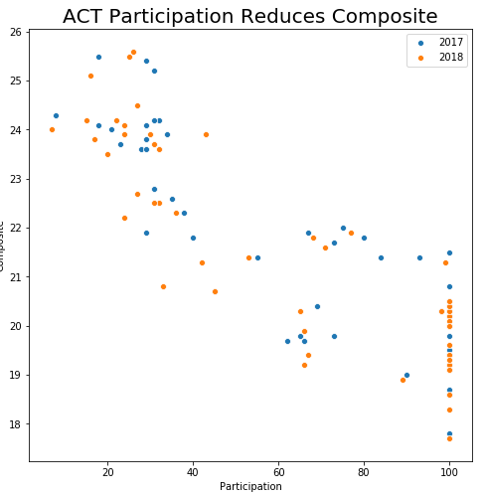
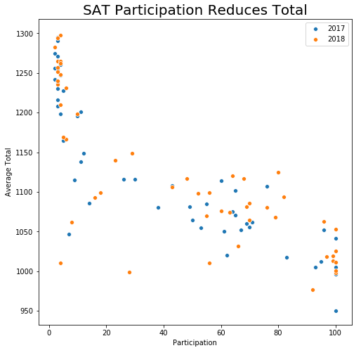
Effects of Increased Participation

Slide 5
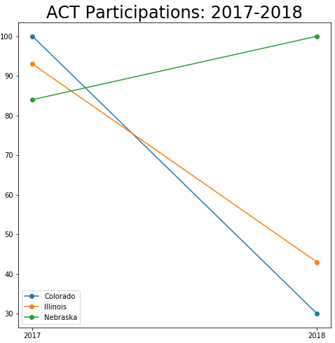
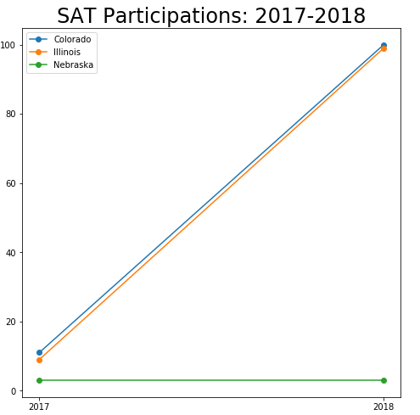
Effects of State Intervention

Slide 6
Conclusions
More participation = lower scores
More of one test = less of another
Best way to increase participation = State Law

